Slide 1


SESSION 7
Dream Treehouse
I can work with my team to learn about jobs related to biodiversity.
I can work with my team to design a treehouse where scientists can conduct their work.
Students will learn about the different jobs in biodiversity and what kind of training and tools they need. Students will build a treehouse for these scientists.

Slide 2

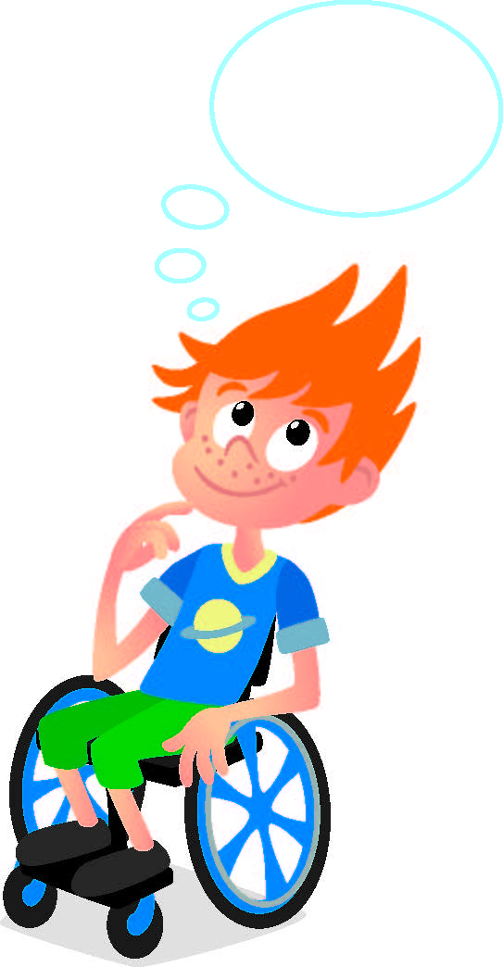
Discussion
What did we do last session?
Notes:
Discuss with students the tools and technology used by scientists in the rainforest they learned about last session. ​And the two jobs covered last session.

Slide 3

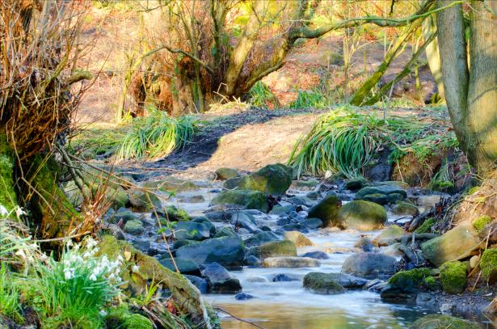
Key Vocabulary
Ecosystem: a community of living things, together with their environment
Nature: living things in their natural state
Notes:
Session specific vocab

Slide 4
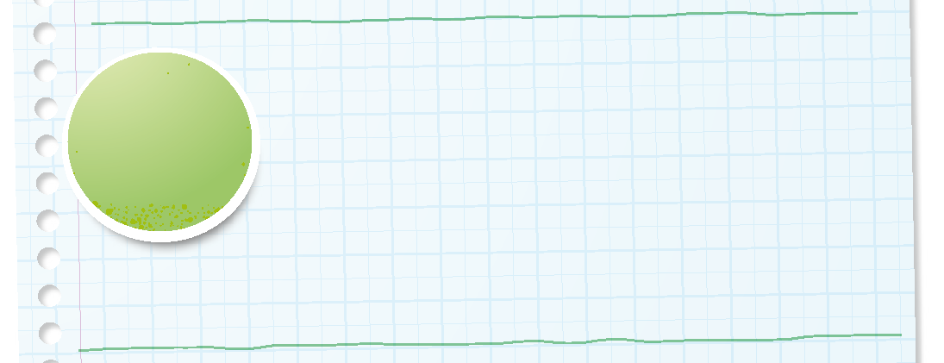

Introduction
How has your team used discovery throughout the sessions?
We explore new skills and ideas.
Notes:
Introduction – Model Discovery (5-10 minutes)
• Introduce the FIRST® Core Values.
• Read the definition for discovery to the team. (see TMG page 5)
• Talk about what discovery is. Have the team provide examples of this Core Value throughout the sessions.
• Have the team build something using the prototyping pieces representing this Core Value.

Slide 5
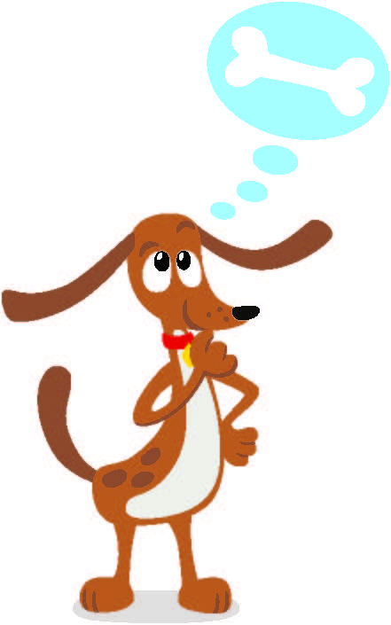
Guiding Questions
What jobs support biodiversity in the rainforest?
What are some animals that people like to study?
What job studies wild animals in the rainforest?
Notes:
Each session has Guiding Questions that can be shared to frame the session.
Talk through each of these questions with the students. Have them start to think about these questions and later their will share their thoughts with their team.

Slide 6
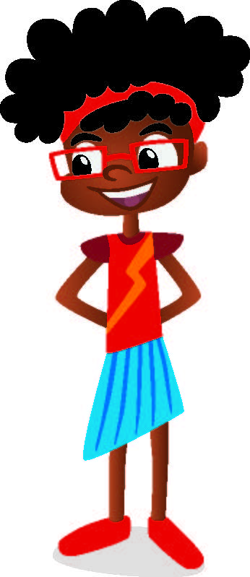
Activity 1 Tasks
Explore the biodiversity jobs on pages 5, 28, and 29.
What jobs interest you?
Notes:
Activity 1 Tasks
Read about the jobs on page 5, 28 and 29.
Design a treehouse where a wildlife biologist can safely watch animals.
Choose an animal to study.
What tools does the scientist need?
Write or draw your ideas below.
Use the prototyping pieces to build the treehouse your team designed.
Session Tips
- The team could add on to the tree model from the Explore Set.
- Use the Multimedia Resources to find example photos, websites, and other activities related to the sessions.
- Use the prototyping pieces and other parts of the Explore Set to have the team build examples of different tools used for the jobs they discuss.

Slide 7
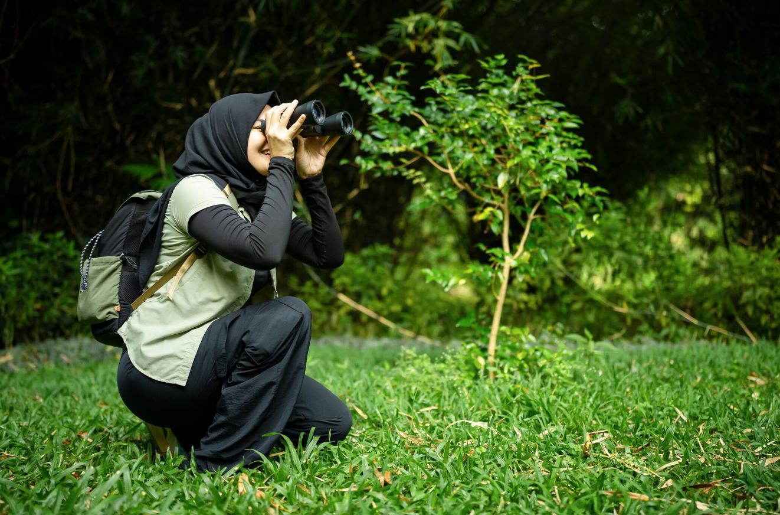
Career Connections
Wildlife Biologist
A wildlife biologist studies animals in the rainforest to learn how they live and what they need to survive.
They help protect animals by finding ways to keep their homes safe.
They use tools like cameras and trackers to safely watch animals in their habitats.
Notes:
Look at the jobs on pages 5, 28, and 29 to see what tools and technology are used in archaeology.

Slide 8
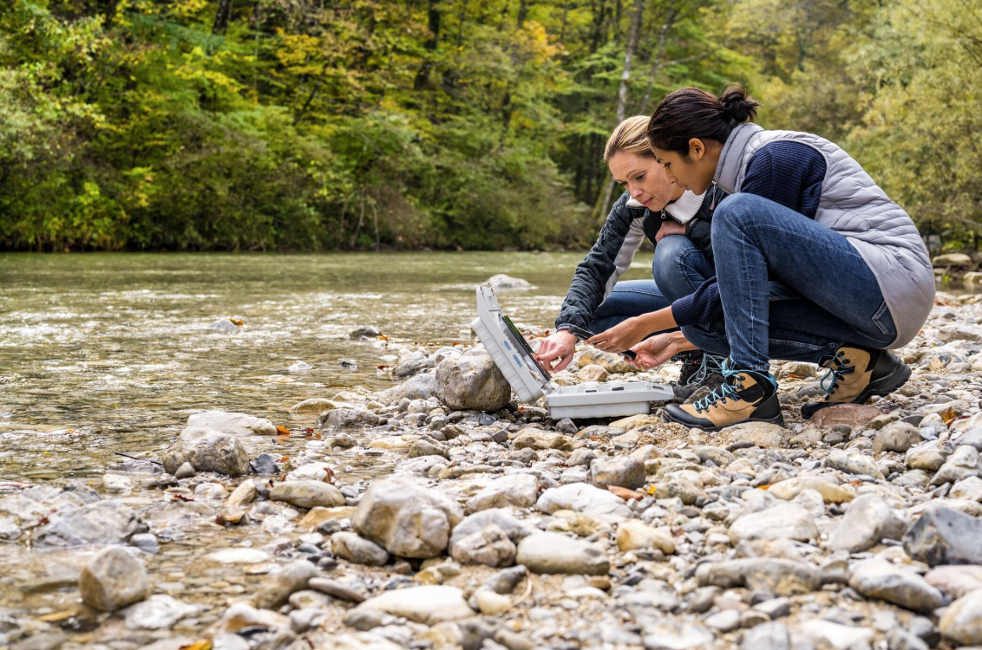
Career Connections
Conservation Scientist
A conservation scientist helps take care of the rainforest and the animals that live there.
They find ways to protect nature and fix places that have been damaged.
They use maps and computer tools to plan how to protect nature and fix damaged areas.
Notes:
Look at the jobs on pages 5, 28, and 29 to see what tools and technology are used in archaeology.

Slide 9
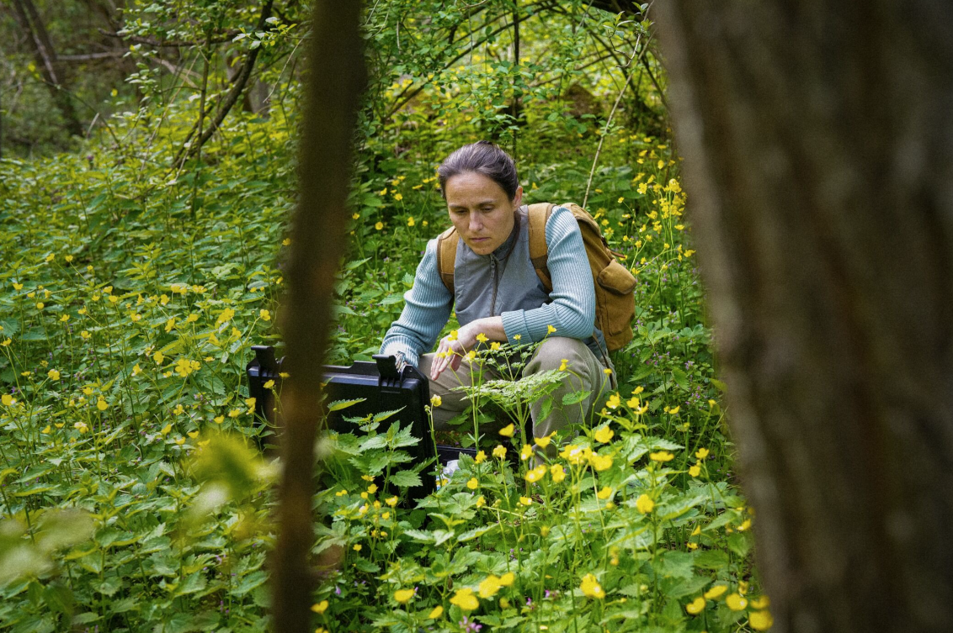
Career Connections
Botanist
A botanist studies plants, trees, and flowers in the rainforest.
They help make sure plants stay healthy so animals and people can use them.
They use magnifying tools and computers to look closely at plants and record what they see.
Notes:
Look at the jobs on pages 5, 28, and 29 to see what tools and technology are used in archaeology.

Slide 10
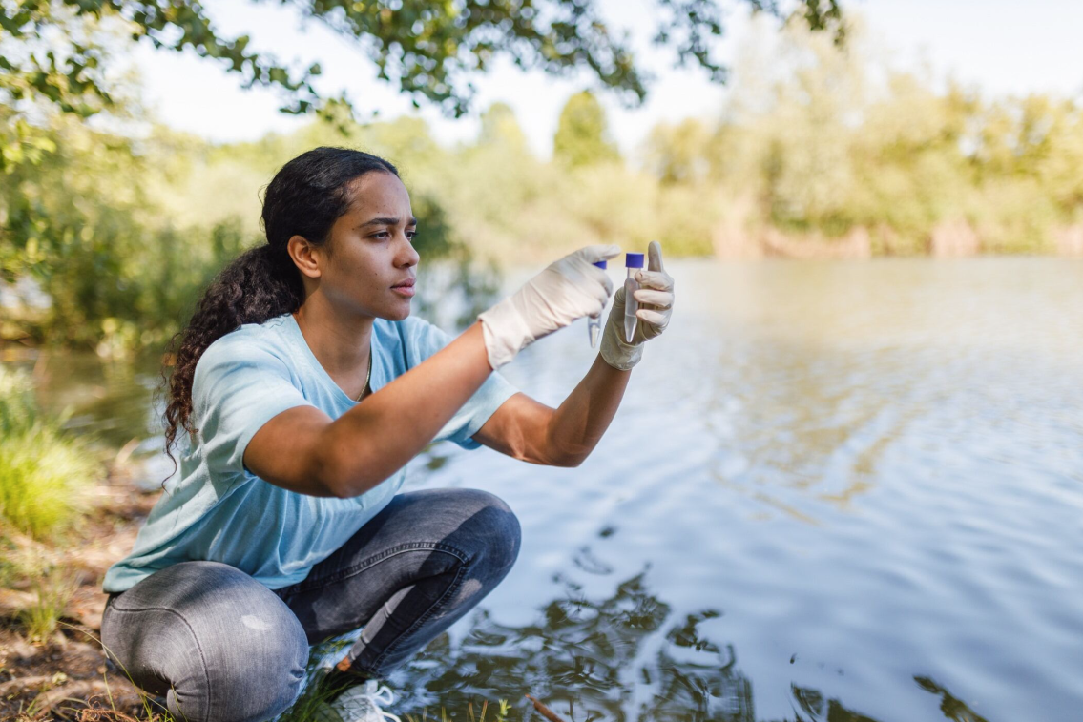
Career Connections
Environmental Scientist
An environmental scientist studies air, water, soil, plants, and animals in the rainforest.
They use water testing tools to check water in rivers and streams to make sure it is clean for animals.
They might also use air and soil sensors to understand how nature changes and how to keep it healthy.
Notes:
Look at the jobs on pages 5, 28, and 29 to see what tools and technology are used in archaeology.

Slide 11
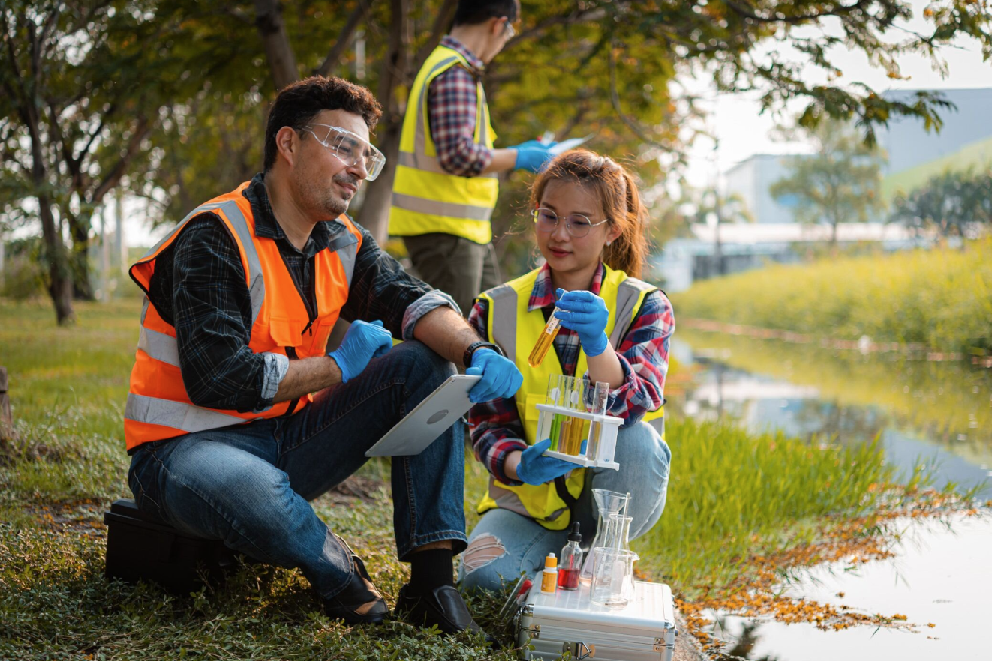
Career Connections
Ecologist
An ecologist studies how plants, animals, and the environment work together in the rainforest.
They look for patterns to know what happens when one plant or animal is missing.
They use charts and data tools to study how living things depend on each other.
Notes:
Look at the jobs on pages 5, 28, and 29 to see what tools and technology are used in archaeology.

Slide 12
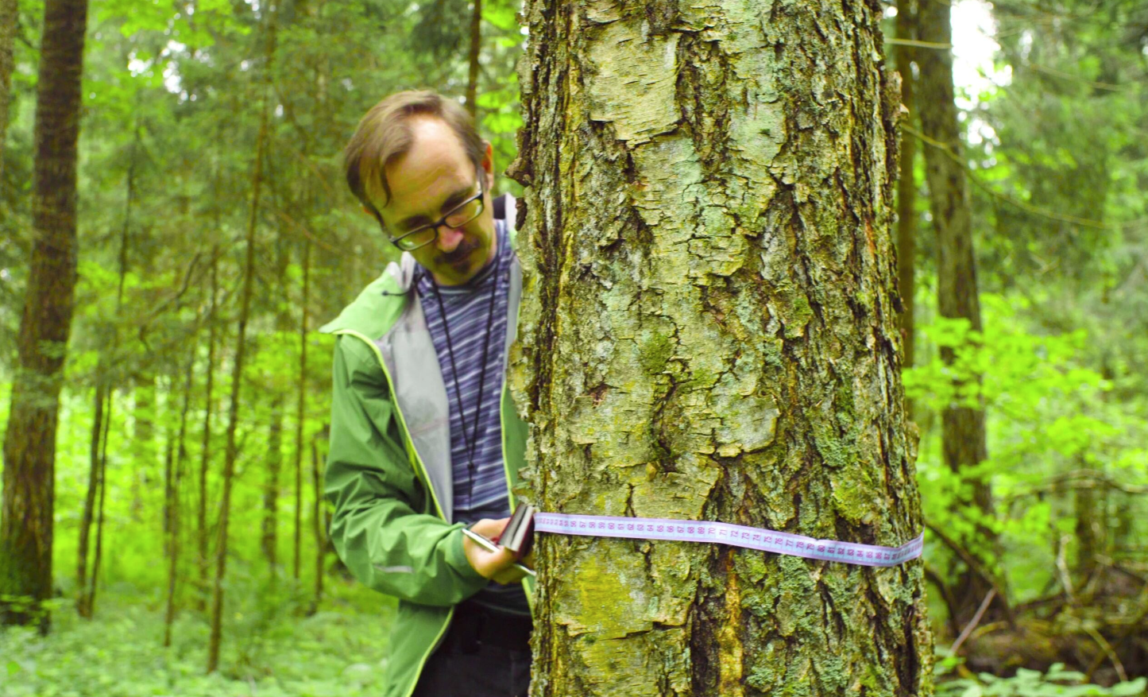
Career Connections
Forestry Technician
A forestry technician helps care for rainforest trees and plants.
They help plant new trees to replace ones that were cut down or damaged by storms.
They use measuring tools and GPS devices to check tree growth and track how a forest grows or decreases in size.
Notes:
Look at the jobs on pages 5, 28, and 29 to see what tools and technology are used in archaeology.

Slide 13
Activity 1 Tasks
Design a treehouse where a wildlife biologist can safely watch animals.
Choose an animal.
What tools would a scientist need to study that animal?
Write your ideas on page 20 of your Engineering Notebook.
Notes:
Activity 1 Tasks
Read about the jobs on page 5, 28 and 29.
Design a treehouse where a wildlife biologist can safely watch animals.
Choose an animal to study.
What tools does the scientist need?
Write or draw your ideas below.
Use the prototyping pieces to build the treehouse your team designed.
Session Tips
- The team could add on to the tree model from the Explore Set.
- Use the Multimedia Resources to find example photos, websites, and other activities related to the sessions.
- Use the prototyping pieces and other parts of the Explore Set to have the team build examples of different tools used for the jobs they discuss.

Slide 14
Activity 2 Tasks
Build a tool or technology that scientists could use in the treehouse.
Which tool or technology did you build?
Notes:
Activity 2 Tasks
Talk about the tools you learned used to study animals.
Record your ideas below.
Use the prototyping pieces to build a tool or technology for the treehouse.
Session Tips
- The team could rebuild tools they discussed in a previous session.
- You could take a walk outside to look at plants and ask the team what tools they would need to learn more about them.
- Use the SPIKE Essential set in Activity 2 and return the pieces to storage at the end of the session.

Slide 15
Challenge
Add a botanist to the treehouse.
Which tool could you build for these people to study plants?
Notes:
Challenge Tasks
Add a plant scientist or botanist to the treehouse.
Change the treehouse so that it has tools to study plants.
Share what you built with your team.
Session Tips
- The team could rebuild tools they discussed in a previous session.
- You could take a walk outside to look at plants and ask the team what tools they would need to learn more about them.
- Use the SPIKE Essential set in Activity 2 and return the pieces to storage at the end of the session.

Slide 16
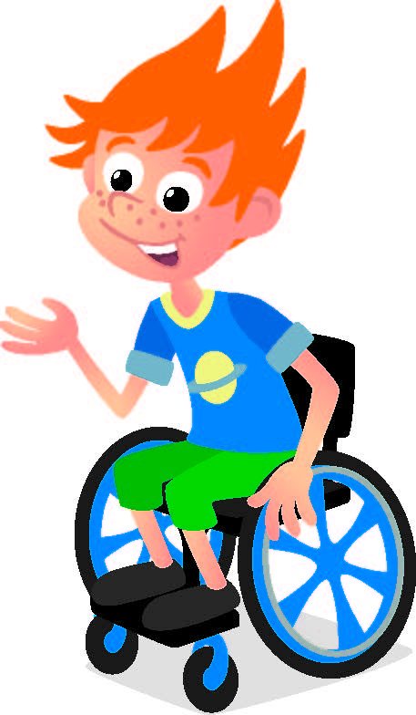
Share
Share what you learned.
What did you learn about biodiversity jobs?
What jobs and technology are used to study biodiversity in the rainforest?
Notes:
Share
Have the team share with the whole room:
- Share what they learned about the jobs in their Engineering Notebook.
- Talk about the jobs and technology used to study biodiversity.

Slide 17

Clean Up
Notes:
Cleanup Pointers
Everything built in this session should be taken apart and returned to storage.
Store the SPIKE™ Essential set and the Explore Set separately.
You may wish to play a video or song during clean up time Link on
GoNoodle:. https://family.gonoodle.com/activities/clean-up
Link on YouTube Kids: https://www.youtubekids.com/watch?v=ZJFk87ZsHn0
Link on Youtube: https://youtu.be/ZJFk87ZsHn0

Slide 18


LEGO, the LEGO logo, the Minifigure, LEGO Education, the LEGO Education logo, and the SPIKE logo are trademarks of the/sont des marques de commerce du/son marcas registradas de LEGO Group. ©2026 The LEGO Group. All rights reserved/Tous droits réservés/Todos los derechos reservados. FIRST®, the FIRST® logo, and FIRST® CANOPY™ are trademarks of For Inspiration and Recognition of Science and Technology (FIRST). LEGO® is a registered trademark of the LEGO Group. FIRST® LEGO® League and BIOGLOW™ are jointly held trademarks of FIRST and the LEGO Group. ©2026 FIRST and the LEGO Group. All rights reserved.

