Slide 1


SESSION 6
Research Tools
I can work with my team to build tools used by scientists to student animals in the rainforest.
I can work with my team to add the sensor and hub to the research device model.
Students will learn about the types of tools and technology used in the rainforest to study plants and animals and the jobs of those who use them.

Slide 2

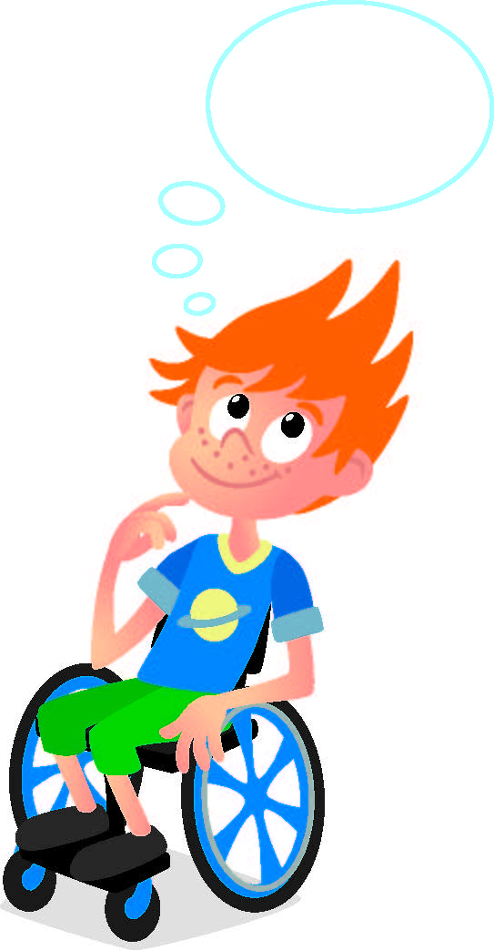
Discussion
What did we do last session?
Notes:
Discuss with students the coding and lifts that scientists use in the rainforest they learned about last session. ​

Slide 3
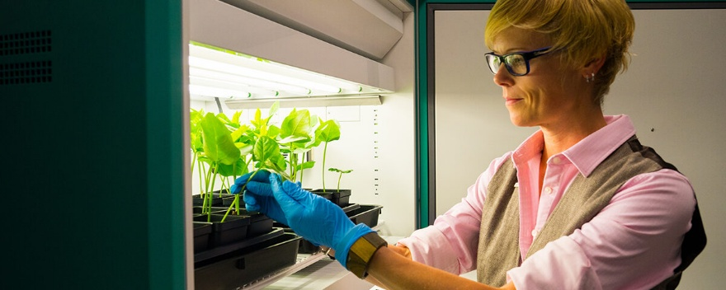
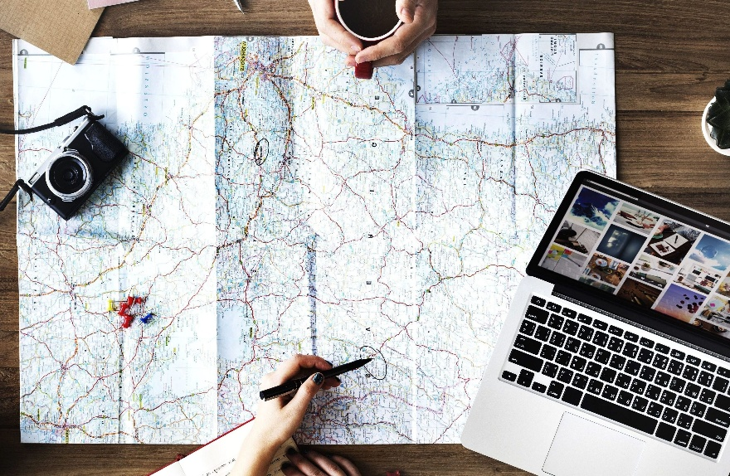
Key Vocabulary
Research: a careful study of something in order to find out information about it
Tool: any thing that helps to get something done
Notes:
Session specific vocab

Slide 4
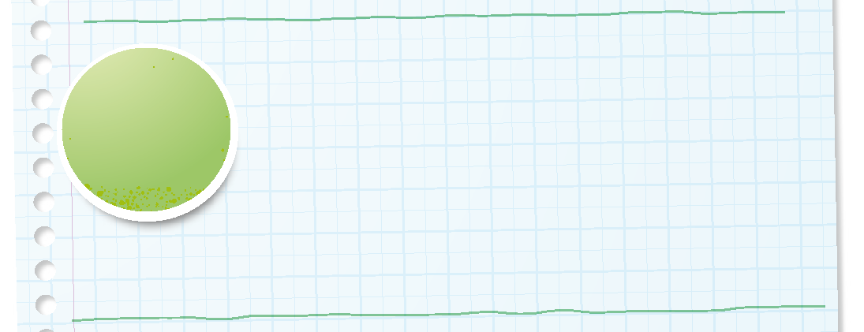

Introduction
Can your team provide examples of how they have used inclusion?
We respect each other and embrace our differences.
Notes:
Introduction – Be Inclusive (5-10 minutes)
• Introduce the FIRST® Core Values.
• Read the definition for inclusion to the team. (see TMG page 5)
• Talk about what inclusion is. Have the team provide examples of this Core Value.
• Have everyone draw a picture of an example of inclusion on the Core Values page in their Engineering Notebook.

Slide 5
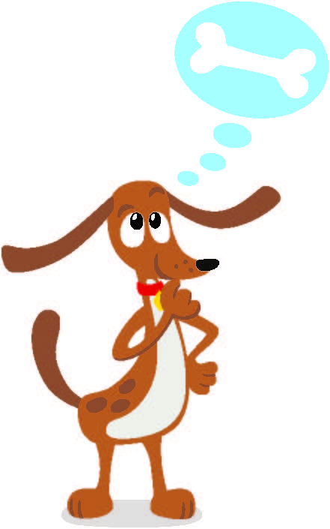
Guiding Questions
What are some tools that are used to study the rainforest?
How do scientists use the tools you talked about with your team?
Which tools will you draw or describe in your Engineering Notebook?
Notes:
Each session has Guiding Questions that can be shared to frame the session.
Talk through each of these questions with the students. Have them start to think about these questions and later their will share their thoughts with their team.

Slide 6
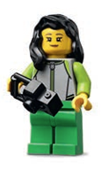
Activity 1 Tasks
Talk with your team about tools used to study the rainforest.
What tools are needed for animal observation?
What tools are used to document or student plants?
Notes:
Activity 1 Tasks
Talk to your team about tools used to study the rainforest.
What tools are needed for animal observation?
What tools are used to document or study plants?
Write your ideas below.
Select a tool to build with your team.
Use the prototyping pieces in Bag 9-13 to create a tool used in the rainforest.
Put the tool on the mat.
Session Tips
- Encourage the team to build tools using the prototyping pieces.
- The team could test the research device with the animals they built in Session 2.
- Ask the children to use words they have learned in previous sessions.

Slide 7
Activity 1 Tasks
Select a tool to build with your team.
Use the prototyping pieces to create a tool used in the rainforest.
Put the tool on the mat.
Notes:
Activity 1 Tasks
Talk to your team about tools used to study the rainforest.
What tools are needed for animal observation?
What tools are used to document or study plants?
Write your ideas below.
Select a tool to build with your team.
Use the prototyping pieces in Bag 9-13 to create a tool used in the rainforest.
Put the tool on the mat.
Session Tips
- Encourage the team to build tools using the prototyping pieces.
- The team could test the research device with the animals they built in Session 2.
- Ask the children to use words they have learned in previous sessions.

Slide 8
Guiding Questions
Why do scientists use cameras to learn about nature?
What other technology could you use in the rainforest?
What are some jobs that study biodiversity in the rainforest?
Notes:
Each session has Guiding Questions that can be shared to frame the session.
Talk through each of these questions with the students. Have them start to think about these questions and later their will share their thoughts with their team.

Slide 9
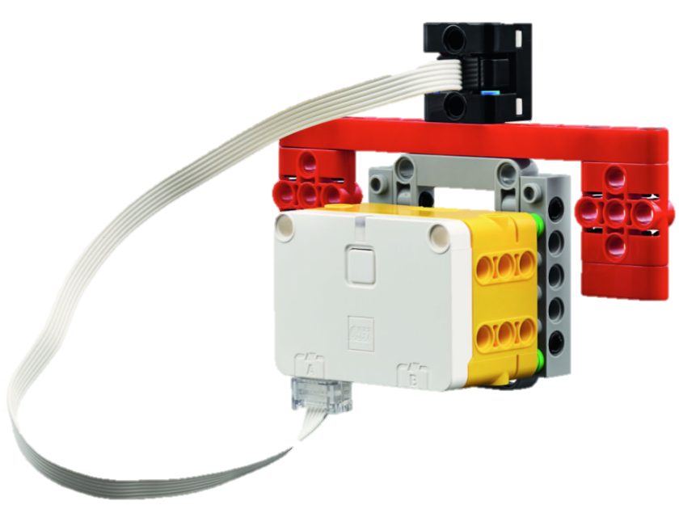
Activity 2 Tasks
Use Book 2 and Bag 8 to build the research device.
Try the provided program.
What does the research device do?
Notes:
Activity 2 Tasks
Use the building instructions in Book 2 and Bag 8 to build the research device.
Open the SPIKE app on your team’s device.
Try the program provided in the box below to activate the research device.
Take turns moving the research device to different places on the mat.
What does it do?
Session Tips
- The team should try the code provided in the Engineering Notebook.
- Use the building instructions in Book 2 to attach the sensor and hub to the research device model.
- Teams will learn about more jobs in the next session. There are jobs listed on pages 5, 28 and 29 in the Engineering Notebook.

Slide 10
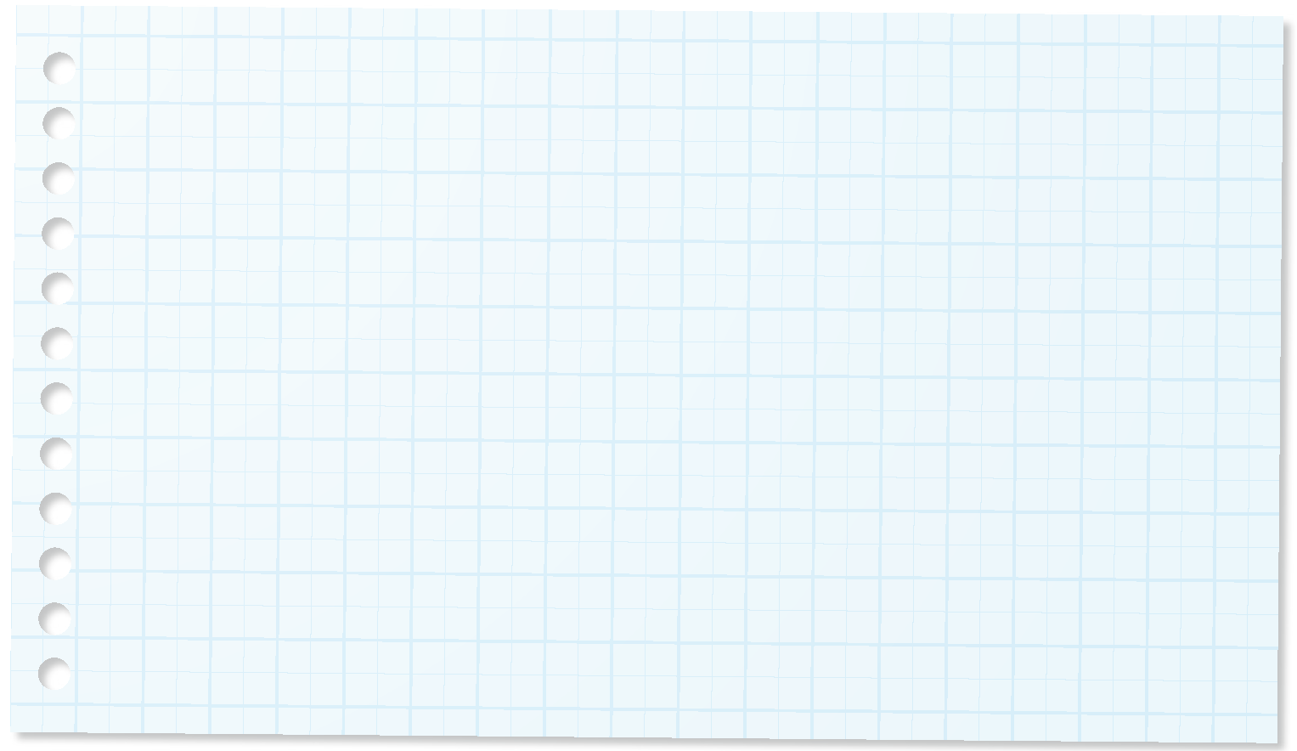
Challenge
Change the program so the research device is activated by a different color.
What does it do when used with the animals you built?
Write your ideas on page 19 of your Engineering Notebook.
Notes:
Challenge Tasks
Change the program for the research device so it is activated by a different color.
What does it do when used on the animals you built?
Write your ideas below.
Session Tips
- The team should try the code provided in the Engineering Notebook.
- Use the building instructions in Book 2 to attach the sensor and hub to the research device model.
- Teams will learn about more jobs in the next session. There are jobs listed on pages 5, 28 and 29 in the Engineering Notebook.

Slide 11
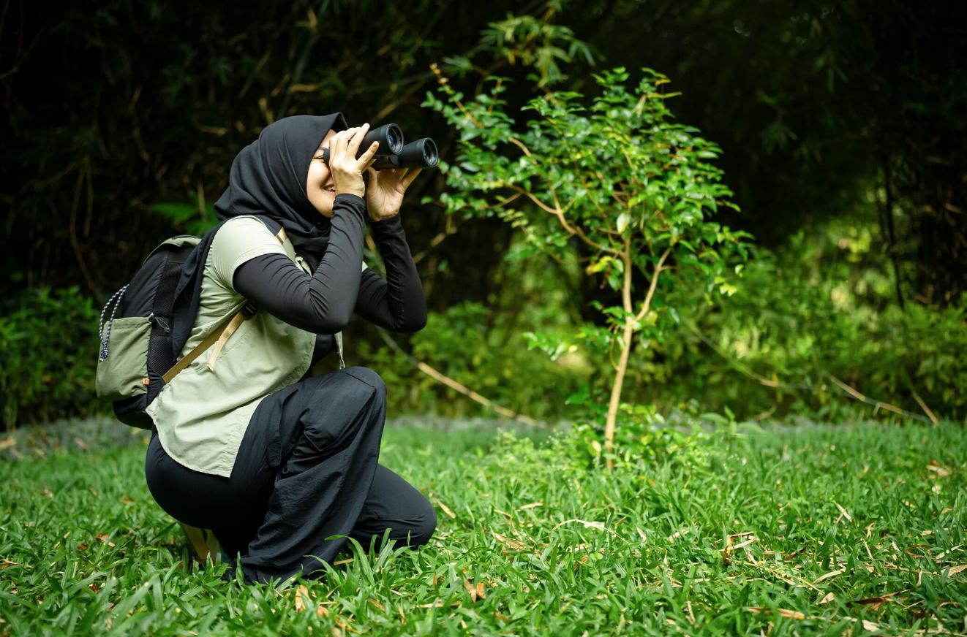
Career Connections
Wildlife Biologist
A wildlife biologist studies animals in the rainforest to learn how they live and what they need to survive.
They help protect animals by finding ways to keep their homes safe.
They use tools like cameras and trackers to safely watch animals in their habitats.
Notes:
Look at the jobs on pages 5, 28, and 29 to see what tools and technology are used in archaeology.

Slide 12
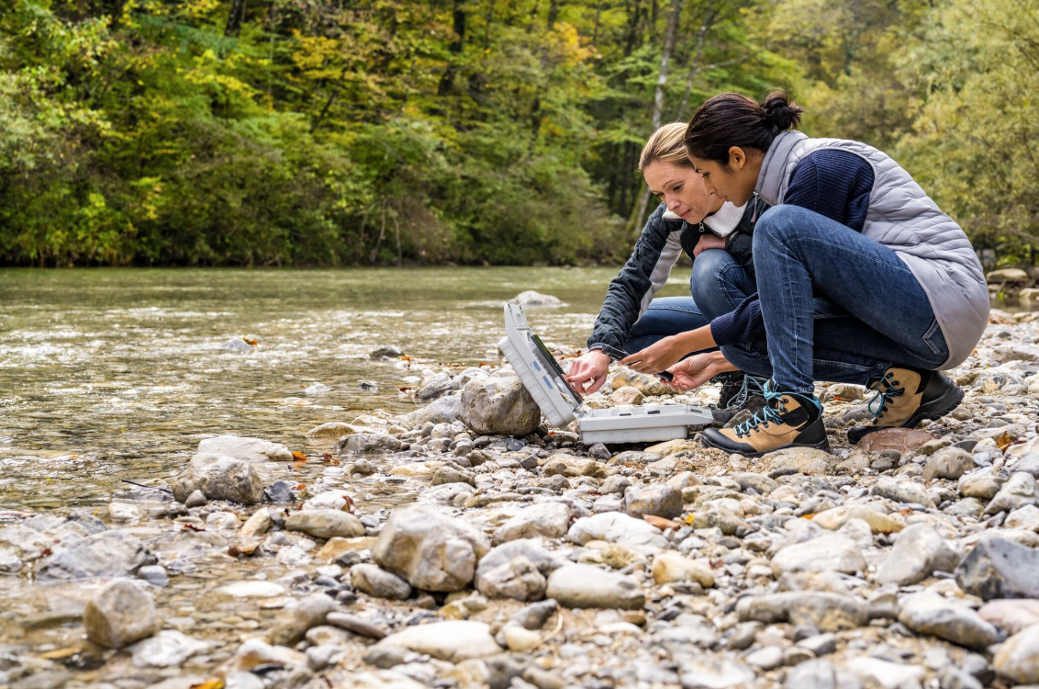
Career Connections
Conservation Scientist
A conservation scientist helps take care of the rainforest and the animals that live there.
They find ways to protect nature and fix places that have been damaged.
They use maps and computer tools to plan how to protect nature and fix damaged areas.
Notes:
Look at the jobs on pages 5, 28, and 29 to see what tools and technology are used in archaeology.

Slide 13
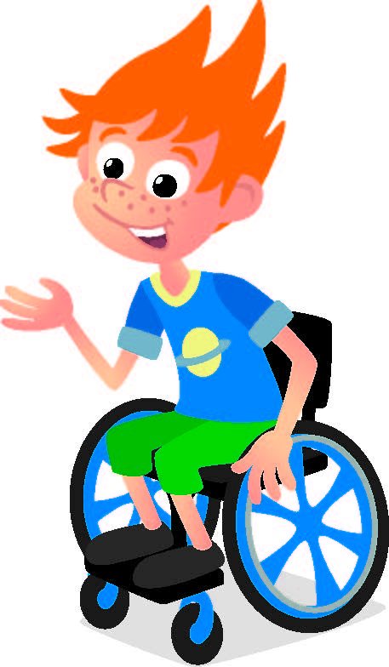
Share
Share what you learned.
What tools and technology are used in the rainforest?
What have you learned about biodiversity?
Notes:
Share
Have the team share with the whole room:
- Talk about the tools and technology used to work in the rainforest.
- Share what they have learned about biodiversity so far.

Slide 14

Clean Up
Notes:
Cleanup Pointers
Keep the research device assembled.
Make sure to charge your LEGO Education set for the next session.
You may wish to play a video or song during clean up time Link on
GoNoodle:. https://family.gonoodle.com/activities/clean-up
Link on YouTube Kids: https://www.youtubekids.com/watch?v=ZJFk87ZsHn0
Link on Youtube: https://youtu.be/ZJFk87ZsHn0

Slide 15


LEGO, the LEGO logo, the Minifigure, LEGO Education, the LEGO Education logo, and the SPIKE logo are trademarks of the/sont des marques de commerce du/son marcas registradas de LEGO Group. ©2026 The LEGO Group. All rights reserved/Tous droits réservés/Todos los derechos reservados. FIRST®, the FIRST® logo, and FIRST® CANOPY™ are trademarks of For Inspiration and Recognition of Science and Technology (FIRST). LEGO® is a registered trademark of the LEGO Group. FIRST® LEGO® League and BIOGLOW™ are jointly held trademarks of FIRST and the LEGO Group. ©2026 FIRST and the LEGO Group. All rights reserved.

