Slide 1


SESSION 1
Canopy Connections
I can work with my team using discovery to explore the BIOGLOWTM theme and share what I know about biodiversity.
I can work with my team to build the tree model.
I can work with my team to share about what we built.
Students will share what they know about biodiversity, look at the Explore Story, and build the tree model and talk about where different animals live.

Slide 2
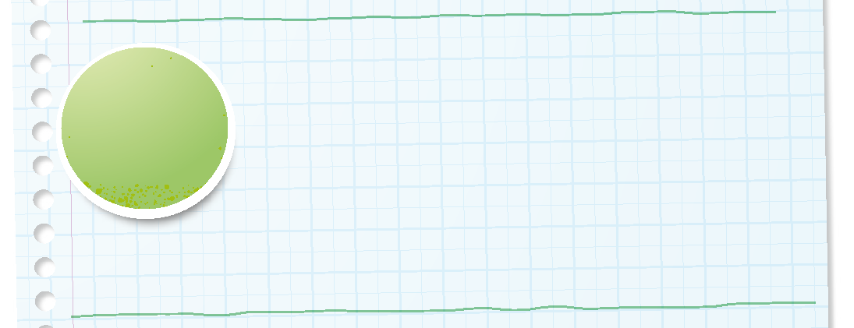

Introduction
Can your team provide examples of how they have used discovery?
We explore new skills and ideas.
Notes:
Introduction - Let’s Discover (5-10 minutes)
• Introduce the FIRST® Core Values.
• Read the definition for discovery to the team. (see TMG page 5)
• Talk about what discovery is. Have the team provide examples of this Core Value.
• Have everyone draw a picture of an example of discovery on the Core Values page in their Engineering Notebook.

Slide 3
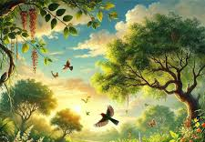
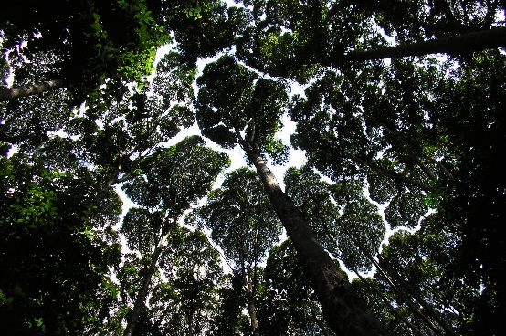
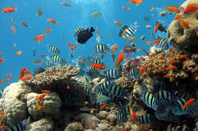
Key Vocabulary
Biodiversity: the many different types of plant and animal life on Earth
Canopy: a giant, leafy room that covers a forest
Habitat: a plant or animal's natural home
Notes:
Session specific vocab

Slide 4
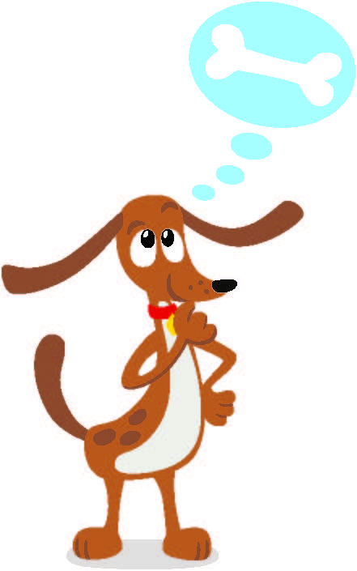
Guiding Questions
What do you know about the rainforest and biodiversity?
What does a wildlife biologist do?
What do you think is happening in the Explore Story?
Notes:
Each session has Guiding Questions that can be shared to frame the session.
Talk through each of these questions with the students. Have them start to think about these questions and later their will share their thoughts with their team.
Session Tips:
The Explore story on page 4 is a wordless comic referenced throughout the sessions to inspire creativity and spark discussions about the season’s theme.
It is okay if they don't know anything about biodiversity yet, that is what the experience is about – learning!

Slide 5
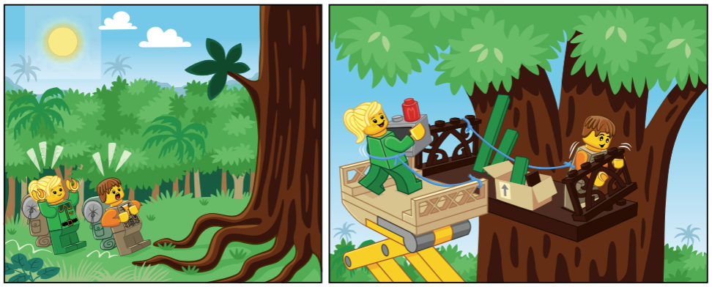
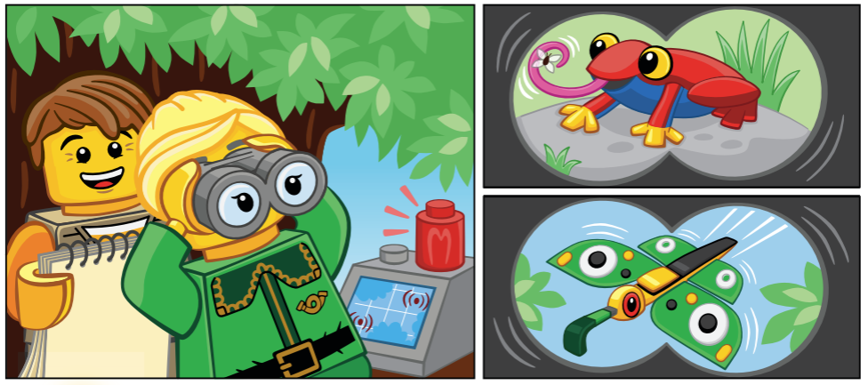
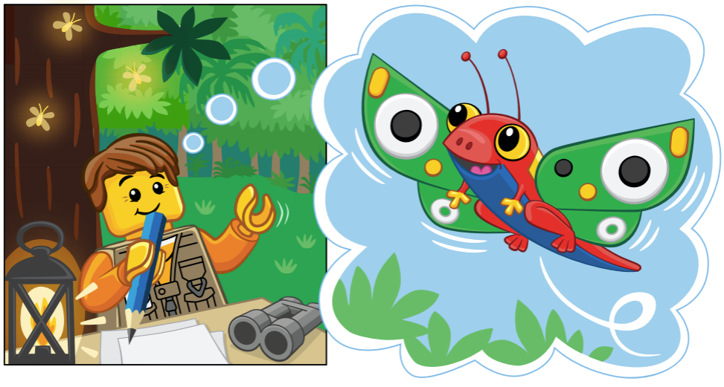
Activity 1 Tasks
Look at the Explore Story on page 4.
What do you see?
What are the characters and animals doing?
Notes:
Activity 1 Tasks
Look at the Explore story on page 4. Look closely at each picture and think about what the characters/animals might be thinking or doing.
Share what you know about the rainforest and biodiversity with your team.
Write or draw what your team shared.
List your team goals on page 6.
Session Tips
Biodiversity describes all the living things in an area. The students will learn about and discuss rainforest biodiversity.
Use the Multimedia Resources to find example photos, websites, and other activities related to the sessions.
The Explore story on page 4 is a wordless comic referenced throughout the sessions to inspire creativity and spark discussions about the season’s theme.
Writing and drawing space is provided throughout the Engineering Notebook for each team member to capture their ideas.

Slide 6

Activity 1 Tasks
Share what you know about animals in rainforests with your team.
Write or draw what your team shared in your Engineering Notebook on page 8.
Notes:
Activity 1 Tasks
Look at the Explore story on page 4. Look closely at each picture and think about what the characters/animals might be thinking or doing.
Share what you know about the rainforest and biodiversity with your team.
Write or draw what your team shared.
List your team goals on page 6.
Session Tips
Biodiversity describes all the living things in an area. The students will learn about and discuss rainforest biodiversity.
Use the Multimedia Resources to find example photos, websites, and other activities related to the sessions.
The Explore story on page 4 is a wordless comic referenced throughout the sessions to inspire creativity and spark discussions about the season’s theme.
Writing and drawing space is provided throughout the Engineering Notebook for each team member to capture their ideas.

Slide 7
Guiding Questions
What are the different layers of the rainforest?
What kinds of animals live in trees?
Why do you think some animals live on the forest floor while others live high up in the canopy?
Notes:
Each session has Guiding Questions that can be shared to frame the session.
Talk through each of these questions with the students. Have them start to think about these questions and later their will share their thoughts with their team.
Session Tips:
The Explore story on page 4 is a wordless comic referenced throughout the sessions to inspire creativity and spark discussions about the season’s theme.
It is okay if they don't know anything about biodiversity yet, that is what the experience is about – learning!

Slide 8
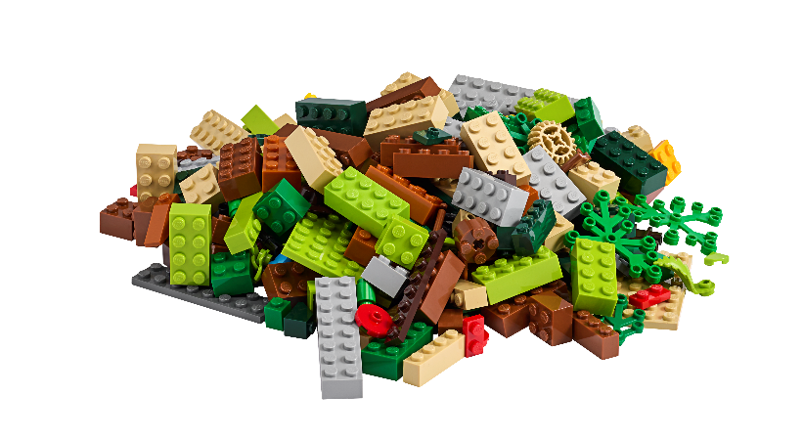
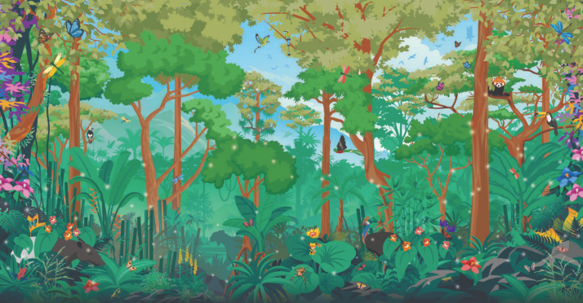
Activity 2 Tasks
Using Book 1 and Bags 1-2, work together to build the tree model.
You Need…
Notes:
Activity 2 Tasks
Build the tree model from the Explore Set using Book 1 and Bags 1-3.
Talk to your team about the different layers of the tree you build. What animals live on the forest floor? What animals live in the canopy?
Session Tips
The team could rearrange the pieces on the tree to create a specific animal habitat.
The layers of the rainforest can be found on page 30 of the Engineering Notebook.
Encourage the children not share what they build and to explain where animals could live in the tree.

Slide 9
Activity 2 Tasks
Talk about what animals live on the forest floor and in the canopy.
Draw a picture of the animals your team talked about on page 9 of your Engineering Notebook.
Notes:
Activity 2 Tasks
Build the tree model from the Explore Set using Book 1 and Bags 1-3.
Talk to your team about the different layers of the tree you build. What animals live on the forest floor? What animals live in the canopy?
Session Tips
The team could rearrange the pieces on the tree to create a specific animal habitat.
The layers of the rainforest can be found on page 30 of the Engineering Notebook.
Encourage the children not share what they build and to explain where animals could live in the tree.

Slide 10
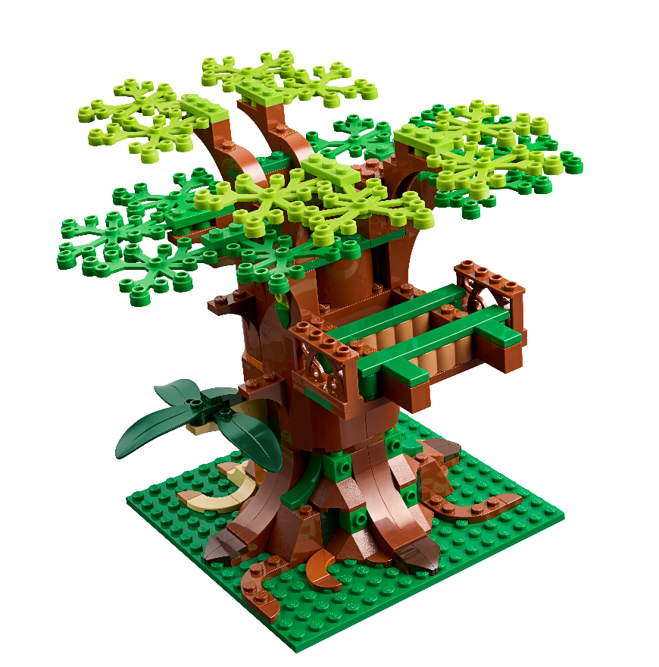
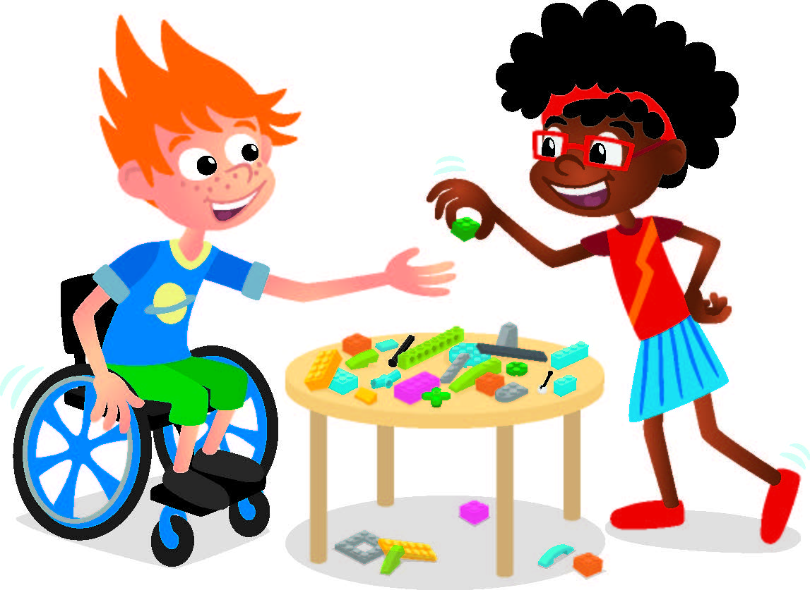
Challenge
Change the tree model by moving the leaves to new places.
Notes:
Challenge
Change the tree model by moving the leaves to new places.
Draw or describe the animals you talked about with your team.
Session Tips
The layers of the rainforest can be found on page 30 of the Engineering Notebook.
Encourage the children not share what they build and to explain where animals could live in the tree.

Slide 11
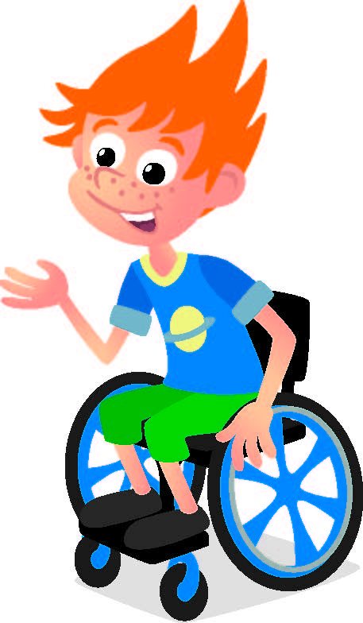
Share
Share what you built.
What do you think happened in the Explore Story?
What do you know about rainforests?
What animals might live in your tree?
Notes:
Share
Have the team share with the whole room:
Talk about what they think happened in the Explore story.
Share what they know about rainforests.
Share what animals might live in their tree model.

Slide 12
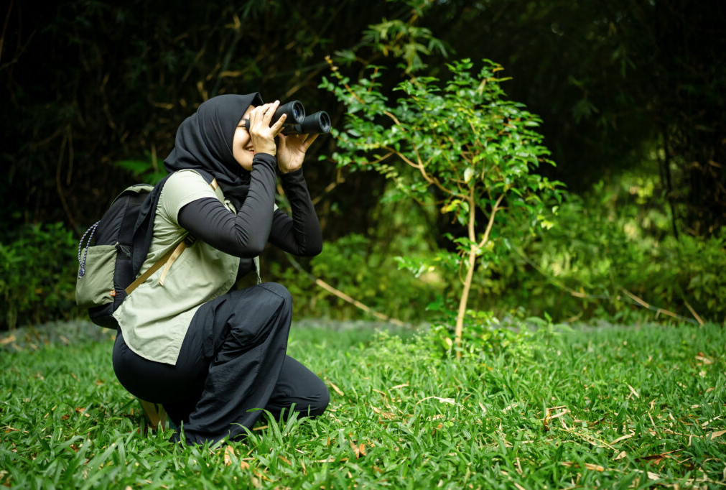
Career Connection
Wildlife Biologist
A wildlife biologist is a scientist who studies wild animals and their homes.
They investigate what animals eat, how they behave, and what keeps them healthy. Their main goal is to protect creatures and make sure their natural habitats stay safe and strong

Slide 13

Clean Up
Notes:
Cleanup Pointers
• Keep the tree model assembled for use in future sessions!
You may wish to play a video or song during clean up time Link on
GoNoodle:. https://family.gonoodle.com/activities/clean-up
Link on YouTube Kids: https://www.youtubekids.com/watch?v=ZJFk87ZsHn0
Link on Youtube: https://youtu.be/ZJFk87ZsHn0

Slide 14


LEGO, the LEGO logo, the Minifigure, LEGO Education, the LEGO Education logo, and the SPIKE logo are trademarks of the/sont des marques de commerce du/son marcas registradas de LEGO Group. ©2026 The LEGO Group. All rights reserved/Tous droits réservés/Todos los derechos reservados. FIRST®, the FIRST® logo, and FIRST® CANOPY™ are trademarks of For Inspiration and Recognition of Science and Technology (FIRST). LEGO® is a registered trademark of the LEGO Group. FIRST® LEGO® League and BIOGLOW™ are jointly held trademarks of FIRST and the LEGO Group. ©2026 FIRST and the LEGO Group. All rights reserved.

