Slide 1


SESSION 7
History Helpers
I can work with my team to learn about jobs related to archaeology.
I can work with my team to add the motor and hub to the excavation model.
Students will learn about the different jobs in archaeology and what kind of training and tools they need.

Slide 2



Discussion
What did we do last session?
Notes:
Discuss with students the tools and technology used at a dig site they learned about last session. ​And the two jobs covered last session.

Slide 3
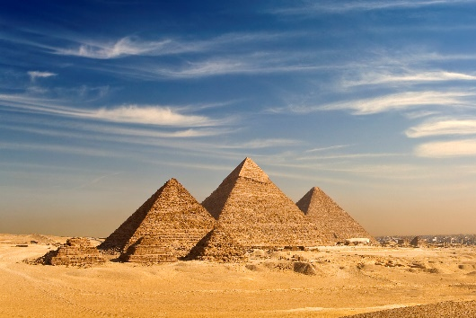

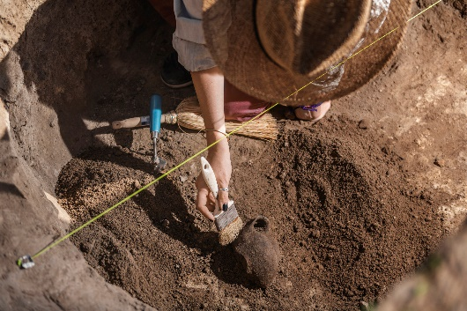
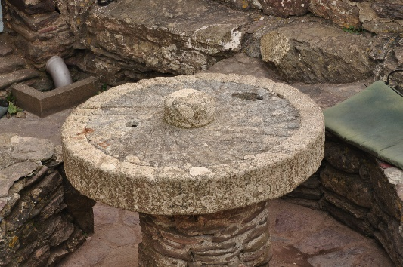
Key Vocabulary
Ancient: age-appropriate definition
Excavation: site or process to uncover by digging away covering earth
Millstone: two circular stones used for grinding a substance
Notes:
Session specific vocab

Slide 4

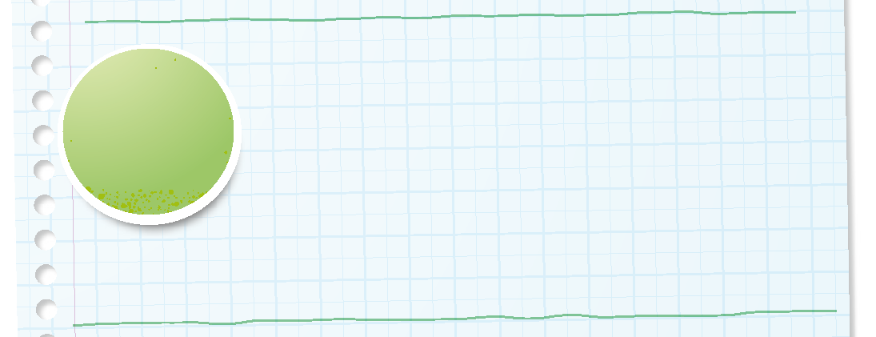

Introduction
How has your team used discovery throughout the sessions?
We explore new skills and ideas.
Notes:
Introduction – Model Discovery (5-10 minutes)
• Introduce the FIRST® Core Values.
• Read the definition for discovery to the team. (see TMG page 5)
• Talk about what discovery is. Have the team provide examples of this Core Value throughout the sessions.
• Have the team build something using the prototyping pieces representing this Core Value.

Slide 5


Guiding Questions
What jobs would you find at an excavation site?
What jobs support the work of archaeologists?
Notes:
Each session has Guiding Questions that can be shared to frame the session.
Talk through each of these questions with the students. Have them start to think about these questions and later their will share their thoughts with their team.

Slide 6


Activity 1 Tasks
Explore the archaeology jobs on pages 5, 28, and 29.
What jobs interest you?
Notes:
Activity 1 Tasks
Explore the archaeology jobs on pages 5, 28, and 29.
Pick a job that interests you. What kind of training does it require? What kind of tools are used?
Write or draw your ideas below.
Use the pieces in the Explore Set to build an example of the job you selected.
Share your ideas with your team.
Session Tips
The team should pick one job to focus on before looking at others.
Use the Multimedia Resources to find example photos, websites, and other activities related to the sessions.
Use the prototyping pieces and other parts of the Explore Set to have the team build examples of different jobs.

Slide 7

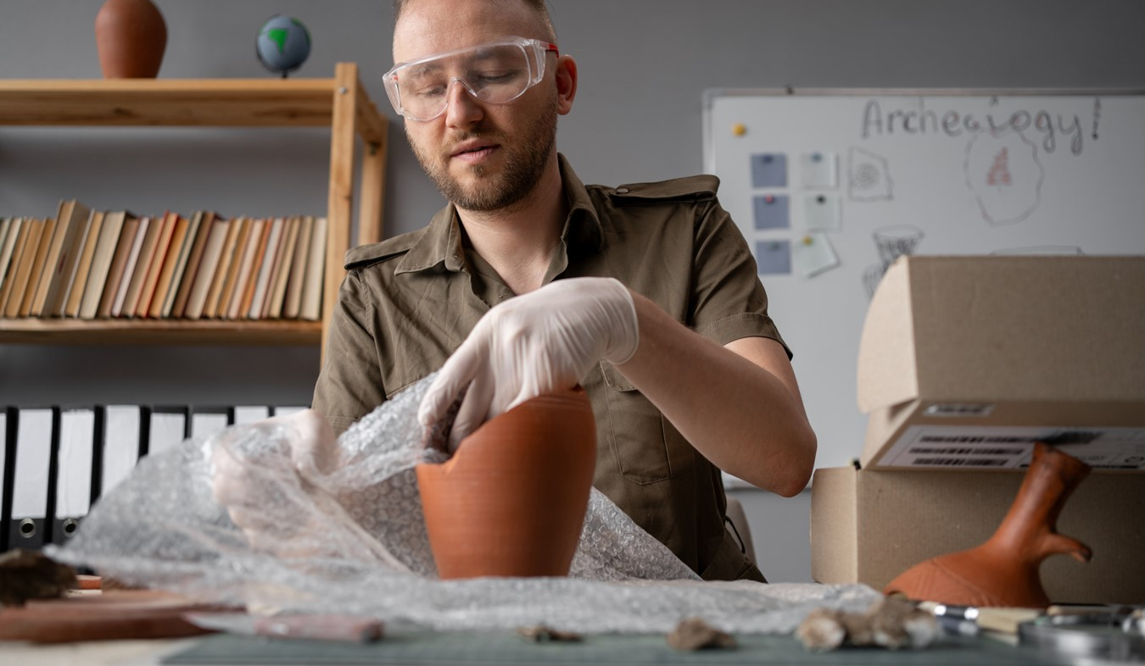
Career Connections
Archaeologist
Archaeologists are storytellers of the past.
Archaeologists do lots of different jobs to help people learn about the past.
They may do research, excavate or dig up treasures from underground, study in a lab, or manage collections of ancient artifacts.
Notes:
Look at the jobs on pages 5, 28, and 29 to see what tools and technology are used in archaeology.

Slide 8
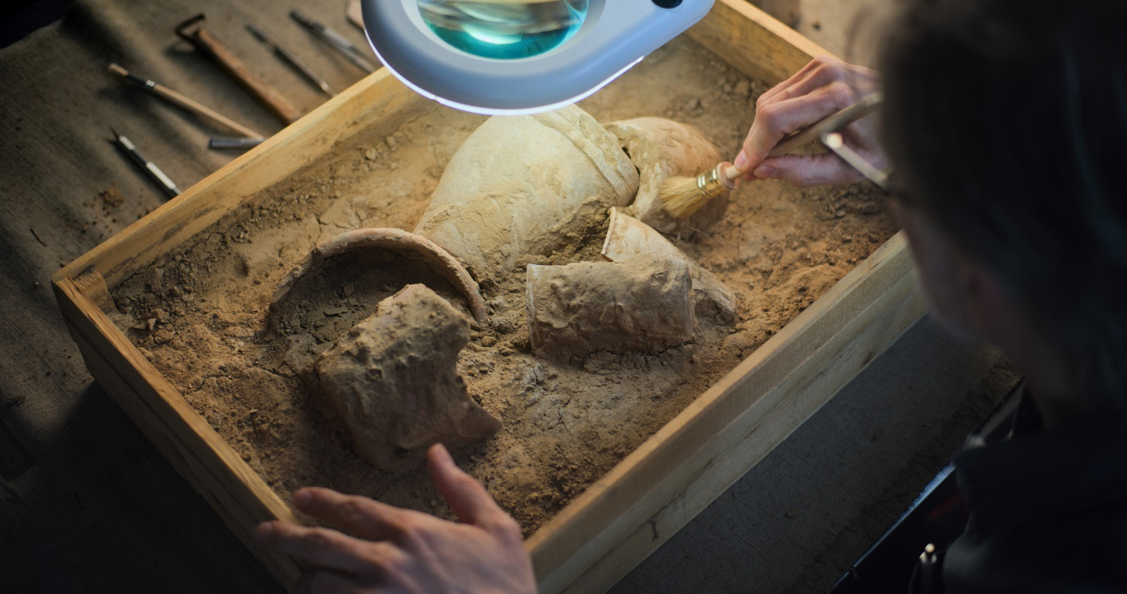
Career Connections
Lab Technician
Lab technicians help organize the things that archaeologists find.
They carefully clean and measure the objects, and they sometimes put broken pieces back together like a puzzle.
Microscopes, cameras, and 3D printers are some of the things that might be used in the lab.
Notes:
Look at the jobs on pages 5, 28, and 29 to see what tools and technology are used in archaeology.

Slide 9
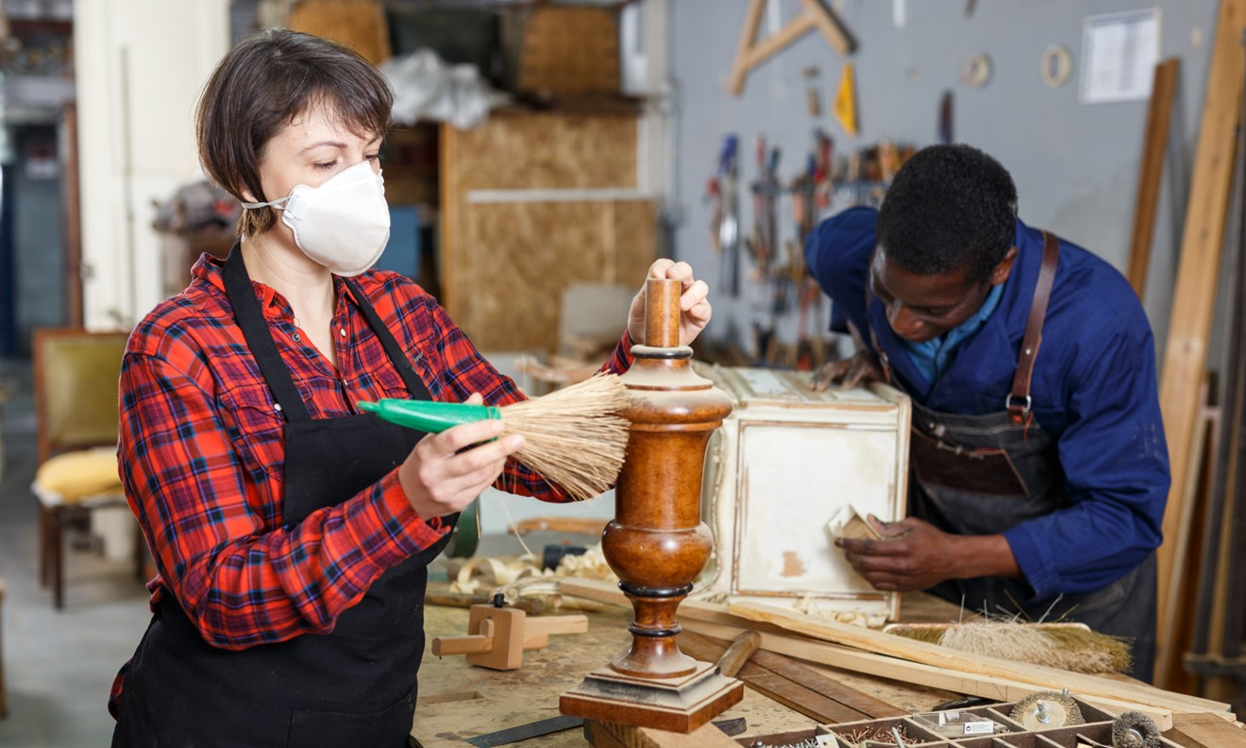
Career Connections
Anthropologist
Anthropologists are interested in how people lived in the past.
They work closely with archaeologists to study human history and how people have changed over time.
They study human-made artifacts and use clues from the site to interpret how the objects were used long ago.
Notes:
Look at the jobs on pages 5, 28, and 29 to see what tools and technology are used in archaeology.

Slide 10
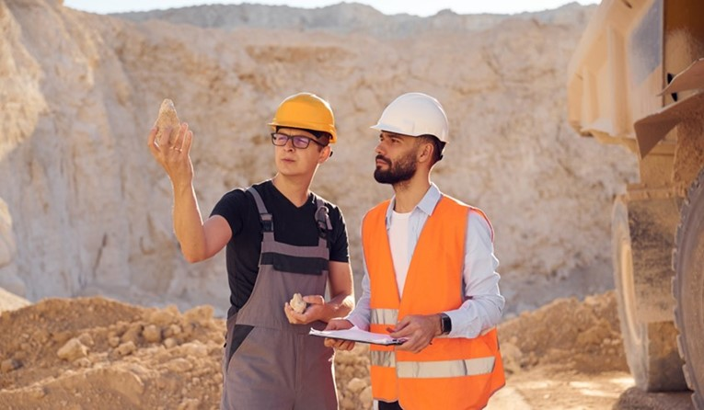
Career Connections
Site Manager
The site manager makes sure everything runs smoothly at the dig site. They help keep the people and supplies organized so the team can work efficiently. If something exciting happens, the site manager might be the first person called.
They also take care of the vehicles and help get people to and from the site.
Notes:
Look at the jobs on pages 5, 28, and 29 to see what tools and technology are used in archaeology.

Slide 11
Career Connections
Conservator
A conservator is an expert in fixing and protecting artifacts so they can be studied for a long time.
When artifacts are found by archaeologists, they may be dirty, damaged, or in multiple pieces.
Conservators may have to work quickly because some artifacts can fall apart if they are not treated carefully.
Notes:
Look at the jobs on pages 5, 28, and 29 to see what tools and technology are used in archaeology.

Slide 12
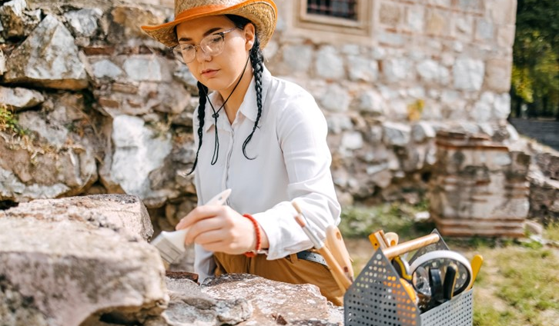
Career Connections
Geologist
Geologists help at dig sites because they are experts in rocks and soil.
They can figure out how old the rocks are to help understand how the site has changed over time. Geologists can help the team
know where to dig and what tools might be necessary.
Notes:
Look at the jobs on pages 5, 28, and 29 to see what tools and technology are used in archaeology.

Slide 13
Guiding Questions
What kinds of skills are needed for these jobs?
Pick two jobs, how are these jobs different?
Notes:
Each session has Guiding Questions that can be shared to frame the session.
Talk through each of these questions with the students. Have them start to think about these questions and later their will share their thoughts with their team.

Slide 14

Activity 1 Tasks
Pick one job that interests you.
What kind of training does it require?
What kind of tools are used?
Write your ideas on page 20
of your Engineering Notebook.
Notes:
Activity 1 Tasks
Explore the archaeology jobs on pages 5, 28, and 29.
Pick a job that interests you. What kind of training does it require? What kind of tools are used?
Write or draw your ideas below.
Use the pieces in the Explore Set to build an example of the job you selected.
Share your ideas with your team.
Session Tips
The team should pick one job to focus on before looking at others.
Use the Multimedia Resources to find example photos, websites, and other activities related to the sessions.
Use the prototyping pieces and other parts of the Explore Set to have the team build examples of different jobs.

Slide 15

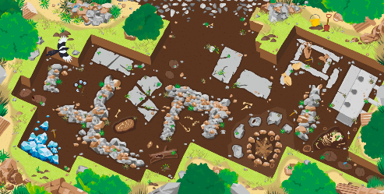
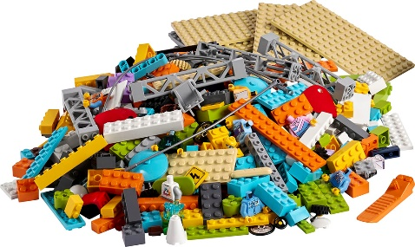
Activity 1 Tasks
Build an example of the job you selected.
Use the Explore Set pieces to create something related to that job.
Write your ideas on page 20 of your Engineering Notebook.
You Need…
Notes:
Activity 1 Tasks
Explore the archaeology jobs on pages 5, 28, and 29.
Pick a job that interests you. What kind of training does it require? What kind of tools are used?
Write or draw your ideas below.
Use the pieces in the Explore Set to build an example of the job you selected.
Share your ideas with your team.
Session Tips
The team should pick one job to focus on before looking at others.
Use the Multimedia Resources to find example photos, websites, and other activities related to the sessions.
Use the prototyping pieces and other parts of the Explore Set to have the team build examples of different jobs.

Slide 16
Guiding Questions
What places are artifacts sent so people can study them?
Notes:
Each session has Guiding Questions that can be shared to frame the session.
Talk through each of these questions with the students. Have them start to think about these questions and later their will share their thoughts with their team.

Slide 17
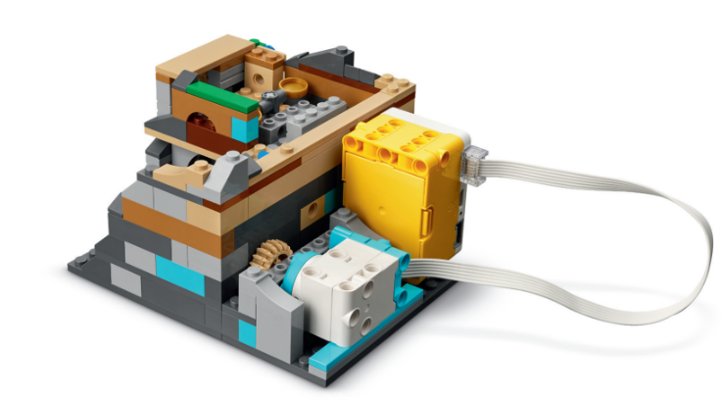
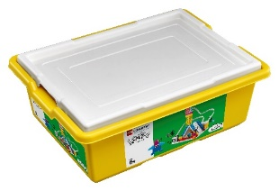




Activity 2 Tasks
Attach the hub and the sensor to the excavation site model from Session 2.
Can you find the millstone?
You Need…
Notes:
Activity 2 Tasks
Locate excavation site model from Session 2 or use Bags 2-5 and Book 2 to build it.
Use the building instructions in Book 2 to attach the hub and motor to the excavation site model.
Open the SPIKE App. Try the program provided in Book 2 to activate the millstone inside the excavation site model
Session Tips
The team can rebuild the excavation site model if it was taken apart or modified in a previous session.
Use Book 2 to attach the motor and hub to the excavation site model.
Use the SPIKE Essential set in Activity 2 and return the pieces to storage at the end of the session.

Slide 18
Activity 2 Tasks
Using the SPIKE App, write the program provided in Book 2 to activate the millstone inside the excavation site model.
You Need…
Notes:
Activity 2 Tasks
Locate excavation site model from Session 2 or use Bags 2-5 and Book 2 to build it.
Use the building instructions in Book 2 to attach the hub and motor to the excavation site model.
Open the SPIKE App. Try the program provided in Book 2 to activate the millstone inside the excavation site model
Session Tips
The team can rebuild the excavation site model if it was taken apart or modified in a previous session.
Use Book 2 to attach the motor and hub to the excavation site model.
Use the SPIKE Essential set in Activity 2 and return the pieces to storage at the end of the session.

Slide 19
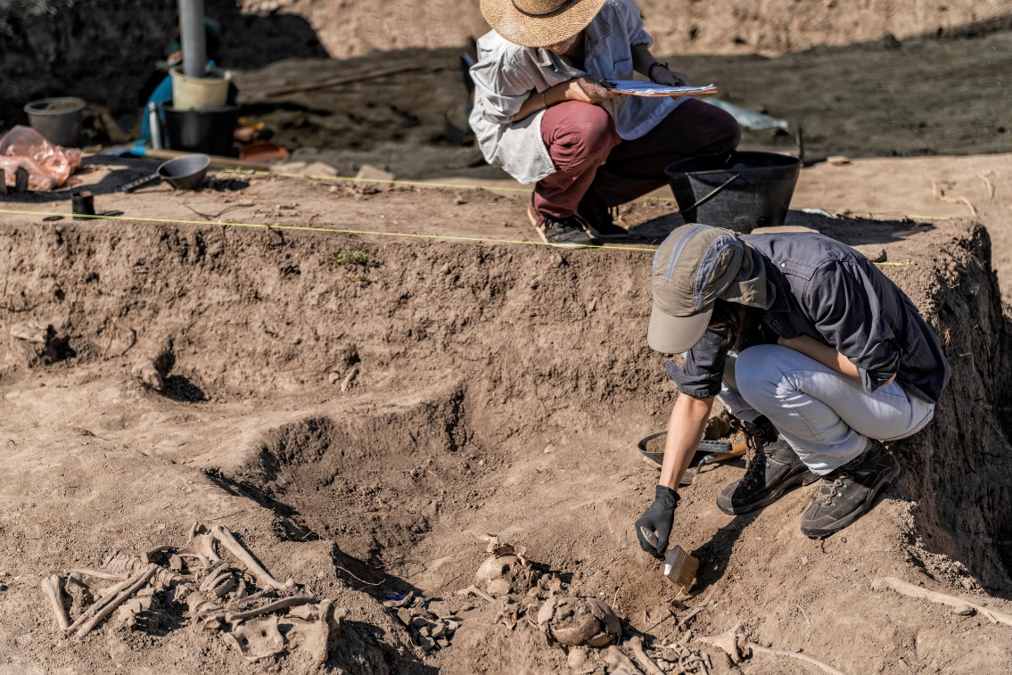
Challenge
Imagine your team is working together at an excavation site.
Pick a job for each person on the team.
Talk to your team about your role at the excavation site.
Notes:
Challenge Tasks
Pick a job for each person on the team and imagine you are all working at the excavation site.
Program the model to move in a different way.
Use the prototyping pieces to add to the model so that it represents your team.
Talk to your team about your role at the excavation site.
Share what you built with your team.
Session Tips

Slide 20
Code
Change the model.
Program the model to move in a different way.
Use the prototyping pieces to add to the model.
Share what you built.
Notes:
Challenge Tasks
Pick a job for each person on the team and imagine you are all working at the excavation site.
Program the model to move in a different way.
Use the prototyping pieces to add to the model so that it represents your team.
Talk to your team about your role at the excavation site.
Share what you built with your team.

Slide 21


Share
Share what you learned.
What did you learn about archaeology jobs?
What jobs and technology are used at excavation sites?
Notes:
Share
Have the team share with the whole room:
Share what they learned about archaeology jobs.
Talk about the jobs and technology used at excavation sites.

Slide 22
Guiding Questions
What else would you want to learn about archaeology?
Notes:
Each session has Guiding Questions that can be shared to frame the session.
Talk through each of these questions with the students. Have them start to think about these questions and later their will share their thoughts with their team.

Slide 23
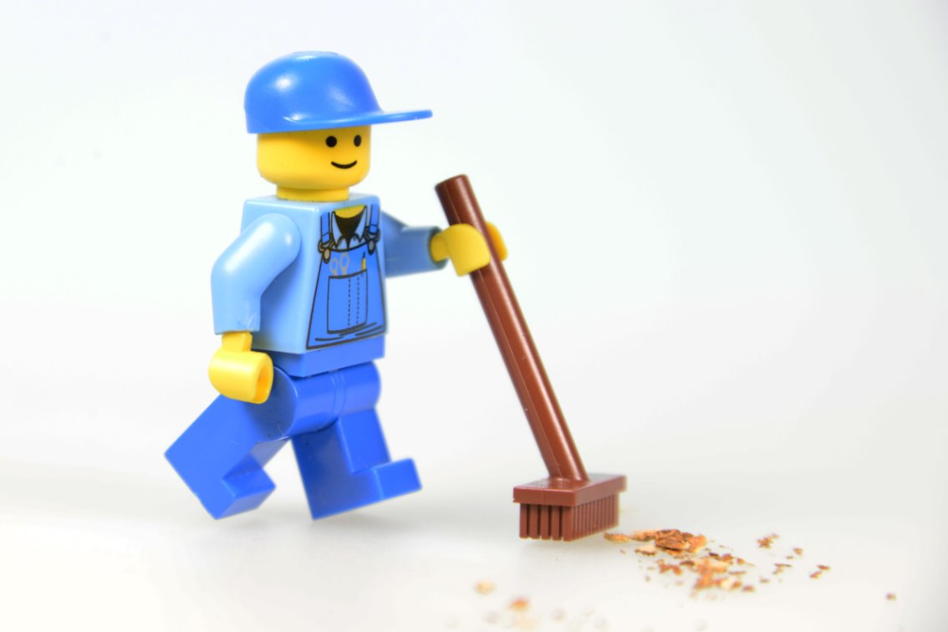
Clean Up
Notes:
Cleanup Pointers
Everything built in this session should be taken apart and returned to storage.
Store the SPIKE™ Essential set and the Explore Set separately.
You may wish to play a video or song during clean up time Link on
GoNoodle:. https://family.gonoodle.com/activities/clean-up
Link on YouTube Kids: https://www.youtubekids.com/watch?v=ZJFk87ZsHn0
Link on Youtube: https://youtu.be/ZJFk87ZsHn0

Slide 24


LEGO, the LEGO logo, and the SPIKE logo are trademarks of the/sont des marques de commerce du/son marcas registradas de LEGO Group. ©2025 The LEGO Group. All rights reserved/Tous droits réservés/Todos los derechos reservados. FIRST®, the FIRST® logo, and FIRST® AGE™ are trademarks of For Inspiration and Recognition of Science and Technology (FIRST). LEGO® is a registered trademark of the LEGO Group. FIRST® LEGO® League and UNEARTHED™ are jointly held trademarks of FIRST and the LEGO Group. ©2025 FIRST and the LEGO Group. All rights reserved.

