Slide 1


SESSION 6
Signal Seekers
I can work with my team to build tools used by archaeologists at excavation sites.
I can work with my team to add the sensor and hub to the radar model.
Students will learn about the types of tools and technology used at excavation sites and the jobs of those who use them.

Slide 2



Discussion
What did we do last session?
Notes:
Discuss with students the coding and vehicles used at a dig site they learned about last session. ​

Slide 3
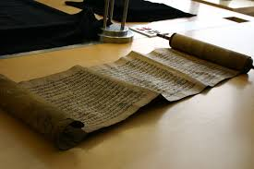

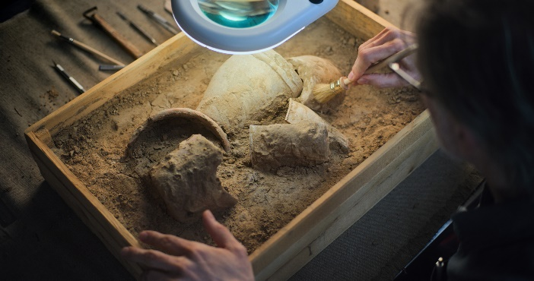
Key Vocabulary
Document: a written or printed paper giving information
Detect: to discover the nature, existence, presence, or fact of
Notes:
Session specific vocab

Slide 4

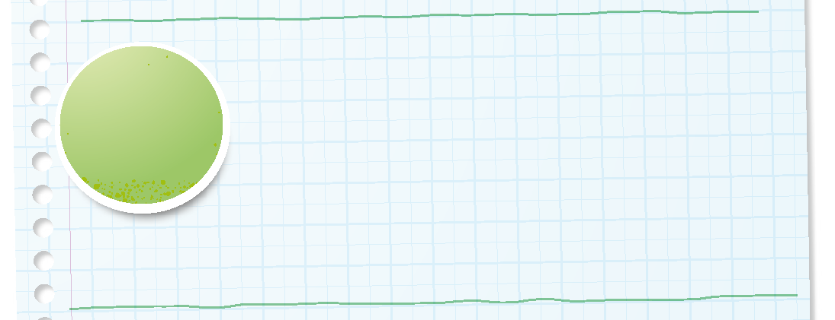

Introduction
Can your team provide examples of how they have used inclusion?
We respect each other and embrace our differences.
Notes:
Introduction – Be Inclusive (5-10 minutes)
• Introduce the FIRST® Core Values.
• Read the definition for inclusion to the team. (see TMG page 5)
• Talk about what inclusion is. Have the team provide examples of this Core Value.
• Have everyone draw a picture of an example of inclusion on the Core Values page in their Engineering Notebook.

Slide 5


Guiding Questions
What archaeology tools have you already learned about?
Notes:
Each session has Guiding Questions that can be shared to frame the session.
Talk through each of these questions with the students. Have them start to think about these questions and later their will share their thoughts with their team.

Slide 6


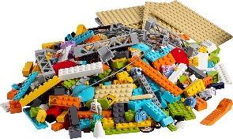
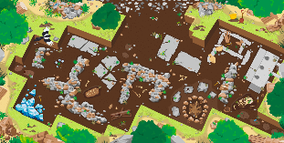
Activity 1 Tasks
Talk with your team about tools used by archaeologists.
What tools are needed for digging?
What tools are used to study or artifacts?
You Need…
Notes:
Activity 1 Tasks
Talk to your team about tools used by archaeologists. What tools are needed for digging? What tools are used to document or study artifacts?
Write your ideas below.
Select a tool to build with your team.
Use the prototyping pieces to create a tool used by archaeologists.
Put the tool on the mat.
Session Tips
Encourage the team to build tools using the prototyping pieces.
Use the Multimedia Resources to find example photos, websites, and other activities related to the sessions.
Have the children use archaeology words they have learned in previous sessions.

Slide 7

Activity 1 Tasks
Select a tool to build with your team.
Use the prototyping pieces to create a tool used by archaeologists.
Put the tool on the mat.
You Need…
Notes:
Activity 1 Tasks
Talk to your team about tools used by archaeologists. What tools are needed for digging? What tools are used to document or study artifacts?
Write your ideas below.
Select a tool to build with your team.
Use the prototyping pieces to create a tool used by archaeologists.
Put the tool on the mat.
Session Tips
Encourage the team to build tools using the prototyping pieces.
Use the Multimedia Resources to find example photos, websites, and other activities related to the sessions.
Have the children use archaeology words they have learned in previous sessions.

Slide 8
Guiding Questions
How do archaeologists use the tools you talked about with your team?
Which tools will you draw in your Engineering Notebook?
Notes:
Each session has Guiding Questions that can be shared to frame the session.
Talk through each of these questions with the students. Have them start to think about these questions and later their will share their thoughts with their team.

Slide 9

Challenge
Build a total of three tools your team thinks an archaeologist would use at an excavation site.
Talk about how each tool is used.
Write your ideas on page 18 of your Engineering Notebook.
Notes:
Challenge Tasks
Build a total of three tools that your team thinks an archaeologist would use at an excavation site.
Talk to your team about how each of the tools are used.
Share what you built with your team.
Session Tips
Encourage the team to build tools using the prototyping pieces.
Use the Multimedia Resources to find example photos, websites, and other activities related to the sessions.
Have the children use archaeology words they have learned in previous sessions.
Look at the jobs on pages 5, 28, and 29 to see what tools and technology are used in archaeology.

Slide 10
Guiding Questions
What do you know about radar and how it is used by archaeologists?
Notes:
Each session has Guiding Questions that can be shared to frame the session.
Talk through each of these questions with the students. Have them start to think about these questions and later their will share their thoughts with their team.

Slide 11
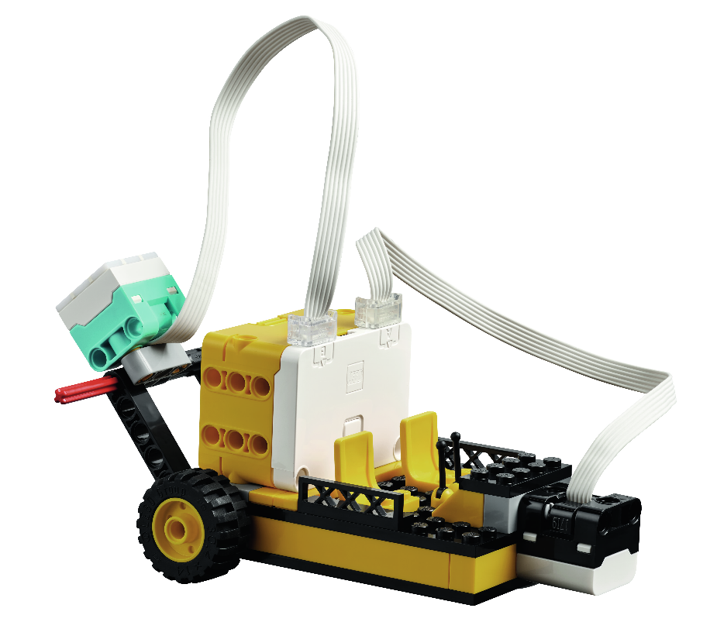

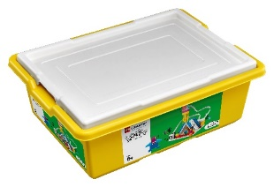



Activity 2 Tasks
Attach the hub and the sensor to the radar model from Session 2.
Using the SPIKE App, test your program from Session 4 on the radar model.
You Need…
Notes:
Activity 1 Tasks
Locate the radar model from Session 2 or use Bag 1 to build it.
Use the building instructions in Book 1 to attach the hub and the sensor to the radar model.
Open the SPIKE App. Try the program you used in Session 4 on the radar model.
Take turns moving the model to different locations on the mat. What kind of artifacts could be detected by radar?
Session Tips
The team can rebuild the radar model if it was taken apart or modified in a previous session.
Use the building instructions in Book 1 to attach the sensor and hub to the radar model.
Use the SPIKE Essential set in Activity 2 and return the pieces to storage at the end of the session.

Slide 12
Activity 2 Tasks
Move the model to different locations on the mat.
What kinds of artifacts could be detected by radar?
You Need…
Notes:
Activity 1 Tasks
Locate the radar model from Session 2 or use Bag 1 to build it.
Use the building instructions in Book 1 to attach the hub and the sensor to the radar model.
Open the SPIKE App. Try the program you used in Session 4 on the radar model.
Take turns moving the model to different locations on the mat. What kind of artifacts could be detected by radar?
Session Tips
The team can rebuild the radar model if it was taken apart or modified in a previous session.
Use the building instructions in Book 1 to attach the sensor and hub to the radar model.
Use the SPIKE Essential set in Activity 2 and return the pieces to storage at the end of the session.

Slide 13
Guiding Questions
What other technology could you find at an excavation site?
Notes:
Each session has Guiding Questions that can be shared to frame the session.
Talk through each of these questions with the students. Have them start to think about these questions and later their will share their thoughts with their team.

Slide 14

Code
Change the program to display different light patterns.
What tools are needed for digging?
What tools are used to study artifacts?
Write your ideas on page 19 of your Engineering Notebook.
Notes:
Challenge Tasks
Program the model to display a different light pattern.
Talk to your team about other tools used by archaeologists. What tools are needed for digging? What tools are used to study artifacts?
Write your ideas below
Session Tips
The team can rebuild the radar model if it was taken apart or modified in a previous session.
Use the building instructions in Book 1 to attach the sensor and hub to the radar model.
Use the SPIKE Essential set in Activity 2 and return the pieces to storage at the end of the session.

Slide 15
Guiding Questions
What other jobs might you find at an excavation site?
Notes:
Each session has Guiding Questions that can be shared to frame the session.
Talk through each of these questions with the students. Have them start to think about these questions and later their will share their thoughts with their team.

Slide 16

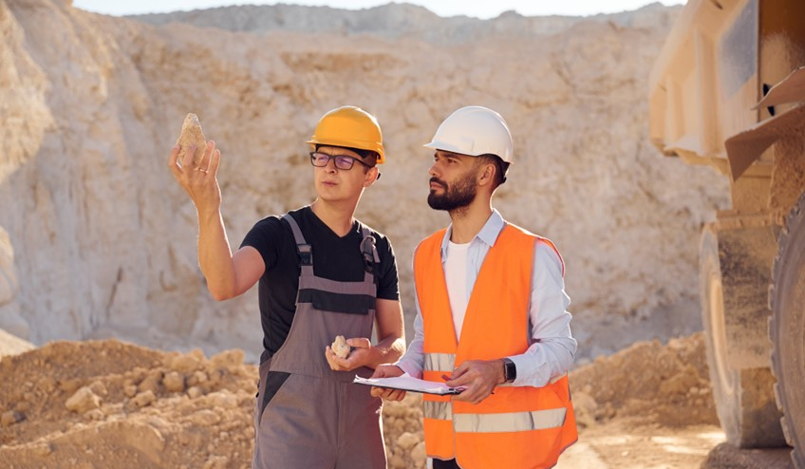
Career Connections
Archaeologist
Archaeologists are storytellers of the past.
Archaeologists do lots of different jobs to help people learn about the past.
They may do research, excavate or dig up treasures from underground, study in a lab, or manage collections of ancient artifacts.
Notes:
Look at the jobs on pages 5, 28, and 29 to see what tools and technology are used in archaeology.

Slide 17

Career Connections
Lab Technician
Lab technicians help organize the things that archaeologists find.
They carefully clean and measure the objects, and they sometimes put broken pieces back together like a puzzle.
Microscopes, cameras, and 3D printers are some of the things that might be used in the lab.
Notes:
Look at the jobs on pages 5, 28, and 29 to see what tools and technology are used in archaeology.

Slide 18


Share
Share what you learned.
What tools and technology are used at excavation sites?
What have you learned about archaeology?
Notes:
Share
Have the team share with the whole room:
Talk about the tools and technology used at excavation sites.
Share what they have learned about archaeology so far.

Slide 19
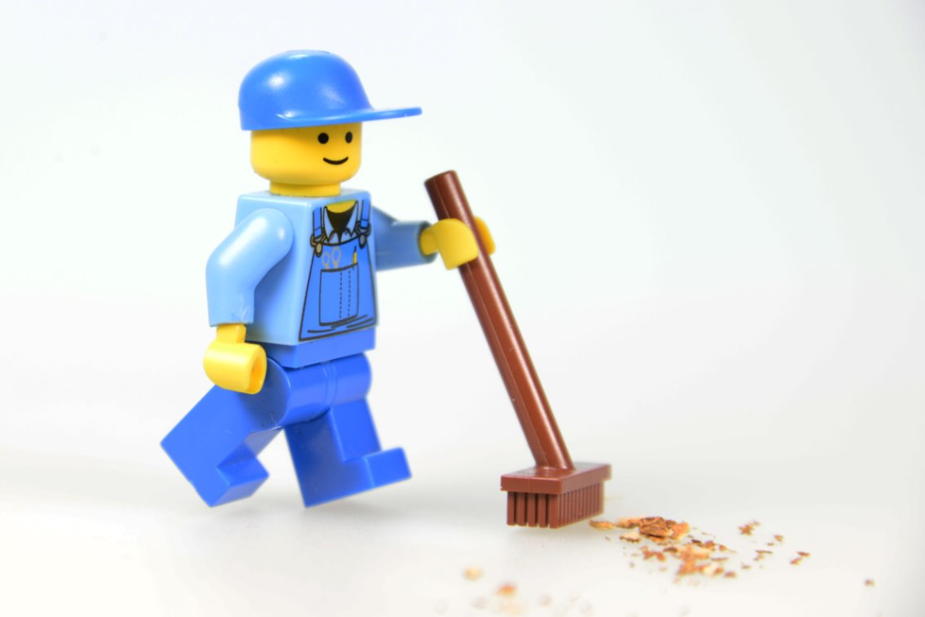
Clean Up
Notes:
Cleanup Pointers
Everything built in this session should be taken apart and returned to storage.
Store the SPIKE™ Essential set and the Explore Set separately.
You may wish to play a video or song during clean up time Link on
GoNoodle:. https://family.gonoodle.com/activities/clean-up
Link on YouTube Kids: https://www.youtubekids.com/watch?v=ZJFk87ZsHn0
Link on Youtube: https://youtu.be/ZJFk87ZsHn0

Slide 20


LEGO, the LEGO logo, and the SPIKE logo are trademarks of the/sont des marques de commerce du/son marcas registradas de LEGO Group. ©2025 The LEGO Group. All rights reserved/Tous droits réservés/Todos los derechos reservados. FIRST®, the FIRST® logo, and FIRST® AGE™ are trademarks of For Inspiration and Recognition of Science and Technology (FIRST). LEGO® is a registered trademark of the LEGO Group. FIRST® LEGO® League and UNEARTHED™ are jointly held trademarks of FIRST and the LEGO Group. ©2025 FIRST and the LEGO Group. All rights reserved.

