Slide 1


SESSION 5
Excellent Excavators
I can work with my team to build the LEGO® model from the lesson and program a robot to drive.
I can work with my team to learn how archaeologists handle and move artifacts at an excavation site.
Students will learn about the types of vehicles are used at excavation sites. Students will build and program a vehicle to move on the mat.

Slide 2



Discussion
What did we do last session?
Notes:
Discuss with students the coding and sensors used at a dig site they learned about last session. ​

Slide 3
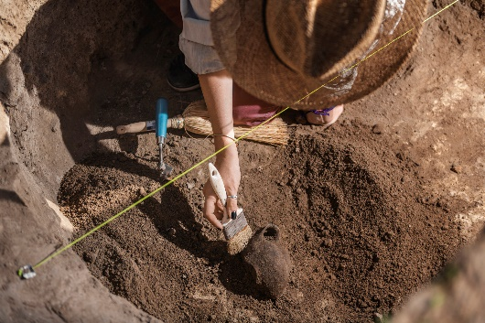

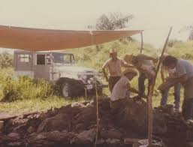
Key Vocabulary
Excavation: site or process to uncover by digging away covering earth
Vehicle: something used to transport persons or goods
Notes:
Session specific vocab

Slide 4

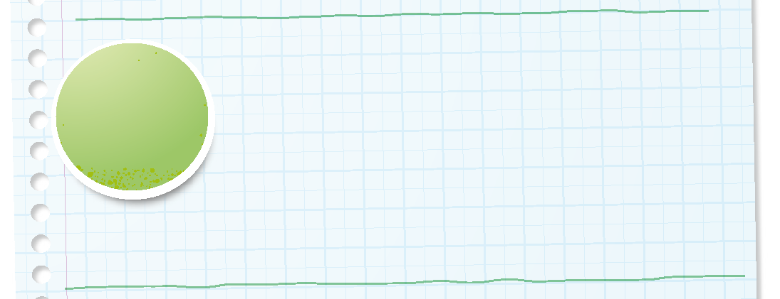

Introduction
Can your team provide examples of how they have used innovation?
We use creativity and persistence to solve problems.
Notes:
Introduction – Let’s Innovate (5-10 minutes)
• Introduce the FIRST® Core Values.
• Read the definition for innovation to the team. (see TMG page 5)
• Talk about what innovation is. Have the team provide examples of this Core Value.
• Have everyone draw a picture of an example of innovation on the Core Values page in their Engineering Notebook.

Slide 5

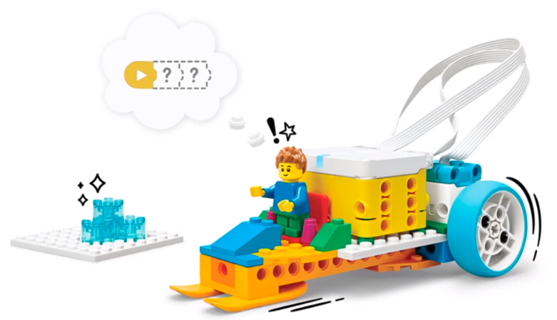


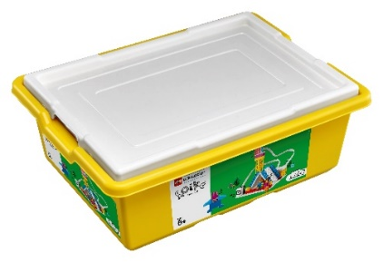
Activity 1 Tasks
In the SPIKE App, complete the Arctic Ride lesson.
This lesson is in the FIRST® LEGO® League Explore Unit.
You Need…
Notes:
Activity 1 Tasks
Open the SPIKE App on your team’s device.
Complete Coding Lesson 3 in the FIRST®LEGO® League Explore Unit – Arctic Ride.
Change the program so that the model will drive in reverse.
Talk with your team about how this model could help an archaeologist.
Write your ideas below.
Session Tips
The team will create a driving robot. Tell the team to watch their robot so that it does not fall off the table.
The team can take turns making changes to the program.
The team will use only their SPIKE Essential set for this activity.

Slide 6

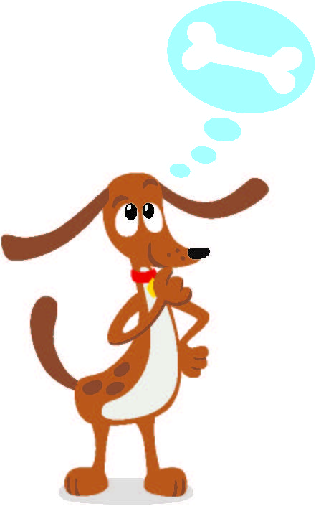
Guiding Questions
How can you make the robot drive in reverse?
Why would an archaeologist need a vehicle at an excavation site?
What other vehicles would be helpful at an excavation site?
Notes:
Each session has Guiding Questions that can be shared to frame the session.
Talk through each of these questions with the students. Have them start to think about these questions and later their will share their thoughts with their team.

Slide 7
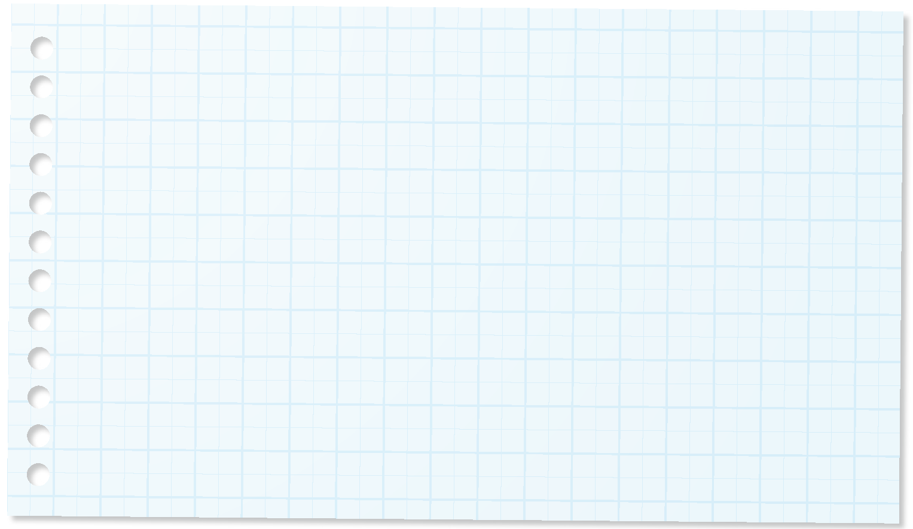
Code
Change the program so that the model will drive in reverse.
How could this model help an archaeologist?
Write your ideas on page 16 of your Engineering Notebook.
Notes:
Activity 1 Tasks
Open the SPIKE App on your team’s device.
Complete Coding Lesson 3 in the FIRST®LEGO® League Explore Unit – Arctic Ride.
Change the program so that the model will drive in reverse.
Talk with your team about how this model could help an archaeologist.
Write your ideas below.
Session Tips
The team will create a driving robot. Tell the team to watch their robot so that it does not fall off the table.
The team can take turns making changes to the program.
The team will use only their SPIKE Essential set for this activity.

Slide 8
Guiding Questions
Can you modify the robot so that it drives with four wheels?
Could you build a truck to carry away lots of material from the excavation site?
Notes:
Each session has Guiding Questions that can be shared to frame the session.
Talk through each of these questions with the students. Have them start to think about these questions and later their will share their thoughts with their team.

Slide 9


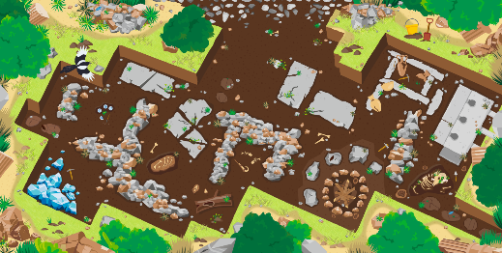

Activity 2 Tasks
Change the Arctic Ride model so that it represents a vehicle used by an archaeologist.
You Need…
It can have two wheels or four.
Can it move items by carrying, picking up, or pushing them?
Notes:
Activity 2 Tasks
Change the Arctic Ride model so that it represents a vehicle used by an archaeologist. You could build one of the ideas you had in the previous task
Session Tips
Use the Multimedia Resources to find example photos, websites, and other activities related to the sessions.
The team should practice positioning the robot so that it reaches a specific location on the mat.
You could place an obstacle on the mat to challenge the team to code their robot to turn.

Slide 10
Guiding Questions
How can you program your robot to stop on one of the artifacts?
Notes:
Each session has Guiding Questions that can be shared to frame the session.
Talk through each of these questions with the students. Have them start to think about these questions and later their will share their thoughts with their team.

Slide 11
Challenge
Change the program so the model will drive between the two artifacts.
Share what built and explain how you coded the model.
Notes:
Challenge
Select two artifacts on the mat.
Change the program so your model will drive between the two artifacts. Try to stop your model on the artifact.
Share what you built and explain how you coded the model.

Slide 12


Share
Share what you learned.
What did you learn about coding?
What vehicles would an
archaeologists use at an excavation site?
Notes:
Share
Have the team share with the whole room:
Share how they applied coding skills in this session.
Share how archaeologists use vehicles at excavation sites.

Slide 13
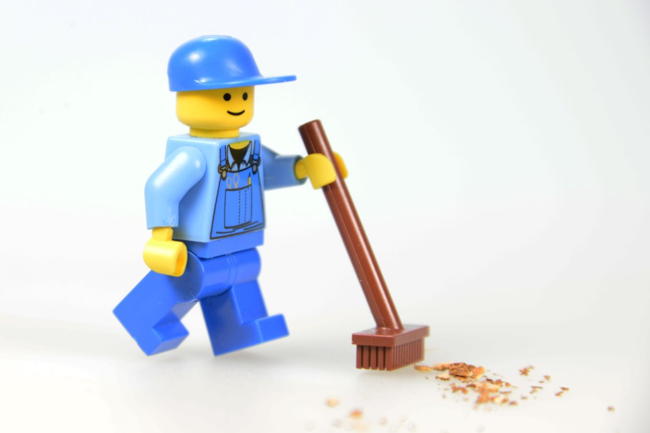
Clean Up
Notes:
Cleanup Pointers
- Everything built in this session should be taken apart and returned to storage.
You may wish to play a video or song during clean up time Link on
GoNoodle:. https://family.gonoodle.com/activities/clean-up
Link on YouTube Kids: https://www.youtubekids.com/watch?v=ZJFk87ZsHn0
Link on Youtube: https://youtu.be/ZJFk87ZsHn0

Slide 14


LEGO, the LEGO logo, and the SPIKE logo are trademarks of the/sont des marques de commerce du/son marcas registradas de LEGO Group. ©2025 The LEGO Group. All rights reserved/Tous droits réservés/Todos los derechos reservados. FIRST®, the FIRST® logo, and FIRST® AGE™ are trademarks of For Inspiration and Recognition of Science and Technology (FIRST). LEGO® is a registered trademark of the LEGO Group. FIRST® LEGO® League and UNEARTHED™ are jointly held trademarks of FIRST and the LEGO Group. ©2025 FIRST and the LEGO Group. All rights reserved.

