Slide 1


SESSION 4
Dirt Detectives
I can work with my team to build the LEGO® model from the lesson and explore sensor blocks.
I can work with my team to learn about how sensors detect things archaeologists cannot see at an excavation site.
Students will learn about sensors, build a model and write code to show how sensors can be used by archaeologists to learn about artifacts.

Slide 2



Discussion
What did we do last session?
Notes:
Discuss with students the coding and technology used at a dig site they learned about last session. ​

Slide 3
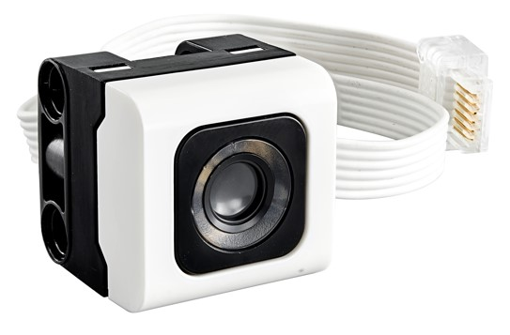

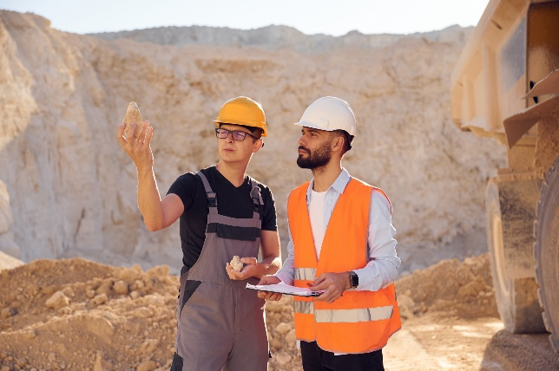
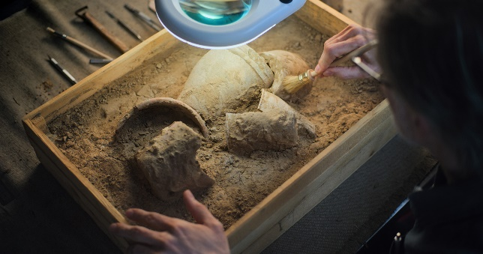
Key Vocabulary
Sensor: a device that detects something and responds by transmitting a signal
Detect: to discover the nature, existence, presence, or fact of
Inspect: to examine closely
Notes:
Session specific vocab

Slide 4

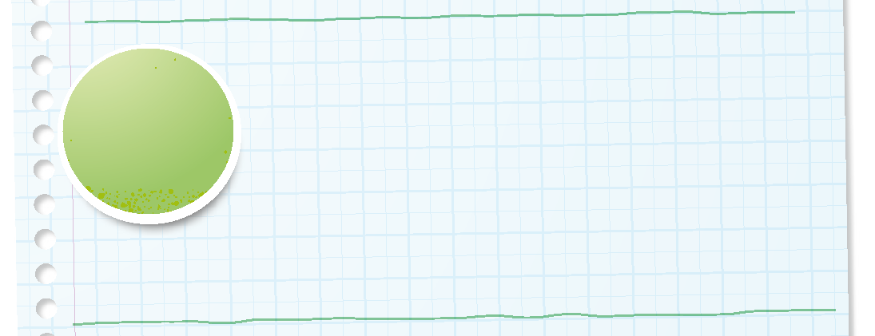
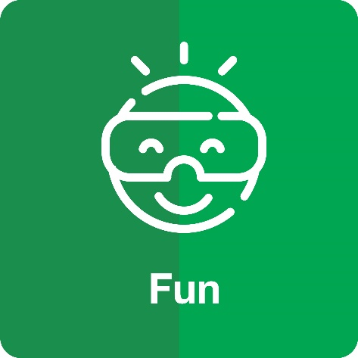
Introduction
Can your team provide examples of how they have used fun?
We enjoy and celebrate what we do.
Notes:
Introduction – Have Fun (5-10 minutes)
• Introduce the FIRST® Core Values.
• Read the definition for fun to the team. (see TMG page 5)
• Talk about what fun is. Have the team provide examples of this Core Value.
• Have everyone draw a picture of an example of fun on the Core Values page in their Engineering Notebook.

Slide 5

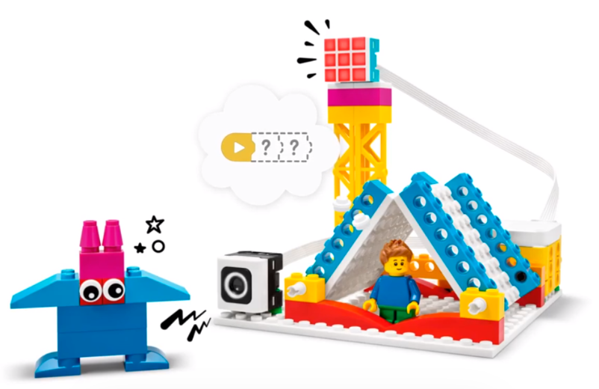


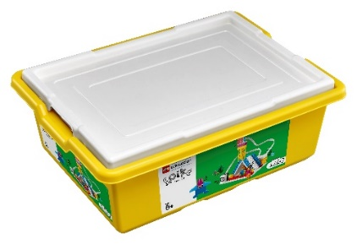
Activity 1 Tasks
In the SPIKE App, complete the Animal Alarm lesson.
This lesson is in the FIRST® LEGO® League Explore Unit.
You Need…
Notes:
Activity 1 Tasks
Open the SPIKE App on your team’s device.
Complete Coding Lesson 2 in the FIRST® LEGO® League Explore Unit – Animal Alarm.
Change the program so that a different color will display on the alarm.
Talk with your team about how this model could help an archaeologist.
Write your ideas below.
Session Tips
The team should focus on using the light blocks in this activity. The team could also incorporate sound into their Animal Alarm model if they have time.
Give the team time to experiment with the program and different coding options.
Questions in the Engineering Notebook are meant to start a discussion and generate ideas.

Slide 6


Guiding Questions
How can you change the program so the LEGO model displays a different light?
How can you code the model to make a sound?
Notes:
Each session has Guiding Questions that can be shared to frame the session.
Talk through each of these questions with the students. Have them start to think about these questions and later their will share their thoughts with their team.

Slide 7

Code
Change the program so that a different color will display on the alarm.
How could this model help an archaeologist?
Write your ideas on page 14 of your Engineering Notebook.
Notes:
Activity 1 Tasks
Open the SPIKE App on your team’s device.
Complete Coding Lesson 2 in the FIRST® LEGO® League Explore Unit – Animal Alarm.
Change the program so that a different color will display on the alarm.
Talk with your team about how this model could help an archaeologist.
Write your ideas below.
Session Tips
The team should focus on using the light blocks in this activity. The team could also incorporate sound into their Animal Alarm model if they have time.
Give the team time to experiment with the program and different coding options.
Questions in the Engineering Notebook are meant to start a discussion and generate ideas.

Slide 8
Guiding Questions
How might an archaeologist use a sensor?
How can you change the model so it can be used on an artifact?
Notes:
Each session has Guiding Questions that can be shared to frame the session.
Talk through each of these questions with the students. Have them start to think about these questions and later their will share their thoughts with their team.

Slide 9


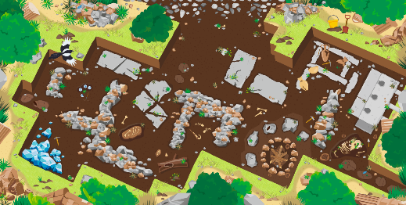

Activity 2 Tasks
Change the Animal Alarm model so that it can be used to inspect artifacts.
Which artifacts on the mat interests your team?
Place the model on the mat near that artifact to inspect it.
You Need…
Notes:
Activity 2 Tasks
Change the Animal Alarm model so that it can be used to inspect artifacts. You could build one of the ideas you had in the previous task.
Select an artifact on the mat or any object your team will investigate.
Session Tips
Use the SPIKE Essential set to modify the model.
Try to keep the Explore Set separate from the other materials. The sensor will be added to the radar model in Session 6.
Test your program by using the sensor on other objects from the Explore Set or elsewhere.

Slide 10
Guiding Questions
What artifacts or objects should be tested with the sensor?
How did you include your team members’ ideas?
Notes:
Each session has Guiding Questions that can be shared to frame the session.
Talk through each of these questions with the students. Have them start to think about these questions and later their will share their thoughts with their team.

Slide 11
Challenge
Change the program so the model will play a sound when your artifact is detected by the sensor.
Share what built and explain how you coded the model.
Notes:
Challenge
Change the program so the model will play a sound when your artifact is detected by the sensor. You could also change the light pattern.
Share what you built and explain how you coded the model.

Slide 12


Share
Share what you learned.
What did you learn about sensors?
What did you learn about coding
sensors?
How do archaeologists use sensors to learn about artifacts?
Notes:
Share
Have the team share with the whole room:
Share the sensor-coding skills they learned.
Share how archaeologists use sensors to learn more about artifacts.

Slide 13
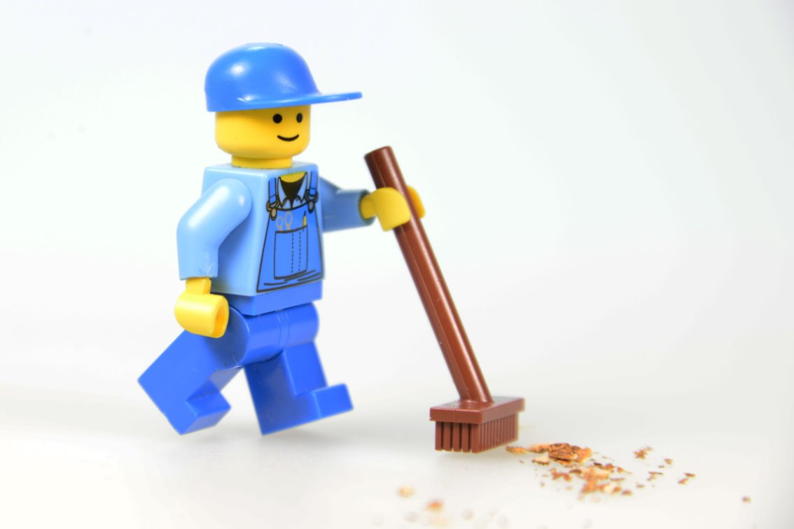
Clean Up
Notes:
Cleanup Pointers
- Everything built in this session should be taken apart and returned to storage.
You may wish to play a video or song during clean up time Link on
GoNoodle:. https://family.gonoodle.com/activities/clean-up
Link on YouTube Kids: https://www.youtubekids.com/watch?v=ZJFk87ZsHn0
Link on Youtube: https://youtu.be/ZJFk87ZsHn0

Slide 14


LEGO, the LEGO logo, and the SPIKE logo are trademarks of the/sont des marques de commerce du/son marcas registradas de LEGO Group. ©2025 The LEGO Group. All rights reserved/Tous droits réservés/Todos los derechos reservados. FIRST®, the FIRST® logo, and FIRST® AGE™ are trademarks of For Inspiration and Recognition of Science and Technology (FIRST). LEGO® is a registered trademark of the LEGO Group. FIRST® LEGO® League and UNEARTHED™ are jointly held trademarks of FIRST and the LEGO Group. ©2025 FIRST and the LEGO Group. All rights reserved.

