Slide 1


SESSION 3
Site Surveyors
I can work with my team to build the LEGO® model from the lesson and explore motor-coding blocks.
I can work with my team to learn about how archaeologists use technology at a dig site.
Students will build a model that could be used by archaeologists and write code to make it move over the mat.

Slide 2


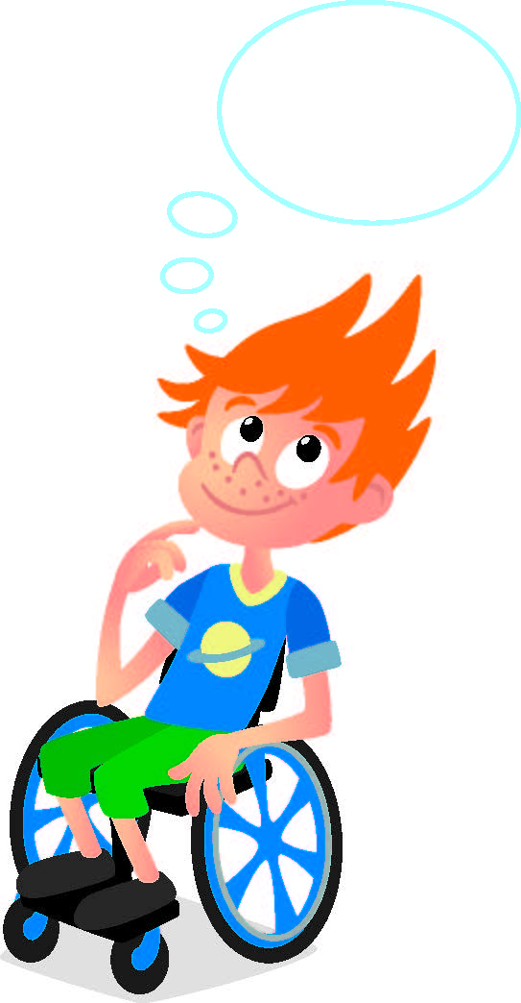
Discussion
What did we do last session?
Notes:
Discuss with students the excavation and radar they learned about last session. ​

Slide 3



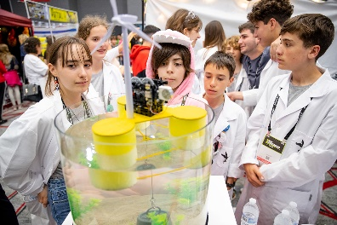
Key Vocabulary
Survey: to gather information from or about
Program: to direct the thinking or behavior of
Technology: the use of science in solving problems
Notes:
Session specific vocab

Slide 4

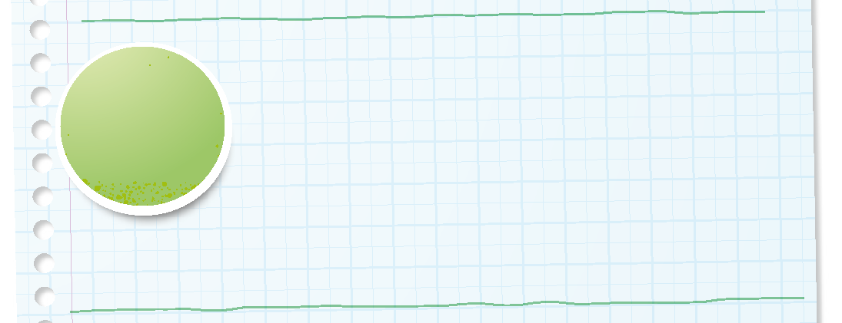

Introduction
Can your team provide examples of how they have used teamwork?
We are stronger when we work together.
Notes:
Introduction – Teamwork makes the dream work! (5-10 minutes)
• Introduce the FIRST® Core Values.
• Read the definition for teamwork to the team. (see TMG page 5)
• Talk about what teamwork is. Have the team provide examples of this Core Value.
• Have everyone draw a picture of an example of teamwork on the Core Values page in their Engineering Notebook.

Slide 5

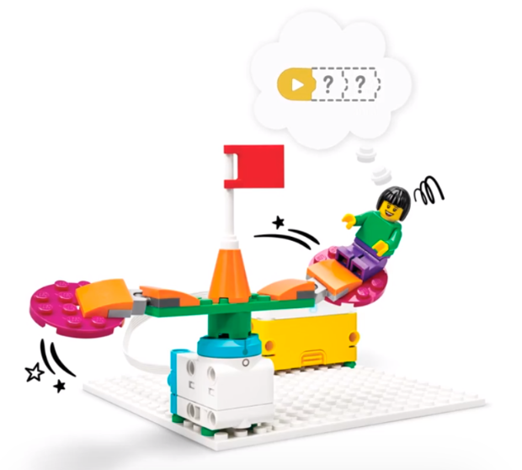


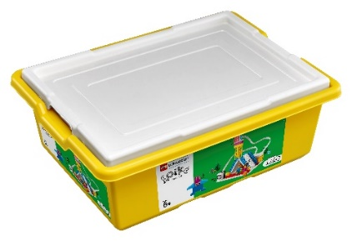
Activity 1 Tasks
In the SPIKE App, complete the Classic Carousel lesson.
This lesson is in the FIRST® LEGO® League Explore Unit.
You Need…
Notes:
Activity 1 Tasks
Open the SPIKE App on your team’s device.
Complete Coding Lesson 1 in the FIRST®LEGO® League Explore Unit – Classic Carousel.
Change the program so the carousel rotates in the opposite direction.
Talk with your team about how this model could help an archaeologist. What changes would you make?
Write your ideas below
Session Tips
The team will only use their SPIKE Essential set for Activity 1.
If your team is new to coding, you could have them complete the Tutorial Activities in the app.
Lessons can be found in the FIRST® LEGO® League Explore Unit. Show the team how to access the Classic Carousel lesson in the app.

Slide 6


Guiding Questions
Which blocks can you use to code the LEGO model?
How do you change the program so the model moves in a different way?
Notes:
Each session has Guiding Questions that can be shared to frame the session.
Talk through each of these questions with the students. Have them start to think about these questions and later their will share their thoughts with their team.

Slide 7

Code
Change the program so the carousel rotates in the opposite direction.
How could this model help an archaeologist?
Write your ideas on page 12 of your Engineering Notebook.
Notes:
Activity 1 Tasks
Open the SPIKE App on your team’s device.
Complete Coding Lesson 1 in the FIRST®LEGO® League Explore Unit – Classic Carousel.
Change the program so the carousel rotates in the opposite direction.
Talk with your team about how this model could help an archaeologist. What changes would you make?
Write your ideas below
Session Tips
The team will only use their SPIKE Essential set for Activity 1.
If your team is new to coding, you could have them complete the Tutorial Activities in the app.
Lessons can be found in the FIRST® LEGO® League Explore Unit. Show the team how to access the Classic Carousel lesson in the app.
For testing, make sure each team knows how to connect their device to their SPIKE Essential set.

Slide 8
Guiding Questions
What would you add to the model to make it look like a tool used for archaeology?
Notes:
Each session has Guiding Questions that can be shared to frame the session.
Talk through each of these questions with the students. Have them start to think about these questions and later their will share their thoughts with their team.

Slide 9


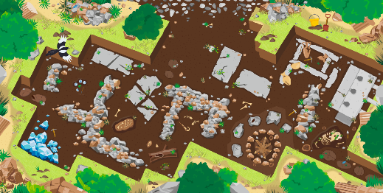

Activity 2 Tasks
Change the carousal model so an archaeologist can use it at an excavation site.
Which artifacts on the mat interests your team?
Place the model on the mat near that artifact.
You Need…
Notes:
Activity 2 Tasks
Change the carousel model so an archaeologist can use it at an excavation site. You could build one of the ideas you had in Activity 1.
Select an artifact on the mat that interests your team.
Place the model on the mat near the artifact
Session Tips
The team should use LEGO® elements from their SPIKE Essential set to modify their model.
The team should determine how to change direction and speed in their program.
Examples of jobs and technology used by archaeologists are listed in the Engineering Notebook on page 5, 28, and 29.

Slide 10
Guiding Questions
Can you code the model so it stops over a different artifact?
Notes:
Each session has Guiding Questions that can be shared to frame the session.
Talk through each of these questions with the students. Have them start to think about these questions and later their will share their thoughts with their team.

Slide 11
Challenge
Change the program so the model rotates and stops above artifacts.
Share what built and explain how you coded the model.
Notes:
Challenge
Open the SPIKE App on your team’s device.
Change the program so that the model rotates and stops above the artifact you selected.
Share what you built and explain how you coded the model.

Slide 12


Share
Share what you learned.
What coding blocks did you learn?
What technology can be used at a dig site?
Notes:
Share
Have the team share with the whole room:
Share the motor-coding skills they learned.
Talk about the kind of technology used at a dig site.

Slide 13
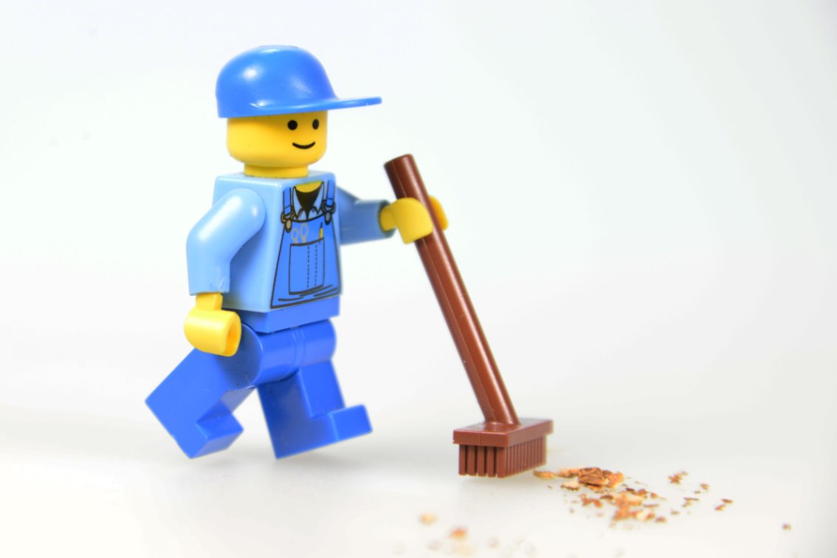
Clean Up
Notes:
Cleanup Pointers
• Everything built in this session should be taken apart and returned to storage.
You may wish to play a video or song during clean up time Link on
GoNoodle:. https://family.gonoodle.com/activities/clean-up
Link on YouTube Kids: https://www.youtubekids.com/watch?v=ZJFk87ZsHn0
Link on Youtube: https://youtu.be/ZJFk87ZsHn0

Slide 14


LEGO, the LEGO logo, and the SPIKE logo are trademarks of the/sont des marques de commerce du/son marcas registradas de LEGO Group. ©2025 The LEGO Group. All rights reserved/Tous droits réservés/Todos los derechos reservados. FIRST®, the FIRST® logo, and FIRST® AGE™ are trademarks of For Inspiration and Recognition of Science and Technology (FIRST). LEGO® is a registered trademark of the LEGO Group. FIRST® LEGO® League and UNEARTHED™ are jointly held trademarks of FIRST and the LEGO Group. ©2025 FIRST and the LEGO Group. All rights reserved.

