Slide 1


SESSION 2
Relic Rescue
I can work with my team to build the radar and excavation site models from the Explore Set.
I can talk with my team about artifacts and the tools used to find them.
Students will build both the radar and excavation models while learning about how archaeologists find artifacts and uncover them.

Slide 2



Discussion
What did we do last session?
Notes:
Discuss with students the term archaeology & artifact and review what archaeologists do. ​

Slide 3
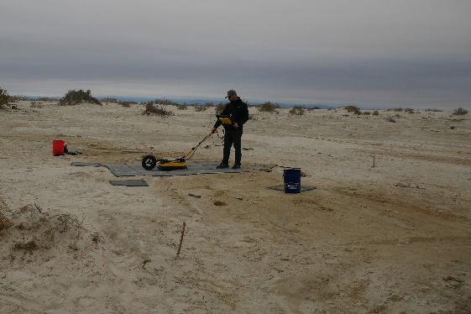

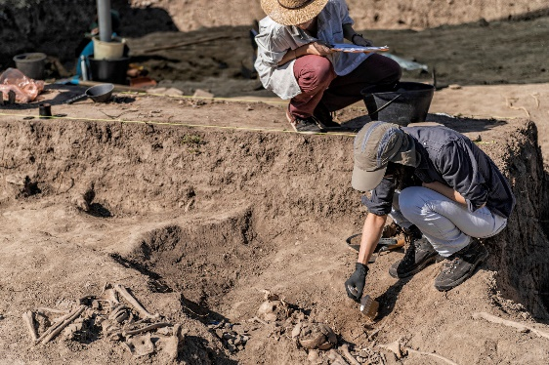
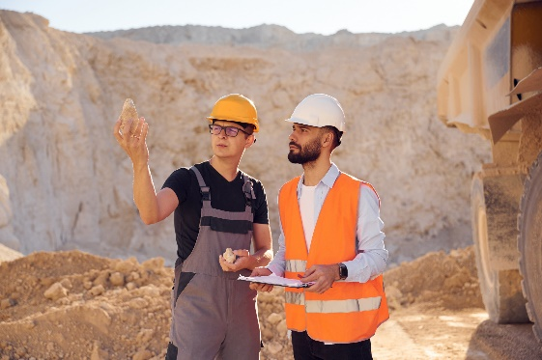
Key Vocabulary
Radar: a device used to detect and locate an object
Archaeological Process: approach archaeologists use to study the past
Dig Site: a place where archaeologists carefully dig to uncover artifacts and learn about the past
Relic: something left behind after decay or disappearance
Notes:
Session specific vocab

Slide 4

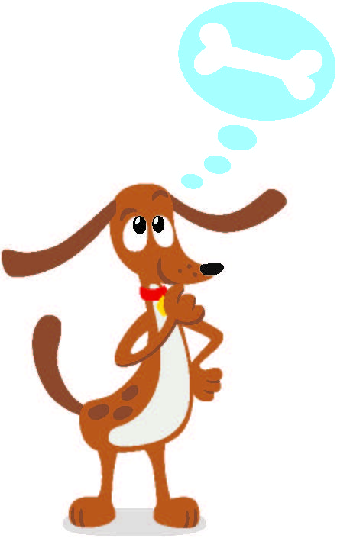
Guiding Questions
How do archaeologists know where to dig?
What are some tools that are used by archaeologist?
How can radar help an archaeologist find an artifact?
Notes:
Each session has Guiding Questions that can be shared to frame the session.
Talk through each of these questions with the students. Have them start to think about these questions and later their will share their thoughts with their team.

Slide 5

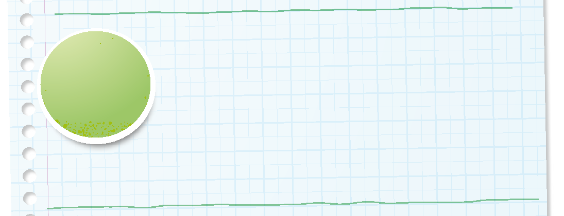

Introduction
Can your team provide examples of how they have used impact?
We apply what we learn to improve our world.
Notes:
Introduction - Let’s Discover (5-10 minutes)
• Introduce the FIRST® Core Values.
• Read the definition for impact to the team. (see TMG page 5)
• Talk about what impact is. Have the team provide examples of this Core Value.
• Have everyone draw a picture of an example of impact on the Core Values page in their Engineering Notebook.

Slide 6

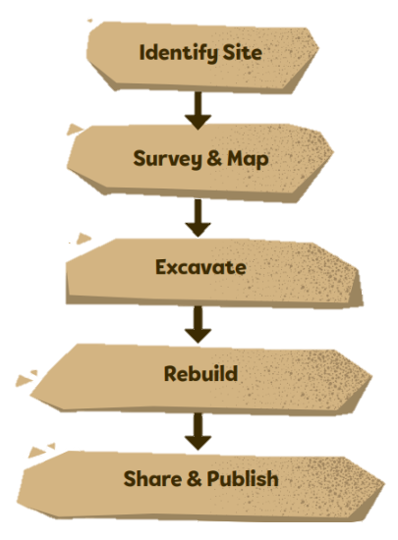
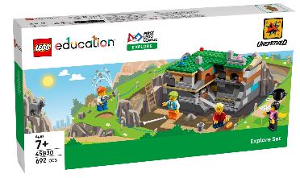
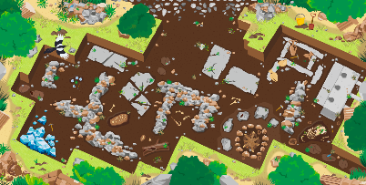
Activity 1 Tasks
Identify Site
Look at the archaeological process on page 30 of the Engineering Notebook.
Survey & Map
How do archaeologists choose where to dig?
Excavate
Rebuild
You Need…
Share & Publish
Notes:
Activity 1 Tasks
Look at the archaeological process on page 30.
Talk to your team about how archaeologists choose where to dig.
Use Bag 1 and Book 1 to build the radar model.
Place the radar model on the mat.
Take turns moving the model to different locations on the mat. What kind of artifacts could be detected by radar?
Talk to your team about other tools used by archaeologists. What tools are needed for digging? What tools are used to document or study artifacts?
Write your ideas below
Session Tips
There is a summary of the archaeological process on page 30 of the Engineering Notebook.
Use Bag 1 and Book 1 to build the radar model. Have the children work as a team to build the models. They should talk about what they are building.
Lead a discussion about tools used at an excavation site.

Slide 7

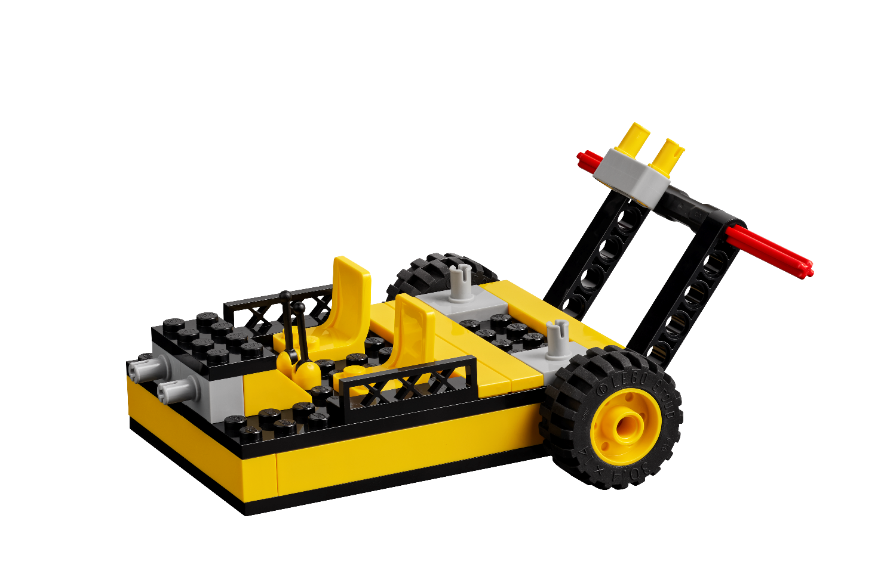
Activity 1 Tasks
Using Bag 1 and Book 1, build the radar model.
Place the radar model on the mat. Take turns moving the model on the mat.
What kinds of artifacts could be detected by radar?
Notes:
Activity 1 Tasks
Look at the archaeological process on page 30.
Talk to your team about how archaeologists choose where to dig.
Use Bag 1 and Book 1 to build the radar model.
Place the radar model on the mat.
Take turns moving the model to different locations on the mat. What kind of artifacts could be detected by radar?
Talk to your team about other tools used by archaeologists. What tools are needed for digging? What tools are used to document or study artifacts?
Write your ideas below
Session Tips
There is a summary of the archaeological process on page 30 of the Engineering Notebook.
Use Bag 1 and Book 1 to build the radar model. Have the children work as a team to build the models. They should talk about what they are building.
Lead a discussion about tools used at an excavation site.

Slide 8

Activity 1 Tasks
Talk to your team about other tools used by archaeologists.
What tools are needed for digging?
What tools are used to document or study artifacts?
Write your ideas in your Engineering Notebook, page 10.
Notes:
Activity 1 Tasks
Look at the archaeological process on page 30.
Talk to your team about how archaeologists choose where to dig.
Use Bag 1 and Book 1 to build the radar model.
Place the radar model on the mat.
Take turns moving the model to different locations on the mat. What kind of artifacts could be detected by radar?
Talk to your team about other tools used by archaeologists. What tools are needed for digging? What tools are used to document or study artifacts?
Write your ideas below
Session Tips
There is a summary of the archaeological process on page 30 of the Engineering Notebook.
Use Bag 1 and Book 1 to build the radar model. Have the children work as a team to build the models. They should talk about what they are building.
Lead a discussion about tools used at an excavation site.

Slide 9
Guiding Questions
How many artifacts are inside the excavation model?
How do archaeologists keep track of what they find?
How did you put the model back together after another team member took it apart?
Notes:
Each session has Guiding Questions that can be shared to frame the session.
Talk through each of these questions with the students. Have them start to think about these questions and later their will share their thoughts with their team.

Slide 10
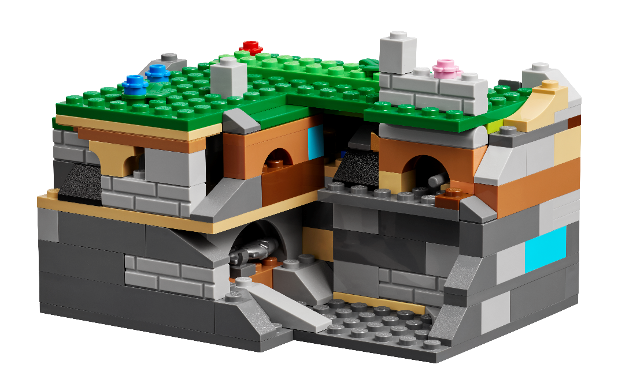

Activity 2 Tasks
Using Bags 2-5 and Book 2, build the excavation model.
What artifacts can be found inside the model?
You Need…
How do you think these artifacts were used?
Notes:
Activity 2 Tasks
Use Bags 2-5 and Book 2 to build the excavation model.
Place the model on the mat.
Explore the layers of the excavation model. Use the archaeology tools to remove pieces. What artifacts can be found inside?
Talk with your team about the artifacts inside the excavation model. How do you think these were used?
Practice removing layers and excavating the model. Can you put it back together?
Look at the different rooms within the model and discuss with your team how they were used.
Session Tips
Use Bags 2-5 and Book 2 to build the excavation model.
Have the children explore the layers of the excavation model. They may need to use some of the tools included in the set to unlock different layers. (See page 31 of the Engineering Notebook.)

Slide 11

Activity 2 Tasks
Remove layers of the model and put it back together.
Look at the different rooms within the model.
How do you think each room was used?
You Need…
Notes:
Activity 2 Tasks
Use Bags 2-5 and Book 2 to build the excavation model.
Place the model on the mat.
Explore the layers of the excavation model. Use the archaeology tools to remove pieces. What artifacts can be found inside?
Talk with your team about the artifacts inside the excavation model. How do you think these were used?
Practice removing layers and excavating the model. Can you put it back together?
Look at the different rooms within the model and discuss with your team how they were used.
Session Tips
Use Bags 2-5 and Book 2 to build the excavation model.
Have the children explore the layers of the excavation model. They may need to use some of the tools included in the set to unlock different layers. (See page 31 of the Engineering Notebook.)

Slide 12
Challenge
Take turns carefully excavating the model and retrieving one of the artifacts.
Share what you learned about artifacts and excavating.
Notes:
Challenge
Excavate the model carefully to retrieve one of the artifacts.
Put the model back together and challenge another team member to excavate another artifact. Make sure everyone has a turn.
Share what you learned about artifacts and excavating.
Session Tips
Use Bags 2-5 and Book 2 to build the excavation model.
Have the children explore the layers of the excavation model. They may need to use some of the tools included in the set to unlock different layers. (See page 31 of the Engineering Notebook.)

Slide 13


Share
Share what you learned.
What did you learn about radar?
What did you notice about the excavation model?
How do archaeologists excavate a site?
Notes:
Share
Have the team share with the whole room:
Talk about the radar and excavation models.
Share what they learned about how archaeologists excavate a site in their Engineering Notebooks.

Slide 14
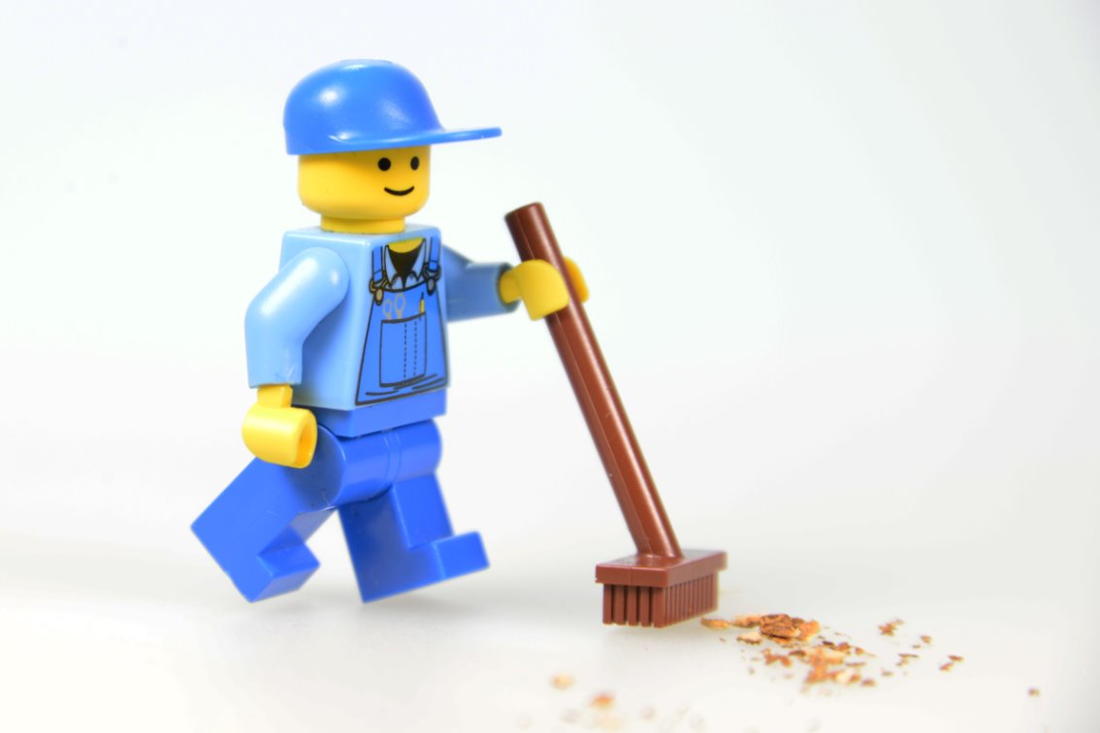
Clean Up
Notes:
Cleanup Pointers
• Fold the mat and store it to keep it from being damaged.
• The radar and excavation site models can stay assembled. They will be used again in Sessions 6 and 7.
You may wish to play a video or song during clean up time Link on
GoNoodle:. https://family.gonoodle.com/activities/clean-up
Link on YouTube Kids: https://www.youtubekids.com/watch?v=ZJFk87ZsHn0
Link on Youtube: https://youtu.be/ZJFk87ZsHn0

Slide 15


LEGO, the LEGO logo, and the SPIKE logo are trademarks of the/sont des marques de commerce du/son marcas registradas de LEGO Group. ©2025 The LEGO Group. All rights reserved/Tous droits réservés/Todos los derechos reservados. FIRST®, the FIRST® logo, and FIRST® AGE™ are trademarks of For Inspiration and Recognition of Science and Technology (FIRST). LEGO® is a registered trademark of the LEGO Group. FIRST® LEGO® League and UNEARTHED™ are jointly held trademarks of FIRST and the LEGO Group. ©2025 FIRST and the LEGO Group. All rights reserved.

