Slide 1


SESSION 1
Archaeology Adventure
I can work with my team using discovery to explore UNEARTHEDTM theme and share what I know about archaeology.
I can work with my team to build things related to archaeology.
Students will share what they know about archaeology, look at the Explore Story, and build an artifact for others to try to replicate.

Slide 2

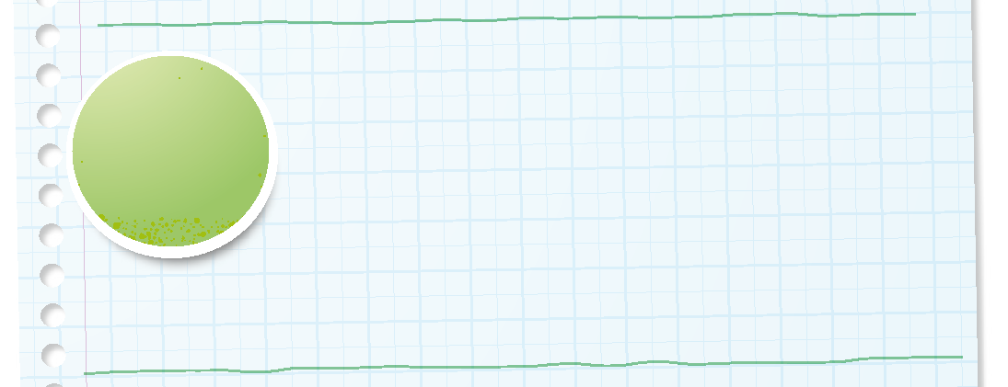

Introduction
Can your team provide examples of how they have used discovery?
We explore new skills and ideas.
Notes:
Introduction - Let’s Discover (5-10 minutes)
• Introduce the FIRST® Core Values.
• Read the definition for discovery to the team. (see TMG page 5)
• Talk about what discovery is. Have the team provide examples of this Core Value.
• Have everyone draw a picture of an example of discovery on the Core Values page in their Engineering Notebook.

Slide 3
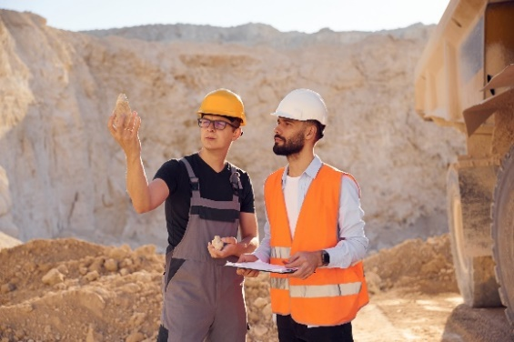

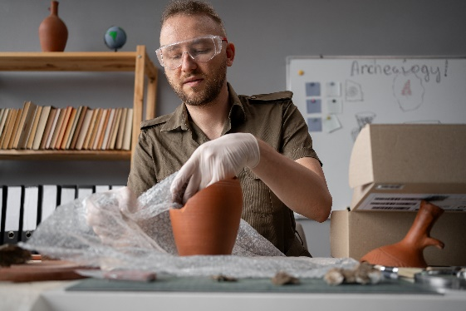
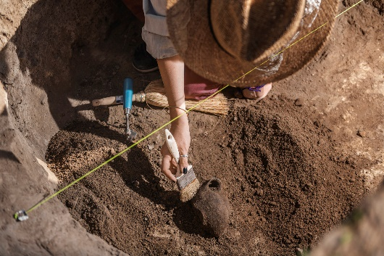
Key Vocabulary
Archaeology: the study of how humans or animals lived in the past
Artifact: an object representing human history or culture
Excavate: to uncover by digging away covering earth
Notes:
Session specific vocab

Slide 4

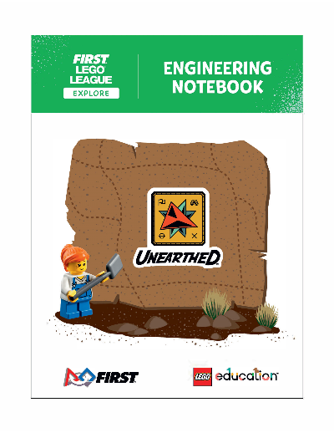
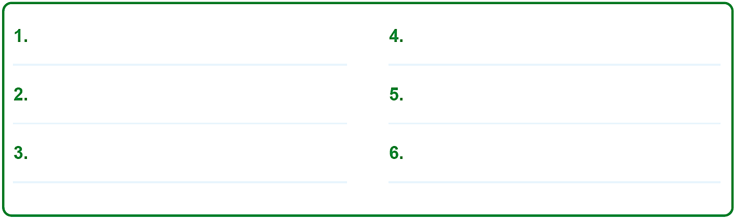
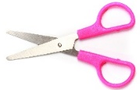
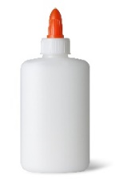
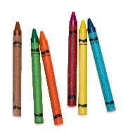
Activity 1 Tasks
Get in your group and pick a team name. Write your team's name in your Engineering Notebook on page 3.
You Need…
Notes:
Activity 1 Tasks
Gather with your team and pick a team name for the UNEARTHED™ season.
Look at the Explore story on page 4. Look closely at each picture and think about what closely at each picture and think about what closely at each picture and think about what closely at each picture and think about what the characters might be thinking or doing.
Share what you know about archaeology with your team.
Write or draw what your team shared. Write or draw what your team shared.
List your team goals on page 6.
Session Tips
Use the Multimedia Resources to find example photos, websites, and other activities related to the sessions.
Help the children select a team name. This is how the team will be recognized at the festival. They can record their name in their Engineering Notebook.
The Explore story on page 4 is a wordless comic referenced throughout the sessions to inspire creativity and spark discussions about the season’s theme.
Writing and drawing space is provided throughout the Engineering Notebook for each team member to capture their ideas.

Slide 5

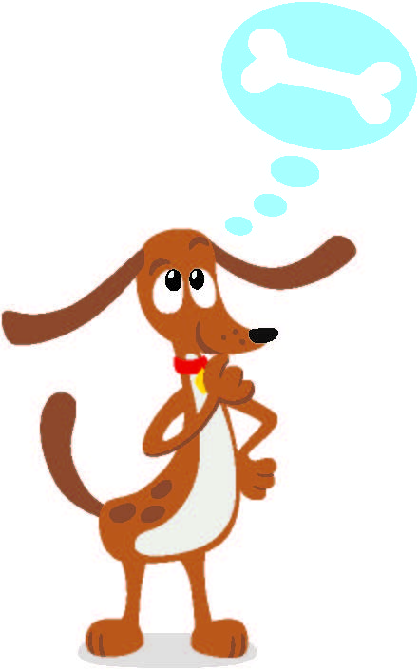
Guiding Questions
What do you know about archaeology?
What does an archaeologist do?
What do you think is happening in the Explore Story?
Notes:
Each session has Guiding Questions that can be shared to frame the session.
Talk through each of these questions with the students. Have them start to think about these questions and later their will share their thoughts with their team.
Session Tips:
The Explore story on page 4 is a wordless comic referenced throughout the sessions to inspire creativity and spark discussions about the season’s theme.
It is okay if they don't know anything about archaeology yet, that is what the experience is about – learning!

Slide 6
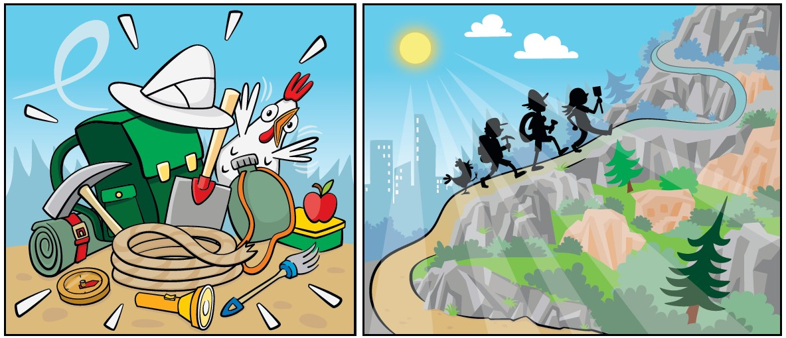
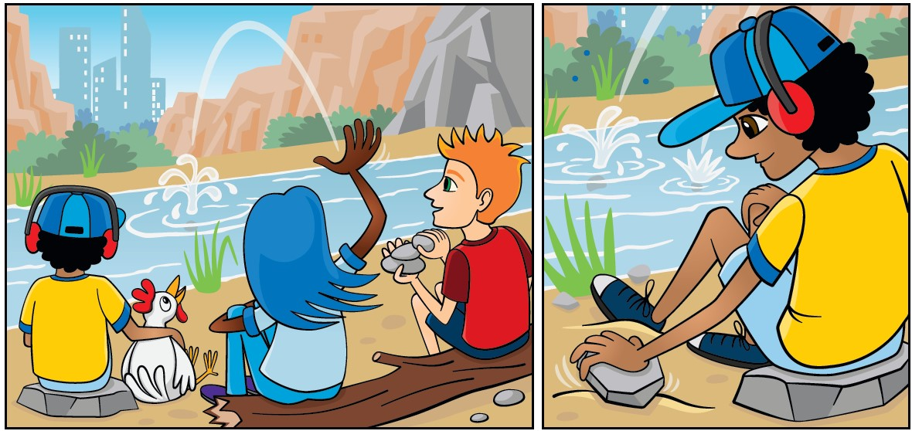
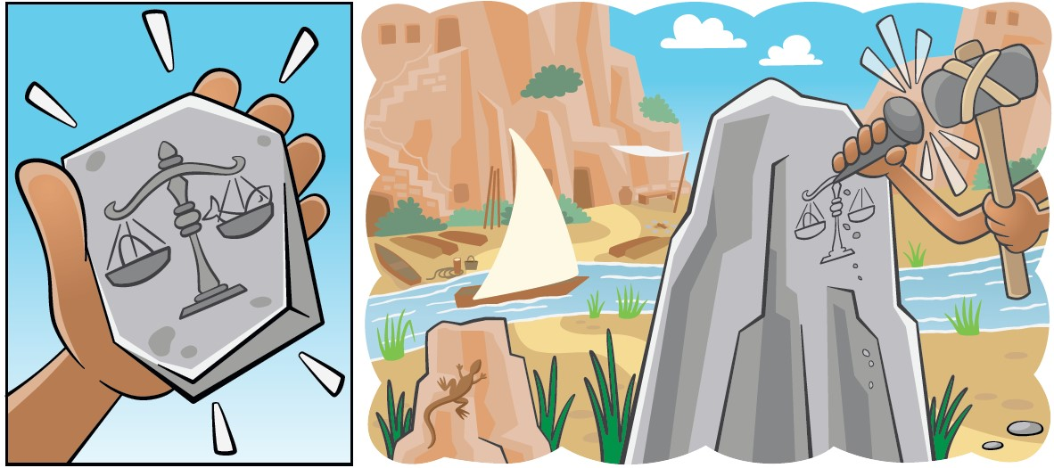
Activity 1 Tasks
Look at the Explore Story on page 4.
What do you see?
What are the characters doing?
Notes:
Activity 1 Tasks
Gather with your team and pick a team name for the UNEARTHED™ season.
Look at the Explore story on page 4. Look closely at each picture and think about what the characters might be thinking or doing.
Share what you know about archaeology with your team.
Write or draw what your team shared. Write or draw what your team shared.
List your team goals on page 6.
Session Tips
Use the Multimedia Resources to find example photos, websites, and other activities related to the sessions.
Help the children select a team name. This is how the team will be recognized at the festival. They can record their name in their Engineering Notebook.
The Explore story on page 4 is a wordless comic referenced throughout the sessions to inspire creativity and spark discussions about the season’s theme.
Writing and drawing space is provided throughout the Engineering Notebook for each team member to capture their ideas.

Slide 7

Activity 1 Tasks
Share what you know about archaeology with your team.
Write or draw what your team shared in your Engineering Notebook on page 8.
Notes:
Activity 1 Tasks
Gather with your team and pick a team name for the UNEARTHED™ season.
Look at the Explore story on page 4. Look closely at each picture and think about what the characters might be thinking or doing.
Share what you know about archaeology with your team.
Write or draw what your team shared. Write or draw what your team shared.
List your team goals on page 6.
Session Tips
Use the Multimedia Resources to find example photos, websites, and other activities related to the sessions.
Help the children select a team name. This is how the team will be recognized at the festival. They can record their name in their Engineering Notebook.
The Explore story on page 4 is a wordless comic referenced throughout the sessions to inspire creativity and spark discussions about the season’s theme.
Writing and drawing space is provided throughout the Engineering Notebook for each team member to capture their ideas.

Slide 8

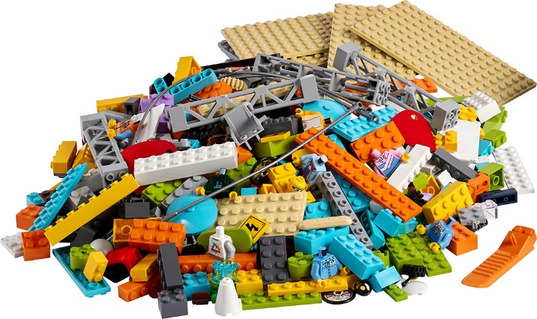
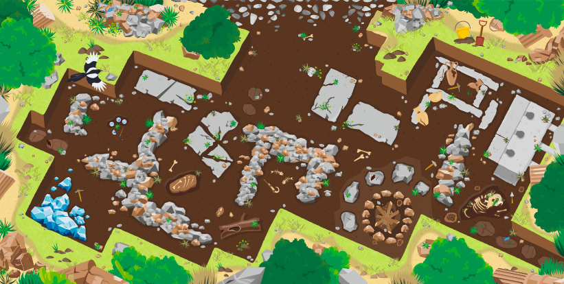
Activity 2 Tasks
Split your team into two groups.
Using the LEGO® pieces, each group should build a small artifact.
You Need…
Notes:
Activity 2 Tasks
Divide your team into two groups and share the prototyping pieces.
Build a small artifact. What did your teammates build?
Put the artifact on the mat.
Draw a picture of the artifact you built.
Session Tips
The prototyping pieces in Bags 7-12 are used throughout the sessions to build solutions to the design challenges. If you have other LEGO® bricks available, you can use those to give the team more options.
Help the team trade their artifact models with the other group. You could limit the number of bricks used to simplify the activity.
Encourage the children to share what they built and to explain how it is related to the theme of archaeology.

Slide 9
Guiding Questions
What do you see on the mat?
How do archaeologists know where to dig?
What do archaeologists look for?
Notes:
Each session has Guiding Questions that can be shared to frame the session.
Talk through each of these questions with the students. Have them start to think about these questions and later their will share their thoughts with their team.
Session Tips:
The Explore story on page 4 is a wordless comic referenced throughout the sessions to inspire creativity and spark discussions about the season’s theme.
It is okay if they don't know anything about archaeology yet, that is what the experience is about – learning!

Slide 10
Activity 2 Tasks
Place your artifact on the mat.
Draw a picture of the artifact your group built on page 9 of your Engineering Notebook.
Notes:
Activity 2 Tasks
Divide your team into two groups and share the prototyping pieces.
Build a small artifact. What did your teammates build?
Put the artifact on the mat.
Draw a picture of the artifact you built.
Session Tips
The prototyping pieces in Bags 7-12 are used throughout the sessions to build solutions to the design challenges. If you have other LEGO® bricks available, you can use those to give the team more options.
Help the team trade their artifact models with the other group. You could limit the number of bricks used to simplify the activity.
Encourage the children to share what they built and to explain how it is related to the theme of archaeology.

Slide 11
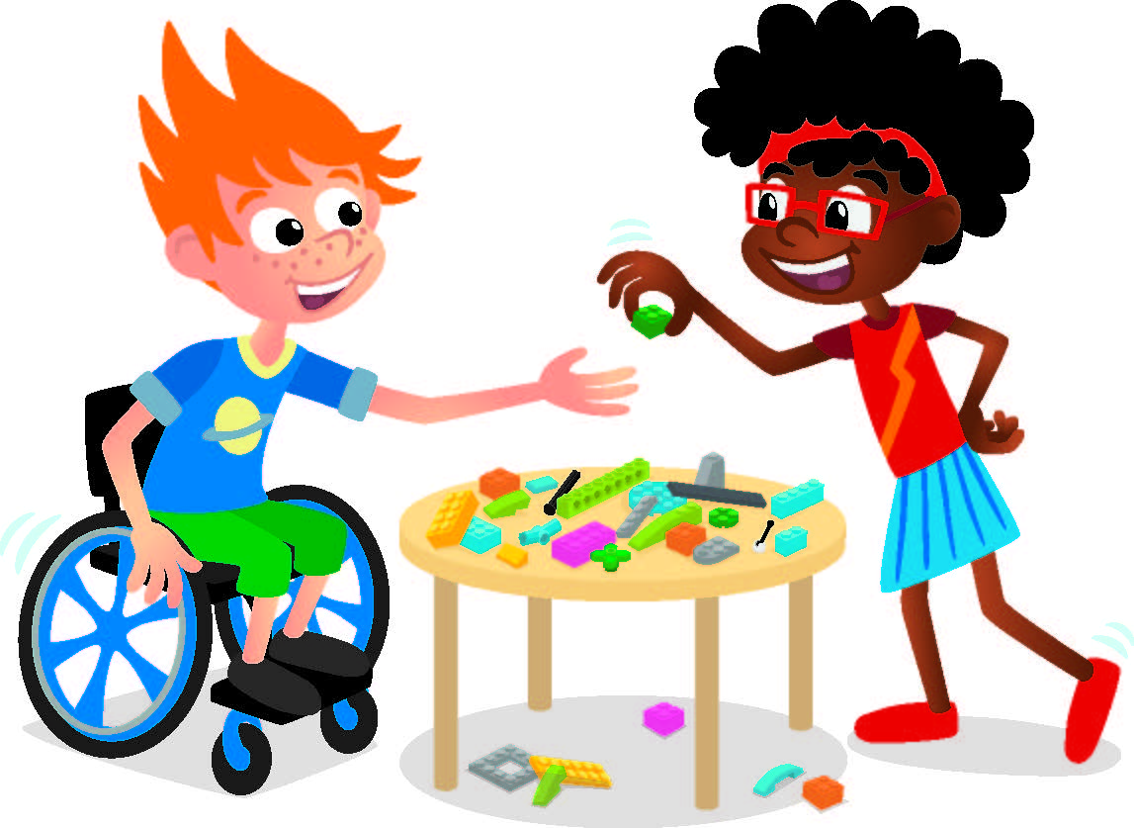
Challenge
Take the artifact apart and trade your pieces and drawing with the other group.
Try to rebuild the other group's artifact based on the drawing.
Notes:
Challenge
Take the artifact apart and trade your pieces and drawing with another group.
You are an archaeologist who made an amazing discovery! The artifact you found is in many pieces and needs to be put back together. A drawing of the artifact was found. Will it help you put it back together?
Rebuild the artifact based on the drawing. Did your group rebuild the artifact correctly?
Session Tips
The prototyping pieces in Bags 7-12 are used throughout the sessions to build solutions to the design challenges. If you have other LEGO® bricks available, you can use those to give the team more options.
Help the team trade their artifact models with the other group. You could limit the number of bricks used to simplify the activity.
Encourage the children to share what they built and to explain how it is related to the theme of archaeology.

Slide 12

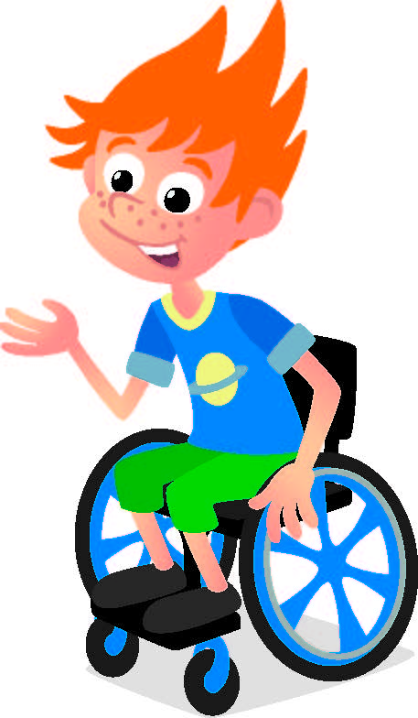
Share
Share what you built.
What do you think happened in the Explore Story?
What do you know about archaeology?
Notes:
Share
Have the team share with the whole room:
Talk about what they think happened in the Explore story.
Share what they know about archaeology.
Share what they built to tell their story.
Session Tips
The prototyping pieces in Bags 7-12 are used throughout the sessions to build solutions to the design challenges. If you have other LEGO® bricks available, you can use those to give the team more options.
Help the team trade their artifact models with the other group. You could limit the number of bricks used to simplify the activity.
Encourage the children to share what they built and to explain how it is related to the theme of archaeology.

Slide 13

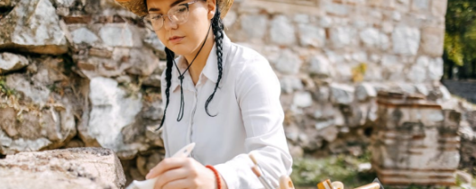
Career Connection
Archaeologist
Archaeologists are storytellers of the past. Archaeologists do lots of different jobs to help people learn about the past.
They may do research, excavate or dig up treasures from underground, study in a lab, or manage collections of ancient artifacts.

Slide 14
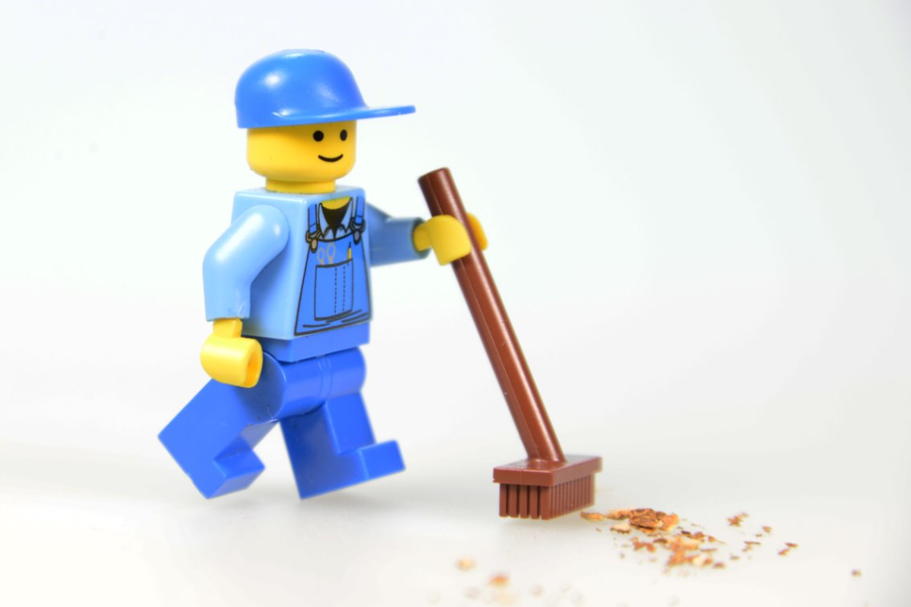
Clean Up
Notes:
Cleanup Pointers
• Anything built with the prototyping pieces should be taken apart.
• Place the prototyping pieces back in the Explore box or in a container labeled “Prototyping Pieces.”
You may wish to play a video or song during clean up time Link on
GoNoodle:. https://family.gonoodle.com/activities/clean-up
Link on YouTube Kids: https://www.youtubekids.com/watch?v=ZJFk87ZsHn0
Link on Youtube: https://youtu.be/ZJFk87ZsHn0

Slide 15


LEGO, the LEGO logo, and the SPIKE logo are trademarks of the/sont des marques de commerce du/son marcas registradas de LEGO Group. ©2025 The LEGO Group. All rights reserved/Tous droits réservés/Todos los derechos reservados. FIRST®, the FIRST® logo, and FIRST® AGE™ are trademarks of For Inspiration and Recognition of Science and Technology (FIRST). LEGO® is a registered trademark of the LEGO Group. FIRST® LEGO® League and UNEARTHED™ are jointly held trademarks of FIRST and the LEGO Group. ©2025 FIRST and the LEGO Group. All rights reserved.

