Slide 1
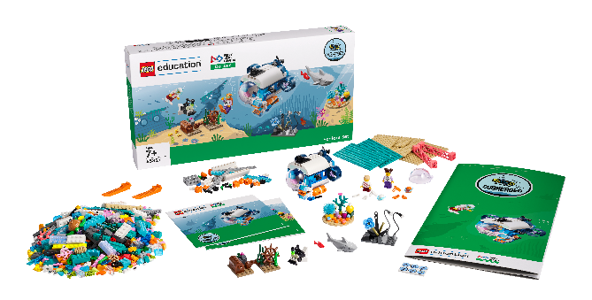
Sessions 8&9
Team Model

Slide 2
Guiding Questions
How will you plan out your design for your team model?
What do you think is the most important part of your team model?
Outcomes
The team will draw their team model design and label its required parts.
The team will create a team model to showcase a talent or interest that uses technology in creative ways.
What are you most proud of in your team model?
What the strengths and the weaknesses of your design?
How can you motorize part of your team model?
How does your team model show your interest or hobby in a new or unique way?
Notes:
Each session has Guiding Questions that can be shared to frame the session.
Session Tips
The team will need all parts of their Explore model and the mat.
Each team member could build a part of the team model.
The team model can use extra LEGO® bricks, minifigures, baseplates, and other LEGO elements. You may NOT use glue, paint, or art supplies.
The team model should be able to fit on a table and be easy to move.
The team will apply coding concepts throughout the sessions to create their programs.
The team should incorporate all parts of the Explore model into their team model as well as the Explore mat.
The team could choose to motorize the submarine model again or use their skills to motorize something new.
​Extension
Create a detailed, labeled drawing of the team model and all its parts.
Look back at the Explore story for additional building ideas.

Slide 3
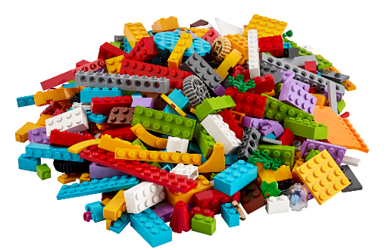
Introduction – Teamwork Build
Session 8
Examples of Teamwork
Ask the students to provide examples of Teamwork and record them here
Example of Teamwork
Example of Teamwork
We found we were stronger when we worked together.
Notes:
***Skip this slide during session 9***
Introduction - Teamwork and Fun Builds (10 minutes)
Have the team provide examples of how they have used teamwork (Session 8) and fun (Session 9) throughout the sessions.
Have the team create a build from the prototyping pieces representing this Core Value or examples of the team using teamwork and fun.

Slide 4
Introduction – Fun Build
Session 9
Examples of Fun
Ask the students to provide examples of Fun and record them here
Example of Fun
Example of Fun
We enjoyed and celebrated what we did!
Notes:
***Skip this slide during session 8***
Introduction - Teamwork and Fun Builds (10 minutes)
Have the team provide examples of how they have used teamwork (Session 8) and fun (Session 9) throughout the sessions.
Have the team create a build from the prototyping pieces representing this Core Value or examples of the team using teamwork and fun.

Slide 5
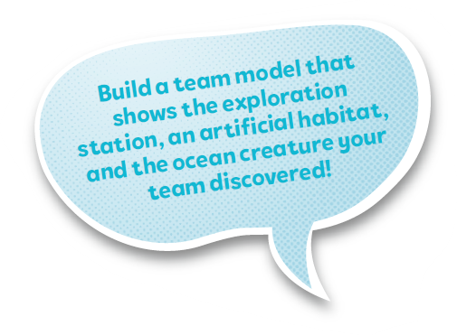
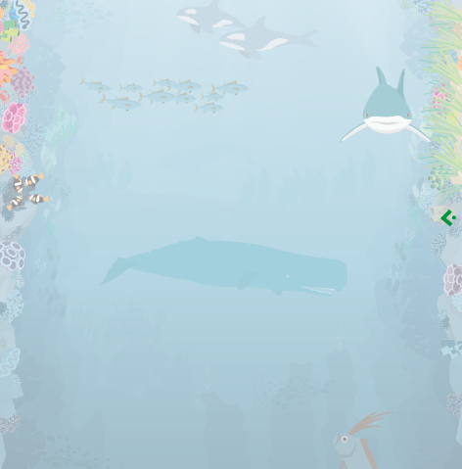
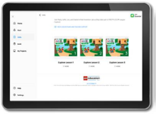
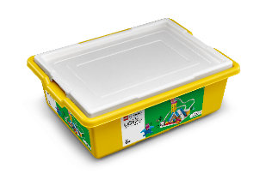
Tasks
Your team has learned a lot about the oceans!
Design a team model that shows your team’s ocean journey.
Draw it!
You need…
Explore the list of required parts on the next slide.
Notes:
Session Tasks (80-100 minutes)
Your team has learned a lot about the oceans!
Design a team model that shows your team’s ocean journey.
Explore the list of required parts on the next page.
Draw your team model design and label the required parts.
Create your team model together. Use the mat and build the different parts of your ocean journey!
Session Tips
The team will need all parts of their Explore model and the mat.
Each team member could build a part of the team model.
The team model can use extra LEGO® bricks, minifigures, baseplates, and other LEGO elements. You may NOT use glue, paint, or art supplies.

Slide 6
Tasks
Notes:
Session Tasks (80-100 minutes)
Your team has learned a lot about the oceans!
Design a team model that shows your team’s ocean journey.
Explore the list of required parts on the next page.
Draw your team model design and label the required parts.
Create your team model together. Use the mat and build the different parts of your ocean journey!
Session Tips
The team will need all parts of their Explore model and the mat.
Each team member could build a part of the team model.
The team model can use extra LEGO® bricks, minifigures, baseplates, and other LEGO elements. You may NOT use glue, paint, or art supplies.
The team model should be able to fit on a table and be easily transportable.
The team will apply coding concepts throughout the sessions to create their programs.
The team should incorporate all parts of the Explore model into their team model as well as the Explore mat.

Slide 7
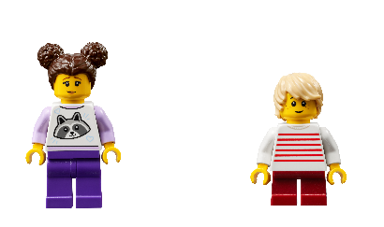
Tasks
Use these two pages to draw your team model design:
Label the required parts of your team model.
Notes:
Session Tasks (80-100 minutes)
Your team has learned a lot about the oceans!
Design a team model that shows your team’s ocean journey.
Explore the list of required parts on the next page.
Draw your team model design and label the required parts.
Create your team model together. Use the mat and build the different parts of your ocean journey!
Session Tips
The team will need all parts of their Explore model and the mat.
Each team member could build a part of the team model.
The team model can use extra LEGO® bricks, minifigures, baseplates, and other LEGO elements. You may NOT use glue, paint, or art supplies.
The team model should be able to fit on a table and be easily transportable.
The team will apply coding concepts throughout the sessions to create their programs.
The team should incorporate all parts of the Explore model into their team model as well as the Explore mat.

Slide 8
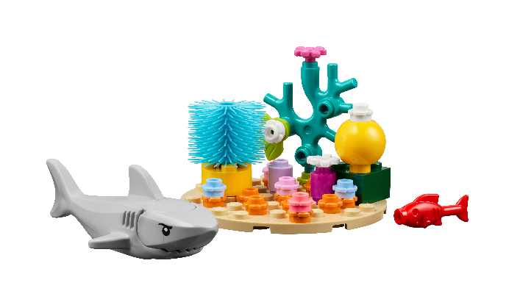
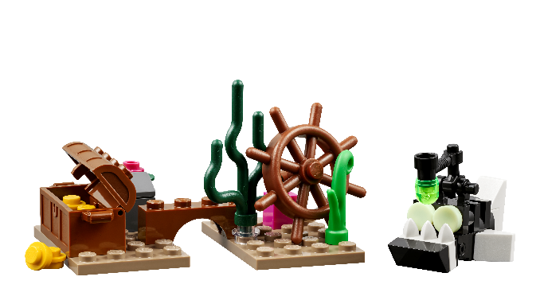
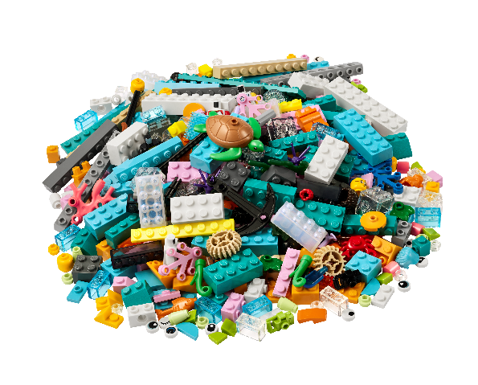
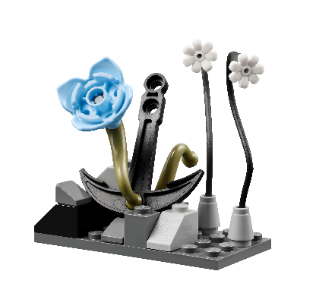
Tasks
Make a plan! Create your team model together.
Notes:
Session Tasks (80-100 minutes)
Your team has learned a lot about the oceans!
Design a team model that shows your team’s ocean journey.
Explore the list of required parts on the next page.
Draw your team model design and label the required parts.
Create your team model together. Use the mat and build the different parts of your ocean journey!
Session Tips
The team will need all parts of their Explore model and the mat.
Each team member could build a part of the team model.
The team model can use extra LEGO® bricks, minifigures, baseplates, and other LEGO elements. You may NOT use glue, paint, or art supplies.
The team model should be able to fit on a table and be easily transportable.
The team will apply coding concepts throughout the sessions to create their programs.
The team should incorporate all parts of the Explore model into their team model as well as the Explore mat.

Slide 9
Share
Share what you did in the session.
Explain the program and how the motor, sensor and light are used in the model.
Review the list of required parts and identify them on the team model.
Demonstrate how the team model works.
What have you discovered? Share with your team!
Notes:
Share (10 minutes)
Have the team:
Share what they did at the end of each session.
Explain the program and how the motor, sensor, and light are used in the model.
Review the list of required parts and identify them on the team model.
Demonstrate how the team model works.

Slide 10
Optional Video:
You may wish to embed a relevant, age-appropriate video for your students here. See the Notes for an example.
Notes:
Choose a relevant, age-appropriate video for your students.

Slide 11
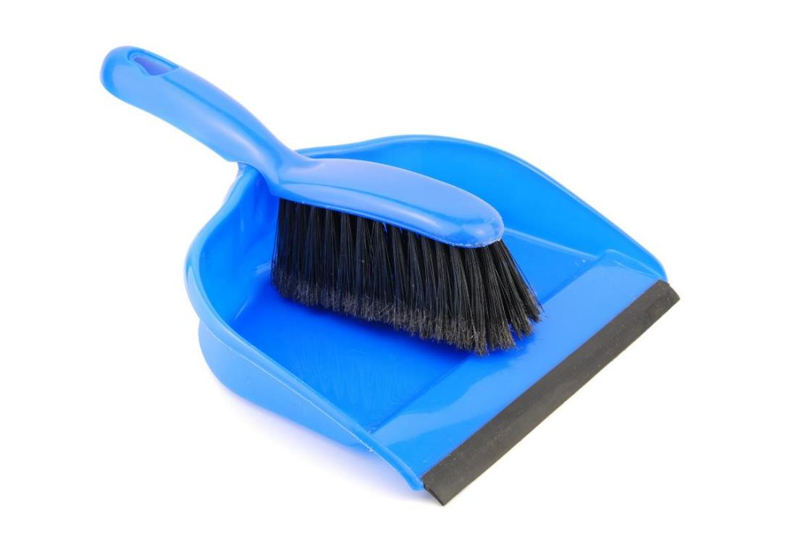
Clean Up
Notes:
Clean Up Pointers
• The team model will remain assembled from this point forward until the event.
• Check that any unused pieces from the LEGO® Education SPIKE™ Essential set are returned to it.
You may wish to play a video or song during clean up time Link on
GoNoodle: https://family.gonoodle.com/activities/clean-up
Link on YouTube Kids: https://www.youtubekids.com/watch?v=ZJFk87ZsHn0
Link on Youtube: https://youtu.be/ZJFk87ZsHn0

Slide 12
LEGO, the LEGO logo, and the SPIKE logo are trademarks of the/sont des marques de commerce du/son marcas registradas de LEGO Group. © 2024 The LEGO Group. All rights reserved/Tous droits réservés/Todos los derechos reservados. FIRST®, the FIRST® logo, and FIRST® DIVESM are trademarks of For Inspiration and Recognition of Science and Technology (FIRST). LEGO® is a registered trademark of the LEGO Group. FIRST® LEGO® League and SUBMERGEDSM are jointly held trademarks of FIRST and the LEGO Group.© 2024 FIRST and the LEGO Group. All rights reserved.

