Slide 1
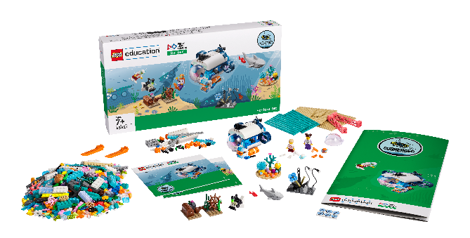
Session 7
Exploration Station

Slide 2
Guiding Questions
What ocean job sounds the most fun to you?
Does a marine biologist use different technology than a submarine pilot?
Outcomes
The team will learn about different ocean jobs.
The team will learn about tools or equipment needed for an ocean exploration.
What kind of technology would you use?
What kind of education is needed for this job?
Where in the ocean would you want to explore the most?
What else would you want to learn about the oceans?
Notes:
Each session has Guiding Questions that can be shared to frame the session.
Session Tips
The team can pick one job to focus on to start.
Show examples of people working in ocean-related jobs and the tools they use.
The team may need to use pieces from the artificial habitat. They can use extra time in this session to return their pieces or modify both models.
Help the team think of different jobs to give them additional challenges.
The team could be challenged to modify their model based on a different spot on the mat.
Use this time to reinforce vocabulary and concepts explored throughout the sessions.
Extension
Research other jobs that use technology to explore different environments.
Research technologies used to learn about ocean life.

Slide 3
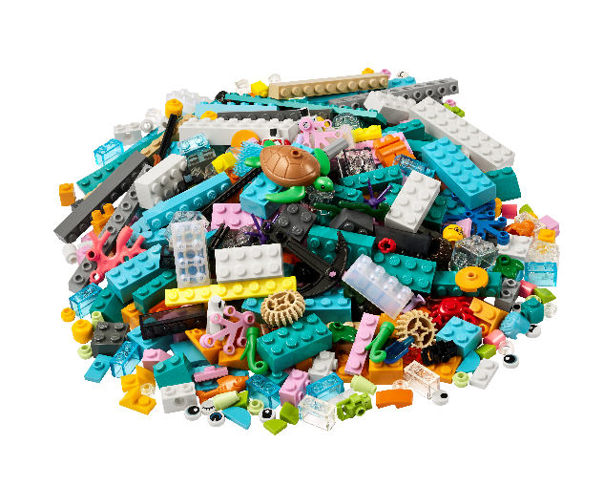
Introduction – Discovery Build
Examples of Discovery
Ask the students to provide examples of Discovery and record them here
Example of Discovery
Example of Discovery
We explored new skills and ideas.
Notes:
Introduction - Discovery Build (10 minutes)
Have the team provide examples of how they have used discovery throughout the sessions.
Have the team create a build from the prototyping pieces representing this Core Value or examples of the team using discovery.

Slide 4
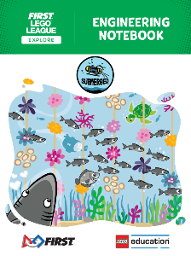
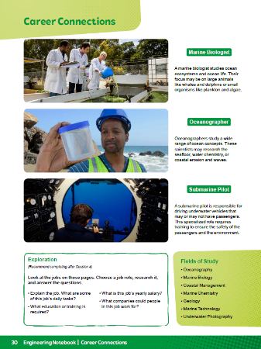
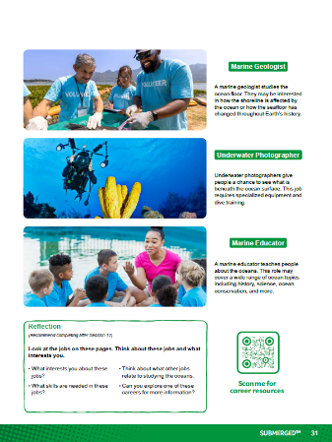
Activity 1 –
Explore the ocean jobs on pages 30-31 of the Engineering Notebook.
You need…
Notes:
Activity 1 Tasks
Explore the ocean jobs on pages 30-31.
Pick a job that interests you. Think about the different tools someone in that role might need to do their work.
Write or draw your ideas below.
Challenge
Use the prototyping pieces to build a place where people can study the ocean.
Build the tools or equipment the people might need.
Session Tips
The team can pick one job to focus on to start.
Show examples of people working in ocean-related jobs and the tools they use.
The team may need to use pieces from the artificial habitat. They can use extra time in this session to return their pieces or modify both models.

Slide 5
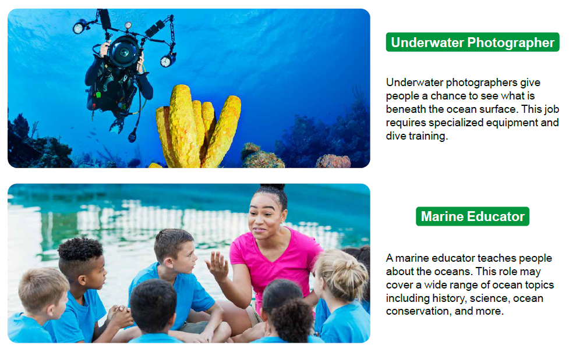
Activity 1 –

Slide 6
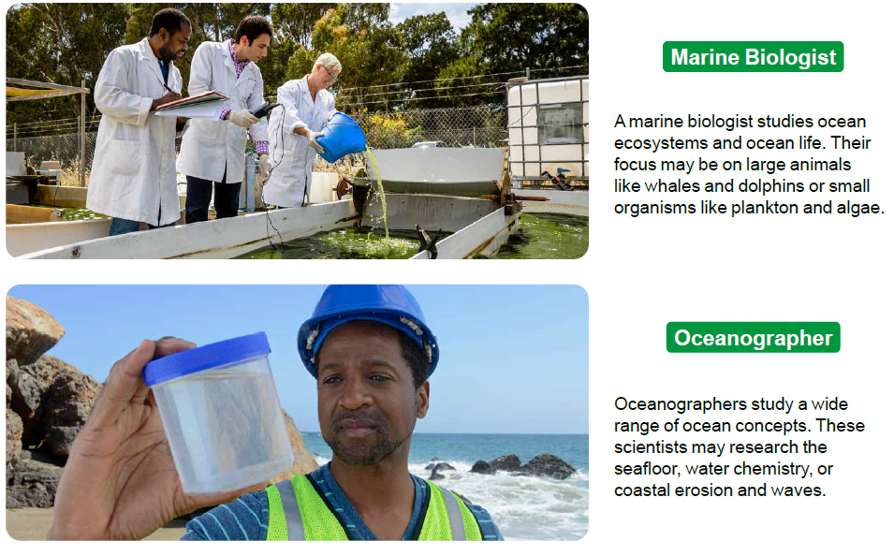
Activity 1 –

Slide 7
Activity 1 –

Slide 8
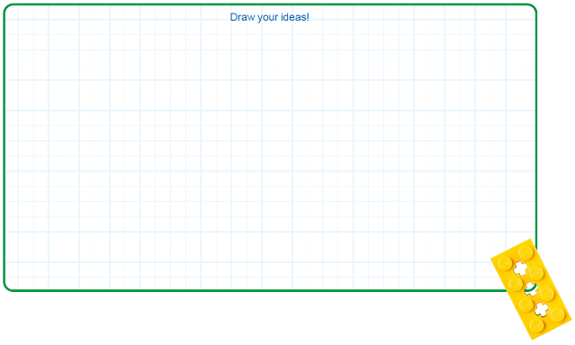
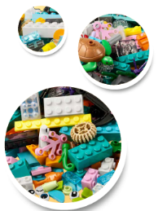
Activity 1
Pick a job that interests you. Think about the different tools someone in that role might need to do their work.
Write or draw your ideas below.
Notes:
Activity 1 Tasks
Explore the ocean jobs on pages 30-31.
Pick a job that interests you. Think about the different tools someone in that role might need to do their work.
Write or draw your ideas below.
Challenge
Use the prototyping pieces to build a place where people can study the ocean.
Build the tools or equipment the people might need.
Session Tips
The team can pick one job to focus on to start.
Show examples of people working in ocean-related jobs and the tools they use.
The team may need to use pieces from the artificial habitat. They can use extra time in this session to return their pieces or modify both models.

Slide 9
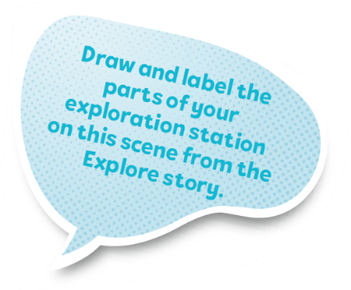
Activity 1
Challenge
Use the prototyping pieces to build a place where people can study the ocean.
Build the tools or equipment the people might need.
Notes:
Activity 1 Tasks
Explore the ocean jobs on pages 30-31.
Pick a job that interests you. Think about the different tools someone in that role might need to do their work.
Write or draw your ideas below.
Challenge
Use the prototyping pieces to build a place where people can study the ocean.
Build the tools or equipment the people might need.
Session Tips
The team can pick one job to focus on to start.
Show examples of people working in ocean-related jobs and the tools they use.
The team may need to use pieces from the artificial habitat. They can use extra time in this session to return their pieces or modify both models.

Slide 10
Activity 2 –
You need…
Think of a different job that explores or studies the ocean.
Talk about what new tools or equipment the different job might require.
Notes:
Activity 2 Tasks
Think of a different job that explores or studies the ocean.
Talk about what new tools or equipment the job might require.
Change your model so it matches the job.
Place your model on the mat.
Talk about what you built.
Session Tips
Help the team think of different jobs to give them additional challenges.
The team could be challenged to modify their model based on a different spot on the mat.
Use this time to reinforce vocabulary and concepts explored throughout the sessions.

Slide 11
Activity 2
Change your model so it matches the new job.
Place your model on the mat.
Notes:
Activity 2 Tasks
Think of a different job that explores or studies the ocean.
Talk about what new tools or equipment the job might require.
Change your model so it matches the job.
Place your model on the mat.
Talk about what you built.
Session Tips
Help the team think of different jobs to give them additional challenges.
The team could be challenged to modify their model based on a different spot on the mat.
Use this time to reinforce vocabulary and concepts explored throughout the sessions.

Slide 12
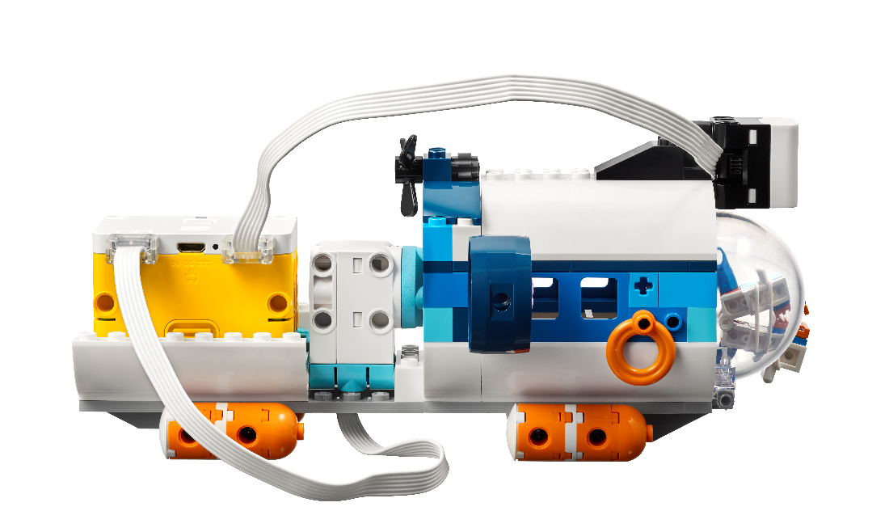
Activity 2
Talk about what you built.
Notes:
Activity 2 Tasks
Think of a different job that explores or studies the ocean.
Talk about what new tools or equipment the job might require.
Change your model so it matches the job.
Place your model on the mat.
Talk about what you built.
Session Tips
Help the team think of different jobs to give them additional challenges.
The team could be challenged to modify their model based on a different spot on the mat.
Use this time to reinforce vocabulary and concepts explored throughout the sessions.

Slide 13
Share
Share what you did in the session.
Share about different ocean jobs.
Share about tools and technology used in ocean exploration.
What have you discovered? Share with your team!
Notes:
Share (10 minutes)
Have the team:
Share what they did in the session.
Share about different ocean jobs.
Share about tools and technology used in ocean exploration.

Slide 14
Optional Video:
You may wish to embed a relevant, age-appropriate video for your students here. See the Notes for an example.
Notes:
Choose a relevant, age-appropriate video for your students.

Slide 15
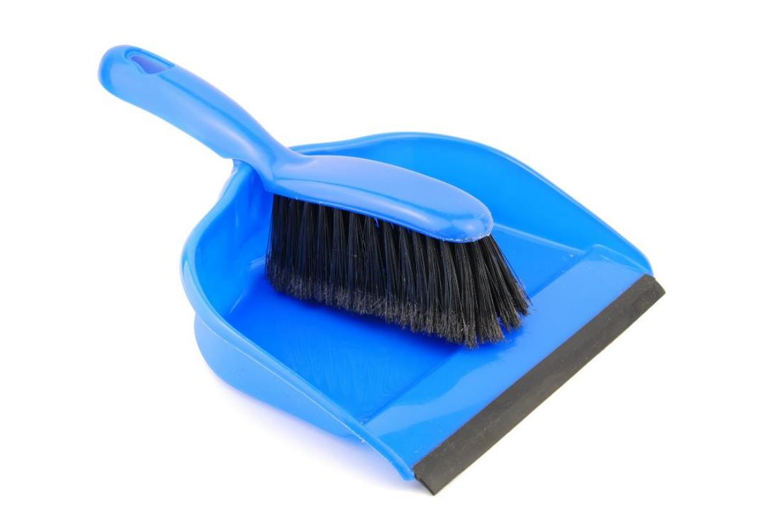
Clean Up
Notes:
Clean Up Pointers
Make sure unused pieces from the SPIKE™ Essential set are returned to it.
You may wish to play a video or song during clean up time Link on
GoNoodle: https://family.gonoodle.com/activities/clean-up
Link on YouTube Kids: https://www.youtubekids.com/watch?v=ZJFk87ZsHn0
Link on Youtube: https://youtu.be/ZJFk87ZsHn0

Slide 16
LEGO, the LEGO logo, and the SPIKE logo are trademarks of the/sont des marques de commerce du/son marcas registradas de LEGO Group. © 2024 The LEGO Group. All rights reserved/Tous droits réservés/Todos los derechos reservados. FIRST®, the FIRST® logo, and FIRST® DIVESM are trademarks of For Inspiration and Recognition of Science and Technology (FIRST). LEGO® is a registered trademark of the LEGO Group. FIRST® LEGO® League and SUBMERGEDSM are jointly held trademarks of FIRST and the LEGO Group.© 2024 FIRST and the LEGO Group. All rights reserved.

