Slide 1
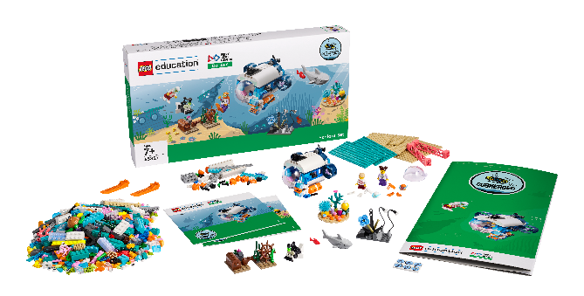
Session 6
Deep Sea Discovery

Slide 2
Guiding Questions
What are some animals you know that live in the oceans?
How much space does your creature need?
Outcomes
The team will build an unknown species discovered in the ocean.
The team will design an artificial habitat for an unknown species to build empathy and understanding for animals.
What does your creature need to be healthy in its environment?
Does your creature live in a cave or in open water?
How would you describe your creature to someone who hasn’t seen it?
Can you draw the habitat you are going to build?
Notes:
Each session has Guiding Questions that can be shared to frame the session.
Session Tips
The team will build their creature using the prototyping pieces in the Explore set.
The team will complete a profile on the creature in their Engineering Notebook.
This creature could be part of the team model, or they can build a new one.
Give examples of artificial habitats in different environments.
Keep the creature and habitat assembled so the team can include them in their team model.
The ideas space can be used to write down the design steps planned or which blocks the team will use.​

Slide 3
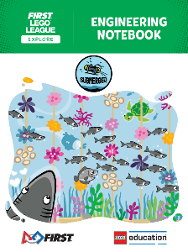
Introduction – Have an Impact
Examples of Impact
Ask the students to provide examples of Impact and record them here
Example of Impact
Example of Impact
We applied what we learned to improve our world.
Extension
Notes:
Introduction - Have an Impact (5-10 minutes)
Read the definition for impact to the team. (see TMG page 5)
Talk about what impact is. Have the team provide examples of this Core Value.
Extension: Have everyone draw a picture of an example of impact on the Core Values page in their Engineering Notebook.

Slide 4
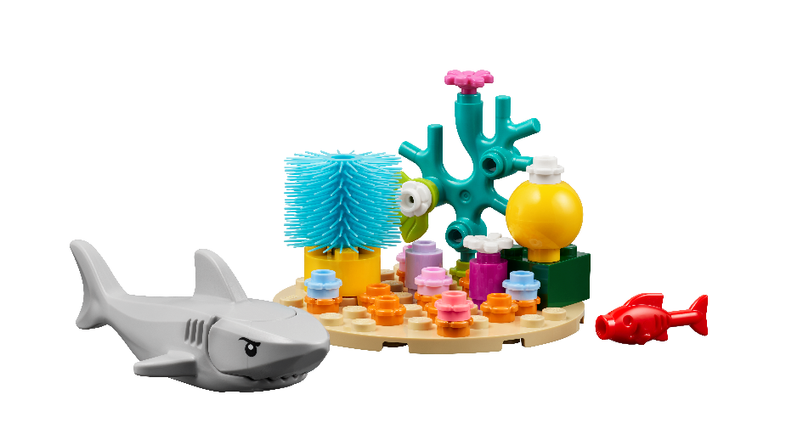
Activity 1 –
You need…
Imagine that your team discovers something strange while traveling through the ocean.
Use the prototyping pieces to build a mysterious and unknown creature.
Notes:
Activity 1 Tasks –
Imagine that your team discovers something strange while traveling through the ocean.
Use the prototyping pieces to build a mysterious and unknown creature.
Challenge
Write a summary of your new species below.
Share your newly discovered species with others.
Session Tips
The team will build their creature using the prototyping pieces in the Explore set.
The team will complete a profile on the creature in their Engineering Notebook.
This creature could be part of the team model, or they can build a new one.

Slide 5
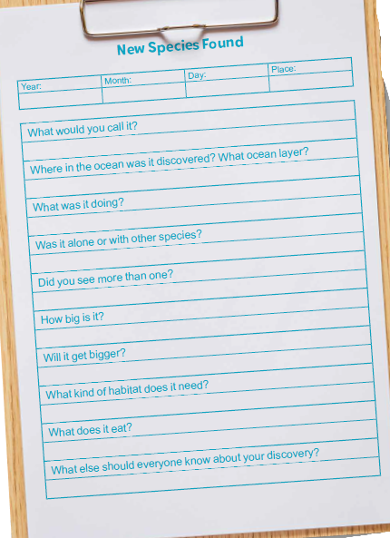
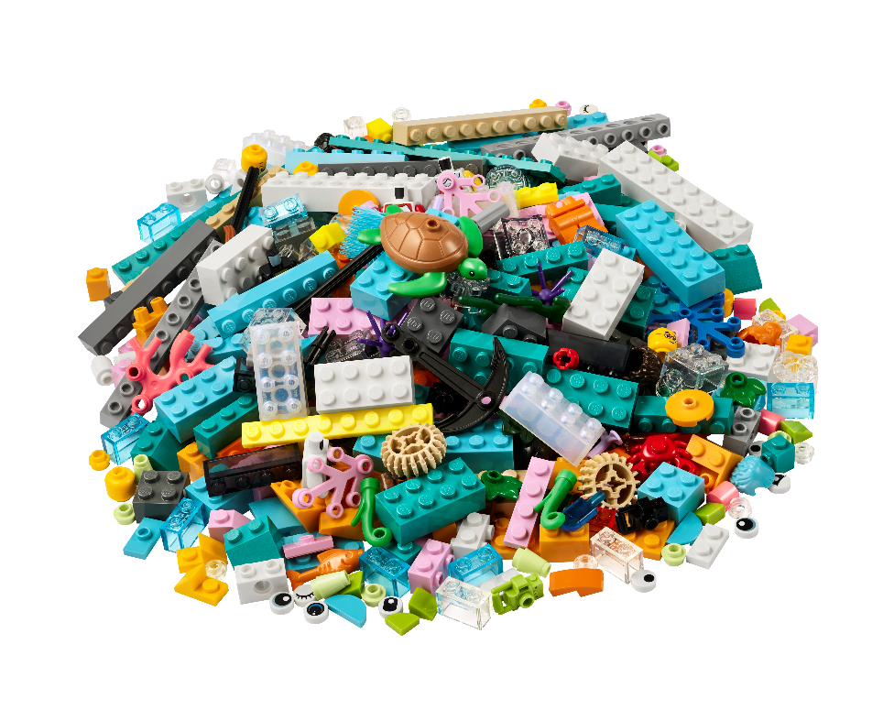
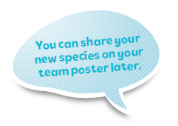
Activity 1
Challenge
Write a summary of your new species.
Share your newly discovered species with others.
Notes:
Activity 1 Tasks –
Imagine that your team discovers something strange while traveling through the ocean.
Use the prototyping pieces to build a mysterious and unknown creature.
Challenge
Write a summary of your new species below.
Share your newly discovered species with others.
Session Tips
The team will build their creature using the prototyping pieces in the Explore set.
The team will complete a profile on the creature in their Engineering Notebook.
This creature could be part of the team model, or they can build a new one.

Slide 6
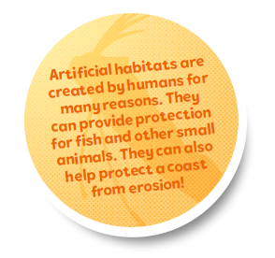
Activity 2 –
Draw your team’s ideas for a habitat below.
Think about what part of the ocean your creature is from and what protection it may need.
You need…
Notes:
Activity 2 Tasks –
Build an artificial habitat for the new species using the prototyping pieces.
Draw your team’s ideas for a habitat below.
Think about what part of the ocean your creature is from and what protection it may need.
Keep your creature in the artificial habitat to share in your team model later.
Session Tips
Give examples of artificial habitats in different environments.
Keep the creature and habitat assembled so the team can include them in their team model.
The ideas space can be used to write down the design steps planned or which blocks the team will use.

Slide 7
Activity 2 –
Build an artificial habitat for the new species using the prototyping pieces.
Keep your creature in the artificial habitat to share in your team model later.
You need…
Notes:
Activity 2 Tasks –
Build an artificial habitat for the new species using the prototyping pieces.
Draw your team’s ideas for a habitat below.
Think about what part of the ocean your creature is from and what protection it may need.
Keep your creature in the artificial habitat to share in your team model later.
Session Tips
Give examples of artificial habitats in different environments.
Keep the creature and habitat assembled so the team can include them in their team model.
The ideas space can be used to write down the design steps planned or which blocks the team will use.

Slide 8
Share
Share what you did in the session.
Share how animals have specific requirements for survival.
Share how you designed a habitat.
Notes:
Share (10 minutes)
Have the team:
Share what they did in the session.
Share how animals have specific requirements for survival.
Share how they designed a habitat.

Slide 9
Optional Video:
You may wish to embed a relevant, age-appropriate video for your students here. See the Notes for an example.
Notes:
Choose a relevant, age-appropriate video for your students.

Slide 10
Career Connections
Notes:
Ask the children to reflect on what a marine geologist does.
Explain the job. What are some of this job’s daily tasks?
What is this job’s yearly salary?
What education or training is required?
What companies could people in this job work for?

Slide 11
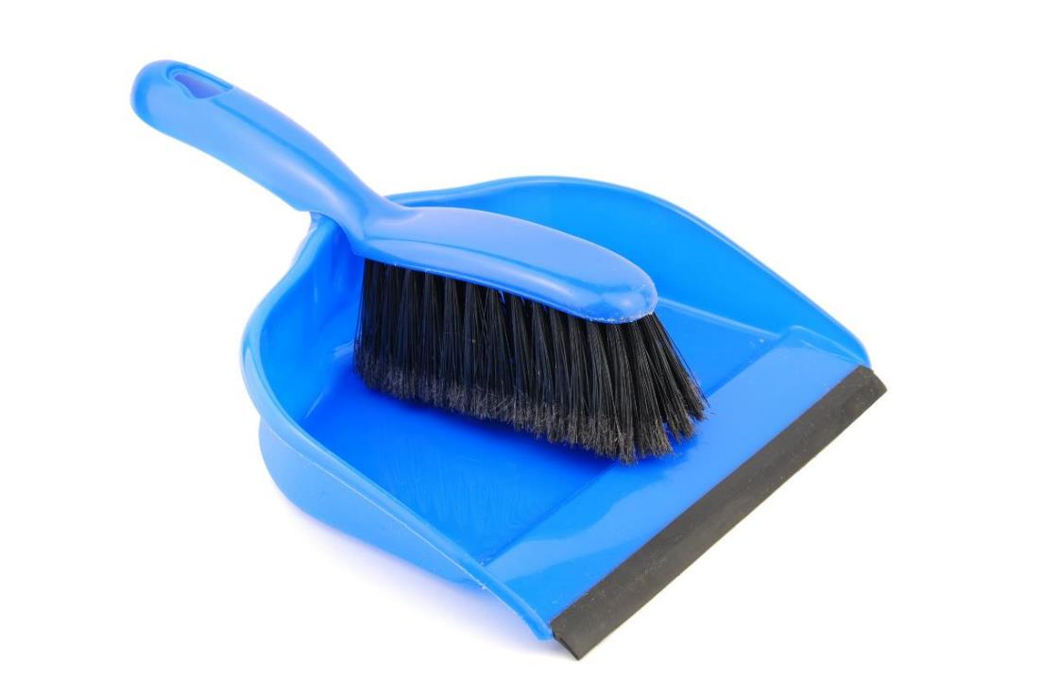
Clean Up
Notes:
Clean Up Pointers
Place the creature in its habitat and put them away so they don’t get damaged.
You may wish to play a video or song during clean up time Link on
GoNoodle: https://family.gonoodle.com/activities/clean-up
Link on YouTube Kids: https://www.youtubekids.com/watch?v=ZJFk87ZsHn0
Link on Youtube: https://youtu.be/ZJFk87ZsHn0

Slide 12
LEGO, the LEGO logo, and the SPIKE logo are trademarks of the/sont des marques de commerce du/son marcas registradas de LEGO Group. © 2024 The LEGO Group. All rights reserved/Tous droits réservés/Todos los derechos reservados. FIRST®, the FIRST® logo, and FIRST® DIVESM are trademarks of For Inspiration and Recognition of Science and Technology (FIRST). LEGO® is a registered trademark of the LEGO Group. FIRST® LEGO® League and SUBMERGEDSM are jointly held trademarks of FIRST and the LEGO Group.© 2024 FIRST and the LEGO Group. All rights reserved.

