Slide 1
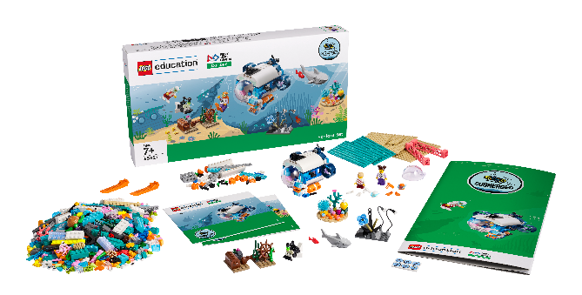
Session 5
Abyssal Zone

Slide 2
Guiding Questions
Can you modify the robot so it drives with four wheels?
What do you hope your submarine will discover at the bottom of the ocean?
Outcomes
The team will build the LEGO® model from the lesson and code the robot to drive.
The team will learn about the living things and mysteries of the deep ocean.
How do you change the program so the LEGO model moves in a different way?
Can you code the robot to start in the sunlight zone and stop in the abyssal zone?
How can you modify your model so it represents a deep sea vehicle?
Can you drive the robot at different speeds?
Notes:
Each session has Guiding Questions that can be shared to frame the session.
Session Tips
The team will create their first mobile robot. Make sure the team watches where the robot drives so that it does not fall if placed on the table.
The team can take turns making changes to the program.
The team will use only their SPIKE™ Essential set for this session. They won’t use anything from the Explore set or Explore model.
The team will practice motor direction and motor speed.
The team can practice positioning the robot so that it reaches a specific location on the mat.
You could place an obstacle on the mat to encourage the team to code their robot to turn.

Slide 3
Introduction – Be Inclusive
Examples of Inclusion
Ask the students to provide examples of Inclusion and record them here
Example of Inclusion
Example of Inclusion
We respected each other and embraced our differences.
Extension
Notes:
Introduction - Be Inclusive (5-10 minutes)
Read the definition for inclusion to the team. (see TMG page 5)
Talk about what inclusion is. Have the team provide examples of this Core Value.
Extension: Have everyone draw a picture of an example of inclusion on the Core Values page in their Engineering Notebook.

Slide 4
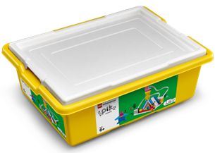
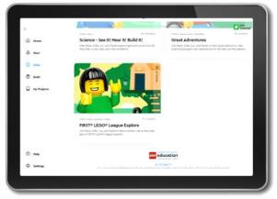
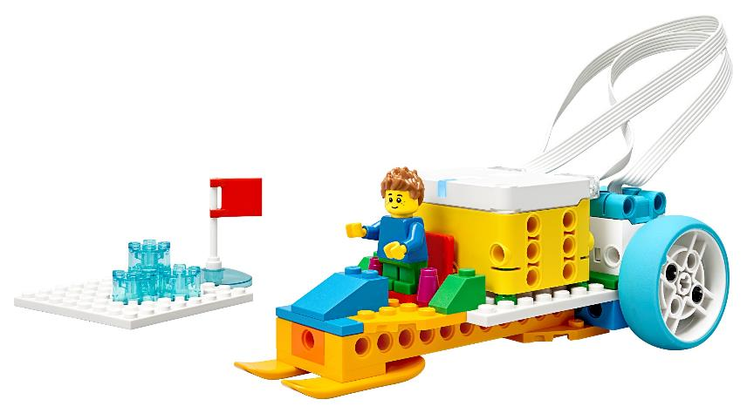
Activity 1 – Arctic Ride
You need…
Open the SPIKETM Essential app. Complete your lesson.
Notes:
Activity 1 Tasks – Arctic Ride
Open the SPIKE™ Essential app. Complete your lesson.
Next, code the model to move backward.
Write your ideas for how to change the program below.
Change the existing program based on your ideas. Test it out!
Challenge
Modify the model so it represents a submarine. What can you add? What would you remove?
Session Tips
The team will create their first mobile robot. Make sure the team watches where the robot drives so that it does not fall if placed on the table.
The team can take turns making changes to the program.
The team will use only their SPIKE™ Essential set for this session. They won’t use anything from the Explore set or Explore model.

Slide 5
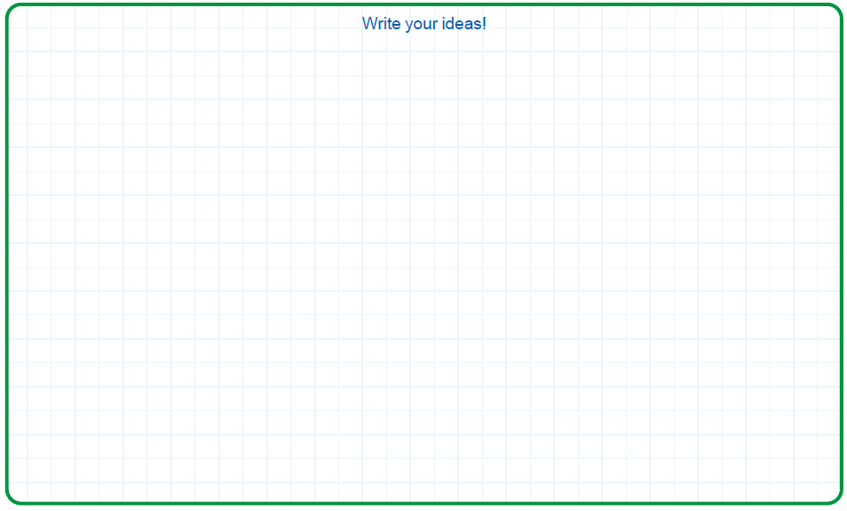
Activity 1
You need…
Next, code the model to move backward.
Notes:
Activity 1 Tasks – Arctic Ride
Open the SPIKE™ Essential app. Complete your lesson.
Next, code the model to move backward.
Write your ideas for how to change the program below.
Change the existing program based on your ideas. Test it out!
Challenge
Modify the model so it represents a submarine. What can you add? What would you remove?
Session Tips
The team will create their first mobile robot. Make sure the team watches where the robot drives so that it does not fall if placed on the table.
The team can take turns making changes to the program.
The team will use only their SPIKE™ Essential set for this session. They won’t use anything from the Explore set or Explore model.

Slide 6
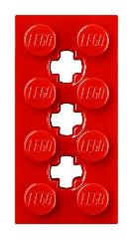
Activity 1
You need…
Change the existing program based on your ideas. Test it out!
Notes:
Activity 1 Tasks – Arctic Ride
Open the SPIKE™ Essential app. Complete your lesson.
Next, code the model to move backward.
Write your ideas for how to change the program below.
Change the existing program based on your ideas. Test it out!
Challenge
Modify the model so it represents a submarine. What can you add? What would you remove?
Session Tips
The team will create their first mobile robot. Make sure the team watches where the robot drives so that it does not fall if placed on the table.
The team can take turns making changes to the program.
The team will use only their SPIKE™ Essential set for this session. They won’t use anything from the Explore set or Explore model.

Slide 7
Activity 1
Challenge
Modify the model so it represents a submarine.
What can you add?
What would you remove?
Notes:
Activity 1 Tasks – Arctic Ride
Open the SPIKE™ Essential app. Complete your lesson.
Next, code the model to move backward.
Write your ideas for how to change the program below.
Change the existing program based on your ideas. Test it out!
Challenge
Modify the model so it represents a submarine. What can you add? What would you remove?
Session Tips
The team will create their first mobile robot. Make sure the team watches where the robot drives so that it does not fall if placed on the table.
The team can take turns making changes to the program.
The team will use only their SPIKE™ Essential set for this session. They won’t use anything from the Explore set or Explore model.

Slide 8
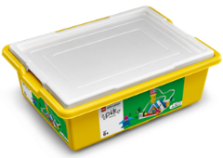
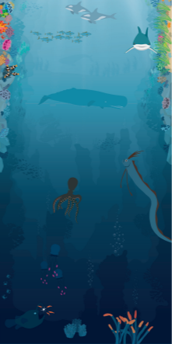
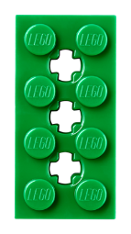
Activity 2
Modify the SPIKE model from the previous task so that it represents a museum exhibit.
Open the SPIKE™ Essential app.
You need…
Notes:
Activity 2 Tasks
Modify the SPIKE model from the previous task so that it represents a submarine and can be driven.
Open the SPIKE™ Essential app.
Change the program so that the vehicle drives slowly on the mat.
Challenge
Pick two spots on the mat the submarine should visit.
Change the program for your vehicle to move between two icons.
Share how you coded your submarine.
Session Tips
The team will practice motor direction and motor speed.
The team can practice positioning the robot so that it reaches a specific location on the mat.
You could place an obstacle on the mat to encourage the team to code their robot to turn.

Slide 9
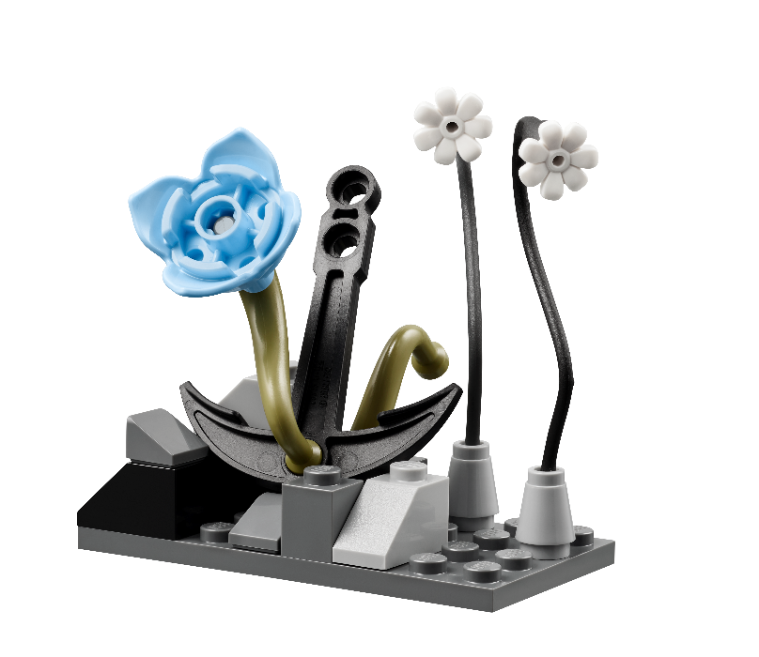
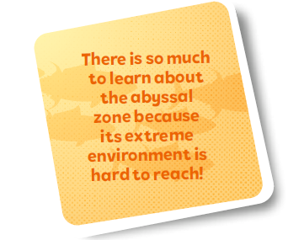
Activity 2
Change the program so that the vehicle drives slowly on the mat.
Notes:
Activity 2 Tasks
Modify the SPIKE model from the previous task so that it represents a submarine and can be driven.
Open the SPIKE™ Essential app.
Change the program so that the vehicle drives slowly on the mat.
Challenge
Pick two spots on the mat the submarine should visit.
Change the program for your vehicle to move between two icons.
Share how you coded your submarine.
Session Tips
The team will practice motor direction and motor speed.
The team can practice positioning the robot so that it reaches a specific location on the mat.
You could place an obstacle on the mat to encourage the team to code their robot to turn.

Slide 10
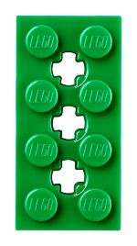
Activity 2
Challenge
Pick two spots on the mat the submarine should visit.
Change the program for your vehicle to move between two icons.
Share how you coded your submarine.
Notes:
Activity 2 Tasks
Modify the SPIKE model from the previous task so that it represents a submarine and can be driven.
Open the SPIKE™ Essential app.
Change the program so that the vehicle drives slowly on the mat.
Challenge
Pick two spots on the mat the submarine should visit.
Change the program for your vehicle to move between two icons.
Share how you coded your submarine.
Session Tips
The team will practice motor direction and motor speed.
The team can practice positioning the robot so that it reaches a specific location on the mat.
You could place an obstacle on the mat to encourage the team to code their robot to turn.

Slide 11
Share
Share what you did in the session.
Show how you have applied coding skills learned in previous sessions.
Explain how technology is used to explore the deep ocean.
What have you discovered? Share with your team!
Notes:
Share (10 minutes)
Have the team:
Share what they did in the session.
Show how they have applied coding skills learned in previous sessions.
Explain how technology is used to explore the deep ocean.

Slide 12
Optional Video:
You may wish to embed a relevant, age-appropriate video for your students here. See the Notes for an example.
Notes:
Choose a relevant, age-appropriate video for your students.

Slide 13
Career Connections
Notes:
Ask the children to reflect on what a submarine pilot does.
Explain the job. What are some of this job’s daily tasks?
What is this job’s yearly salary?
What education or training is required?
What companies could people in this job work for?

Slide 14
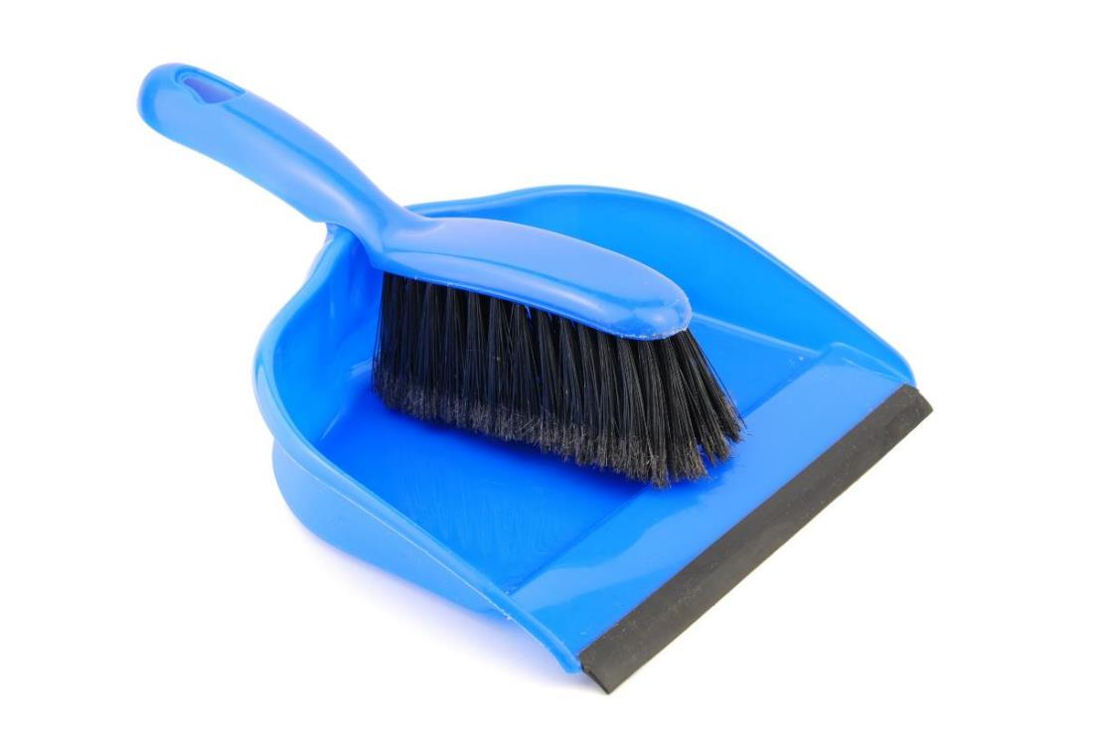
Clean Up
Notes:
Clean Up Pointers
Everything built in this session should be taken apart and returned to storage.
Fold the mat and store it in a place where it won’t get damaged.
You may wish to play a video or song during clean up time Link on
GoNoodle: https://family.gonoodle.com/activities/clean-up
Link on YouTube Kids: https://www.youtubekids.com/watch?v=ZJFk87ZsHn0
Link on Youtube: https://youtu.be/ZJFk87ZsHn0

Slide 15
LEGO, the LEGO logo, and the SPIKE logo are trademarks of the/sont des marques de commerce du/son marcas registradas de LEGO Group. © 2024 The LEGO Group. All rights reserved/Tous droits réservés/Todos los derechos reservados. FIRST®, the FIRST® logo, and FIRST® DIVESM are trademarks of For Inspiration and Recognition of Science and Technology (FIRST). LEGO® is a registered trademark of the LEGO Group. FIRST® LEGO® League and SUBMERGEDSM are jointly held trademarks of FIRST and the LEGO Group.© 2024 FIRST and the LEGO Group. All rights reserved.

