Slide 1
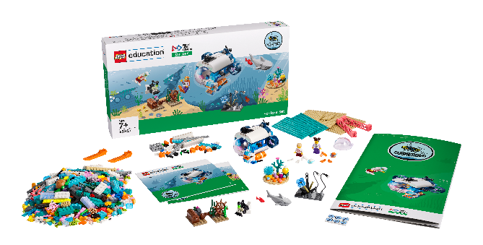
Session 4
Twilight Zone

Slide 2
Guiding Questions
How do you change the program so the LEGO model displays a different light?
Can you change the speed of the motor?
Outcomes
The team will build the LEGO® model from the lesson and explore the use of lights and sensors.
The team will learn about living things in the twilight zone.
Can you code the model to make a sound?
How are submarines used to explore the ocean?
What kinds of sensors would be useful on a submarine?
Can you make the sensor activate a sound?
Notes:
Each session has Guiding Questions that can be shared to frame the session.
Some additional time may be needed in the second half of this lesson for the team to modify the submarine model from the Explore set. This is the submarine they built in Session 1.
Session Tips
The team will learn about and use light and sound blocks.
The team should focus on light blocks in this activity.
Questions in the Engineering Notebook are meant to start a discussion or generate ideas.​
Some extra time may be needed to allow the team to modify the submarine model.
Use the prototyping pieces or other objects to activate the sensor.
Children can find more information on the careers mentioned in the Engineering Notebook on pages 30-31.

Slide 3
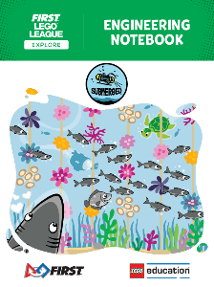
Introduction – Let’s Innovate
Examples of Innovation
Ask the students to provide examples of Innovation and record them here
Example of Innovation
Example of Innovation
We used creativity and persistence to solve problems.
Extension
Notes:
Introduction - Let’s Innovate (5-10 minutes)
Read the definition for innovation to the team. (see TMG page 5)
Talk about what innovation is. Have the team provide examples of this Core Value.
Extension: Have everyone draw a picture of an example of innovation on the Core Values page in their Engineering Notebook.

Slide 4
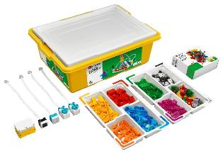
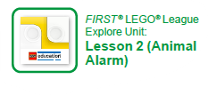
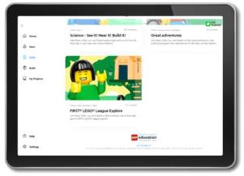
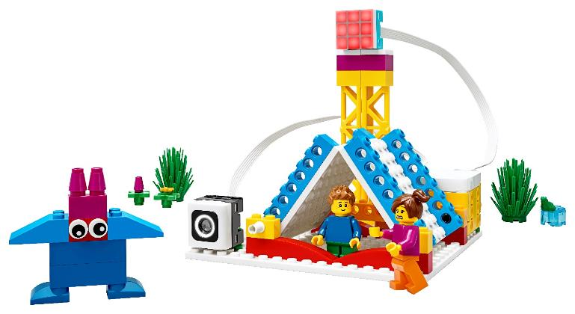
Activity 1 – Animal Alarm
You need…
Open the SPIKE™ Essential app. Complete your lesson.
Notes:
Activity 1 Tasks – Animal Alarm
Open the SPIKE™ Essential app. Complete your lesson.
Make the model go in a different direction or rotate at a different speed.
Write down your ideas below for how to change the program.
Modify the program based on your ideas.
Run your new program. See what happens.
Session Tips
Walk the team through how to access their appropriate lesson in the app.
If your team is new to coding, you could have them complete the getting started tutorials.
The team will only use their LEGO Education SPIKE™ Essential set for this session. They won’t use anything from the Explore set or Explore model.

Slide 5
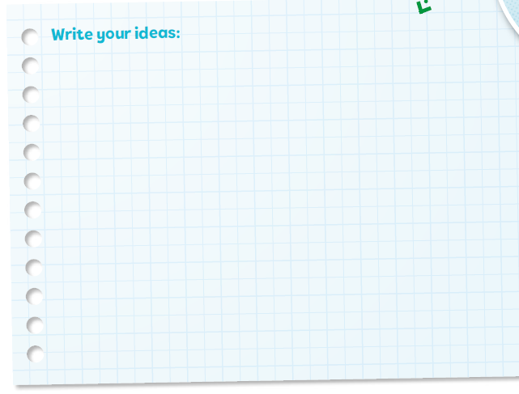
Activity 1 – Animal Alarm
You need…
Code the model to flash a light when a team member approaches the sensor.
Write your ideas for how to change the program.
Notes:
Activity 1 Tasks – Animal Alarm
Open the SPIKE™ Essential app. Complete your lesson.
Make the model go in a different direction or rotate at a different speed.
Write down your ideas below for how to change the program.
Modify the program based on your ideas.
Run your new program. See what happens.
Session Tips
Walk the team through how to access their appropriate lesson in the app.
If your team is new to coding, you could have them complete the getting started tutorials.
The team will only use their LEGO Education SPIKE™ Essential set for this session. They won’t use anything from the Explore set or Explore model.

Slide 6
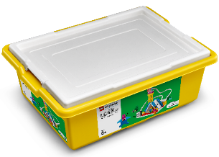
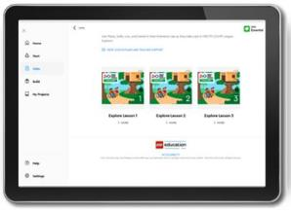
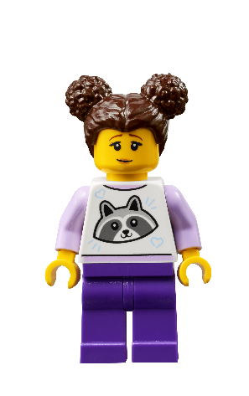
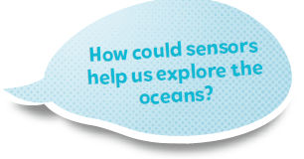
Activity 1
You need…
Modify the program based on your ideas and test it out!
Notes:
Activity 1 Tasks – Animal Alarm
Open the SPIKE™ Essential app. Complete your lesson.
Make the model go in a different direction or rotate at a different speed.
Write down your ideas below for how to change the program.
Modify the program based on your ideas.
Run your new program. See what happens.
Session Tips
Walk the team through how to access their appropriate lesson in the app.
If your team is new to coding, you could have them complete the getting started tutorials.
The team will only use their LEGO Education SPIKE™ Essential set for this session. They won’t use anything from the Explore set or Explore model.

Slide 7
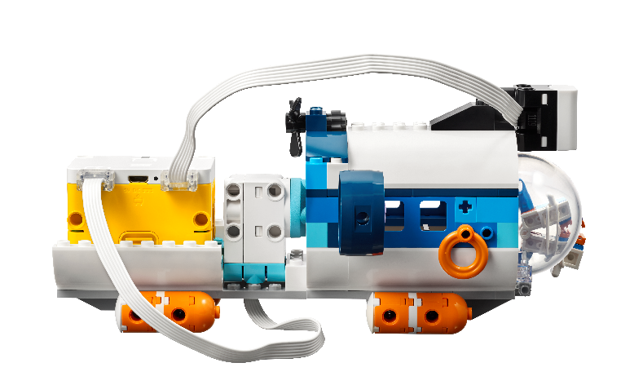
Submarine Time!
You need…
Notes:
Retrieve the submarine model that was built in session 1. If the model was disassembled, have the team put it back together. In the next activity the team will attach the motor and hub pieces to the existing submarine. This activity may take additional time. Remove and store the SPIKE Essential materials separately if they are needed for another lesson.

Slide 8
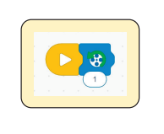
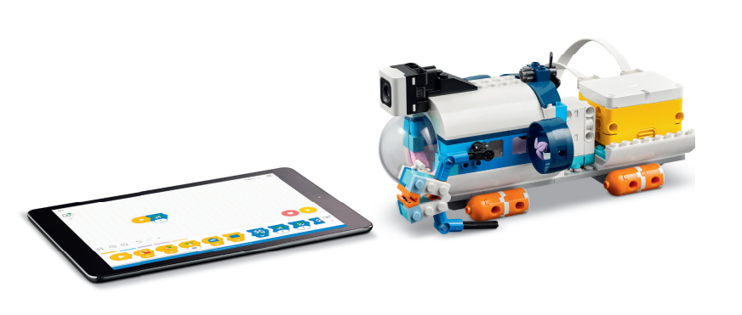
Activity 2
Use the building instructions in Book 2 to attach the sensor, motor, and hub to the submarine from Session 1.
Open the SPIKE™ Essential app.
Try the program provided in Book 2 to motorize your model.
Notes:
Activity 2 Tasks
Use the building instructions in Book 2 to attach the sensor, motor, and hub to the submarine from Session 1.
Open the SPIKE™ Essential app. Try the program provided in Book 2 to motorize your model.
Challenge
Change the program so that the submarine will do the following:
When the sensor detects a black or gray object, the propeller spins quickly to back away.
When the sensor detects a blue or yellow object, the propeller spins slowly to move in and get a closer look.
Share what you built and explain how you coded the model.
Session Tips
​Some extra time may be needed to allow the team to modify the submarine model.
Use the prototyping pieces or other objects to activate the sensor.
Children can find more information on the careers mentioned in the Engineering Notebook on pages 30-31.

Slide 9
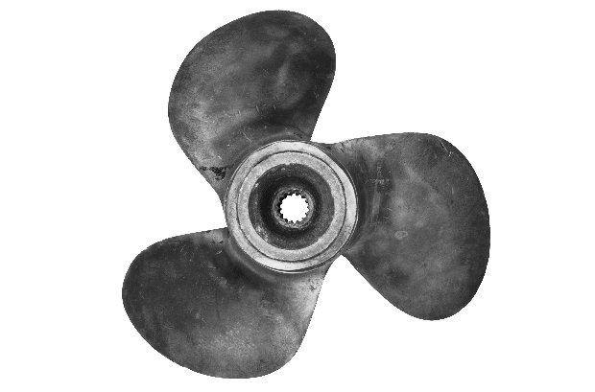
Activity 2
Challenge
Change the program so that the submarine will do the following:
When the sensor detects a black or gray object, the propeller spins quickly to back away.
When the sensor detects a blue or yellow object, the propeller spins slowly to move in and get a closer look.
Share what you built and explain how you coded the model.
This Photo by Unknown Author is licensed under CC BY
Notes:
Activity 2 Tasks
Use the building instructions in Book 2 to attach the sensor, motor, and hub to the submarine from Session 1.
Open the SPIKE™ Essential app. Try the program provided in Book 2 to motorize your model.
Challenge
Change the program so that the submarine will do the following:
When the sensor detects a black or gray object, the propeller spins quickly to back away.
When the sensor detects a blue or yellow object, the propeller spins slowly to move in and get a closer look.
Share what you built and explain how you coded the model.
Session Tips
​Some extra time may be needed to allow the team to modify the submarine model.
Use the prototyping pieces or other objects to activate the sensor.
Children can find more information on the careers mentioned in the Engineering Notebook on pages 30-31.

Slide 10
Share
Share what you did in the session.
Show the sensor coding skills you learned.
Talk about how you modified a model and code so that motion is triggered by a sensor.
What have you discovered? Share with your team!
Notes:
Share (10 minutes)
Have the team:
Share what they did in the session.
Show the sensor coding skills they learned.
Demonstrate how they modified a model and code so that motion is triggered by a sensor.

Slide 11
Optional Video:
You may wish to embed a relevant, age-appropriate video for your students here. See the Notes for an example.
Notes:
Choose a relevant, age-appropriate video for your students.

Slide 12
Career Connections
Notes:
Ask the children to reflect on what an oceanographer does.
Explain the job. What are some of this job’s daily tasks?
What is this job’s yearly salary?
What education or training is required?
What companies could people in this job work for?

Slide 13
Clean Up
Notes:
Clean Up Pointers
The submarine should be left assembled. Anything built with the prototyping pieces should be taken apart and returned to storage.
Help the team remove the hub, motor, and sensor pieces from the submarine model and return them to the SPIKE™ Essential set.
You may wish to play a video or song during clean up time
Link on
GoNoodle: https://family.gonoodle.com/activities/clean-up
Link on YouTube Kids: https://www.youtubekids.com/watch?v=ZJFk87ZsHn0
Link on Youtube: https://youtu.be/ZJFk87ZsHn0

Slide 14
LEGO, the LEGO logo, and the SPIKE logo are trademarks of the/sont des marques de commerce du/son marcas registradas de LEGO Group. © 2024 The LEGO Group. All rights reserved/Tous droits réservés/Todos los derechos reservados. FIRST®, the FIRST® logo, and FIRST® DIVESM are trademarks of For Inspiration and Recognition of Science and Technology (FIRST). LEGO® is a registered trademark of the LEGO Group. FIRST® LEGO® League and SUBMERGEDSM are jointly held trademarks of FIRST and the LEGO Group.© 2024 FIRST and the LEGO Group. All rights reserved.

