Slide 1
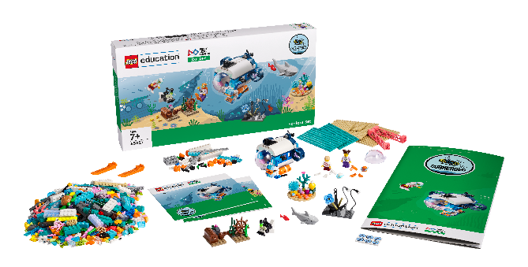
Session 3
Sunlight Zone

Slide 2
Guiding Questions
Can you build and code the LEGO model using motor blocks?
What would you add to the boat model?
Outcomes
The team will build the LEGO® model from the lesson and explore motor coding blocks.
The team will learn about the living things in the ocean’s sunlight zone.
How do you change the program so the LEGO model moves in a different way?
What tools does a marine biologist use when studying ocean animals?
Can you launch the boat at a different speed?
Notes:
Each session has Guiding Questions that can be shared to frame the session.
Session Tips
Walk the team through how to access the appropriate lesson in the app.
If your team is new to coding, you could have them complete the Tutorial Activities.
The team will use only their SPIKE™ Essential set for this task.
The team will determine how to change motor direction and motor speed.
The team should use the SPIKE™ Essential set to modify their boat.
Career connections in the Engineering Notebook highlight jobs related to oceans.
Extension
• Explore different jobs and careers related to the arts.
• Research what it takes to become and expert in one of the jobs that was discussed.

Slide 3
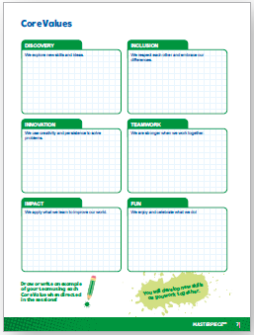
Introduction – Let’s Have Fun
Examples of Fun
Ask the students to provide examples of Fun and record them here
Example of Fun
Example of Fun
We enjoyed and celebrated what we did!
Extension
Notes:
Introduction - Let’s Have Fun (5-10 minutes)
• Read the definition for fun to the team. (see TMG page 5)
• Talk about what fun is. Have the team provide examples of this Core Value.
• Extension: Have everyone draw a picture of an example of fun on the Core Values page in their Engineering Notebook.

Slide 4
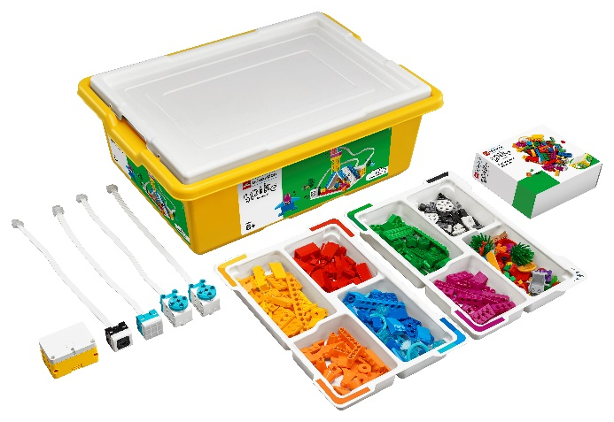
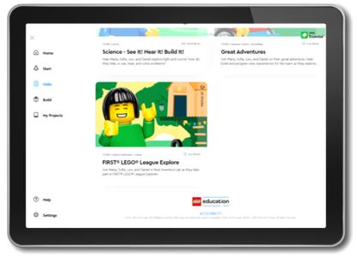
Activity 1 – Boat Trip
You need…
Open the SPIKE™ Essential app. Complete your lesson.
Make the model go in a different direction or rotate at a different speed.
Notes:
Activity 1 Tasks – Do Lesson 1 (15-20 minutes)
Open the SPIKE™ Essential app. Complete your lesson.
Make the model go in a different direction or rotate at a different speed.
Write down your ideas below for how to change the program.
Modify the program based on your ideas.
Run your new program. See what happens.
Session Tips
Walk the team through how to access their appropriate lesson in the app.
If your team is new to coding, you could have them complete the getting started tutorials.
The team will only use their LEGO Education SPIKE™ Essential set for this session. They won’t use anything from the Explore set or Explore model.

Slide 5
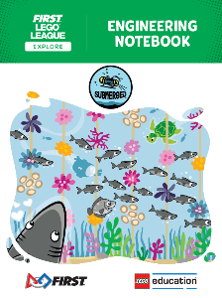
Activity 1
You need…
Write down your ideas below for how to change the program.
Notes:
Activity 1 Tasks – Do Code 1 (15-20 minutes)
Open the SPIKE™ Essential app. Complete your lesson.
Make the model go in a different direction or rotate at a different speed.
Write down your ideas below for how to change the program.
Modify the program based on your ideas.
Run your new program. See what happens.
Session Tips
Walk the team through how to access their appropriate lesson in the app.
If your team is new to coding, you could have them complete the getting started tutorials.
The team will only use their LEGO Education SPIKE™ Essential set for this session. They won’t use anything from the Explore set or Explore model.

Slide 6
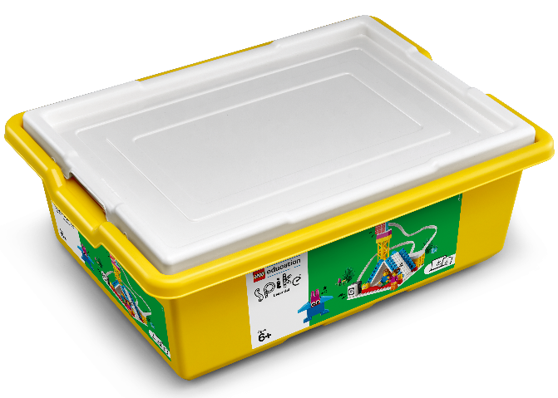
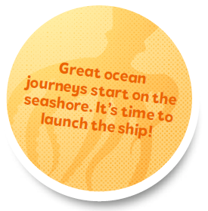
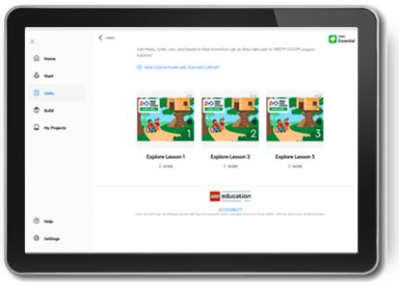
Activity 1
You need…
Modify the program based on your ideas.
Run your new program. See what happens.
Notes:
Activity 1 Tasks – Do Code 1 (15-20 minutes)
Open the SPIKE™ Essential app. Complete your lesson.
Make the model go in a different direction or rotate at a different speed.
Write down your ideas below for how to change the program.
Modify the program based on your ideas.
Run your new program. See what happens.
Session Tips
Walk the team through how to access their appropriate lesson in the app.
If your team is new to coding, you could have them complete the getting started tutorials.
The team will only use their LEGO Education SPIKE™ Essential set for this session. They won’t use anything from the Explore set or Explore model.

Slide 7
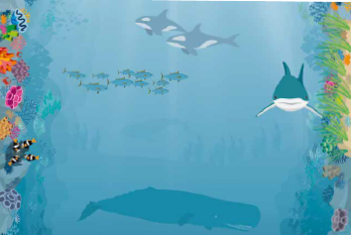
Activity 2 – Team Boat
You need…
Modify the boat model from the previous task so it represents your team.
Will you need special tools or equipment?
Notes:
Activity 2 Tasks – Team Boat (15-20 minutes)
Modify the boat model from the previous task so it represents your team. Will you need special tools or equipment?
Challenge
Open the SPIKE™ Essential app.
Change the program to launch your team boat in the sunlight zone. Try it out!
Session Tips
The team will determine how to change motor direction and motor speed.
The team should use the SPIKE™ Essential set to modify their boat.
Career connections in the Engineering Notebook highlight jobs related to oceans.

Slide 8
Activity 2
Open the SPIKE™ Essential app.
Change the program to launch your team boat in the sunlight zone. Try it out!
Notes:
Activity 2 Tasks – Build a Theater Stage (15-20 minutes)
Modify the boat model from the previous task so it represents your team. Will you need special tools or equipment?
Challenge
Open the SPIKE™ Essential app.
Change the program to launch your team boat in the sunlight zone. Try it out!
Session Tips
The team will determine how to change motor direction and motor speed.
The team should use the SPIKE™ Essential set to modify their boat.
Career connections in the Engineering Notebook highlight jobs related to oceans.

Slide 9
Share
Share what you did in the session.
Share the motor coding skills you learned.
Show where the sunlight zone is on the mat and talk about the life found there.
What have you discovered? Share with your team!
Notes:
Share Have the team:
Share what they did in the session.
Share the motor coding skills they learned.
Show where the sunlight zone is on the mat and talk about the life found there.

Slide 10
Optional Video:
You may wish to embed a relevant, age-appropriate video for your students here. See the Notes for an example.
Notes:
Choose a relevant, age-appropriate video for your students.

Slide 11
Career Connections
Notes:
Ask the children to reflect on what a marine biologist does.
Explain the job. What are some of this job’s daily tasks?
What is this job’s yearly salary?
What education or training is required?
What companies could people in this job work for?

Slide 12
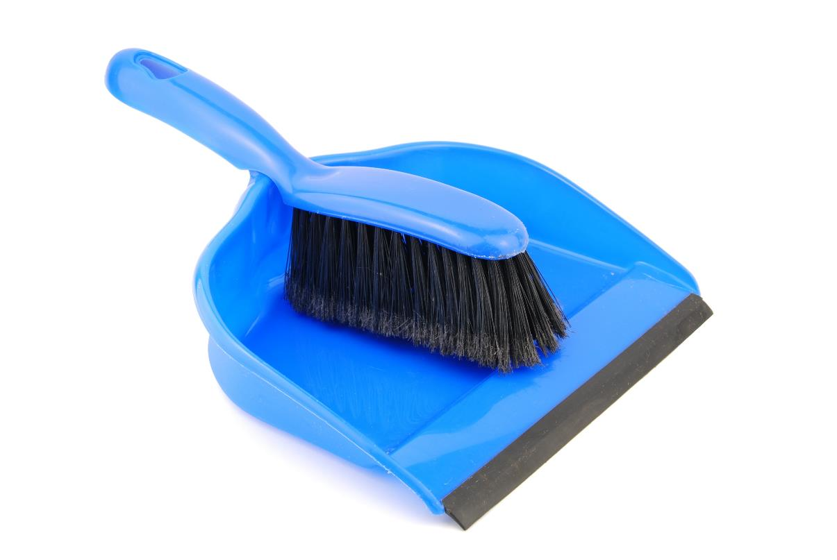
Clean Up
Notes:
Clean Up Pointers
Everything built in this session should be taken apart and returned to storage.
Fold the mat and store it in a place where it won’t get damaged.
You may wish to play a video or song during clean up time Link on
GoNoodle: https://family.gonoodle.com/activities/clean-up
Link on YouTube Kids: https://www.youtubekids.com/watch?v=ZJFk87ZsHn0
Link on Youtube: https://youtu.be/ZJFk87ZsHn0

Slide 13
LEGO, the LEGO logo, and the SPIKE logo are trademarks of the/sont des marques de commerce du/son marcas registradas de LEGO Group. © 2024 The LEGO Group. All rights reserved/Tous droits réservés/Todos los derechos reservados. FIRST®, the FIRST® logo, and FIRST® DIVESM are trademarks of For Inspiration and Recognition of Science and Technology (FIRST). LEGO® is a registered trademark of the LEGO Group. FIRST® LEGO® League and SUBMERGEDSM are jointly held trademarks of FIRST and the LEGO Group.© 2024 FIRST and the LEGO Group. All rights reserved.

