Slide 1
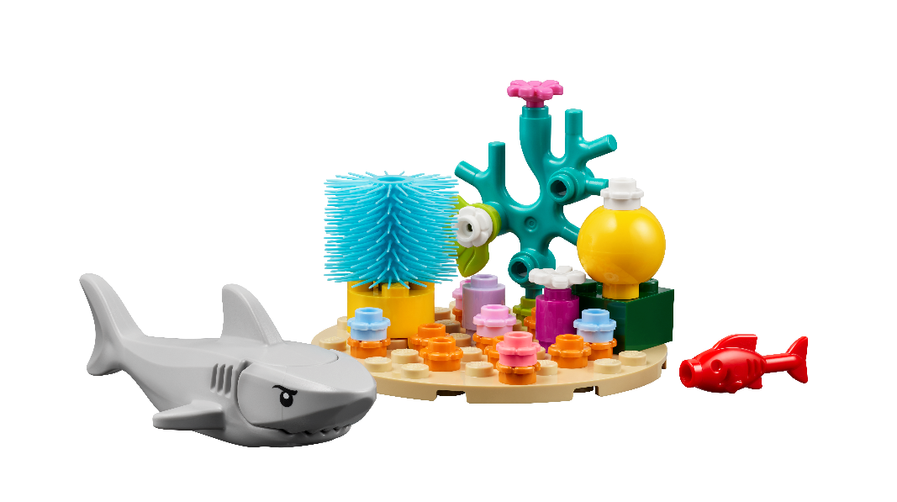
Session 2
Ocean Layers

Slide 2
Guiding Questions
How do we explore the sunlight zone?
What do you think lives in the deepest parts of the ocean?
Outcomes
The team will build the sunlight, twilight, and abyssal zone models.
The team will learn about ocean layers and what makes each environment unique.
Can you name other animals that live in the sunlight zone?
What is challenging about exploring the deepest parts of the ocean?
What is different about animals that live in darker parts of the ocean?
How do humans explore the ocean and what do they need to do it?
Notes:
Each session has Guiding Questions that can be shared to frame the session.
Session Tips
Have the children work in pairs to build the models. They should talk about what they are building.
The mat lines up with the back of the Explore set box to make a larger image of the ocean layers.
Lead a discussion about the ocean layers, allowing the children to ask questions.
Some abyssal animals have unique adaptations and may be frightening to some children.
The team can look at the mat or Explore story to learn more or generate ideas.
The team could talk about each model they built and where it exists in the oceans.
Extension
Identify books or movies that relate to the ocean theme.
Explore other living things found in different ocean layers.

Slide 3
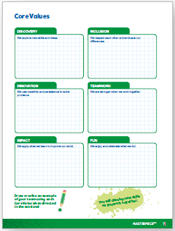
Introduction – Go Team
Examples of Teamwork
Ask the students to provide examples of Teamwork and record them here
Example of Teamwork
Example of Teamwork
We found we were stronger when we worked together.
Extension
Notes:
Introduction - Go Team (5-10 minutes)
Read the definition for teamwork to the team. (see TMG page 5)
Talk about what teamwork is. Have the team provide examples of this Core Value.
Extension: Have everyone draw a scientists using teamwork on the Core Values page in their Engineering Notebook.

Slide 4
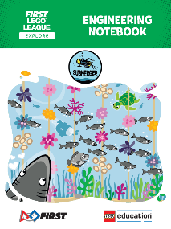
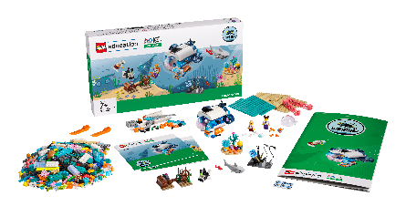
Activity 1
You need…
Build the coral reef and shark models using the pieces in Bag 4. Place them on the mat.
These living things are found in the sunlight zone of the ocean.
Notes:
Activity 1 Tasks Sunlight Zone
Build the coral reef and shark models using the pieces in Bag 4. Place them on the mat.
These living things are found in the sunlight zone of the ocean.
Twilight Zone
Build the sunken treasure and anglerfish models using the pieces in Bag 5. Place them on the mat.
These things can be found in the twilight zone of the ocean.
Challenge
Learn about the sunlight and twilight zone in the ocean. What makes them different?
Session Tips
Have the children work in pairs to build the models. They should talk about what they are building.
The mat lines up with the back of the Explore set box to make a larger image of the ocean layers.
Lead a discussion about the ocean layers, allowing the children to ask questions.

Slide 5
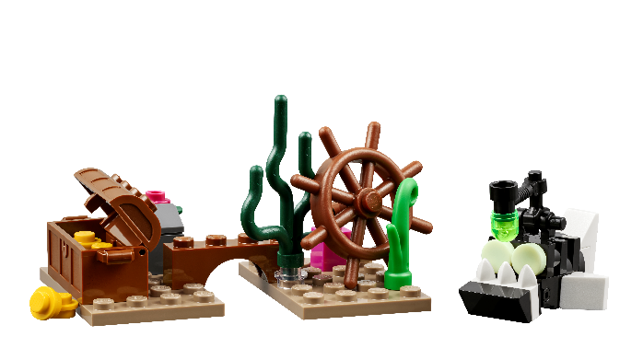
Activity 1
You need…
Build the sunken treasure and anglerfish models using the pieces in Bag 5. Place them on the mat.
These things can be found in the twilight zone of the ocean.
Learn about the sunlight and twilight zone in the ocean. What makes them different?
Notes:
Activity 1 Tasks Sunlight Zone
Build the coral reef and shark models using the pieces in Bag 4. Place them on the mat.
These living things are found in the sunlight zone of the ocean.
Twilight Zone
Build the sunken treasure and anglerfish models using the pieces in Bag 5. Place them on the mat.
These things can be found in the twilight zone of the ocean.
Challenge
Learn about the sunlight and twilight zone in the ocean. What makes them different?
Session Tips
Have the children work in pairs to build the models. They should talk about what they are building.
The mat lines up with the back of the Explore set box to make a larger image of the ocean layers.
Lead a discussion about the ocean layers, allowing the children to ask questions.

Slide 6
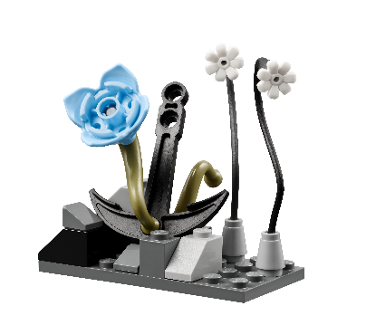
Activity 2
You need…
Build the two abyss models in Bag 6. Place them on the mat.
These things can be found in the abyssal zone of the ocean.
Learn about the abyssal zone. What does ocean life look like in this extreme environment?
Notes:
Activity 2 Tasks
Build the two abyss models in Bag 6. Place them on the mat.
These things can be found in the abyssal zone of the ocean.
Learn about the abyssal zone. What does ocean life look like in this extreme environment?
Challenge
Label the picture of the mat to show the different layers.
Share what you learned about the ocean layers.
Session Tips
Some abyssal animals have unique adaptations and may be frightening to some children.
The team can look at the mat or Explore story to learn more or generate ideas.
The team could talk about each model they built and where it exists in the oceans.

Slide 7
Activity 2
You need…
Learn about the abyssal zone. What does ocean life look like in this extreme environment?
Notes:
Activity 2 Tasks
Build the two abyss models in Bag 6. Place them on the mat.
These things can be found in the abyssal zone of the ocean.
Learn about the abyssal zone. What does ocean life look like in this extreme environment?
Challenge
Label the picture of the mat to show the different layers.
Share what you learned about the ocean layers.
Session Tips
Some abyssal animals have unique adaptations and may be frightening to some children.
The team can look at the mat or Explore story to learn more or generate ideas.
The team could talk about each model they built and where it exists in the oceans.

Slide 8
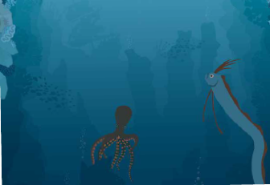
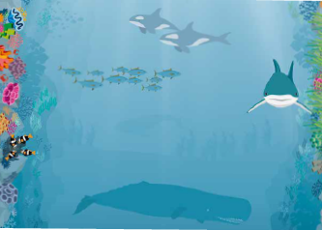
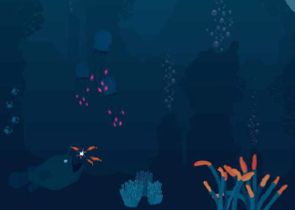
Activity 2 – Challenge
Label the picture of the mat to show the different layers.
Notes:
Activity 2 Tasks
Build the two abyss models in Bag 6. Place them on the mat.
These things can be found in the abyssal zone of the ocean.
Learn about the abyssal zone. What does ocean life look like in this extreme environment?
Challenge
Label the picture of the mat to show the different layers.
Share what you learned about the ocean layers.
Session Tips
Some abyssal animals have unique adaptations and may be frightening to some children.
The team can look at the mat or Explore story to learn more or generate ideas.
The team could talk about each model they built and where it exists in the oceans.

Slide 9
Activity 2 – Challenge
Share what you learned about the ocean layers.
Notes:
Activity 2 Tasks
Build the two abyss models in Bag 6. Place them on the mat.
These things can be found in the abyssal zone of the ocean.
Learn about the abyssal zone. What does ocean life look like in this extreme environment?
Challenge
Label the picture of the mat to show the different layers.
Share what you learned about the ocean layers.
Session Tips
Some abyssal animals have unique adaptations and may be frightening to some children.
The team can look at the mat or Explore story to learn more or generate ideas.
The team could talk about each model they built and where it exists in the oceans.

Slide 10
Share
Share what they did in the session.
Talk about the different models and where they belong on the mat.
Share what they learned about each ocean layer.
What have you discovered? Share with your team!
Notes:
Share (10 minutes)
Have the team:
Share what they did in the session.
Talk about the different models and where they belong on the mat.
Share what they learned about each ocean layer.

Slide 11
Optional Video:
You may wish to embed a relevant, age-appropriate video for your students here. See the Notes for an example.
Notes:
Choose a relevant, age-appropriate video for your students.

Slide 12
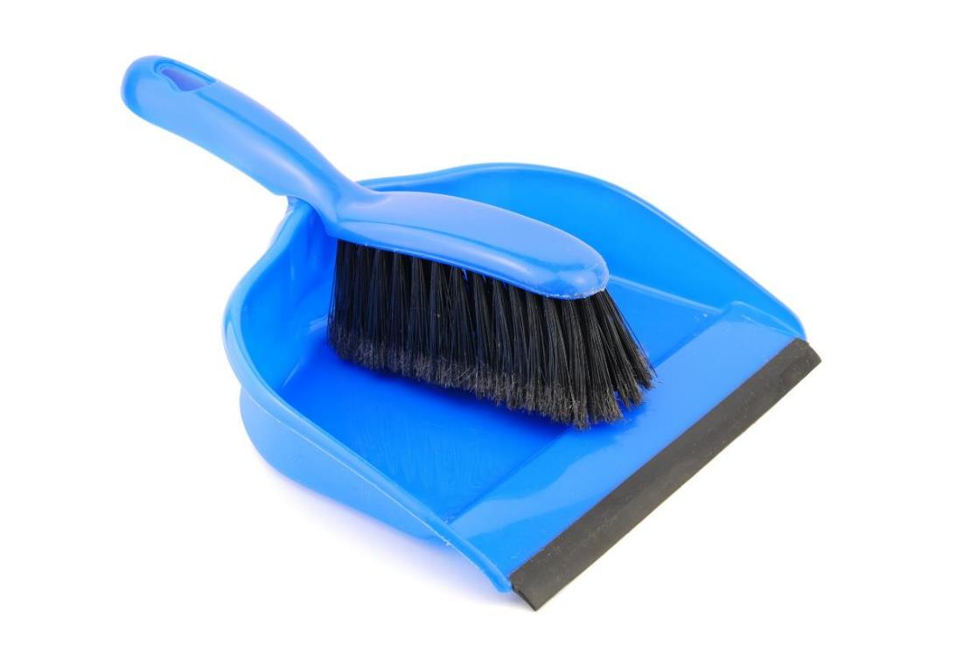
Clean Up
Notes:
Clean Up Pointers
Fold the mat and store it in a place where it won’t get damaged.
Models used in this session should stay assembled.
You may wish to play a video or song during clean up time Link on
GoNoodle: https://family.gonoodle.com/activities/clean-up
Link on YouTube Kids: https://www.youtubekids.com/watch?v=ZJFk87ZsHn0
Link on Youtube: https://youtu.be/ZJFk87ZsHn0

Slide 13
LEGO, the LEGO logo, and the SPIKE logo are trademarks of the/sont des marques de commerce du/son marcas registradas de LEGO Group. © 2024 The LEGO Group. All rights reserved/Tous droits réservés/Todos los derechos reservados. FIRST®, the FIRST® logo, and FIRST® DIVESM are trademarks of For Inspiration and Recognition of Science and Technology (FIRST). LEGO® is a registered trademark of the LEGO Group. FIRST® LEGO® League and SUBMERGEDSM are jointly held trademarks of FIRST and the LEGO Group.© 2024 FIRST and the LEGO Group. All rights reserved.

