Slide 1
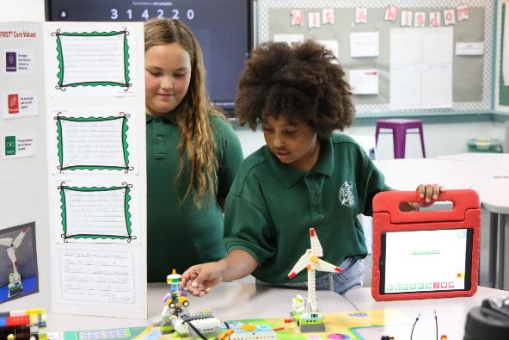
Session 12
Prepare for Event

Slide 2
Guiding Questions
Can you explain the code you created for your motorized part?
How will you present your poster and model at the event?
Outcomes
The team will reflect on their SUBMERGEDSM experience.
The team will create a plan for what to share at their final event.
How does your team model relate to the SUBMERGEDSM theme?
How do you show Core Values?
Can you share about your team’s journey?
What does your team need for the event?
Notes:
Each session has Guiding Questions that can be shared to frame the session.
Session Tips
Go over the reviewing sheet and reviewing questions with your team.
Ask the team the reviewing questions and practice the responses they would give the reviewers.
A festival is a critical part of the FIRST® LEGO® League Explore experience. If you are unable to attend an official one, plan a celebration of your own. Class Pack teachers can use the Class Pack Guide.
The team doesn’t need to answer every question on this page. These are meant to help the team feel ready for the event.
You could have the team practice their presentation by presenting to others before their event.
Your team could register for an Explore festival or you can run your own. Whatever you decide, be sure to celebrate what the children have learned and accomplished during their Explore experience.

Slide 3
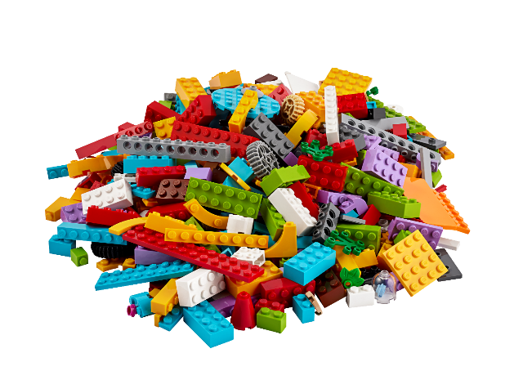
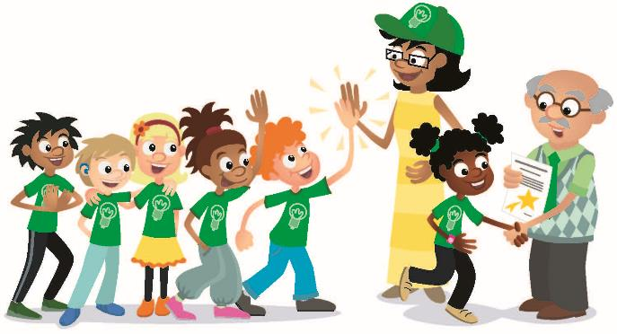
Introduction – Impact Build
Examples of Impact
Ask the students to provide examples of Impact and record them here
Example of Impact
Example of Impact
We applied what we learned to improve our world.
Notes:
• Have the team provide examples of how they have had an impact throughout the sessions.
• Have the team create a build from the prototyping pieces representing this Core Value or examples of how the team has had an impact.

Slide 4
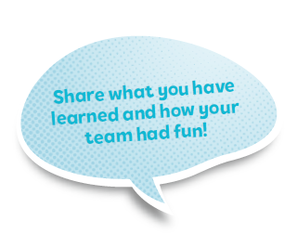
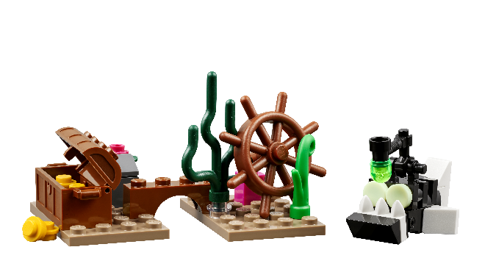
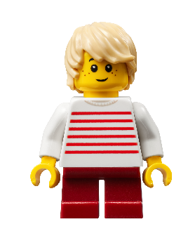
Tasks
Gather your completed team model and team poster.
Notes:
Tasks (40 minutes)
Gather your completed team model and team poster.
Talk about what your team would like to share at your event!
Complete the next page to prepare for your event.
Look over the reviewing sheet with your coach.
Practice your presentation.
Communicate what you have learned with others.
Session Tips
Go over the reviewing sheet and reviewing questions with your team.
Ask the team the reviewing questions and practice the responses they would give the reviewers.
A festival is a critical part of the FIRST® LEGO® League Explore experience. If you are unable to attend an official one, plan a celebration of your own. Class Pack teachers can use the Class Pack Guide.
The team doesn’t need to answer every question on this page. These are meant to help the team feel ready for the event.
You could have the team practice their presentation by presenting to others before their event.
Your team could register for an Explore festival or you can run your own. Whatever you decide, be sure to celebrate what the children have learned and accomplished during their Explore experience.

Slide 5
Tasks
Talk about what your team would like to share at your event!
Notes:
Tasks (40 minutes)
Gather your completed team model and team poster.
Talk about what your team would like to share at your event!
Complete the next page to prepare for your event.
Look over the reviewing sheet with your coach.
Practice your presentation.
Communicate what you have learned with others.
Session Tips
Go over the reviewing sheet and reviewing questions with your team.
Ask the team the reviewing questions and practice the responses they would give the reviewers.
A festival is a critical part of the FIRST® LEGO® League Explore experience. If you are unable to attend an official one, plan a celebration of your own. Class Pack teachers can use the Class Pack Guide.
The team doesn’t need to answer every question on this page. These are meant to help the team feel ready for the event.
You could have the team practice their presentation by presenting to others before their event.
Your team could register for an Explore festival or you can run your own. Whatever you decide, be sure to celebrate what the children have learned and accomplished during their Explore experience.

Slide 6
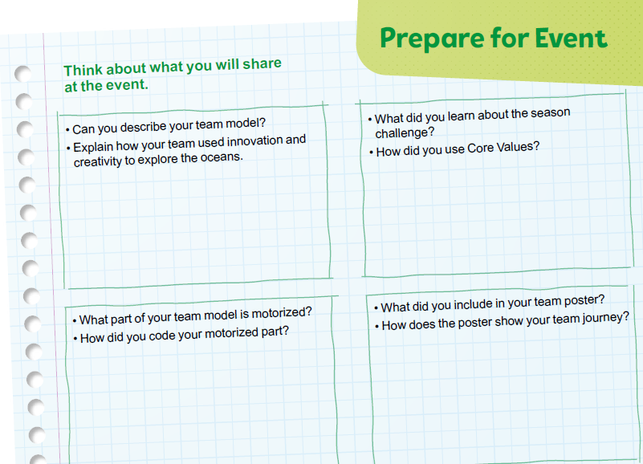
Tasks
Complete page 29 in Engineering Notebook to prepare for your event.
Notes:
Tasks (40 minutes)
Gather your completed team model and team poster.
Talk about what your team would like to share at your event!
Complete the next page to prepare for your event.
Look over the reviewing sheet with your coach.
Practice your presentation.
Communicate what you have learned with others.
Session Tips
Go over the reviewing sheet and reviewing questions with your team.
Ask the team the reviewing questions and practice the responses they would give the reviewers.
A festival is a critical part of the FIRST® LEGO® League Explore experience. If you are unable to attend an official one, plan a celebration of your own. Class Pack teachers can use the Class Pack Guide.
The team doesn’t need to answer every question on this page. These are meant to help the team feel ready for the event.
You could have the team practice their presentation by presenting to others before their event.
Your team could register for an Explore festival or you can run your own. Whatever you decide, be sure to celebrate what the children have learned and accomplished during their Explore experience.

Slide 7
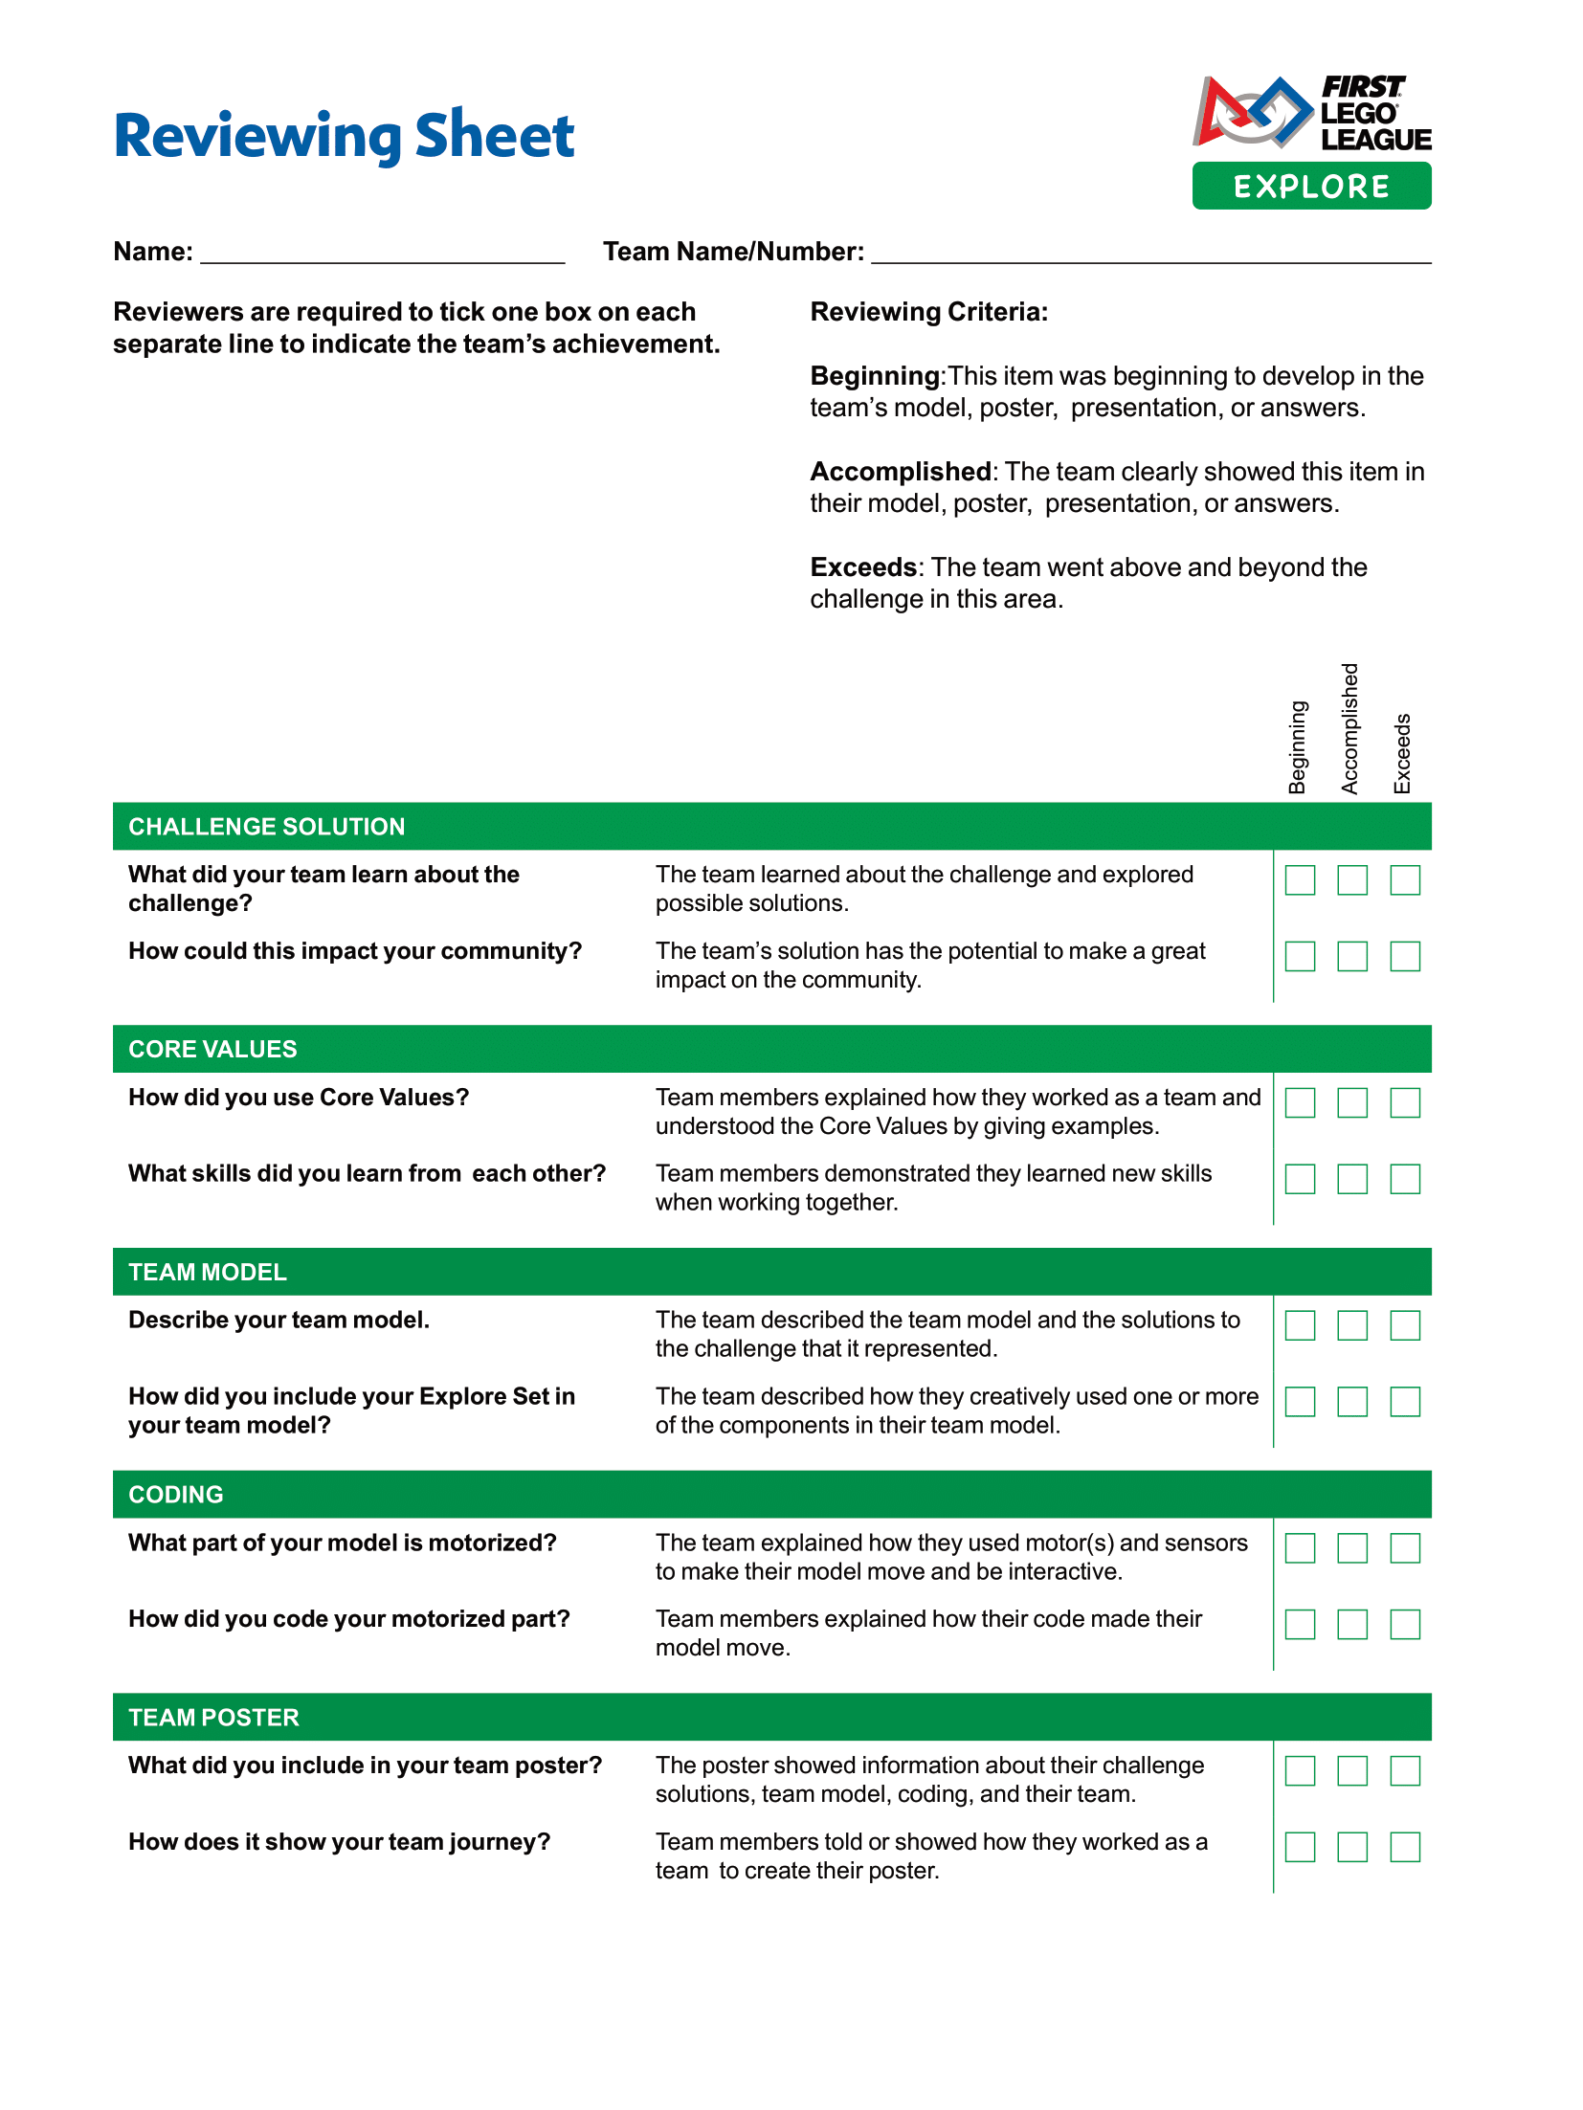
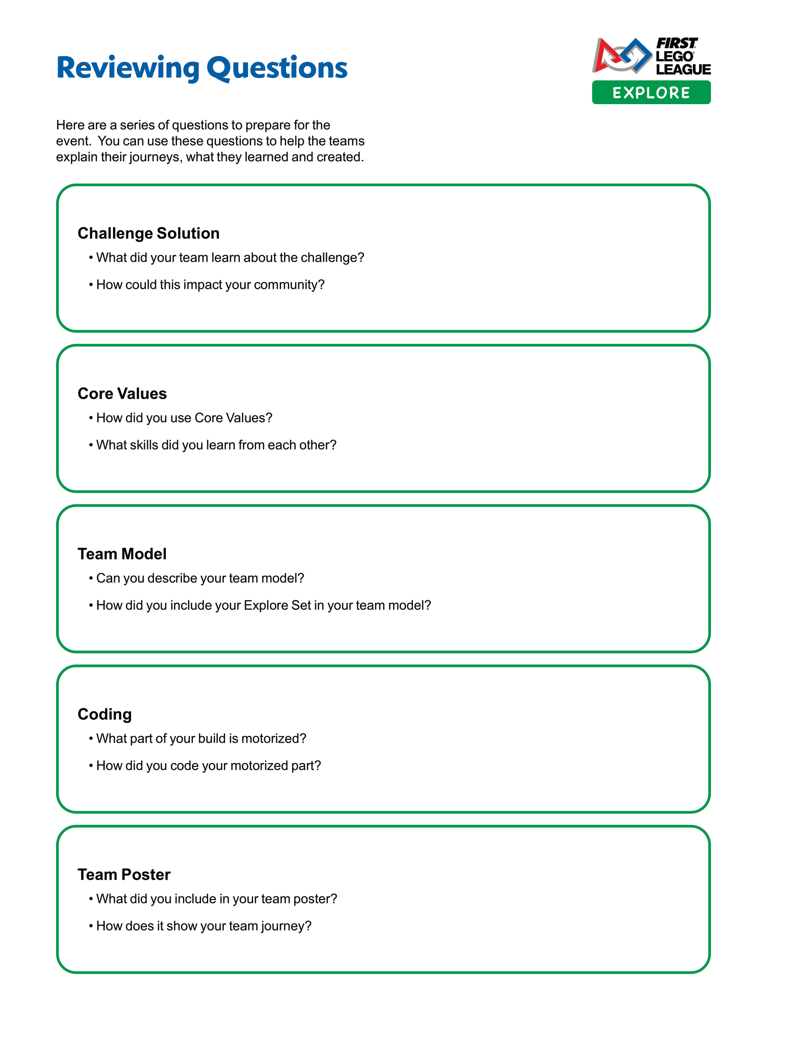
Tasks
Look over the reviewing sheet with your coach.
Notes:
Tasks (40 minutes)
Gather your completed team model and team poster.
Talk about what your team would like to share at your event!
Complete the next page to prepare for your event.
Look over the reviewing sheet with your coach.
Practice your presentation.
Communicate what you have learned with others.
Session Tips
Go over the reviewing sheet and reviewing questions with your team.
Ask the team the reviewing questions and practice the responses they would give the reviewers.
A festival is a critical part of the FIRST® LEGO® League Explore experience. If you are unable to attend an official one, plan a celebration of your own. Class Pack teachers can use the Class Pack Guide.
The team doesn’t need to answer every question on this page. These are meant to help the team feel ready for the event.
You could have the team practice their presentation by presenting to others before their event.
Your team could register for an Explore festival or you can run your own. Whatever you decide, be sure to celebrate what the children have learned and accomplished during their Explore experience.

Slide 8
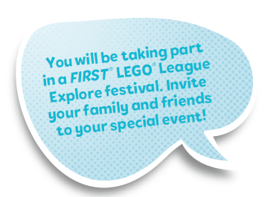
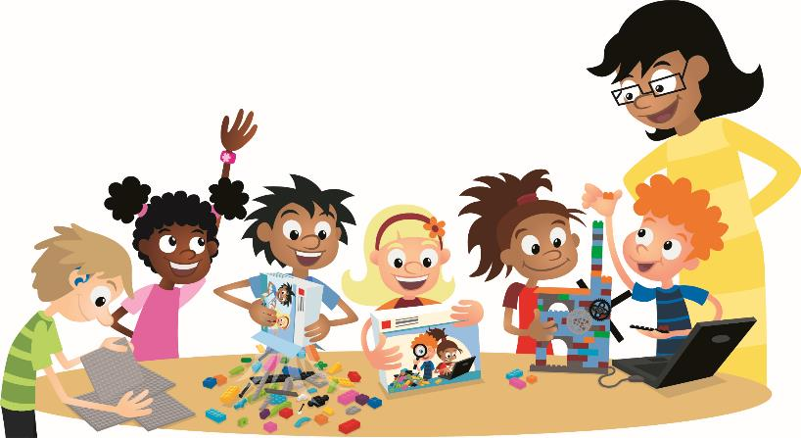
Tasks
Practice your presentation.
Notes:
Tasks (40 minutes)
Gather your completed team model and team poster.
Talk about what your team would like to share at your event!
Complete the next page to prepare for your event.
Look over the reviewing sheet with your coach.
Practice your presentation.
Communicate what you have learned with others.
Session Tips
Go over the reviewing sheet and reviewing questions with your team.
Ask the team the reviewing questions and practice the responses they would give the reviewers.
A festival is a critical part of the FIRST® LEGO® League Explore experience. If you are unable to attend an official one, plan a celebration of your own. Class Pack teachers can use the Class Pack Guide.
The team doesn’t need to answer every question on this page. These are meant to help the team feel ready for the event.
You could have the team practice their presentation by presenting to others before their event.
Your team could register for an Explore festival or you can run your own. Whatever you decide, be sure to celebrate what the children have learned and accomplished during their Explore experience.

Slide 9
Share
Practice your team poster presentation.
Practice your team model presentation.
Notes:
Share (10 minutes)
Have the team:
Practice their team poster presentation.
Practice their team model presentation.

Slide 10
Optional Video:
You may wish to embed a relevant, age-appropriate video for your students here. See the Notes for an example.
Notes:
Choose a relevant, age-appropriate video for your students.
Here is one example from the IET in the United Kingdom on how to prepare for your festival: https://youtu.be/sWHGL7RcYrM

Slide 11
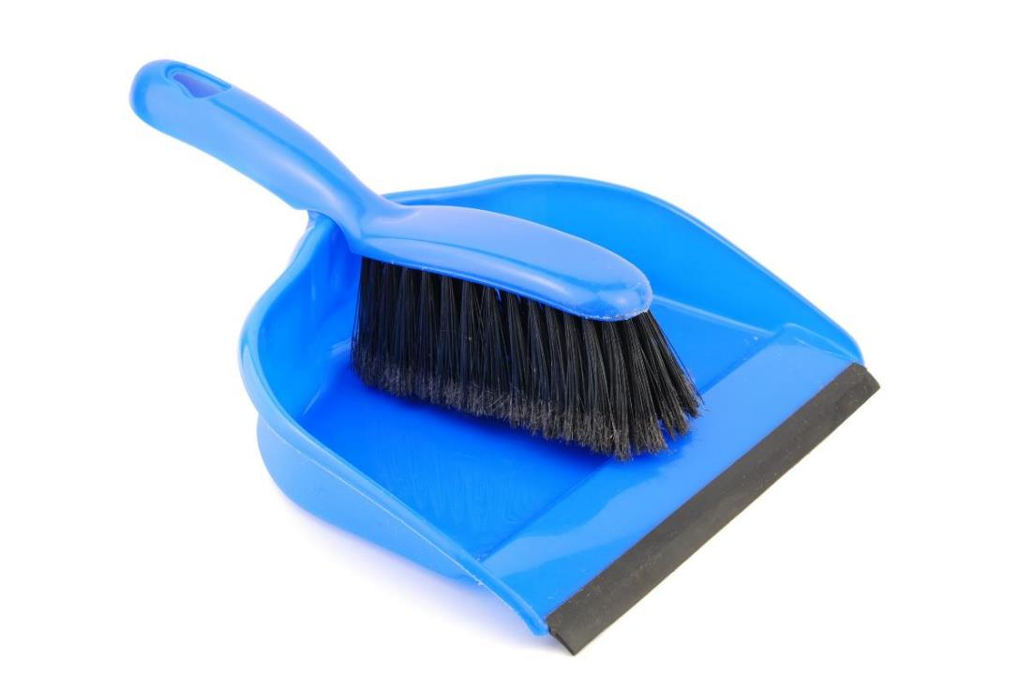
Clean Up
Notes:
Clean Up Pointers
Make sure the team model and team poster are stored and ready to be transported to the event.
Check that you have the device, charging cord, and fully charged battery for the event.
You may wish to play a video or song during clean up time Link on
GoNoodle: https://family.gonoodle.com/activities/clean-up
Link on YouTube Kids: https://www.youtubekids.com/watch?v=ZJFk87ZsHn0
Link on Youtube: https://youtu.be/ZJFk87ZsHn0

Slide 12
LEGO, the LEGO logo, and the SPIKE logo are trademarks of the/sont des marques de commerce du/son marcas registradas de LEGO Group. © 2024 The LEGO Group. All rights reserved/Tous droits réservés/Todos los derechos reservados. FIRST®, the FIRST® logo, and FIRST® DIVESM are trademarks of For Inspiration and Recognition of Science and Technology (FIRST). LEGO® is a registered trademark of the LEGO Group. FIRST® LEGO® League and SUBMERGEDSM are jointly held trademarks of FIRST and the LEGO Group.© 2024 FIRST and the LEGO Group. All rights reserved.

