Slide 1
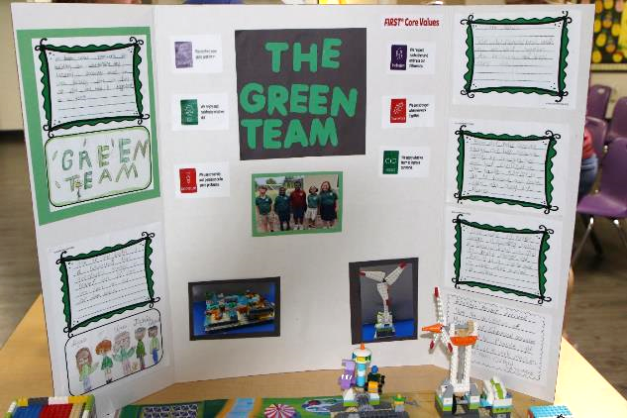
Sessions 10&11
Team Poster

Slide 2
Guiding Questions
What different topics did you explore?
What did you create and build?
Outcomes
The team will create a plan for what they will include on their team poster.
The team will design and create their team poster.
How can you share information about the creature you
discovered?
How can you show your team journey on the poster?
What will you include on your team poster?
How will each person on the team share about the poster?
Notes:
Each session has Guiding Questions that can be shared to frame the session.
Session Tips
You will need to provide a large poster board and various art supplies. A trifold poster board works well.
The goal is for the team to create the poster themselves. You can support them and provide insight.
The team can look back at the Team Journey and Core Values pages in their Engineering Notebooks.
Sample topics for the poster are provided for the students.
They can choose to include whatever they want!
Provide extra scrap paper for the team to draw and write their ideas for their team poster.
Two boxes would fit on each fold on a trifold poster board.
Extension
Look back at the Explore story and extension suggestions to further explore the season theme.
The Multimedia Resources also have additional activities you could do with your team.

Slide 3
Introduction – Innovation Build
Session 10
Examples of Innovation
Ask the students to provide examples of Innovation and record them here
Example of Innovation
Example of Innovation
We used creativity and persistence to solve problems.
Notes:
***Skip this slide during session 11***
Introduction - Innovation and Inclusion Builds (10 minutes)
Have the team provide examples of how they have used innovation (Session 10) and inclusion (Session 11) throughout the sessions.
Have the team create a build from the prototyping pieces representing this Core Value or examples of the team using innovation and inclusion.
Extension
• Look back at the extensions in Sessions 1-4 to further explore the season theme.
• The Multimedia Resources also have additional activities you could do with your team.

Slide 4
Introduction – Inclusion Build
Session 11
Examples of Inclusion
Ask the students to provide examples of Inclusion and record them here
Example of Inclusion
Example of Inclusion
We respected each other and embraced our differences.
Notes:
***Skip this slide during session 10***
Introduction - Innovation and Inclusion Builds (10 minutes)
Have the team provide examples of how they have used innovation (Session 10) and inclusion (Session 11) throughout the sessions.
Have the team create a build from the prototyping pieces representing this Core Value or examples of the team using innovation and inclusion.
Extension
• Look back at the extensions in Sessions 1-4 to further explore the season theme.
• The Multimedia Resources also have additional activities you could do with your team.

Slide 5
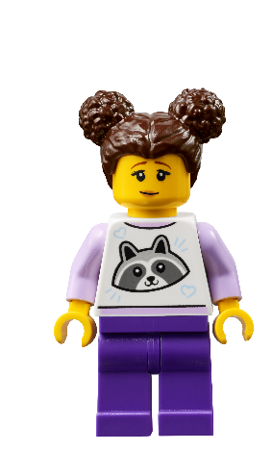
Tasks
You need…
Notes:
Tasks (100 minutes)
Find your poster board and art supplies. Brainstorm what to put on your poster. Use the next page as a draft for your ideas. Work together to create your team poster. Teamwork! You can use words, drawings, and photos on your poster.
Session Tips
You will need to provide a large poster board and various art supplies. A trifold poster board works well.
The goal is for the team to create the poster themselves. You can support them and provide insight.
The team can look back at the Team Journey and Core Values pages in their Engineering Notebooks.
Sample topics for the poster are provided for the students.
They can choose to include whatever they want!
Provide extra scrap paper for the team to draw and write their ideas for their team poster.
Two boxes would fit on each fold on a trifold poster board.
Extension
Look back at the Explore story and extension suggestions to further explore the season theme.
The Multimedia Resources also have additional activities you could do with your team.

Slide 6
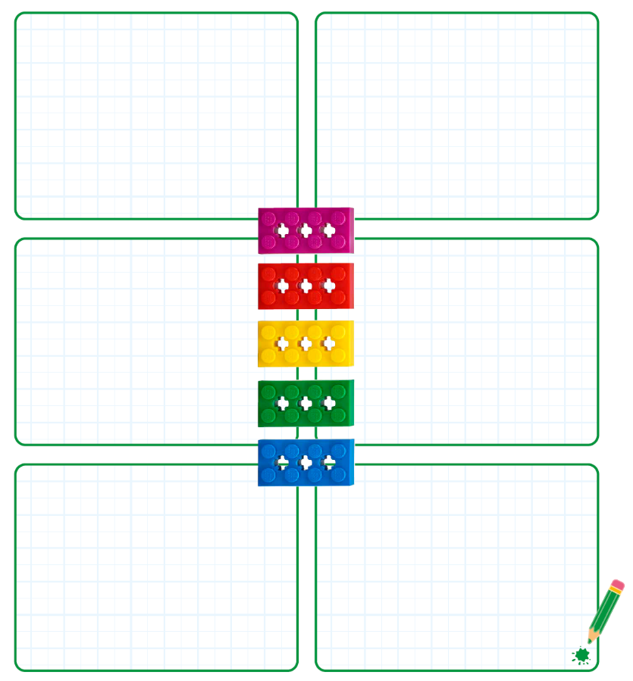
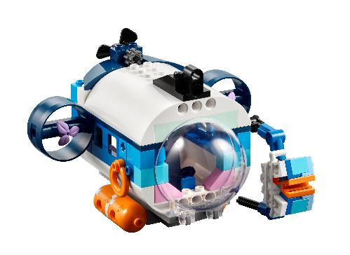
Tasks
Find your poster board and art supplies.
Brainstorm what to put on your poster.
Use the next page as a draft for your ideas.
Notes:
Tasks (100 minutes)
Find your poster board and art supplies. Brainstorm what to put on your poster. Use the next page as a draft for your ideas. Work together to create your team poster. Teamwork! You can use words, drawings, and photos on your poster.
Session Tips
You will need to provide a large poster board and various art supplies. A trifold poster board works well.
The goal is for the team to create the poster themselves. You can support them and provide insight.
The team can look back at the Team Journey and Core Values pages in their Engineering Notebooks.
Sample topics for the poster are provided for the students.
They can choose to include whatever they want!
Provide extra scrap paper for the team to draw and write their ideas for their team poster.
Two boxes would fit on each fold on a trifold poster board.
Extension
Look back at the Explore story and extension suggestions to further explore the season theme.
The Multimedia Resources also have additional activities you could do with your team.

Slide 7
Tasks
Work together to create your team poster. Teamwork!
You can use words, drawings, and photos on your poster.
Notes:
Tasks (100 minutes)
Find your poster board and art supplies. Brainstorm what to put on your poster. Use the next page as a draft for your ideas. Work together to create your team poster. Teamwork! You can use words, drawings, and photos on your poster.
Session Tips
You will need to provide a large poster board and various art supplies. A trifold poster board works well.
The goal is for the team to create the poster themselves. You can support them and provide insight.
The team can look back at the Team Journey and Core Values pages in their Engineering Notebooks.
Sample topics for the poster are provided for the students.
They can choose to include whatever they want!
Provide extra scrap paper for the team to draw and write their ideas for their team poster.
Two boxes would fit on each fold on a trifold poster board.
Extension
Look back at the Explore story and extension suggestions to further explore the season theme.
The Multimedia Resources also have additional activities you could do with your team.

Slide 8
Share
Share what you did in each session.
Show your team poster design.
Explain your team journey.
Demonstrate how you will present your team poster.
What have you discovered? Share with your team!
Notes:
Share (10 minutes)
Have the team:
Share what they did at the end of each session.
Show their team poster design.
Explain their team journey.
Demonstrate how they will present their team poster.

Slide 9
Optional Video:
You may wish to embed a relevant, age-appropriate video for your students here. See the Notes for an example.
Notes:
Choose a relevant, age-appropriate video for your students.
Here is one example from FIRST® LEGO® League on the poster: https://www.youtube.com/watch?v=FnOLUKoK9vY

Slide 10
Clean Up
Notes:
Clean Up Pointers
Make sure you have a safe place to store the poster, especially if it needs to lay open to dry.
You may need extra time at the end of each session to clean up the art supplies.
You may wish to play a video or song during clean up time Link on
GoNoodle: https://family.gonoodle.com/activities/clean-up
Link on YouTube Kids: https://www.youtubekids.com/watch?v=ZJFk87ZsHn0
Link on Youtube: https://youtu.be/ZJFk87ZsHn0

Slide 11
LEGO, the LEGO logo, and the SPIKE logo are trademarks of the/sont des marques de commerce du/son marcas registradas de LEGO Group. © 2024 The LEGO Group. All rights reserved/Tous droits réservés/Todos los derechos reservados. FIRST®, the FIRST® logo, and FIRST® DIVESM are trademarks of For Inspiration and Recognition of Science and Technology (FIRST). LEGO® is a registered trademark of the LEGO Group. FIRST® LEGO® League and SUBMERGEDSM are jointly held trademarks of FIRST and the LEGO Group.© 2024 FIRST and the LEGO Group. All rights reserved.

