Slide 1
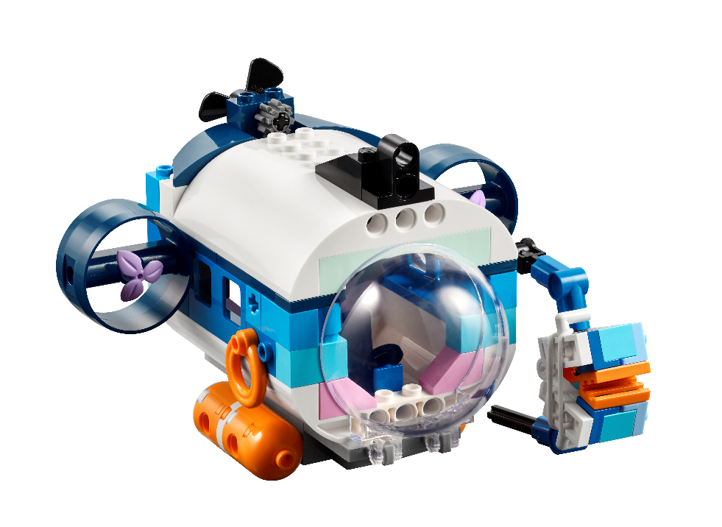



Session 1
Dive In!

Slide 2
Guiding Questions
What did the Explore story make you think about?
What plants and animals live in the ocean?
Outcomes
The team will use discovery to explore the SUBMERGEDSM theme and share what they know about the oceans.
The team will build different things found in the ocean and the submarine from the Explore set.
How do people explore the oceans?
What is a submarine used for?
What can a submarine do that a diver cannot do?
What kinds of animals would you want to discover in the ocean?
Notes:
Each session has Guiding Questions that can be shared to frame the session.
Session Tips
Check out the Multimedia Resources for more resources you can use with your team.
You will find various sessions reference different ocean jobs. These jobs are listed on the Career Connections pages in the Engineering Notebook.
Writing and drawing space is provided throughout the notebook for each child to capture their thoughts and ideas.
Children can set goals and share their progress in their Engineering Notebook.
Give the team the LEGO® prototyping pieces (bags labeled 7 to 11) to create their designs.
At the end of each session, children should share what they have accomplished.
Extension
Have the team research ocean discoveries and learn about the technology that was used.
Do a show and tell activity with the team.

Slide 3


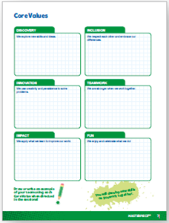
Introduction – Let’s Discover
Examples of Discovery
Ask the students to provide examples of Discovery and record them here
Example of Discovery
Example of Discovery
We explored new skills and ideas.
Extension
Notes:
Introduction - Let’s Discover (5-10 minutes)
• Read the definition for discovery to the team. (see TMG page 5)
• Talk about what discovery is. Have the team provide examples of this Core Value.
• Extension: Have everyone draw a picture of an example of discovery on the Core Values page in their Engineering Notebook.

Slide 4

SUBMERGEDSM
Visit the
FIRST® LEGO ® League
YouTube Channel
to watch the
SUBMERGEDSM Season Launch Video
Notes:
If you have already watched the season launch video in the introductory slides, you may choose to skip it here.

Slide 5
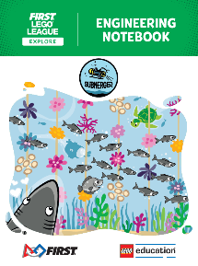
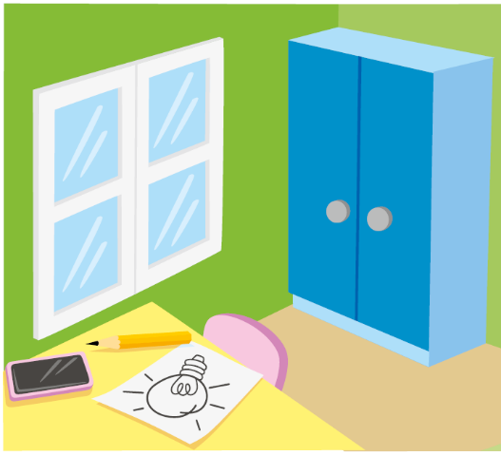
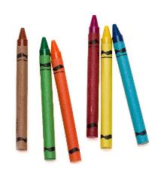
Activity 1 – Explore Season Theme
You need…
Read the Explore story and explore the SUBMERGEDSM theme.
Talk about what you know about the oceans with your teammates.
Notes:
Activity 1 Tasks – Explore Season Theme
Read the Explore story and explore the SUBMERGEDSM theme.
Talk about what you know about the oceans with your teammates.
Think about how you use art or creativity in your hobbies or interests.
List your questions about the oceans in the box provided in the Engineering Notebook.
Session Tips
Check out the Multimedia Resources for more resources you can use with your team.
You will find various sessions reference different ocean jobs. These jobs are listed on the Career Connections pages in the Engineering Notebook.
Writing and drawing space is provided throughout the notebook for each child to capture their thoughts and ideas.

Slide 6
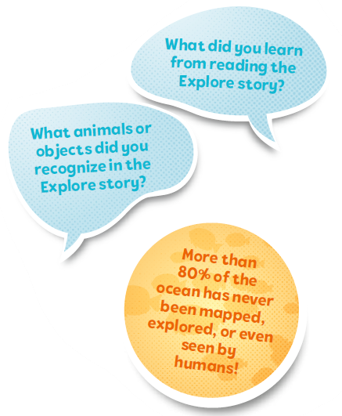
Activity 1
There are many ocean mysteries left to explore. Think about what part of the oceans you and your teammates would want to explore and hope to discover.
List your questions about the ocean below.
Notes:
Activity 1 Tasks – Explore Season Theme
Read the Explore story and explore the SUBMERGEDSM theme.
Talk about what you know about the oceans with your teammates.
Think about how you use art or creativity in your hobbies or interests.
List your questions about the oceans in the box provided in the Engineering Notebook.
Session Tips
Check out the Multimedia Resources for more resources you can use with your team.
You will find various sessions reference different ocean jobs. These jobs are listed on the Career Connections pages in the Engineering Notebook.
Writing and drawing space is provided throughout the notebook for each child to capture their thoughts and ideas.

Slide 7
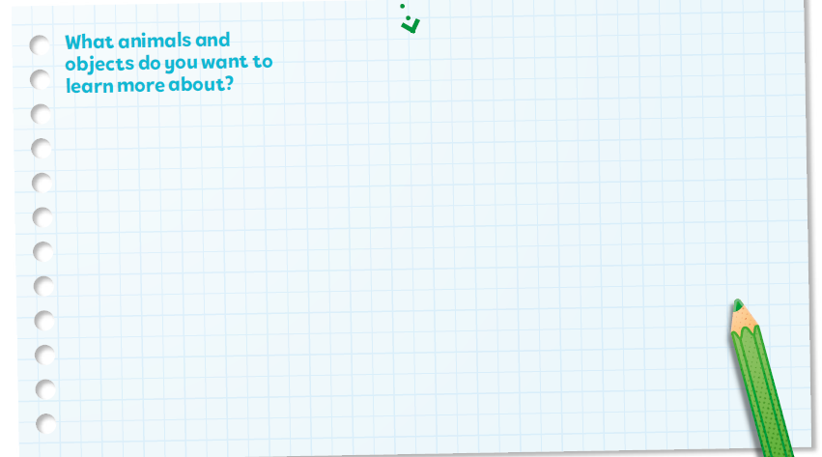
Activity 1
What animals and objects do you want to learn more about?
Notes:
Activity 1 Tasks – Explore Season Theme
Read the Explore story and explore the SUBMERGEDSM theme.
Talk about what you know about the oceans with your teammates.
Think about how you use art or creativity in your hobbies or interests.
List your questions about the oceans in the box provided in the Engineering Notebook.
Session Tips
Check out the Multimedia Resources for more resources you can use with your team.
You will find various sessions reference different ocean jobs. These jobs are listed on the Career Connections pages in the Engineering Notebook.
Writing and drawing space is provided throughout the notebook for each child to capture their thoughts and ideas.

Slide 8

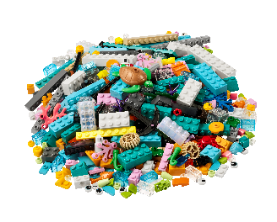
Activity 2
Build the submarine from the Explore set using Bags 1 and 2.
Talk about the different parts of the submarine and what they might be used for.
You need…
Notes:
Activity 2 Tasks –
Build the submarine from the Explore set using Bags 1 and 2.
Talk about the different parts of the submarine and what they might be used for.
Think of something your submarine might discover in the ocean.
Use the space below to draw your ideas.
Challenge
Use the prototyping pieces to build animals, plants, or unknown object that your team wants to learn about.
Share your ideas.

Slide 9

Activity 2
Challenge
Think of something your submarine might discover in the ocean.
Use the prototyping pieces to build animals, plants, or unknown object that your team wants to learn about.
Notes:
Activity 2 Tasks –
Build the submarine from the Explore set using Bags 1 and 2.
Talk about the different parts of the submarine and what they might be used for.
Think of something your submarine might discover in the ocean.
Use the space below to draw your ideas.
Challenge
Use the prototyping pieces to build animals, plants, or unknown object that your team wants to learn about.
Share your ideas.

Slide 10
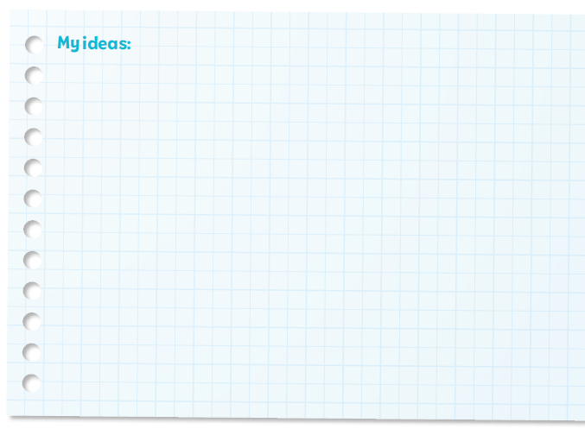
Activity 2
Share your ideas.
Notes:
Activity 2 Tasks –
Build the submarine from the Explore set using Bags 1 and 2.
Talk about the different parts of the submarine and what they might be used for.
Think of something your submarine might discover in the ocean.
Use the space below to draw your ideas.
Challenge
Use the prototyping pieces to build animals, plants, or unknown object that your team wants to learn about.
Share your ideas.

Slide 11

Share
What have you discovered? Share with your team!
Share what you did in the session.
Talk about the submarine.
Show what you want to learn about the oceans.
Notes:
Share (10 -15 minutes)
Have the team:
• Share what you did in the session.
Talk about the submarine.
Show what you want to learn about the oceans.

Slide 12
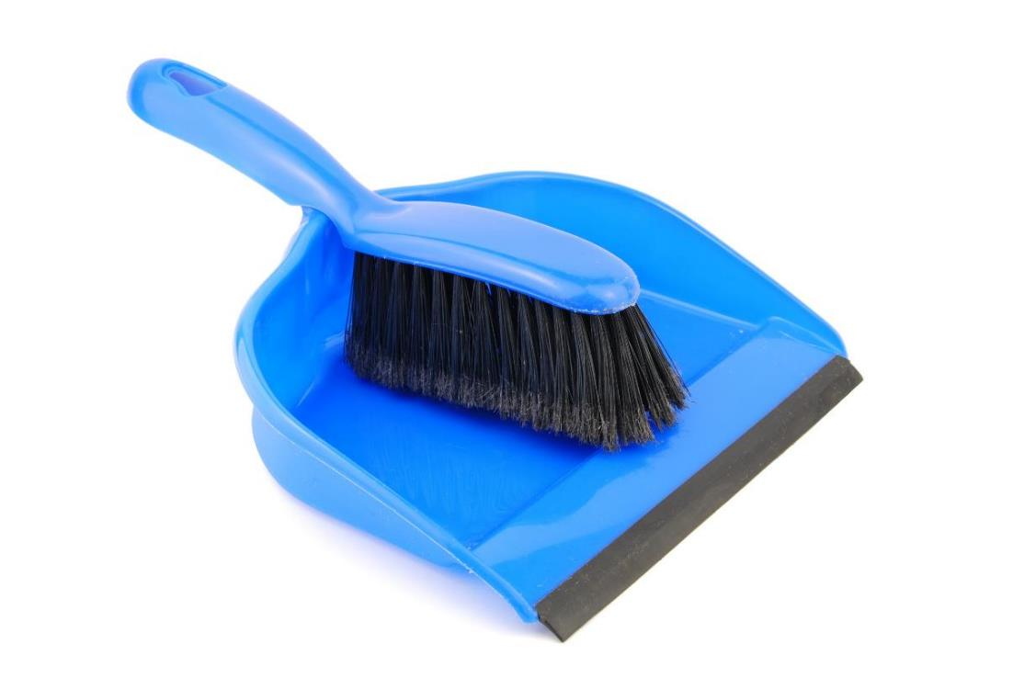
Clean Up
Notes:
Cleanup Pointers
• Anything built with the prototyping pieces should be taken apart.
• Place the prototyping pieces back in the Explore box or in a container labeled “Prototyping Pieces.”
You may wish to play a video or song during clean up time Link on
GoNoodle:. https://family.gonoodle.com/activities/clean-up
Link on YouTube Kids: https://www.youtubekids.com/watch?v=ZJFk87ZsHn0
Link on Youtube: https://youtu.be/ZJFk87ZsHn0

Slide 13


LEGO, the LEGO logo, and the SPIKE logo are trademarks of the/sont des marques de commerce du/son marcas registradas de LEGO Group. © 2024 The LEGO Group. All rights reserved/Tous droits réservés/Todos los derechos reservados. FIRST®, the FIRST® logo, and FIRST® DIVESM are trademarks of For Inspiration and Recognition of Science and Technology (FIRST). LEGO® is a registered trademark of the LEGO Group. FIRST® LEGO® League and SUBMERGEDSM are jointly held trademarks of FIRST and the LEGO Group.© 2024 FIRST and the LEGO Group. All rights reserved.

