Slide 1
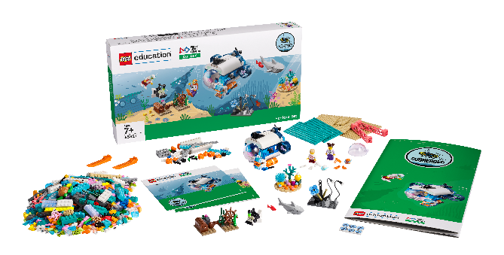
INTRODUCTION
Let’s Get Started

Slide 2
What is FIRST® LEGO League Explore?
Notes:
What is Explore video
YouTube link: https://youtu.be/afYrsiQ48wA

Slide 3
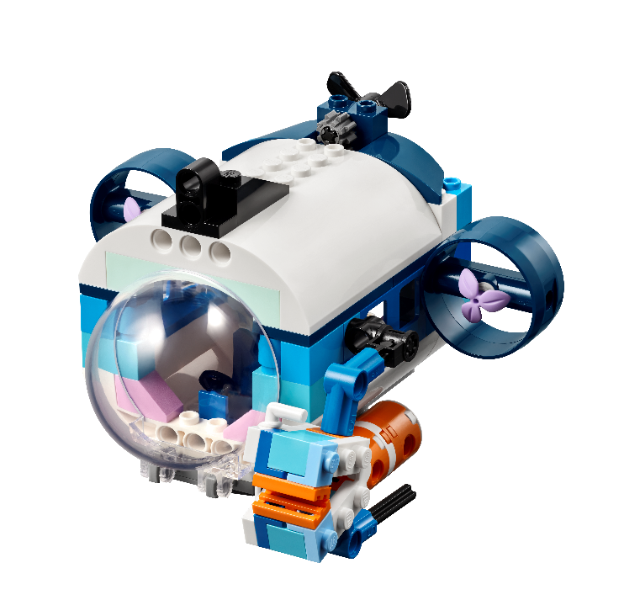
Welcome to SUBMERGEDSM!
Notes:
Welcome to SUBMERGED!
Welcome to the FIRST® DIVESM presented by Qualcomm season. This year’s FIRST LEGO League challenge is called SUBMERGEDSM.
This season, children will learn about how and why people explore the oceans. Our discoveries beneath the ocean surface teach us how this complex ecosystem supports a healthy future for the plants and animals that live there. During each session, teams will experience the engineering design process. There is no set order for this process, and they may go through each step several times in a single session. This means that during a session, children will be exploring the theme and ideas, creating solutions, testing them,
iterating and changing them, and then sharing what they’ve learned with others. More than 80% of the ocean remains unexplored, offering curious minds deep opportunities to dive into expeditions.

Slide 4
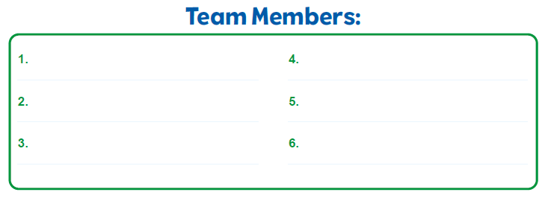
Form Your Team
Write your Team Members’ Names in your Engineering Notebook.

Slide 5
Together with your teammates, you will:
Discover real-world challenges and opportunities in this season’s theme.
Create a team model and program it to make part of it move.
Test and improve your code and build changes.
Track your work in the Engineering Notebook.
Make a team poster that reflects your team’s journey.
Share your model and poster with reviewers at an Explore festival.
Celebrate your accomplishments with family and other teams at the festival.
Notes:
Working in Teams
Together with your teammates, you will:
Discover real-world challenges and opportunities in this season’s theme.
Create a team model and program it to make part of it move.
Test and improve your code and build changes.
Track your work in the Engineering Notebook.
Make a team poster that reflects your team’s journey.
Share your model and poster with reviewers at an Explore festival.
Celebrate your accomplishments with family and other teams at the festival.

Slide 7
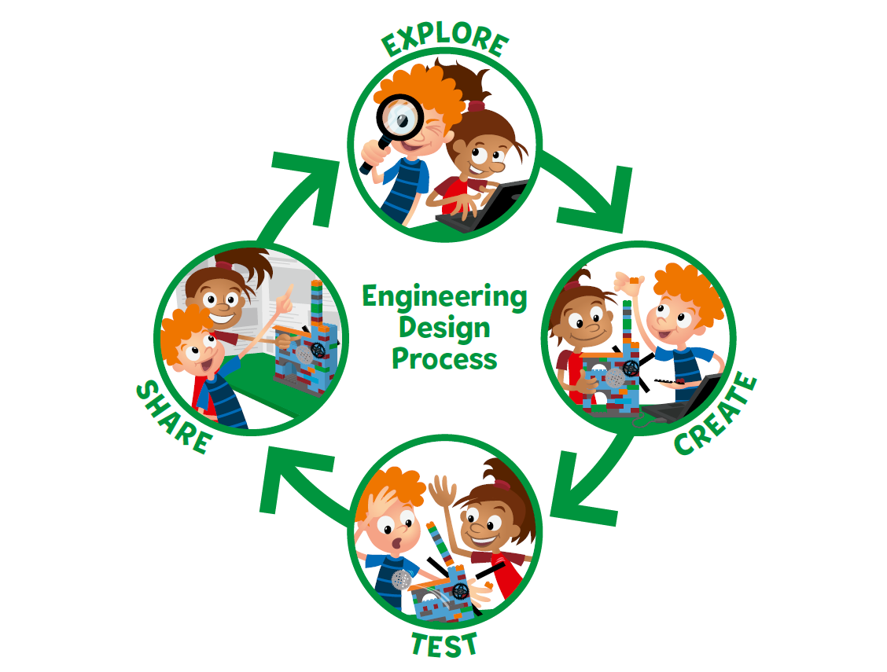
Notes:
During each session, they will experience the engineering design process. There is no set order for this process, and they may go through each part several times in a single session. This means that during a session, children will be exploring the theme and ideas, creating solutions, testing them, iterating and changing them, and then sharing what they’ve learned with others.

Slide 9
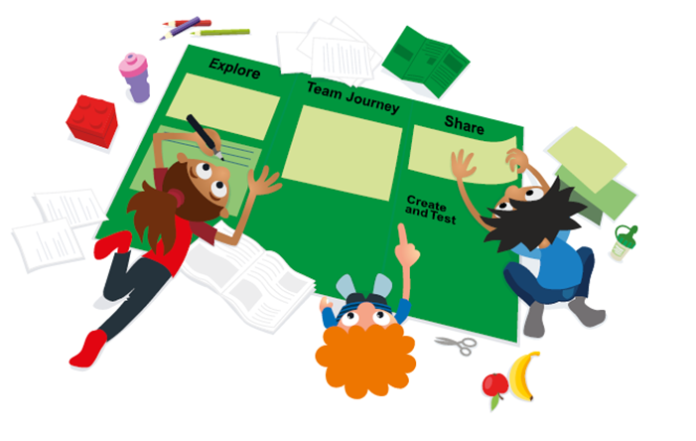

Slide 11
SUBMERGEDSM
Visit the
FIRST® LEGO ® League
YouTube Channel
to watch the
SUBMERGEDSM Season Reveal Video

Slide 12
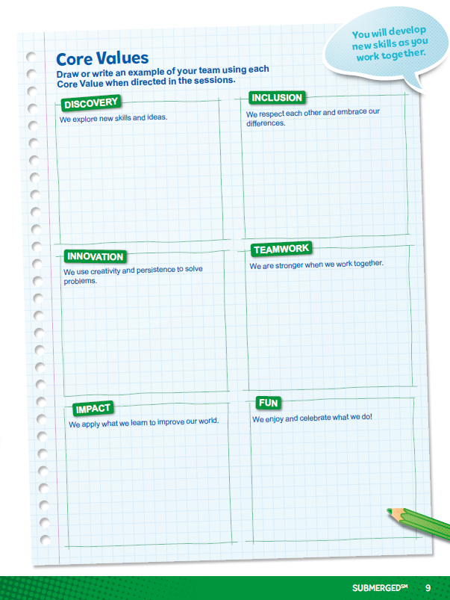
Core Values
Notes:
Draw or write an example of your team demonstrating each Core Value when directed in the sessions!
Use the Core Values to guide your team through your journey.
Have lots of FUN as you develop new skills and work together.

Slide 13
Team Roles
Notes:
Here are sample team roles to use during the sessions. Everyone on the team could experience each role multiple times throughout their FIRST® LEGO® League Explore experience. Using roles helps the team function more efficiently and ensures that everyone on the team is engaged. Some roles will be filled by multiple children during a session. For example, the builder and coder roles can be duplicated where the experience is designed for a pair of children.

Slide 14
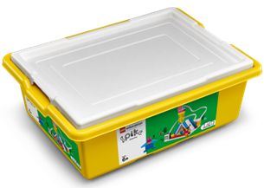
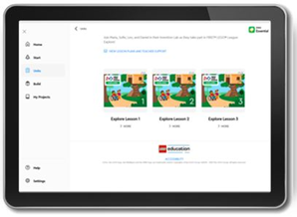
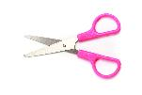
You Need
Each session lists the materials needed.
SUBMERGEDSM Explore Set
Notes:
You might provide any instructions your students need about managing materials during the Explore sessions.
Material Management
Place any extra or found LEGO® pieces in a cup.
Have the children who are missing pieces come to the cup to look for them.
Wait to dismiss your team until you look over their LEGO® set.
The lid of the LEGO® set can be used as a tray to keep pieces from rolling away.
Use plastic bags or containers to store any unfinished builds and their associated pieces or assembled models.
Designate a storage space for the built models, Explore set, and LEGO® container.
The role of the Material Manager is to help in the process of clearing away and storing materials.

Slide 15
Clean Up
Notes:
Clean Up Pointers
You may wish to play a video or song during clean up time Link on
GoNoodle: https://family.gonoodle.com/activities/clean-up
Link on YouTube Kids: https://www.youtubekids.com/watch?v=ZJFk87ZsHn0
Link on Youtube: https://youtu.be/ZJFk87ZsHn0

Slide 16
LEGO, the LEGO logo, and the SPIKE logo are trademarks of the/sont des marques de commerce du/son marcas registradas de LEGO Group. © 2024 The LEGO Group. All rights reserved/Tous droits réservés/Todos los derechos reservados. FIRST®, the FIRST® logo, and FIRST® DIVESM are trademarks of For Inspiration and Recognition of Science and Technology (FIRST). LEGO® is a registered trademark of the LEGO Group. FIRST® LEGO® League and SUBMERGEDSM are jointly held trademarks of FIRST and the LEGO Group.© 2024 FIRST and the LEGO Group. All rights reserved.

