Slide 1
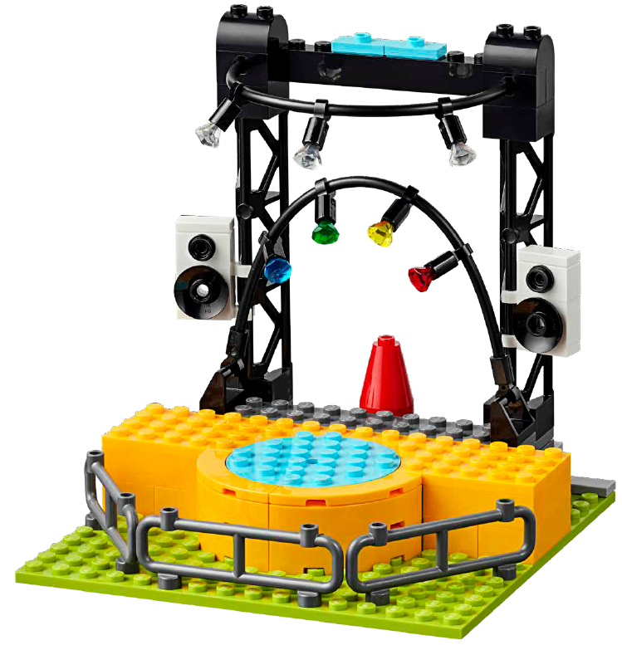

Session 3
Sound All Around

Slide 2
Guiding Questions
What kind of music do you like to listen to?
What instruments do you see in the music concert pieces?
Outcomes
The team will add the music concert pieces to the basic stage.
The team will identify different ways sound is used to help make an impact on an audience.
What kind of technology is used in the music industry?
What pieces of technology do you see that were added to the stage?
What technology would you like to add to the stage?
What sounds would you feature on your stage?
Notes:
Each session has Guiding Questions that can be shared to frame the session.
Session Tips
The team will need Book 2 and Bag 2 located in the Explore set.
The children can decide how to arrange the performers on the stage.
Questions in the Engineering Notebook are meant to start a discussion or generate ideas.
Examples of the technology include the lights, speakers, and other music equipment.
Share photos of music venues in your community that the children may have seen before.
Children can find more information on the careers mentioned in the Engineering Notebook on pages 30-31.
Extension
• Explore different jobs and careers related to the arts.
• Research what it takes to become and expert in one of the jobs that was discussed.

Slide 3


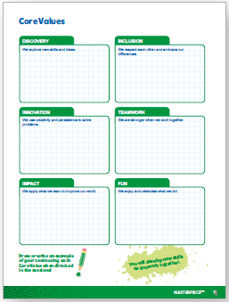
Introduction – Let’s Have Fun
Examples of Fun
Ask the students to provide examples of Fun and record them here
Example of Fun
Example of Fun
We enjoyed and celebrated what we did!
Extension
Notes:
Introduction - Let’s Have Fun (5-10 minutes)
• Read the definition for fun to the team. (see TMG page 5)
• Talk about what fun is. Have the team provide examples of this Core Value.
• Extension: Have everyone draw a picture of an example of fun on the Core Values page in their Engineering Notebook.

Slide 4
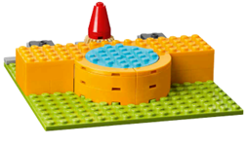
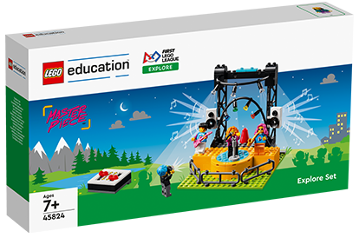
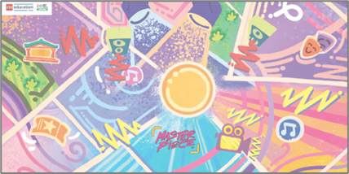

Activity 1 – Build Music Concert
Follow the building instructions in Book 2 to build the music concert pieces.
Add the music concert pieces to the basic stage you built last session.
You need…
Watch video of the music concert model!
Notes:
Activity 1 Tasks – Build Music Concert (15-20 minutes)
Follow the building instructions in Book 2 to build the music concert pieces.
Add the music concert pieces to the basic stage you built last session.
Place the concert stage on the mat near the music notes.
Discuss how sound or music is used to help performers entertain their audience.
Session Tips
The team will need Book 2 and Bag 2 located in the Explore set.
The children can decide how to arrange the performers on the stage.
Questions in the Engineering Notebook are meant to start a discussion or generate ideas.

Slide 5
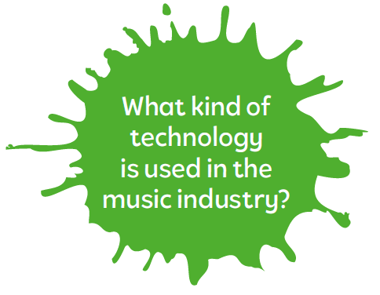
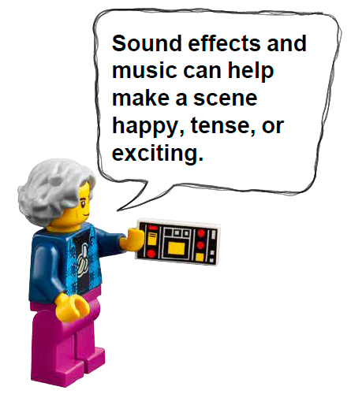
Activity 1
Place the concert stage on the mat near the music notes.
Notes:
Activity 1 Tasks – Build Music Concert (15-20 minutes)
Follow the building instructions in Book 2 to build the music concert pieces.
Add the music concert pieces to the basic stage you built last session.
Place the concert stage on the mat near the music notes.
Discuss how sound or music is used to help performers entertain their audience.
Session Tips
The team will need Book 2 and Bag 2 located in the Explore set.
The children can decide how to arrange the performers on the stage.
Questions in the Engineering Notebook are meant to start a discussion or generate ideas.

Slide 6
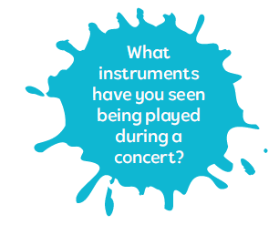
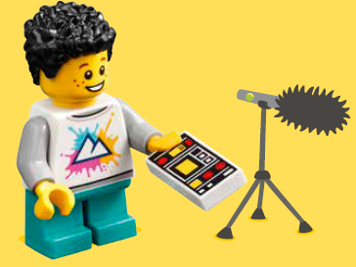
Activity 1
Discuss how sound or music is used to help performers entertain their audience.
Notes:
Activity 1 Tasks – Build Music Concert (15-20 minutes)
Follow the building instructions in Book 2 to build the music concert pieces.
Add the music concert pieces to the basic stage you built last session.
Place the concert stage on the mat near the music notes.
Discuss how sound or music is used to help performers entertain their audience.
Session Tips
The team will need Book 2 and Bag 2 located in the Explore set.
The children can decide how to arrange the performers on the stage.
Questions in the Engineering Notebook are meant to start a discussion or generate ideas.

Slide 7

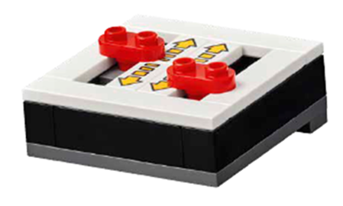

Activity 2 – Build Sound Effects
Identify the concert pieces that were added to the basic stage.
You need…
Notes:
Activity 2 Tasks - Build Sound Effects (15-20 minutes)
Identify the concert pieces that were added to the basic stage.
Discuss what other technology you would like to add to the concert stage.
Challenge
Build examples of the additional technology using the prototyping pieces and add them to the stage.
Share the technology represented in your model.
Session Tips
Examples of the technology include the lights, speakers, and other music equipment.
Share photos of music venues in your community that the children may have seen before.
Children can find more information on the careers mentioned in the Engineering Notebook on pages 30-31.

Slide 8
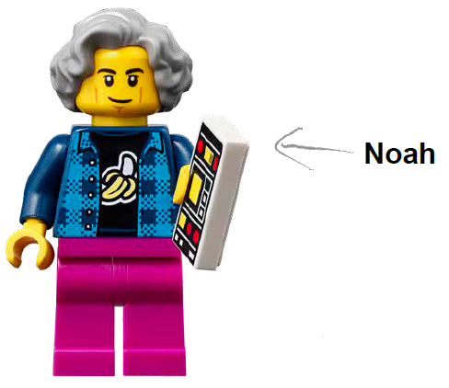

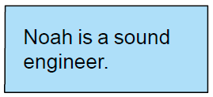
Activity 2
Discuss what other technology you would like to add to the concert stage.
Notes:
Activity 2 Tasks - Build Sound Effects (15-20 minutes)
Identify the concert pieces that were added to the basic stage.
Discuss what other technology you would like to add to the concert stage.
Challenge
Build examples of the additional technology using the prototyping pieces and add them to the stage.
Share the technology represented in your model.
Session Tips
Examples of the technology include the lights, speakers, and other music equipment.
Share photos of music venues in your community that the children may have seen before.
Children can find more information on the careers mentioned in the Engineering Notebook on pages 30-31.

Slide 9

Activity 2
Challenge
Build examples of the additional technology using the prototyping pieces and add them to the stage.
Share the technology represented in your model.
Notes:
Activity 2 Tasks - Build Sound Effects (15-20 minutes)
Identify the concert pieces that were added to the basic stage.
Discuss what other technology you would like to add to the concert stage.
Challenge
Build examples of the additional technology using the prototyping pieces and add them to the stage.
Share the technology represented in your model.
Session Tips
Examples of the technology include the lights, speakers, and other music equipment.
Share photos of music venues in your community that the children may have seen before.
Children can find more information on the careers mentioned in the Engineering Notebook on pages 30-31.

Slide 10
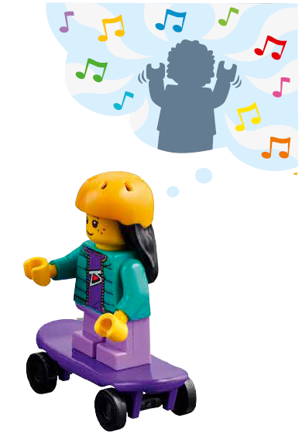
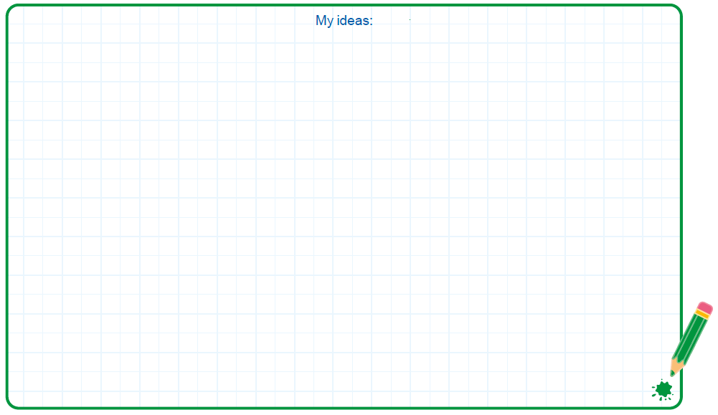
Capture Your Ideas!
Record ideas in the Engineering Notebook.
Notes:
Activity 2 Tasks - Build Sound Effects (15-20 minutes)
Identify the concert pieces that were added to the basic stage.
Discuss what other technology you would like to add to the concert stage.
Challenge
Build examples of the additional technology using the prototyping pieces and add them to the stage.
Share the technology represented in your model.
Session Tips
Examples of the technology include the lights, speakers, and other music equipment.
Share photos of music venues in your community that the children may have seen before.
Children can find more information on the careers mentioned in the Engineering Notebook on pages 30-31.

Slide 11

Share
Share what you did in the session
Demonstrate how the concert stage works.
Explain how sound is used to make an impact for an audience.
Show different examples of sounds icons on the mat.
What have you discovered? Share with your team!
Notes:
Share (10-15 minutes)
Have the team:
• Share what they did in the session.
• Demonstrate how the concert stage works.
• Explain how sound is used to make an impact for an audience.
• Show different examples of sounds icons on the mat.

Slide 12

Optional Video:
You may wish to embed a relevant, age-appropriate video for your students here. See the Notes for an example.
Notes:
Choose a relevant, age-appropriate video for your students.
Here is one example = Sound Effects at https://youtu.be/B3sDrmZmgLA

Slide 13
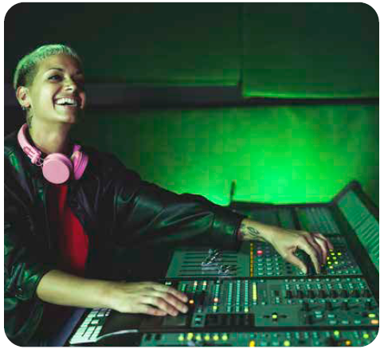
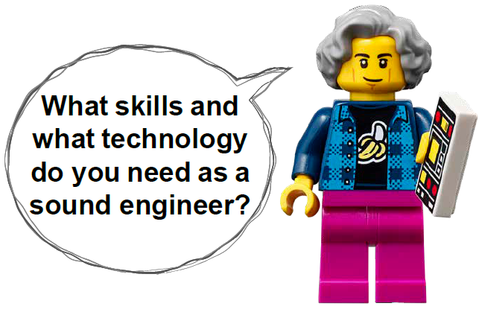

Career Connections
Sound Engineer
Role:
A sound engineer mixes different sounds, controls volume, and creates an optimal listening experience.
Notes:
Ask the children to reflect on what a sound engineer does.
Explain the job. What are some of this job’s daily tasks?
What is this job’s yearly salary?
What education or training is required?
What companies could people in this job work for?

Slide 14

Clean Up
Notes:
Clean Up Pointers
The stage can remain assembled. Bag 4 contains enough pieces for two additional stages. Another stage will be needed in Session 7.
Anything built with the prototyping pieces should be taken apart.
You may wish to play a video or song during clean up time Link on
GoNoodle: https://family.gonoodle.com/activities/clean-up
Link on YouTube Kids: https://www.youtubekids.com/watch?v=ZJFk87ZsHn0
Link on Youtube: https://youtu.be/ZJFk87ZsHn0

Slide 15

LEGO, the LEGO logo and the SPIKE logo are trademarks of the/sont des marques de commerce du/son marcas registradas de LEGO Group. ©2023 The LEGO Group. All rights reserved/Tous droits réservés/Todos los derechos reservados. FIRST®, the FIRST® logo, and FIRST® in SHOWSM are registered trademarks of For Inspiration and Recognition of Science and Technology (FIRST). LEGO® is a registered trademark of the LEGO Group. FIRST® LEGO® League and MASTERPIECESM are jointly held trademarks of FIRST and the LEGO Group. ©2023 FIRST and the LEGO Group. All rights reserved.

