Slide 1
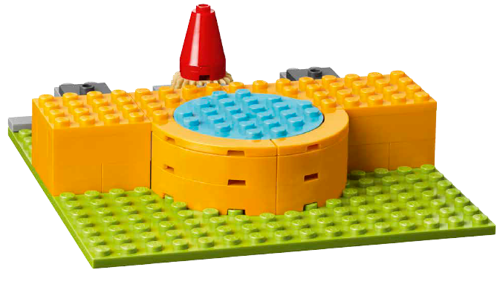

Session 2
Behind the Scenes

Slide 2
Guiding Questions
What do you think could happen on the stage?
What do the icons on the mat represent?
Outcomes
The team will build the basic stage and minifigures in Bag 1.
The team will explore different jobs in the arts and tools or objects used.
What would you showcase on the stage?
How would the characters in the
Explore story use the minifigure items?
What scene are you going to create on your stage?
Notes:
Each session has Guiding Questions that can be shared to frame the session.
Session Tips
You will find the estimated timing in the lesson for each page’s tasks. This is to assist with children’s self-regulation.
The team will need Book 1 and Bag 1 from the Explore Set.
The team will add the music concert pieces to the basic stage in Session 3.
The team could also think of other jobs that are related to concert venues, museums, or theaters.
Challenges are provided for the team to go further with the session tasks.
The team can build their stage model on the mat to help contain the materials.
Extension
• Explore different jobs and careers related to the arts.
• Research what it takes to become and expert in one of the jobs that was discussed.

Slide 3


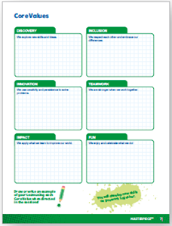
Introduction – Go Team
Examples of Teamwork
Ask the students to provide examples of Teamwork and record them here
Example of Teamwork
Example of Teamwork
We found we were stronger when we worked together.
Extension
Notes:
Introduction - Go Team (5-10 minutes)
Read the definition for teamwork to the team. (see TMG page 5)
Talk about what teamwork is. Have the team provide examples of this Core Value.
Extension: Have everyone draw a scientists using teamwork on the Core Values page in their Engineering Notebook.

Slide 4

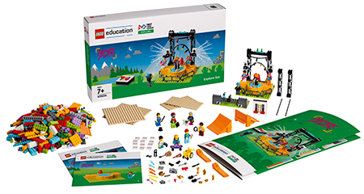
Activity 1 – Build a Basic Stage
You need…
Follow the building instructions in Book 1 to make the basic stage.
Talk about what you would share if you were on the stage.
Notes:
Activity 1 Tasks – Build a Basic Stage (15-20 minutes)
Follow the building instructions in Book 1 to make the basic stage.
Talk about what you would share if you were on the stage.
Identify the icons on the mat. Think about what the icons represent.
Move the stage to different icons on the mat and discuss what could be shared there.
Session Tips
You will find the estimated timing in the lesson for each page’s tasks. This is to assist with children’s self-regulation.
The team will need Book 1 and Bag 1 from the Explore Set.
The team will add the music concert pieces to the basic stage in Session 3.

Slide 5

Activity 1
Identify the icons on the mat. Think about what the icons represent.
Move the stage to different icons on the mat and discuss what could be shared there.
You need…
Notes:
Activity 1 Tasks – Build a Basic Stage (15-20 minutes)
Follow the building instructions in Book 1 to make the basic stage.
Talk about what you would share if you were on the stage.
Identify the icons on the mat. Think about what the icons represent.
Move the stage to different icons on the mat and discuss what could be shared there.
Session Tips
You will find the estimated timing in the lesson for each page’s tasks. This is to assist with children’s self-regulation.
The team will need Book 1 and Bag 1 from the Explore Set.
The team will add the music concert pieces to the basic stage in Session 3.

Slide 6
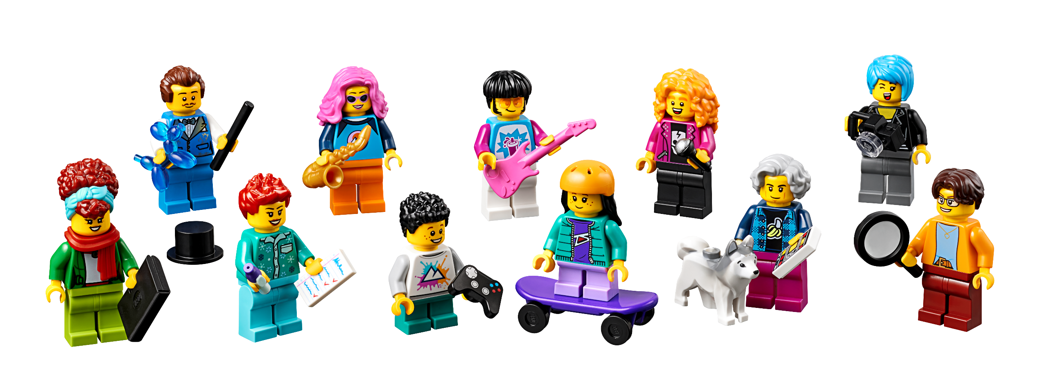
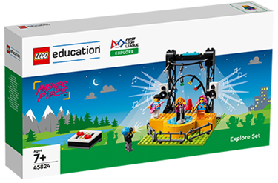
Activity 2 – Build Minifigure Experts
Follow the building instructions in Book 1 to make the minifigures.
You need…
Notes:
Activity 2 Tasks – Build Minifigure Experts (15-20 minutes)
Follow the building instructions in Book 1 to make the minifigures.
Explore the minifigure items.
Re-read the Explore story (p. 4-5). Explain how the characters might use one or more of the items to help them in their job.
Challenge
Using the minifigures and stage, build another scene for the Explore Story that shows the stage being used in a different way.
Share your design and explain what is happening.
Session Tips
The team could also think of other jobs that are related to concert venues, museums, or theaters.
Challenges are provided for the team to go further with the session tasks.
The team can build their stage model on the mat to help contain the materials.

Slide 7










Activity 2
Explore the minifigure items.
Notes:
Activity 2 Tasks – Build Minifigure Experts (15-20 minutes)
Follow the building instructions in Book 1 to make the minifigures.
Explore the minifigure items.
Re-read the Explore story (p. 4-5). Explain how the characters might use one or more of the items to help them in their job.
Challenge
Using the minifigures and stage, build another scene for the Explore Story that shows the stage being used in a different way.
Share your design and explain what is happening.
Session Tips
The team could also think of other jobs that are related to concert venues, museums, or theaters.
Challenges are provided for the team to go further with the session tasks.
The team can build their stage model on the mat to help contain the materials.

Slide 8

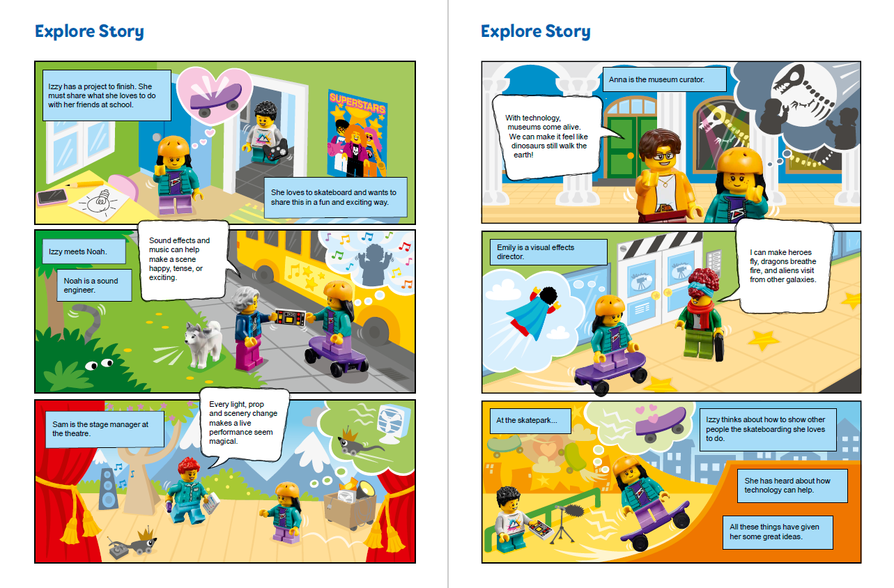




Activity 2
Re-read the Explore Story (p. 4-5).
Explain how the characters might use one or more of the items to help them in their job.
Notes:
Activity 2 Tasks – Build Minifigure Experts (15-20 minutes)
Follow the building instructions in Book 1 to make the minifigures.
Explore the minifigure items.
Re-read the Explore Story (p. 4-5). Explain how the characters might use one or more of the items to help them in their job.
Challenge
Using the minifigures and stage, build another scene for the Explore Story that shows the stage being used in a different way.
Share your design and explain what is happening.
Session Tips
The team could also think of other jobs that are related to concert venues, museums, or theaters.
Challenges are provided for the team to go further with the session tasks.
The team can build their stage model on the mat to help contain the materials.

Slide 9
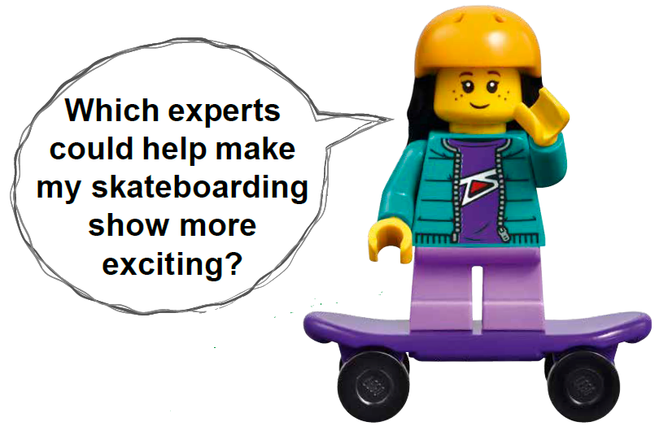
Activity 2 – Challenge
Using the minifigures and stage, build another scene for the Explore Story that shows the stage being used in a different way.
Notes:
Activity 2 Tasks – Build Minifigure Experts (15-20 minutes)
Follow the building instructions in Book 1 to make the minifigures.
Explore the minifigure items.
Re-read the Explore story (p. 4-5). Explain how the characters might use one or more of the items to help them in their job.
Challenge
Using the minifigures and stage, build another scene for the Explore Story that shows the stage being used in a different way.
Share your design and explain what is happening.
Session Tips
The team could also think of other jobs that are related to concert venues, museums, or theaters.
Challenges are provided for the team to go further with the session tasks.
The team can build their stage model on the mat to help contain the materials.

Slide 10

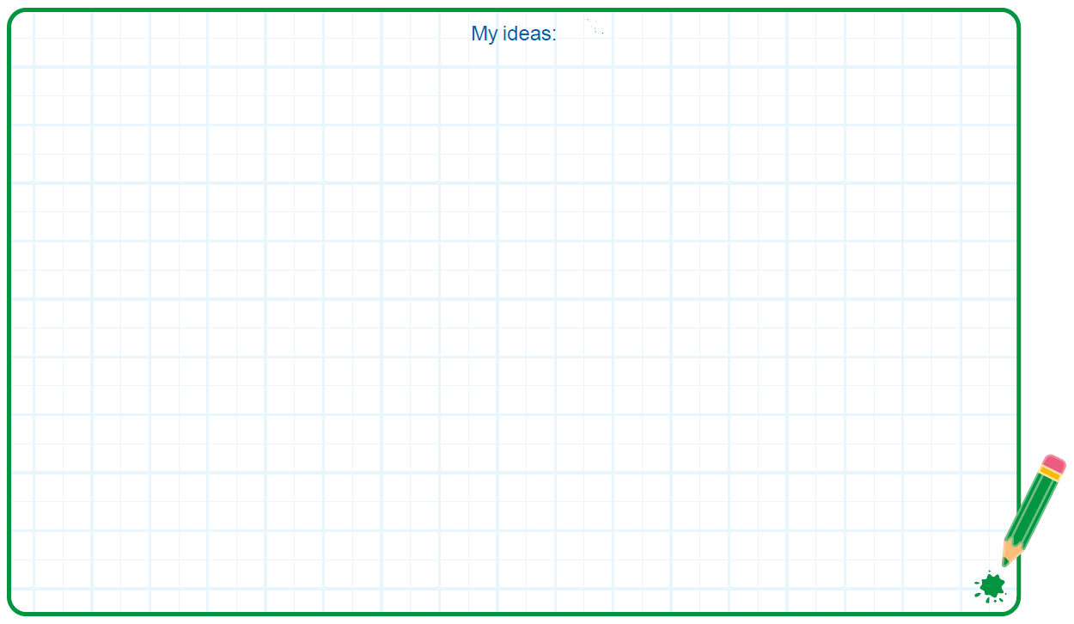

Activity 2
You need…
Share your design and explain what is happening.
Notes:
Activity 2 Tasks – Build Minifigure Experts (15-20 minutes)
Follow the building instructions in Book 1 to make the minifigures.
Explore the minifigure items.
Re-read the Explore story (p. 4-5). Explain how the characters might use one or more of the items to help them in their job.
Challenge
Using the minifigures and stage, build another scene for the Explore Story that shows the stage being used in a different way.
Share your design and explain what is happening.
Session Tips
The team could also think of other jobs that are related to concert venues, museums, or theaters.
Challenges are provided for the team to go further with the session tasks.
The team can build their stage model on the mat to help contain the materials.

Slide 11

Share
Share what you did in the session.
Share what they learned about the experts in the Explore Story.
Demonstrate how the different minifigure items could be used.
Describe their scene for the Explore Story.
What have you discovered? Share with your team!
Notes:
Share (10 minutes)
Have the team:
Share what you did in the session.
Share what they learned about the experts in the Explore Story.
Demonstrate how the different minifigure items could be used.
Describe their scene for the Explore Story.

Slide 12

Optional Video:
You may wish to embed a relevant, age-appropriate video for your students here. See the Notes for an example.
Notes:
Choose a relevant, age-appropriate video for your students.
What is a Play? By Lido Learning
Here is one example: https://youtu.be/9Y498O7yL8E

Slide 13

Clean Up
Notes:
Clean Up Pointers
The basic stage should stay assembled.
Anything built with the prototyping pieces should be taken apart.
You may wish to play a video or song during clean up time Link on
GoNoodle: https://family.gonoodle.com/activities/clean-up
Link on YouTube Kids: https://www.youtubekids.com/watch?v=ZJFk87ZsHn0
Link on Youtube: https://youtu.be/ZJFk87ZsHn0

Slide 14

LEGO, the LEGO logo and the SPIKE logo are trademarks of the/sont des marques de commerce du/son marcas registradas de LEGO Group. ©2023 The LEGO Group. All rights reserved/Tous droits réservés/Todos los derechos reservados. FIRST®, the FIRST® logo, and FIRST® in SHOWSM are registered trademarks of For Inspiration and Recognition of Science and Technology (FIRST). LEGO® is a registered trademark of the LEGO Group. FIRST® LEGO® League and MASTERPIECESM are jointly held trademarks of FIRST and the LEGO Group. ©2023 FIRST and the LEGO Group. All rights reserved.

