Slide 1
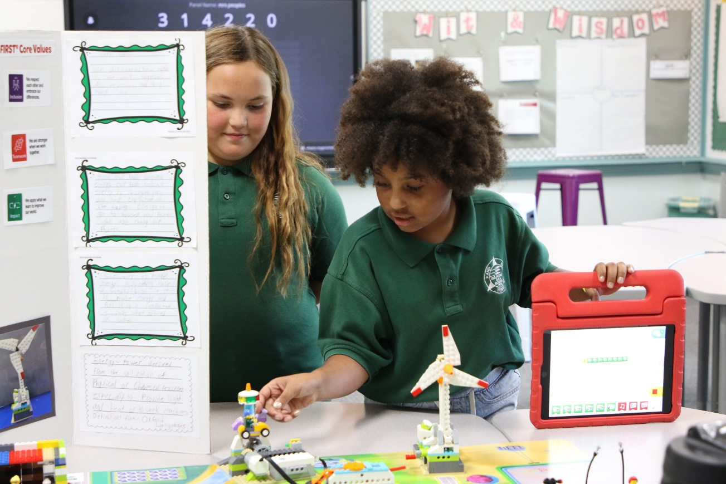

Session 12
Prepare for Event

Slide 2
Guiding Questions
Can you explain the code you created for your motorized part?
How does your team model related to the MASTERPIECESM theme?
Outcomes
The team will reflect on their MASTERPIECESM experience.
The team create a plan for what to share at their final event.
Can you share about your team’s journey?
How will you present your poster and model at the event?
How do we show Core Values?
What does your team need for the event?
Notes:
Each session has Guiding Questions that can be shared to frame the session.
Session Tips
Go over the reviewing sheet and reviewing questions with your team.
Ask the team the reviewing questions and practice the responses they would give the reviewers.
If you are not attending an official festival, you can still run your own festival or have an informal sharing event.
Every question on this page doesn’t need to be answered. They are just to help your team feel ready for the event.
You could have the team practice their presentation by presenting to others before their event.
Your team could register for an Explore festival or you can run your own festival.

Slide 3

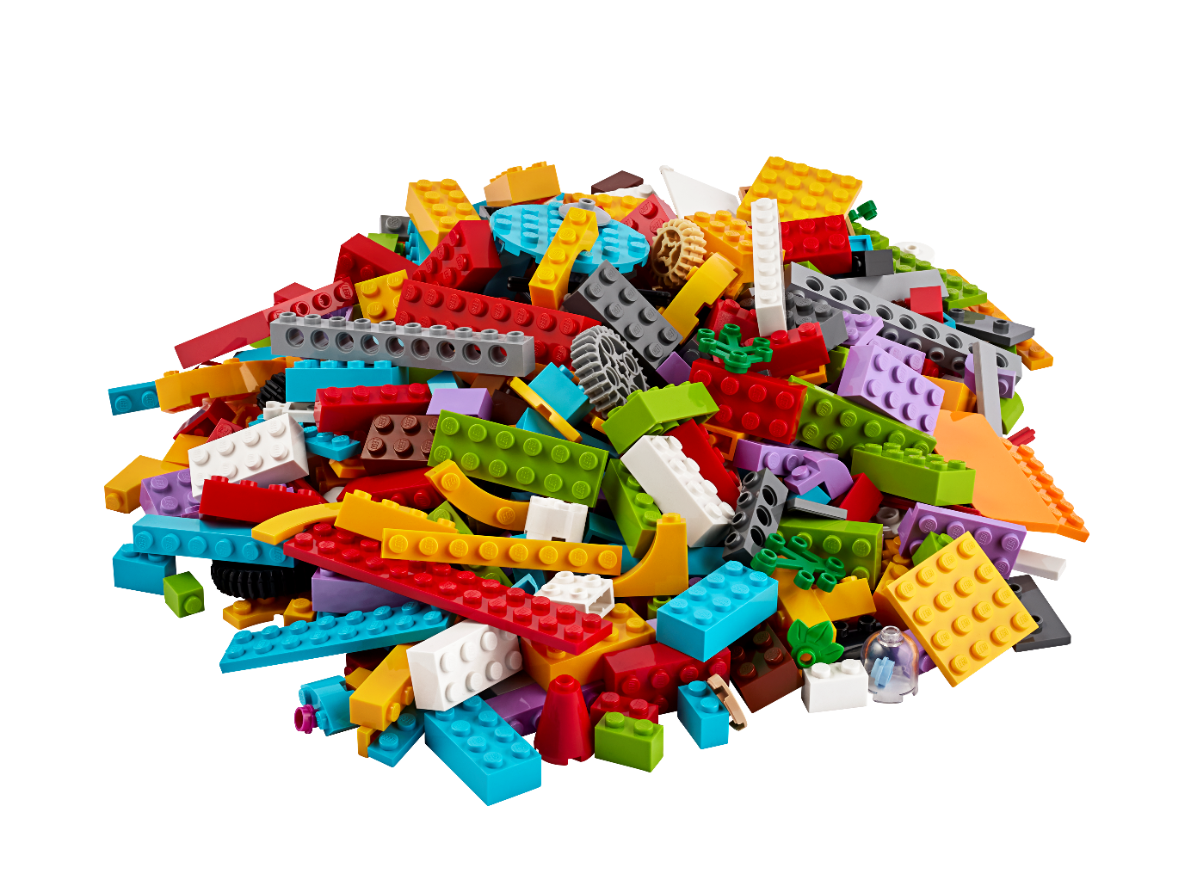

Introduction – Impact Build
Examples of Impact
Ask the students to provide examples of Impact and record them here
Example of Impact
Example of Impact
We applied what we learned to improve our world.
Notes:
• Have the team provide examples of how they have had an impact throughout the sessions.
• Have the team create a build from the prototyping pieces representing this Core Value or examples of how the team has had an impact.

Slide 4
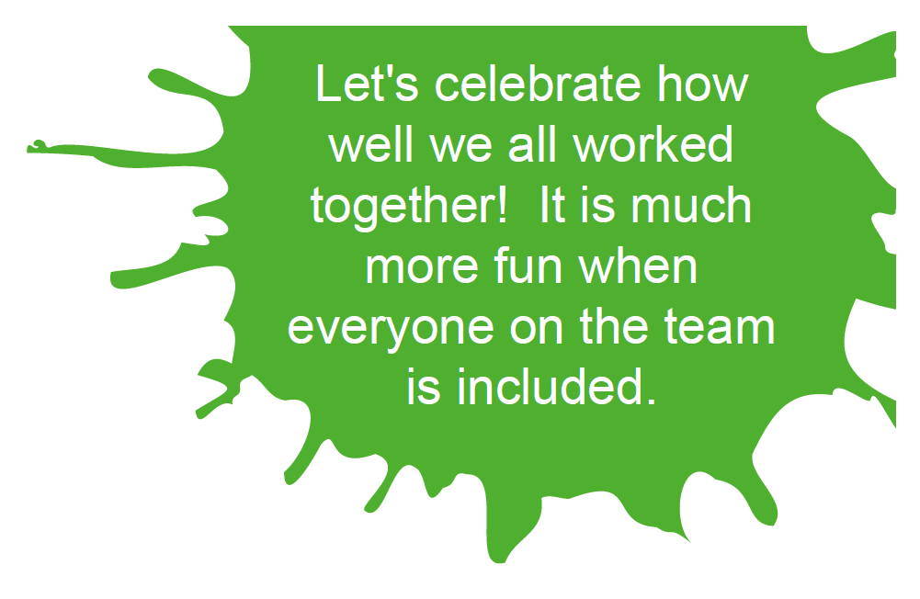
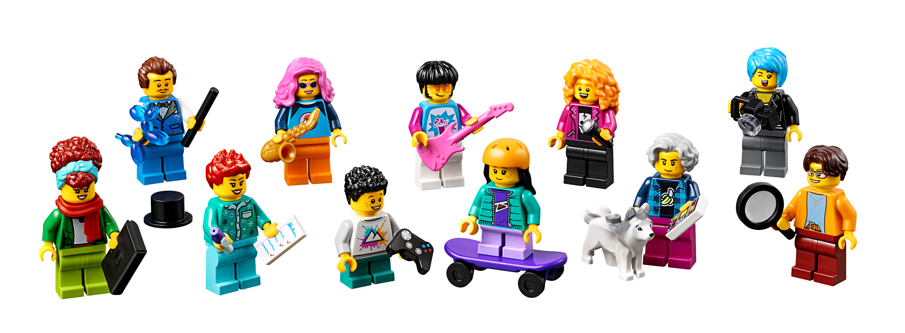
Tasks
Gather your completed team model and team poster.
Notes:
Tasks (40 minutes)
Gather your completed team model and team poster.
Talk about what your team would like to share at your event!
Complete the next page to prepare for your event.
Look over the reviewing sheet with your coach.
Practice your presentation.
Communicate what you have learned with others.
Session Tips
Go over the reviewing sheet and reviewing questions with your team.
Ask the team the reviewing questions and practice the responses they would give the reviewers.
If you are not attending an official festival, you can still run your own festival or have an informal sharing event.
Every question on this page doesn’t need to be answered. They are just to help your team feel ready for the event.
You could have the team practice their presentation by presenting to others before their event.
Your team could register for an Explore festival or you can run your own festival.

Slide 5
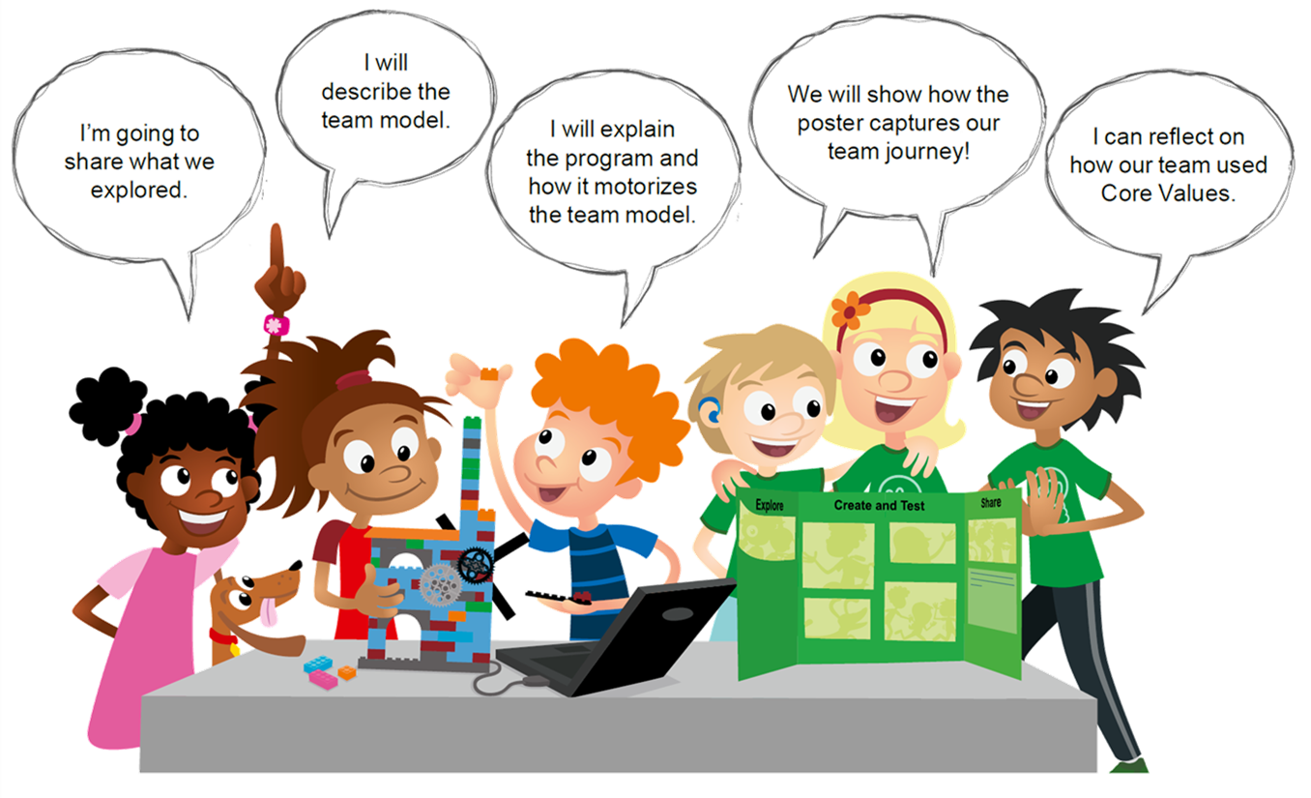
Tasks
Talk about what your team would like to share at your event!
Notes:
Tasks (40 minutes)
Gather your completed team model and team poster.
Talk about what your team would like to share at your event!
Complete the next page to prepare for your event.
Look over the reviewing sheet with your coach.
Practice your presentation.
Communicate what you have learned with others.
Session Tips
Go over the reviewing sheet and reviewing questions with your team.
Ask the team the reviewing questions and practice the responses they would give the reviewers.
If you are not attending an official festival, you can still run your own festival or have an informal sharing event.
Every question on this page doesn’t need to be answered. They are just to help your team feel ready for the event.
You could have the team practice their presentation by presenting to others before their event.
Your team could register for an Explore festival or you can run your own festival.

Slide 6
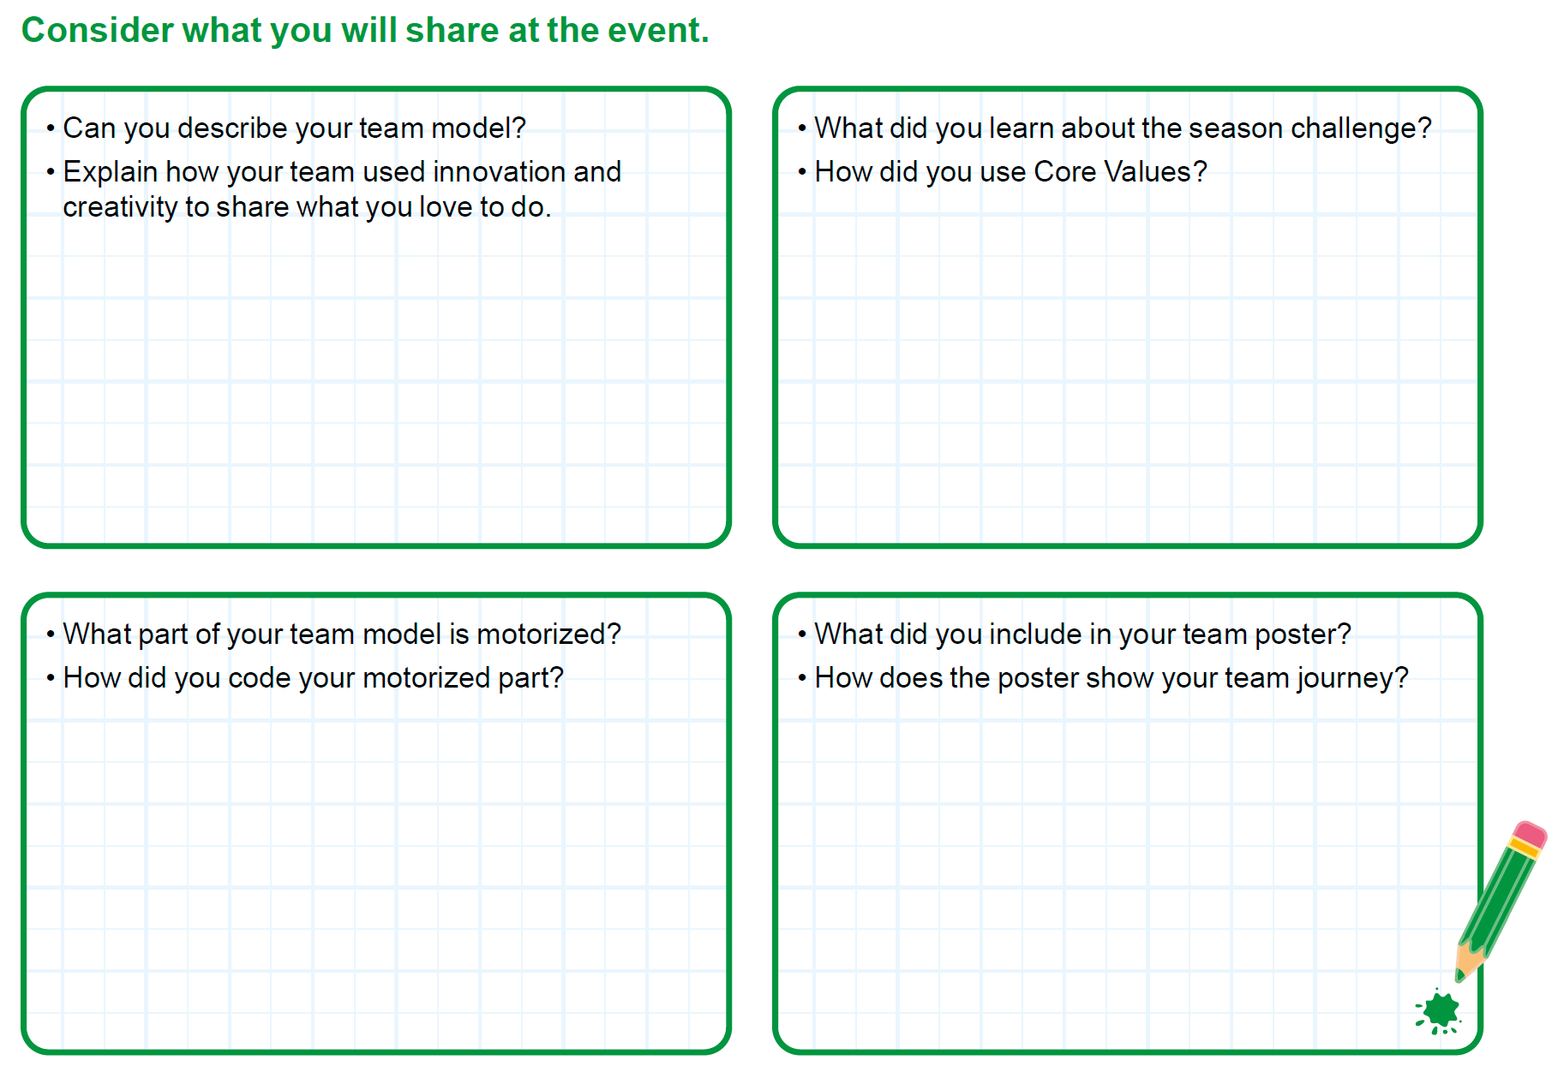
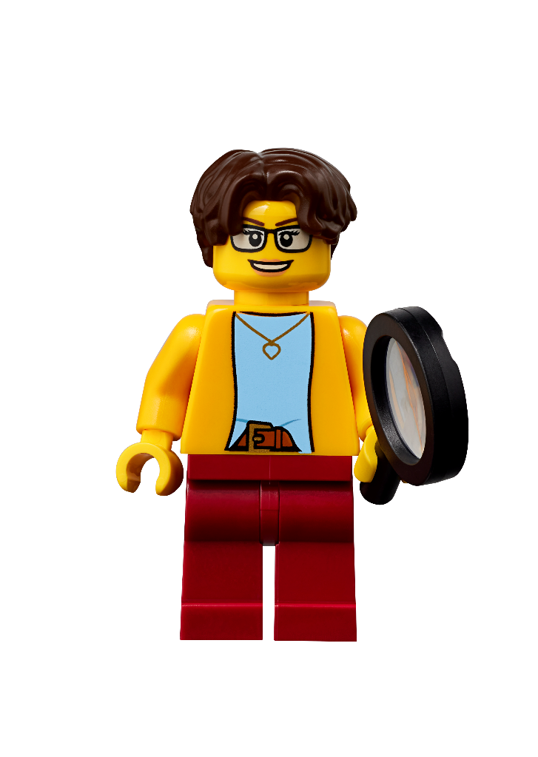
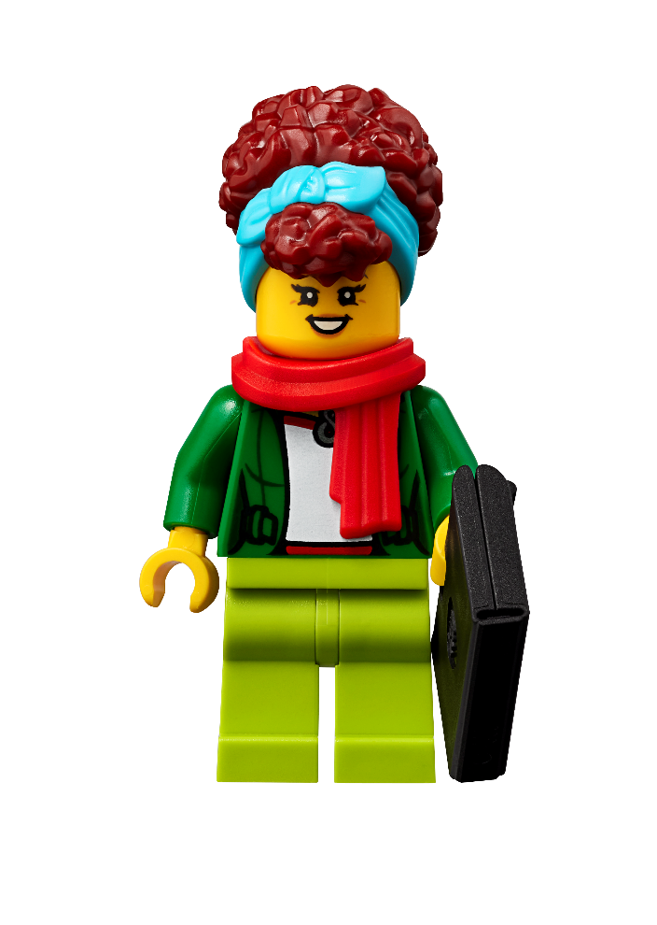
Tasks
Complete page 27 in Engineering Notebook to prepare for your event.
Notes:
Tasks (40 minutes)
Gather your completed team model and team poster.
Talk about what your team would like to share at your event!
Complete the next page to prepare for your event.
Look over the reviewing sheet with your coach.
Practice your presentation.
Communicate what you have learned with others.
Session Tips
Go over the reviewing sheet and reviewing questions with your team.
Ask the team the reviewing questions and practice the responses they would give the reviewers.
If you are not attending an official festival, you can still run your own festival or have an informal sharing event.
Every question on this page doesn’t need to be answered. They are just to help your team feel ready for the event.
You could have the team practice their presentation by presenting to others before their event.
Your team could register for an Explore festival or you can run your own festival.

Slide 7
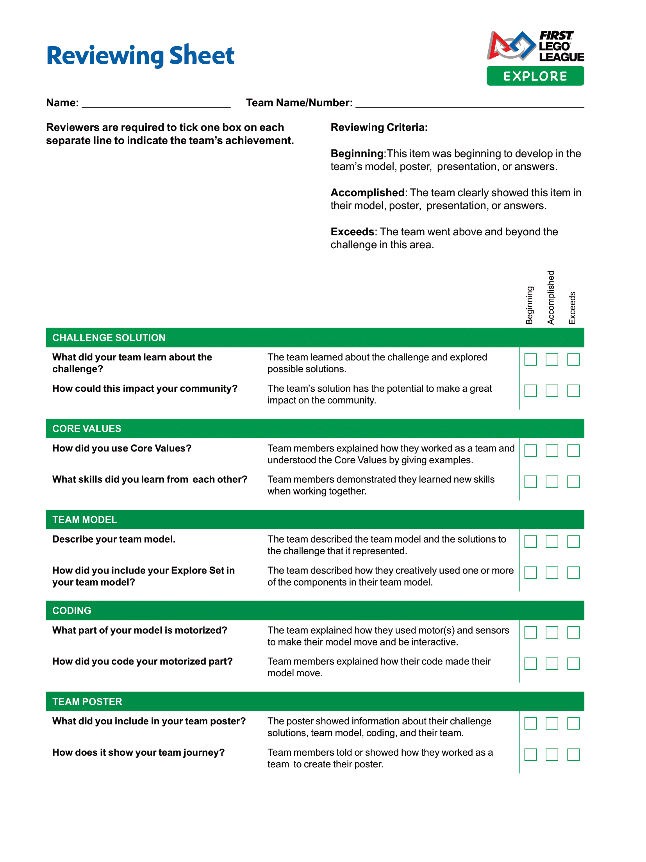
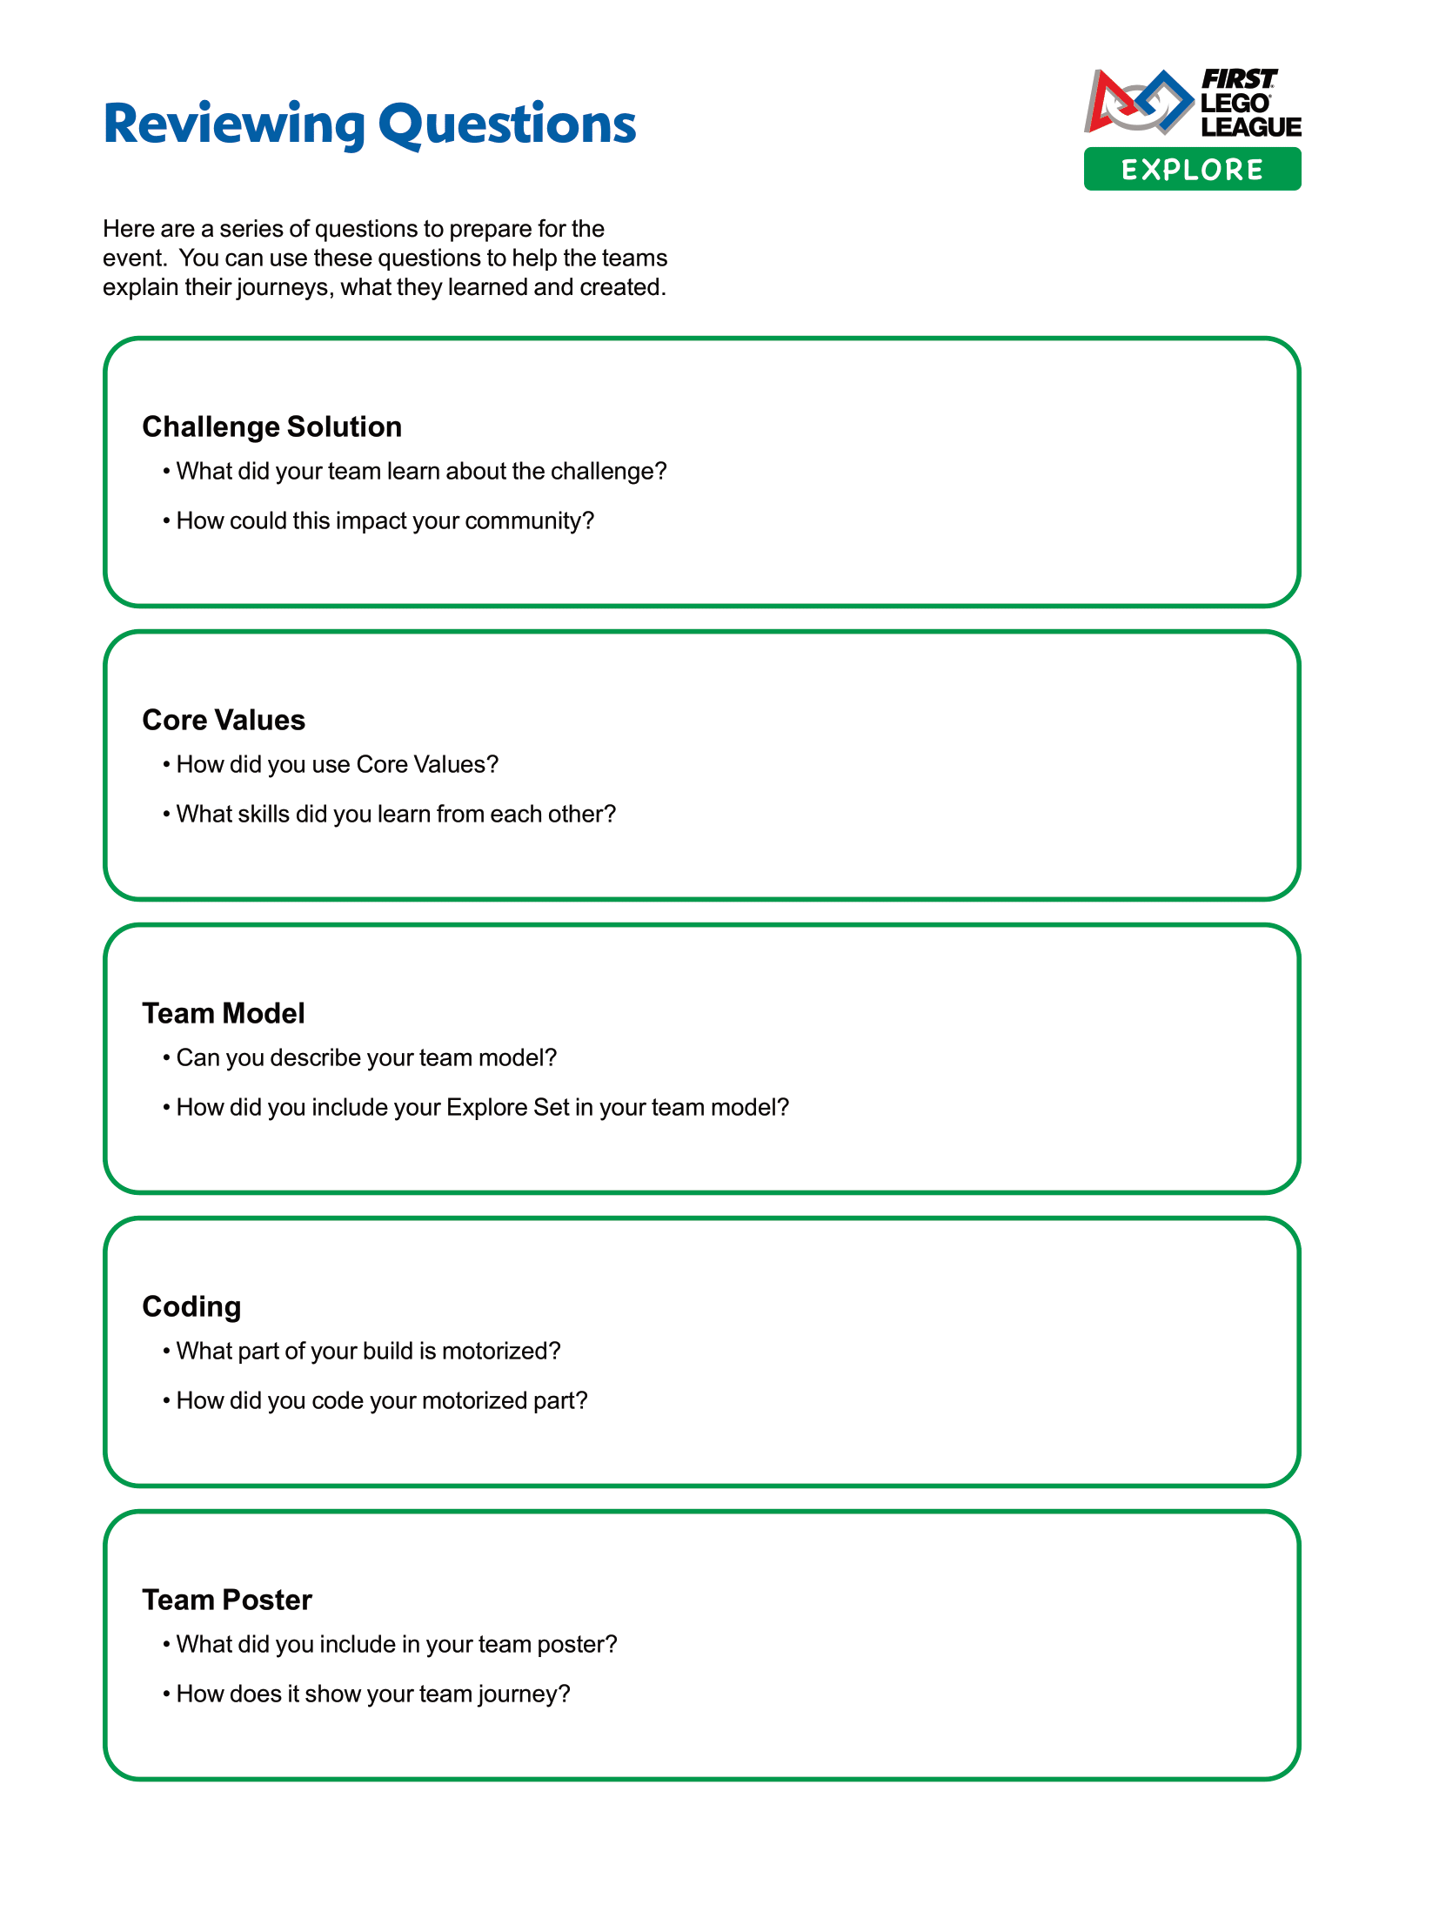
Tasks
Look over the reviewing sheet with your coach.
Notes:
Tasks (40 minutes)
Gather your completed team model and team poster.
Talk about what your team would like to share at your event!
Complete the next page to prepare for your event.
Look over the reviewing sheet with your coach.
Practice your presentation.
Communicate what you have learned with others.
Session Tips
Go over the reviewing sheet and reviewing questions with your team.
Ask the team the reviewing questions and practice the responses they would give the reviewers.
If you are not attending an official festival, you can still run your own festival or have an informal sharing event.
Every question on this page doesn’t need to be answered. They are just to help your team feel ready for the event.
You could have the team practice their presentation by presenting to others before their event.
Your team could register for an Explore festival or you can run your own festival

Slide 8

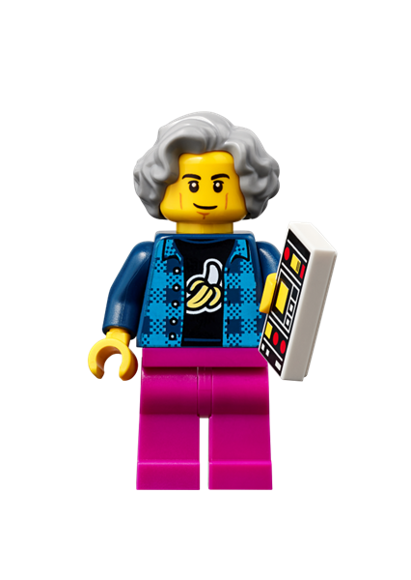
Tasks
Practice your presentation.
Notes:
Tasks (40 minutes)
Gather your completed team model and team poster.
Talk about what your team would like to share at your event!
Complete the next page to prepare for your event.
Look over the reviewing sheet with your coach.
Practice your presentation.
Communicate what you have learned with others.
Session Tips
Go over the reviewing sheet and reviewing questions with your team.
Ask the team the reviewing questions and practice the responses they would give the reviewers.
If you are not attending an official festival, you can still run your own festival or have an informal sharing event.
Every question on this page doesn’t need to be answered. They are just to help your team feel ready for the event.
You could have the team practice their presentation by presenting to others before their event.
Your team could register for an Explore festival or you can run your own festival.

Slide 9
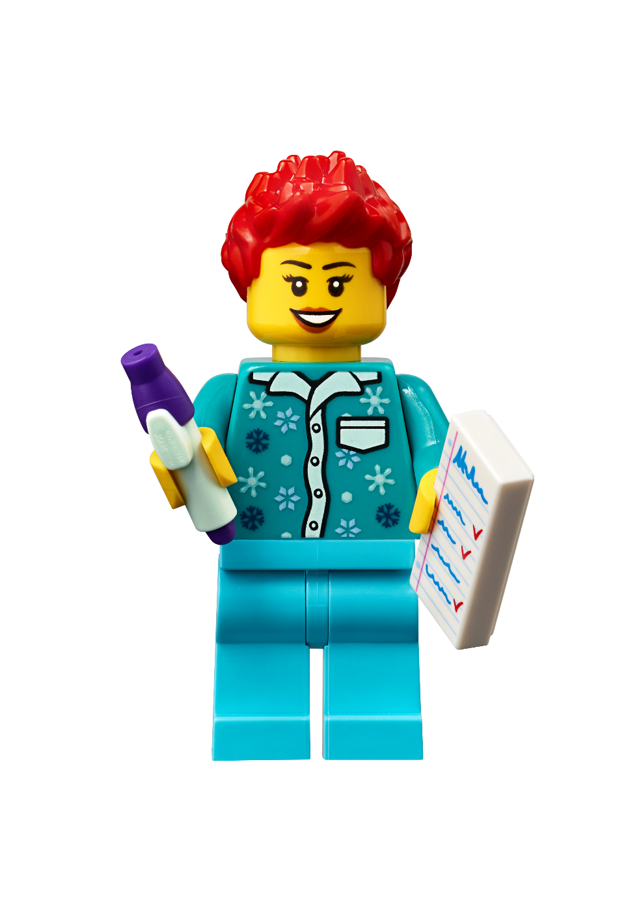
Tasks
Communicate what you have learned with others.
Notes:
Tasks (40 minutes)
Gather your completed team model and team poster.
Talk about what your team would like to share at your event!
Complete the next page to prepare for your event.
Look over the reviewing sheet with your coach.
Practice your presentation.
Communicate what you have learned with others.
Session Tips
Go over the reviewing sheet and reviewing questions with your team.
Ask the team the reviewing questions and practice the responses they would give the reviewers.
If you are not attending an official festival, you can still run your own festival or have an informal sharing event.
Every question on this page doesn’t need to be answered. They are just to help your team feel ready for the event.
You could have the team practice their presentation by presenting to others before their event.
Your team could register for an Explore festival or you can run your own festival.

Slide 10

Share
Practice your team poster presentation.
Practice your team model presentation.
Notes:
Share (10 minutes)
Have the team:
Practice their team poster presentation.
Practice their team model presentation.

Slide 11

Optional Video:
You may wish to embed a relevant, age-appropriate video for your students here. See the Notes for an example.
Notes:
Choose a relevant, age-appropriate video for your students.
Here is one example from the IET in the United Kingdom on how to prepare for your festival: https://youtu.be/sWHGL7RcYrM

Slide 12
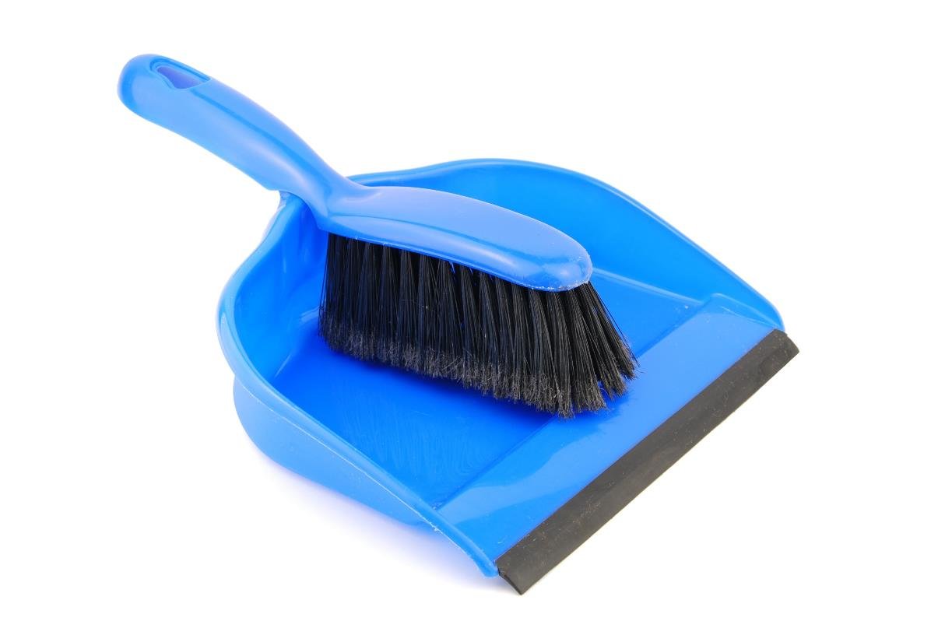
Clean Up
Notes:
Clean Up Pointers
Make sure the team model and team poster are stored and ready to be transported to the event.
Check that you have the device, charging cord, and fully charged battery for the event.
You may wish to play a video or song during clean up time Link on
GoNoodle: https://family.gonoodle.com/activities/clean-up
Link on YouTube Kids: https://www.youtubekids.com/watch?v=ZJFk87ZsHn0
Link on Youtube: https://youtu.be/ZJFk87ZsHn0

Slide 13

LEGO, the LEGO logo and the SPIKE logo are trademarks of the/sont des marques de commerce du/son marcas registradas de LEGO Group. ©2023 The LEGO Group. All rights reserved/Tous droits réservés/Todos los derechos reservados. FIRST®, the FIRST® logo, and FIRST® in SHOWSM are registered trademarks of For Inspiration and Recognition of Science and Technology (FIRST). LEGO® is a registered trademark of the LEGO Group. FIRST® LEGO® League and MASTERPIECESM are jointly held trademarks of FIRST and the LEGO Group. ©2023 FIRST and the LEGO Group. All rights reserved.

