Slide 1
Let’s play
Discover More and
Family Engagement
Updated for the 2022-2023 SUPERPOWEREDSM FIRST LEGO League season
Notes:
Teachers: These slides are for you! You can customize them by changing the text, switching images, or by inserting slides to reflect how your school is doing FIRST LEGO League. Do not change the FIRST or LEGO trademarks or any logos included in the slides.
FIRST® and the FIRST® logo are registered trademarks of For Inspiration and Recognition of Science and Technology (FIRST). LEGO® and DUPLO® are registered trademarks of the LEGO Group. FIRST® LEGO® League and SUPERPOWEREDSM are jointly held trademarks of FIRST and the LEGO Group. All other trademarks are the property of their respective owners. ©2022 FIRST and the LEGO Group. All rights reserved.

Slide 2
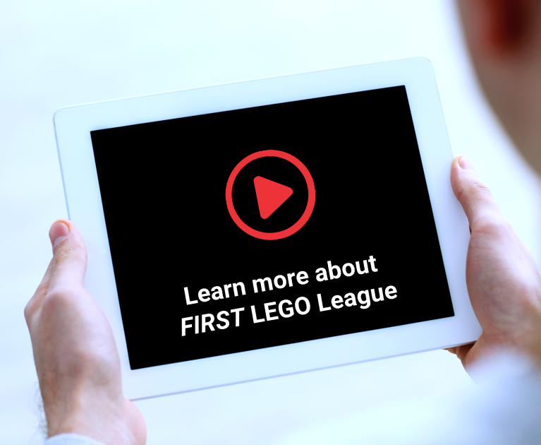
FIRST® Family Engagement
Families who participate together in FIRST® LEGO® League discover the power of curiosity, creativity, and problem solving, building the foundation for life-long confidence in STEM learning.
Notes:
Before you get started, share About FIRST® LEGO® League Video: https://www.youtube.com/watch?v=kkN08bDv9EI&t
If you are doing FIRST LEGO League Discover, you may want to just show the video up through Discover section (stop it at 1:37).
If you have enough time, share full video to give a glimpse of all the FIRST LEGO League divisions.
If you are unable to access YouTube at your location, the video is also available through Thinkscape for US/CAN teams (Accessed through the FIRST Dashboard at firstinspires.org) and through your Program Delivery Partner for teams outside US/CAN.
Explain that you will be doing FIRST LEGO League:
Include the start day, usual day and time for the sessions, how long the program will last, and when your celebration event will take place.
Will family volunteers be invited to help during the sessions? Will families attend the celebration?
What will students and families get out of participating in FIRST LEGO League?:
Families provide critical support for student learning. Through FIRST LEGO League, you'll see your child building habits of learning like confidence and persistence, taking risks, working as a team, and improving their listening skills.
You get to join in the fun too! Families who participate together in FIRST® LEGO® League discover the power of curiosity, creativity, and problem solving, building the foundation for life-long confidence in STEM learning.

Slide 3
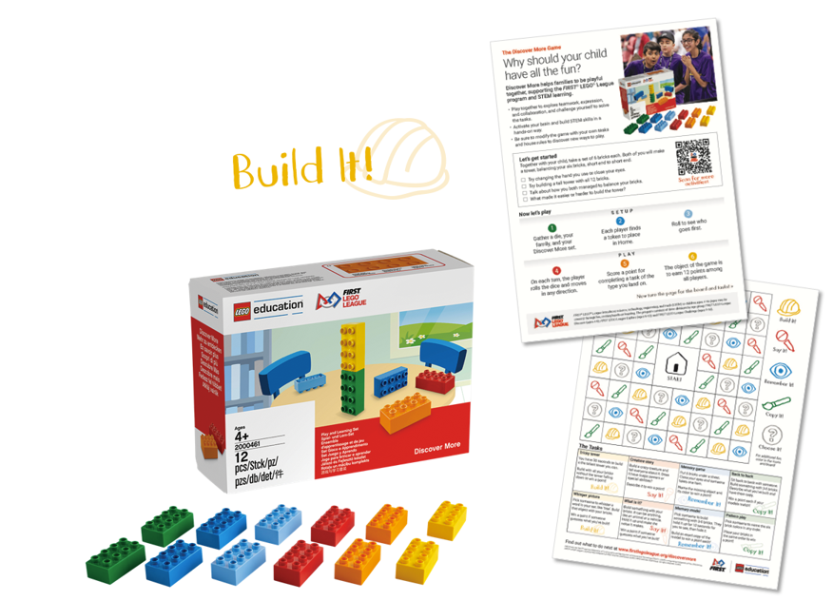
Let’s play
Your Discover More LEGO® DUPLO® brick set is for your family to take home and keep, so you can play anytime and anywhere to add to the ways you play together!
  Discover More game sheet
  Discover More set
  Get a die or number generator
  Get player pieces
Try the Tricky Tower
Notes:
Hand out the Discover More sets. Let families know this is their set to take home.
Hand out Discover More sets and printed game sheets.
Explain that families will need a few more items to be able to play at home:
Number generator app or find a die from another game or print out cube and make your own
Player pieces – Can come from another game, can create their own, Mini figures, random objects from house
Do the Tricky Tower intro activity
Build a tower as tall as you can using only one hand.
Give a minute to open box and a minute to build. Ask people to look at what others have done when they are finished.
Ask some guiding questions:
What made it easier or harder to build?
How did you balance your bricks? (in turn, let some of the adults explain what they did)
If you have to try a new way of balancing the bricks, what will you do?

Slide 4
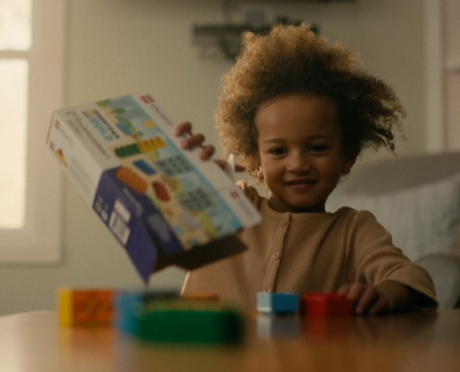
Make it your own
What works for your family?
Add your own rules
Other materials
Other players
Other settings
Notes:
Make the game your own and develop your own way of playing that works for your family
Create your own “house rules” and add them to the game – makes it fun and builds confidence
Try using other materials (other building toys, boxes, food packages, etc.)
Invite more players! Have the whole family join in, play with friends, visiting with grandparents, etc.
Where else could you play the game? Take your six bricks with you – on the bus, in the car, at the store, waiting at a doctor’s office, or wherever you could be more engaged with your family.
Play in the ways that work for your family
If time allows, play the whole game or just have families try a few more activities from the game.

Slide 5
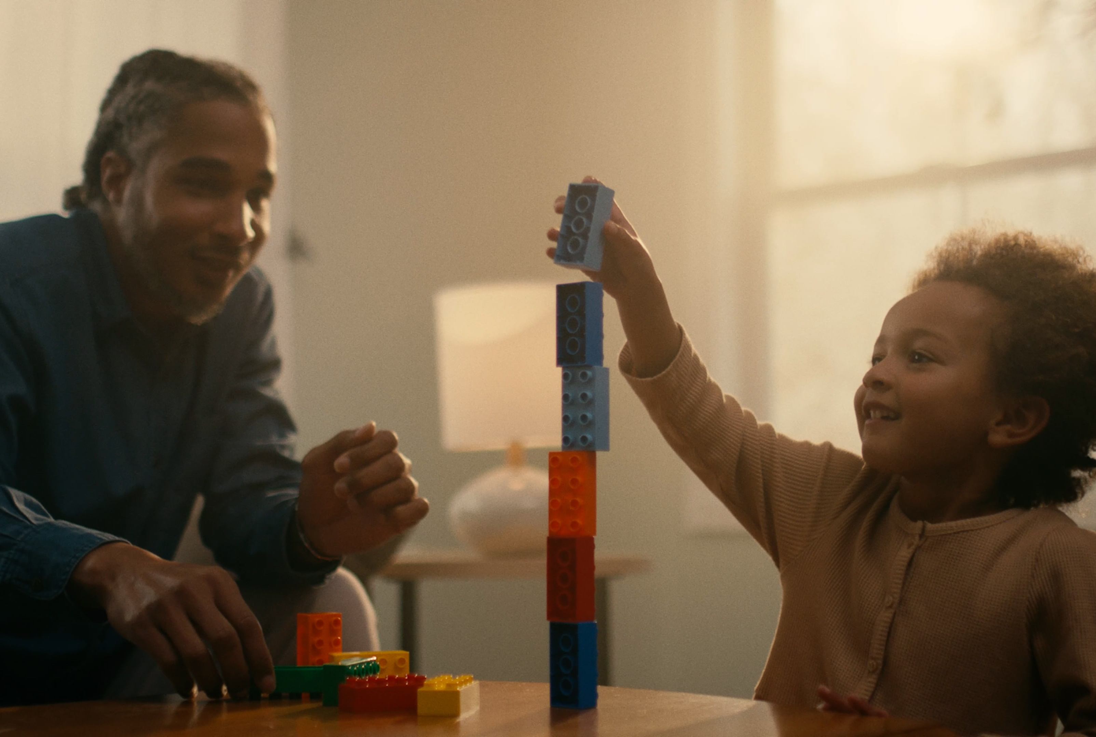
Learn together
Ask open-ended, guiding questions
  “What makes a tower stable?”
Spark more conversation
  “What happens if we try…?”
  “Tell me more about…”
Be an example
  “I wonder if we could…?”
  “Let’s try working together to…”
  “This is hard but I’m going to keep trying.”
Match your child’s interests
  “I saw you liked that activity. Let’s try it again!”
Keep playing and enjoy learning together!
Notes:
Discuss how families can facilitate the Discover More game.
Ask open-ended, guiding questions like “what makes a tower stable?”
Using these types of questions instead of yes/no questions prompts critical thinking and extends the discussion.
As you and your child ask questions, use them as a spark to talk more. Examples are “What happens if we try this?” or “Tell me more about that.”
Help the conversation go even further by talking more on the topic, making up a story about their build, or helping the child apply knowledge to ask new questions.“
Demonstrate the behaviors we want to encourage in children. Serve as a role model for them to follow your example. Ask questions like “I wonder if we could…?”
Match your child’s interests – if they like an activity, keep doing it!
It’s okay if it doesn’t go perfectly at first. Keep playing and enjoy the experience together.
If time allows, complete the rest of the Tricky Tower activity. Encourage families to participate together and ask guiding questions during the activity.
Encourage families to ask questions like:
What makes a tower stable?
How do you make the highest or shortest towers?
​What is different about building with 12 bricks?
What is helpful or hard about working in pairs?
If time allows, add a reflection question or two about working together as a family:
What was it like working together as a family to build the tower?
Did each person have a job or role in building the tower? Could you switch roles when you do the activity again?

Slide 6
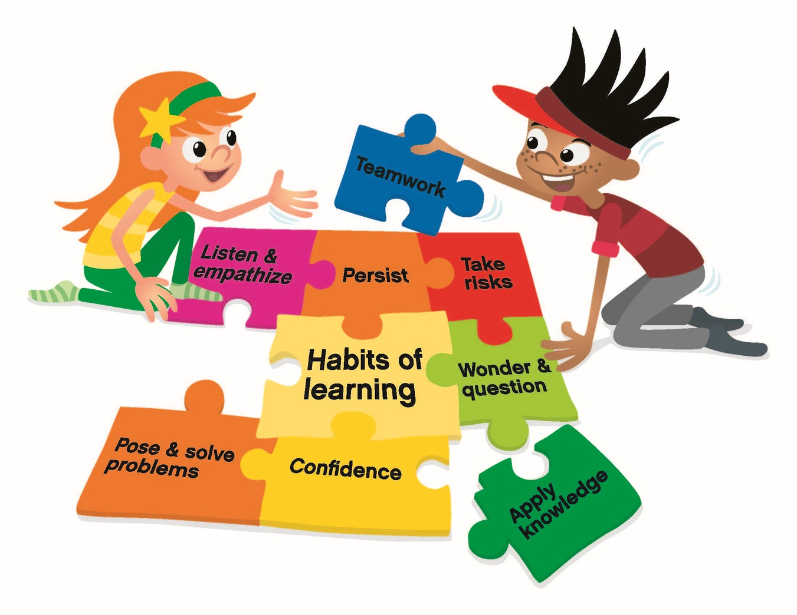
What you do at home supports learning in the classroom
You'll see your child building habits of learning like:
confidence and persistence
taking risks
working as a team
improving their listening skills
Notes:
Why would you want to play this together as a family?
You'll see your child building habits of learning like confidence and persistence, taking risks, working as a team, and improving their listening skills.
These social and emotional skills help children succeed in STEM learning and life
You might want to repeat the purpose statement from earlier slide: Families who participate together in FIRST® LEGO® League discover the power of curiosity, creativity, and problem solving, building the foundation for life-long confidence in STEM learning.
If your school has a similar framework, consider adding a slide after this one to connect to concepts that are already familiar to families.

Slide 7

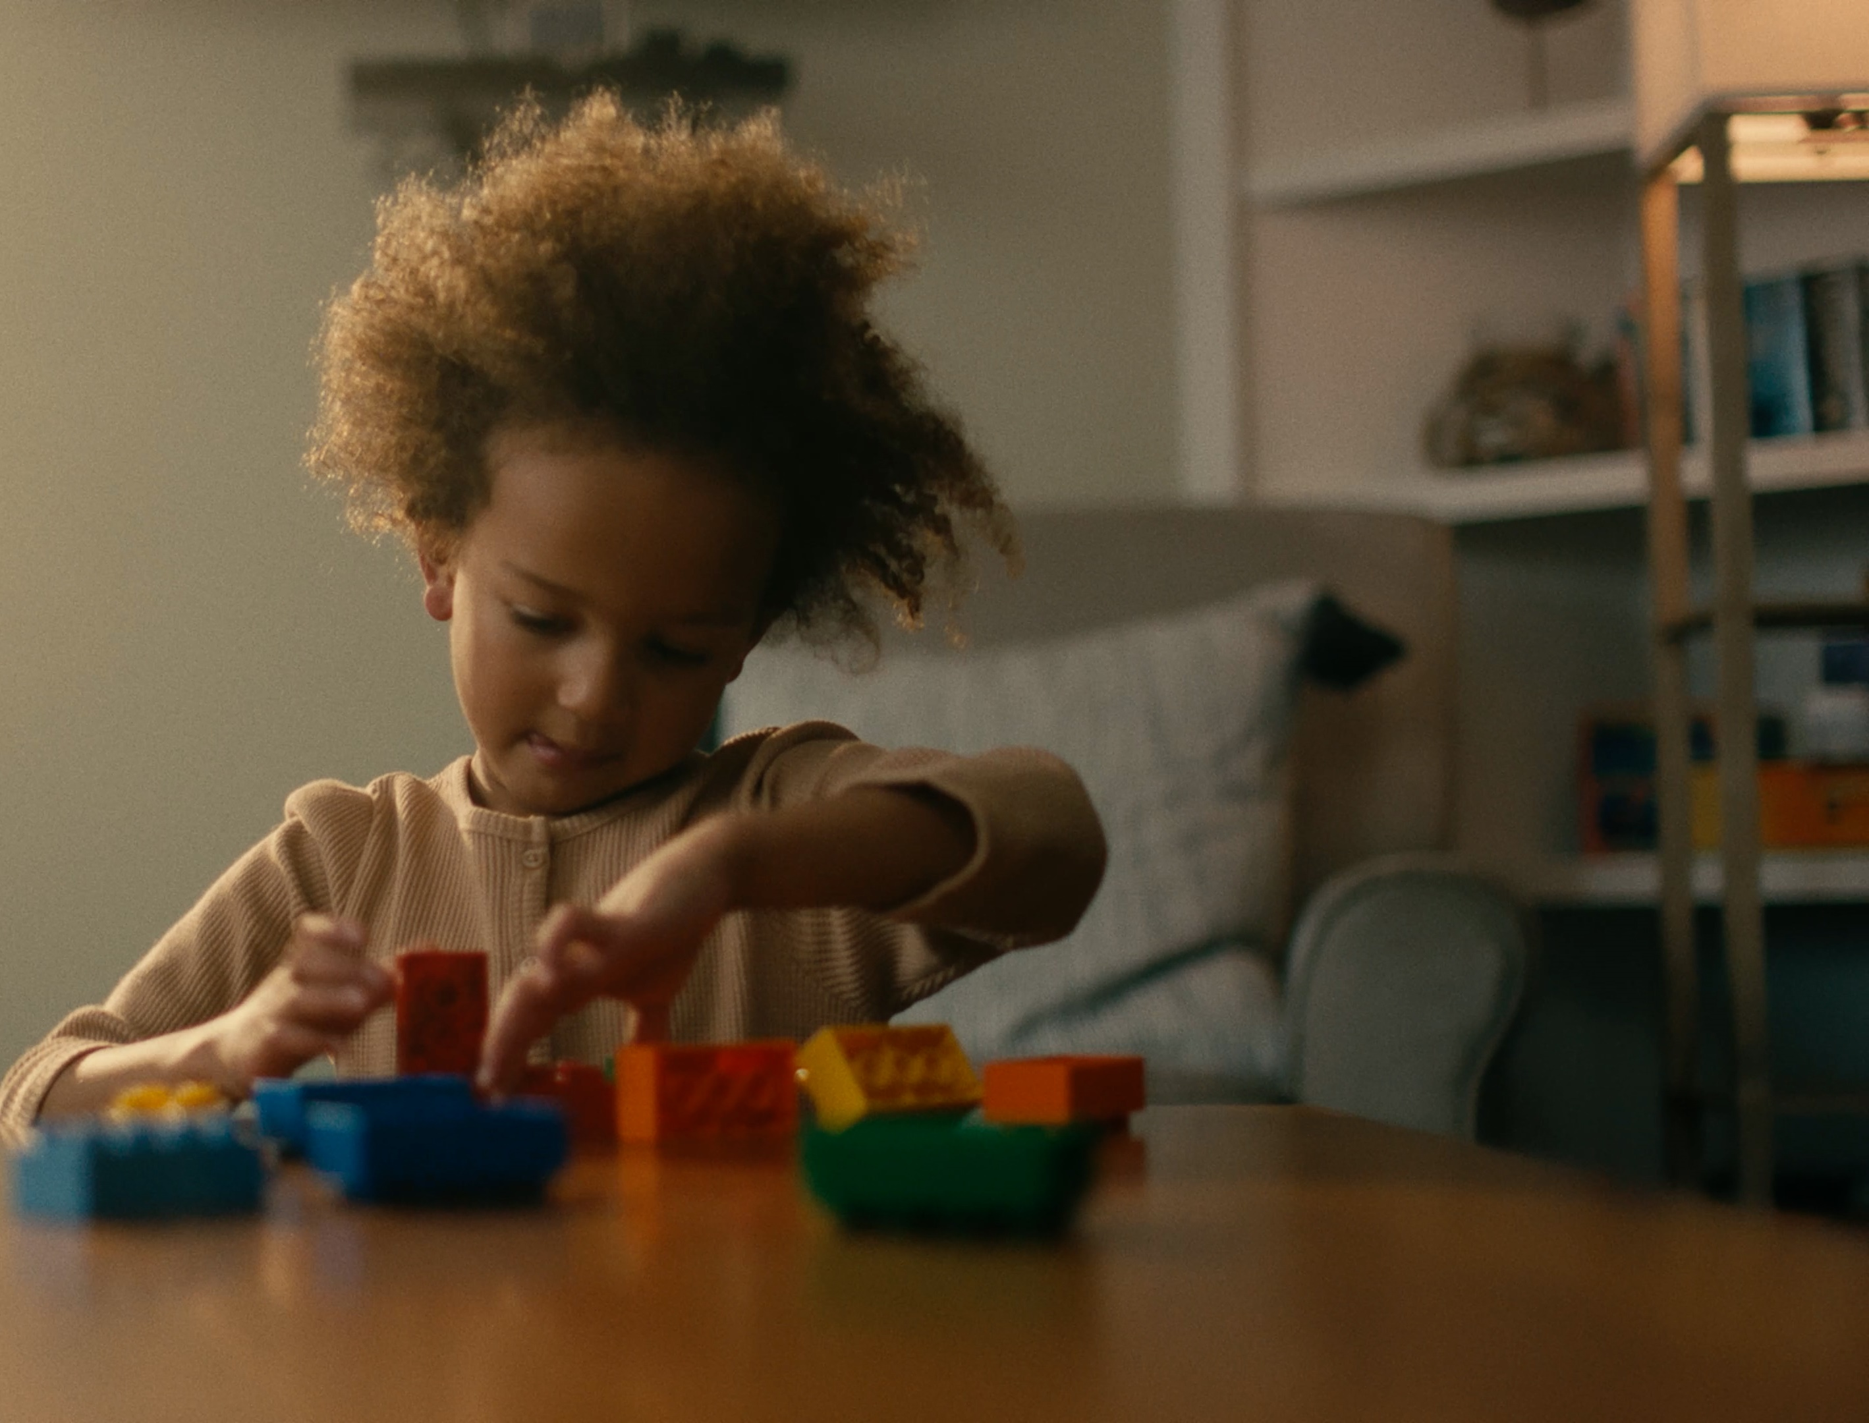

Discover More –
Family Engagement in
FIRST LEGO League
Notes:
We recommend watching the Discover More – Family Engagement in FIRST LEGO League video if you have time (1:33): https://youtu.be/-3OfhZ1FCsU
If time allows, you may wish to have a brief discussion of the video with the families using questions such as:
How is this family like your family?
What do you think your family might gain by playing the Discover More Game together?
When or where do you think you’ll play the game together as a family?
How can you make sure the game will be fun for your family?

Slide 8
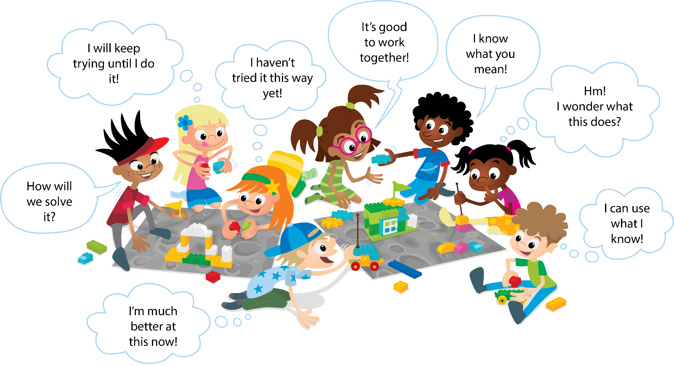
Learning through play
Notes:
Optional: You may wish to show this slide as an example of students demonstrating the habits of learning practiced in FIRST LEGO League.

Slide 9
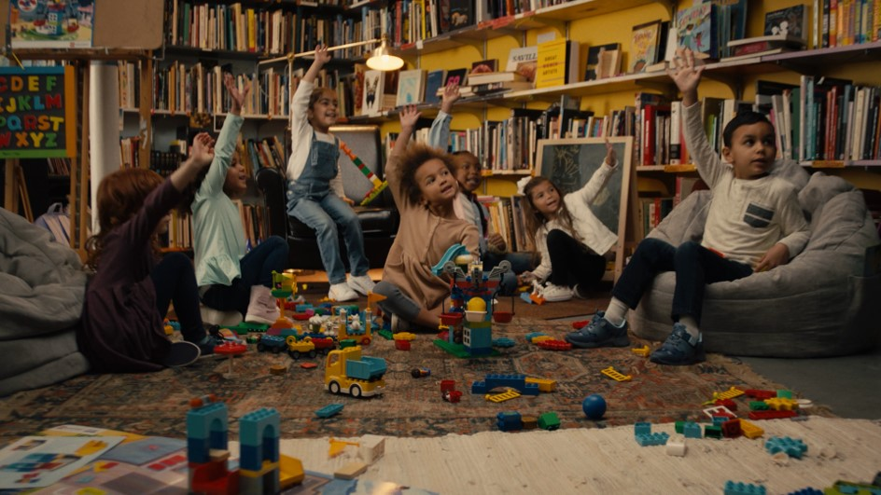
Questions?
Notes:
Answer questions as time allows. If any questions come up that you can’t answer about FIRST LEGO League, contact the administrator coordinating FIRST LEGO League for your school or organization or reach out to customerservice@firstinspires.org to ask FIRST directly.

