Slide 1
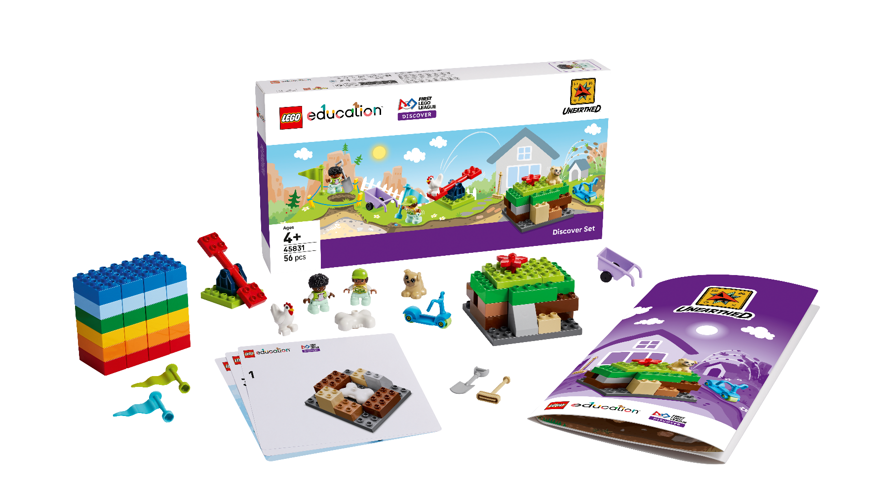


INTRODUCTION
Let’s Get Started

Slide 2
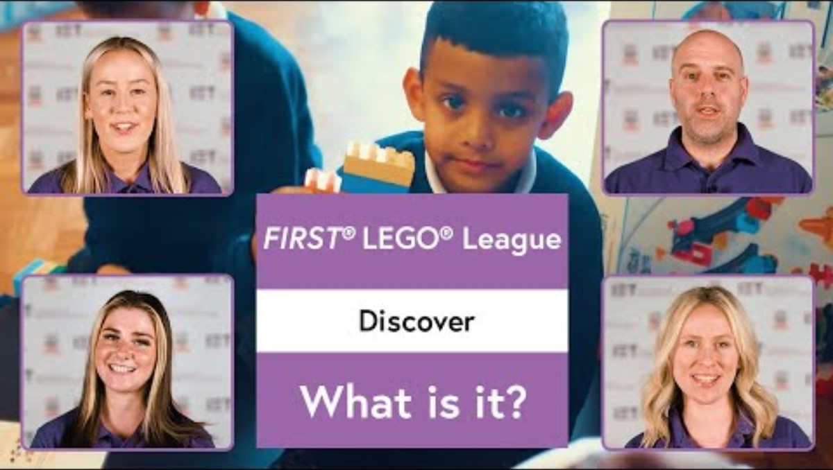
What is FIRST® LEGO® League?

Slide 3
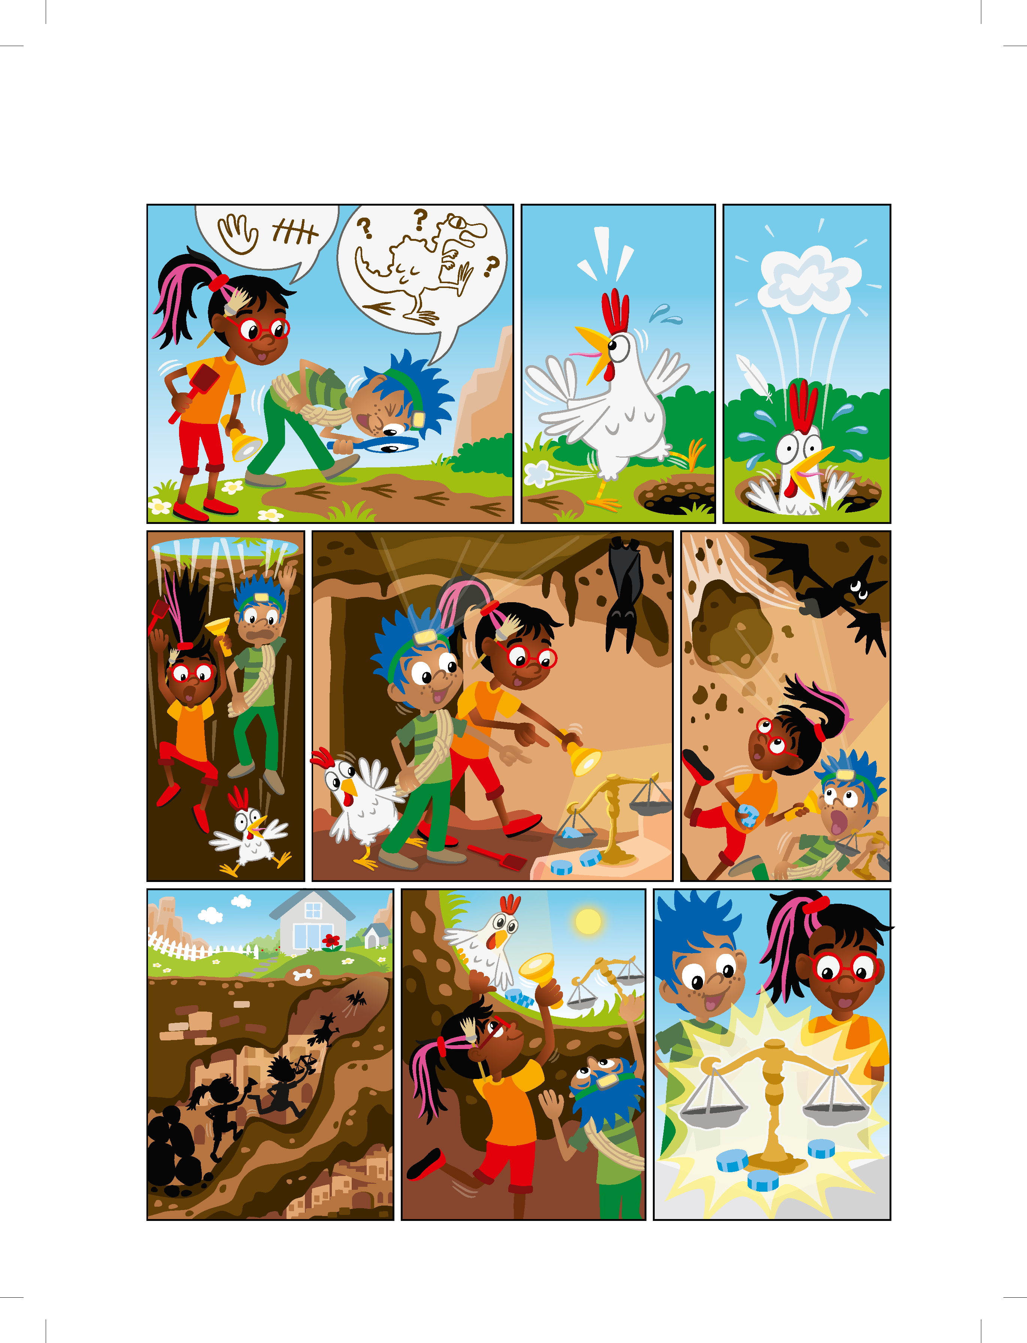
Discover Story

Slide 4
Discover Story

Slide 5
Discover Story

Slide 6







Each Session has…
Big Question
Key Vocabulary
Six Bricks Warm-Up
Create Task
Explore Task
Share Task
Reflect
Notes:
Each session has...
Big question: Each session has a Big Question that can be shared to frame the session.​
Six Bricks Warm-Up: Every session has a short warm-up activity using the six bricks sets.
Explore Task: The sessions start with a task to help students learn about the topic.
Key Vocabulary: Key words that will help with the content.
Create Task: Students will create builds during each session.
Share Task with your classmates or in your Engineering Notebook: Students share their work by either showing and explaining their builds or completing a task in their Engineering Notebook.
Reflect: Students will think about their create task and answer questions.
Clean Up: Take time during each session to have the students clean up and put away the materials.

Slide 7
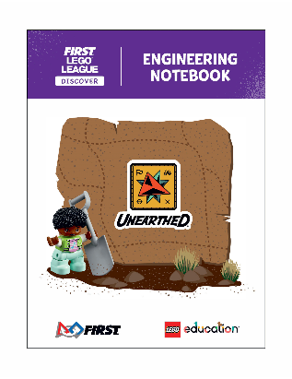
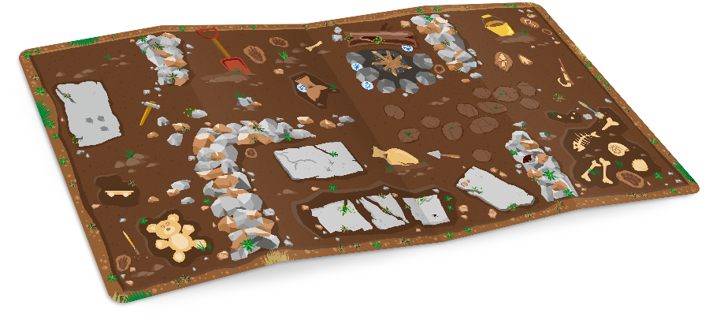
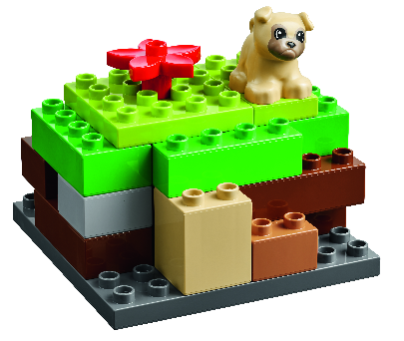

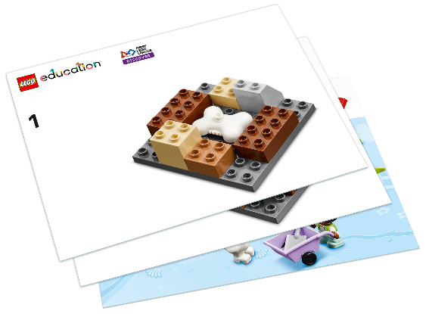
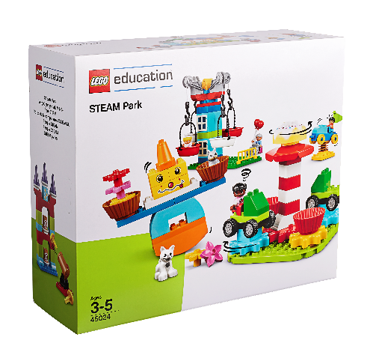
You will use...
Engineering Notebook
Discover Mat
Discover Model
Six Bricks Sets
Build Cards
STEAM Park Sets
Notes:
Materials that come with the FIRST LEGO League Discover registration.

Slide 8
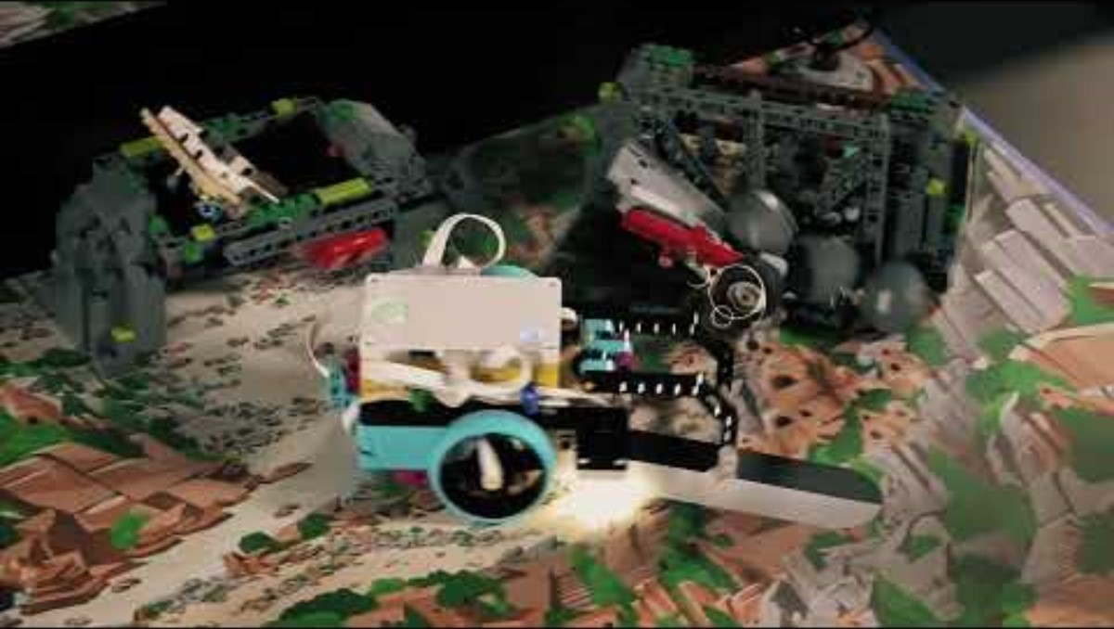

UNEARTHEDTM
Visit the FIRST LEGO League YouTube Channel for more videos. Click "Play" to view the 2025-2026 UNEARTHED Season Playlist.

Slide 9



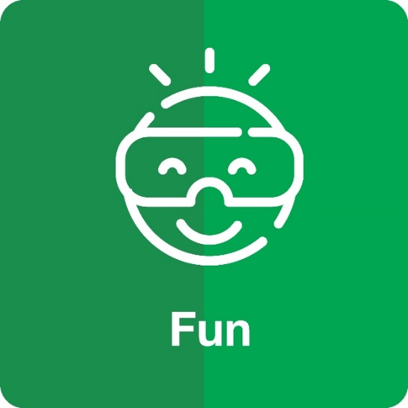


FIRST ® Core Values
Notes:
Review the FIRST® Core Values:
Discovery: We explore new skills and ideas.
Innovation: We use creativity and persistence to solve problems.
Impact: We apply what we learn to improve our world.
Inclusion: We respect each other and embrace our differences.
Teamwork: We are stronger when we work together.
Fun: We enjoy and celebrate what we do!

Slide 10


LEGO, the LEGO logo, DUPLO and the DUPLO logo are trademarks of the LEGO Group. ©2025 The LEGO Group. All rights reserved. FIRST®, the FIRST ® logo, and FIRST® AGETM are trademarks of For Inspiration and Recognition of Science and Technology (FIRST). LEGO® is a registered trademark of the LEGO Group. FIRST ® LEGO® League and UNEARTHEDTM are jointly held trademarks of FIRST and the LEGO Group. ©2025 FIRST and the LEGO Group. All rights reserved.

