Slide 1


SESSION 9
Ancient City
I can work with my team to reflect on their experiences throughout the sessions.
I can work with my team to work collaboratively to build an ancient city.
Students will work together to build an ancient city using everything they have learned in the prior sessions.

Slide 2


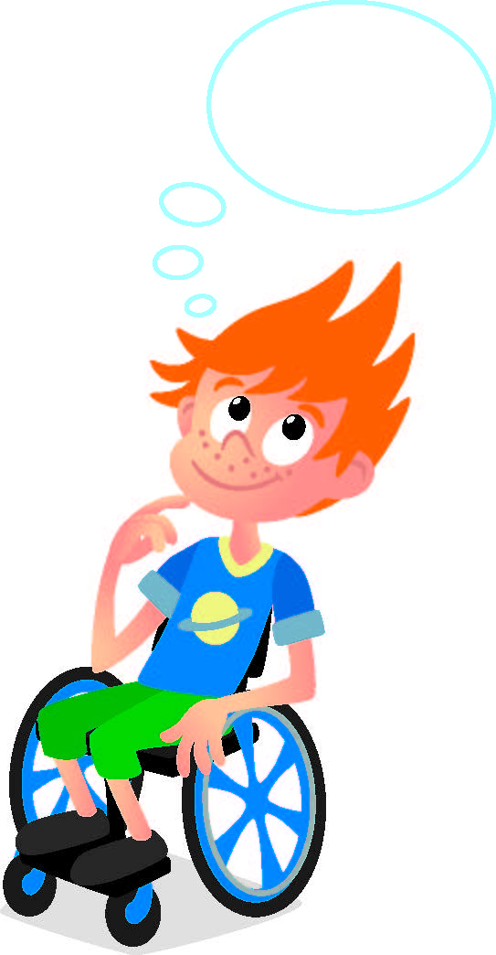
Discussion
What did we do last session?​
Notes:
Discuss with the students what they learned about time capsules in the previous session.

Slide 3
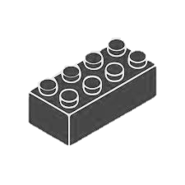
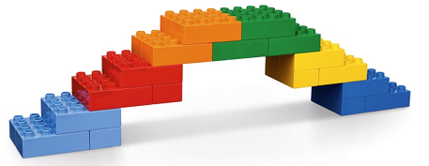

Warm Up
Build a Bridge
10 Minute Timer
Start
Click to Start Timer
2
8
4
6
Notes:
Warm-Up: (10 minutes) Build a Bridge​
​
Base Activity​
In groups of four, children combine their bricks and think of ways to build a bridge. The bridge can be built on the Discover Mat to connect two areas.
2. Give the children time to discuss and plan which areas they will connect and how they will connect them.
Guiding Questions: ​
• Why did you choose to connect these two areas of the Discover Mat?
• Did your original plan work? What ideas did you change?
• How did you work together with your team?
Children learn to: ​
• Engage in creative problem-solving.
• Negotiate when and how to carry out tasks.
• Make reasoned choices and decisions.

Slide 4
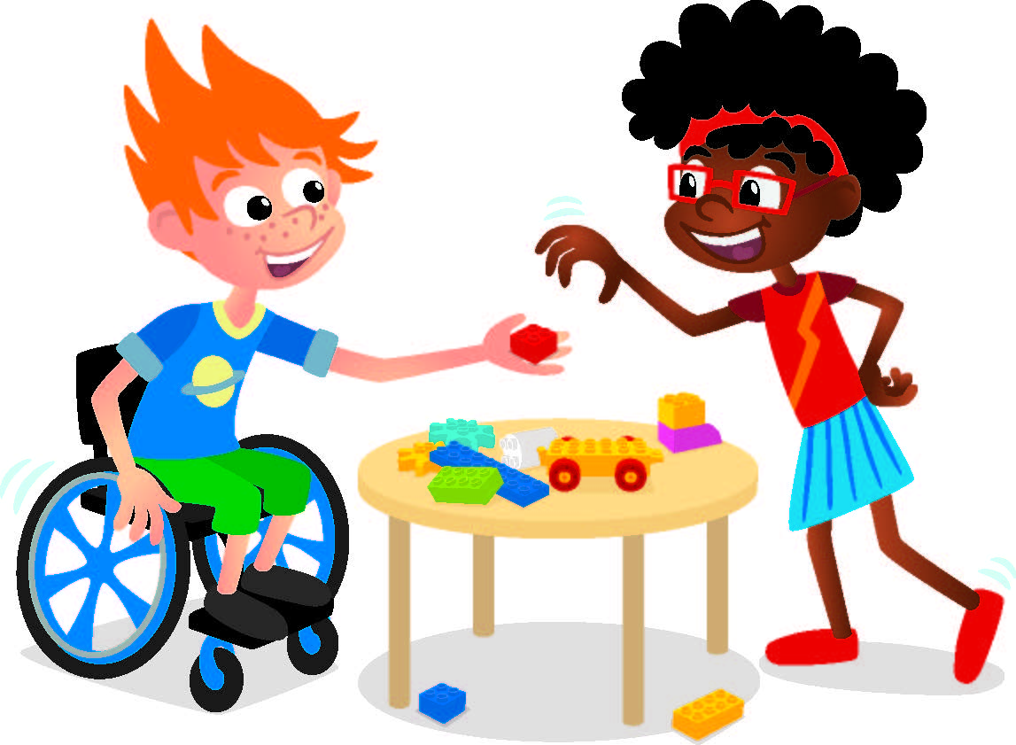
Big Question
Can you build an ancient city?
Notes:
Outcomes
Teams will reflect on their experiences throughout the sessions.
Teams will work collaboratively to build an ancient city.

Slide 5

Explore
What have you learned about archaeologists?
Notes:
Explore Task (10 minutes) ​
Ask the children to reflect on their experience throughout the sessions. The celebration event is next; reviewers will ask them about what they learned during the UNEARTHED™ season.
They could talk about:
• Archaeologist jobs (collecting, digging, and mapping).
• Artifacts (treasure, time capsules, or things people used long ago).
• Tools (shovels, brushes, and wheelbarrows).
Explain to the children that when archaeologists have the right tools and the right information, they can describe how people used to live. Share photos of ancient cities and ask the children to share what it would have been like to live there.

Slide 6



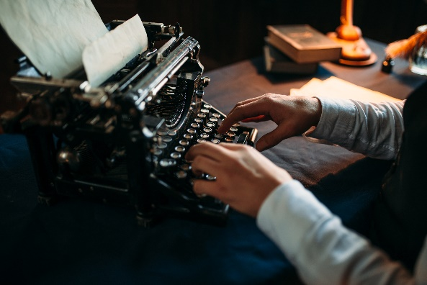
Key Vocabulary
Reflect: to think seriously and carefully
Storytelling: to speak or write stories
History: a written record of important events and their causes
Notes:
Key Vocabulary
Reflect, storytelling, history

Slide 7

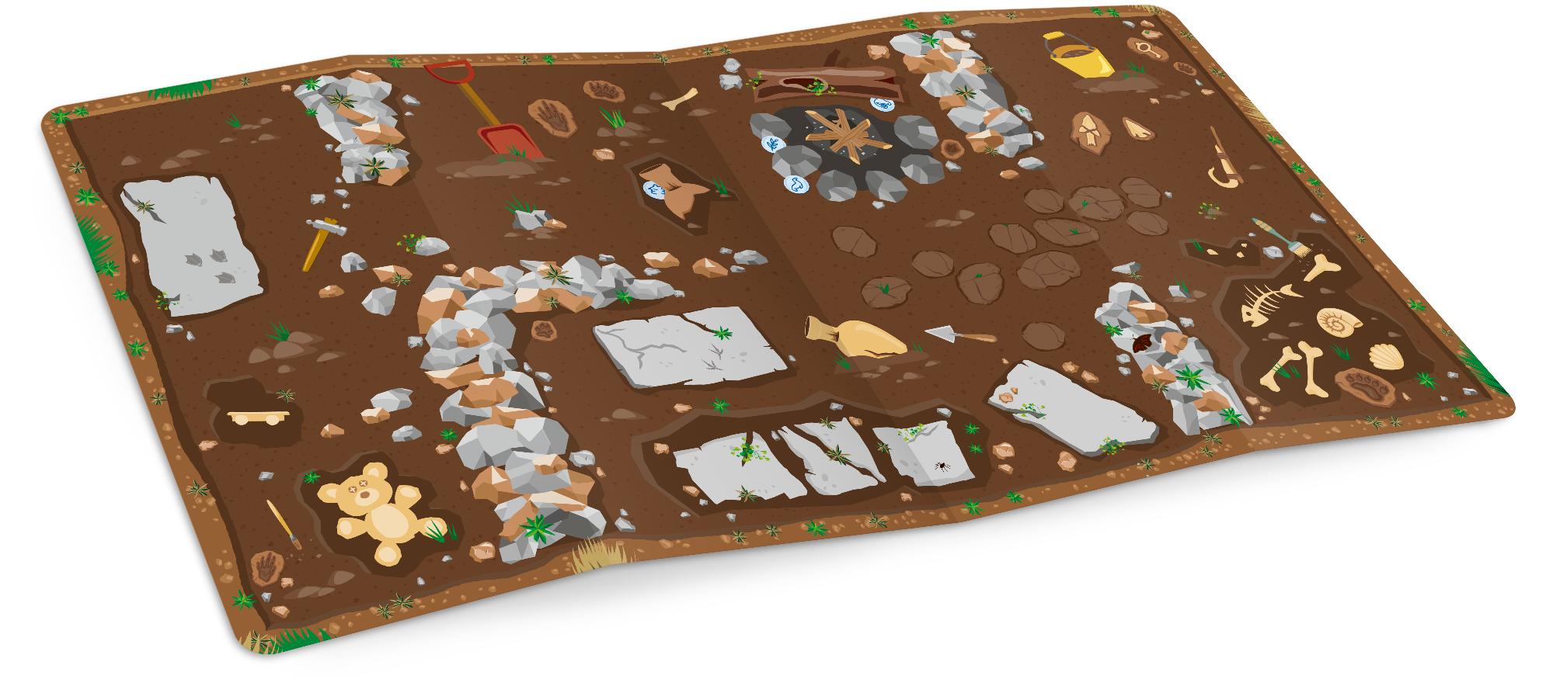
Create
Build an ancient city on the mat.
Notes:
Create Task
Tell the children to work together to create an ancient city on the mat. They should build places where people lived. Their model should show things that were important to the imaginary people that lived there. Encourage the children to come up with stories about their ancient city as they build.
You could ask them questions like:
• What makes your ancient city special?
• What games did children play in the ancient city?
• How did they build their buildings?
• If you lived in this city, what job would you have?
Archaeologists are storytellers because they uncover clues to the past. By building their own ancient city model, children will explore the importance of artifacts, tools, and history while building their creativity, teamwork, and storytelling skills.
Facilitator Tip:
You could encourage children to collaborate by assigning roles like city planner, builder, fixer, and storyteller.

Slide 8

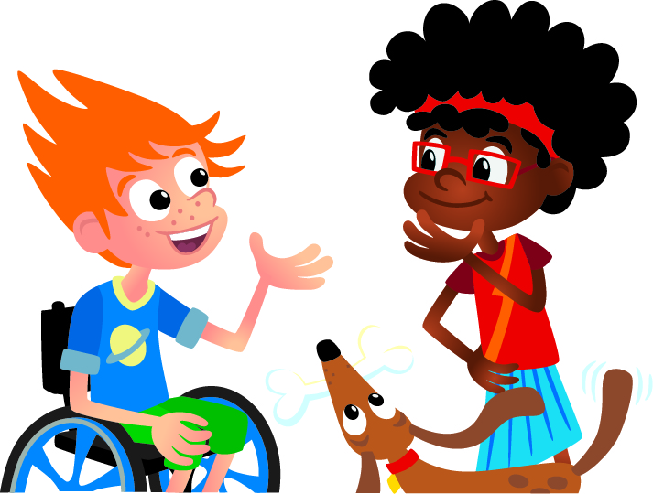
Share
Describe the ancient city you built.
Notes:
Share Task (15 minutes) ​
After the children are finished building, have them talk about their ancient city. They can share answers to the questions above as a team or they can share what they contributed. Have the children complete Sessions 9 and 10 in their Engineering Notebooks before the celebration event.

Slide 9
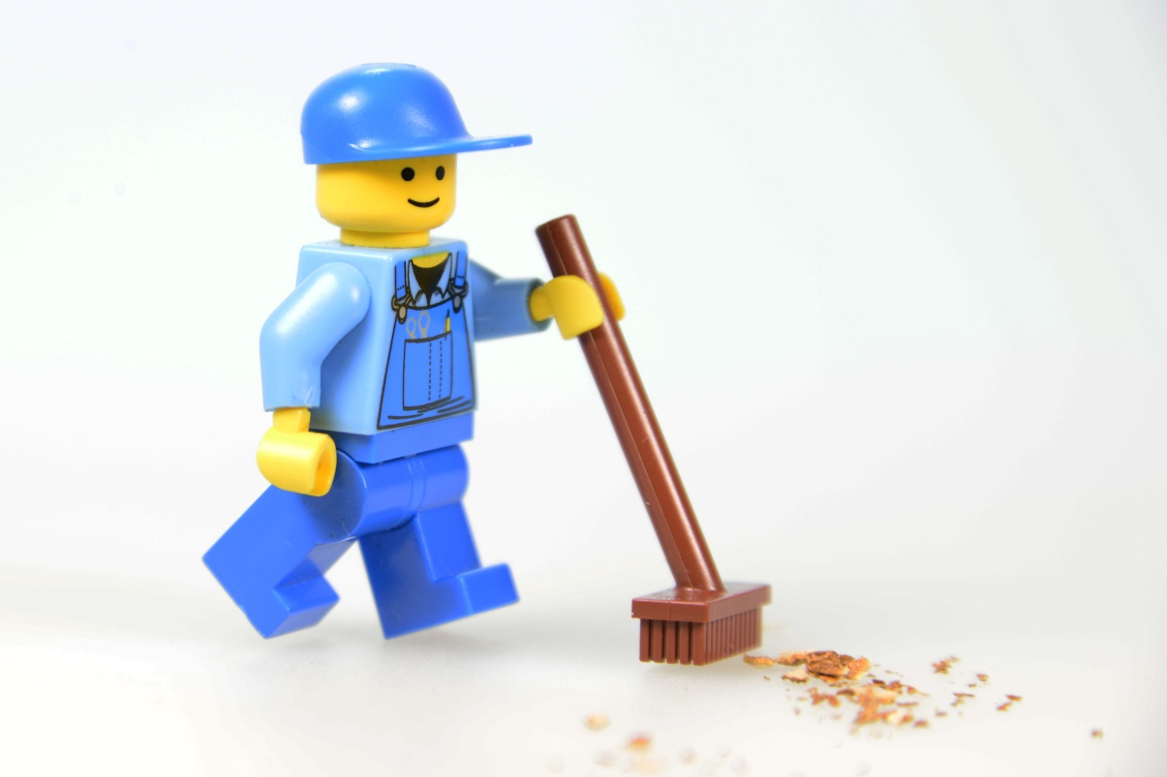
Clean Up
Notes:
You may wish to play a video or song during clean up time.
Link on GoNoodle: https://family.gonoodle.com/activities/clean-up
Link on YouTube Kids: https://www.youtubekids.com/watch?v=ZJFk87ZsHn0
Link on YouTube: https://youtu.be/ZJFk87ZsHn0
Send home the Discover More set with each child for home learning and exploration. Check out page 8 of the Team Meeting Guide for how to use this set for family engagement.

Slide 10
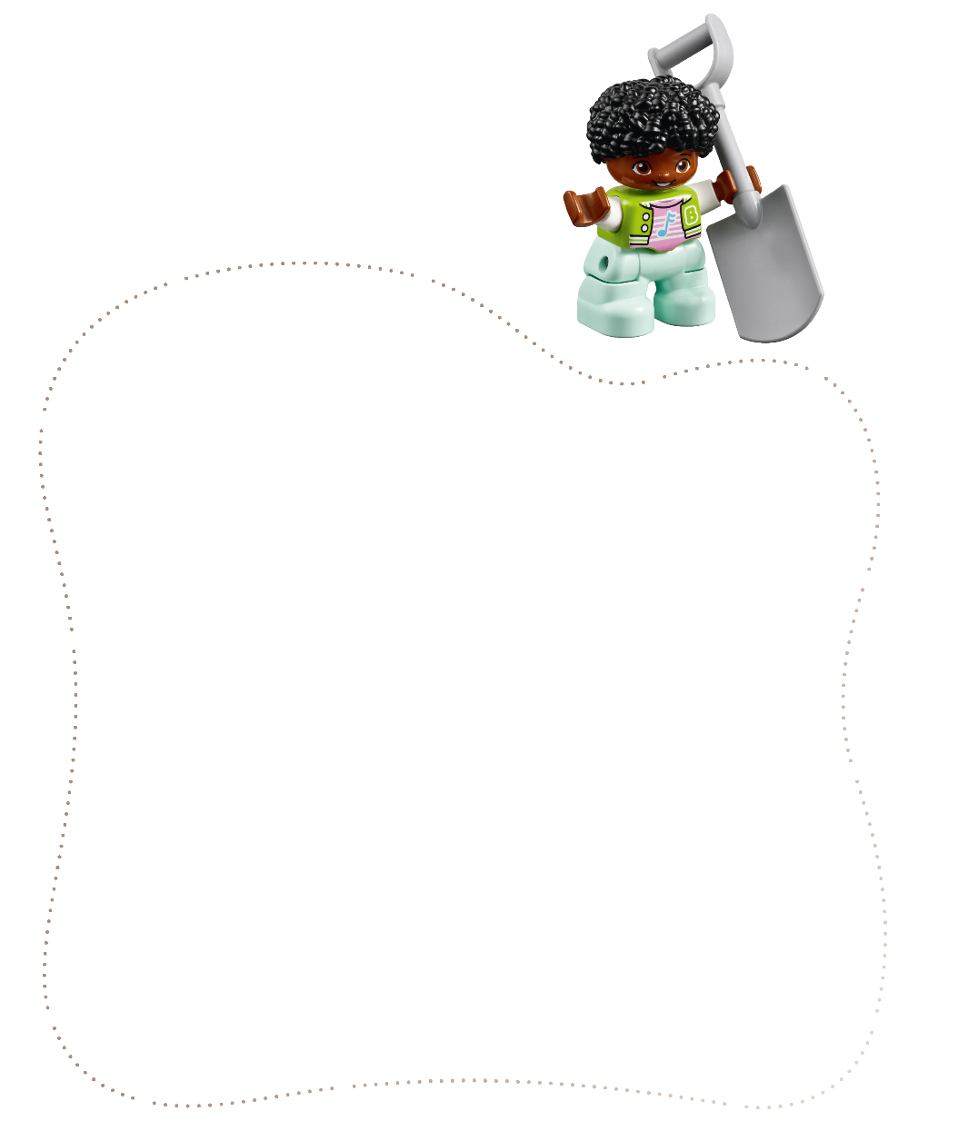
Engineering Notebook
Draw a picture of your ancient city on page 9.
Notes:
Have the children complete the activity in their Engineering Notebooks.

Slide 11
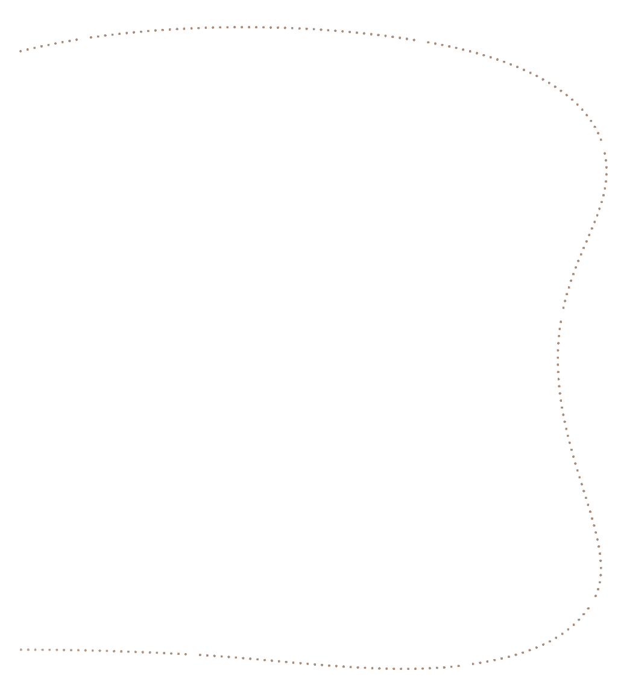

Engineering Notebook
Draw what you learned about archaeology on pages 10-11.
Notes:
Have the children complete the activity in their Engineering Notebooks.

Slide 12

Reflect
Which part did you contribute to the build?

Slide 13


LEGO, the LEGO logo, DUPLO and the DUPLO logo are trademarks of the LEGO Group. ©2025 The LEGO Group. All rights reserved. FIRST®, the FIRST ® logo, and FIRST® AGETM are trademarks of For Inspiration and Recognition of Science and Technology (FIRST). LEGO® is a registered trademark of the LEGO Group. FIRST ® LEGO® League and UNEARTHEDTM are jointly held trademarks of FIRST and the LEGO Group. ©2025 FIRST and the LEGO Group. All rights reserved.

