Slide 1


SESSION 8
Time Capsule
I can work with my team to learn how archaeologists study history through time capsules.
I can work with my team to create a time capsule to be opened in the future.
Students will learn about what a time capsule is and build something they want to place in the time capsule for archaeologists to find in the future.

Slide 2


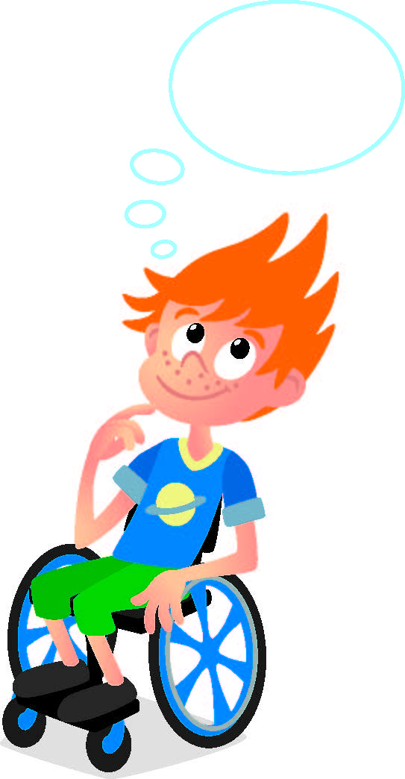
Discussion
What did we do last session?​
Notes:
Discuss with the students what happened in the adventure story they wrote in the previous session.

Slide 3
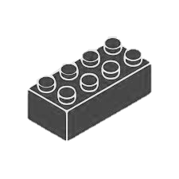
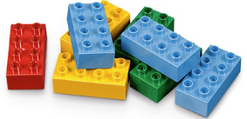

Warm Up
Build a Cube
10 Minute Timer
Start
Click to Start Timer
2
8
4
6
Notes:
Warm-Up: (10 minutes) Build a Cube​
​
Base Activity​
Children build a cube with Six Bricks so it does not fall apart.
Guiding Questions: ​
• Which two colors are on top, at the bottom, and in the middle?
• In pairs, how can one of you give instructions for the other to build a cube?
• What types of instructions are easier and harder to use? ​
Children learn to: ​
Enjoy solving problems.
• Engage in collaborative tasks with peers.

Slide 4

Big Question
What would you put inside a time capsule for the future?
Notes:
Outcomes
Teams will learn how archaeologists study history through time capsules.
Teams will create a time capsule to be opened in the future.

Slide 5
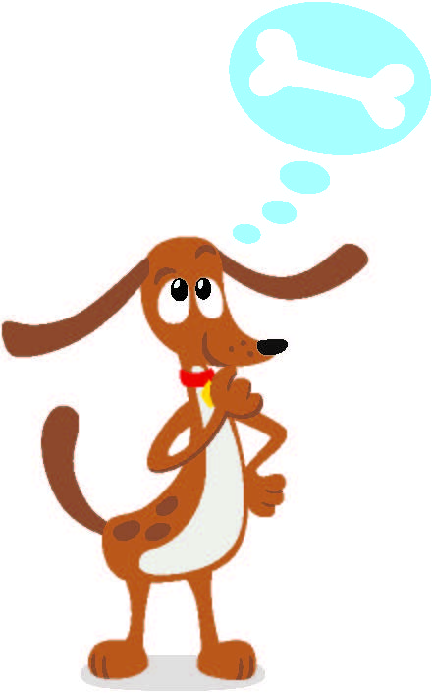

Explore
Have you heard of a time capsule?
What things can go inside of it?
Notes:
Explore Task (10 minutes) ​
Ask the children if they have ever heard of a time capsule. Time capsules are a way for people to pass information to future generations that represent how they lived at the time. Time capsules help to preserve their contents for a long time. Archaeologists sometimes find and study time capsules to understand the past. Discuss what kinds of things could be put inside of a time capsule. You could ask the children what they think people in the future would find interesting about their life today. What would someone think if they found these things many years from now?
Facilitator Tips:
Check to see if there are any sealed or recently opened time capsules locally.

Slide 6
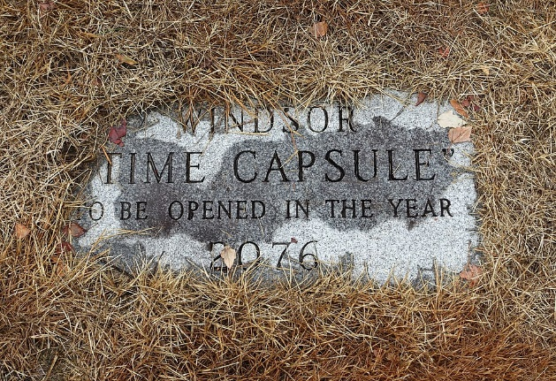

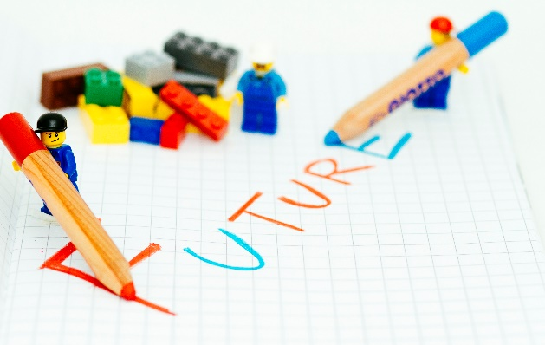
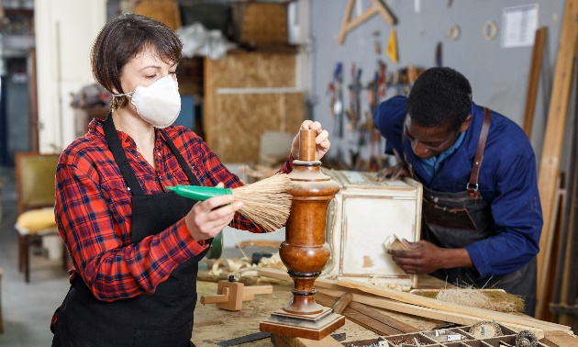
Key Vocabulary
Time capsule: a place to store items to save them
Future: coming after the present
Preserve: to keep or save from injury, loss, or ruin
Notes:
Key Vocabulary
Time capsule, future, preserve

Slide 7

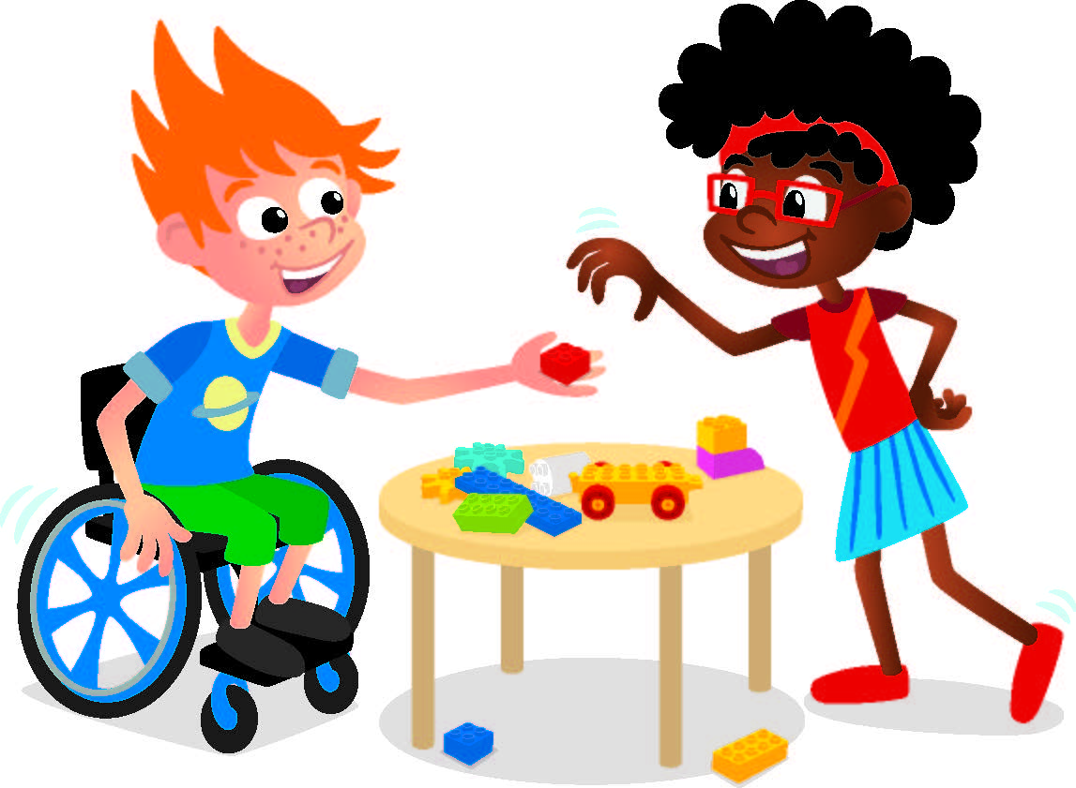
Create
Build a small item to put in the time capsule.
Notes:
Create Task
Have the children build something small to represent what they would like to put inside a time capsule.
Build a small capsule out of LEGO® bricks or other materials to protect what you placed inside.
Encourage the children to think about how archaeologists find artifacts hidden away.
What do the children want people to discover in the future?
Where should the capsule be placed so it is protected?
Close the capsule when the team is finished building.
Decide how long the capsule should remain closed. It could be a week, a month, or longer! When it is opened, the children can reflect on the things they have learned about archaeology.
Facilitator Tip:
Plan to open the time capsule before your time as a team is complete.

Slide 8
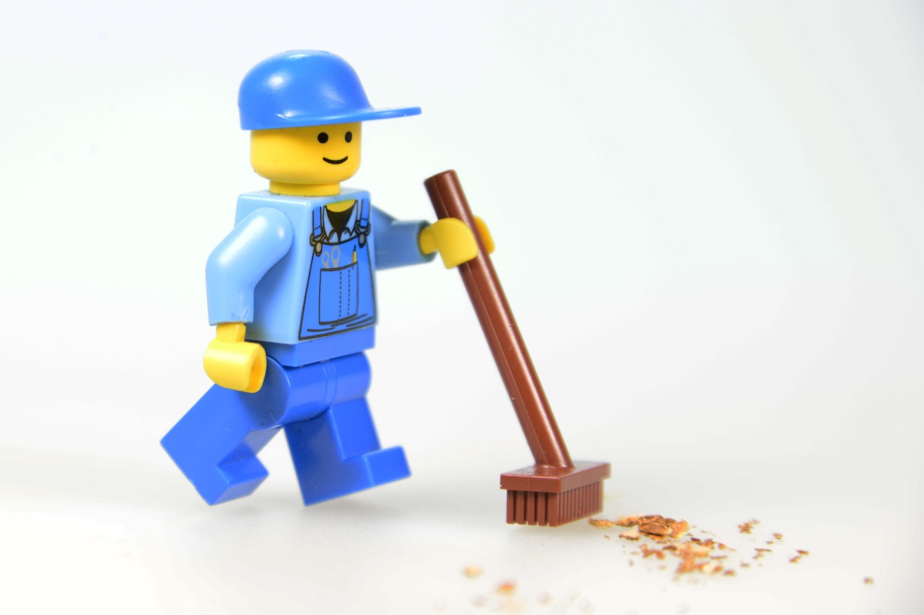
Clean Up
Notes:
You may wish to play a video or song during clean up time.
Link on GoNoodle: https://family.gonoodle.com/activities/clean-up
Link on YouTube Kids: https://www.youtubekids.com/watch?v=ZJFk87ZsHn0
Link on YouTube: https://youtu.be/ZJFk87ZsHn0
Send home the Discover More set with each child for home learning and exploration. Check out page 8 of the Team Meeting Guide for how to use this set for family engagement.

Slide 9
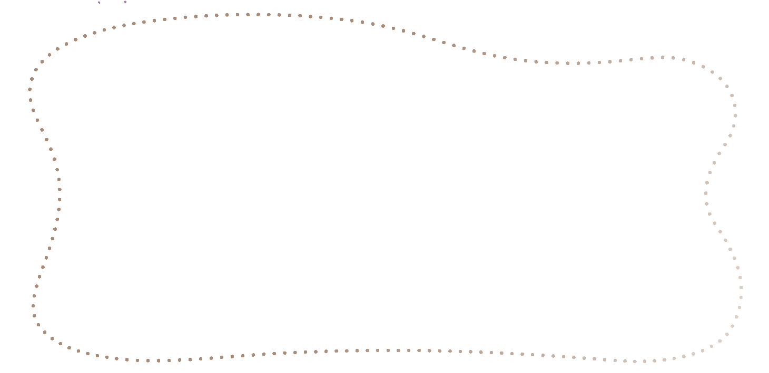
Engineering Notebook
Draw the item you would put in a time capsule.
Notes:
Have the children complete the activity in their Engineering Notebooks.

Slide 10

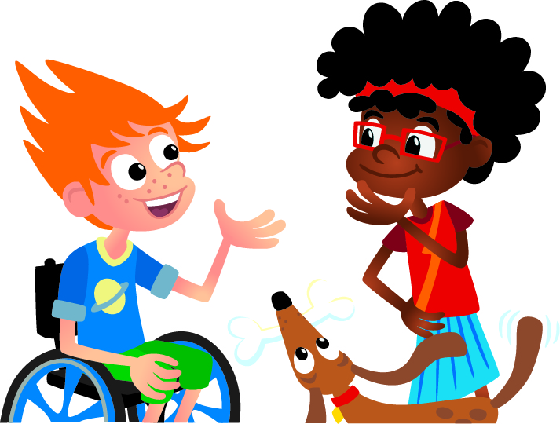
Share
What did you place in the time capsule?
Notes:
Share Task (15 minutes) ​
Ask the children to recall what a time capsule is and why archaeologists are interested in them.
Have the children complete their Engineering Notebook page by drawing the item they would put in a time capsule and share what they want people to know about it.
When the tasks are finished, everything built in this session should be taken apart and returned to storage.

Slide 11

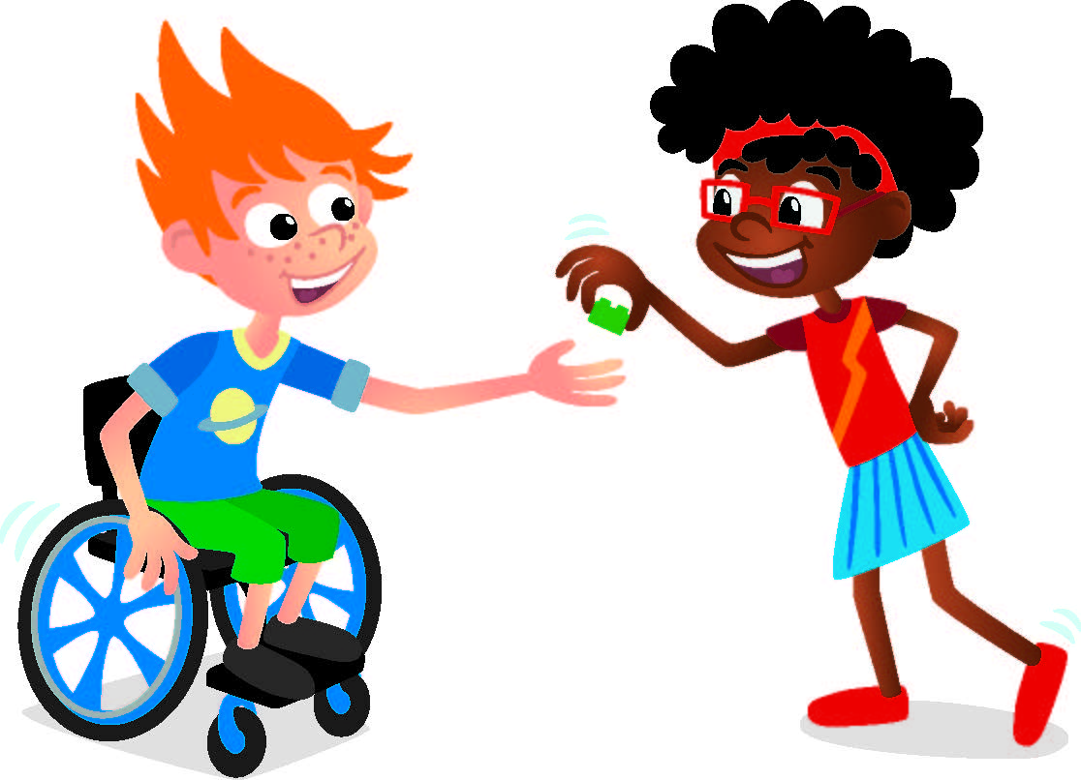
Reflect
Did anyone have the same item as you?

Slide 12


LEGO, the LEGO logo, DUPLO and the DUPLO logo are trademarks of the LEGO Group. ©2025 The LEGO Group. All rights reserved. FIRST®, the FIRST ® logo, and FIRST® AGETM are trademarks of For Inspiration and Recognition of Science and Technology (FIRST). LEGO® is a registered trademark of the LEGO Group. FIRST ® LEGO® League and UNEARTHEDTM are jointly held trademarks of FIRST and the LEGO Group. ©2025 FIRST and the LEGO Group. All rights reserved.

