Slide 1


SESSION 7
Archaeology Adventure
I can work with my team to tell a story about an archaeological adventure to recover an artifact.
I can work with my team to think about the archaeological process from discovery to sharing what they found.
Students will write a story about an archaeological adventure to recover an artifact, then build a model accompanying it.

Slide 2


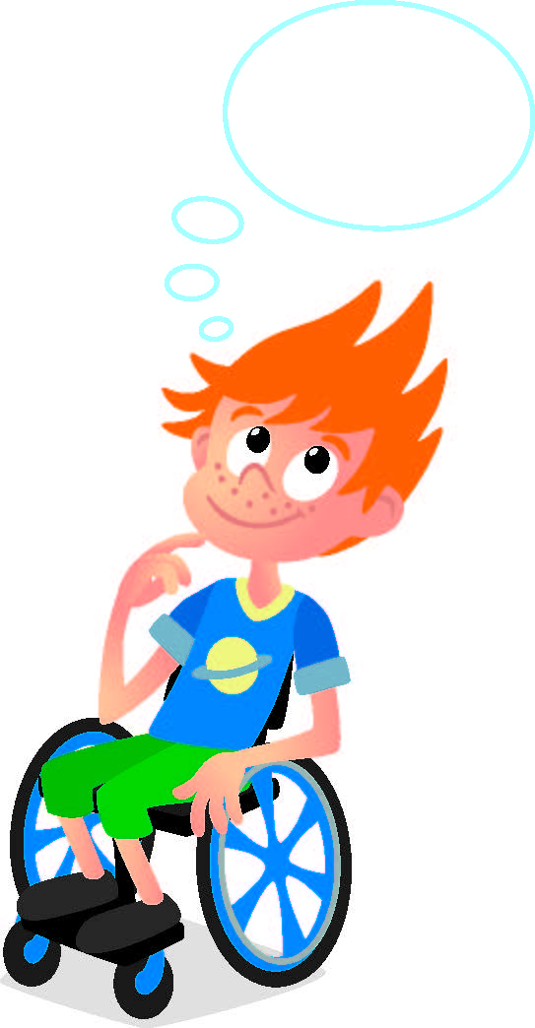
Discussion
What did we do last session?​
Notes:
Discuss with the students what tools were useful at a dig site in the previous session.

Slide 3
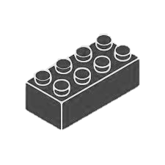
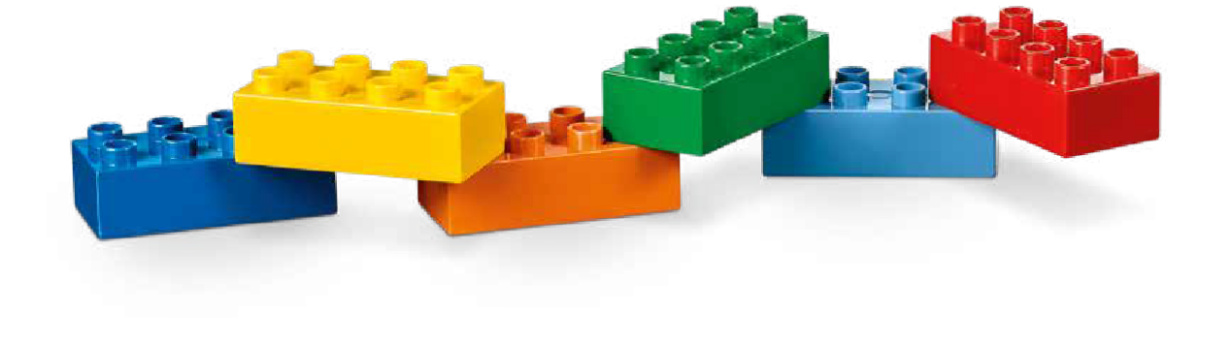
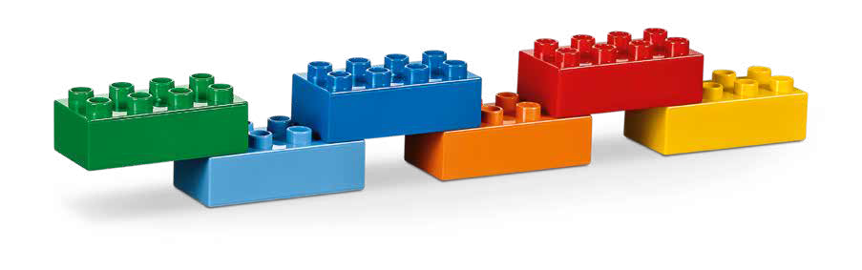

Warm Up
It Takes a Team
10 Minute Timer
Start
Click to Start Timer
2
8
4
6
Notes:
Warm-Up: (10 minutes) It Takes a Team​
​
Base Activity​
In groups of 4, have the children mix their bricks together.​
The children should work together to build a long line of connected blocks to represent a person that is part of a team and how they support each other to achieve success.​
The children should think about what happens if a brick is missing from the line.​
​
Guiding Questions: ​
What job does each brick represent? ​
How do the different jobs work together? ​
What would happen if there was a break in the line? ​
​
Children learn to: ​
Use strategies learned earlier (patterns). ​
Negotiate when and how to carry out a task. ​
Imagine and tell stories.

Slide 4
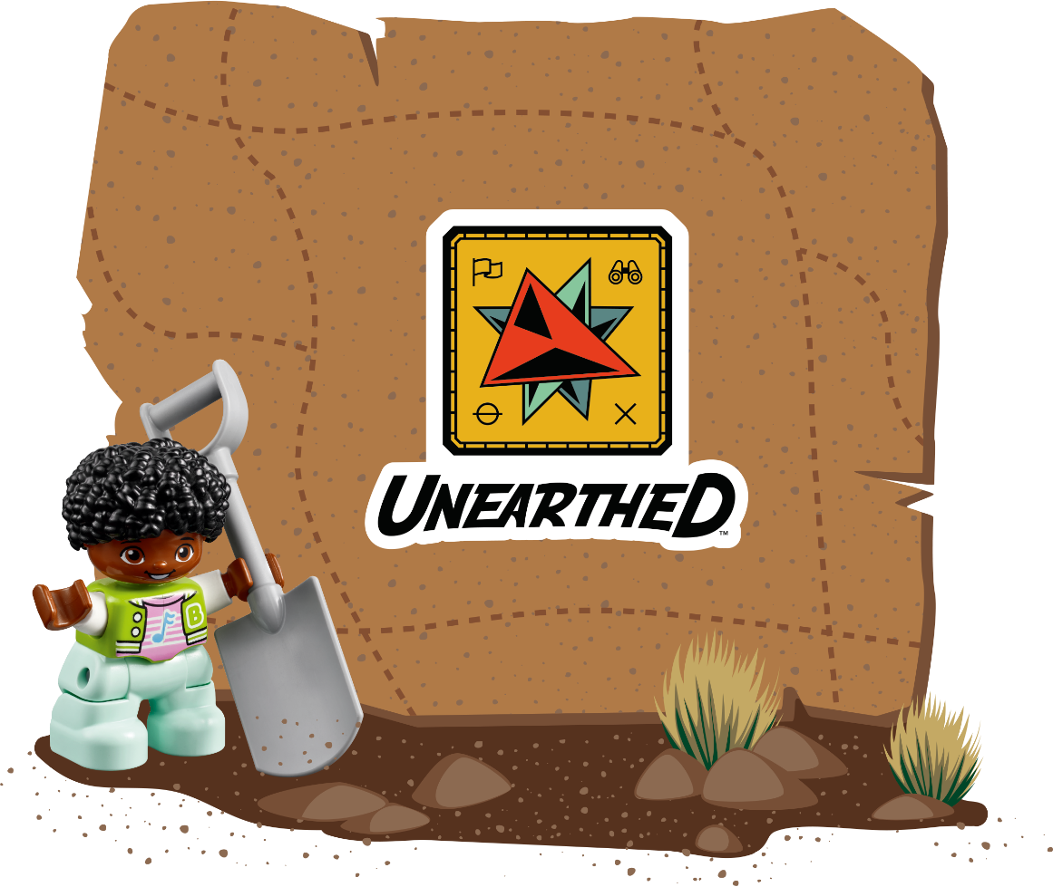
Big Question
Can you tell an archaeology adventure story?

Slide 5

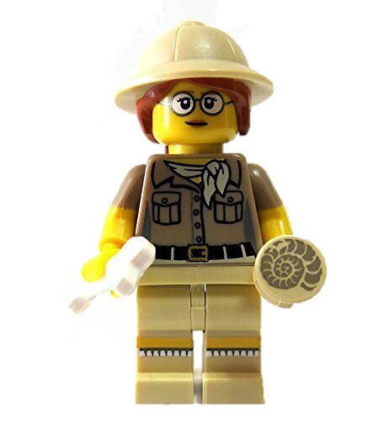
Explore
How would an archaeologist recover an artifact buried under our school?
Notes:
Explore Task (10 minutes) ​
When something new and exciting is found, archaeologists may need to work quickly to plan how to excavate. Sometimes, artifacts are found in unusual places. For example, how would an archaeologist recover an artifact buried under a house or a school?
To prepare for the next task, spark imagination in the team by creating a character for an archaeology adventure. Introduce the character to the children and explain that they will tell the story of an archaeologist who finds an ancient treasure and shares it with the community. Describe a location where the dig will take place.
Facilitator Tips:
You can use one of the DUPLO® figures from the Discover or STEAM Park Sets.

Slide 6
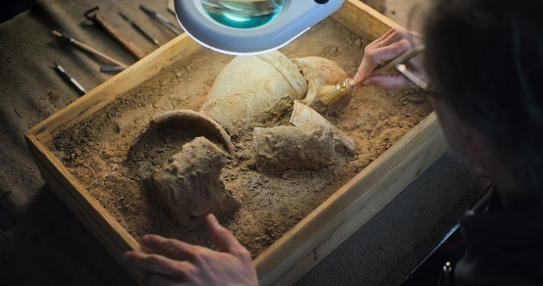

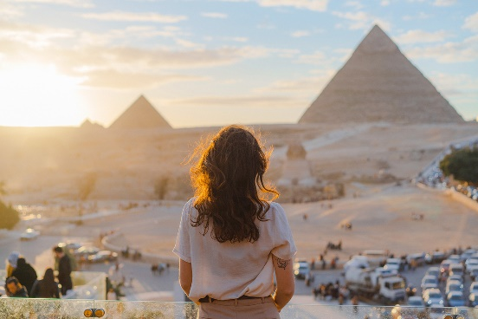
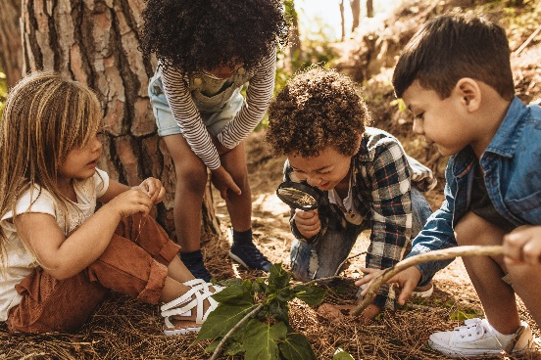
Key Vocabulary
Recover: to get something back or save it
Adventure: an action involving unknown risks or dangers
Share: to use, experience, or enjoy with others
Notes:
Key Vocabulary
Recover, adventure, share

Slide 7

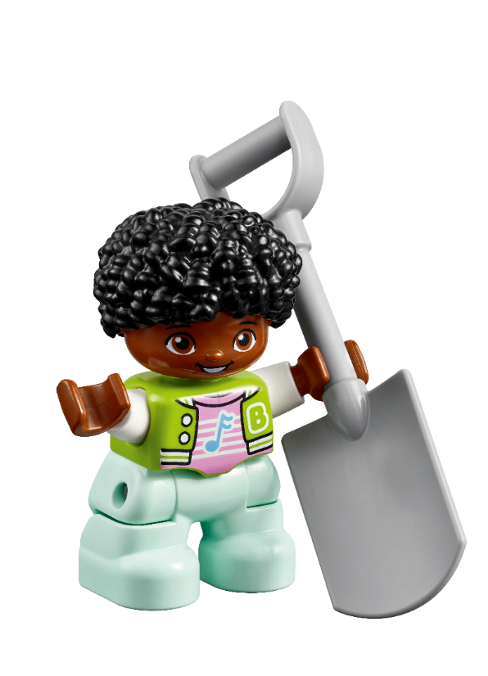
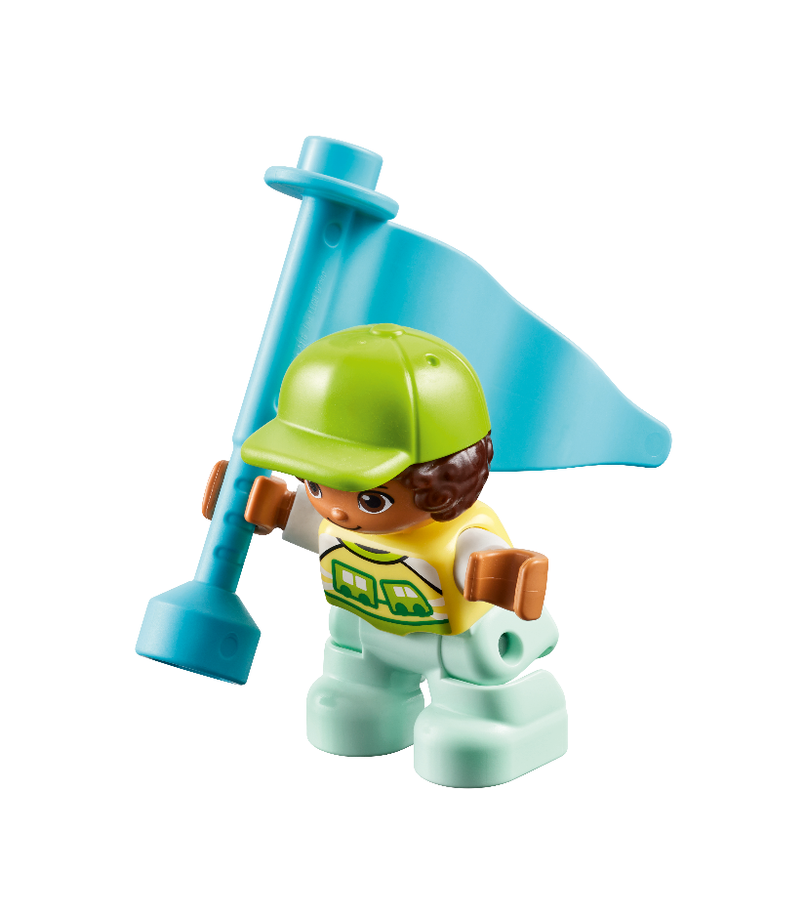
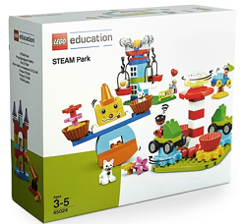
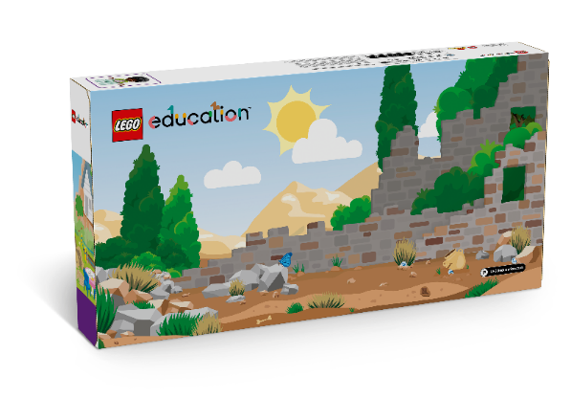
Create
Build a model to go with your archaeological adventure story.
You Need…
Notes:
Create Task
Have the children build and tell the story of the archaeologist discovering an artifact.
Use the Discover Set or STEAM Park Set. They should include the following things in their model:
• Archaeologist
• Tool
• Dig site
• Buried treasure or artifact
Look at the Discover Story or Mat for inspiration.
The team can build their model on the mat, which may help them visualize the story create.
Facilitator Tip:
The team can build the artifact they are trying to recover.

Slide 8
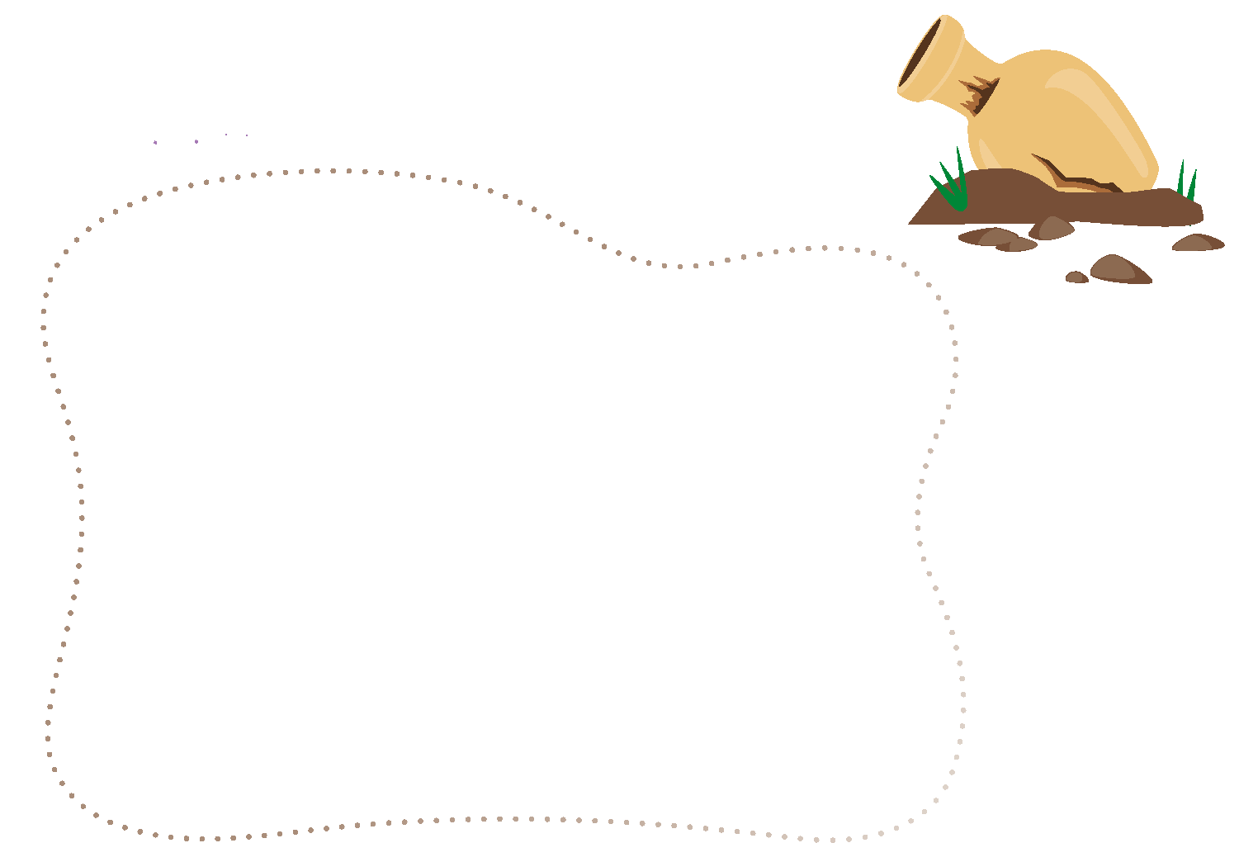
Engineering Notebook
Draw your archaeology story.
Notes:
Have the children complete the activity in their Engineering Notebooks.

Slide 9

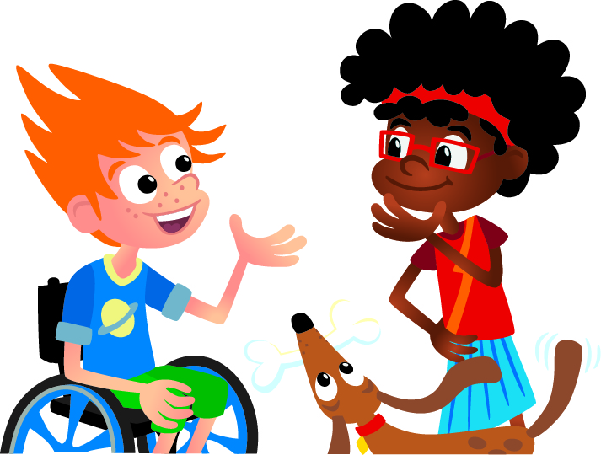
Share
What artifact did you find?
Notes:
Share Task (15 minutes) ​
Ask the children to write or draw their story in their Engineering Notebooks.
What was the artifact they discovered?
Encourage them to imagine what they would do if they were real archaeologists.
When the tasks are finished, everything built in this session should be taken apart and returned to storage.

Slide 10
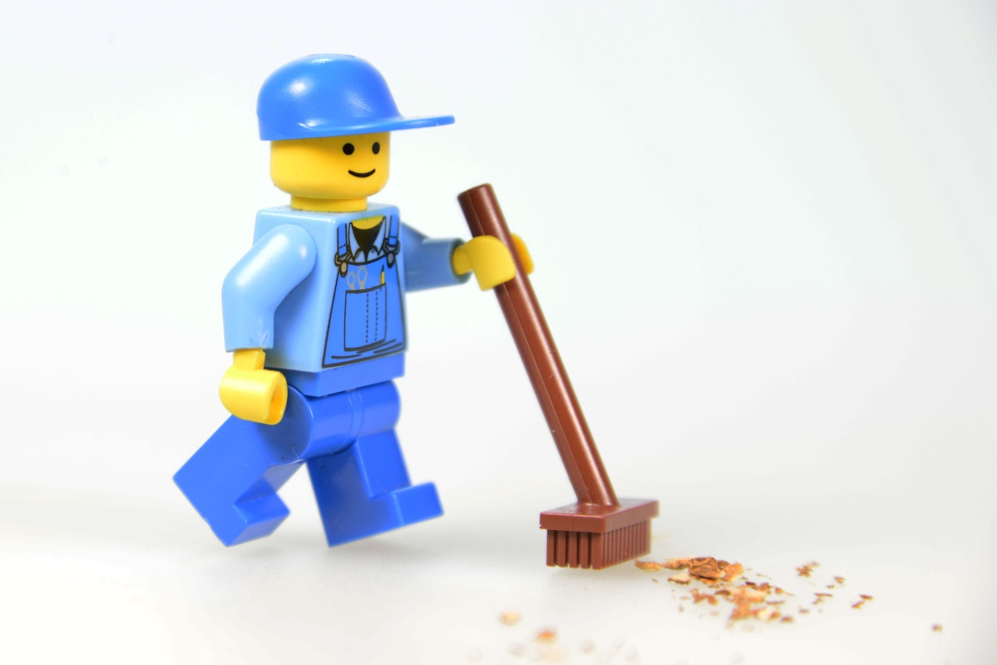
Clean Up
Notes:
You may wish to play a video or song during clean up time.
Link on GoNoodle: https://family.gonoodle.com/activities/clean-up
Link on YouTube Kids: https://www.youtubekids.com/watch?v=ZJFk87ZsHn0
Link on YouTube: https://youtu.be/ZJFk87ZsHn0
Send home the Discover More set with each child for home learning and exploration. Check out page 8 of the Team Meeting Guide for how to use this set for family engagement.

Slide 11

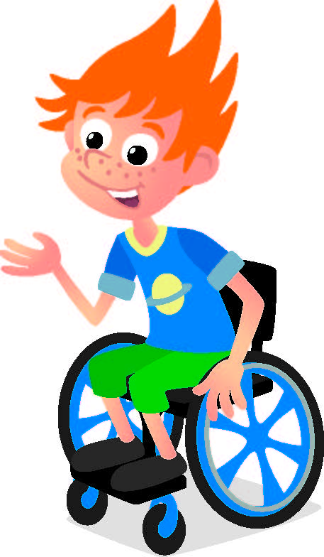
Reflect
What all did your character do in the story?

Slide 12


LEGO, the LEGO logo, DUPLO and the DUPLO logo are trademarks of the LEGO Group. ©2025 The LEGO Group. All rights reserved. FIRST®, the FIRST ® logo, and FIRST® AGETM are trademarks of For Inspiration and Recognition of Science and Technology (FIRST). LEGO® is a registered trademark of the LEGO Group. FIRST ® LEGO® League and UNEARTHEDTM are jointly held trademarks of FIRST and the LEGO Group. ©2025 FIRST and the LEGO Group. All rights reserved.

