Slide 1


SESSION 5
Ancient Homes
I can work with my team to use critical thinking to make connections between the past and present.
I can work with my team to document our ideas in our Engineering Notebooks.
Students will learn about what homes looked like in the past and make connections between the different homes in the past and the present.

Slide 2



Discussion
What did we do last session?​
Notes:
Discuss with students the sorting of artifacts in the previous session.

Slide 3
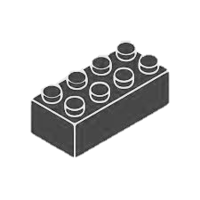
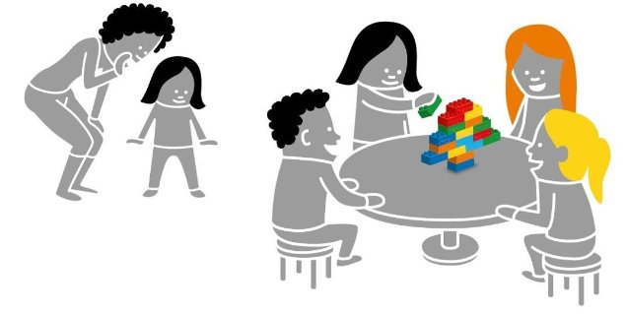

Warm Up
Build the Picture
10 Minute Timer
Start
Click to Start Timer
2
8
4
6
Notes:
Warm-Up: (10 minutes) Build The Picture ​
Base Activity ​
1. In groups of 4, children mix their bricks together and choose a leader. ​
2. Whisper a word related to archaeology (e.g., shovel, scale, brush, or artifact) to the leader.
3. Back with their group, the leader quickly builds a representation of that word for the others to guess. ​
4. The group may not ask questions but can call out words. The leader can say when they get it right. ​
Part 2 ​
5. Choose a new leader and repeat the activity with a new word. ​
6. Continue until all children in the group have been a leader. ​
​
Guiding Questions: ​
How did the first group figure out the word? ​
What can you do to help the next leader of the group? ​
​
Children learn to: ​
Engage in creative problem-solving. ​
Develop own ways of carrying tasks. ​
Use strategies learned earlier (representing).

Slide 4
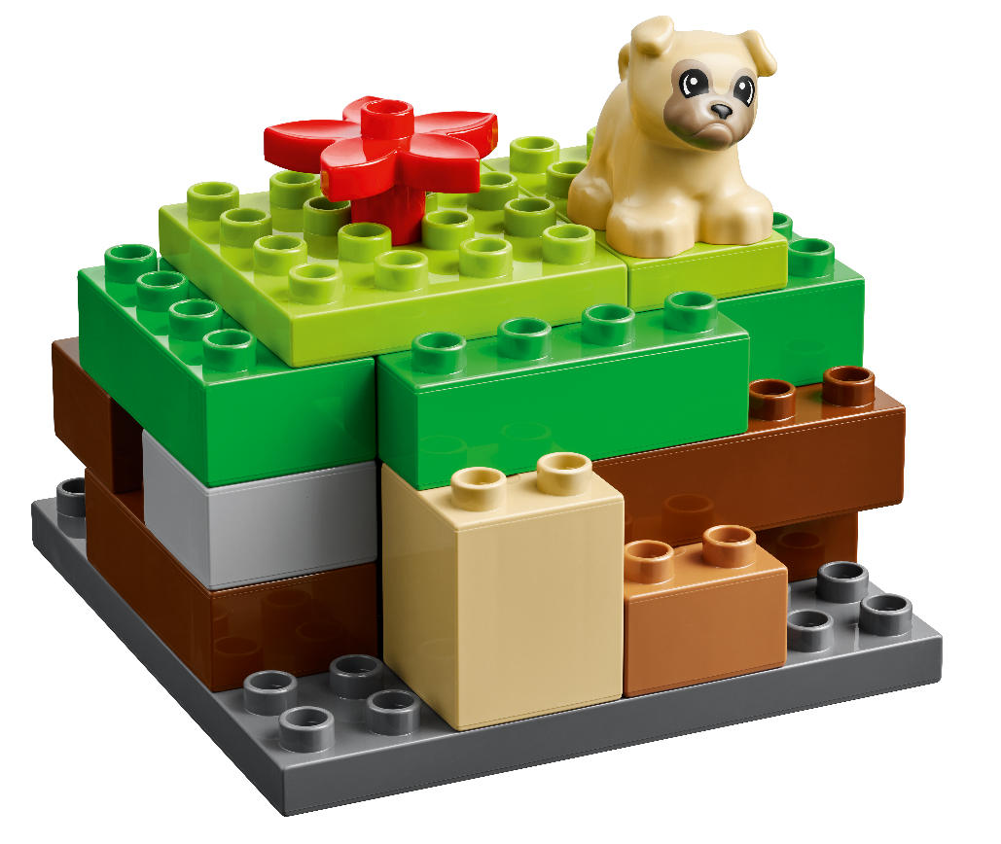
Big Question
What do you think homes looked like a long time ago?
Notes:
Explore Task (10 minutes) ​
Ask the children what they think homes looked like a long time ago. The homes that people lived in then looked different from the homes we live in today.
Ask the children what materials they think would make a strong house. Sometimes, buildings are made from natural materials like wood, mud, or stone that fall apart over long periods of time. Archaeologists hope to make discoveries that are in good condition.
When archaeologists find damaged buildings, they try to figure out what they used to look like. Technology can be used to build digital or physical models of what buildings looked like when they were new.
Facilitator Tips:
Share what old or ancient homes looked like where you live.

Slide 5
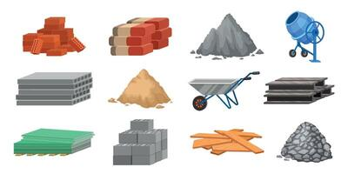

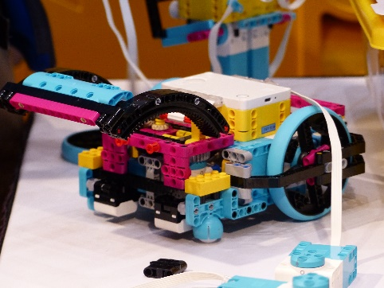
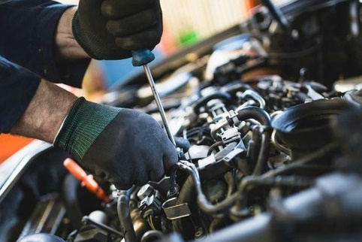
Key Vocabulary
Materials: the parts of which something is made
Technology: the use of science in solving problems
Rebuild: to make important repairs to or changes
Notes:
Key Vocabulary
Materials, technology, rebuild

Slide 6

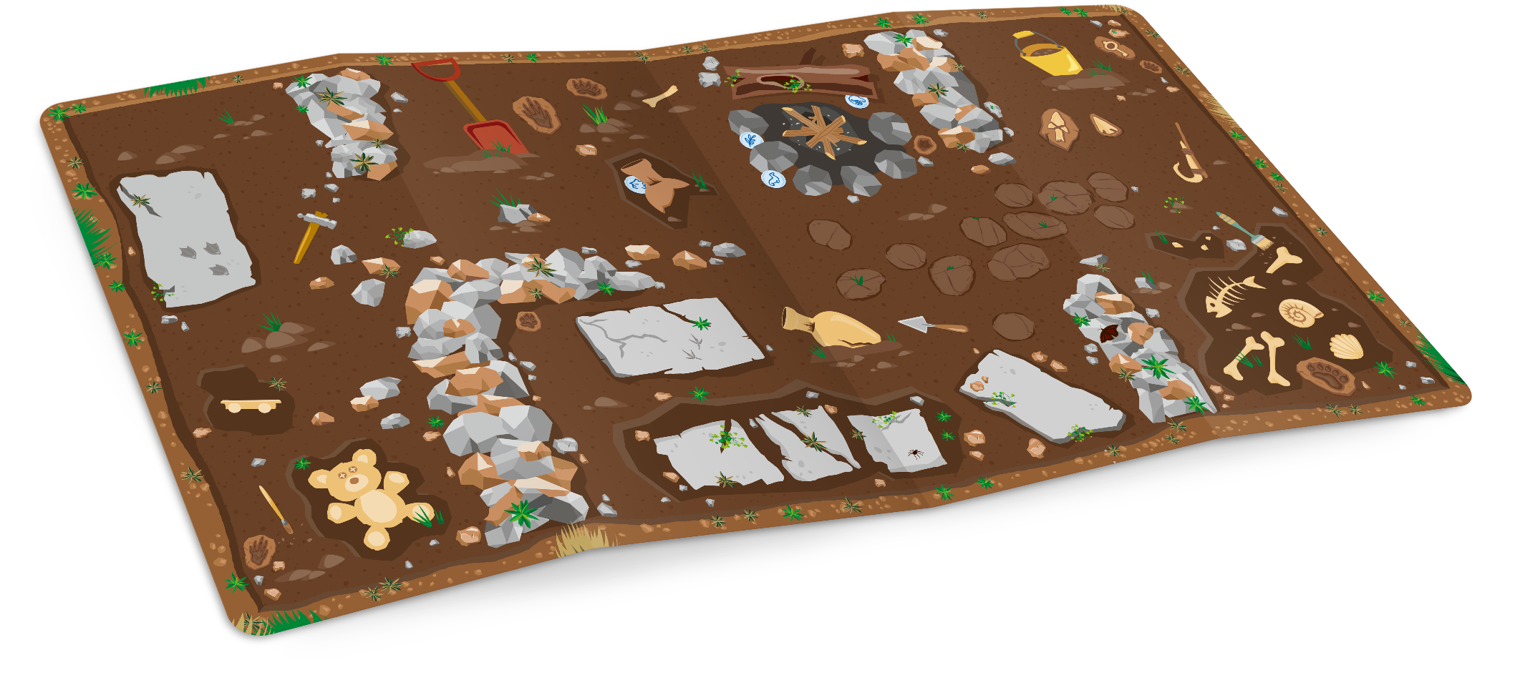
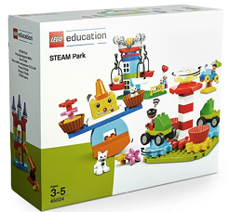
Build Together
Build a house
You Need…
Notes:
Create Task
Using the STEAM Park set, have the team build a model of a simple home on the mat. When the team is finished building their model, tell them they need to take it apart one piece at a time and rebuild it on the other end of the mat.
The rebuilt model should look as close to the original as possible. This mimics how an archaeologist would excavate a site and recreate something to study it.
Facilitator Tip: ​
This would be a great activity to use with one set of Six Bricks. More bricks can be added if the team needs a challenge.

Slide 7
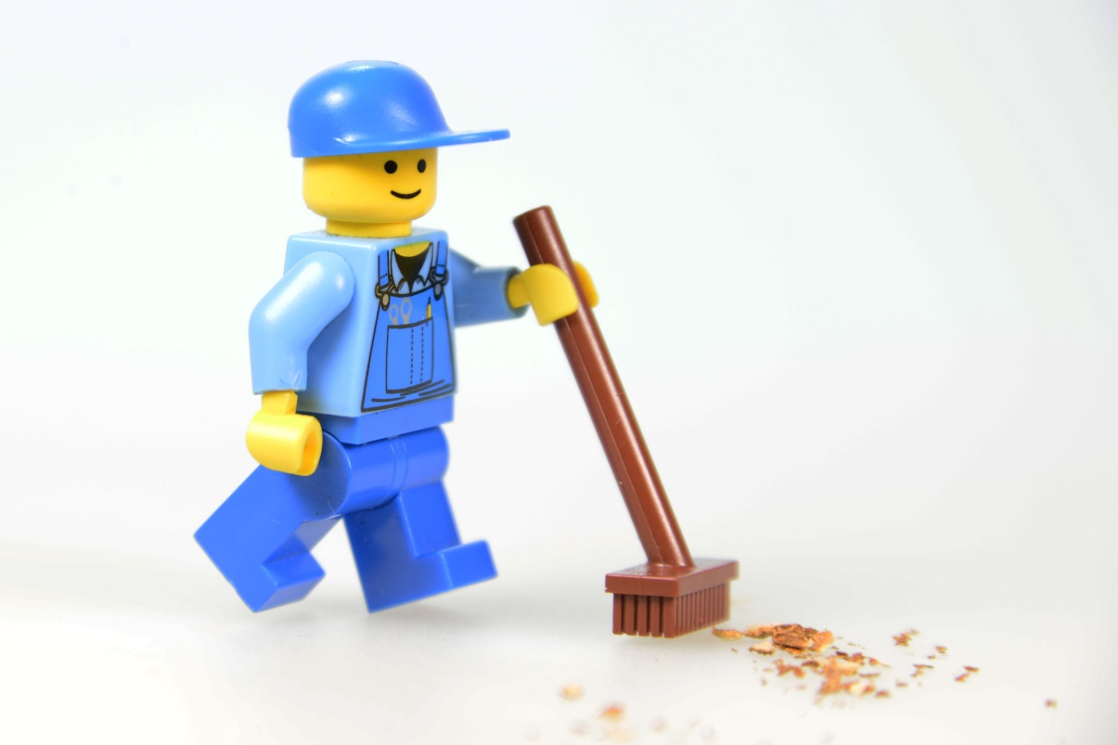
Clean Up
Notes:
You may wish to play a video or song during clean up time.
Link on GoNoodle: https://family.gonoodle.com/activities/clean-up
Link on YouTube Kids: https://www.youtubekids.com/watch?v=ZJFk87ZsHn0
Link on YouTube: https://youtu.be/ZJFk87ZsHn0
Send home the Discover More set with each child for home learning and exploration. Check out page 8 of the Team Meeting Guide for how to use this set for family engagement.

Slide 8
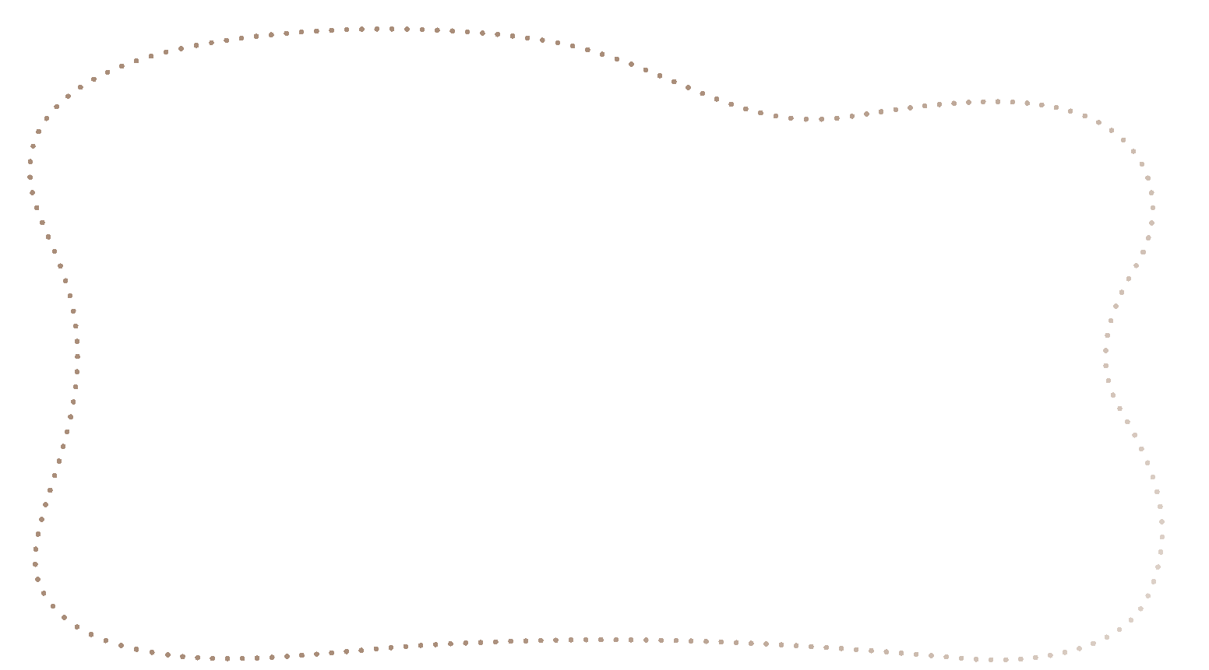
Engineering Notebook
Draw an old home.
Notes:
Share Task
In their Engineering Notebook, have the children draw what they think an ancient home looked like.

Slide 9


Share
Share your ancient home drawing.
Notes:
Share Task (15 minutes) ​
Have the children talk about their ancient home drawing.
When the tasks are finished, everything built in this session should be taken apart and returned to storage.

Slide 10


Reflect
What do your homes have in common?
What is different about your homes?

Slide 11


LEGO, the LEGO logo, DUPLO and the DUPLO logo are trademarks of the LEGO Group. ©2025 The LEGO Group. All rights reserved. FIRST®, the FIRST ® logo, and FIRST® AGETM are trademarks of For Inspiration and Recognition of Science and Technology (FIRST). LEGO® is a registered trademark of the LEGO Group. FIRST ® LEGO® League and UNEARTHEDTM are jointly held trademarks of FIRST and the LEGO Group. ©2025 FIRST and the LEGO Group. All rights reserved.

