Slide 1


SESSION 4
Scale Sorting
I can work with my team to practice sorting objects into different categories.
I can work with my team to explore how archaeologists sort things they find when excavating.
Students will discuss what artifacts are and why archaeologists sort them, then practice sorting the pieces in the STEAM Park Set by different criteria.

Slide 2


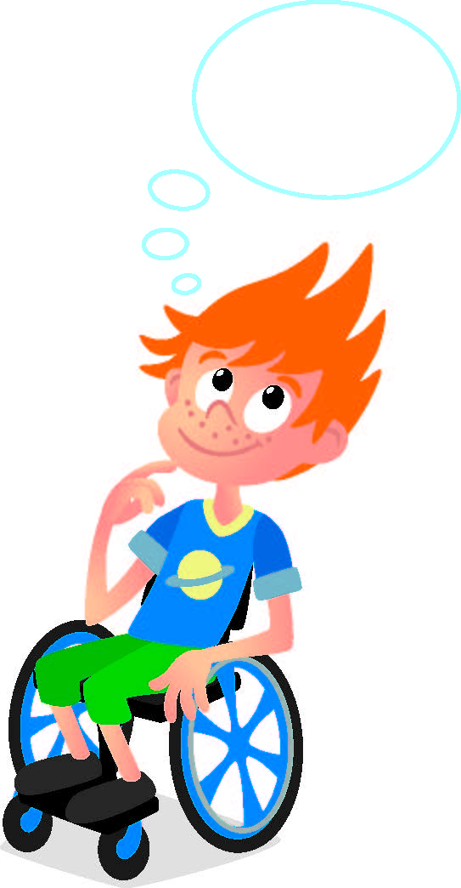
Discussion
What did we do last session?​
Notes:
Discuss with students the map they made in the previous session.

Slide 3
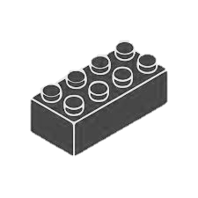
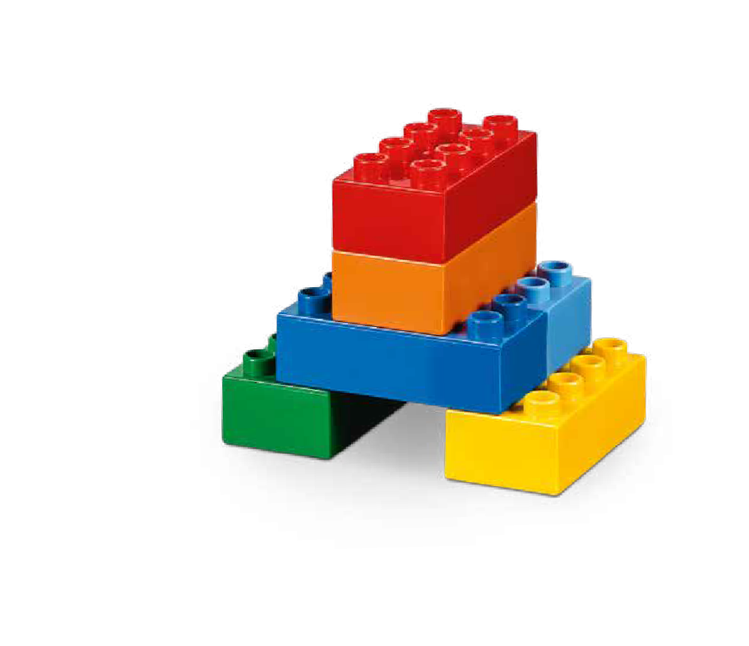
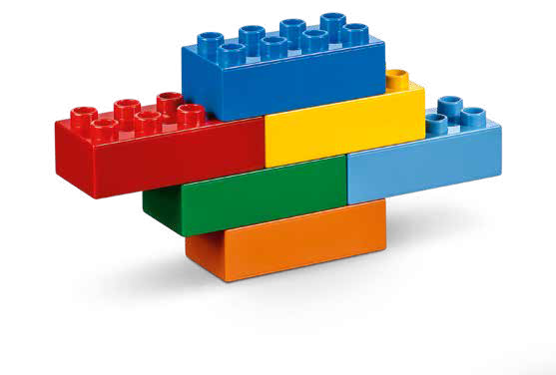

Warm Up
What Can You Build?
10 Minute Timer
Start
Click to Start Timer
2
8
4
6
Notes:
Warm-Up: (10 minutes) What Can You Build? ​
​
Base Activity ​
In groups of 4, children mix their bricks together. ​
The children use their bricks to build a model of a home where people lived a long time ago.
They take turns describing the model and explaining their model’s features.
This activity can also be linked to a theme, story, or book. ​
​
Guiding Questions: ​
Where is the home located?
What is the home made of?
Who lived in the home?
Children learn to: ​
Invent and describe characters (for stories). ​
Create stories in groups. ​
Ask questions and suggest answers.

Slide 4
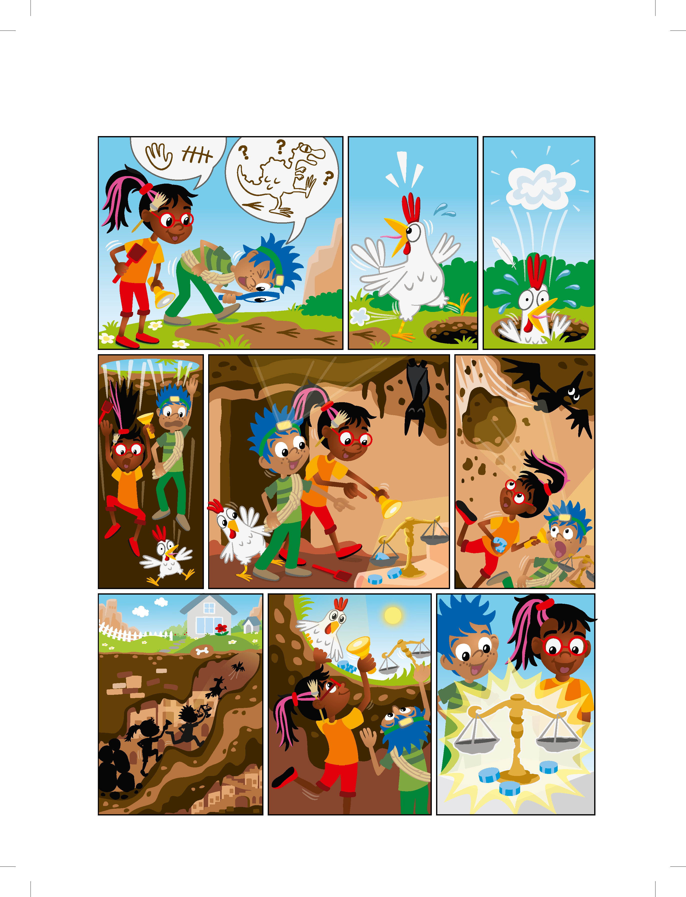
Discovery Story
Notes:
Explore Task (10 minutes) ​
Have the children review the Discover Story and discuss what the young archaeologists found in the tunnel.

Slide 5
Discovery Story
Notes:
Explore Task (10 minutes) ​
Have the children review the Discover Story and discuss what the young archaeologists found in the tunnel.

Slide 6
Discovery Story
Notes:
Explore Task (10 minutes) ​
Have the children review the Discover Story and discuss what the young archaeologists found in the tunnel.

Slide 7
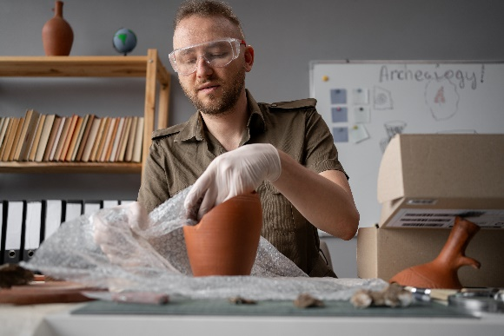

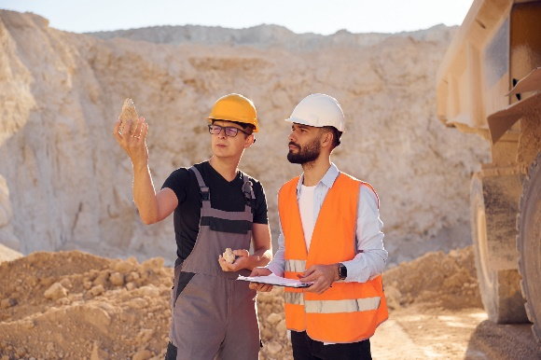
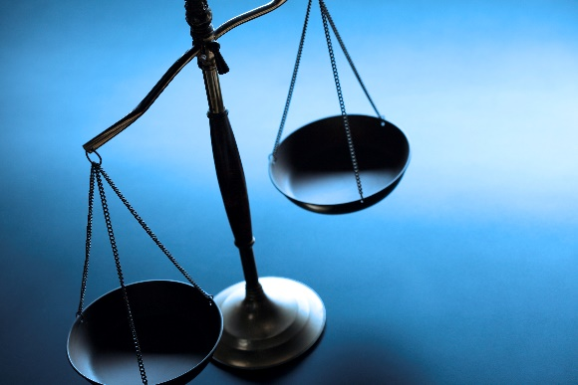
Key Vocabulary
Artifact: an object representing human history or culture
Sort: to separate and arrange by kind
Scale: an instrument used for measuring mass or weight
Notes:
Key Vocabulary
Artifact, sort, scale

Slide 8
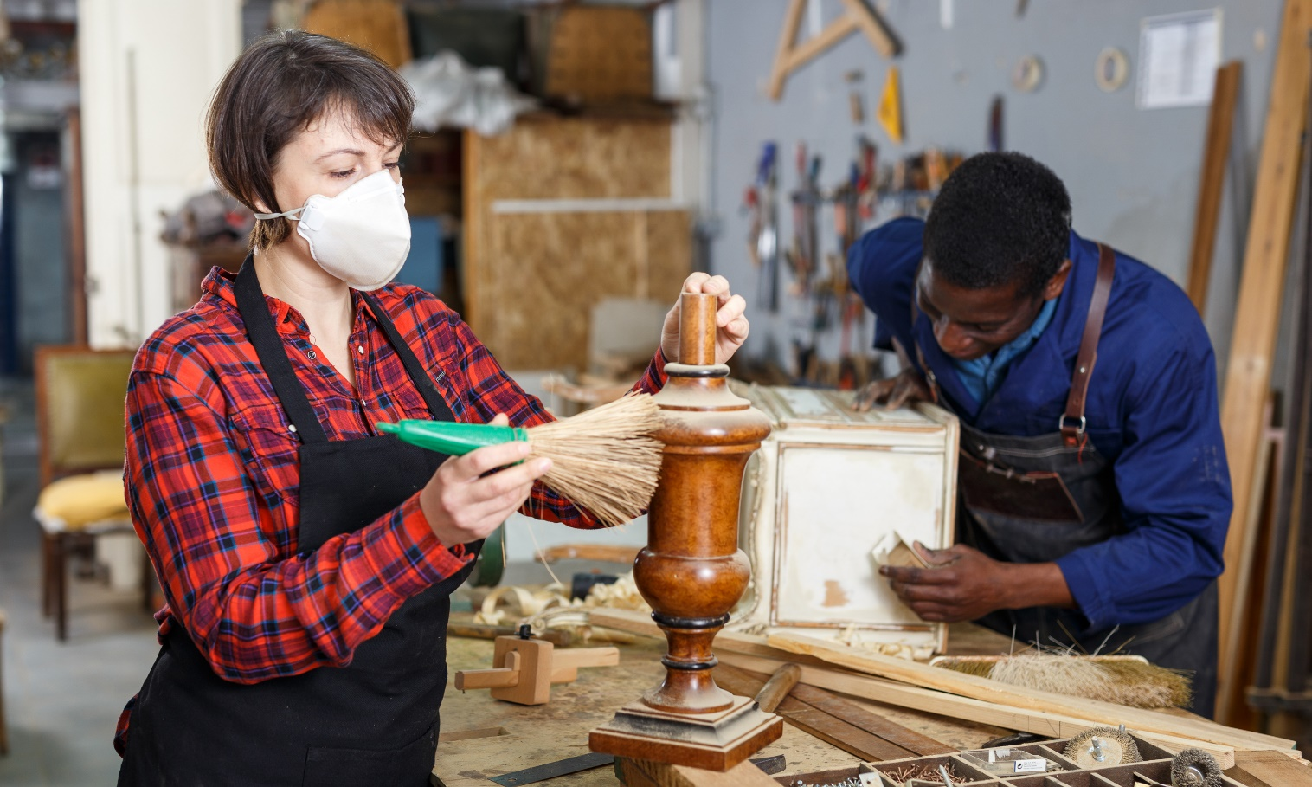
Big Question
Why do archaeologists sort what they find?
Notes:
Explore Task (10 minutes) ​
Discoveries of artifacts should be recorded so other people know what was found, know where it was located, and can make comparisons. Artifacts can be valuable treasures, but they can also be everyday objects used by people in the past. Artifacts that teach us about everyday life are very important to our understanding of how people used to live.

Slide 9
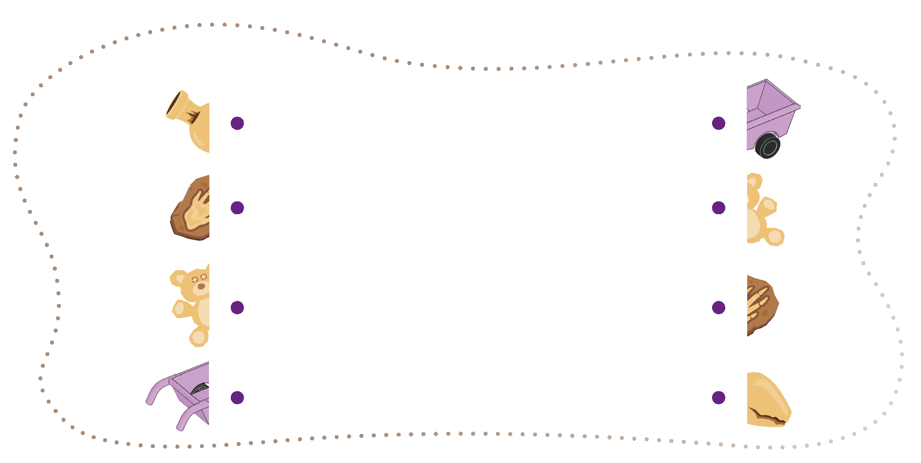
Engineering Notebook
Connect the objects to sort them.
Notes:
Explore Task
Have the children complete the sorting activity in the Engineering Notebook. Look at the artifacts included in the Discover Set. Discuss the scooter and the scale by asking the children how they think they were used a long time ago. How are they different?
Facilitator Tip: ​
Start small with two categories and introduce new pieces as the children make progress.
You could have the children build small models of other types of artifacts.

Slide 10

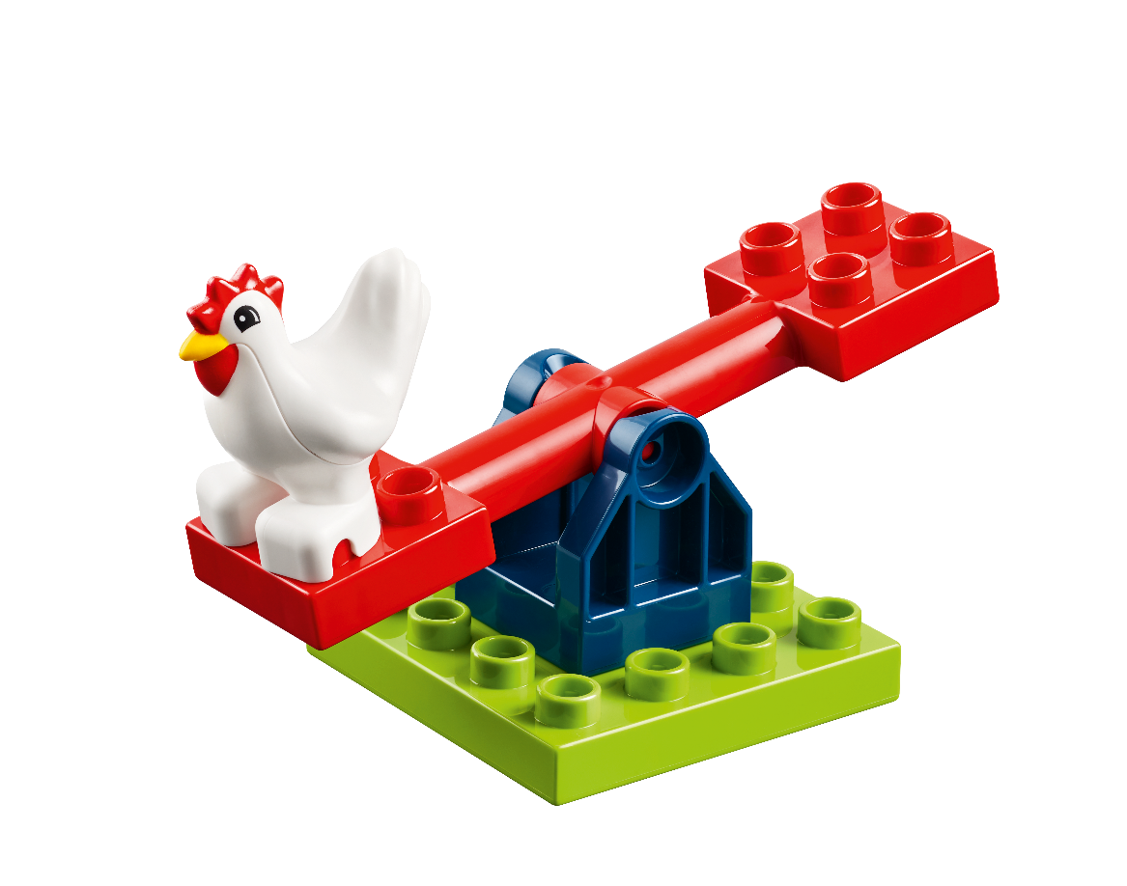
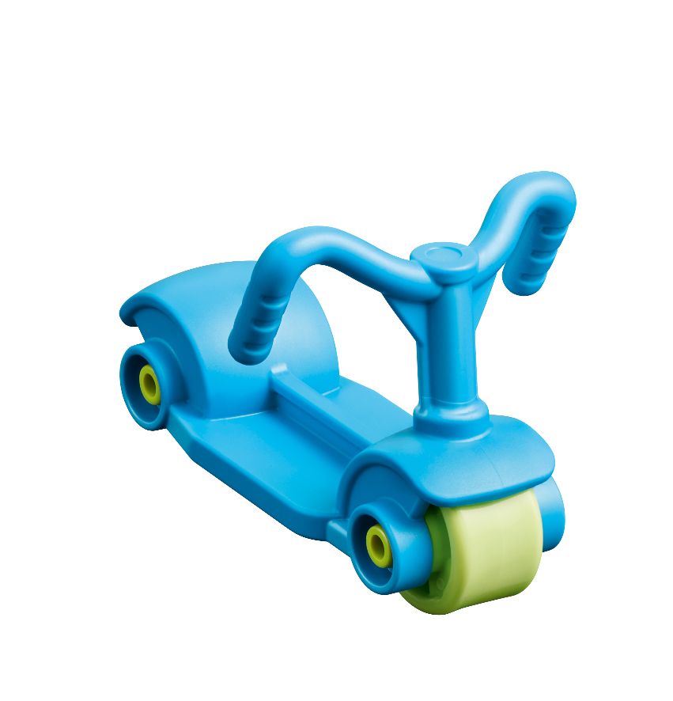
Create
Sort artifacts into categories.
Notes:
Create Task
Look at the artifacts included in the Discover Set. Discuss the scooter and the scale by asking the children how they think they were used a long time ago. How are they different?
Choose pieces from the STEAM Park Set to represent artifacts. Have the children sort them into categories the way an archaeologist would. The categories could include:
• Size
• Fun
• Work
• Shape
• Weight
• Transportation
• Color
• Food
Repeat the activity with a new set of artifacts or different categories. Sorting or grouping artifacts helps archaeologists make comparisons. You could also use the scale to sort pieces by weight. Sometimes archaeologists need to make guesses about what an artifact might be.
Facilitator Tip: ​
Start small with two categories and introduce new pieces as the children make progress.
You could have the children build small models of other types of artifacts.

Slide 11

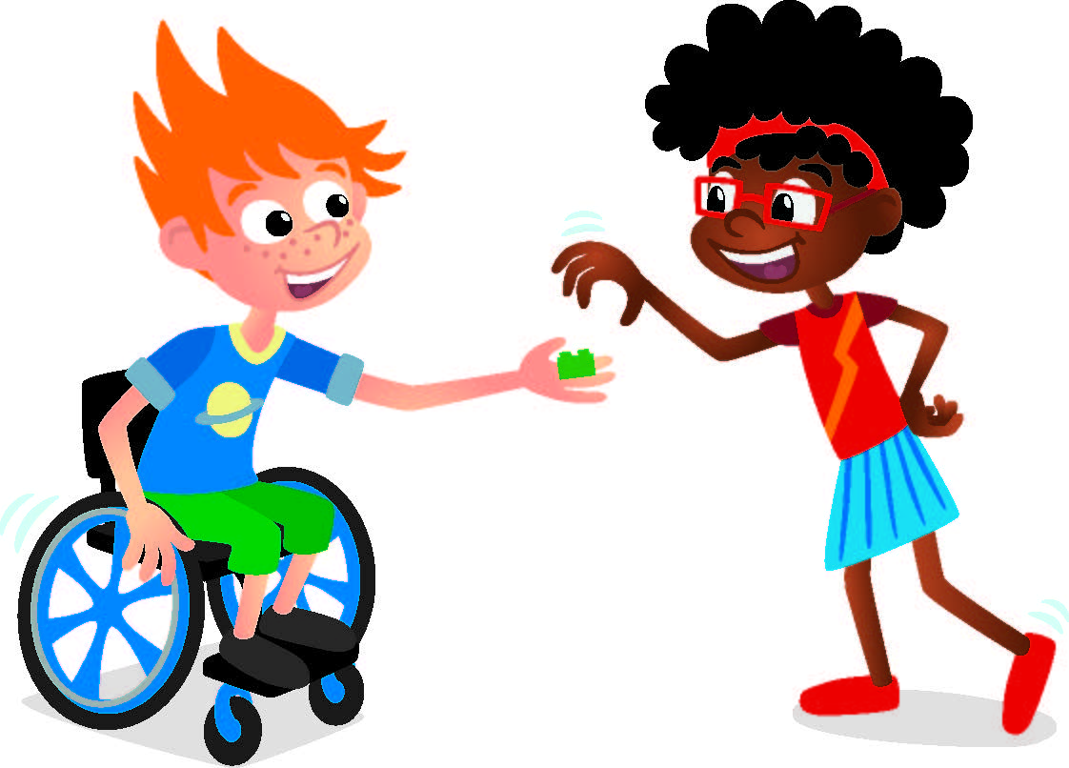
Share
Share your sorted pieces.
Notes:
Share Task (15 minutes) ​
Have the children talk about why they sorted the pieces the way they did. They could explain how grouping them in a certain way would be helpful for an archaeologist.
When the tasks are finished, everything built in this session should be taken apart and returned to storage.

Slide 12

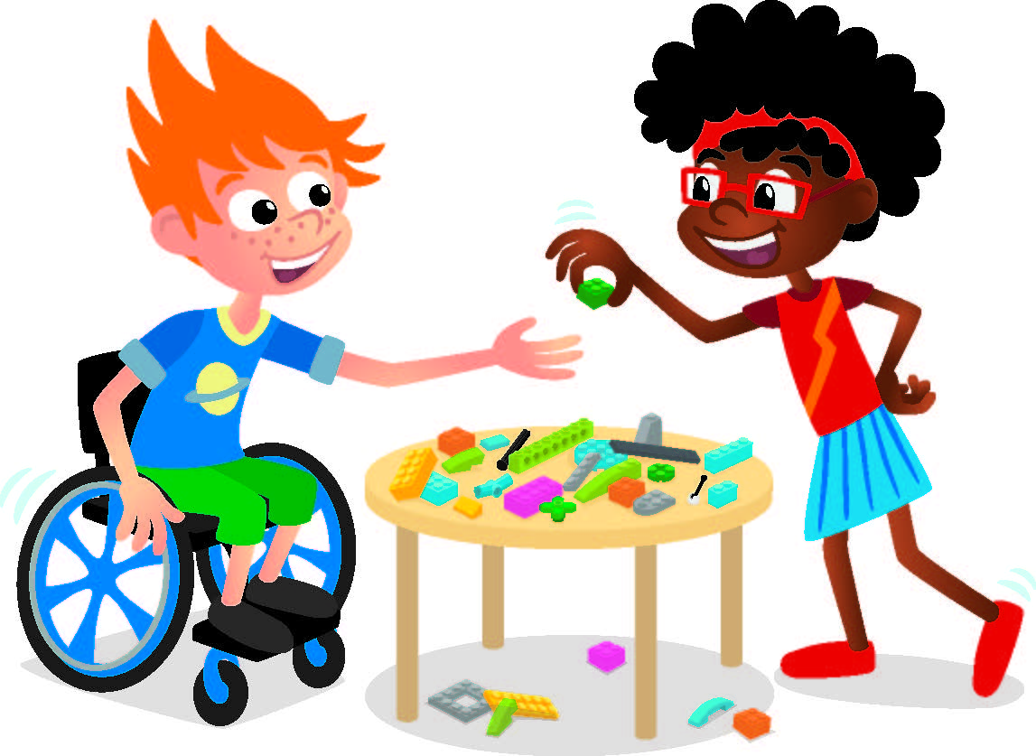
Reflect
Did you sort things the same way as someone else?

Slide 13
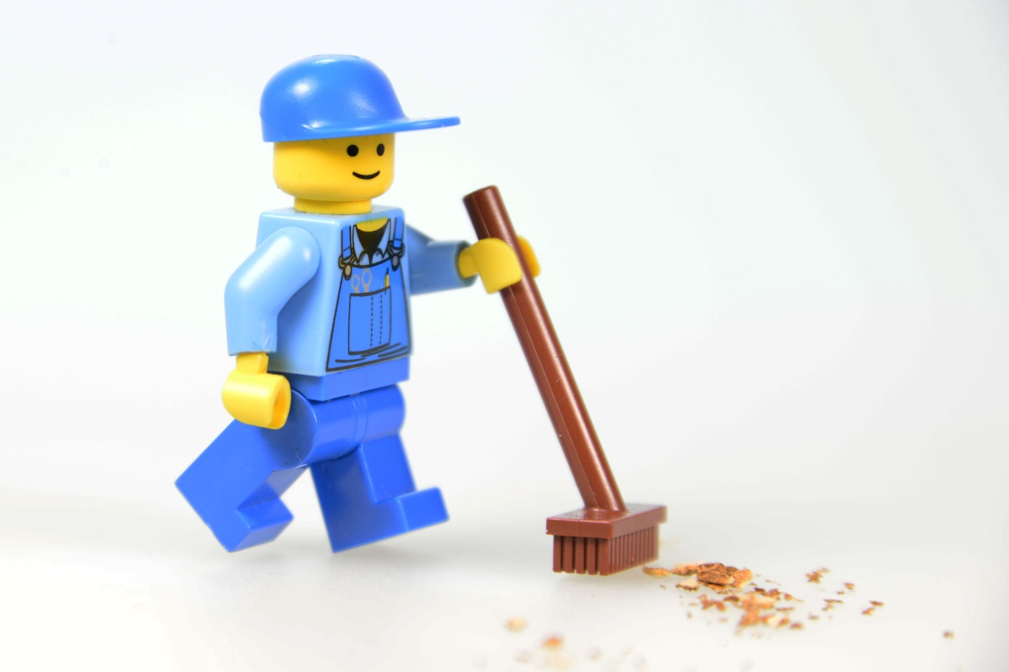
Clean Up
Notes:
You may wish to play a video or song during clean up time.
Link on GoNoodle: https://family.gonoodle.com/activities/clean-up
Link on YouTube Kids: https://www.youtubekids.com/watch?v=ZJFk87ZsHn0
Link on YouTube: https://youtu.be/ZJFk87ZsHn0
Send home the Discover More set with each child for home learning and exploration. Check out page 8 of the Team Meeting Guide for how to use this set for family engagement.

Slide 14


LEGO, the LEGO logo, DUPLO and the DUPLO logo are trademarks of the LEGO Group. ©2025 The LEGO Group. All rights reserved. FIRST®, the FIRST ® logo, and FIRST® AGETM are trademarks of For Inspiration and Recognition of Science and Technology (FIRST). LEGO® is a registered trademark of the LEGO Group. FIRST ® LEGO® League and UNEARTHEDTM are jointly held trademarks of FIRST and the LEGO Group. ©2025 FIRST and the LEGO Group. All rights reserved.

