Slide 1


SESSION 3
Map Makers
I can work with my team to learn how archaeologists create maps of their discoveries.
I can work with my team to create a map of a room.
Students learn about how archaeologists use maps to record where they find things. In their Engineering Notebook, they will make a map and flag where important things are.

Slide 2


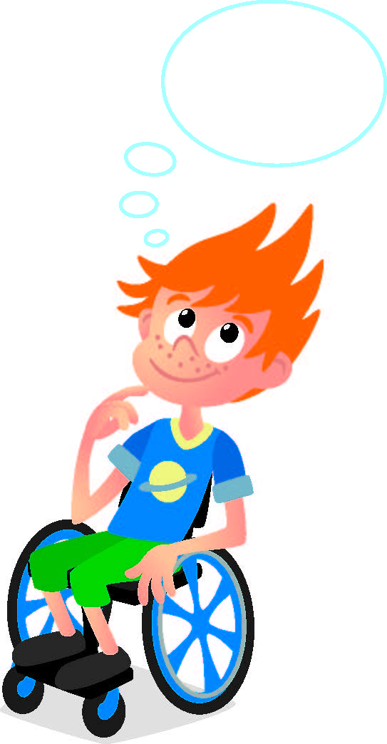
Discussion
What did we do last session?​
Notes:
Discuss with students the key term excavate and review where archaeologists make discoveries.

Slide 3
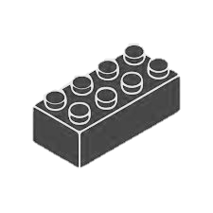
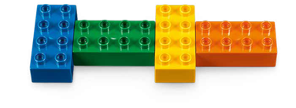
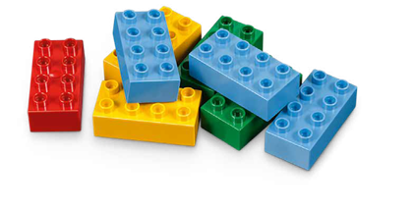

Warm Up
Can You Remember?
10 Minute Timer
Start
Click to Start Timer
2
8
4
6
Notes:
Six Bricks Warm-Up (1O minutes) ​
Can You Remember? ​
​
Base Activity ​
The adult takes any two bricks and secretly builds one on top of the other, covering all the studs. ​
Hold them up for the children to see for five seconds and then hide them away. ​
The children copy the brick sequence. ​
​
Guiding Questions: ​
Match your sequence to mine. Are they the same? ​
If it is different, how can you make it the same? ​
​
Children learn to: ​
Hold information in their memory. ​
Keep attention and resist distraction. ​
Speak about how they have done something.

Slide 4
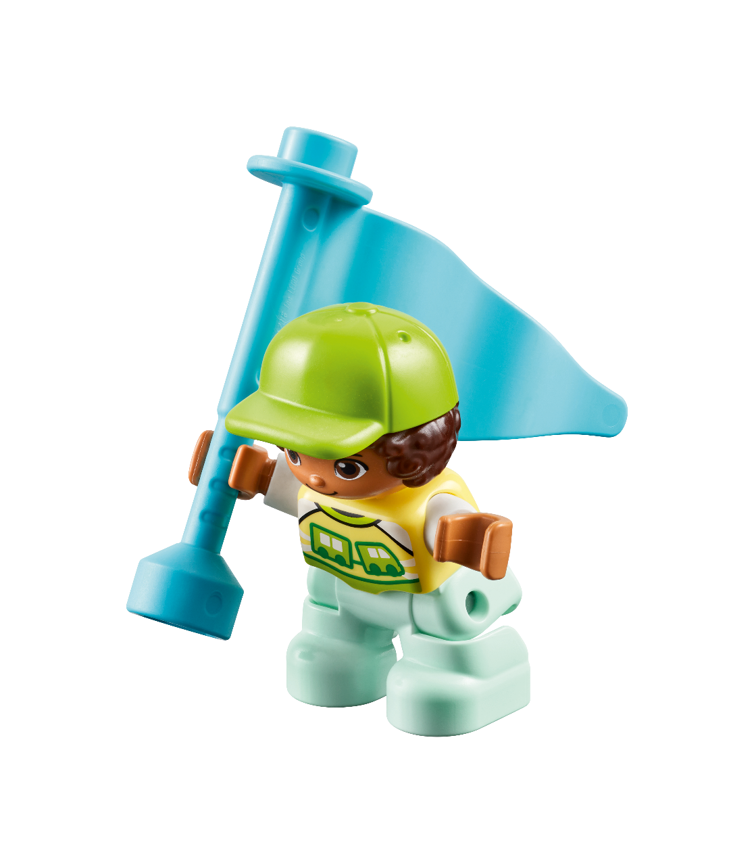
Big Question
Why do archaeologists use maps?
Notes:
Explore Task (10 minutes) ​
Have a discussion about what can be seen on the Discover mat. The mat is similar to a map that an archaeologist makes when they want to record where artifacts are found.
Archaeologists will stick flags into the ground close to artifacts that need to be recorded.
Place a flag on the Discover mat next to an artifact and ask the children what they think it might be.
Have the children take turns placing the flags on the mat. Explain that archaeologists use maps to record the exact location of their discoveries, which helps them understand more about how people lived in the past.
Facilitator Tip: ​
Relate this to the map the children will create in their notebook, reinforcing the importance of mapping to record information.
Help the students understand why maps are useful for more than just archaeology.

Slide 5
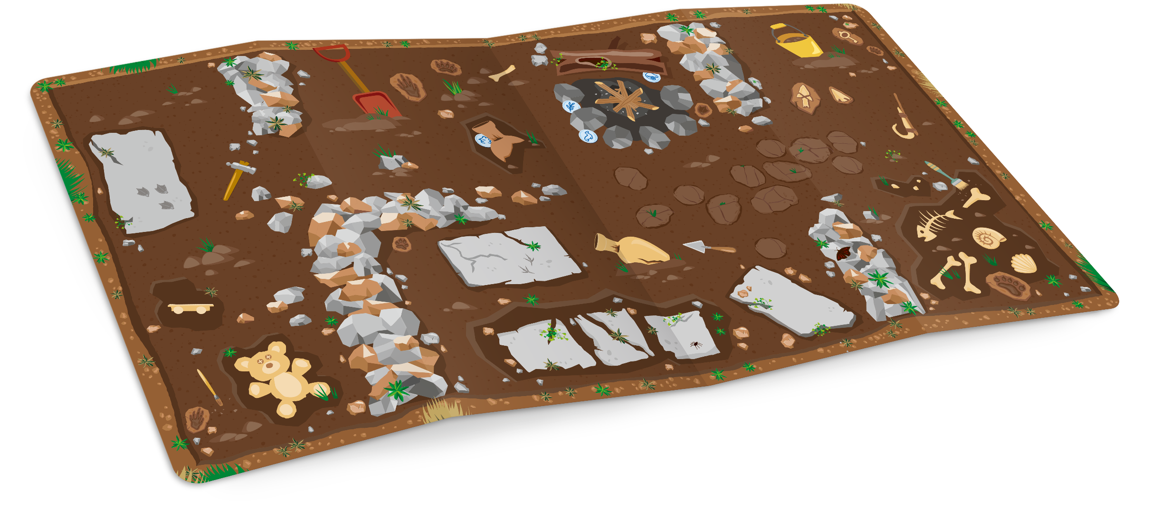
Discussion
What do you see on the Discover mat?
Notes:
Explore Task
Archaeologists will stick flags into the ground close to artifacts that need to be recorded.
Place a flag on the Discover mat next to an artifact and ask the children what they think it might be.
Have the children take turns placing the flags on the mat. Explain that archaeologists use maps to record the exact location of their discoveries, which helps them understand more about how people lived in the past.
Facilitator Tip: ​
Relate this to the map the children will create in their notebook, reinforcing the importance of mapping to record information.
Help the students understand why maps are useful for more than just archaeology.

Slide 6
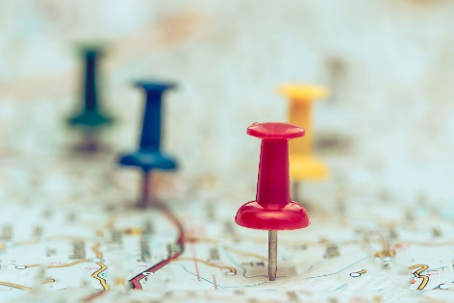



Key Vocabulary
Map: a drawing or picture showing selected features of an area
Flag: a piece of cloth with a special design that is used as a symbol or for signaling
Record: to put down in writing
Notes:
Key Vocabulary
Map, flag, record

Slide 7

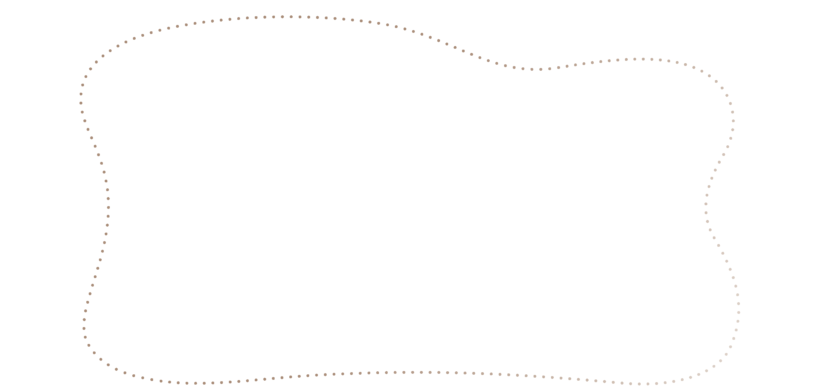
Create
Draw a map of a room.
Notes:
Create Task (25 minutes) ​
In the Engineering Notebook, draw a map of a room. It could be the room your team meets in or a room somewhere else.
On the map, include the door, windows, furniture, and any other important things in the room. Have the children place the flags from the Discover Set on something they drew.
Explain that flags help archaeologists remember where important objects were discovered, just like how they are using flags in this task. Alternately, place the flag on an object in the room. Have the children find the flag and draw the object in their notebook.​
Facilitator Tip​
Use colored pencils to draw the map and pick one color for flags.

Slide 8
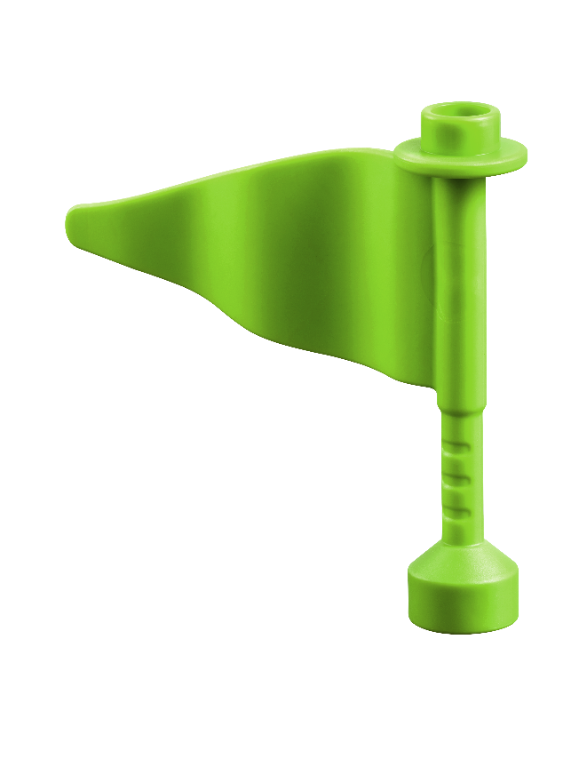
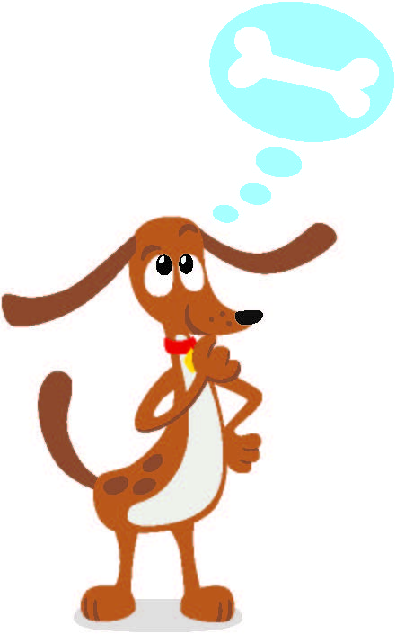
Engineering Notebook
Include doors, windows, furniture and any other important things in the room.
Notes:
Create Task (25 minutes) ​
In the Engineering Notebook, draw a map of a room. It could be the room your team meets in or a room somewhere else.
On the map, include the door, windows, furniture, and any other important things in the room. Have the children place the flags from the Discover Set on something they drew.
Explain that flags help archaeologists remember where important objects were discovered, just like how they are using flags in this task. Alternately, place the flag on an object in the room. Have the children find the flag and draw the object in their notebook.​
Facilitator Tip​
Use colored pencils to draw the map and pick one color for flags.

Slide 9

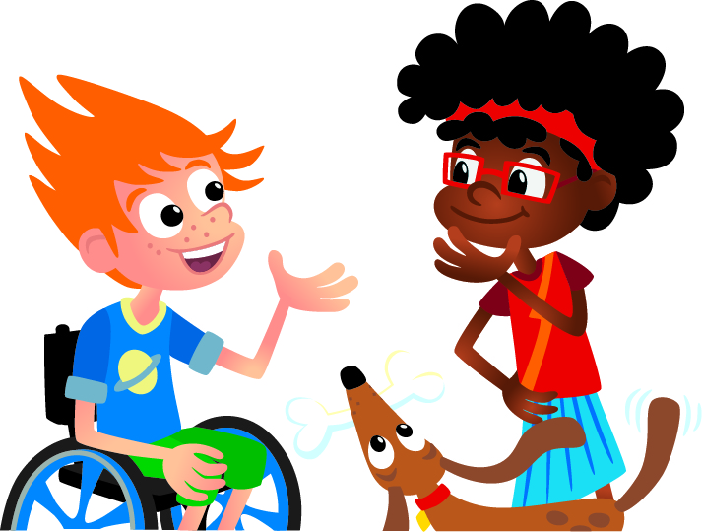
Share
Share your map!
Notes:
Share Task (15 minutes) ​
Have the children talk about the map that they drew of a room.
They can share about the features they drew and where they decided to place their flags. ​

Slide 10

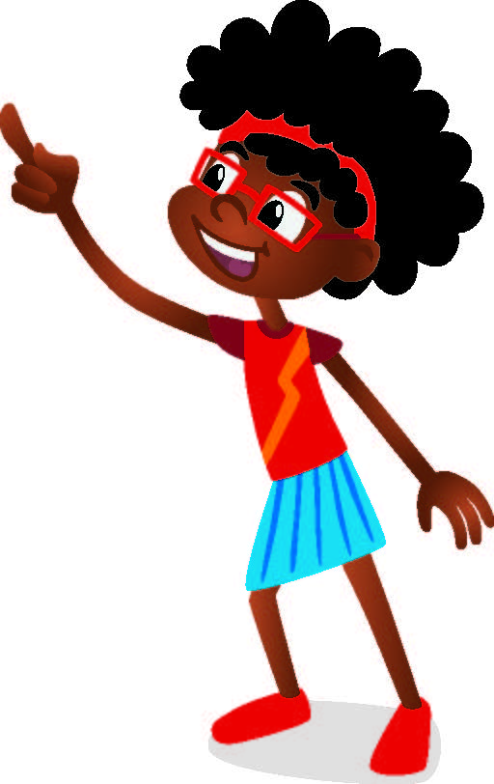
Reflect
Does everyone’s map show the same things?
Did they mark the same things with flags?

Slide 11
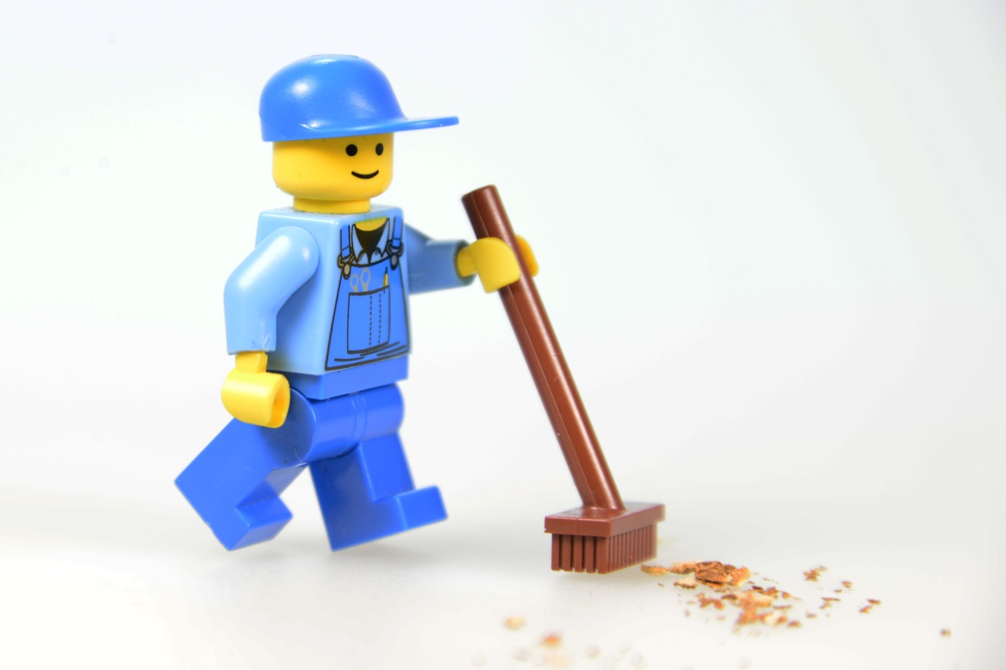
Clean Up
Notes:
You may wish to play a video or song during clean up time.
Link on GoNoodle: https://family.gonoodle.com/activities/clean-up
Link on YouTube Kids: https://www.youtubekids.com/watch?v=ZJFk87ZsHn0
Link on YouTube: https://youtu.be/ZJFk87ZsHn0
Send home the Discover More set with each child for home learning and exploration. Check out page 8 of the Team Meeting Guide for how to use this set for family engagement.

Slide 12


LEGO, the LEGO logo, DUPLO and the DUPLO logo are trademarks of the LEGO Group. ©2025 The LEGO Group. All rights reserved. FIRST®, the FIRST ® logo, and FIRST® AGETM are trademarks of For Inspiration and Recognition of Science and Technology (FIRST). LEGO® is a registered trademark of the LEGO Group. FIRST ® LEGO® League and UNEARTHEDTM are jointly held trademarks of FIRST and the LEGO Group. ©2025 FIRST and the LEGO Group. All rights reserved.

