Slide 1


SESSION 2
Exciting Excavations
I can work with my team to learn about where archaeologists make discoveries.
I can work with my team to explore the excavation model from the UNEARTHEDTM Discover Set.
Students will learn about the different places archaeologists make discoveries, build the excavation model and area around it using the Discover Set and STEAM Park Set.

Slide 2


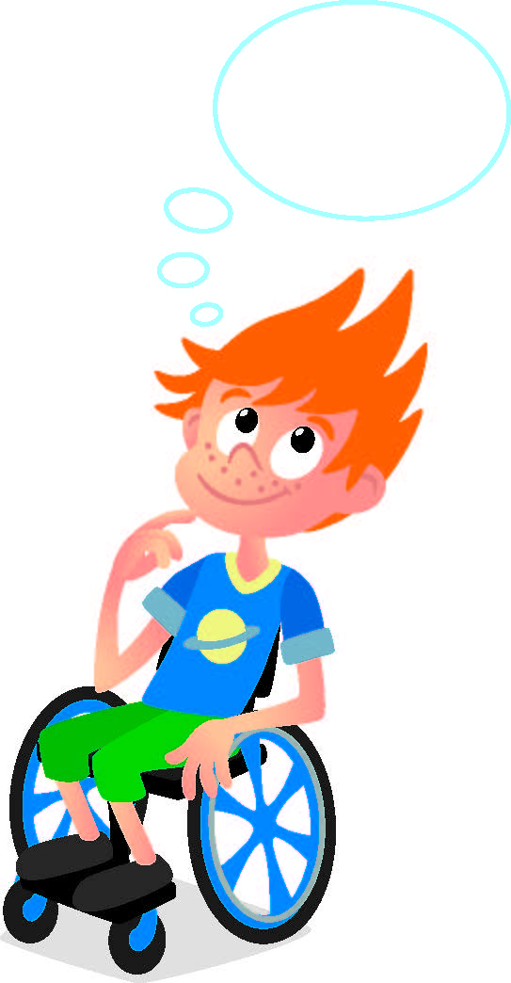
Discussion
What did we do last session?​
Notes:
Discuss with students the key term archaeology and review what archaeologists do.

Slide 3
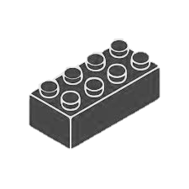
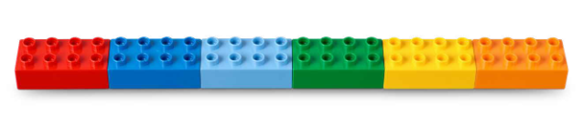

Warm Up
Discover Six Bricks II
10 Minute Timer
Start
Click to Start Timer
2
8
4
6
Notes:
Six Bricks Warm Up (10 minutes)
Discover Six Bricks II The children will use the Six Bricks both in the classroom and at home with the Discover More set to learn new skills and explore new ideas.
Base Activity
Children lay out their bricks in any order (see the picture).​
Then they put a finger on the red brick and move it left.​
They turn the dark blue brick upside down (or on its side).​
Children click the green brick on the red and cover all studs.​
Vary the instructions you give such as colors, moving bricks left/right, and positions.
Guiding Questions:
How did you keep your attention? (Encourage some of the children to explain in turn.)
How can we make this activity harder? (Give more instructions, say them faster, and so on.)

Slide 4

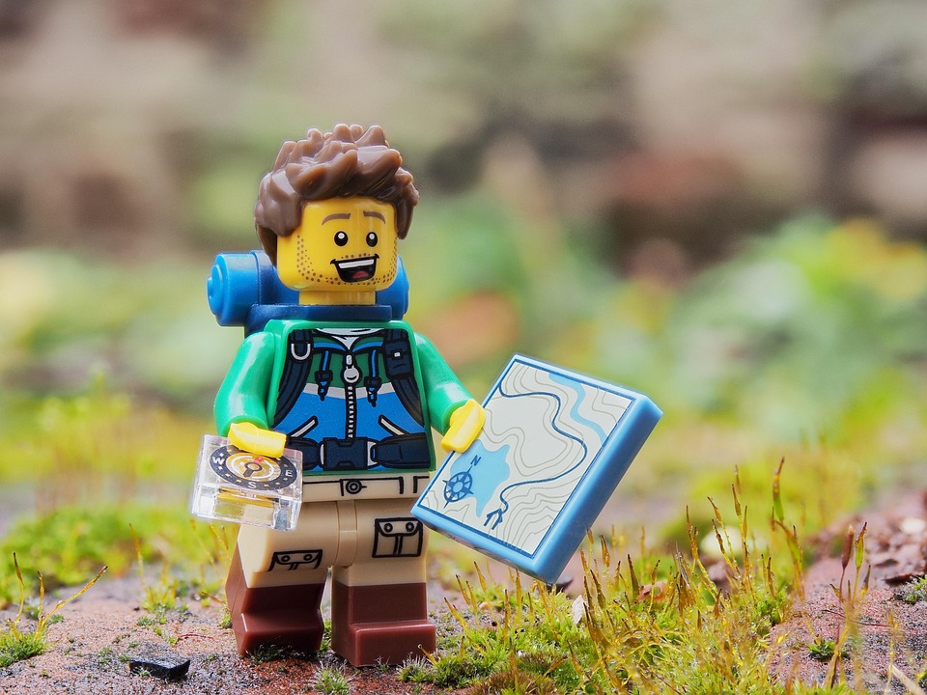
Big Question
Have you ever made a discovery?
Notes:
Session 2: Exciting Excavations
Look at the questions in the Explore task. Ask the students questions of different levels and complexity so that they further develop their thinking skills. This will lead them on their learning paths.​
​
Outcomes​
Teams will learn about where archaeologists make discoveries.​
Teas will explore the excavation model from the UNEARTHED Discover Set.​
​
Key Vocabulary​
Discovery, buried, excavate

Slide 5

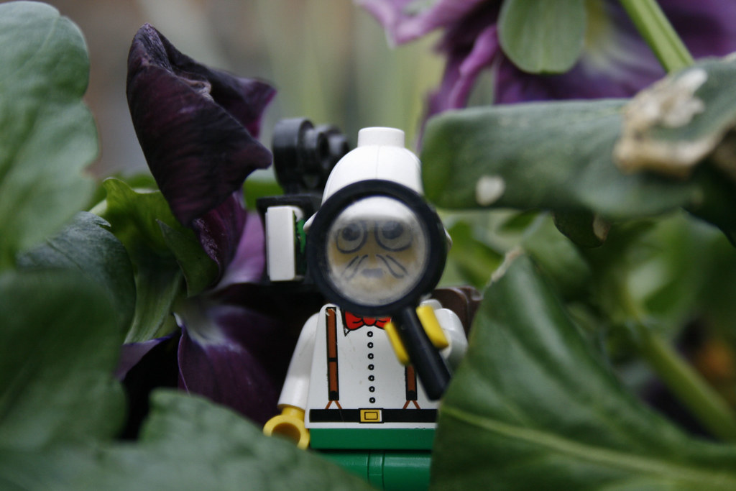
Explore
Have you ever found a treasure or something that used to be lost?
Notes:
Explore Task (10 minutes)
Ask students to share if they have ever found a treasure or something that used to be lost.
What was it and where did they find it?
Look at the pages of the Discover Story and discuss what can be seen in each of the illustrations. Ask the children what they notice.
Explain that archaeology is a science that studies how humans lived in the past. People who work in this field are called archaeologists.
Look at the Discover Story and discuss what the young archaeologists are doing in the illustrations. Ask the students what else they think an archaeologist might do.
Archaeologists make discoveries:
• In jungles or deserts where something is buried in plants or sand.
• At construction sites where big holes have been dug or excavated.
• In old shipwrecks found underwater.
• Everywhere!
Key Vocabulary
Discovery, buried, excavate

Slide 6
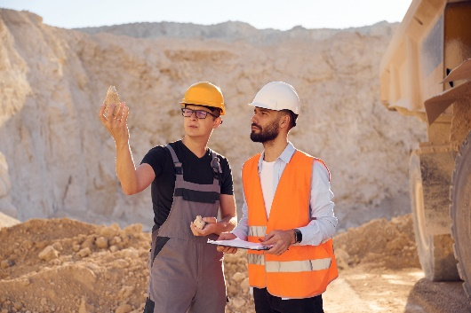

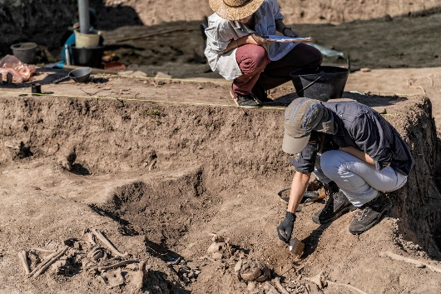
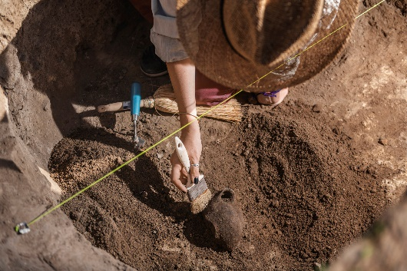
Key Vocabulary
Discovery: the act or process of discovering
Buried: to place in the ground and cover up
Excavate: to uncover by digging away covering earth
Notes:
Key Vocabulary​
Discovery, buried, excavate

Slide 7
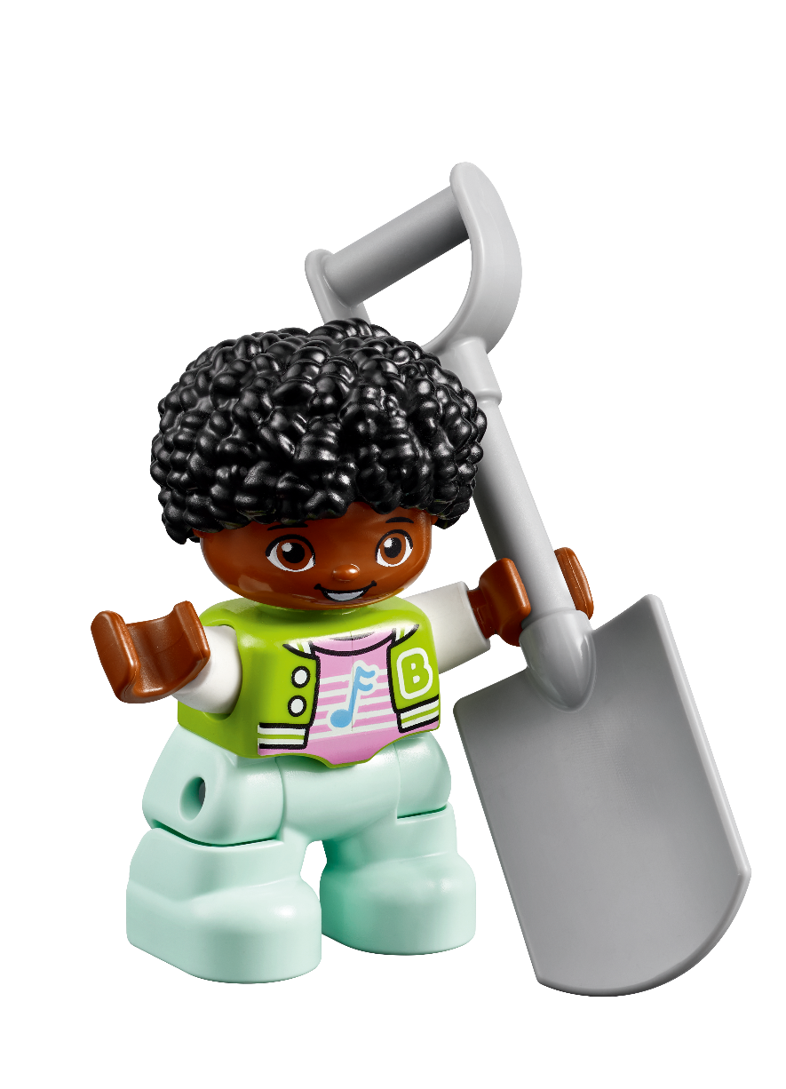
Discussion
What did the young archaeologist find in the Discover Story?
Notes:
Explore Task (10 minutes)
Look at the pages of the Discover Story and discuss what can be seen in each of the illustrations. Ask the children what they notice.
Explain that archaeology is a science that studies how humans lived in the past. People who work in this field are called archaeologists.
Look at the Discover Story and discuss what the young archaeologists are doing in the illustrations. Ask the students what else they think an archaeologist might do.

Slide 8
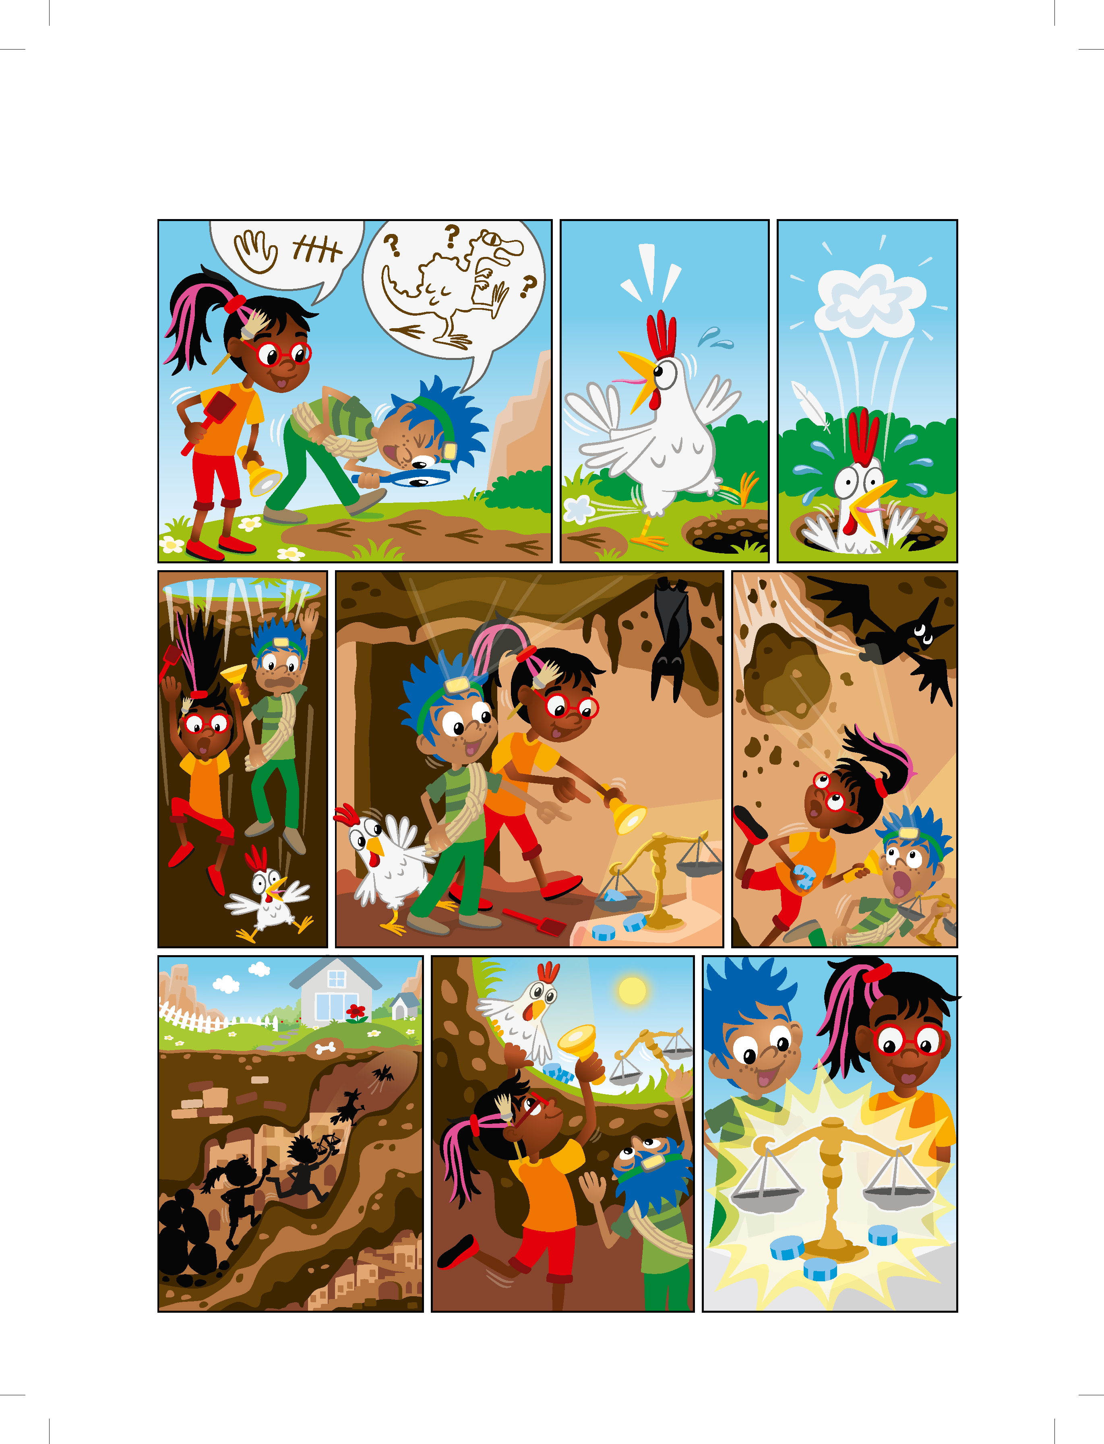
Discover Story
Notes:
Explore Task (10 minutes)
Look at the pages of the Discover Story and discuss what can be seen in each of the illustrations. Ask the children what they notice.
Explain that archaeology is a science that studies how humans lived in the past. People who work in this field are called archaeologists.
Look at the Discover Story and discuss what the young archaeologists are doing in the illustrations. Ask the students what else they think an archaeologist might do.

Slide 9
Discover Story
Notes:
Explore Task (10 minutes)
Look at the pages of the Discover Story and discuss what can be seen in each of the illustrations. Ask the children what they notice.
Explain that archaeology is a science that studies how humans lived in the past. People who work in this field are called archaeologists.
Look at the Discover Story and discuss what the young archaeologists are doing in the illustrations. Ask the students what else they think an archaeologist might do.

Slide 10
Discover Story
Notes:
Explore Task (10 minutes)
Look at the pages of the Discover Story and discuss what can be seen in each of the illustrations. Ask the children what they notice.
Explain that archaeology is a science that studies how humans lived in the past. People who work in this field are called archaeologists.
Look at the Discover Story and discuss what the young archaeologists are doing in the illustrations. Ask the students what else they think an archaeologist might do.

Slide 11

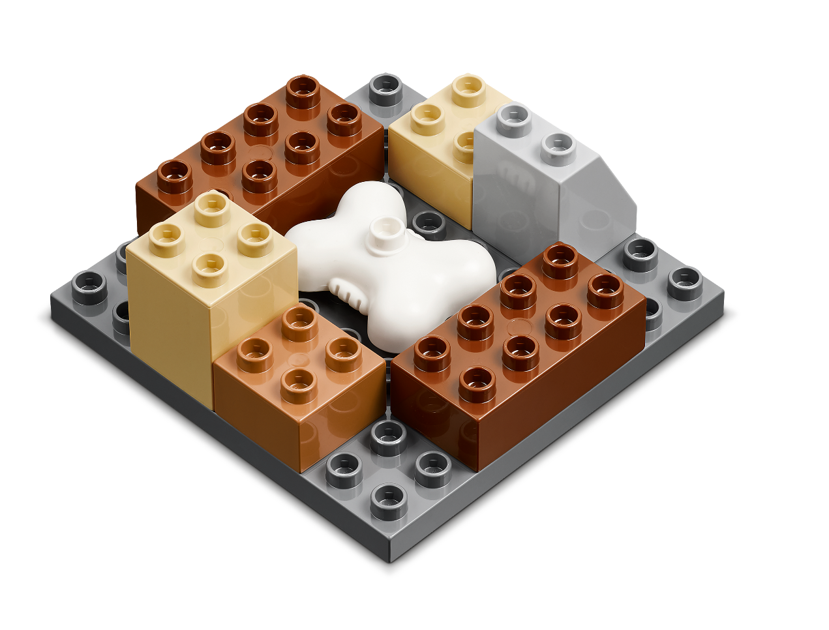
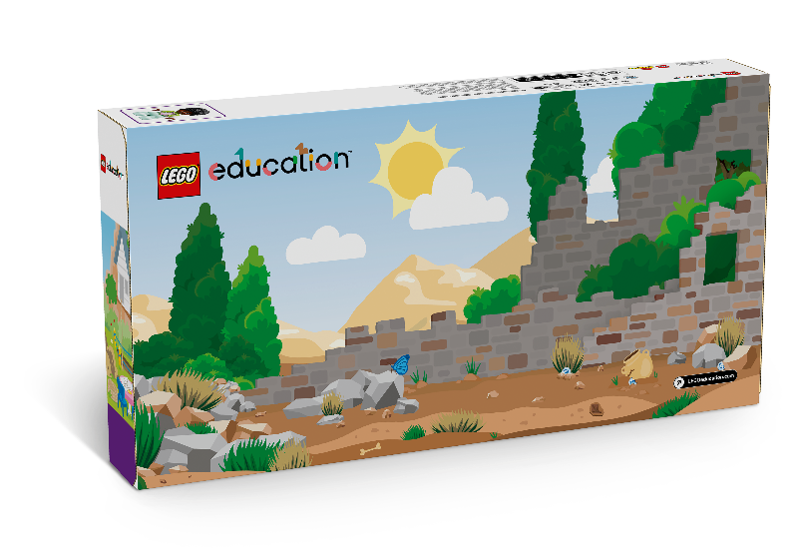
Build Together
Build the excavation model from the Discover Set.
You Need…
Notes:
Create Task (25 minutes)​
Have each team build the excavation model from the Discover set, using the building cards. Archaeologists must dig very carefully to make sure discoveries are not damaged. Take turns to practice taking the model apart and putting it back together.
Use the STEAM Park Set to build around the excavation model. Have the team build creatively around the excavation model and describe where their model is located (e.g., in a city, desert, or forest). Can the team retrieve the bone from the excavation site without damaging the rest of their model?
Facilitator Tip:​
Building Cards in the Discover set provide visual instructions to make the different parts of the Discover model.

Slide 12

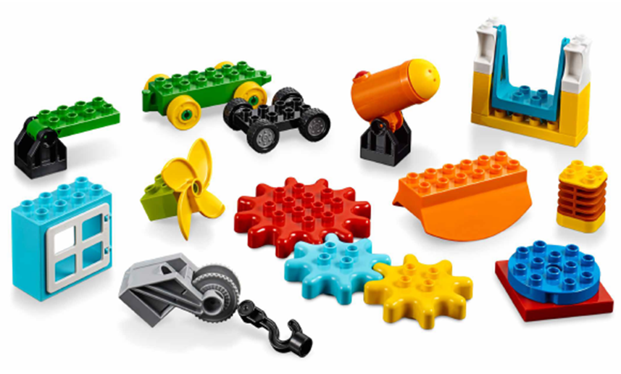
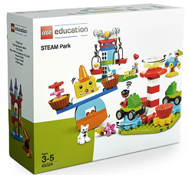
Create
Use the STEAM Park Set to build around the excavation model.
You Need…
Notes:
Create Task (25 minutes)​
Use the STEAM Park Set to build around the excavation model. Have the team build creatively around the excavation model and describe where their model is located (e.g., in a city, desert, or forest). Can the team retrieve the bone from the excavation site without damaging the rest of their model?

Slide 13
Create
Can you retrieve the bone from the excavation model without damaging what you built?
Notes:
Create Task (25 minutes)​
Can the team retrieve the bone from the excavation site without damaging the rest of their model?

Slide 14

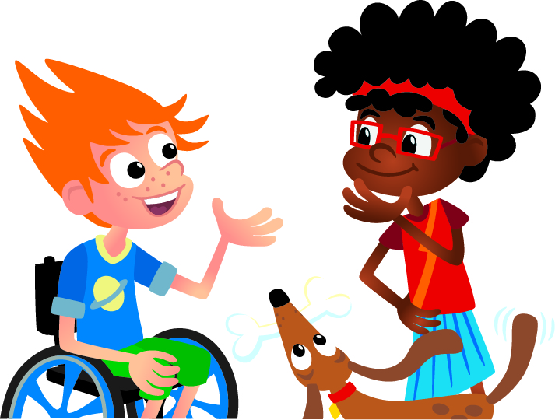
Share
Share what you built!
Notes:
Share Task (15 minutes)​
In their Engineering Notebooks, have the children write about or draw a place where archaeologists make discoveries. The children can also share and describe what they built.

Slide 15
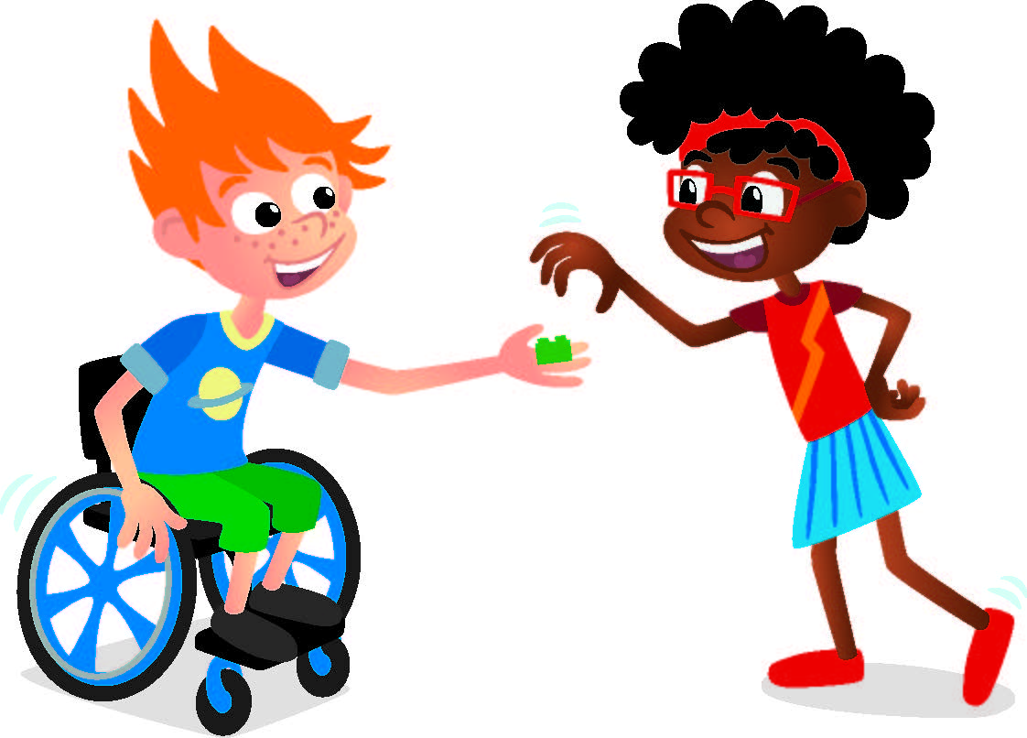
Reflect
Does everyone's build look the same?
Notes:
Share Task (15 minutes)​
In their Engineering Notebooks, have the children write about or draw a place where archaeologists make discoveries. The children can also share and describe what they built.

Slide 16
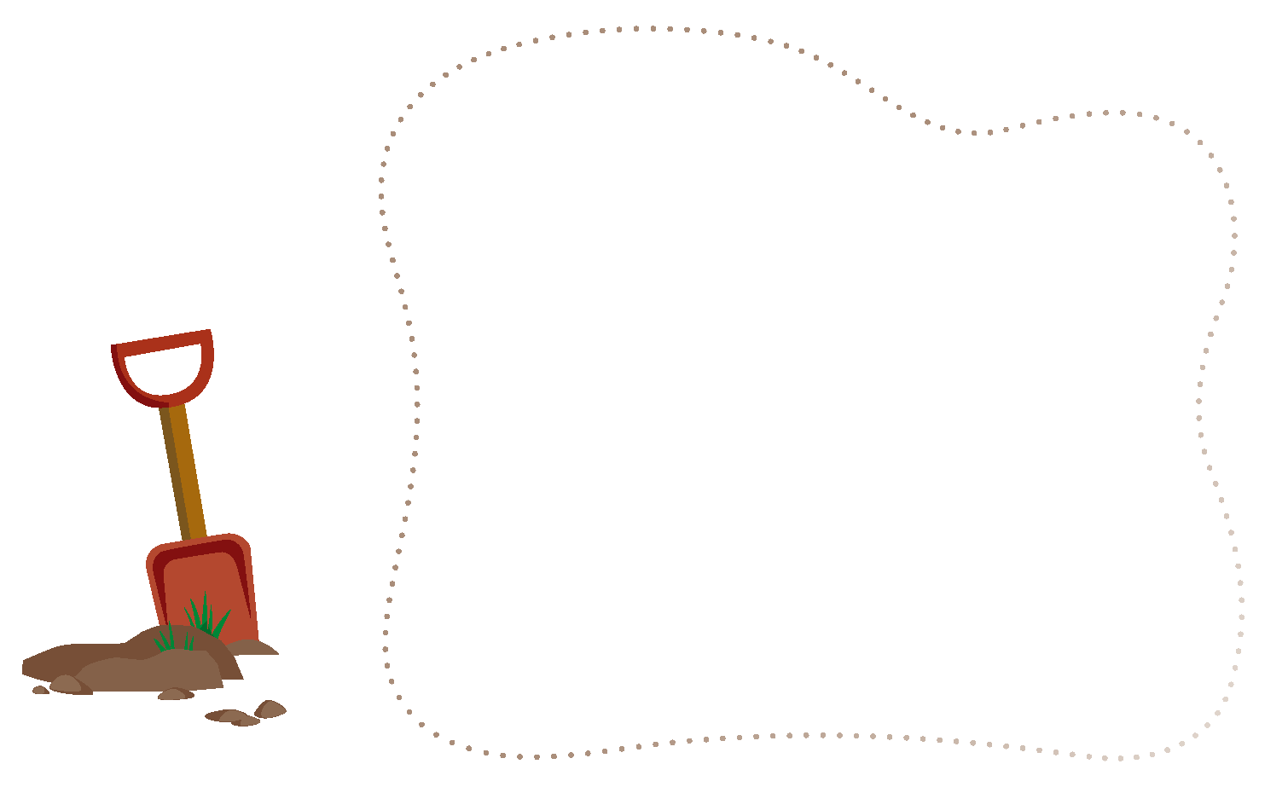
Engineering Notebook
Write or draw a place where archaeologists make discoveries.
Notes:
Share Task (15 minutes)​
In their Engineering Notebooks, have the children write about or draw a place where archaeologists make discoveries. The children can also share and describe what they built.

Slide 17
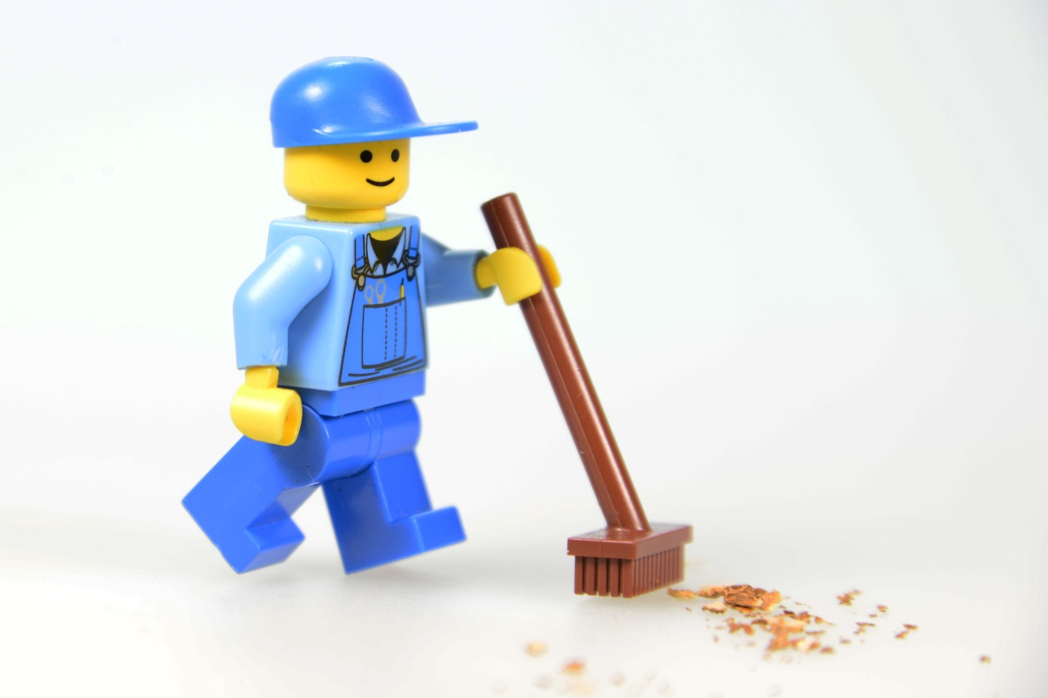
Clean Up
Notes:
You may wish to play a video or song during clean up time.
Link on GoNoodle: https://family.gonoodle.com/activities/clean-up
Link on YouTube Kids: https://www.youtubekids.com/watch?v=ZJFk87ZsHn0
Link on YouTube: https://youtu.be/ZJFk87ZsHn0
Send home the Discover More set with each child for home learning and exploration. Check out page 8 of the Team Meeting Guide for how to use this set for family engagement.

Slide 18


LEGO, the LEGO logo, DUPLO and the DUPLO logo are trademarks of the LEGO Group. ©2025 The LEGO Group. All rights reserved. FIRST®, the FIRST ® logo, and FIRST® AGETM are trademarks of For Inspiration and Recognition of Science and Technology (FIRST). LEGO® is a registered trademark of the LEGO Group. FIRST ® LEGO® League and UNEARTHEDTM are jointly held trademarks of FIRST and the LEGO Group. ©2025 FIRST and the LEGO Group. All rights reserved.

