Slide 1


SESSION 10
Celebration Event
I can work with my team to build a model that represents a discovery made at a dig site.
I can work with my team to answer questions asked by the reviewers.
Students will share what they learned about archaeology with the reviewers and complete a final challenge. Finally, they will celebrate each team’s achievements.

Slide 2
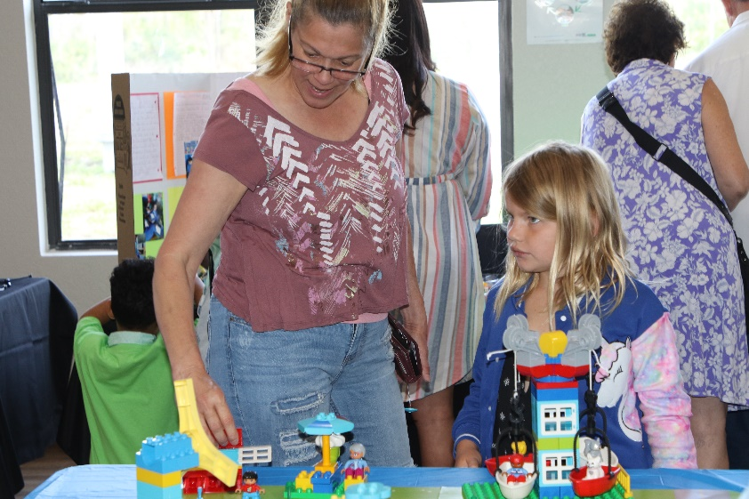
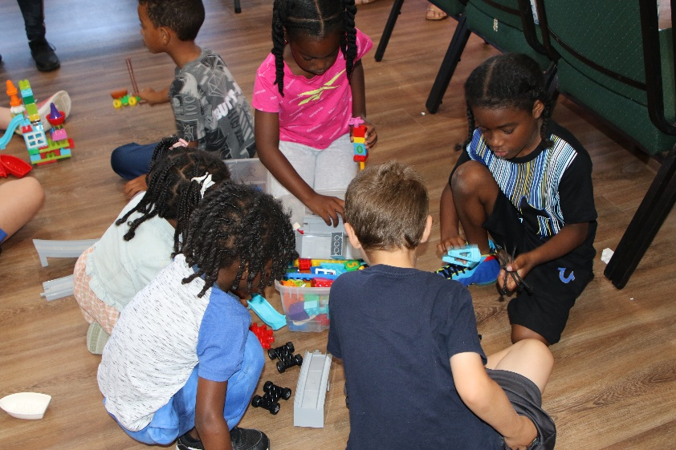
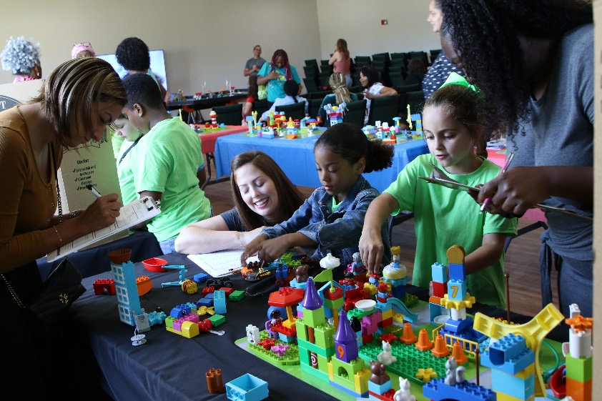
What happens before the Celebration Event?
Choose a time and space for the event.
Read all of Session 10 to understand what teams and spectators will do during the event.

Slide 3
What happens before the Celebration Event?
Send invitations to families, caregivers, teachers, and friends.
Find and assign volunteer reviewers who will listen to what the children have learned and provide encouraging feedback.
Notes:
Print the reviewing prompts and award certificates. https://www.firstlegoleague.org/season#resources

Slide 4
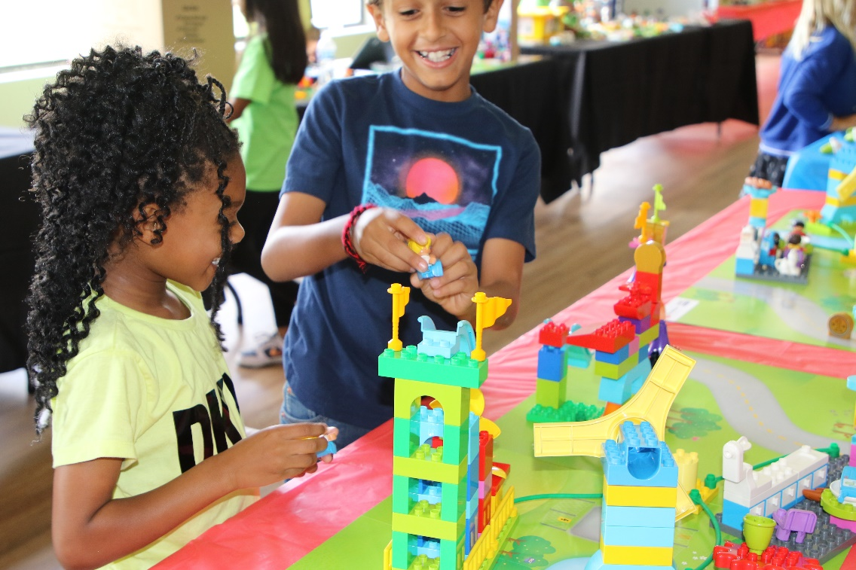
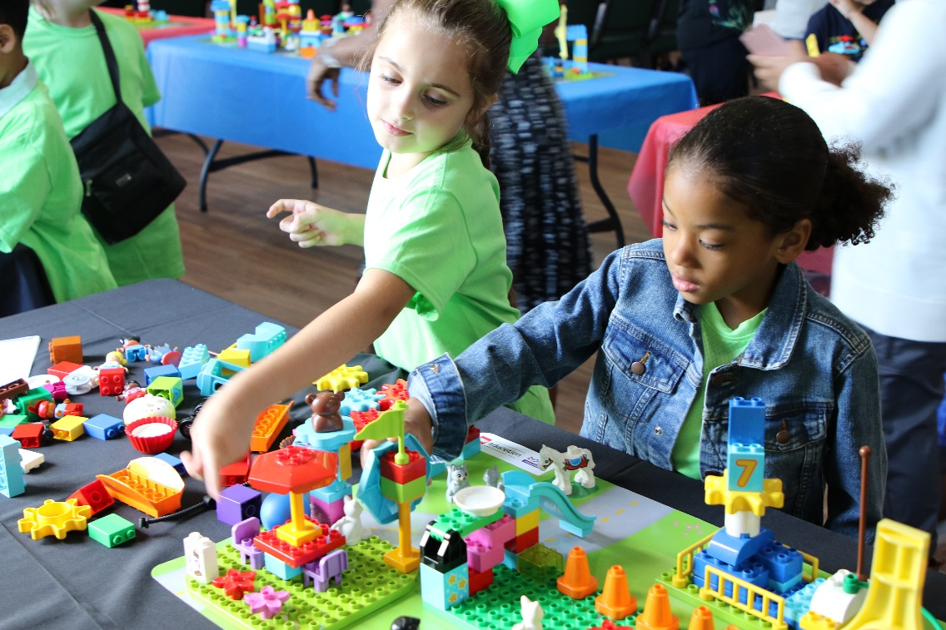
What happens during the Celebration Event?
Lay out the mats so teams can build on them. You could push two mats together so teams can work together.
Get the children excited for the final challenge.

Slide 5
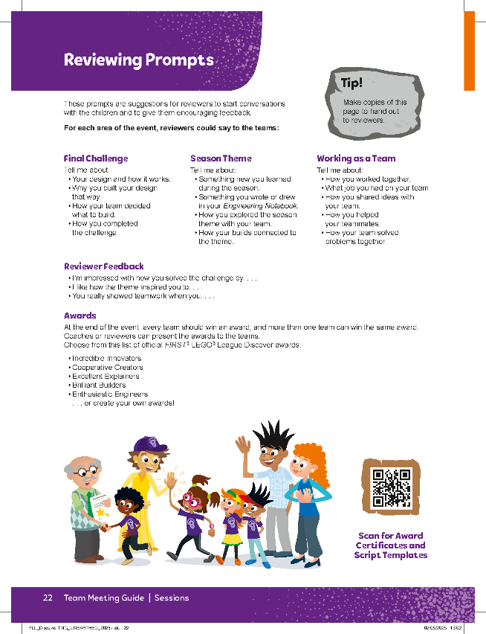
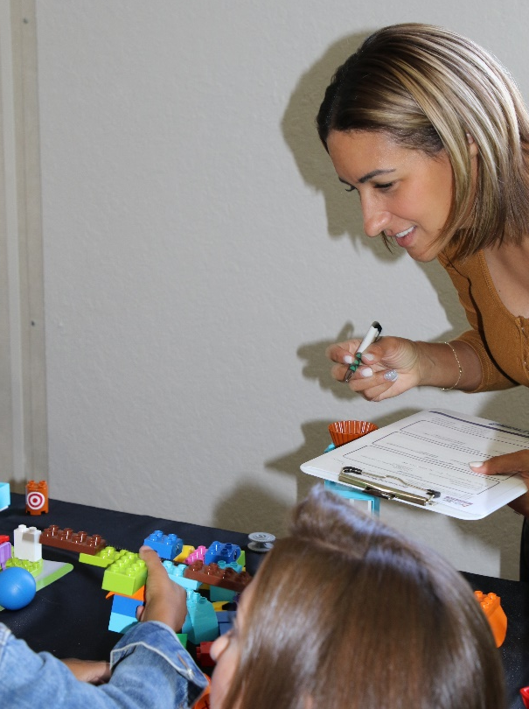
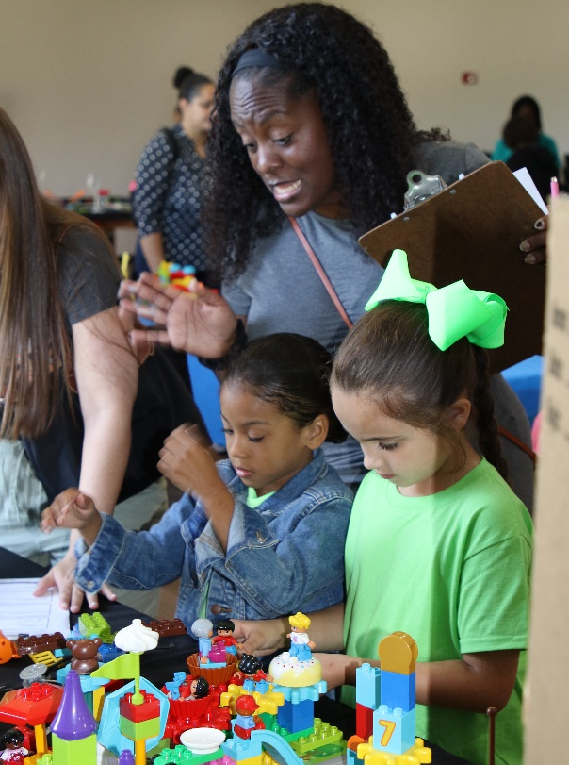
What happens during the Celebration Event?
Hand out reviewing prompts and assign at least one adult reviewer to each pair of teams.

Slide 6
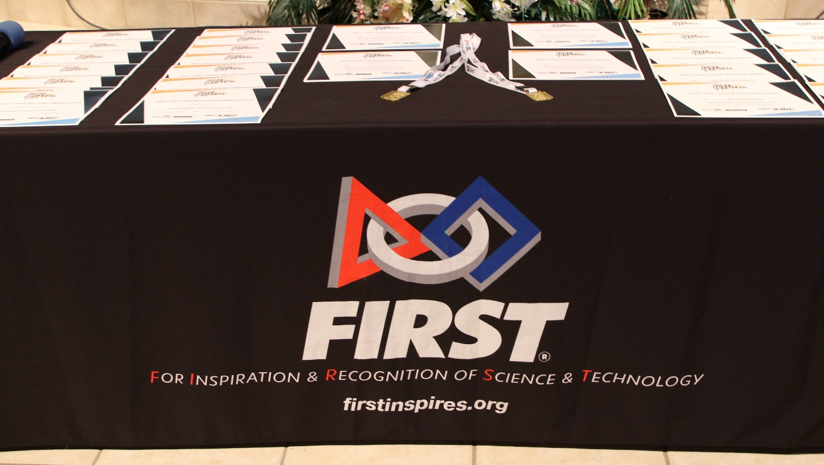
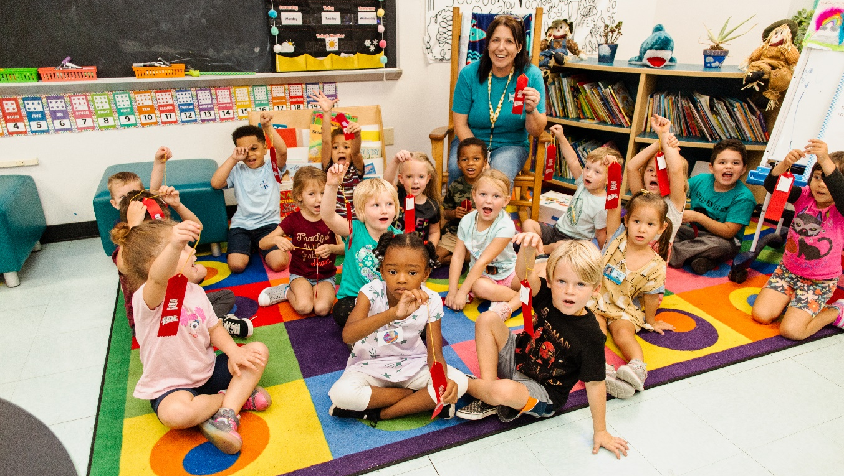
What happens during the Celebration Event?
Hand out certificates at the end of the celebration.
Have fun and celebrate the children’s achievements.

Slide 7

What happens after the Celebration Event?
Continue to teach STEAM Park lessons.
Teach additional STEAM activities related to the theme.
Find opportunities to use the vocabulary learned through the experience.

Slide 8






Welcoming the Teams
Notes:
Welcome (15 minutes)
Welcome the children to the event. Let them know there will be a final challenge, followed by time to share and answer questions about what they learned with reviewers. Welcome any guests and reviewers and let them know what to do during the event.
The teams will use their ideas to build a model that represents a discovery made at a dig site. They will use all parts of their UNEARTHED™ Discover Set. Reviewers will ask the teams about what they learned and built and then give encouraging feedback. The reviewing prompts will help ensure teams can relate what they do at the event to the sessions they have completed.
Facilitator Tips:
It is important that teams can relate what they do at the event to the sessions they have completed.

Slide 9
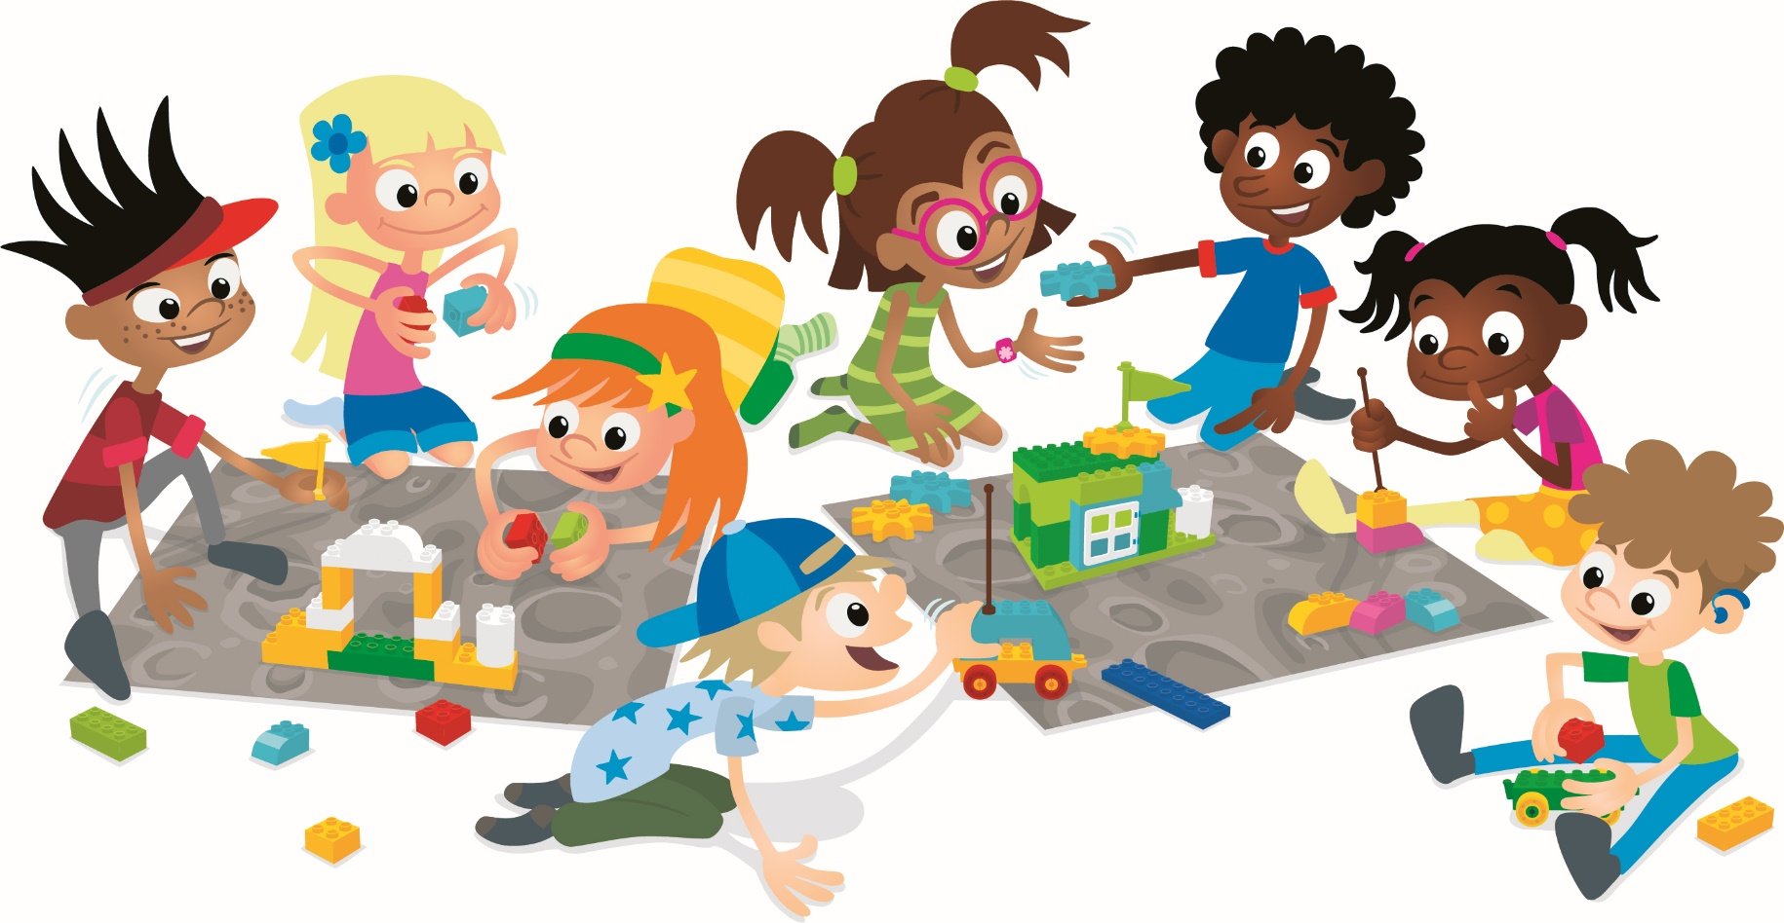
Final Challenge
Teams will build artifacts, build up around them, act like archaeologists and recover artifacts.
Notes:
Final Challenge (30+ minutes)
5 minutes: Tell the children to select or build a small artifact that represents something their team learned. The artifact should be small enough that it can be covered in the next part of the challenge. They can use pieces from the Discover or STEAM Park Sets or any other LEGO® DUPLO® elements to build the artifact. The team should place their artifact on the mat.
10 minutes: Tell the teams they will use LEGO elements to build on top of their artifact, covering it up at least partially. This is the first step in creating a dig site. The bricks must be connected to each other.
10-15 minutes: Tell them they will now act like archaeologists to very carefully remove their team artifact from underneath the LEGO bricks. Remind them that archaeologists use tools and make a plan before excavating artifacts. Have the children carefully remove their team artifact and then rebuild the LEGO brick structure.
Optional: Have teams trade dig sites to see if another team can recover the artifact.
Facilitator Tips:
If possible, assign at least one adult to each pair of teams. They can help the teams stay on task.

Slide 10
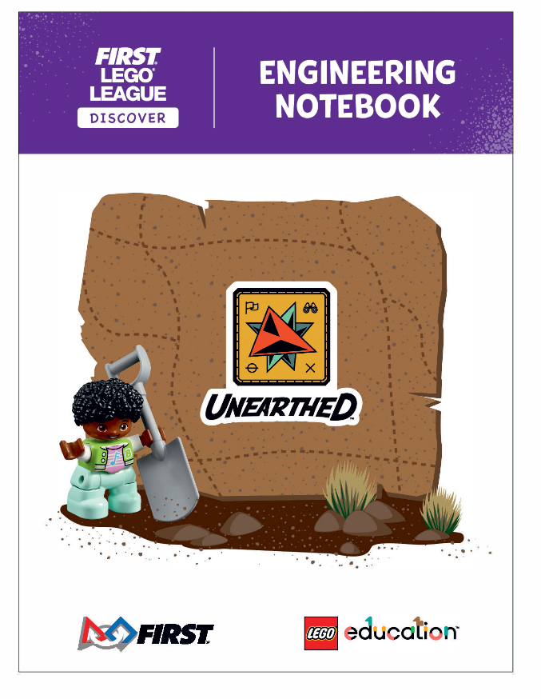
Reviewing the Teams
Adult reviewers ask each team questions about their Engineering Notebooks and build.
Notes:
Reviewing the Teams (5 minutes per team)
The reviewers should observe the teams during the final challenge. After teams are finished building, the reviewers can begin talking with them, asking questions, and viewing their Engineering Notebooks. Reviewers can use the provided prompts to start a conversation and share encouraging feedback.
Facilitator Tips:
The reviewers will decide on awards for each team. Reviewing prompts are on page 22.

Slide 11
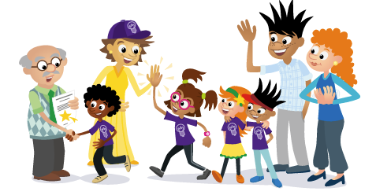
Closing Celebration
Hand out certificates or say something nice about each team and what they learned/accomplished.
Notes:
Closing Celebration (10+ minutes)
Allow plenty of time to celebrate each team’s achievements in front of everyone at the event. You could extend this time and let the children present what they learned.
Facilitator Tips:
Print certificates for every child. Have the children come up one at a time, or in their team, to be recognized and applauded. A great FIRST® LEGO® League Discover event always ends in celebration.

Slide 12
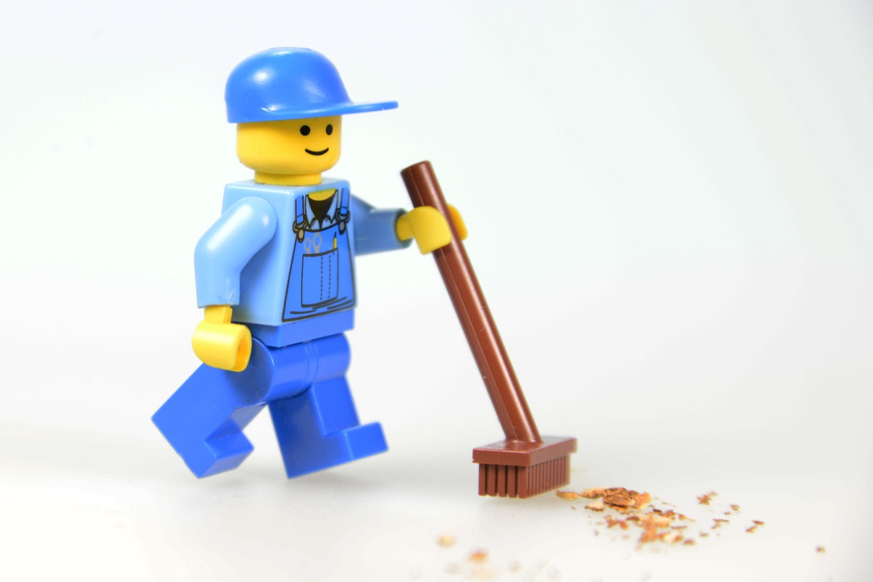
Clean Up
Notes:
You may wish to play a video or song during clean up time.
Link on GoNoodle: https://family.gonoodle.com/activities/clean-up
Link on YouTube Kids: https://www.youtubekids.com/watch?v=ZJFk87ZsHn0
Link on YouTube: https://youtu.be/ZJFk87ZsHn0
Send home the Discover More set with each child for home learning and exploration. Check out page 8 of the Team Meeting Guide for how to use this set for family engagement.

Slide 13


LEGO, the LEGO logo, DUPLO and the DUPLO logo are trademarks of the LEGO Group. ©2025 The LEGO Group. All rights reserved. FIRST®, the FIRST ® logo, and FIRST® AGETM are trademarks of For Inspiration and Recognition of Science and Technology (FIRST). LEGO® is a registered trademark of the LEGO Group. FIRST ® LEGO® League and UNEARTHEDTM are jointly held trademarks of FIRST and the LEGO Group. ©2025 FIRST and the LEGO Group. All rights reserved.

