Slide 1


SESSION 1
Let’s Discover
I can play with the STEAM Park Set, building creatively and trying new things.
I can identify LEGO® pieces and relate them to what they know about archaeology.
Students will learn about what archaeologists do, then build and share what they learned about.

Slide 2
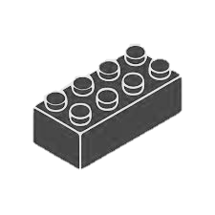
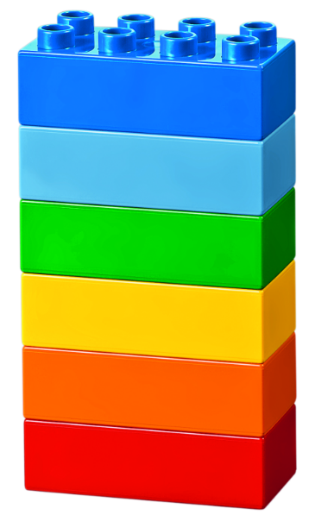

Warm Up
Discover Six Bricks I
10 Minute Timer
Start
Click to Start Timer
2
8
4
6
Notes:
Six Bricks Warm Up (10 minutes)
Discover Six Bricks I The children will use the Six Bricks both in the classroom and at home with the Discover More set to learn new skills and explore new ideas.
Base Activity
Each child separates his or her bricks and spreads them out.
With closed eyes, they shuffle their bricks around.
Keeping their eyes closed, each child picks any brick and holds it up high.
Now they open their eyes and see what color they hold.
Part 2
5. Let them pick any brick, look at it carefully, and turn it around and over in their hands.
Guiding Questions:
What color brick do you have?
Can you name all the different colors?
Can you sort the bricks into warm and cold colors?
Can you create a rainbow with your bricks?
What color is your brick? How does it feel (rough, smooth, hard, soft, shiny, dull, etc.)?
What spaces and shapes can you see on your brick?
How many studs does each brick have?

Slide 3

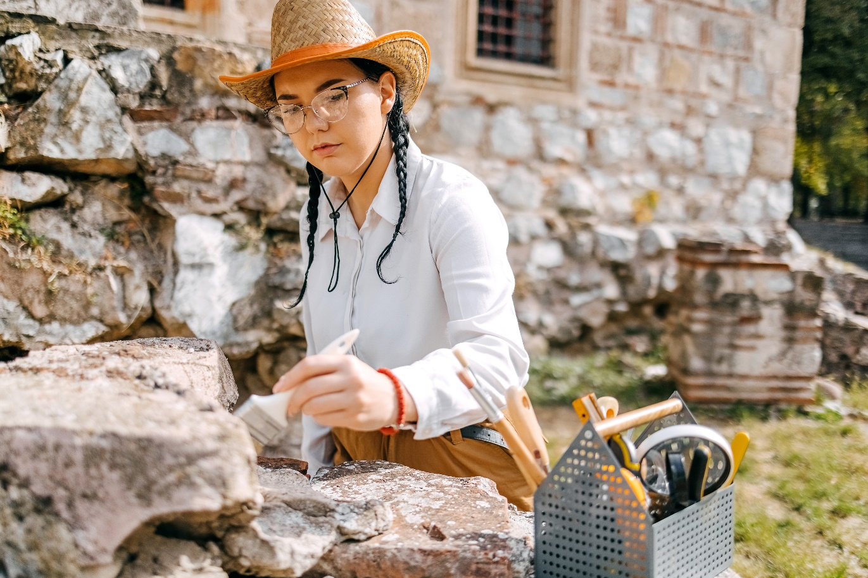
Big Question
What does an archaeologist do?
Notes:
Each session has a Big Question that can be shared to frame the session.​
Outcomes
Teams will play with the STEAM Park Set, building creatively and trying new things.
Teams will identify LEGO® pieces and relate them to what they know about archaeology.
Key Vocabulary
Archaeology, tools, dig site

Slide 4

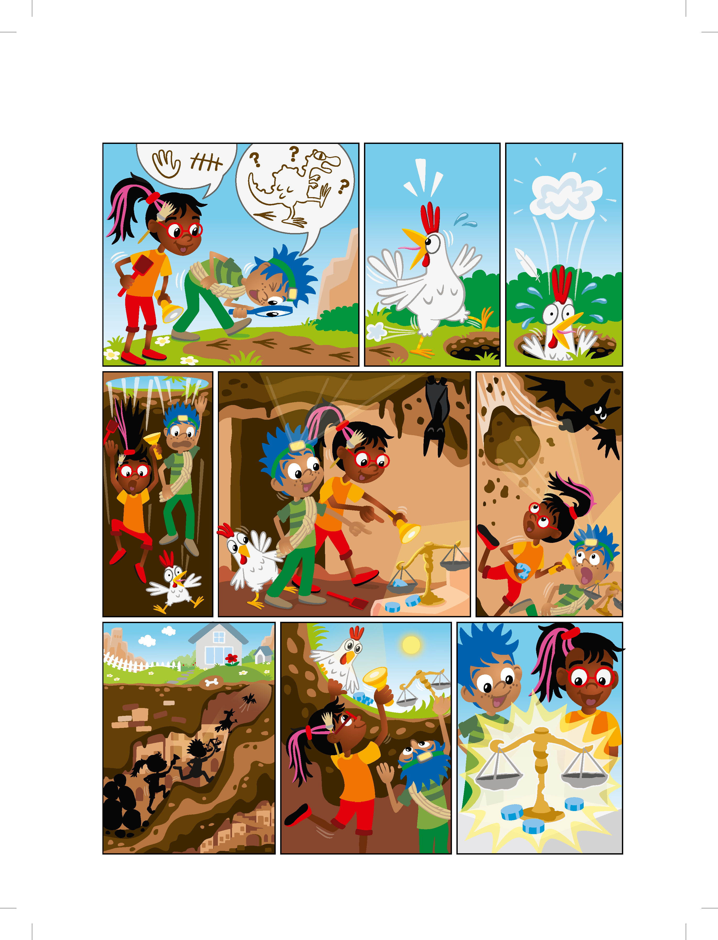
Explore
What do you think an archaeologist might do?
Notes:
Explore Task (10 minutes)
Lead a discussion about the archaeology. Let the students share anything they know about archaeology.
Look at the pages of the Discover Story and discuss what can be seen in each of the illustrations. Ask the children what they notice.
Explain that archaeology is a science that studies how humans lived in the past. People who work in this field are called archaeologists.
Look at the Discover Story and discuss what the young archaeologists are doing in the illustrations. Ask the students what else they think an archaeologist might do.
An archaeologist could:
Dig in the ground using tools like shovels, rakes, and brushes.
Look for old things that people used a long time ago.
Find treasures such as coins or art that might give us clues about how people used to live.
Key Vocabulary
Archaeology, tools, dig site

Slide 5
Explore
What do you think an archaeologist might do?
Notes:
Explore Task (10 minutes)
Lead a discussion about the archaeology. Let the students share anything they know about archaeology.
Look at the pages of the Discover Story and discuss what can be seen in each of the illustrations. Ask the children what they notice.
Explain that archaeology is a science that studies how humans lived in the past. People who work in this field are called archaeologists.
Look at the Discover Story and discuss what the young archaeologists are doing in the illustrations. Ask the students what else they think an archaeologist might do.
An archaeologist could:
Dig in the ground using tools like shovels, rakes, and brushes.
Look for old things that people used a long time ago.
Find treasures such as coins or art that might give us clues about how people used to live.
Key Vocabulary
Archaeology, tools, dig site

Slide 6
Explore
What do you think an archaeologist might do?
Notes:
Explore Task (10 minutes)
Lead a discussion about the archaeology. Let the students share anything they know about archaeology.
Look at the pages of the Discover Story and discuss what can be seen in each of the illustrations. Ask the children what they notice.
Explain that archaeology is a science that studies how humans lived in the past. People who work in this field are called archaeologists.
Look at the Discover Story and discuss what the young archaeologists are doing in the illustrations. Ask the students what else they think an archaeologist might do.
An archaeologist could:
Dig in the ground using tools like shovels, rakes, and brushes.
Look for old things that people used a long time ago.
Find treasures such as coins or art that might give us clues about how people used to live.
Key Vocabulary
Archaeology, tools, dig site

Slide 7
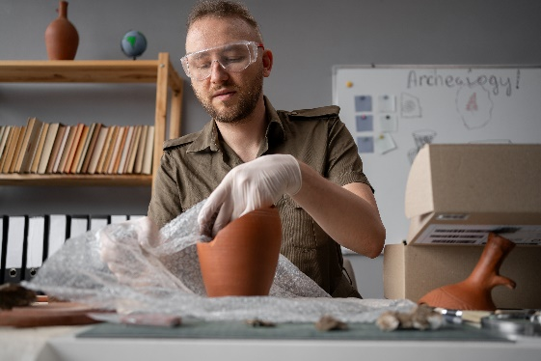

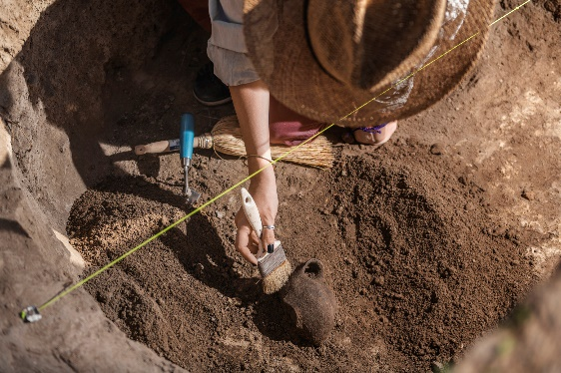
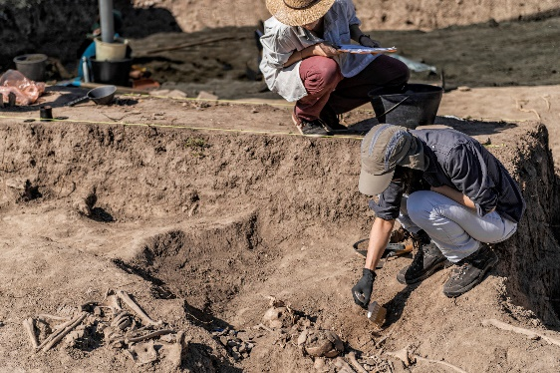
Key Vocabulary
Archaeology: the study of how humans or animals lived in the past
Tools: anything that is used to make a change to something else or to help do a job
Dig Site: a place where archaeologists carefully dig to uncover artifacts and learn about the past
Notes:
Key Vocabulary
Archaeology, tools, dig site

Slide 8

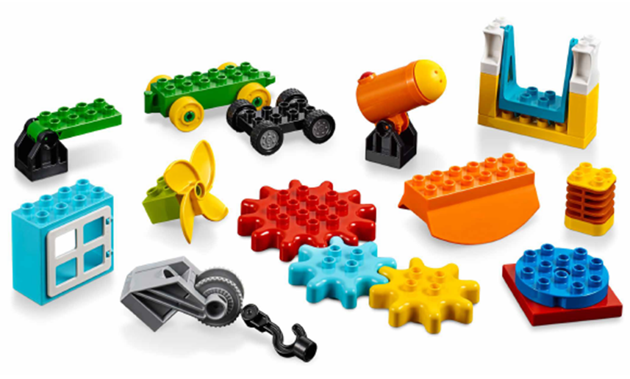
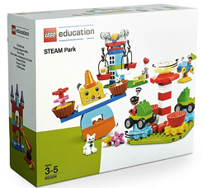
Create
Can you build something related to archaeology?
You Need…
Notes:
Create Task (25 minutes)
Have the children build using the different pieces in STEAM Park. Encourage them to play freely and build anything they want that relates to archaeology. They could build tools, treasure, buildings, or a dig site. Look at the Discover Story for ideas.
Key Vocabulary – Archaeology, tools, dig site
Facilitator Tip
Check out the STEAM Park Functional Elements lesson plan - https://education.lego.com/en-us/lessons/preschool-steam-park/functional-elements

Slide 9

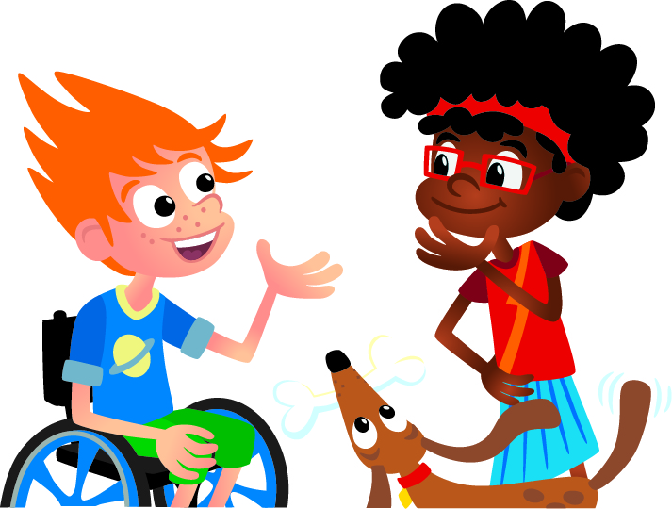
Share
Share what you built and how it relates to archaeology.
Notes:
Share Task (15 minutes)
Have the children share and explain what they built and how the pieces relate to archaeology. They could share in pairs or in their teams if they aren’t comfortable sharing with entire class. All the children’s builds will be meaningful, and there is no one right answer to these sessions.
Image of the prehistoric monument at Stonehenge in southern England.

Slide 10
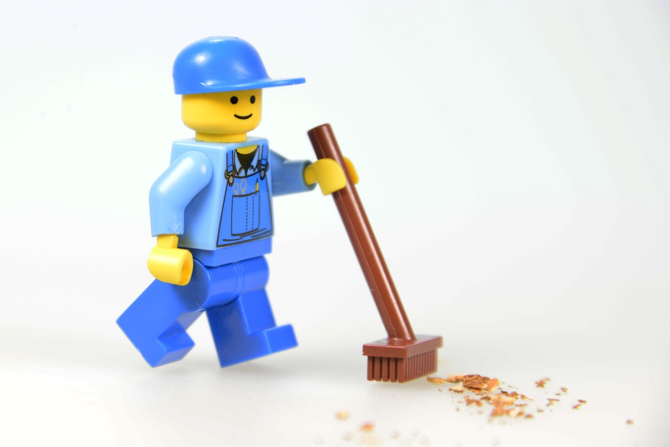
Clean Up
Notes:
You may wish to play a video or song during clean up time.
Link on GoNoodle: https://family.gonoodle.com/activities/clean-up
Link on YouTube Kids: https://www.youtubekids.com/watch?v=ZJFk87ZsHn0
Link on YouTube: https://youtu.be/ZJFk87ZsHn0
Send home the Discover More set with each child for home learning and exploration. Check out page 8 of the Team Meeting Guide for how to use this set for family engagement.

Slide 11
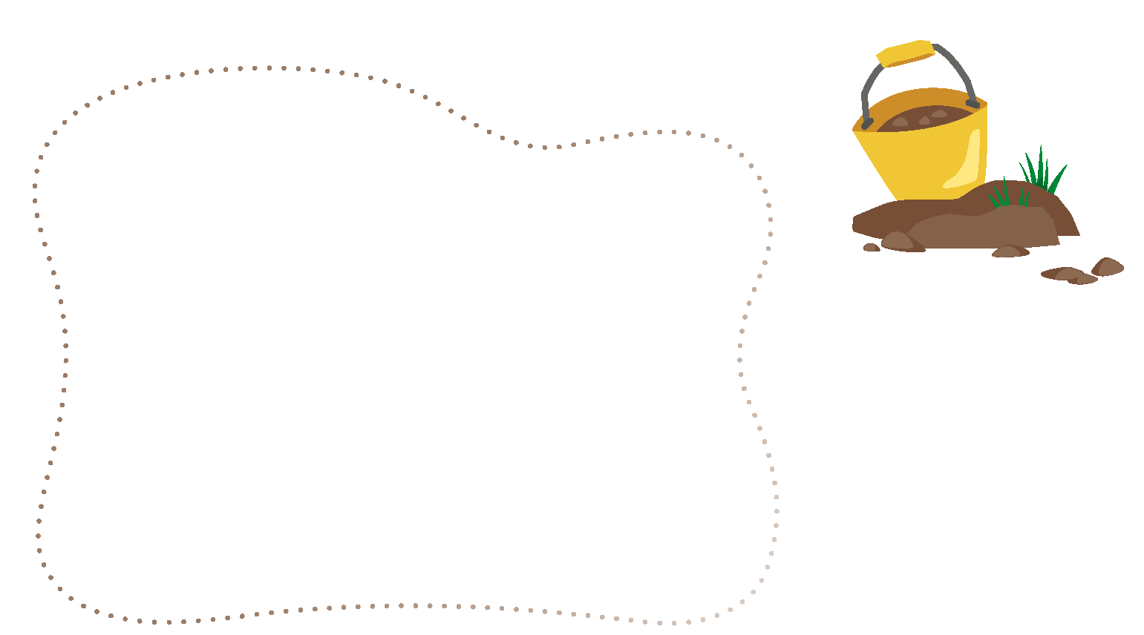
Engineering Notebook
Draw an archaeologist
Notes:
Share Task (15 minutes)
Have the children fill in Session 1 of their Engineering Notebook.

Slide 12


LEGO, the LEGO logo, DUPLO and the DUPLO logo are trademarks of the LEGO Group. ©2025 The LEGO Group. All rights reserved. FIRST®, the FIRST ® logo, and FIRST® AGETM are trademarks of For Inspiration and Recognition of Science and Technology (FIRST). LEGO® is a registered trademark of the LEGO Group. FIRST ® LEGO® League and UNEARTHEDTM are jointly held trademarks of FIRST and the LEGO Group. ©2025 FIRST and the LEGO Group. All rights reserved.

