Slide 1


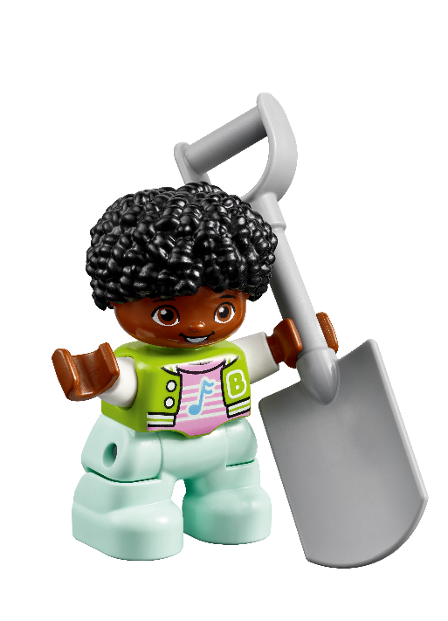

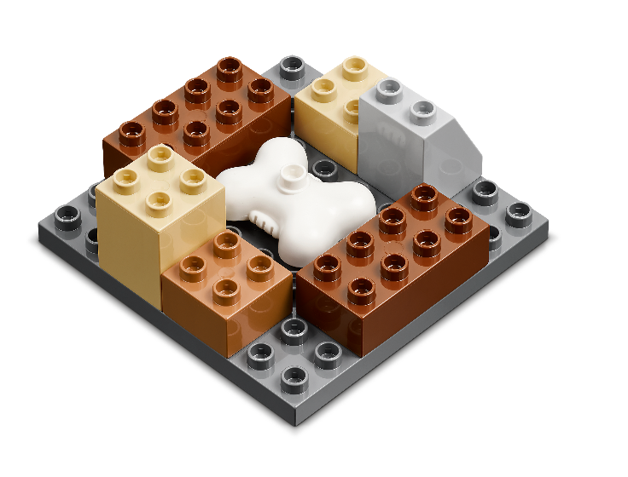
Family Engagement Activity – Session 1
Instructions: Play a game. Each person should take turns describing how they are archaeologists and are using tools while at a dig site.
Activity: Use the Six Bricks or other materials and build a dig site. Everyone guesses what kind of site it is until someone gets it right.
Discussion Questions: What is your favorite dig site built or what tools would you use to uncover the dig site? Everyone takes a turn to answer.
  Activity Log: Write down what was at your dig site and which tools you used to uncover it.
Habits of Learning
We will wonder and question during this activity.
Family Engagement Activity – Session 2
Instructions: You are an archaeologist making a discovery. Each person should take turns sharing what item they excavated.
Activity: Use the Six Bricks to build an item you have unburied and share where you found it.
Discussion Questions: What kinds of items are found buried in the ground? What tools would you use to excavate them?
  Activity Log: List what items you found in your excavation and what tools you used.
Habits of Learning
We will apply knowledge during this activity.

Slide 2
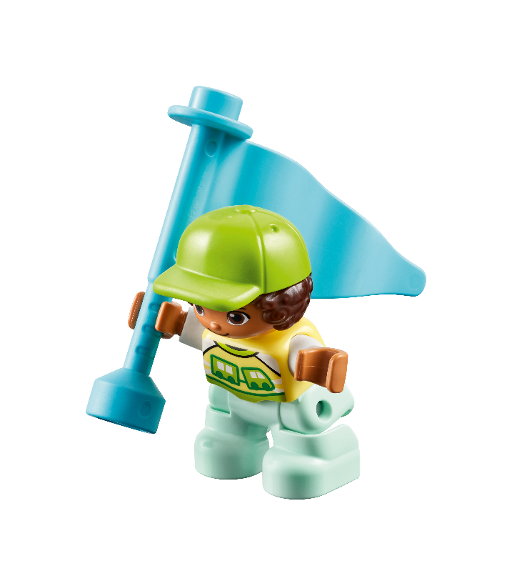

Family Engagement Activity – Session 3
Instructions: Maps are used by archaeologists to record where artifacts are found at a dig site. They will often stick flags into the ground to mark these artifacts.
Activity: Use your Six Bricks or other materials to create a map or some flags just like archaeologists use.
Discussion Questions: What is your map of? What do your flags look like? Did you want different kinds of flags for different artifacts?
  Activity Log: Write about your map and the flags you built.
Habits of Learning
We will apply knowledge during this activity.
Family Engagement Activity – Session 4
Instructions: Once an artifact is found, information should be recorded about where it was found and details about what it looks like, so others learn about it. It also helps with sorting and comparing it to other artifacts.
Activity: As a family, use your Six Bricks or other materials and sort them by different categories – size, color, shape, etc.
Discussion Questions: What are the different ways you can organize things you find?
  Activity Log: Write down one way you organized your artifacts.
Habits of Learning
We will use teamwork during this activity.

Slide 3
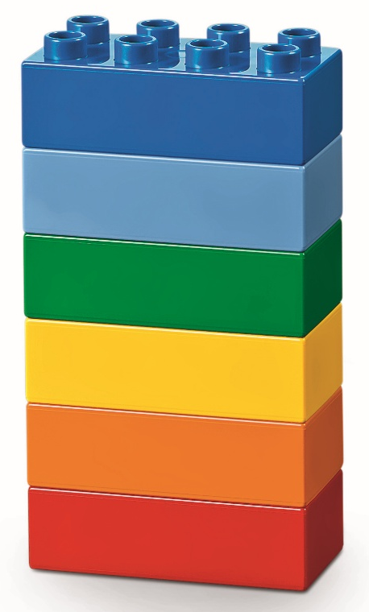
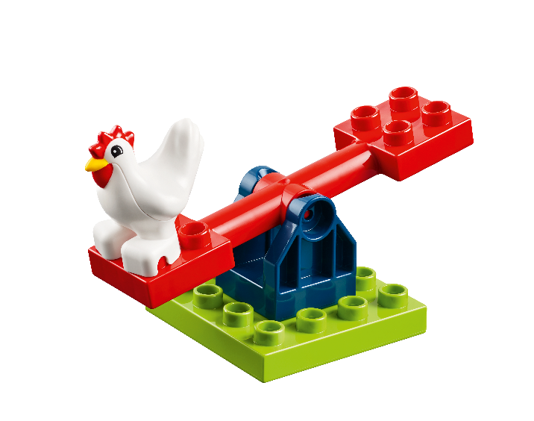
Family Engagement Activity – Session 5
Instructions: A long time ago, homes might have looked different than they do now. There were different materials like wood, mud, or even stone that were used to build them. New technology helps us build images or models of what these old homes might have looked like.
Activity: Use your Six Bricks or other materials to build homes the way you think they looked in the past.
Discussion Questions: What features does the home have? What materials did you use to build it?
  Activity Log: Draw or write about the home you built.
Habits of Learning
We will use confidence during this activity.
Family Engagement Activity – Session 6
Instructions: Archaeologists use all kids of tools in their jobs. Things like shovels, brushes, and wheelbarrows are all useful.
Activity: Work together to come up with a list of 10 tools that you would see at a dig site and write down or draw what they would be used for. Make sure everyone involved gets to share at least one idea.
Discussion Questions: How close did you get? What was easy
or hard about this activity?
  Activity Log: List or draw a picture of each tool that you all came up with.
Habits of Learning
We will use listen & empathy during this activity.

Slide 4


Family Engagement Activity – Session 7
Instructions: It takes a team of people working together to recover artifacts. Often it can be an adventure from discovering the site, digging, and recording the artifacts. Once they are ready, archaeologists share their findings with the community.
Activity: Use your Six Bricks or other materials and work together to design and build a display of an artifact. Write or draw about where you found it and what you think it was used for so that others can learn too.
Discussion Questions: What is your artifact? How did you choose to display it? What was it used for?
  Activity Log: Share about the display you made and the
  artifact it shows off.
Habits of Learning
We will take risks during this activity.
Family Engagement Activity – Session 8
Instructions: Have you ever heard of a time capsule? This is a way for people to share things with future generations and preserve a piece of the past.
Activity: Have them share with you one thing they would want to place in a time capsule.
Discussion Questions: What did you choose to place in the time capsule? Why that thing? What do you think future generations will think about what they will discover?
  Activity Log: Write down what you would place in the capsule and why.
Habits of Learning
We will wonder and question during this activity.

Slide 5

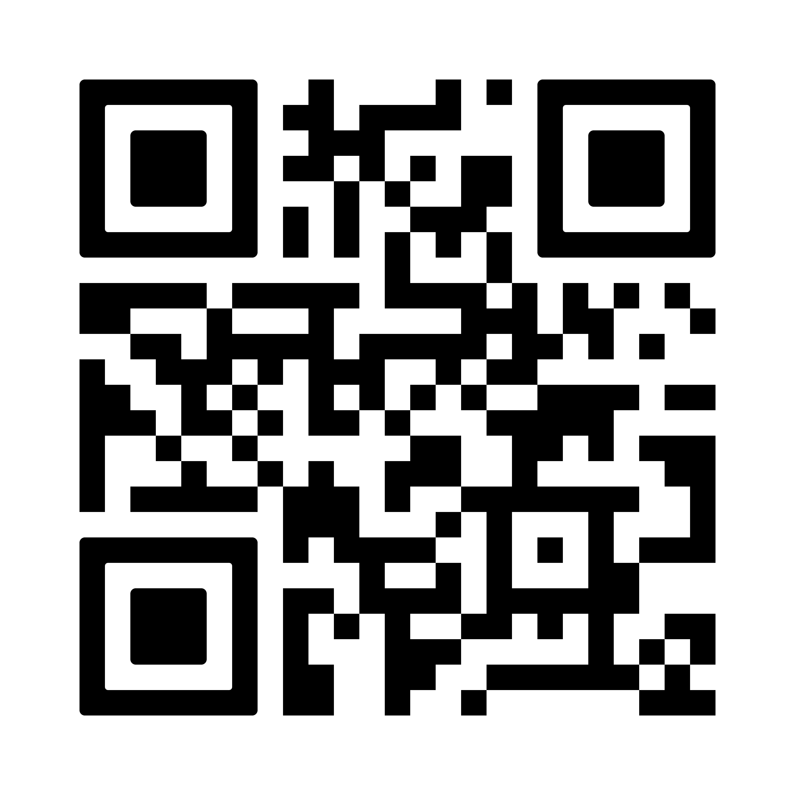
Family Engagement Activity – Session 9
Instructions: Use your imagination! Reflect and think about what they have learned about archaeology.
Activity: As a family, imagine you are all archaeologists discovering a new piece of history. Using your Six bricks or other materials, become storytellers and share about what you have discovered.
Discussion Questions: Where did you discover this artifact? Are there more nearby? Who used it? What was it for?
  Activity Log: Write down the story you come up with about what you discovered.
Habits of Learning
We will build confidence during this activity.
Family Engagement Activity – Session 10
Instructions: Play the Discover More Game! Celebrate the FIRST LEGO League Discover season by playing the Discover More Game together as a family.
Activity: Use the printed game sent home or download it here. You can also scan the QR code to access the game page. Play at least once, repeat as many times as you want, and add at least one rule, material, or activity of your choice.
Discussion Questions: Who is going to keep score?
How will you decide which tasks to do?
  Activity Log: Share your favorite part of the Discover
  More Game.
Habits of Learning
We will apply knowledge during this activity.

Slide 6
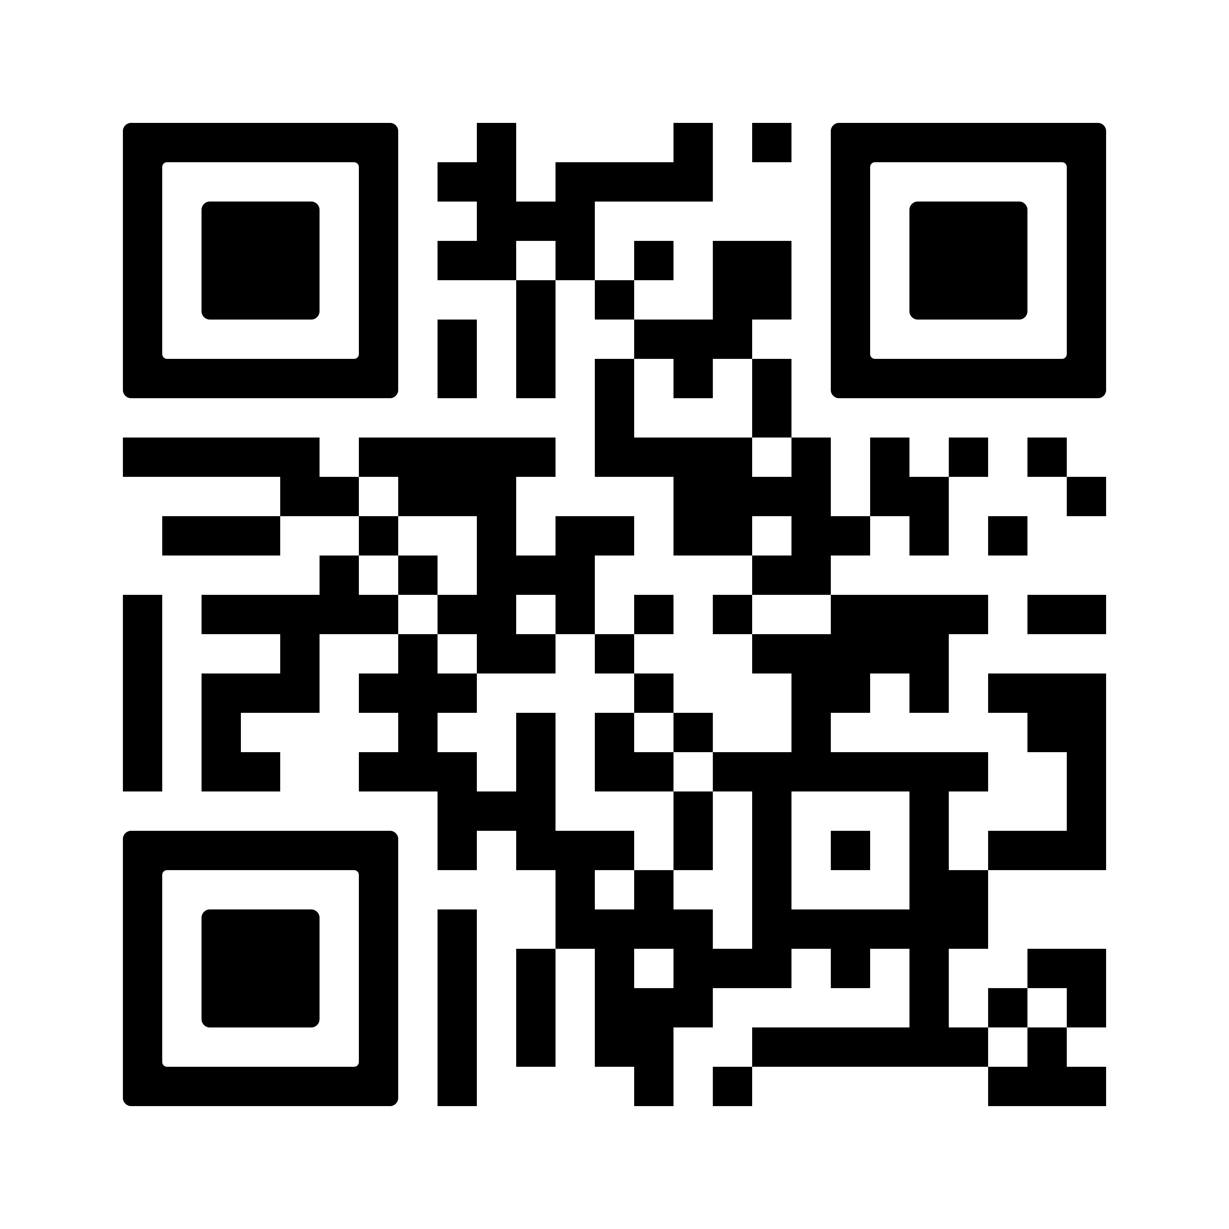
Family Engagement Activity – Bonus
Instructions: Find more activities to do as a family!
Activity: Visit the LEGO Foundation’s website or scan the QR Code and try out at least one activity from there. If you cannot visit the website (or even if you can), make up a game to play together using materials you already have. Play your game!
  Activity Log: Write down what activity your family chose to do.
Habits of Learning
We will use listen & empathy during this activity.

