Slide 1


















Session 9
Future Ocean
Notes:
Session 9: Future Ocean
Teams have learned about what it takes to go on an ocean journey and what ocean exploration can reveal. This session will challenge teams to think about how innovation can help to explore the oceans in the future.
Outcomes
Teams will reflect on their experiences throughout the sessions.
Teams will build an innovative vehicle that will help people learn about the oceans.
Key Vocabulary
reflect, innovate, future

Slide 2
Big Question
How will people explore the oceans in the future?
Notes:
Session 8: Future Ocean
Teams have learned about what it takes to go on an ocean journey and what ocean exploration can reveal. This session will challenge teams to think about how innovation can help to explore the oceans in the future.
Outcomes
Teams will reflect on their experiences throughout the sessions.
Teams will build an innovative vehicle that will help people learn about the oceans.
Key Vocabulary
reflect, innovate, future

Slide 3
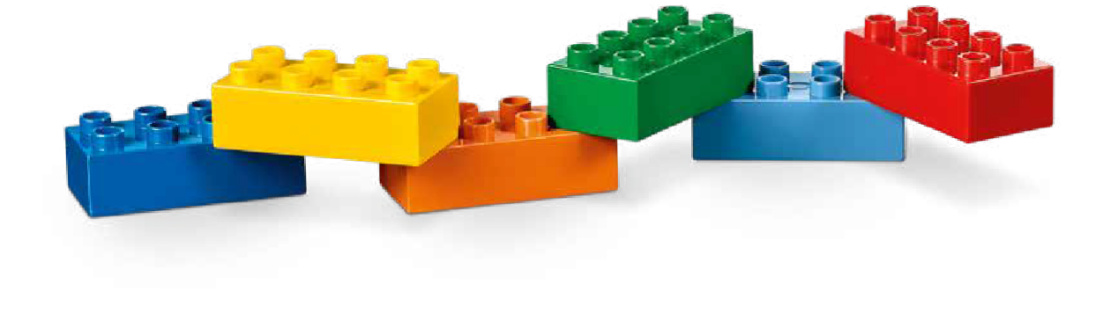
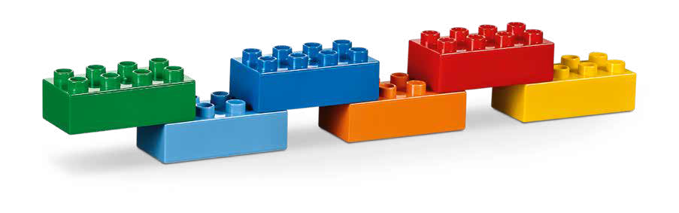
Six Bricks Warm-Up
It Takes a Team
Notes:
Six Bricks Warm-Up (1O minutes)
It Takes a Team
Base Activity
In groups of 4, have the children mix their bricks together.
The children should work together to build a long line of connected blocks to represent a person that is part of a team and how they support each other to achieve success.
The children should think about what happens if a brick is missing from the line.
Guiding Questions:
What job does each brick represent?
How do the different jobs work together?
What would happen if there was a break in the line?
Children learn to:
Use strategies learned earlier (patterns).
Negotiate when and how to carry out a task.
Imagine and tell stories.

Slide 4
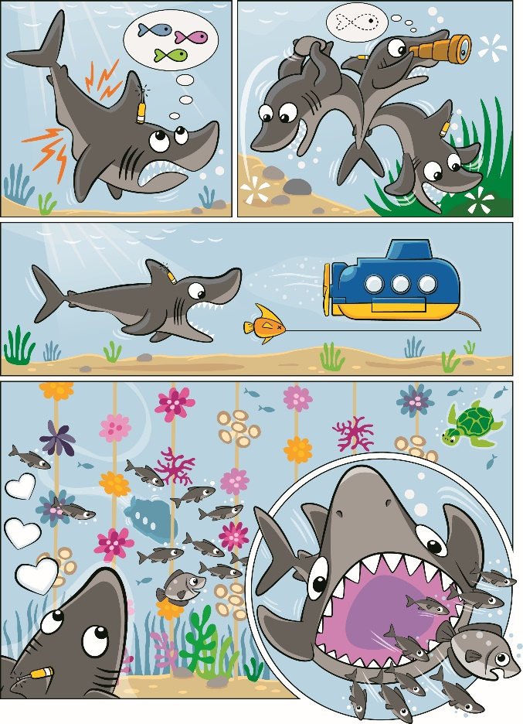
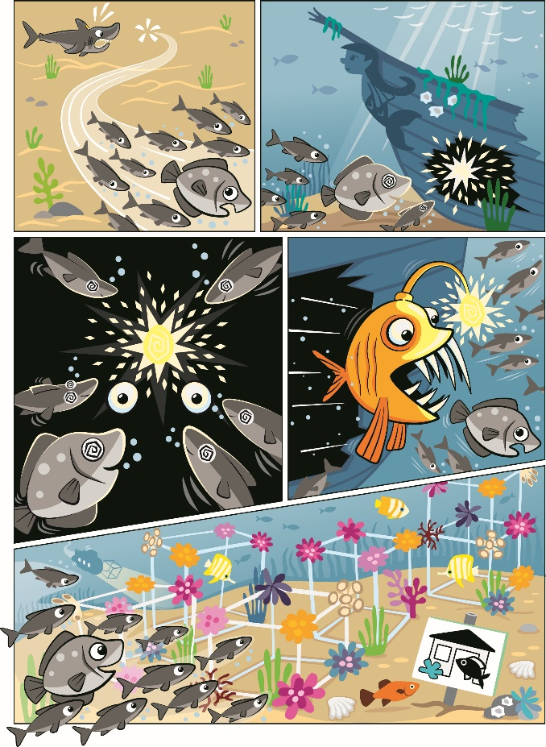
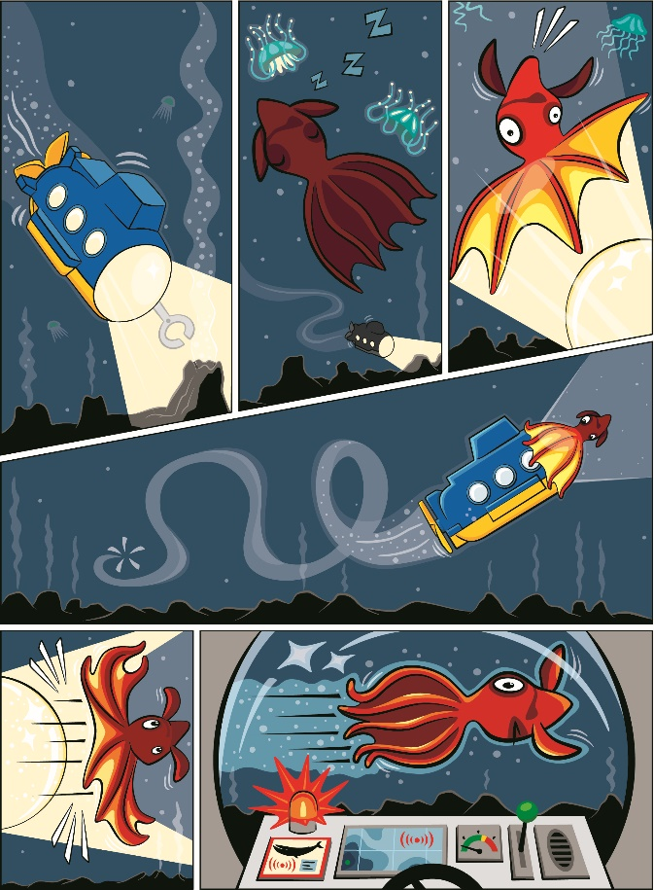
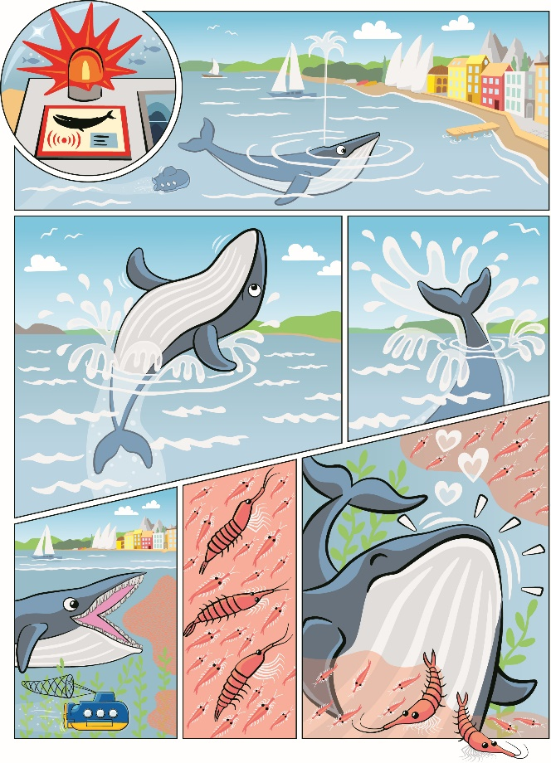
Explore Task
What challenges do ocean explorers face?
Notes:
Explore Task (10 minutes)
Ask the children to reflect on their experiences throughout the sessions.
Discuss the different places that ocean explorers visit and the challenges with each environment (i.e., low visibility, cold temperatures). Ask the children to think about creative ways to overcome challenges when exploring the ocean on their own ship.
You could ask the children:
How would you improve a submarine so it can visit a reef and not damage any coral?
What kind of tool or equipment would a diver need to stay warm underwater?
Tip:
Encourage the children to recall different sessions by using visuals like the mat or Discover Story.
Key Vocabulary
reflect, innovate, future

Slide 5
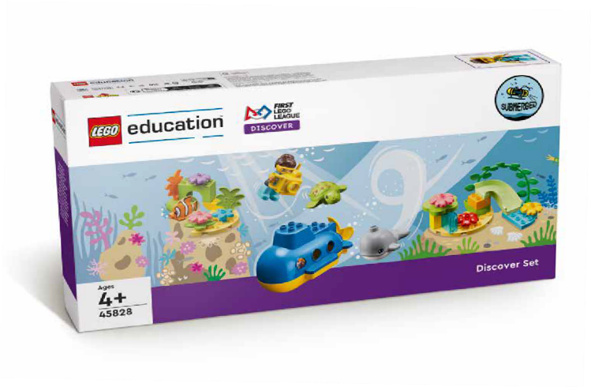
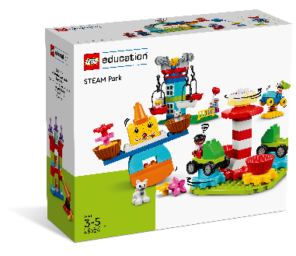









































































































Create Task
You Need..
Build a futuristic ocean exploration vehicle.
Notes:
Create Task (25 minutes)
Tell the teams to apply everything they have learned this season to build an innovative and futuristic ocean exploration vehicle. They should think about the entire ocean journey from the seashore to the deepest depths. Who are the people on the vehicle and what do they want to learn? What kinds of animals will they encounter? How will their vehicle navigate in the dark?
The teams can use pieces from the Discover set and STEAM Park. Have them decide where their model should go on the mat.
Key Vocabulary
reflect, innovate, future

Slide 6

Playful Learning in Action
Key Vocabulary
information, unknown, iterate
Notes:
Create Task (25 minutes)
Tell the teams to apply everything they have learned this season to build an innovative and futuristic ocean exploration vehicle. They should think about the entire ocean journey from the seashore to the deepest depths.
Playful Learning in Action – Teams will use innovation in their approach to creating an ocean exploration vehicle and iterate upon designs they have seen previously.
Key Vocabulary
information, unknown, iterate

Slide 7
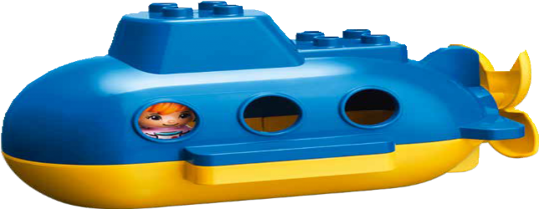
Share Task
What does your exploration team want to learn?
Notes:
Share Task (15 minutes)
Have the children share what they have built with the whole class. Have them explain their vehicle and what the exploration team wants to learn.
Tips:
Have the children tell a story about exploring the ocean.

Slide 8

THE CELEBRATION
EVENT IS NEXT!
Notes:
Tell teams that the celebration event is next.
The final session in the FIRST ® LEGO® League Discover experience is a celebration event. All children should participate in the celebration. The children will love sharing with others what they have built and learned. It could be held in your usual session meeting space, a classroom, a library, or anywhere else that has appropriate room for the teams to spread out, build, and have fun.
BEFORE THE EVENT:
Choose a time and space.
Send invitations to families, caregivers, teachers, and friends.
Find volunteer reviewers*.
Print reviewing prompts (page 26 of the Team Meeting Guide) and certificates.
Read Session 10 to understand what should happen during the celebration event.

Slide 9
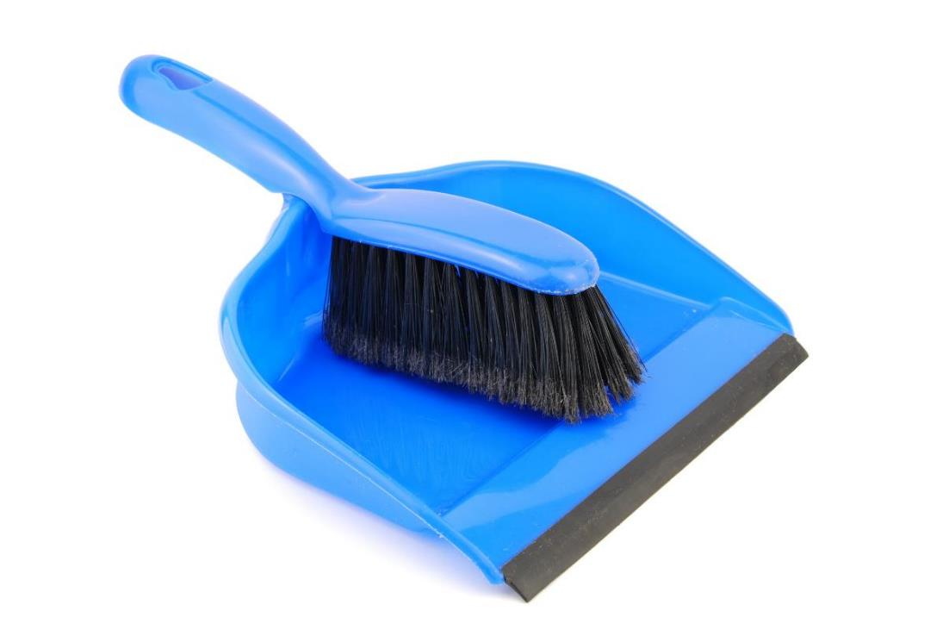
Clean Up
Notes:
You may wish to play a video or song during clean up time.
Link on GoNoodle: https://family.gonoodle.com/activities/clean-up
Link on YouTube Kids: https://www.youtubekids.com/watch?v=ZJFk87ZsHn0
Link on YouTube: https://youtu.be/ZJFk87ZsHn0

Slide 10


LEGO, the LEGO logo, DUPLO and the DUPLO logo are trademarks of the LEGO Group. ©2023 The LEGO Group. All rights reserved. FIRST®, the FIRST ® logo, and FIRST® in SHOWSM are trademarks of For Inspiration and Recognition of Science and Technology (FIRST). LEGO® is a registered trademark of the LEGO Group. FIRST ® LEGO® League and SUBMERGEDSM are jointly held trademarks of FIRST and the LEGO Group. ©2023 FIRST and the LEGO Group. All rights reserved.

