Slide 1
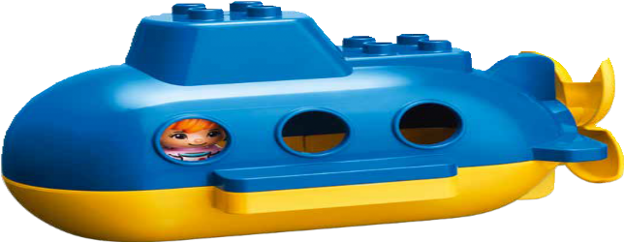
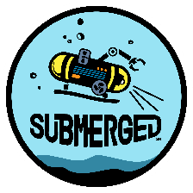

Session 8
Ocean Facts
Notes:
Session 8: Ocean Facts
This session is devoted to sharing knowledge. Encourage children to focus on creating something they want to teach others about and refrain from putting limits on what they build.
Outcomes
The teams will apply knowledge and experience from the previous sessions.
The teams will teach others about what they have learned about the oceans.
Key Vocabulary
information, unknown, iterate

Slide 2
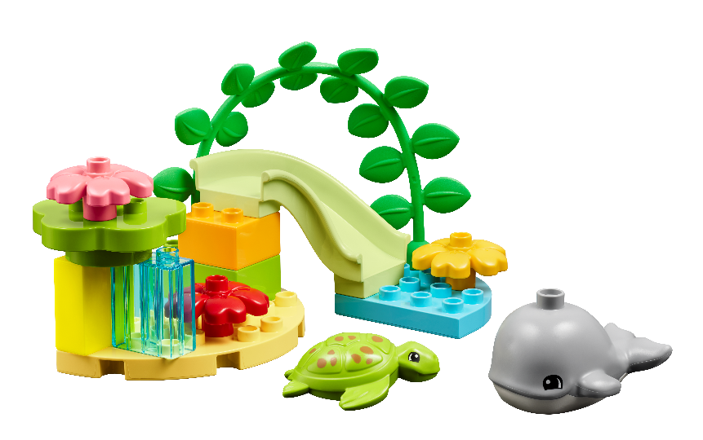
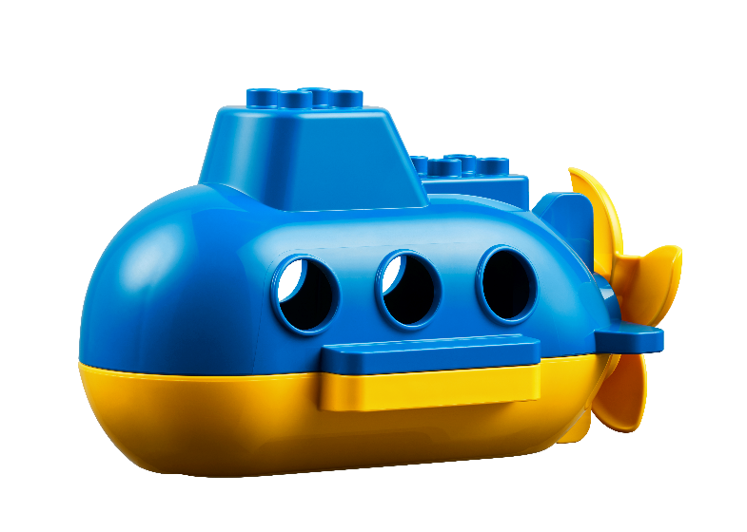
Big Question
Can you share what you learned about the oceans?
Notes:
Session 8: Ocean Facts
This session is devoted to sharing knowledge. Encourage children to focus on creating something they want to teach others about and refrain from putting limits on what they build.
Outcomes
The teams will apply knowledge and experience from the previous sessions.
The teams will teach others about what they have learned about the oceans.
Key Vocabulary
information, unknown, iterate

Slide 3
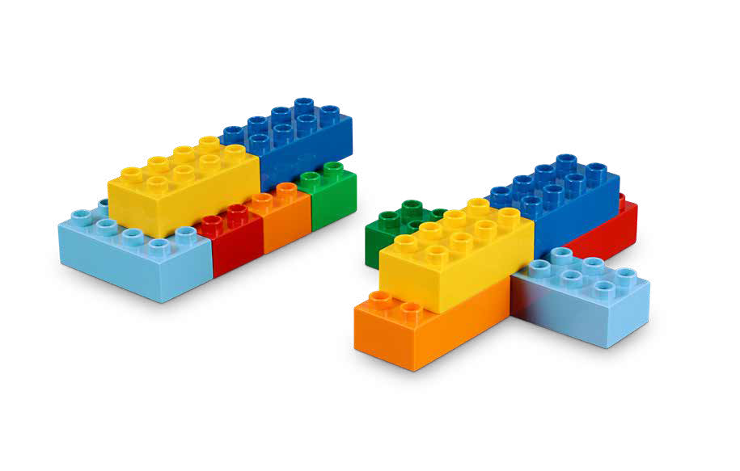
Six Bricks Warm-Up
Future Ship
Notes:
Six Bricks Warm-Up (1O minutes)
Future Ship
Base Activity
Children use their six bricks to build a vehicle of the future that might be used in the ocean.
Then, they take turns describing their vehicle. They can explain who uses the vehicle and what purpose it serves to explore the oceans.
Guiding Questions:
How will your vehicle be used in the ocean?
How does your vehicle move?
Who is the person that operates the vehicle?
Do you have any questions to ask your friends about their model?
Children learn to:
Engage in creative problem-solving.
Imagine and tell stories.
Use strategies learned earlier (representing).

Slide 4
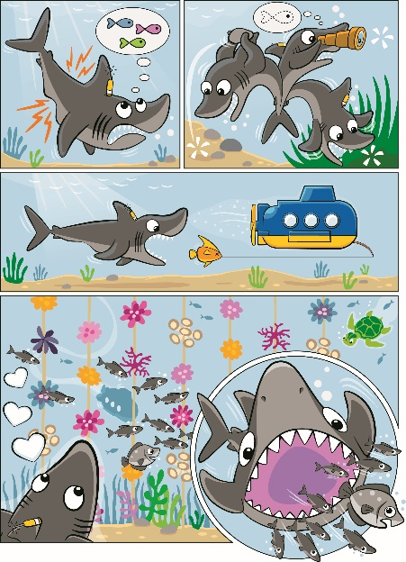
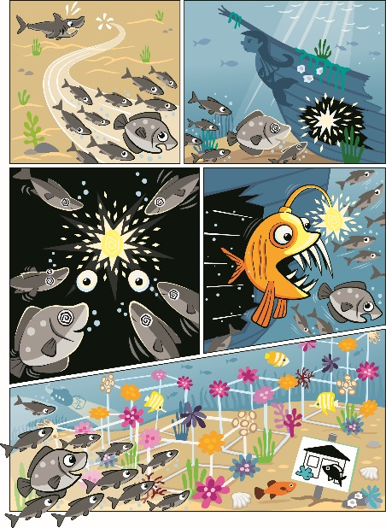
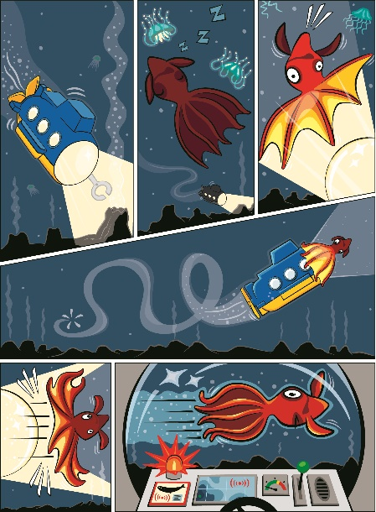
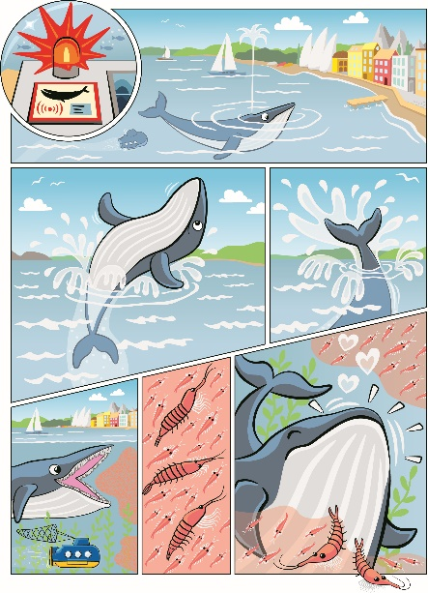
Explore Task
What else do you want to learn about the ocean?
Notes:
Explore Task (10 minutes)
Discuss the different topics the teams have learned throughout the sessions. Encourage children to share facts they learned about the oceans. Ask the children if there is anything we could improve in the way we explore the oceans (i.e., better navigation, artificial reefs, tools to collect information).
You could ask the children:
How would you make it safer to travel to different parts of the ocean?
Why is it important to take care of the oceans?
What other questions do you have about the unknown parts of the oceans?
Tip:
Review the Discover Story and vocabulary words to help the conversation.
Key Vocabulary
information, unknown, iterate

Slide 5
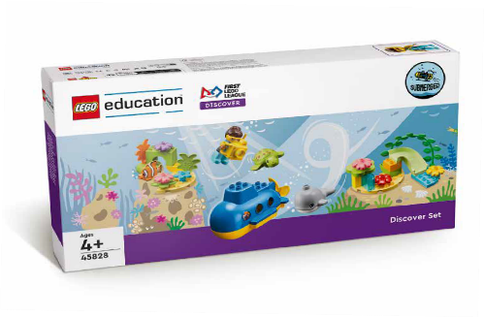
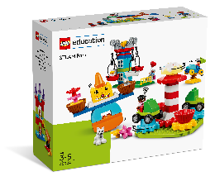



















































































































































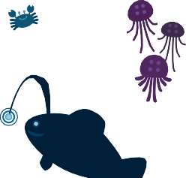



Create Task
You Need..
Build something to teach others about an area of the ocean.
Notes:
Create Task (25 minutes)
Assign a team an area of the Discover mat to focus on for the create task (i.e., coral reef, deep ocean). Tell the team they need to build something in their assigned area to help teach others about what they learned.
Use pieces from the Discover and STEAM Park sets to create more possibilities.
Their model can be a ship, a reef, a habitat or anything else they can imagine. They should be able to talk about their model and how it fits into the area of the ocean they were assigned. They can iterate on their designs as the teams form new ideas.
Have the teams share what they built with the other children.
Tips:
Teams can choose an area that interests them or try multiple areas if time allows.
Key Vocabulary
information, unknown, iterate

Slide 6

Playful Learning in Action
Key Vocabulary
information, unknown, iterate
Notes:
Create Task (25 minutes)
Ask the children to think about how they would rescue a turtle or other ocean animal. Have them build a safe place for the animal while it is being transported to a veterinarian. They should include people and animals in their build.
After, have the teams build a way to release the healthy animal back into the ocean. They could use a ramp or the functional elements from the STEAM Park set.
Playful Learning in Action – Teams will share what they have discovered about the oceans, ocean jobs, and animals.
Key Vocabulary
information, unknown, iterate

Slide 7
Share Task
Which ocean area did you choose?
What did you build?
Notes:
Share Task (15 minutes)
In their Engineering Notebooks, have the children write or draw about their assigned area of the ocean. They could write about a change or iteration they made on their model.

Slide 8
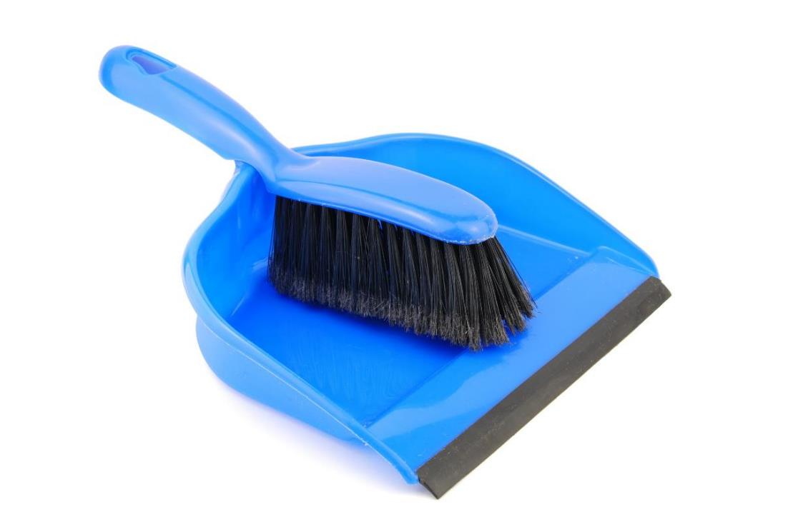
Clean Up
Notes:
You may wish to play a video or song during clean up time.
Link on GoNoodle: https://family.gonoodle.com/activities/clean-up
Link on YouTube Kids: https://www.youtubekids.com/watch?v=ZJFk87ZsHn0
Link on YouTube: https://youtu.be/ZJFk87ZsHn0

Slide 9


LEGO, the LEGO logo, DUPLO and the DUPLO logo are trademarks of the LEGO Group. ©2023 The LEGO Group. All rights reserved. FIRST®, the FIRST ® logo, and FIRST® in SHOWSM are trademarks of For Inspiration and Recognition of Science and Technology (FIRST). LEGO® is a registered trademark of the LEGO Group. FIRST ® LEGO® League and SUBMERGEDSM are jointly held trademarks of FIRST and the LEGO Group. ©2023 FIRST and the LEGO Group. All rights reserved.

