Slide 1
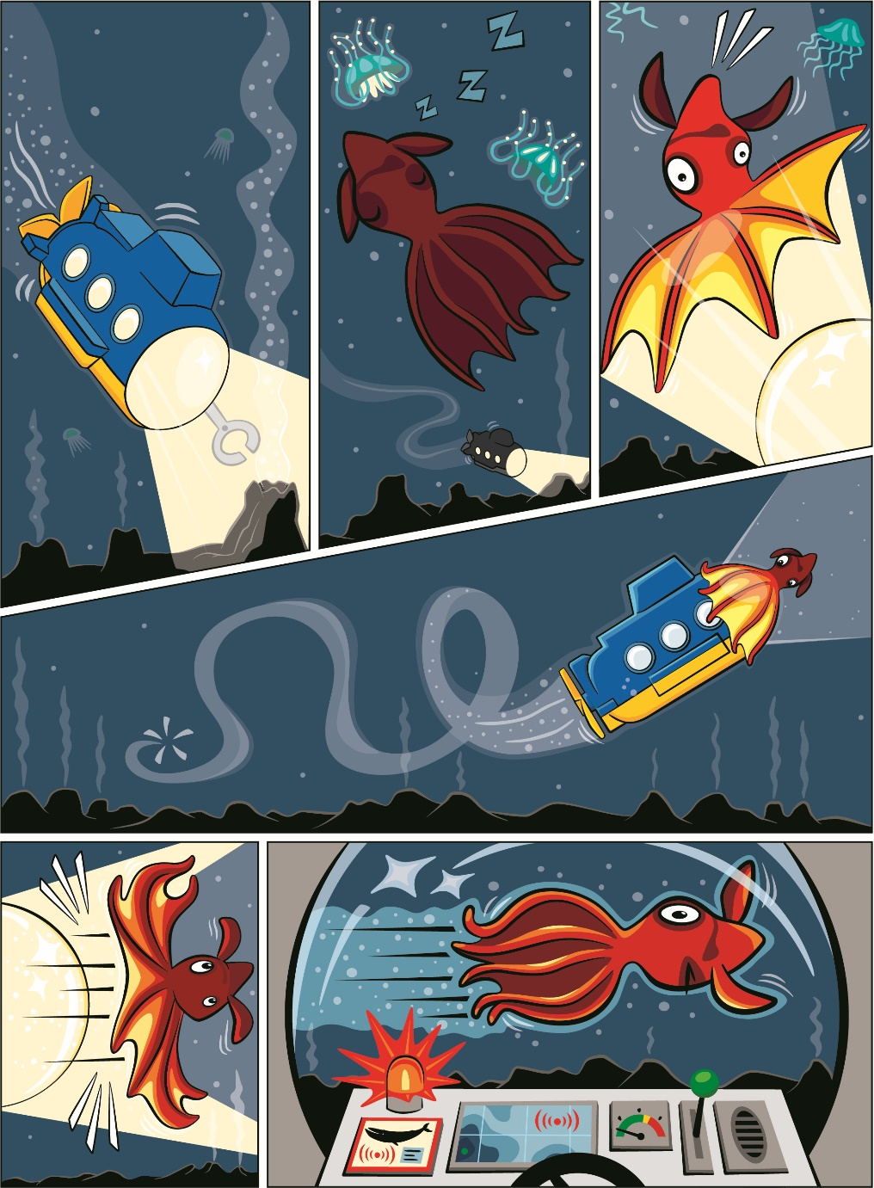


Session 7
Ocean Rescue
Notes:
Session 7: Ocean Rescue
Think about how the STEM content is explored in this lesson. When the children ask a question, prompt them with a question back to guide their learning instead of giving them the answer. The children should be able to share facts from multiple sessions.
Outcomes
Teams will explore how people are involved in the rescue of ocean animals.
The children will demonstrate empathy toward oceans and ocean animals.
Key Vocabulary
rescue, veterinarian, ramp

Slide 2
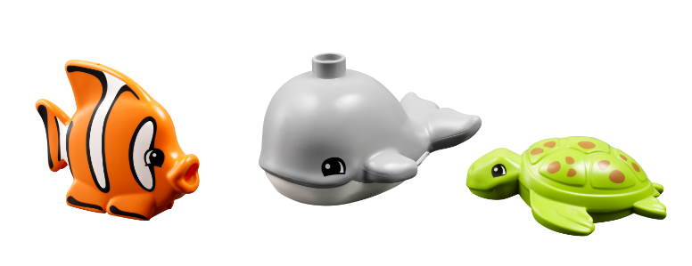
Big Question
How can you help rescue an ocean animal?
Notes:
Session 7: Ocean Rescue
Think about how the STEM content is explored in this lesson. When the children ask a question, prompt them with a question back to guide their learning instead of giving them the answer. The children should be able to share facts from multiple sessions.
Outcomes
Teams will explore how people are involved in the rescue of ocean animals.
The children will demonstrate empathy toward oceans and ocean animals.
Key Vocabulary
rescue, veterinarian, ramp

Slide 3
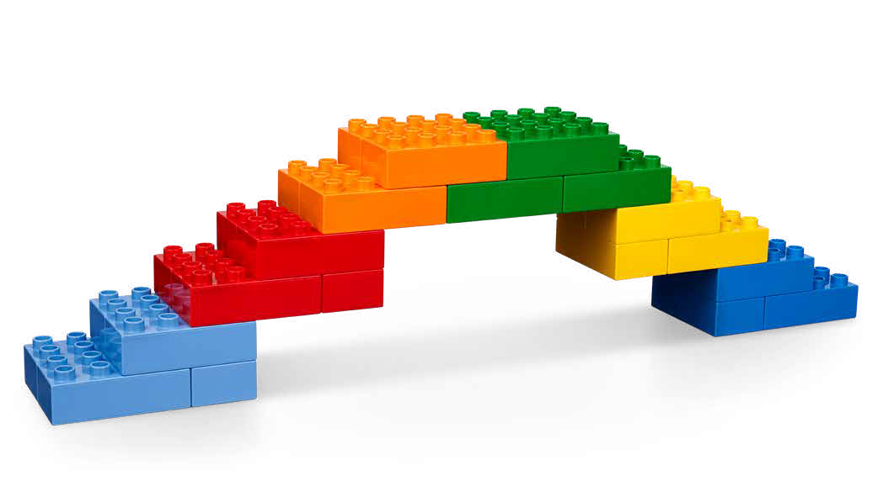
Six Bricks Warm-Up
Build a Bridge
Notes:
Six Bricks Warm-Up (1O minutes)
Build a Bridge
Base Activity
In groups of 4, children combine their bricks and think of ways to build a bridge. The bridge can be built on the Discover Mat to connect two areas.
Give the children time to discuss and plan which areas they
will connect and how they will connect them.
Guiding Questions:
Why did you choose to connect the two areas of the Discover Mat?
Did your original plan work? What ideas did you change?
How did you work together with your team?
Children learn to:
Engage in creative problem-solving.
Negotiate when and how to carry out tasks.
Make reasoned choices and decisions.

Slide 4
Explore Task
How can people help ocean animals?
Notes:
Explore Task (10 minutes)
Have a discussion about the different animals included in the Discover set. Ask the children to talk about where the animals live in the ocean (i.e., coral reefs, deep sea). Explain that animals in the wild are sometimes injured or lost and are in need of rescue.
You could ask the children:
Have you ever needed to help an animal?
What kind of expert knows how to help animals? (i.e., marine biologists, veterinarians)

Slide 5
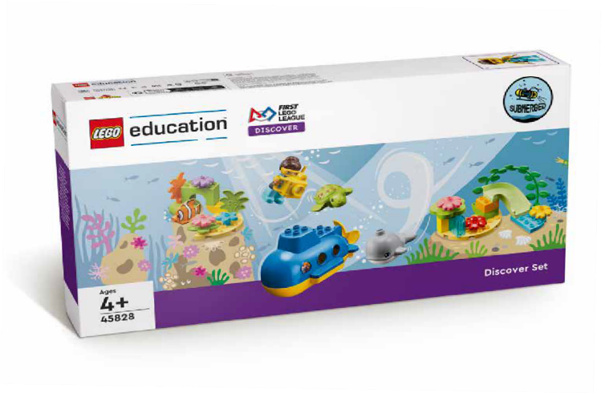
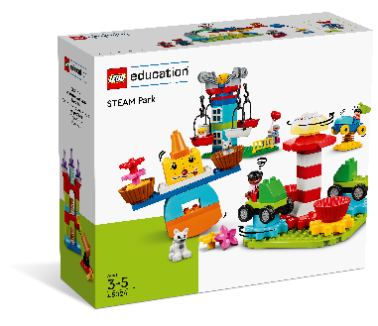
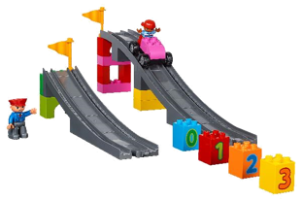
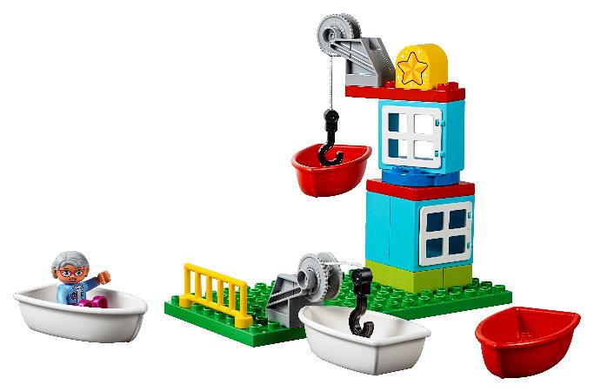
Create Task
You Need..
Design a way to rescue an ocean animal.
Notes:
Create Task (25 minutes)
Ask the children to think about how they would rescue a turtle or other ocean animal. Have them build a safe place for the animal while it is being transported to a veterinarian. They should include people and animals in their build.
After, have the teams build a way to release the healthy animal back into the ocean. They could use a ramp or the functional elements from the STEAM Park set.
Tips:
Use the DUPLO figures in the STEAM Park set.
Check out the STEAM Park lesson on ramps for ideas.
Key Vocabulary
rescue, veterinarian, ramp

Slide 6

Playful Learning in Action
Key Vocabulary
rescue, veterinarian, ramp
Notes:
Create Task (25 minutes)
Ask the children to think about how they would rescue a turtle or other ocean animal. Have them build a safe place for the animal while it is being transported to a veterinarian. They should include people and animals in their build.
After, have the teams build a way to release the healthy animal back into the ocean. They could use a ramp or the functional elements from the STEAM Park set.
Playful Learning in Action – Teams will have fun building and testing what they built. They will use communication to share their ideas and designs.​
Key Vocabulary
rescue, veterinarian, ramp

Slide 7
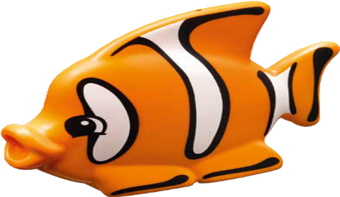
Share Task
How did you help rescue animals?
Notes:
Share Task (15 minutes)
Have the teams share their solution and show what they have built to safely move their animals. Each team could also share a story about the rescue of the animal.

Slide 8
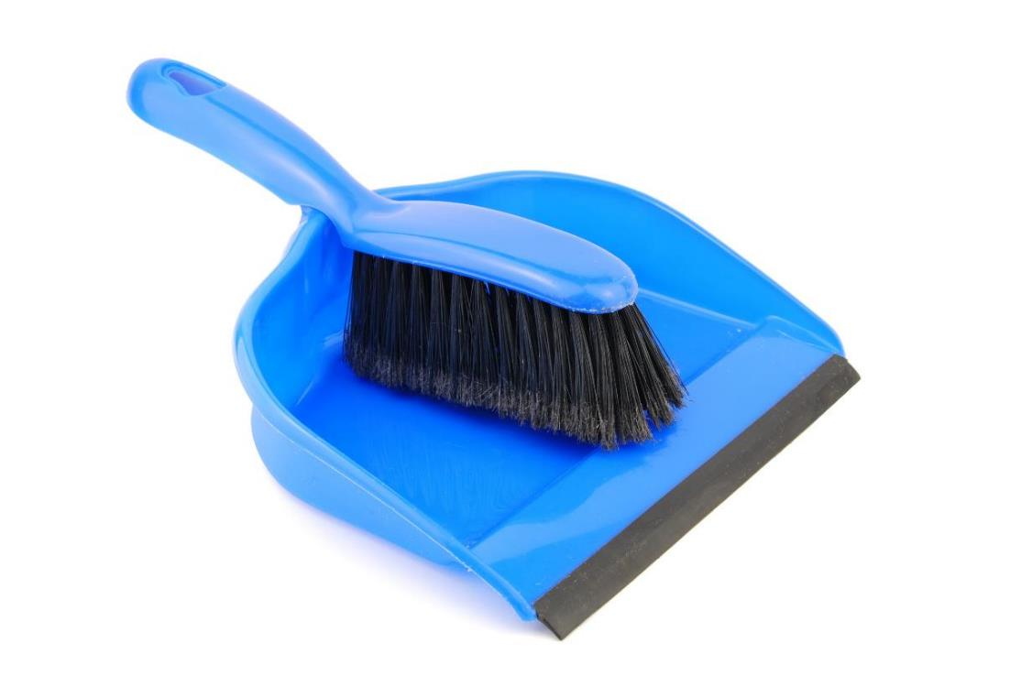
Clean Up
Notes:
You may wish to play a video or song during clean up time.
Link on GoNoodle: https://family.gonoodle.com/activities/clean-up
Link on YouTube Kids: https://www.youtubekids.com/watch?v=ZJFk87ZsHn0
Link on YouTube: https://youtu.be/ZJFk87ZsHn0

Slide 9


LEGO, the LEGO logo, DUPLO and the DUPLO logo are trademarks of the LEGO Group. ©2023 The LEGO Group. All rights reserved. FIRST®, the FIRST ® logo, and FIRST® in SHOWSM are trademarks of For Inspiration and Recognition of Science and Technology (FIRST). LEGO® is a registered trademark of the LEGO Group. FIRST ® LEGO® League and SUBMERGEDSM are jointly held trademarks of FIRST and the LEGO Group. ©2023 FIRST and the LEGO Group. All rights reserved.

