Slide 1
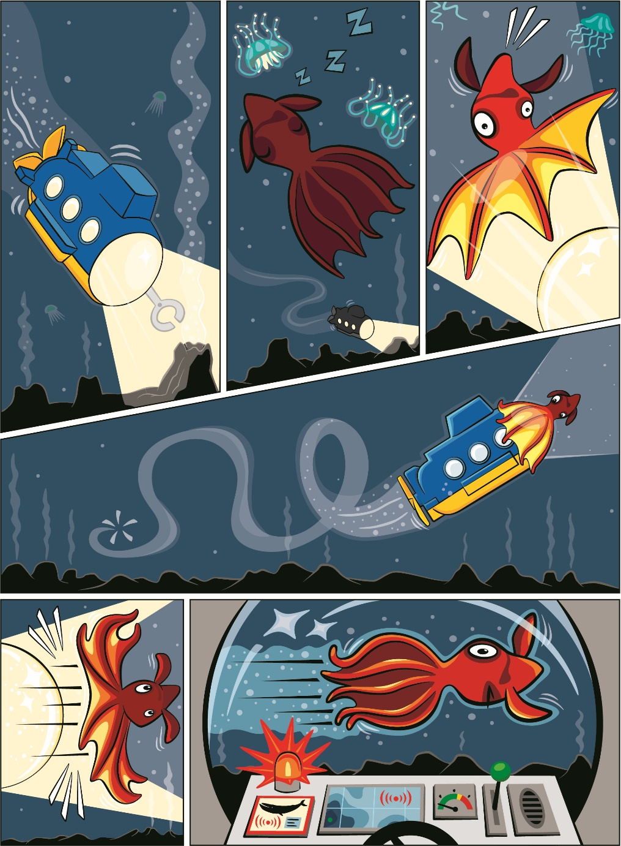


Session 5
Deep Ocean
Notes:
Session 5: Deep Ocean
Take what the teams have learned and challenge them to take it one stage further. Take notice in this session how they can apply knowledge of the functional elements in STEAM Park set. Check out the Functional Elements lesson for more guidance.
Outcomes
Teams will use imagination and creativity to create a deep-sea vehicle.
Teams will apply knowledge of functional pieces to create a model with moving parts.
Key Vocabulary
deep, submarine, functional

Slide 2
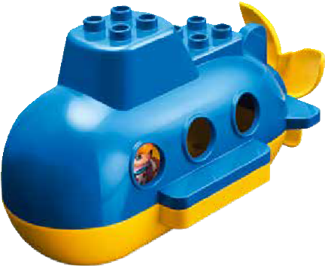
Big Question
How would you explore the deepest parts of the ocean?
Notes:
Session 5: Deep Ocean
Take what the teams have learned and challenge them to take it one stage further. Take notice in this session how they can apply knowledge of the functional elements in STEAM Park set. Check out the Functional Elements lesson for more guidance.
Outcomes
Teams will use imagination and creativity to create a deep-sea vehicle.
Teams will apply knowledge of functional pieces to create a model with moving parts.
Key Vocabulary
deep, submarine, functional

Slide 3
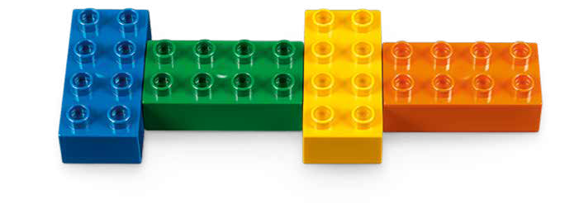
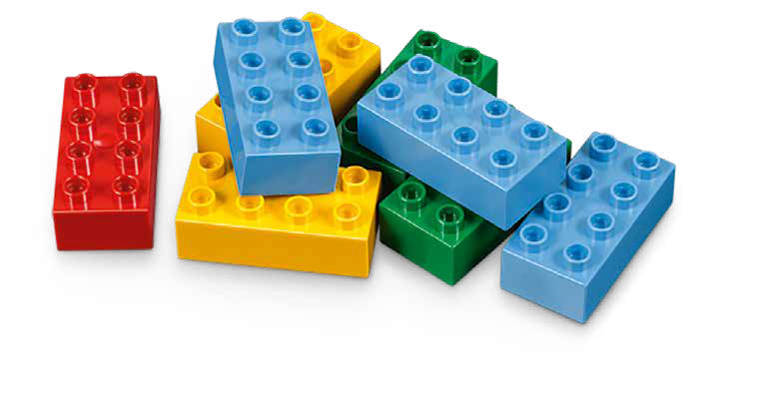
Six Bricks Warm-Up
Can You Remember?
Notes:
Six Bricks Warm-Up (1O minutes)
Can You Remember?
Base Activity
The adult takes any two bricks and secretly builds one on top of the other, covering all the studs.
Hold them up for the children to see for five seconds and then hide them away.
The children copy the brick sequence.
Guiding Questions:
Match your sequence to mine. Are they the same?
If it is different, how can you make it the same?
Children learn to:
Hold information in their memory.
Keep attention and resist distraction.
Speak about how they have done something.

Slide 4
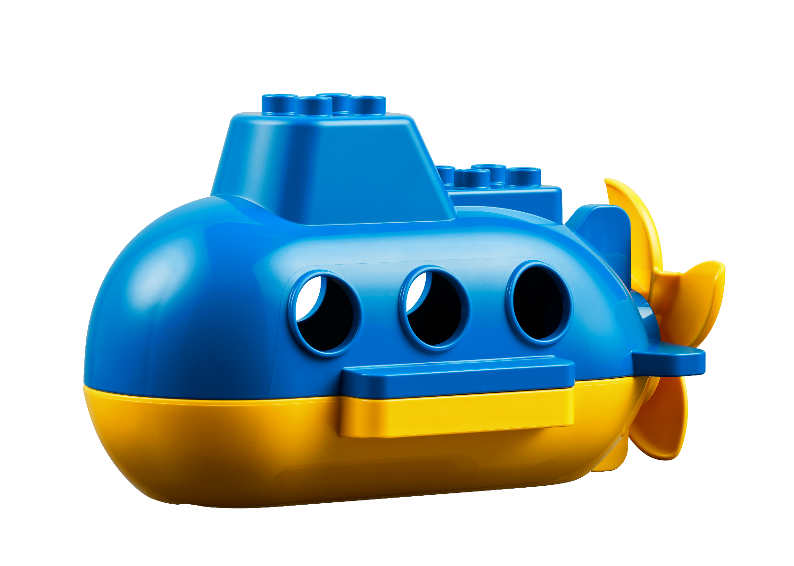
Explore Task
Why do we explore the deepest parts of the ocean?
Notes:
Explore Task (10 minutes)
Introduce the idea of exploring the deepest parts of the ocean. Use the following questions to guide your discussion:
How can you safely explore the bottom of the ocean (i.e., submarines, autonomous underwater vehicles [AUV])?
How do you learn about the environment (i.e., water testing, thermometers, pictures)?
Why is it important to learn about the bottom of the ocean?
Facilitator Tip:
The Children could reference the Discover Story to generate ideas.

Slide 5
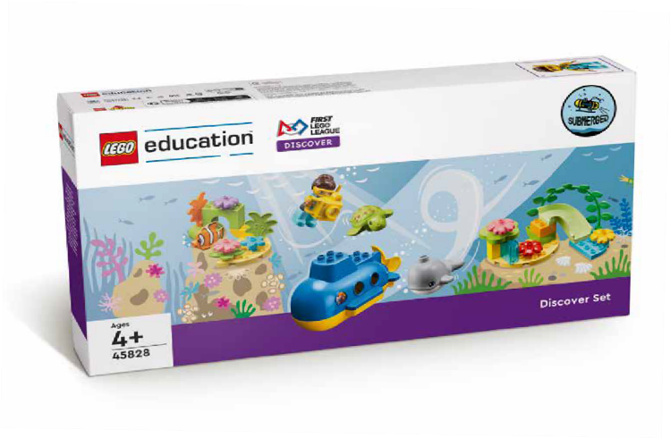
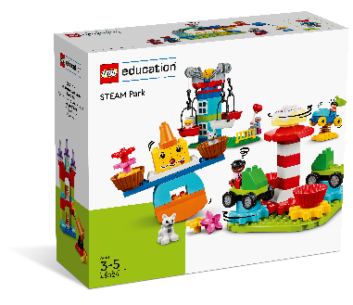
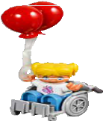
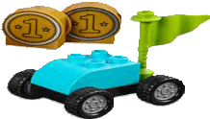
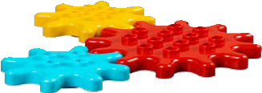

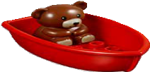

Create Task
You Need..
Build your own deep-sea vehicle.
Notes:
Create Task (25 minutes)
Have the children build a submarine or other type of deep-sea vehicle that can travel to the deepest part of the ocean using the STEAM Park set. Children may also choose to modify the submarine included in the Discover set.
Have each team pick out the functional pieces in the STEAM Park set and show how they move. The vehicle should make use of functional pieces that will help it move carefully through the water. The vehicle and its moving pieces should be placed on the part of the mat that represents the greatest depths.

Slide 6

Playful Learning in Action
Key Vocabulary
seashore, crew, ship
Notes:
Create Task (25 minutes)
Have the children build a submarine or other type of deep-sea vehicle that can travel to the deepest part of the ocean using the STEAM Park set. Children may also choose to modify the submarine included in the Discover set.
Have each team pick out the functional pieces in the STEAM Park set and show how they move. The vehicle should make use of functional pieces that will help it move carefully through the water. The vehicle and its moving pieces should be placed on the part of the mat that represents the greatest depths.
Playful Learning in Action – Teams will apply knowledge from previous sessions and use innovation to creatively build their designs.
Key Vocabulary
deep, submarine, functional

Slide 7
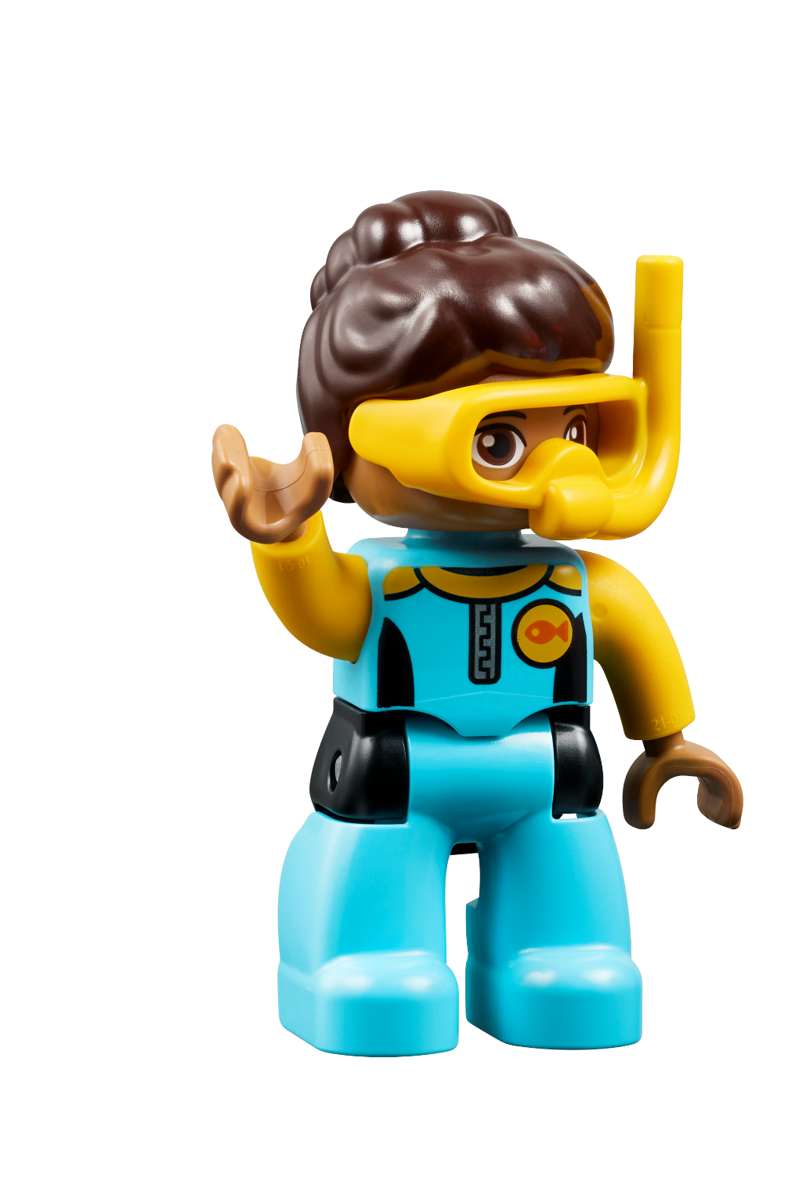
Share Task
How does your vehicle move?
Notes:
Share Task (15 minutes)
Have the teams describe the movement in their models. The teams could share together to give them more confidence in talking in front of people. They can talk about the design of their vehicle, what features it has, and what they hope to discover at the bottom of the ocean.
Facilitator Tip
The team could their vehicles assembled for use in the next session.

Slide 8
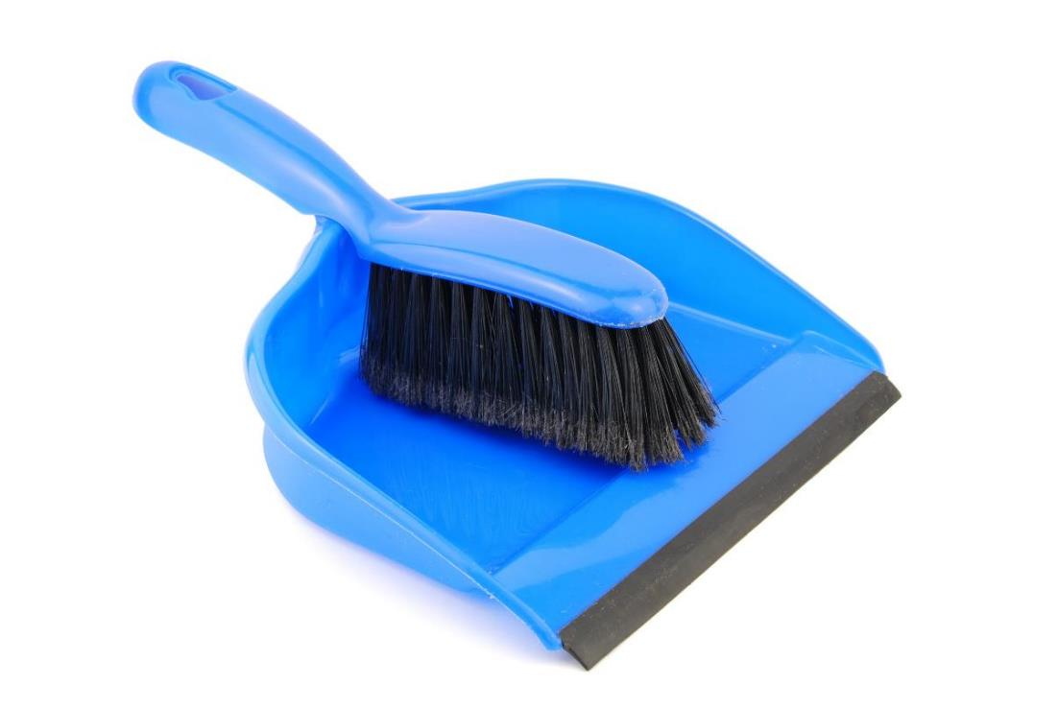
Clean Up
Notes:
You may wish to play a video or song during clean up time.
Link on GoNoodle: https://family.gonoodle.com/activities/clean-up
Link on YouTube Kids: https://www.youtubekids.com/watch?v=ZJFk87ZsHn0
Link on YouTube: https://youtu.be/ZJFk87ZsHn0

Slide 9


LEGO, the LEGO logo, DUPLO and the DUPLO logo are trademarks of the LEGO Group. ©2023 The LEGO Group. All rights reserved. FIRST®, the FIRST ® logo, and FIRST® in SHOWSM are trademarks of For Inspiration and Recognition of Science and Technology (FIRST). LEGO® is a registered trademark of the LEGO Group. FIRST ® LEGO® League and SUBMERGEDSM are jointly held trademarks of FIRST and the LEGO Group. ©2023 FIRST and the LEGO Group. All rights reserved.

