Slide 1
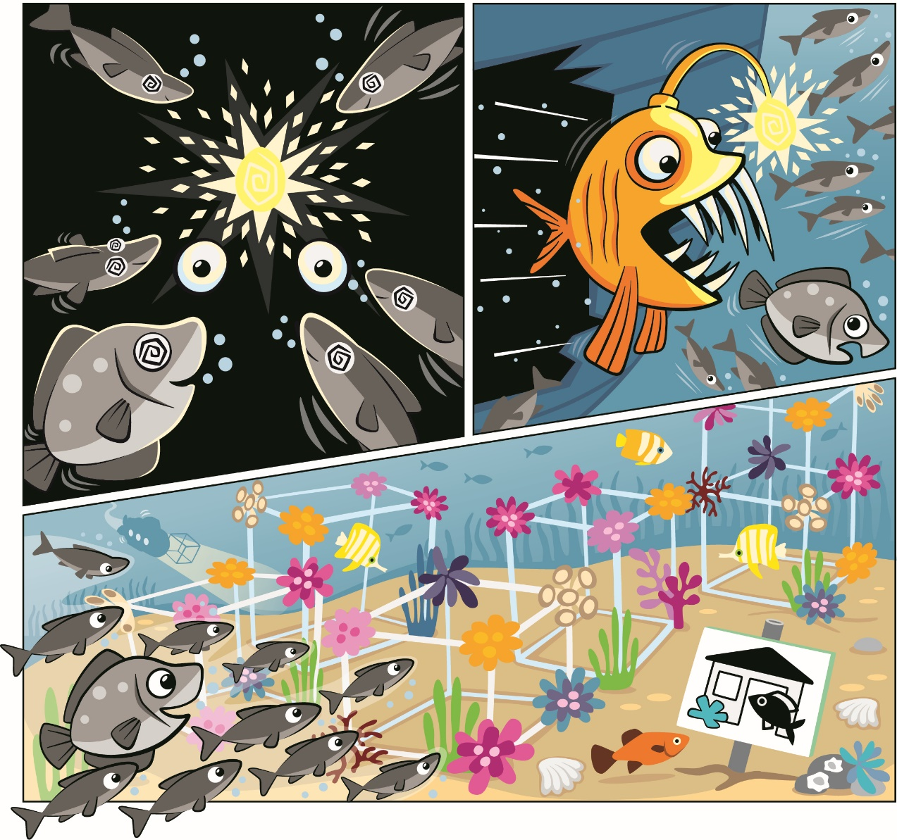


Session 4
Artificial Reef
Notes:
Session 4: Artificial Reef
Provide real-world examples, including photos and videos, when introducing the tasks. Set expectations for use of voice when sharing ideas. Expect productive talk, movement, and interactions between children. Circulate and redirect children to the task as needed.
Outcomes
Teams will understand why artificial reefs can be helpful to the environment.
The children will document their artificial reef in their Engineering Notebooks.
Key Vocabulary
artificial reef, shipwreck, shelter

Slide 2
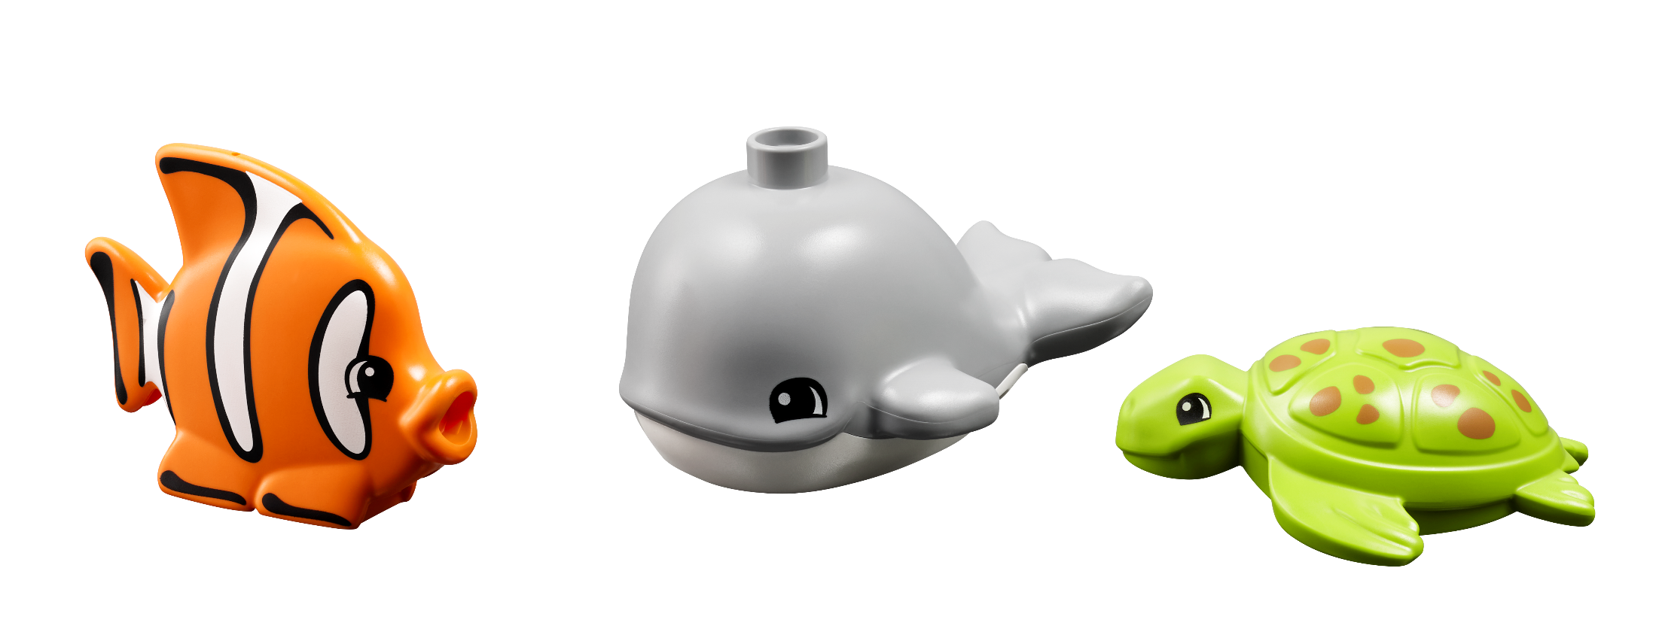
Big Question
Why do people create artificial reefs?
Notes:
Session 4: Artificial Reef
Provide real-world examples, including photos and videos, when introducing the tasks. Set expectations for use of voice when sharing ideas. Expect productive talk, movement, and interactions between children. Circulate and redirect children to the task as needed.
Outcomes
Teams will understand why artificial reefs can be helpful to the environment.
The children will document their artificial reef in their Engineering Notebooks.
Key Vocabulary
artificial reef, shipwreck, shelter

Slide 3
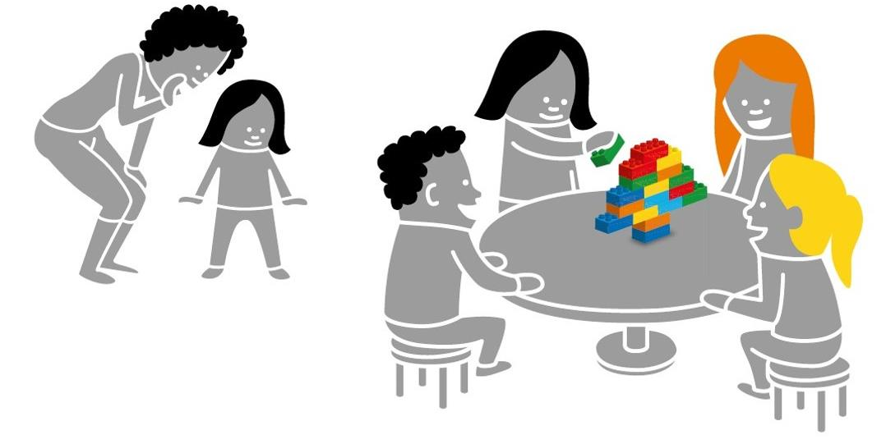
Six Bricks Warm-Up
Build the Picture
Notes:
Warm-Up: (10 minutes) Build The Picture
Base Activity
1. In groups of 4, children mix their bricks together and choose a leader.
2. The adult whispers a word related to a theater (e.g., stage, actor, light, speakers) to the leader.
3. Back with their group, the leader quickly builds a representation of that word for the others to guess.
4. The group may not ask questions but can call out words. The leader can say when they get it right.
Part 2
5. Choose a new leader and repeat the activity with a new word.
6. Continue until all children in the group have been a leader.
Guiding Questions:
How did the first group figure out the word?
What can you do to help the next leader of the group?
Children learn to:
Engage in creative problem-solving.
Develop own ways of carrying tasks.
Use strategies learned earlier (representing).

Slide 4

Explore Task
Why should we protect coral reefs?
Notes:
Explore Task (1O minutes)
Ask the children to recall the previous session about coral reefs and the animals that live there.
Artificial reefs are created for many reasons but most often to create new places to live for ocean life. Shipwrecks and other large objects can provide shelter for fish and other animals. An artificial reef can be seen on the second page of the Discover Story. Give examples of materials used to create artificial reefs (i.e., rocks, concrete, metal).

Slide 5
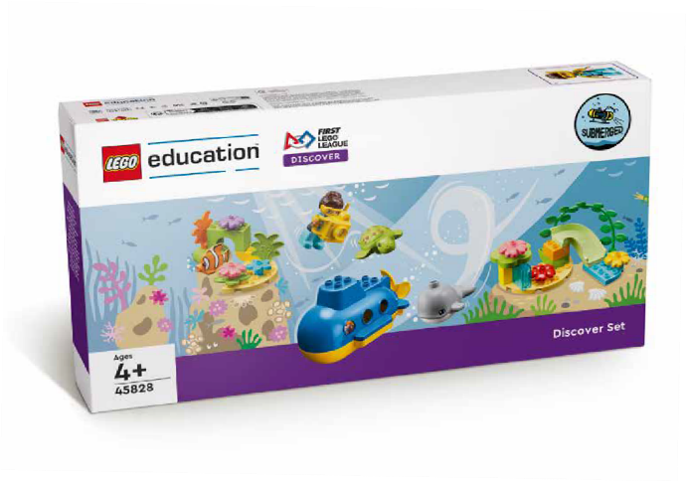
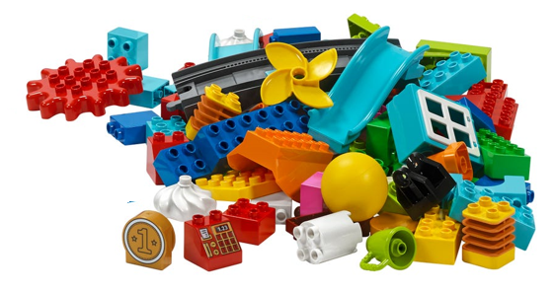
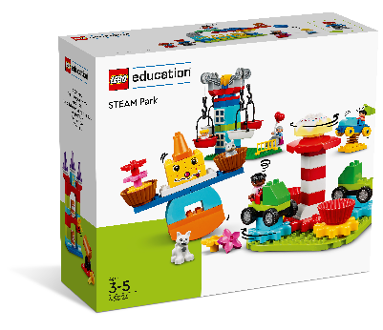
Create Task
You Need..
Build an artificial reef!
Notes:
Create Task (25 minutes)
Have each team build an artificial reef using the STEAM Park set. The team should build their artificial reef on the mat. The team can refer to the Discover Story to help get them started.
The children should work together to create their reef. They can use their imagination to think about what it is made of, where in the ocean it is located, and what types of ocean life live there. If additional water-themed pieces are needed, they may use the Discover set.
Facilitator Tips
Allow the children to be creative and use any elements that will help complete their reef design.
The team could divide responsibilities between the different parts of the reef they build.

Slide 6

Playful Learning in Action
Key Vocabulary
artificial reef, shipwreck, shelter
Notes:
Create Task (25 minutes)
Have each team build an artificial reef using the STEAM Park set. The team should build their artificial reef on the mat. The team can refer to the Discover Story to help get them started.
The children should work together to create their reef. They can use their imagination to think about what it is made of, where in the ocean it is located, and what types of ocean life live there. If additional water-themed pieces are needed, they may use the Discover set.
Playful Learning in Action – The children will listen and begin to empathize with the animals that live in the reef and about each other’s ideas. The team will listen to everyone’s ideas, demonstrating inclusion.
Key Vocabulary – artificial reef, shipwreck, shelter
Facilitator Tip
Allow the children to be creative and use any elements that will help complete their reef design.
The team could divide responsibilities between the different parts of the reef they build.

Slide 7
Share Task
Tell me about your artificial reef.
Notes:
Share Task (15 minutes)
In their Engineering Notebooks, have the children write about or draw a picture of their artificial reef. At the end of the session, have the children share what they built in the Create Task.

Slide 8
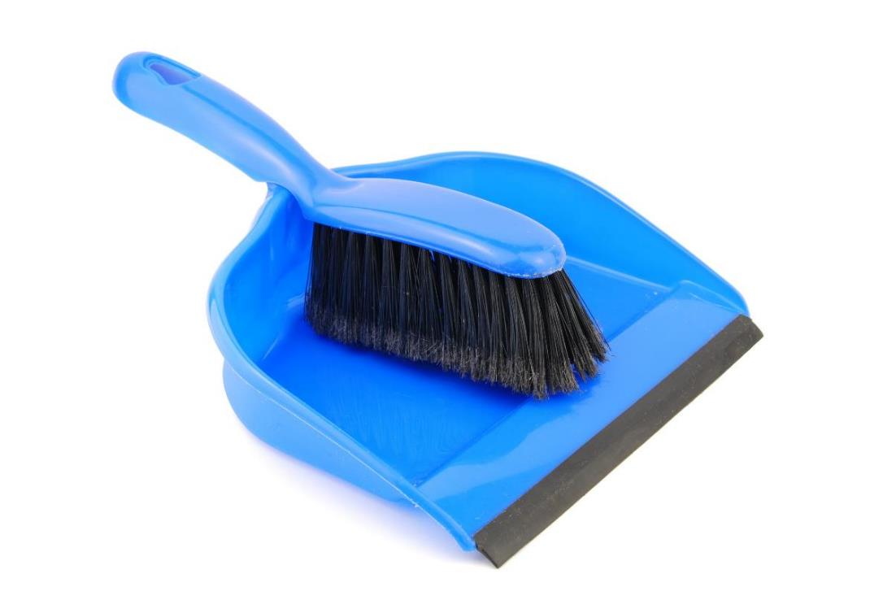
Clean Up
Notes:
You may wish to play a video or song during clean up time.
Link on GoNoodle: https://family.gonoodle.com/activities/clean-up
Link on YouTube Kids: https://www.youtubekids.com/watch?v=ZJFk87ZsHn0
Link on YouTube: https://youtu.be/ZJFk87ZsHn0

Slide 9


LEGO, the LEGO logo, DUPLO and the DUPLO logo are trademarks of the LEGO Group. ©2023 The LEGO Group. All rights reserved. FIRST®, the FIRST ® logo, and FIRST® in SHOWSM are trademarks of For Inspiration and Recognition of Science and Technology (FIRST). LEGO® is a registered trademark of the LEGO Group. FIRST ® LEGO® League and SUBMERGEDSM are jointly held trademarks of FIRST and the LEGO Group. ©2023 FIRST and the LEGO Group. All rights reserved.

