Slide 1
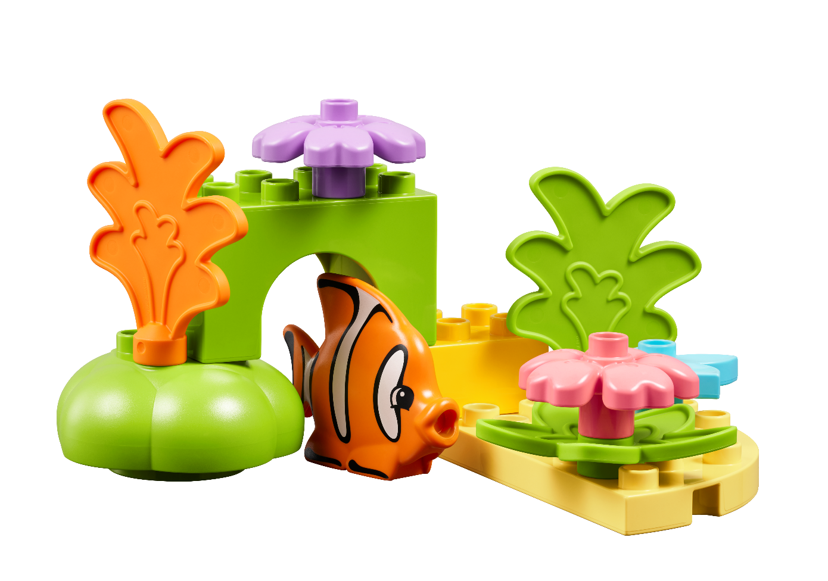


Session 3
Sunlight Zone
Notes:
Session 3: Sunlight Zone
This session introduces problem-solving tasks. Problem-solving is a habit of learning children should practice. Encourage the teams to persevere in the creation of their solutions. Teams can communicate and share their solutions with others.
Outcomes
Teams will explore how scientists learn about living things in the sunlight zone.
Teams will build a coral reef and talk about animals that live there.
Key Vocabulary
sunlight zone, coral reef, ocean life

Slide 2
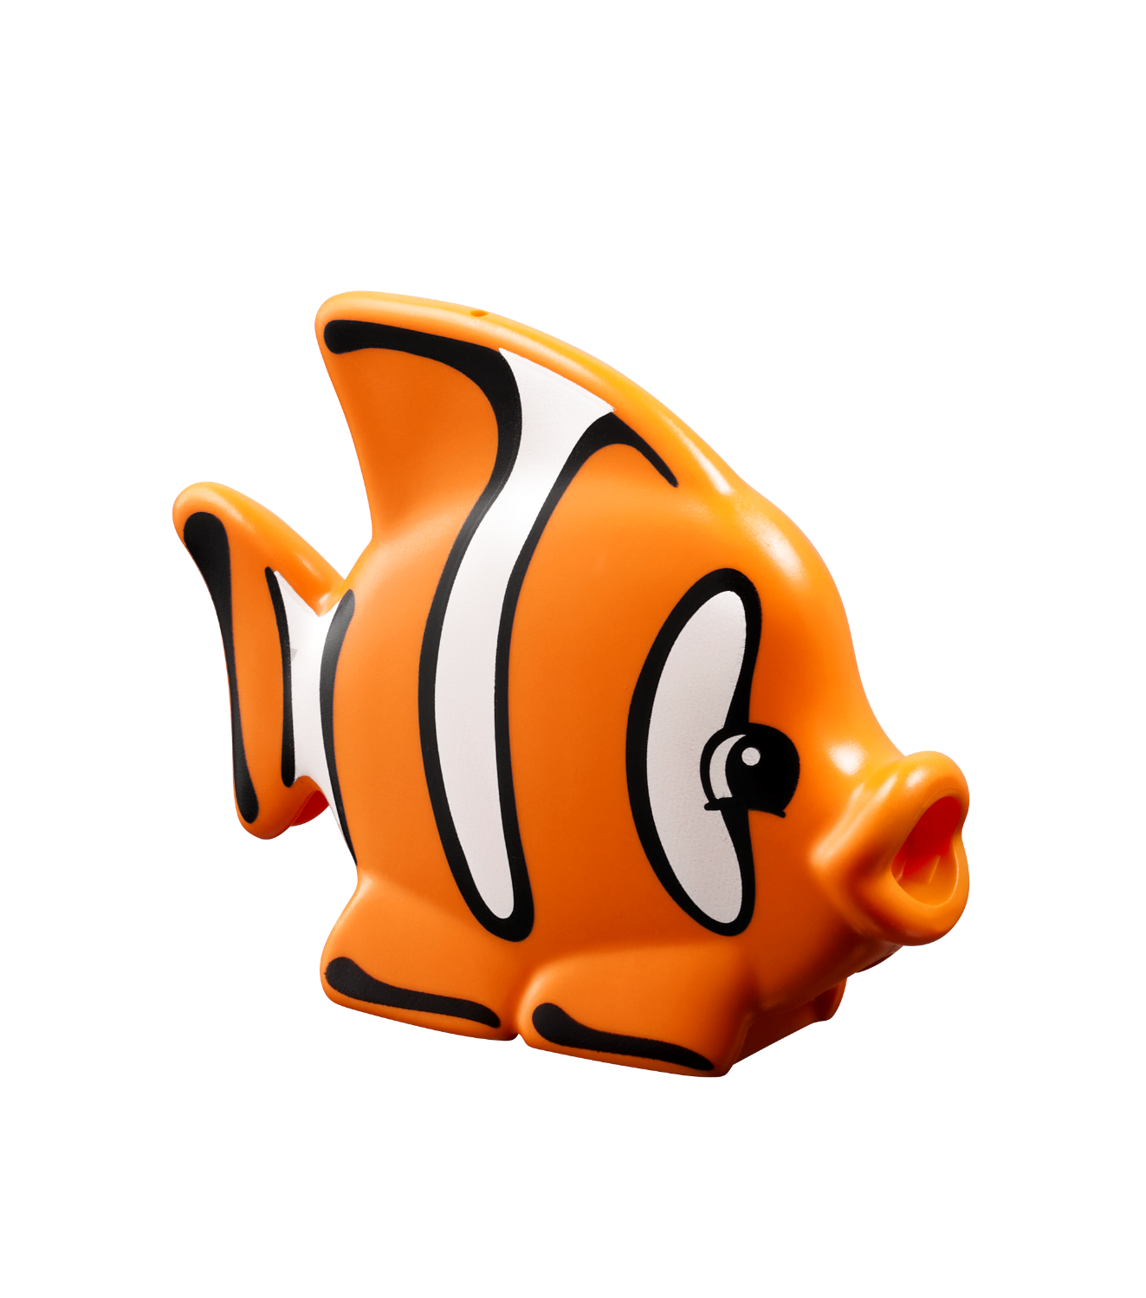
Big Question
How can we protect coral reefs?
Notes:
Session 3: Sunlight Zone
This session introduces problem-solving tasks. Problem-solving is a habit of learning children should practice. Encourage the teams to persevere in the creation of their solutions. Teams can communicate and share their solutions with others.
Outcomes
Teams will explore how scientists learn about living things in the sunlight zone.
Teams will build a coral reef and talk about animals that live there.
Key Vocabulary
sunlight zone, coral reef, ocean life

Slide 3
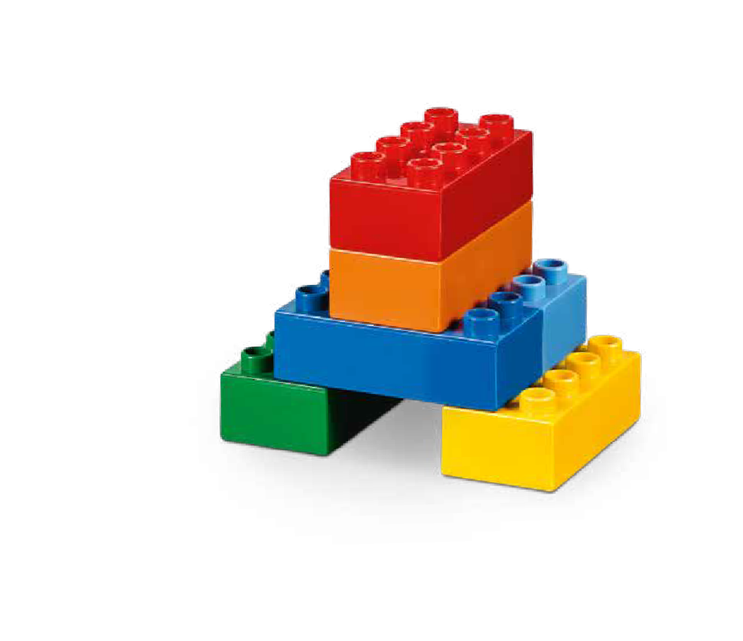
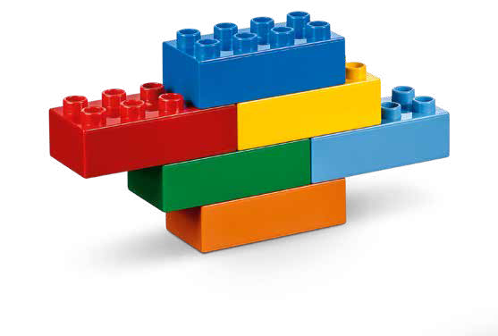
Six Bricks Warm-Up
What Can You Build?
Notes:
Warm-Up: (10 minutes) What Can You Build?
Base Activity
In groups of 4, children mix their bricks together.
Have the children use their bricks to build a model that represents something they would find in the ocean.
Then have them take turns and describe the model and explain where in the ocean it can be found.
This activity can also be linked to a theme, story, or book.
Guiding Questions:
Where can you find this in the ocean?
Does it make any sound?
Is it alive?
Children learn to:
Invent and describe characters (for stories).
Create stories in groups.
Ask questions and suggest answers.

Slide 4

Explore Task
What lives in a coral reef?
Notes:
Explore Task (10 minutes)
The sunlight zone of the ocean, which includes coral reefs, is full of life. Coral reefs can be damaged easily, and scientists must be careful when exploring these special places.
Fish and other animals make coral reefs their home. Ask the children if there is anything in their home that is fragile and needs to be protected. Show examples of natural reefs around the world (i.e., the Great Barrier Reef). Share examples of the living things that can be found in a coral reef.
Key Vocabulary
sunlight zone, coral reef, ocean life

Slide 5
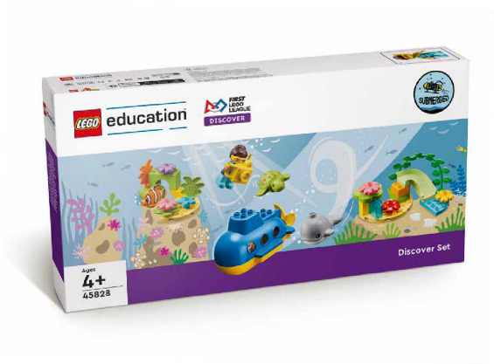



































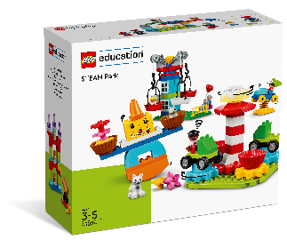


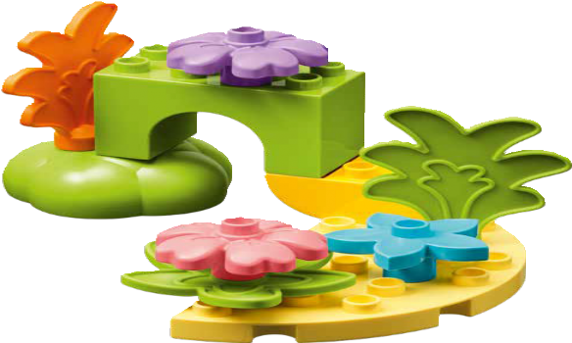
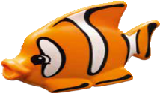

Create Task
You Need..
Build a coral reef.
Notes:
Create Task (25 minutes)
Have the children assemble the coral reef and seagrass meadow from the Discover set and place them on the mat. They can use the building cards to help them get started.
Have each team expand their coral reef by adding examples of ocean life or other underwater structures. They could build seaweed, fish, whales, or snails. Use the Discover set and allow them to add pieces from the STEAM Park set to encourage creative building.
Facilitator Tip
Children may be inspired to create their own designs different than what’s on the building cards.

Slide 6

Playful Learning in Action
Key Vocabulary
sunlight zone, coral reef, ocean life
Notes:
Create Task (25 minutes)
Have the children assemble the coral reef and seagrass elements from the Discover set and place them on the mat. They can use the building cards to help them get started.
Have each team expand their coral reef by adding examples of ocean life or other underwater structures. They could build seaweed, fish, whales, or snails. Use the Discover set and allow them to add pieces from the STEAM Park set to encourage creative building.
Playful Learning in Action – Teams will use teamwork and problem-solving to build their solutions.
Key Vocabulary – sunlight zone, coral reef, ocean life
Facilitator Tip
Children may be inspired to create their own designs different than what’s on the building cards.

Slide 7
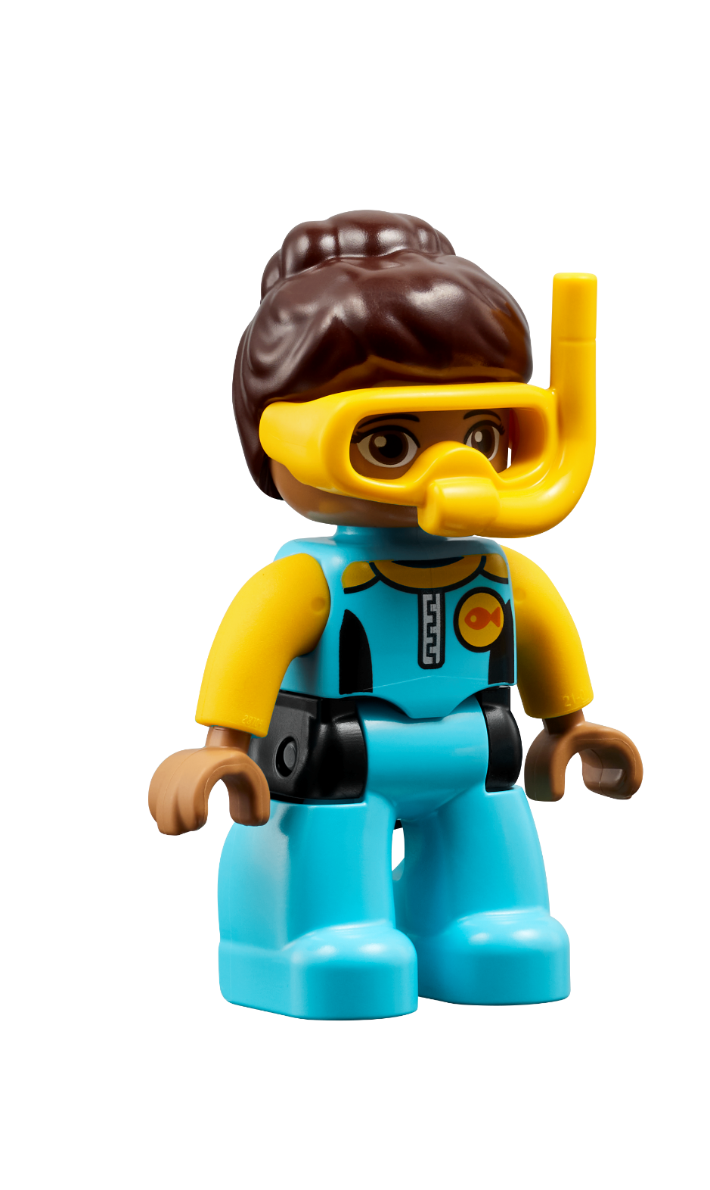
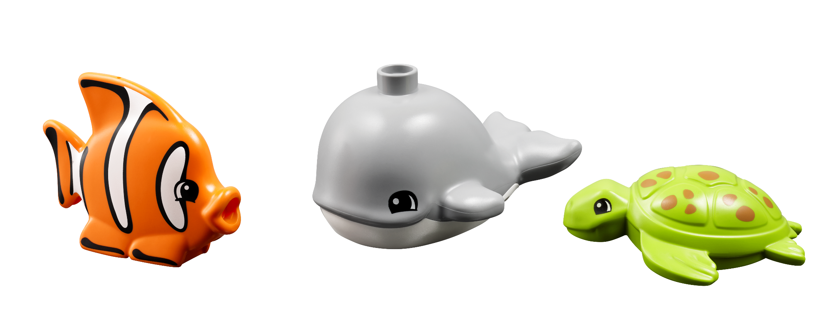
Share Task
How will you learn about the animals that live in your reef?
Notes:
Share Task (15 minutes)
Have each team share what they chose to include in their reef.
They could explain different features of their reef and how they would carefully move through the water to learn about the animals that live there.
Facilitator Tip
Encourage the teams to talk about their reef, the animals found there, and how they will observe them.

Slide 8
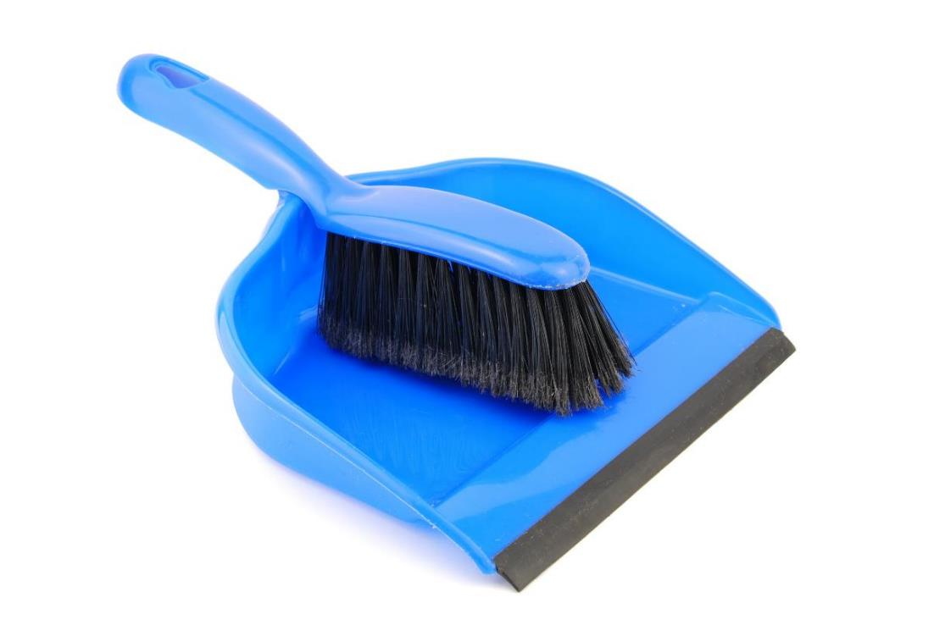
Clean Up
Notes:
You may wish to play a video or song during clean up time.
Link on GoNoodle: https://family.gonoodle.com/activities/clean-up
Link on YouTube Kids: https://www.youtubekids.com/watch?v=ZJFk87ZsHn0
Link on YouTube: https://youtu.be/ZJFk87ZsHn0

Slide 9


LEGO, the LEGO logo, DUPLO and the DUPLO logo are trademarks of the LEGO Group. ©2023 The LEGO Group. All rights reserved. FIRST®, the FIRST ® logo, and FIRST® in SHOWSM are trademarks of For Inspiration and Recognition of Science and Technology (FIRST). LEGO® is a registered trademark of the LEGO Group. FIRST ® LEGO® League and MASTERPIECESM are jointly held trademarks of FIRST and the LEGO Group. ©2023 FIRST and the LEGO Group. All rights reserved.

