Slide 1
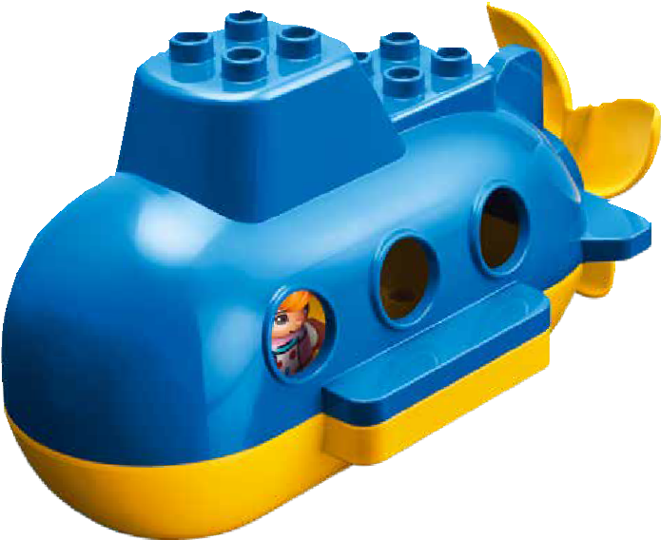


Session 2
Ocean Journey
Notes:
Session 2: Ocean Journey
Look at the questions in the Explore task. Ask the students questions of different levels and complexity so that they further develop their thinking skills. This will lead them on their learning paths.
Outcomes
Teams will describe how to prepare for an ocean journey.
The children will document features of a ship in their Engineering Notebooks.
Key Vocabulary
seashore, crew, ship

Slide 2
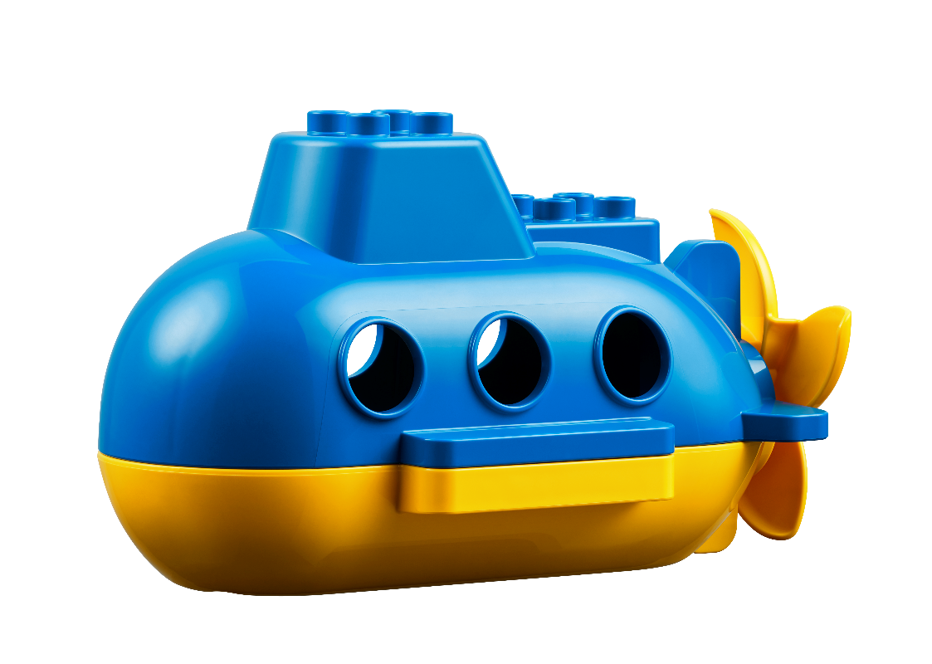
Big Question
What do you need for an ocean journey?
Notes:
Session 2: Ocean Journey
Look at the questions in the Explore task. Ask the students questions of different levels and complexity so that they further develop their thinking skills. This will lead them on their learning paths.
Outcomes
Teams will describe how to prepare for an ocean journey.
The children will document features of a ship in their Engineering Notebooks.
Key Vocabulary
seashore, crew, ship

Slide 3
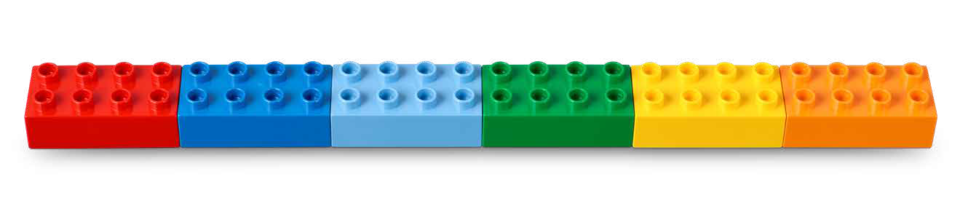
Six Bricks Warm-Up
Discover Six Bricks II
Notes:
Six Bricks Warm-Up (1O minutes)
Discover Six Bricks II
Base Activity
Children lay out their bricks in any order (see the picture).
Then they put a finger on the red brick and move it left.
They turn the dark blue brick upside down (or on its side).
Children click the green brick on the red and cover all studs.
Vary the instructions you give such as colors, moving bricks left/right, and positions.
Guiding Questions:
How did you keep attention? (Encourage some of the children to explain in turn.)
How can we make this activity harder? (Give more instructions, say them faster…?)
Children learn to:
Use spatial skills to orient themselves.
Keep attention and resist distraction.
Initiate activities.

Slide 4
Explore Task
Find the submarine in the Discover Story pages.
Notes:
Explore Task (1O minutes)
Show the Discover Story to the children again and point out the submarine on each page. Tell them they will be getting ready for a journey into the ocean to see what they can discover.
Ocean adventures start on the seashore. Discuss how a crew will get ready for their trip.
What will their ship look like?
What do ocean explorers need for their journey?
Key Vocabulary
seashore, crew, ship

Slide 5
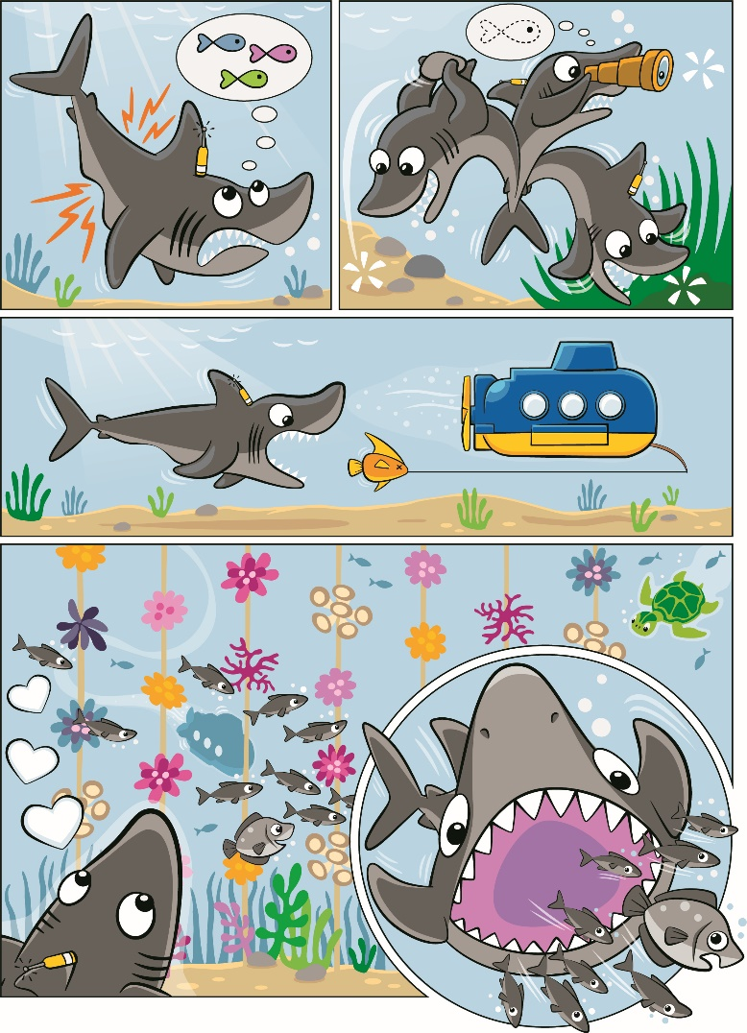
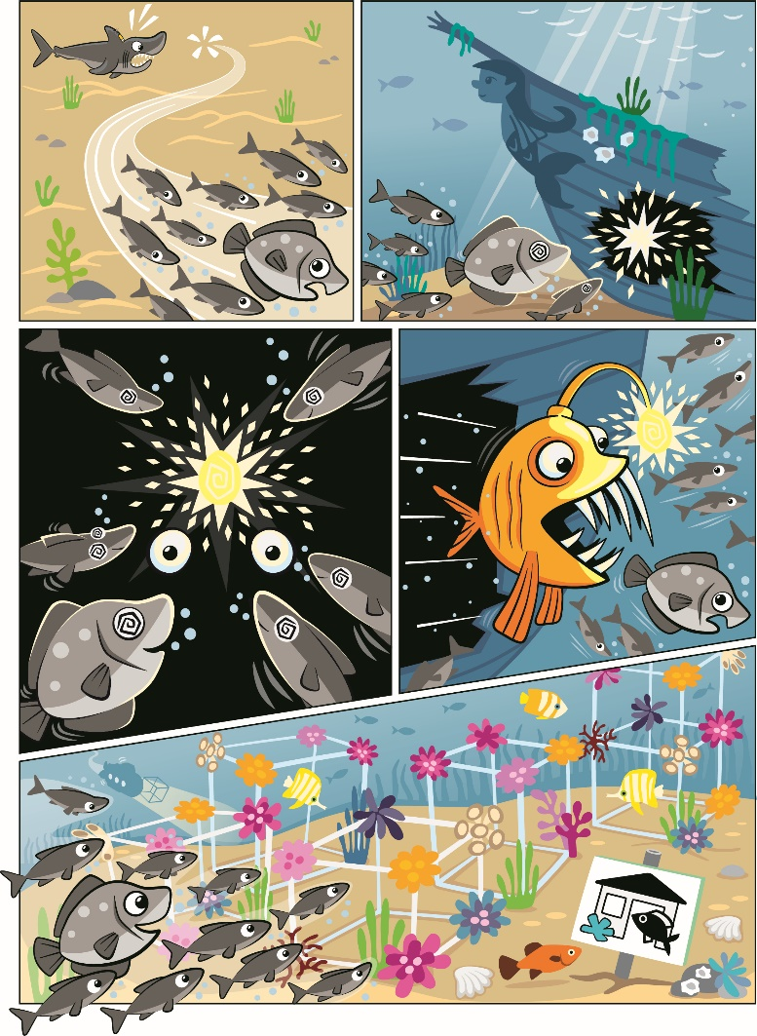
Discover Story
Notes:
Explore Task (1O minutes)
Show the Discover Story to the children again and point out the submarine on each page. Tell them they will be getting ready for a journey into the ocean to see what they can discover.
Ocean adventures start on the seashore. Discuss how a crew will get ready for their trip.
What will their ship look like?
What do ocean explorers need for their journey?
Key Vocabulary
seashore, crew, ship

Slide 6
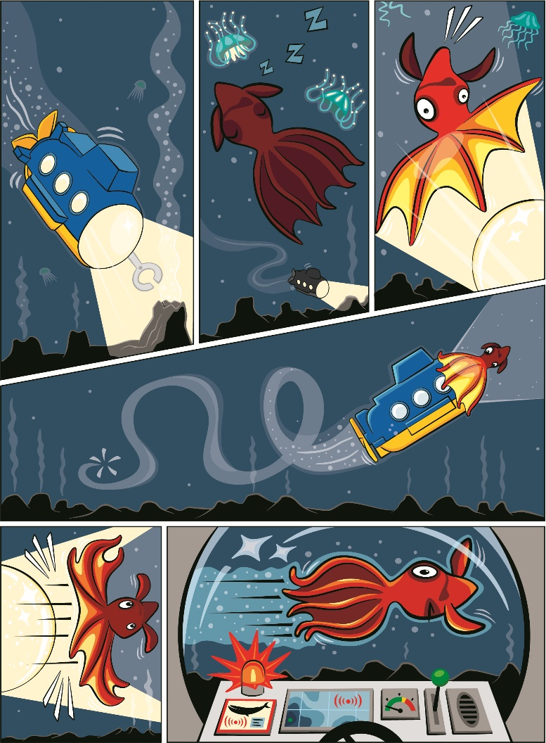
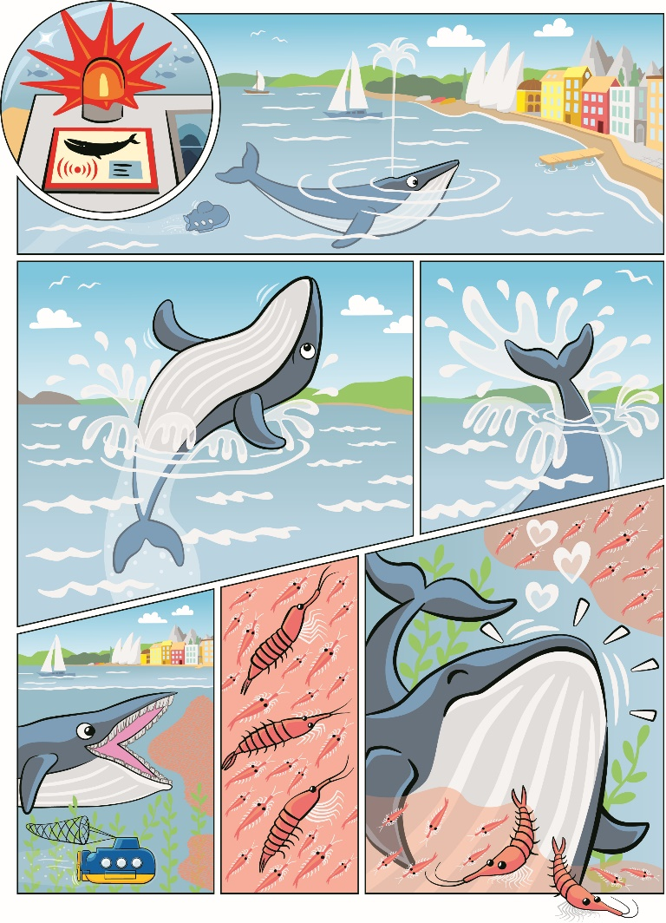
Discover Story
Notes:
Explore Task (1O minutes)
Show the Discover Story to the children again and point out the submarine on each page. Tell them they will be getting ready for a journey into the ocean to see what they can discover.
Ocean adventures start on the seashore. Discuss how a crew will get ready for their trip.
What will their ship look like?
What do ocean explorers need for their journey?
Key Vocabulary
seashore, crew, ship

Slide 7
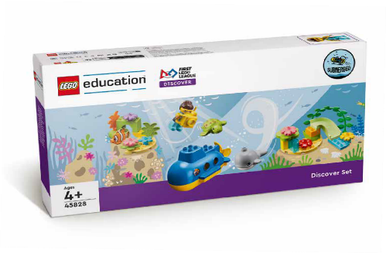

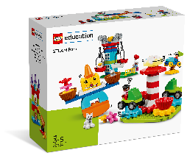
Create Task
You Need..
Build the submarine.
Notes:
Create Task (25 minutes)
Have each team build the submarine from the Discover set, using the building cards. They can place the submarine on the mat to start their journey. In the following sessions, the children will explore different ocean depths and the creatures that live there.
Facilitator Tip:
Building Cards in the Discover set provide visual instructions to make the different parts of the Discover model.

Slide 8
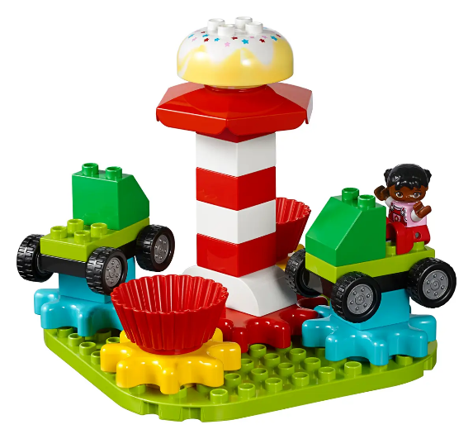
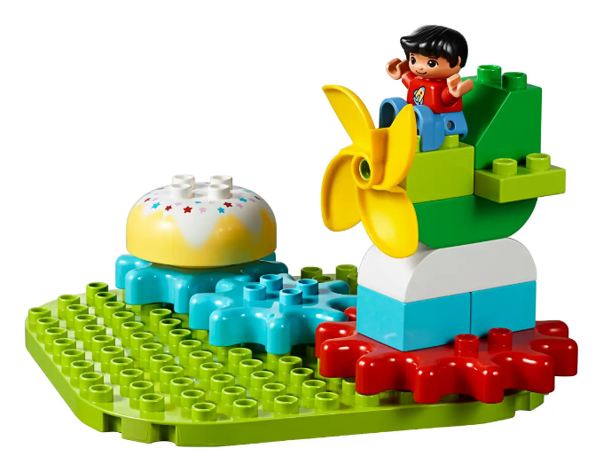
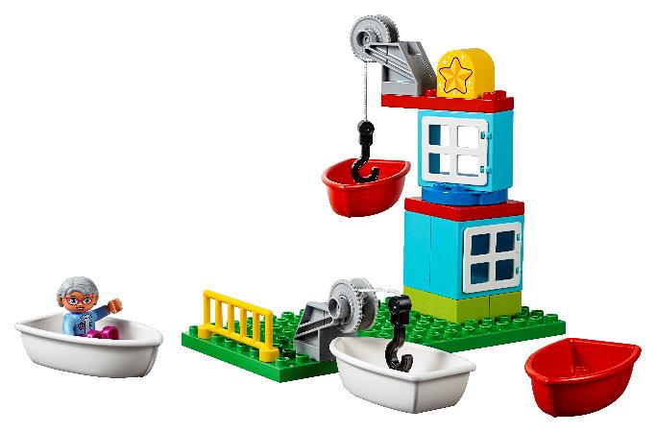
Create Task
What else can you build for your ocean journey?
Notes:
Create Task Part 2
Have teams use the STEAM Park set to build additional pieces of their ocean journey. Have them look at the mat and think about where they could explore as ocean adventurers. As with Session 1, encourage them to build freely, using their creativity and imagination to create new and amazing designs.

Slide 9

Playful Learning in Action
Key Vocabulary
seashore, crew, ship
Notes:
Playful Learning in Action – Teams will apply teamwork and discovery to explore the season topics.
Key Vocabulary – seashore, crew, ship
Facilitator Tip
Building cards in the Discover set provide visual instructions to make the different parts of the Discover model.

Slide 10
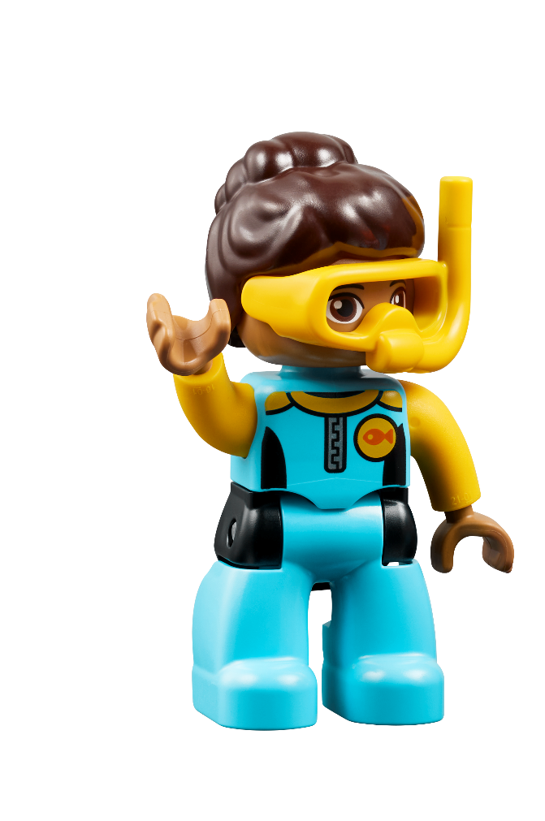
Share Task
Show the ship that will take you on your ocean journey!
Notes:
Share Task (15 minutes)
In their Engineering Notebooks, have the children write about or draw a picture of the ship they will travel on during their imaginary ocean journey. The children can also share and describe what they built.

Slide 11
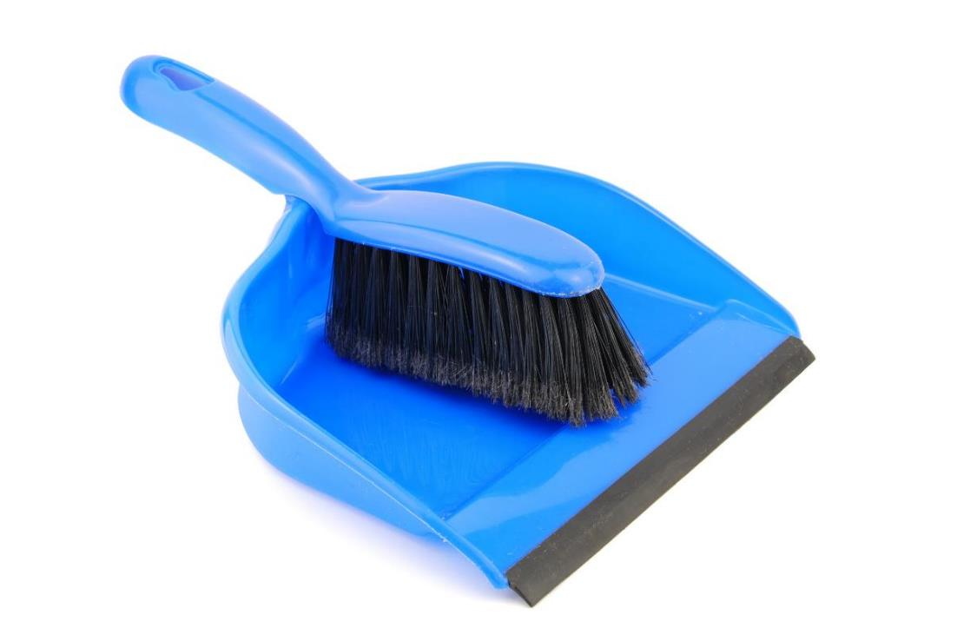
Clean Up
Notes:
You may wish to play a video or song during clean up time.
Link on GoNoodle: https://family.gonoodle.com/activities/clean-up
Link on YouTube Kids: https://www.youtubekids.com/watch?v=ZJFk87ZsHn0
Link on YouTube: https://youtu.be/ZJFk87ZsHn0

Slide 12


LEGO, the LEGO logo, DUPLO and the DUPLO logo are trademarks of the LEGO Group. ©2023 The LEGO Group. All rights reserved. FIRST®, the FIRST ® logo, and FIRST® in SHOWSM are trademarks of For Inspiration and Recognition of Science and Technology (FIRST). LEGO® is a registered trademark of the LEGO Group. FIRST ® LEGO® League and MASTERPIECESM are jointly held trademarks of FIRST and the LEGO Group. ©2023 FIRST and the LEGO Group. All rights reserved.

