Slide 1













































Session 9
Celebrate!
Notes:
Session 10: Celebrate
Preparing the Teams (10-minutes)
Welcome the children and any guests to the celebration and tell them what they will do during the event. The teams will use their ideas to build a model that represents the ship they would use to explore the oceans. They will also share their Engineering Notebooks with reviewers. The reviewing prompts used by the adults will help ensure teams can relate what they do at the event to the sessions they have completed.
Tips for DURING THE EVENT:
Lay out the mats so teams can build on them. You could push them together so two teams can work together.
Assign at least one adult reviewer with each pair of teams.
Get the kids excited for the final challenge.
Ensure the reviewers talk with the children.
Hand out certificates at the end of the celebration.
Have fun and celebrate the children’s achievements.
It is important that teams can relate what they do at the event to the sessions they have completed.

Slide 2
















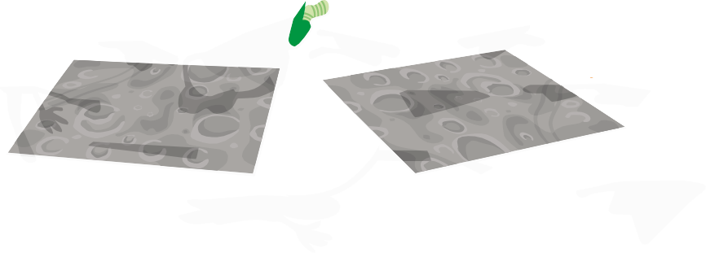





























Final Challenge
Build the Discover set and a ship or vessel for ocean explorers.
Notes:
Final Challenge (30+ minutes)
At the event, challenge the teams to build the following models on the Discover mat:
The complete Discover set
A ship or other ocean vessel with at least one tool or piece of equipment. They can build the futuristic ship they created in Session 9. It’s okay if they use some of the Discover set in their ship model.
After 10 minutes, the children can continue to work with their team or teams can be paired to work together. Have the team update their models using one or more of the following prompts:
Build a container to safely rescue an injured animal.
Navigate your ship to a new area of the mat (or another teams mat) and collect a scientific sample along the way.
Modify your ship model so that it includes one or more functional pieces.
Reviewing the Teams (during the final challenge)
The reviewers should visit the teams during the final challenge, talking with them, asking questions and viewing their Engineering Notebooks. They can use the reviewing prompts on the next page to start a conversation. Encourage the reviewers to interact with the children. They should ask about what the teams have done throughout the program.
Reviewing Prompts:
Tell me about…
Your design and build.
Why you built it that way.
What pieces you included in your model.
How you decided what you wanted to build.
How it works.
Tips:
If possible, assign at least one adult to each pair of teams. They can help the teams stay on task and talk with them. The reviewers will decide on awards for each team. Reviewing prompts are on page 26 of the Team Meeting Guide.

Slide 3






Playful Learning in Action
Notes:
Reviewers should also ask teams how they worked together during the final challenge and throughout the sessions.
Tell me about…
How you worked together.
The job you had on your team.
How you shared ideas in your team.
How you worked as a team.

Slide 4
Celebrate!
Notes:
Celebrate! (10 minutes)
While the building, problem-solving, and reviewing are the most important part of how the event works, you should allow plenty of time to celebrate each team’s achievements in front of everyone at the event. You could extend this time and allow time for the children to share and present what they learned.
Awards
Every team should win an award, and more than one team can win the same award.
Choose from this list of official FIRST ® LEGO® League Discover awards:
Incredible Innovators
Cooperative Creators
Excellent Explainers
Brilliant Builders
Enthusiastic Engineers
… or create your own!
Tip:
For the celebration, print certificates for every child. Have the children come up one at a time, or in their team, to be recognized and applauded. A great FIRST ® LEGO® League Discover event always ends in a celebration.

Slide 5
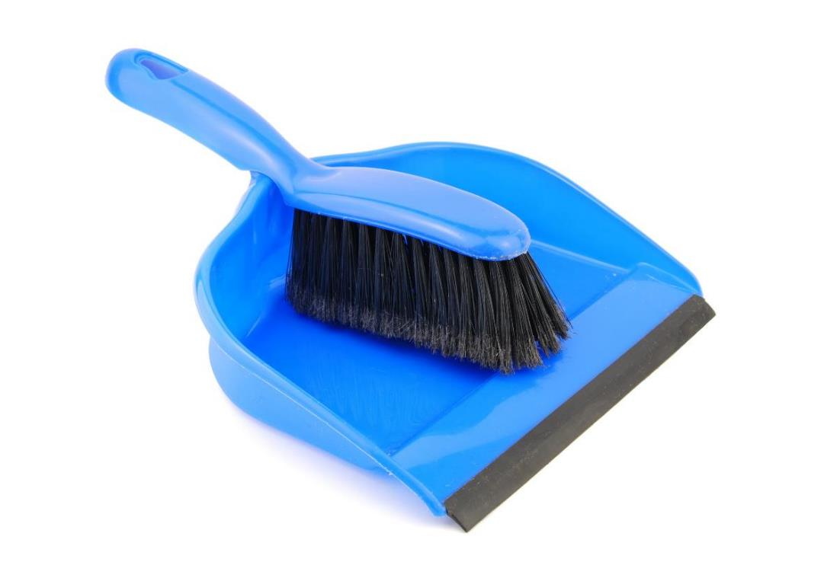
Clean Up
Notes:
You may wish to play a video or song during clean up time.
Link on GoNoodle: https://family.gonoodle.com/activities/clean-up
Link on YouTube Kids: https://www.youtubekids.com/watch?v=ZJFk87ZsHn0
Link on YouTube: https://youtu.be/ZJFk87ZsHn0
Tips for AFTER THE EVENT:
Teach the other STEAM Park lessons.
Continue to teach other STEAM activities related to the theme.
Find opportunities to use the vocabulary learned through the experience.
Have the children use their teamwork skills in other sessions.

Slide 6

LEGO, the LEGO logo, DUPLO and the DUPLO logo are trademarks of the LEGO Group. ©2023 The LEGO Group. All rights reserved. FIRST®, the FIRST ® logo, and FIRST® in SHOWSM are trademarks of For Inspiration and Recognition of Science and Technology (FIRST). LEGO® is a registered trademark of the LEGO Group. FIRST ® LEGO® League and SUBMERGEDSM are jointly held trademarks of FIRST and the LEGO Group. ©2023 FIRST and the LEGO Group. All rights reserved.

