Slide 1
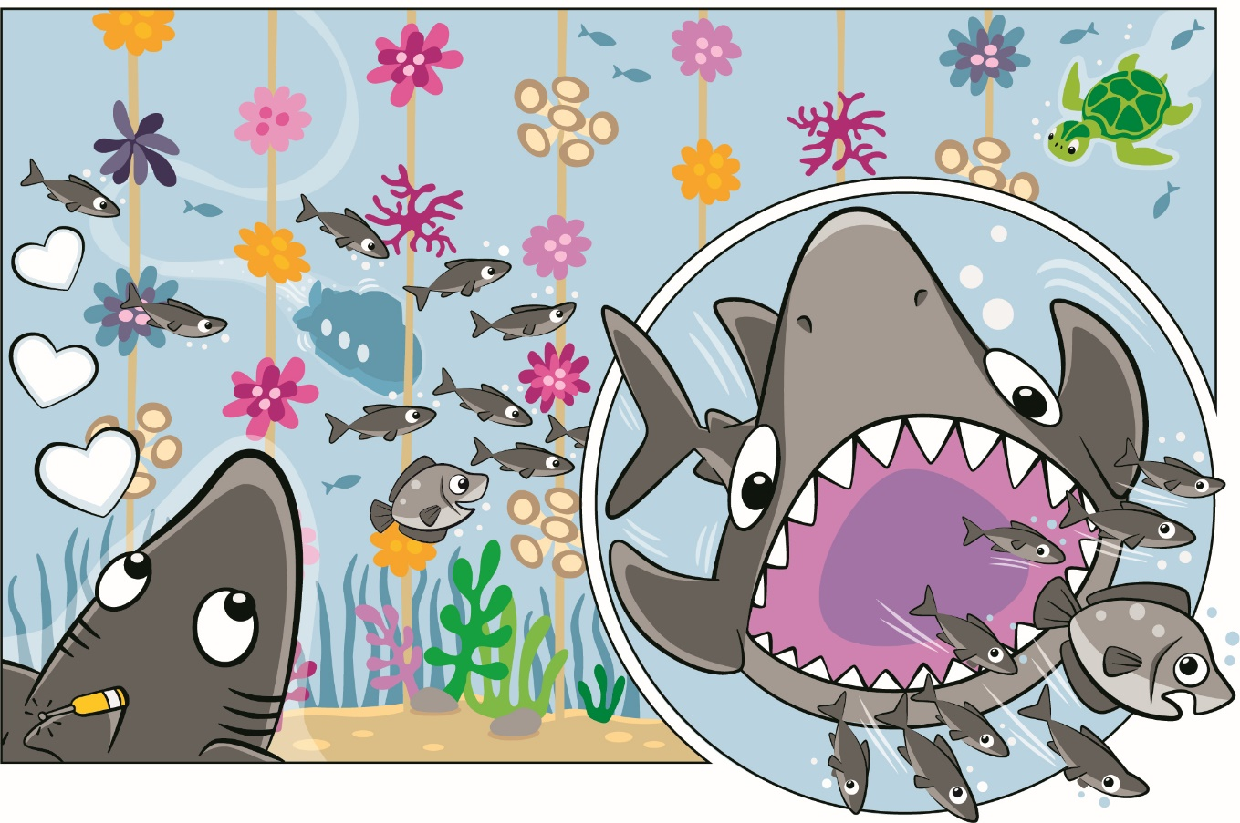


Session 1
Let’s Discover
Notes:
Session 1: Let’s Discover
As you go through these sessions, don’t worry if you don’t know all the answers – and remember, there is no such thing as failure! Also, know that the children will make mistakes and iterate on their designs.

Slide 2
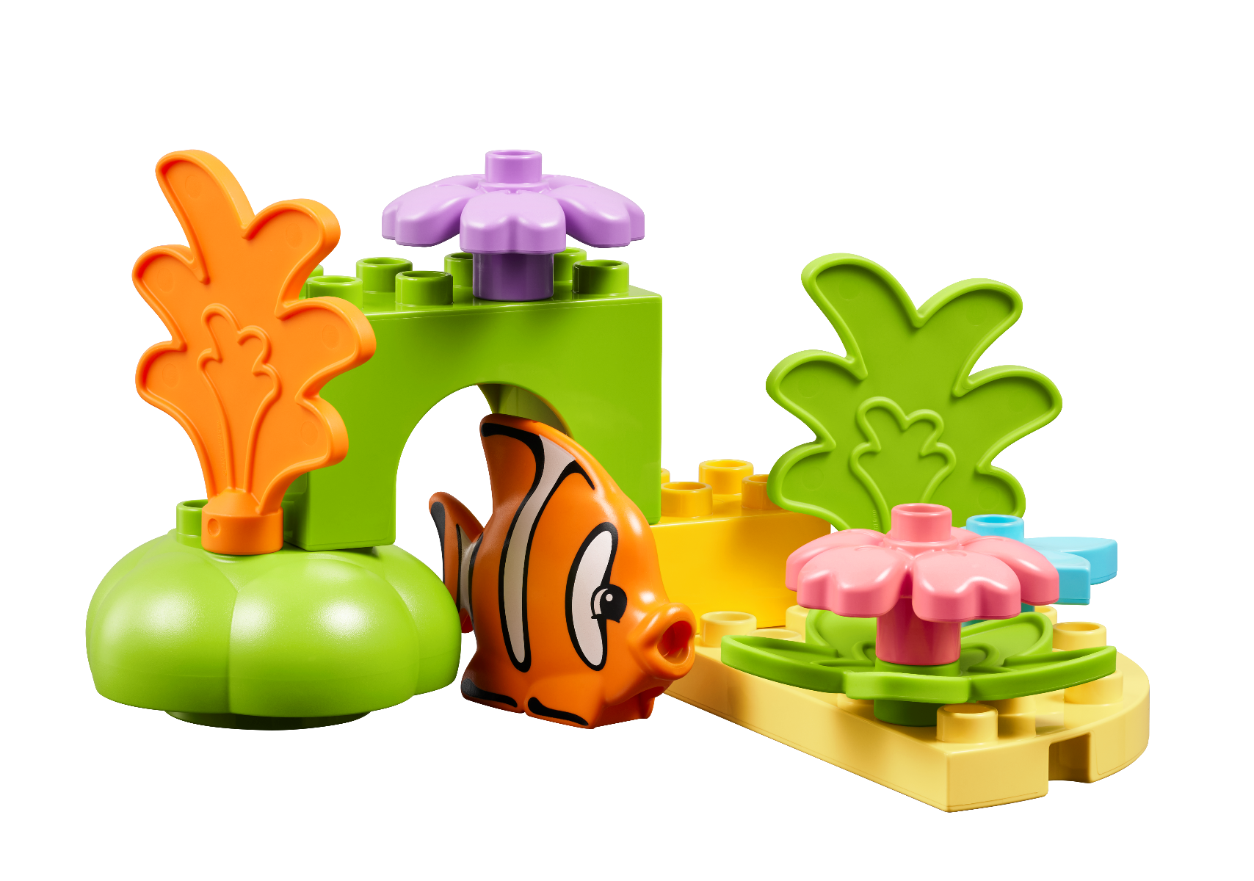
Big Question
What do we know about oceans?
Notes:
Each session has a Big Question that can be shared to frame the session.​
Outcomes
The children will play with STEAM Park, building creatively and trying new things.
The children will identify LEGO® pieces that relate to what they know about the oceans.
Key Vocabulary
ocean, habitat, explore

Slide 3
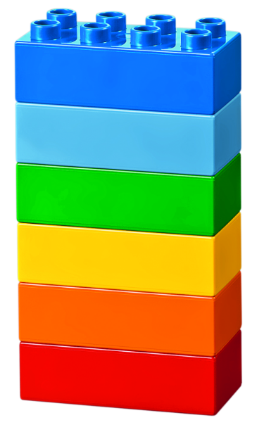
Warm Up
Discover Six Bricks I
Notes:
Six Bricks Warm Up (10 minutes)
Discover Six Bricks I The children will use the Six Bricks both in the classroom and at home with the Discover More set to learn new skills and explore new ideas.
Base Activity
Each child separates his or her bricks and spreads them out.
With closed eyes, they shuffle their bricks around.
Keeping their eyes closed, each child picks any brick and holds it up high.
Now they open their eyes and see what color they hold.
Part 2
5. Let them pick any brick, look at it carefully, and turn it around and over in their hands.
Guiding Questions:
What color brick do you have?
Can you name all the different colors?
Can you sort the bricks into warm and cold colors?
Can you create a rainbow with your bricks?
What color is your brick? How does it feel (rough, smooth, hard, soft, shiny, dull, etc.)?
What spaces and shapes can you see on your brick? How many studs does each brick have?

Slide 4
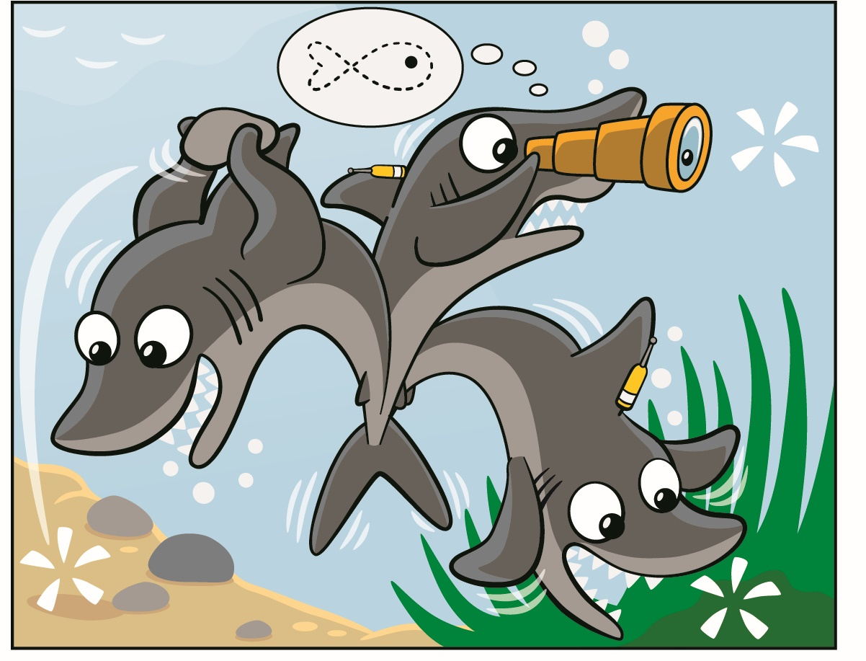
Explore Task
Share what you know about the ocean!
Notes:
Explore Task (10 minutes)
Lead a discussion about the oceans. Let the students share anything they know about oceans around the world. Introduce the idea of an ocean habitat. Discuss what animals or plants live in different parts of the ocean.
Look at the pages of the Discover Story and discuss what can be seen in each of the illustrations. Ask the children what they notice.
Explain FIRST ® LEGO® League Discover to the children and proceed to the next task.
Key Vocabulary
ocean, habitat, explore

Slide 5
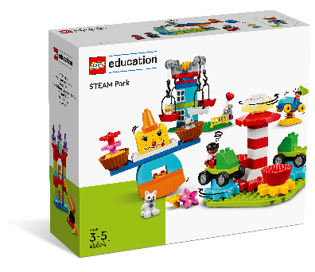
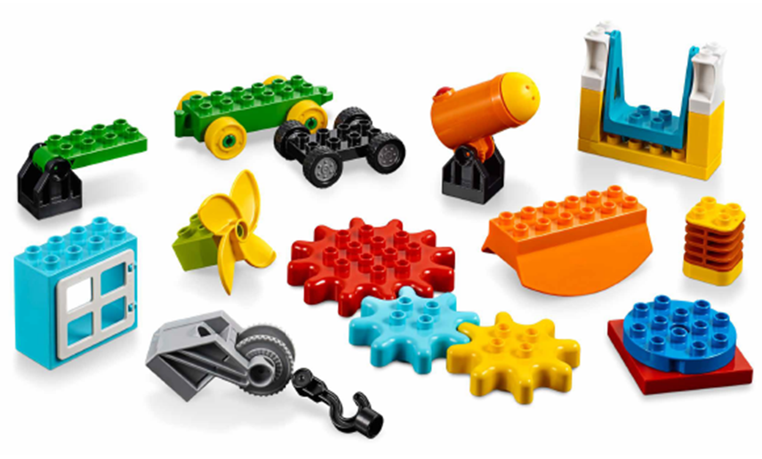
Create Task
You Need…
Can you build something related to the ocean?
Notes:
Create Task (25 minutes)
Have the children build using the different pieces in STEAM Park. Encourage them to play freely and build anything they want that relates to the oceans or how they are explored. They could build something like a ship, an animal, or a habitat.
Key Vocabulary – ocean, habitat, explore
Facilitator Tip
Check out the STEAM Park Functional Elements lesson plan - https://education.lego.com/en-us/lessons/preschool-steam-park/functional-elements

Slide 6

Playful Learning in Action
Key Vocabulary
ocean, habitat, explore
Notes:
Create Task (25 minutes)
Have the children build using the different pieces in STEAM Park.
Encourage them to play freely and build anything they want that relates the oceans or how they are explored.
Playful Learning in Action – The children will use discovery to explore new ideas with STEAM Park. They will wonder and question what the pieces do.
Key Vocabulary – ocean, habitat, explore

Slide 7
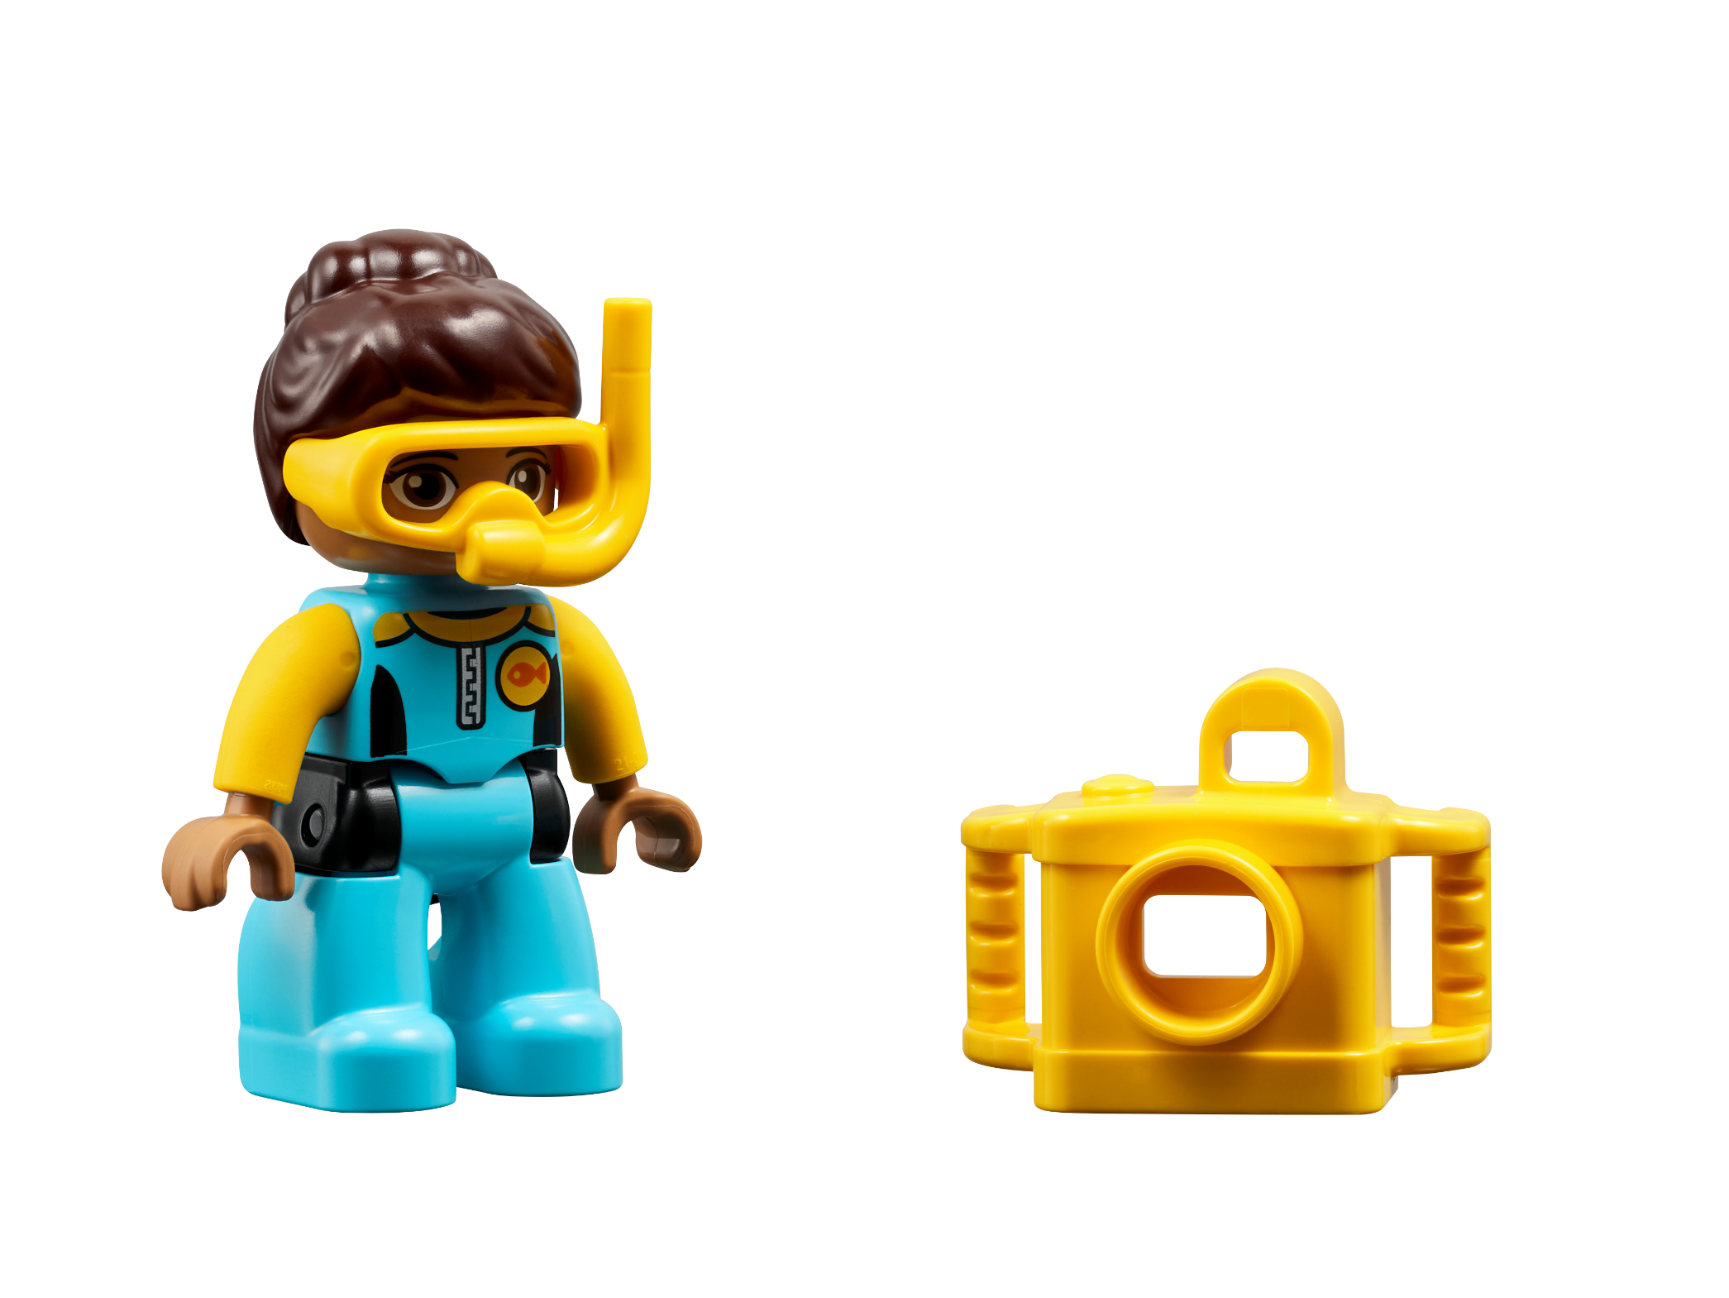
Share Task
Share what you built and how it relates to the oceans.
Notes:
Share Task (15 minutes)
Have the children share and explain what they built and how the pieces relate to ocean exploration. They could share in pairs or in their teams if they aren’t comfortable sharing with entire class. All the children’s builds will be meaningful, and there is no one right answer to these sessions.

Slide 8

Clean Up
Notes:
You may wish to play a video or song during clean up time.
Link on GoNoodle: https://family.gonoodle.com/activities/clean-up
Link on YouTube Kids: https://www.youtubekids.com/watch?v=ZJFk87ZsHn0
Link on YouTube: https://youtu.be/ZJFk87ZsHn0
Send home the Discover More set with each child for home learning and exploration. Check out page 7 of the Team Meeting Guide for how to use this set for family engagement.

Slide 9


LEGO, the LEGO logo, DUPLO and the DUPLO logo are trademarks of the LEGO Group. ©2023 The LEGO Group. All rights reserved. FIRST®, the FIRST ® logo, and FIRST® in SHOWSM are trademarks of For Inspiration and Recognition of Science and Technology (FIRST). LEGO® is a registered trademark of the LEGO Group. FIRST ® LEGO® League and SUBMERGEDSM are jointly held trademarks of FIRST and the LEGO Group. ©2023 FIRST and the LEGO Group. All rights reserved.

