Slide 1
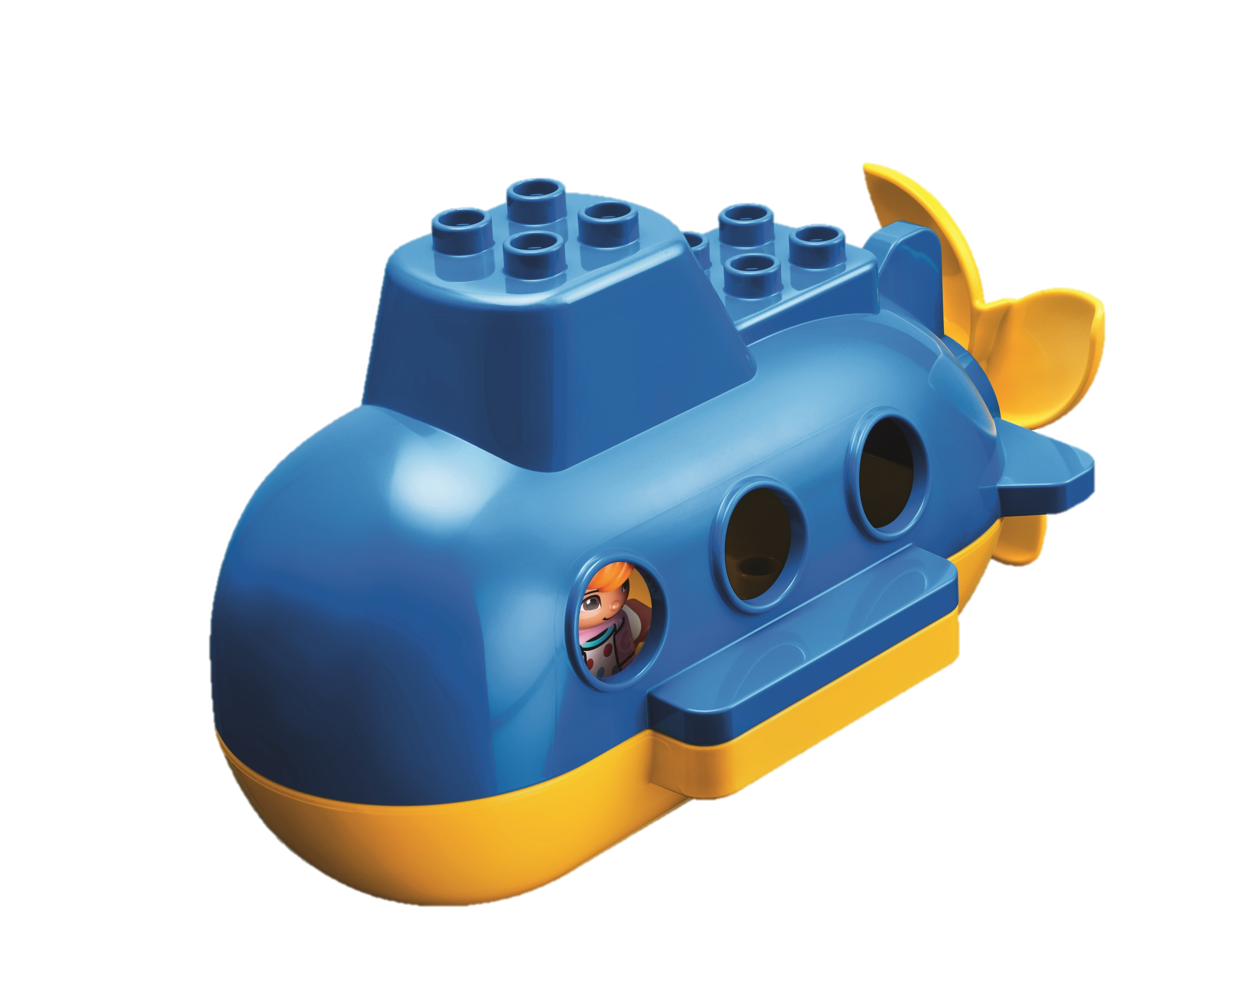
Family Engagement Activity – Session 1
Instructions: Play a game. Each person should take turns describing how they would explore the ocean and name one plant and animal they might see.
Activity: Use the Six Bricks or other materials and build a habitat for the plant or animal you saw when you explored the ocean. Everyone guesses until someone gets it right.
Discussion Questions: What is your favorite part about the habitat or why did you choose this habitat or animal? Everyone takes a turn to answer.
Activity Log: Write down what each person saw in the ocean and what habitat they built.
Habits of Learning
We will wonder and question during this activity.
Family Engagement Activity – Session 2
Instructions: You are going on a trip in the ocean in a ship. Each person should take turns sharing what they will bring on this trip.
Activity: Each person takes a turn: Use each of the Six Bricks to represent six items you would bring on the trip and share why you choose them.
Discussion Questions: What would you need to bring on to a ship for a trip on the ocean? What kinds of people would you want to be in your crew? What might you find on the trip that you want to bring
back to the seashore?
Activity Log: List what you would bring on the ship for
your ocean journey and what you might bring back to the seashore.
Habits of Learning
We will apply knowledge during this activity.

Slide 2
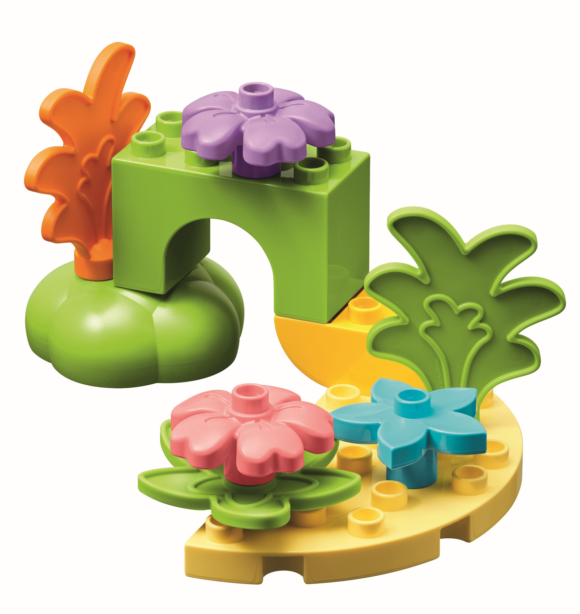
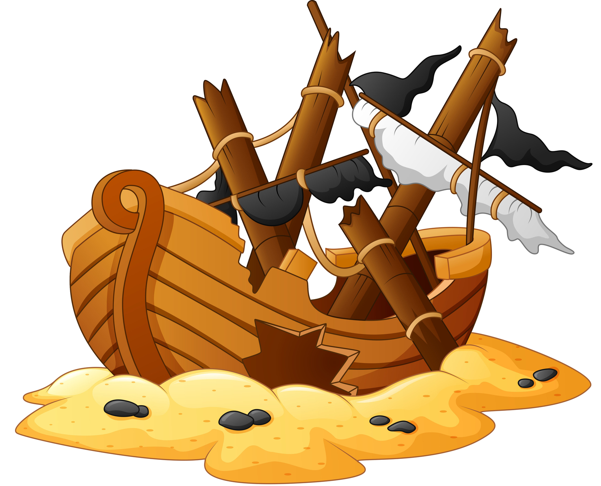
Family Engagement Activity – Session 3
Instructions: Coral reefs are home to the most diverse ocean life found in the top layer of the ocean known as the sunlight zone. Look at pictures of coral reefs. What sunlight do you see? Talk about the colors and what animals you see.
Activity: Use your Six Bricks or other materials to create a coral reef together.
Discussion Questions: What animals are there? What colors are in your coral reef? Which animals and plants help each other?
Activity Log: Write about your coral reef and an animal that lives there.
Habits of Learning
We will apply knowledge during this activity.
Family Engagement Activity – Session 4
Instructions: Coral reefs can take many years to grow. Humans can help create artificial reefs by using things like shipwrecks which ocean life can use as shelter.
Activity: As a family, use your Six Bricks or other materials to build a shipwreck or other large shelter for fish and other animals.
Discussion Questions: What animals are in your artificial reef? What is it made of?
Activity Log: Write down what your artificial reef is made from.
Habits of Learning
We will use teamwork during this activity.

Slide 3
Family Engagement Activity – Session 5
Instructions: As you get deeper in the ocean, light cannot reach as far, and everything gets darker and darker. We use submarines to explore these deep dark areas.
Activity: Put your Six Bricks in order from lightest to darkest to represent the different depths of the ocean.
Discussion Questions: Why did you choose that order? Which bricks would represent the sunlight zone?
Activity Log: Draw or write down the colored order of the bricks from lightest to darkest.
Habits of Learning
We will use confidence during this activity.
Family Engagement Activity – Session 6
Instructions: Test your communication skills! Having strong communication skills is a great tool that will help in a variety of
careers from ship captains and marine biologists.
Activity: Sit or stand in pairs. Each person has a set of Six Bricks. One person builds a model, then explains to their partner how to build the same model. The partner builds without looking or asking questions. Compare your models. Swap roles and repeat.
Discussion Questions: How close did you get? What was easy
or hard about this activity?
Activity Log: Share one problem you had while listening
to your partner and how you overcame it.
Habits of Learning
We will use listen & empathy during this activity.

Slide 4
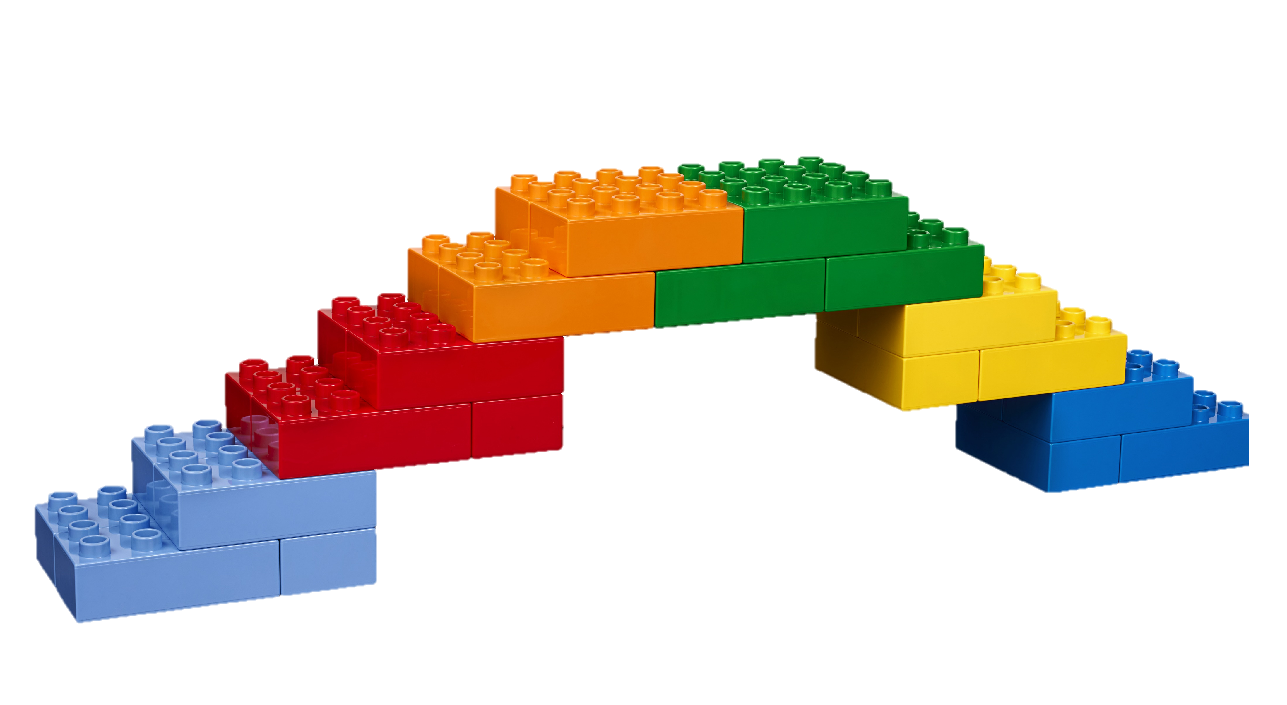
Family Engagement Activity – Session 7
Instructions: Many different animals live in the ocean. Sometimes these animals might get injured and need to be rescued by a veterinarian. One tool they might use is a ramp to get the animals in and out of the water.
Activity: Use your Six Bricks or other materials and
work together to design and build your bridge that has
a ramp you could use to rescue animals. Then test your
bridge and ramp by seeing how much weight it can hold.
Discussion Questions: What kind of animals might need
rescuing? What might happen to them?
Activity Log: Share about the animal you rescued and
what you made your structure out of.
Habits of Learning
We will take risks during this activity.
Family Engagement Activity – Session 8
Instructions: Share your learning! Your student has been learning about the oceans and it is time to bring that learning home where they can continue to iterate.
Activity: Have them share with you one piece of information that they have learned and one thing they are still curious about. Together, spend time researching answers to the questions about the unknown.
Discussion Questions: What have you learned about animals in the ocean? What about the plants in the ocean? What are you still wondering about?
Activity Log: Write down the new things you learned.
Habits of Learning
We will wonder and question during this activity.

Slide 5
Family Engagement Activity – Session 9
Instructions: Use your imagination! Reflect and think about what they have already found in the ocean and where it lives.
Activity: As a family, imagine you discover a new place in the ocean and find a new animal that lives there that no one else has seen. Using your Six bricks or other materials, innovate and build that animal and where it lives.
Discussion Questions: What does it look like? What might it do? Where does this new animal live? What does it eat?
Activity Log: Write down what you think they might discover in the ocean in the future.
Habits of Learning
We will build confidence during this activity.
Family Engagement Activity – Session 10
Instructions: Play the Discover More Game! Celebrate the FIRST LEGO League Discover season by playing the Discover More Game together as a family.
Activity: Use the printed game sent home or download it here. You can also scan the QR code to access the game page. Play at least once, repeat as many times as you want, and add at least one rule, material, or activity of your choice.
Discussion Questions: Who is going to keep score?
How will you decide which tasks to do?
Activity Log: Share your favorite part of the Discover
More Game.
Habits of Learning
We will apply knowledge during this activity.

Slide 6
Family Engagement Activity – Bonus
Instructions: Find more activities to do as a family!
Activity: Visit the LEGO Foundation’s website or scan the QR Code and try out at least one activity from there. If you cannot visit the website (or even if you can), make up a game to play together using materials you already have. Play your game!
Activity Log: Write down what activity your family chose to do.
Habits of Learning
We will use listen & empathy during this activity.

