Slide 1

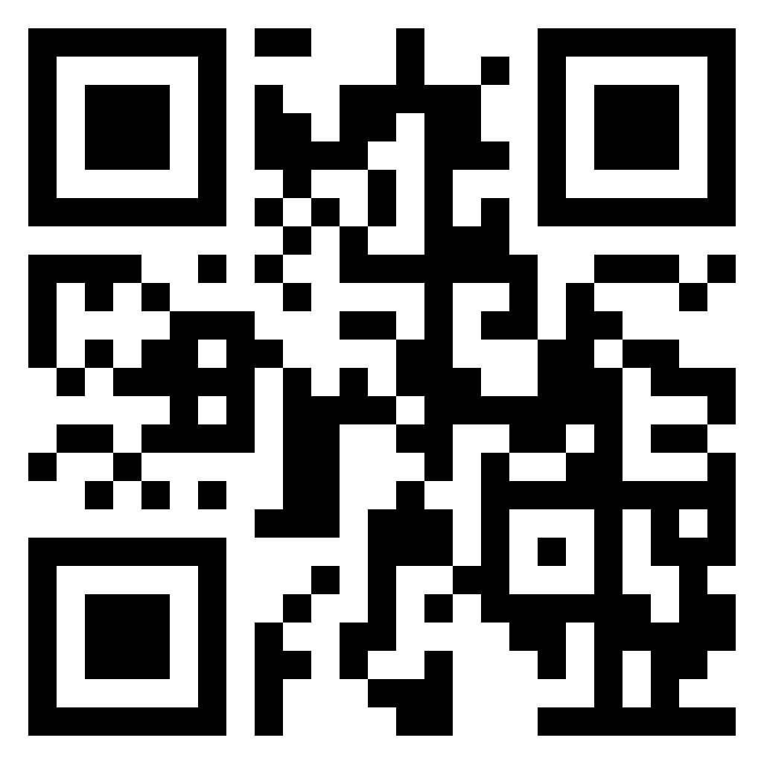
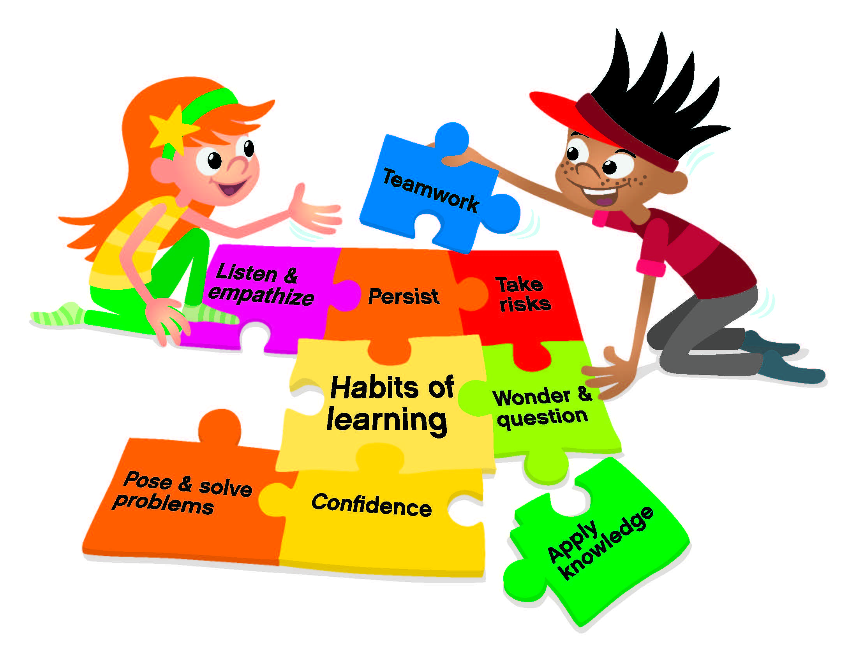
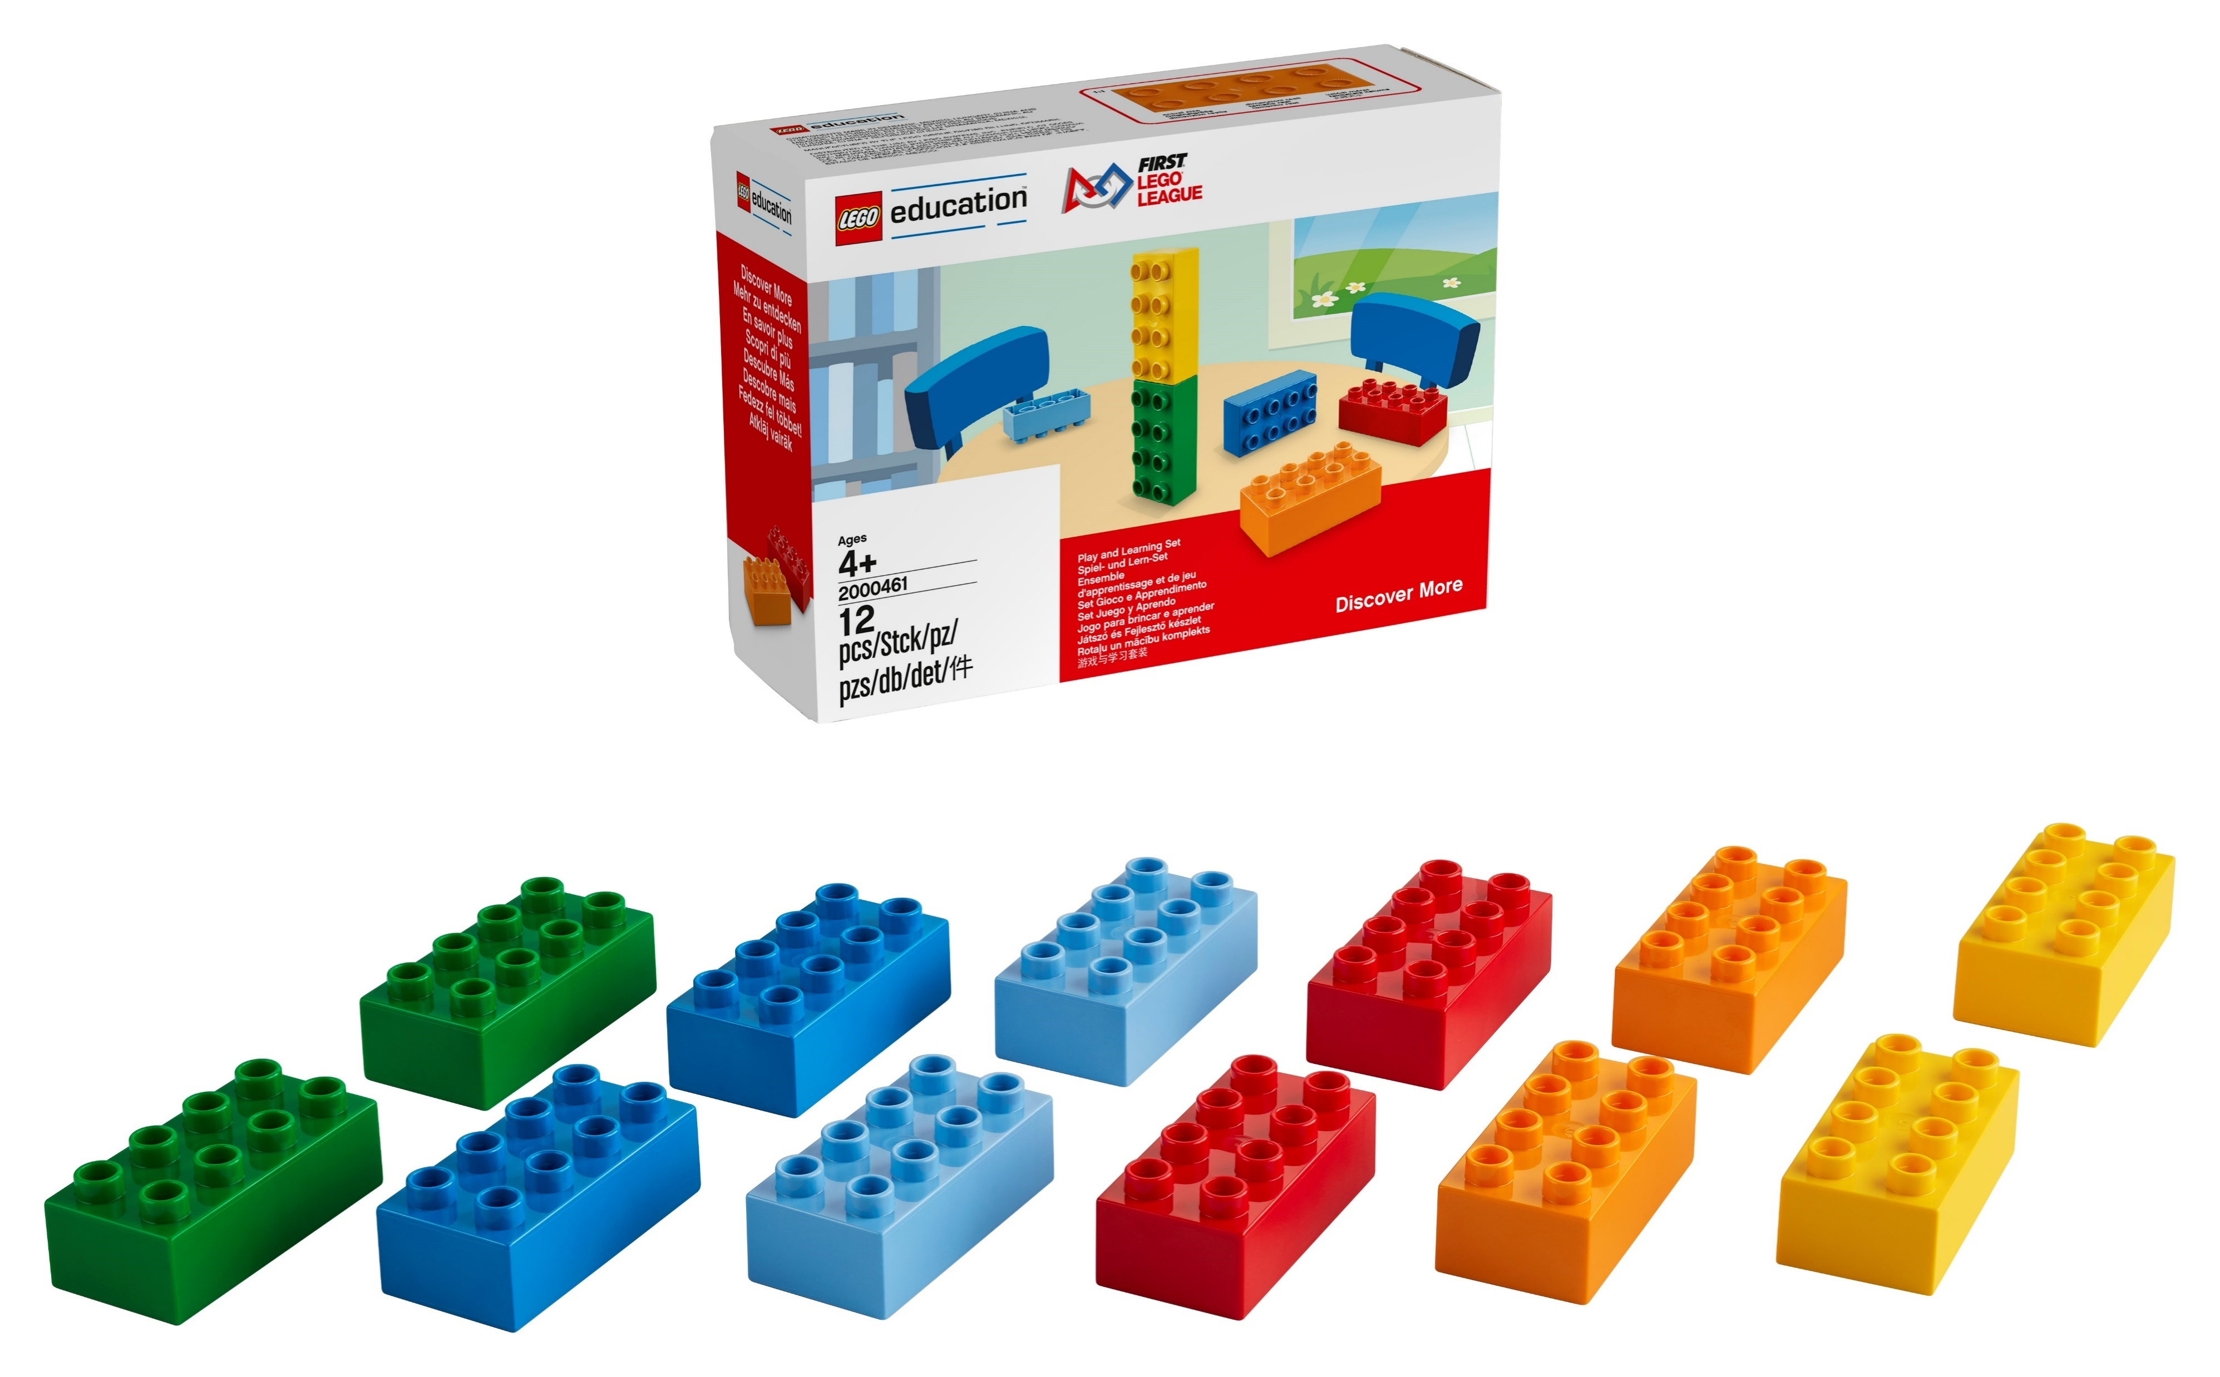
Family Engagement Activities –
Instructions for Teachers
Introduce your families to FIRST LEGO League Discover before starting these activities – use the slide deck, templated messaging and send home the family flyer with your students. All available at the QR code above.
You should have received Discover More sets for your students with your FIRST LEGO League Discover Class Pack. These sets include two sets of Six Bricks and are intended to be sent home and stay home with your students. Each activity can be done using Six Bricks, other LEGO elements, or any readily available crafting material (paper, cardboard, boxes, other building toys, etc.).
Each card is structured in the following manner to guide families through the activity: instructions, activity, discussion questions, and the activity log. Additionally, the vocabulary words from the session are in bold on the card, allowing families to reinforce new learning at home.
These fun, at-home activities are for your students and their families to complete together. You can print them out and send them home before or after each session or share them in the way that works for you and your families. If you’re sending the activities digitally, we suggest sending them as PDF or image files and have provided these file formats in separate documents for you in the QR code above.
The FIRST LEGO League Discover Family Engagement Activity Log is included as a tool to help you track whether families are doing the activities and give them a space to ask questions or share comments with you.
The Family Engagement Activity Student Page provides families the opportunity to talk about what happened in the activity and answer the prompt given on each card. Adults can complete the form. We hope this helps encourage conversation between teachers and families as you build a partnership to support student success.
Consider providing a way for families to share videos or photos of them doing the activities. You might recognize students who submit a completed log with a certificate or other prize.

