Slide 1
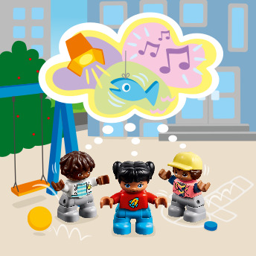
Session 8
Places of the Future
Notes:
Session 8: Places of the Future
This session is entirely devoted to iterating and improving ideas. Encourage children to focus on what they’re creating instead of putting limits on what they build.

Slide 2
Big Question
How can we combine our ideas to make a cool place to share what we love?
Outcomes
The teams will apply knowledge and experience from the previous sessions to solve a problem.
The teams will work together to combine ideas to create a cohesive solution.
Notes:
Outcomes
The teams will apply knowledge and experience from the previous sessions to solve a problem.
The teams will work together to combine ideas to create a cohesive solution.
Facilitator Tip
Teams are improving their ideas not necessarily their actual models from past sessions.
You could assign each child part of the place for which they can create a future design.

Slide 3
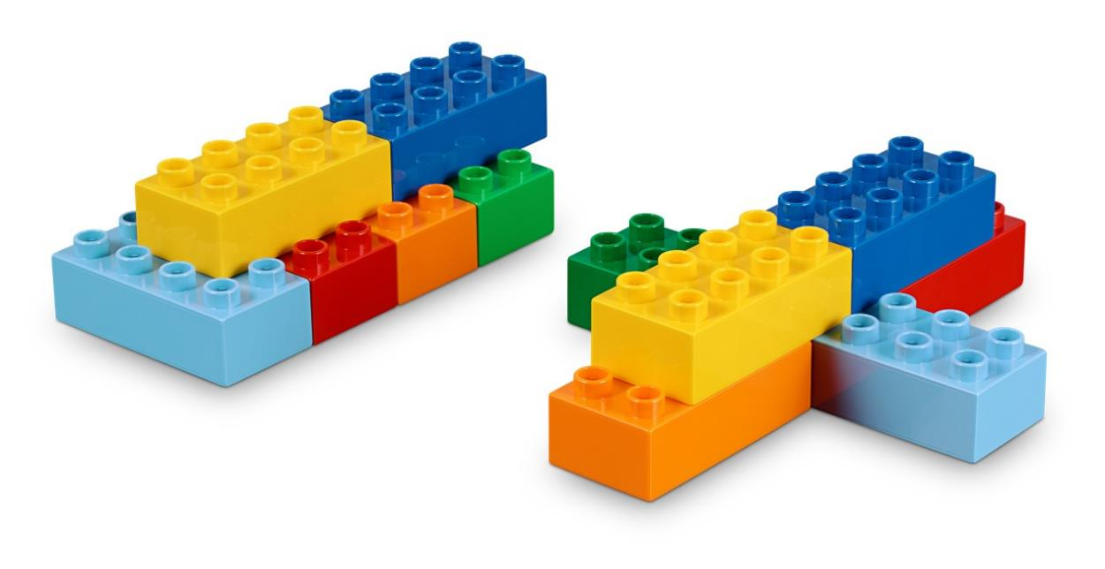
Warm-Up – Six Bricks
Notes:
Warm-Up: (10 minutes) Future Car
Base Activity
1. Children use their six bricks to build a vehicle of the future that might be used in a theater play or performance.
2. Then, they take turns describing their vehicle. They can explain who uses the vehicle and what purpose it serves to help share an interest.
Guiding Questions:
• How will your vehicle be used in a show?
• How does your vehicle move?
• Who is the person that operates the vehicle?
• Do you have any questions to ask your friends about their model?

Slide 4
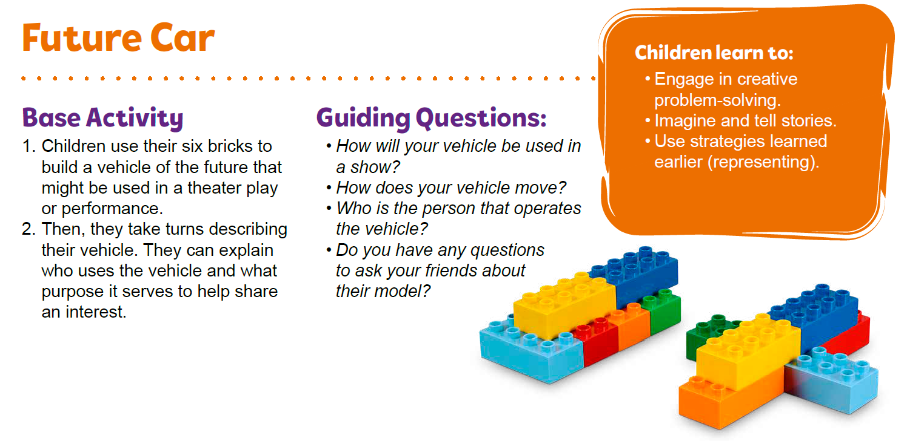
Warm-Up – Six Bricks
Notes:
Facilitator Tip – TMG Appendix (see page 28)

Slide 5
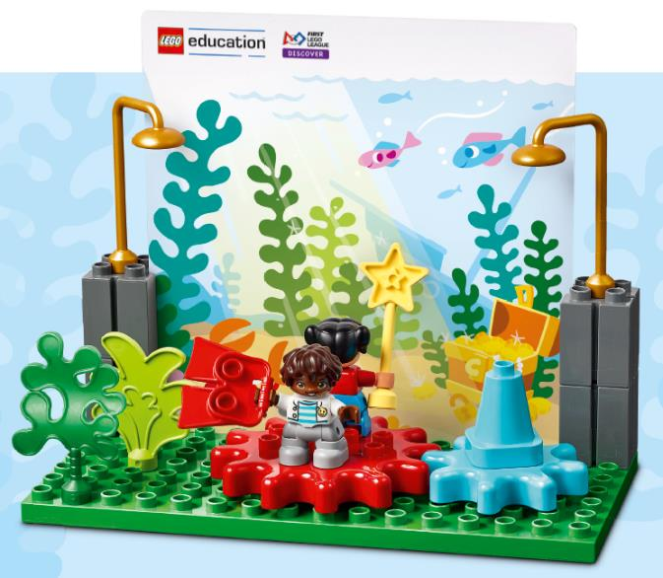
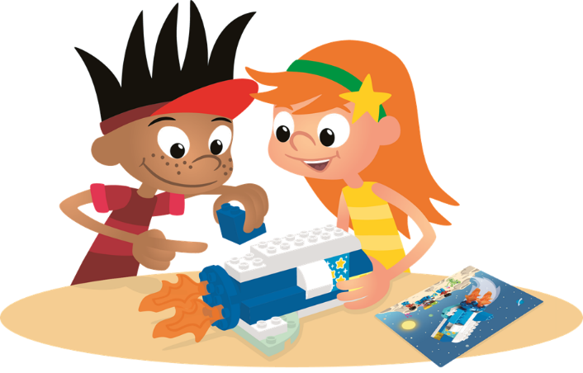
Explore Task
What kinds of places can we built in the future?
Notes:
Explore Task (1O minutes)
Discuss the different types of places where people share their interests. Have the children think about what kinds of places they want to be built in the future. Examples could include a concert arena on the moon, a museum on top of a skyscraper, or a theater under the sea.
Ask the children:
• How would a future place use technology in a creative way (i.e., virtual reality, 3D printing, surround sound)?
• Who is the audience at these different places?
• What kind of jobs do people have in these places?
Tell the children they will work to combine their ideas into a new space.
Facilitator Tip
Teams are improving their ideas not necessarily their actual models from past sessions.

Slide 6
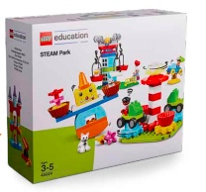
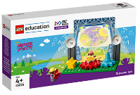
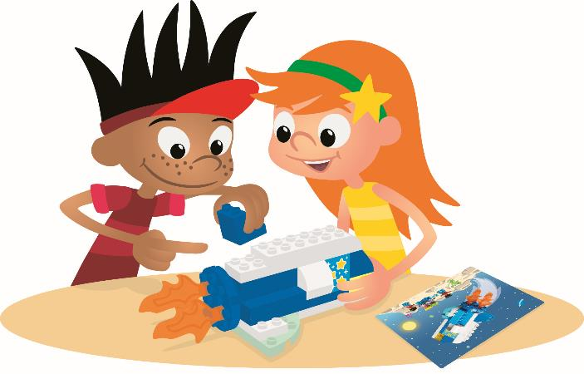
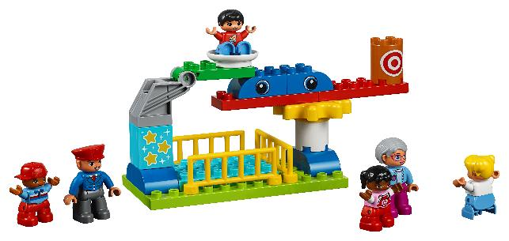
Create Task
You Need..
Build somewhere hobbies or interests are performed or displayed.
Notes:
Create Task (25 minutes)
Before building, have each team decide who will build each part of their place. Each child should build their idea within their team and then combine them for what you imagine a future place could look like. Have the children think about who the space is for. Use pieces from the Discover and STEAM Park sets to create more possibilities.
Their place can be somewhere hobbies or interests are performed or displayed and shared with others. They should use their imagination and be as creative as possible when finding innovative ways to connect the parts together. They can iterate on their designs to combine each other’s builds.
Playful Learning in Action – Teams create solutions while considering the impact on their community. By improving their designs, children will show confidence in their ability to build and iterate.
Key Vocabulary – future, combine, iterate
Facilitator Tip
You could assign each child part of the place for which they can create a future design.

Slide 7

Playful Learning in Action
Teams create solutions while considering the impact on their community. By improving their designs, children will show confidence in their ability to build and iterate.
Key Vocabulary
future, combine, iterate
Notes:
Create Task (25 minutes)
Before building, have each team decide who will build each part of their place. Each child should build their idea within their team and then combine them for what you imagine a future place could look like. Have the children think about who the space is for. Use pieces from the Discover and STEAM Park sets to create more possibilities.
Their place can be somewhere hobbies or interests are performed or displayed and shared with others. They should use their imagination and be as creative as possible when finding innovative ways to connect the parts together. They can iterate on their designs to combine each other’s builds.
Playful Learning in Action – Teams create solutions while considering the impact on their community. By improving their designs, children will show confidence in their ability to build and iterate.
Key Vocabulary – future, combine, iterate
Facilitator Tip
You could assign each child part of the place for which they can create a future design.

Slide 8
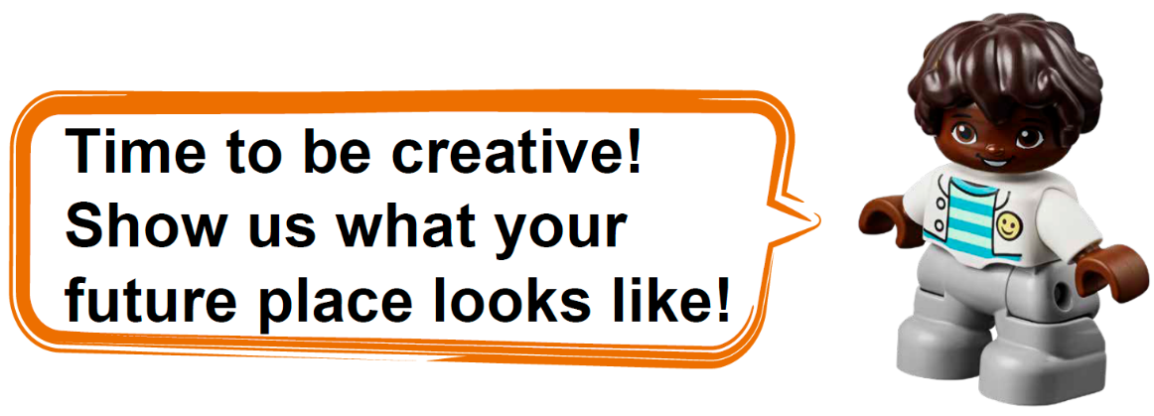
Share Task
Notes:
Share Task – (15 minutes)
In their Engineering Notebooks, have the children write or draw their future space where hobbies or interests are shared. Ask them to explain how they combined their ideas to create an awesome solution.

Slide 9
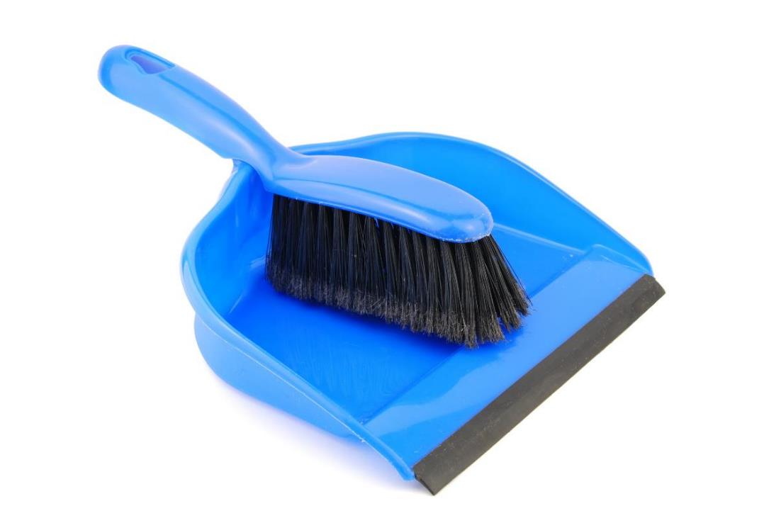
Clean Up
Notes:
You may wish to play a video or song during clean up time.
Link on GoNoodle: https://family.gonoodle.com/activities/clean-up
Link on YouTube Kids: https://www.youtubekids.com/watch?v=ZJFk87ZsHn0
Link on YouTube: https://youtu.be/ZJFk87ZsHn0

Slide 10


LEGO, the LEGO logo, DUPLO and the DUPLO logo are trademarks of the LEGO Group. ©2023 The LEGO Group. All rights reserved. FIRST®, the FIRST ® logo, and FIRST® in SHOWSM are trademarks of For Inspiration and Recognition of Science and Technology (FIRST). LEGO® is a registered trademark of the LEGO Group. FIRST ® LEGO® League and MASTERPIECESM are jointly held trademarks of FIRST and the LEGO Group. ©2023 FIRST and the LEGO Group. All rights reserved.

