Slide 1
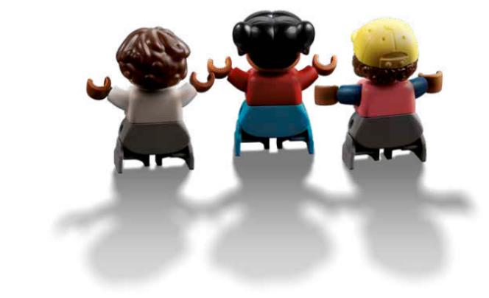
Session 7
The Audience
Notes:
Session 7: The Audience
Think about how the STEM content is explored in this lesson. When the children ask a question, prompt them with a question back to guide their learning instead of giving them the answer.

Slide 2
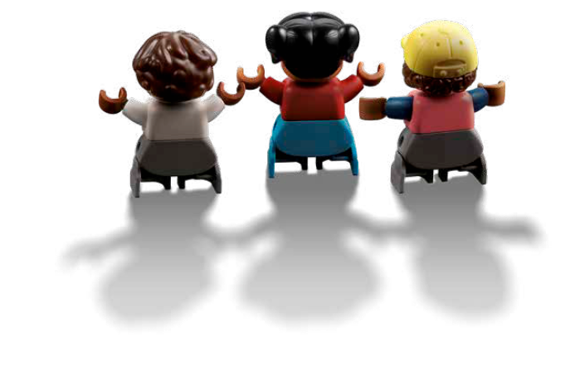
Big Question
How do we make sure the audience is having fun?
Outcomes
Teams will explore how people have different interests and needs.
Teams will explore how to create a place that can safely allow for an audience to enter and exit.
Notes:
Outcomes
Teams will explore how people have different interests and needs.
Teams will explore how to create a place that can safely allow for an audience to enter and exit.
Facilitator Tip
Think about how the audience would get in and out of the place safely.
Have the children create a space before prompting them with addition questions.

Slide 3
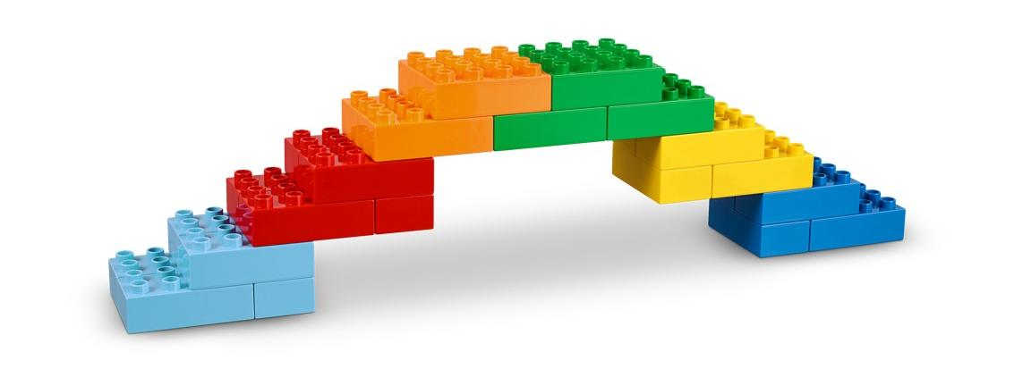
Warm-Up – Six Bricks
Notes:
Warm-Up: (10 minutes) Build a Bridge
Base Activity
1. In groups of 4, children combine their bricks and think of ways to build a bridge. The bridge can be built on the Discover Mat to connect two areas.
2. Give the children time to discuss and plan which areas they will connect and how they will connect them.
Guiding Questions:
• Why did you choose to connect the two areas of the Discover Mat?
• Is your bridge for an audience to move around your new place?
• Did your original plan work? What ideas did you change?
• How did you work together with your team?

Slide 4
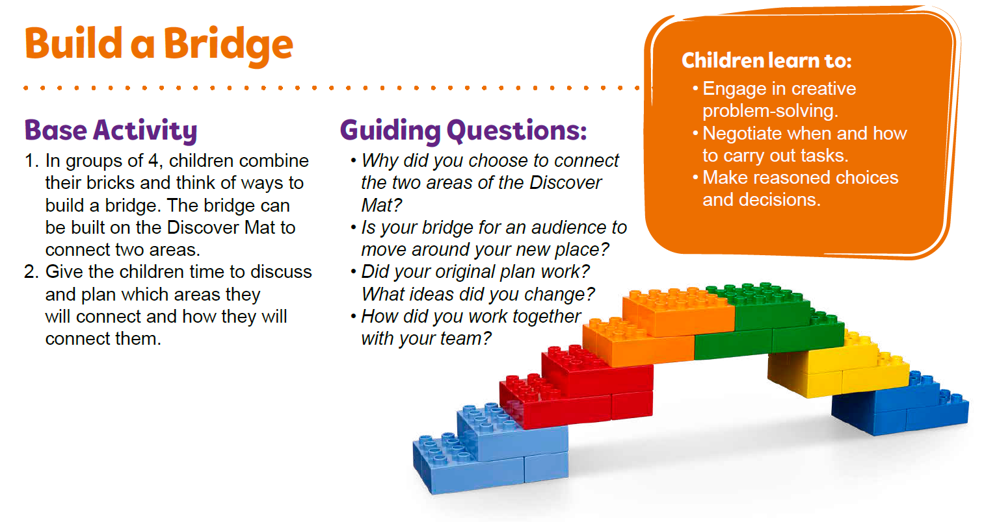
Warm-Up – Six Bricks
Notes:
Facilitator Tip – TMG Appendix (see page 28)

Slide 5
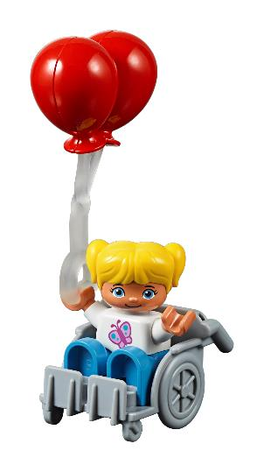
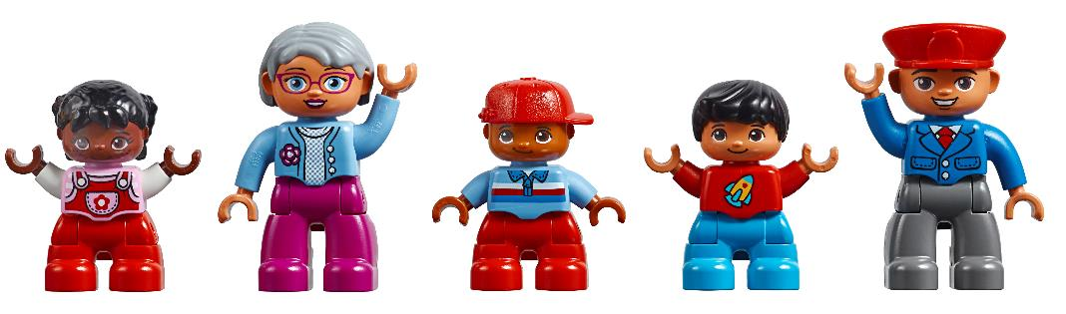
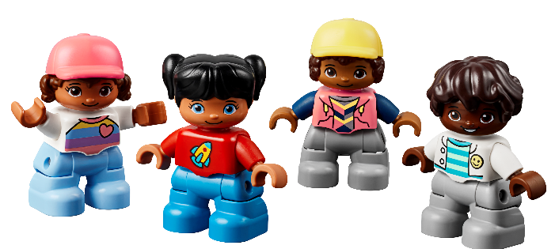
Explore Task
What are the needs of an audience?
Notes:
Explore Task (1O minutes)
Have a discussion about how an audience at a music show might be different from an audience for a museum exhibit. Help the children recognize that people have different interests and needs. The children could share where they would like to be an audience member.
You could ask the children:
• If you were at a concert, what would make you more excited?
• What would make a theater show more interesting for you (i.e., colorful costumes, special effects, etc.)?
• What kind of museum would your friends like to visit?

Slide 6
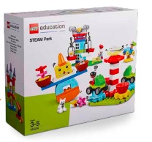
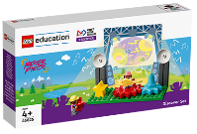
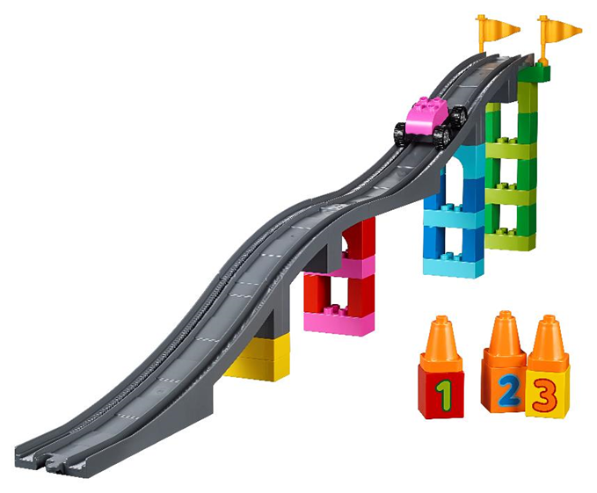
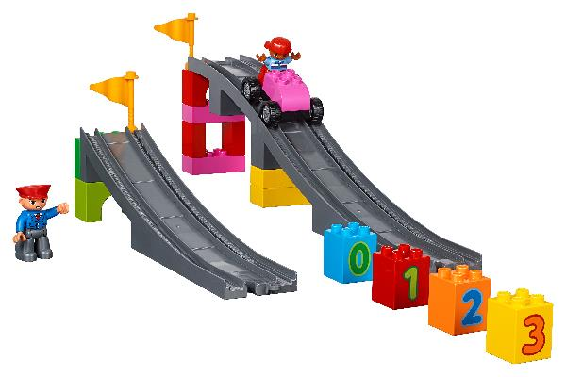
Create Task
You Need..
How could an audience get safely in and out of the place?
Notes:
Create Task (25 minutes)
Create a place where there would be a stage or something on display. Ask the children to think about who would be in the audience for their show. Think about how the audience would get in and out of the place safely. You could use ramps from the STEAM Park set to make it easier and more accessible for people to enter.
Ask the children what they would do to make sure everyone would be interested and entertained in the place. Have the children think about the entire place, including where the audience will be. They could think about lighting a room with fun colors, playing sounds, or using other special effects.
Ramps lesson plan - https://education.lego.com/en-us/lessons/preschool-steam-park/ramps
Playful Learning in Action – Teams will have fun building and testing their vehicles on the ramp. They will use communication to share their ideas and designs.
Key Vocabulary – audience, interesting, accessible
Facilitator Tip
Think about how the audience would get in and out of the place safely.
Have the children create a space before prompting them with addition questions.

Slide 7

Playful Learning in Action
Teams will have fun building and testing their vehicles on the ramp. They will use communication to share their ideas and designs.
Key Vocabulary
audience, interesting, accessible
Notes:
Create Task (25 minutes)
Create a place where there would be a stage or something on display. Ask the children to think about who would be in the audience for their show. Think about how the audience would get in and out of the place safely. You could use ramps from the STEAM Park set to make it easier and more accessible for people to enter.
Ask the children what they would do to make sure everyone would be interested and entertained in the place. Have the children think about the entire place, including where the audience will be. They could think about lighting a room with fun colors, playing sounds, or using other special effects.
Ramps lesson plan - https://education.lego.com/en-us/lessons/preschool-steam-park/ramps
Playful Learning in Action – Teams will have fun building and testing their vehicles on the ramp. They will use communication to share their ideas and designs.
Key Vocabulary – audience, interesting, accessible
Facilitator Tip
Think about how the audience would get in and out of the place safely.
Have the children create a space before prompting them with addition questions.

Slide 8
Share Task
Describe how the audience will enter and exit the space.
Notes:
Share Task – (15 minutes)
Have the teams share their solution and show what they have built to engage and entertain the people in the audience. Each team should also share how their audience will enter and exit the space they created.

Slide 9
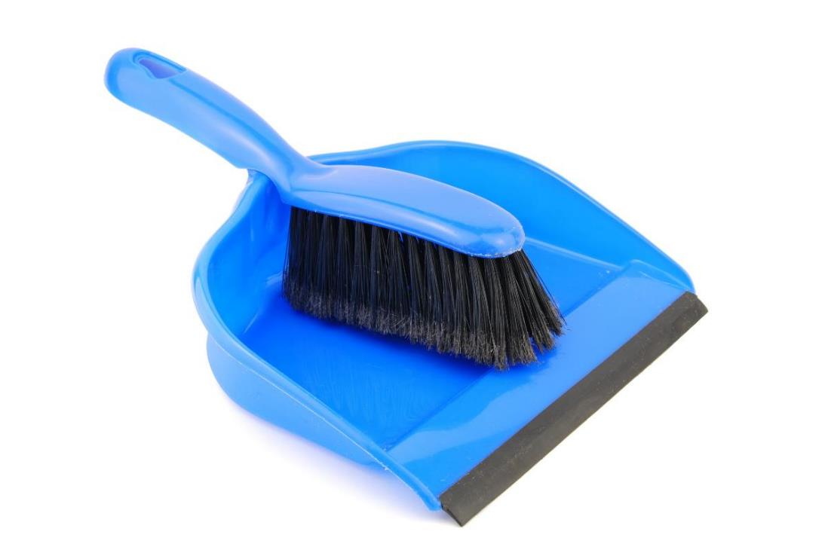
Clean Up
Notes:
You may wish to play a video or song during clean up time.
Link on GoNoodle: https://family.gonoodle.com/activities/clean-up
Link on YouTube Kids: https://www.youtubekids.com/watch?v=ZJFk87ZsHn0
Link on YouTube: https://youtu.be/ZJFk87ZsHn0

Slide 10


LEGO, the LEGO logo, DUPLO and the DUPLO logo are trademarks of the LEGO Group. ©2023 The LEGO Group. All rights reserved. FIRST®, the FIRST ® logo, and FIRST® in SHOWSM are trademarks of For Inspiration and Recognition of Science and Technology (FIRST). LEGO® is a registered trademark of the LEGO Group. FIRST ® LEGO® League and MASTERPIECESM are jointly held trademarks of FIRST and the LEGO Group. ©2023 FIRST and the LEGO Group. All rights reserved.

