Slide 1
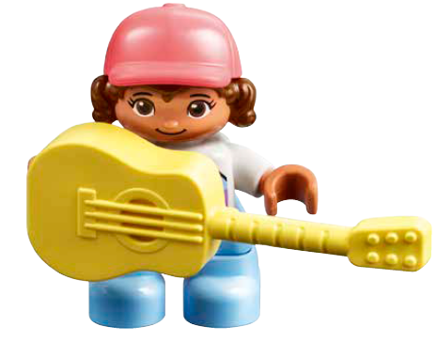
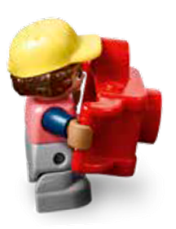
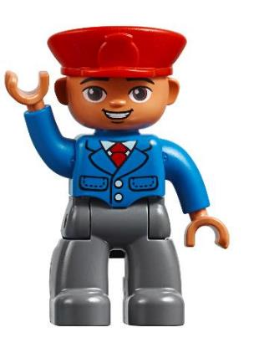
Session 6
Behind the Scenes
Notes:
Session 6: Behind the Scenes
Provide real-world examples, including photos and videos, of people who have jobs related to performing both on stage and behind the scenes. Include examples of the technology, tools and vehicles used in their jobs. You could connect this to your social studies/global studies lessons on community helpers.

Slide 2

Big Question
Who are the people that make a show happen?
Outcomes
Teams will identify different jobs in the arts.
Teams will identify tools, objects or vehicles used in jobs related the arts.
Notes:
Outcomes
Teams will identify different jobs in the arts.
Teams will identify tools, objects or vehicles used in jobs related the arts.
Facilitator Tip
Giving examples of unique objects used in concerts, museums and theaters can help children identify more jobs.
Teams could place the objects they build on the corresponding area of the Discover mat.

Slide 3


Warm-Up – Six Bricks
Notes:
Warm-Up: (10 minutes) Back-to-Back
Base Activity
1. Children sit or stand in pairs with the same four bricks.
2. One child builds a model and then explains to the partner how to build the same model.
3. The partner builds without looking or asking questions.
4. The pairs compare their models and discuss how it went.
5. Children then swap roles and repeat the activity.
Guiding Questions:
• How did you explain how to build the model?
• What instructions were the most helpful?
• How does this activity relate to an actor who is waiting to go on stage?

Slide 4
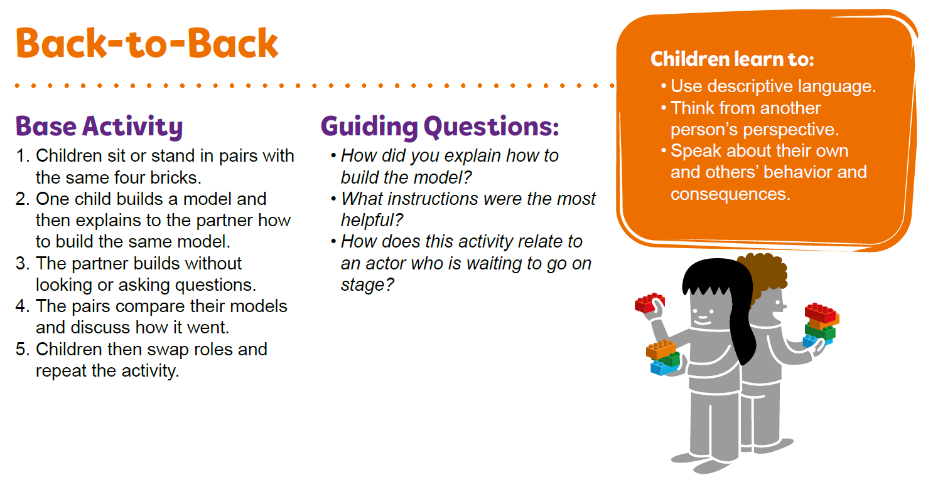
Warm-Up – Six Bricks
Notes:
Facilitator Tip – TMG Appendix (see page 27)

Slide 5
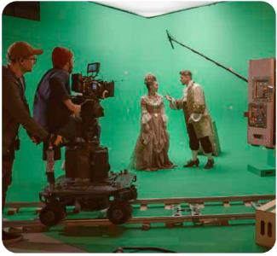
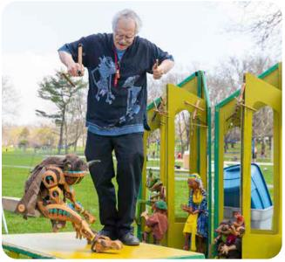
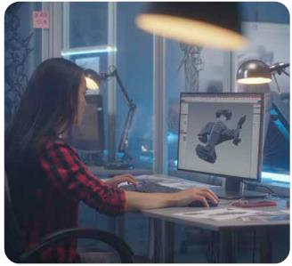
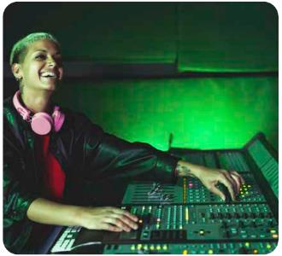
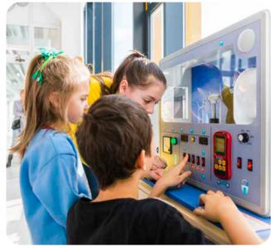
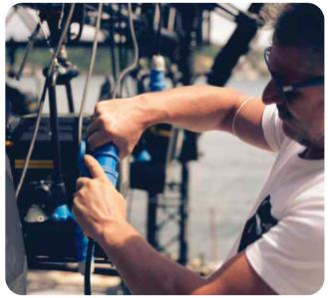
Explore Task
What are different jobs?
Notes:
Explore Task (1O minutes)
Have the children think about the different jobs people have when they work in a theater, a museum or a music hall. Have some children act out (mime) the different jobs and select others to guess what they are miming. Then repeat, swapping the children miming and guessing.
You could ask the children:
• What does a stage manager do in a theater?
• How does a curator select items to display in a museum?
• What do performers need to do to prepare for their concert or play?
• Who operates the projector in a movie theater?
• What tools do these people use in their jobs?

Slide 6
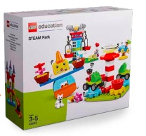

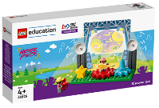
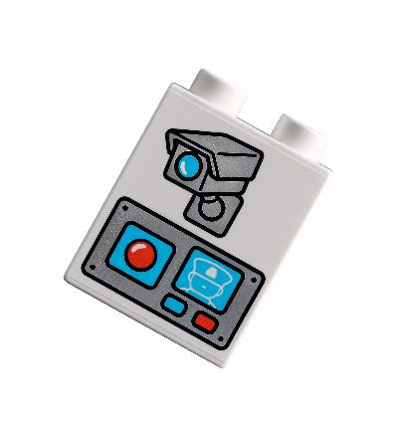
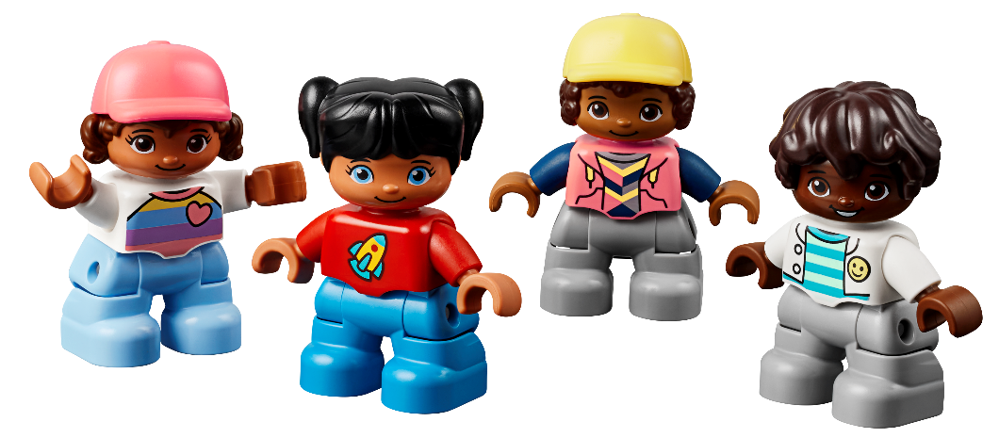

Create Task
You Need..
Build objects, tools, or vehicles used in the jobs.
Notes:
Create Task (25 minutes)
Have each team build objects, tools, or vehicles that would help someone be successful in a job that was discussed in the Explore Task. They should think about people who are working on stage and behind the scenes.
The teams could use pieces from the Discover set and STEAM Park and the various LEGO® DUPLO® figures to represent different workers, their tools, and equipment.
Playful Learning in Action – Using teamwork, the team will think about the impact of different energy jobs in their communities.
Key Vocabulary – stage manager, curator, projector
Facilitator Tip
Giving examples of unique objects used in concerts, museums and theaters can help children identify more jobs.
Teams could place the objects they build on the corresponding area of the Discover mat.

Slide 7

Playful Learning in Action
Using teamwork, the team will think about the impact of different energy jobs in their communities.
Key Vocabulary
stage manager, curator, projector
Notes:
Create Task (25 minutes)
Have each team build objects, tools, or vehicles that would help someone be successful in a job that was discussed in the Explore Task. They should think about people who are working on stage and behind the scenes.
The teams could use pieces from the Discover set and STEAM Park and the various LEGO® DUPLO® figures to represent different workers, their tools, and equipment.
Playful Learning in Action – Using teamwork, the team will think about the impact of different energy jobs in their communities.
Key Vocabulary – stage manager, curator, projector
Facilitator Tip
Giving examples of unique objects used in concerts, museums and theaters can help children identify more jobs.
Teams could place the objects they build on the corresponding area of the Discover mat.

Slide 8
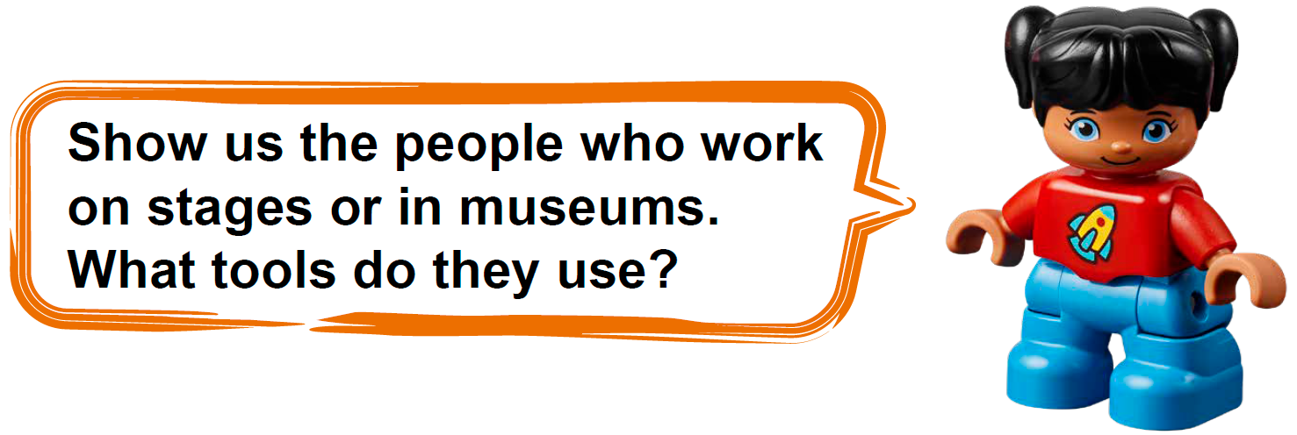
Share Task
Notes:
Share Task – (15 minutes)
In their Engineering Notebooks, have the children write or draw a picture of a person in a job previously discussed.
They can also draw a picture of the tools, objects or vehicles needed for the job.

Slide 9
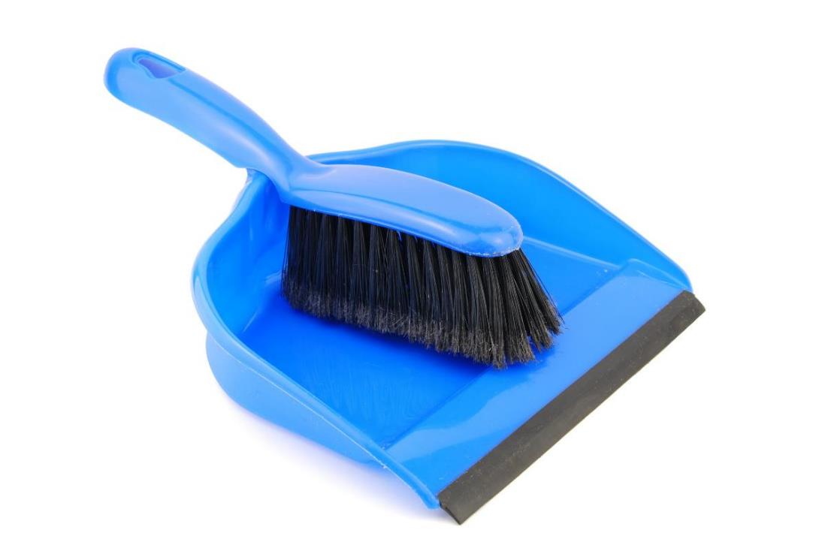
Clean Up
Notes:
You may wish to play a video or song during clean up time.
Link on GoNoodle: https://family.gonoodle.com/activities/clean-up
Link on YouTube Kids: https://www.youtubekids.com/watch?v=ZJFk87ZsHn0
Link on YouTube: https://youtu.be/ZJFk87ZsHn0

Slide 10


LEGO, the LEGO logo, DUPLO and the DUPLO logo are trademarks of the LEGO Group. ©2023 The LEGO Group. All rights reserved. FIRST®, the FIRST ® logo, and FIRST® in SHOWSM are trademarks of For Inspiration and Recognition of Science and Technology (FIRST). LEGO® is a registered trademark of the LEGO Group. FIRST ® LEGO® League and MASTERPIECESM are jointly held trademarks of FIRST and the LEGO Group. ©2023 FIRST and the LEGO Group. All rights reserved.

